Slide 1



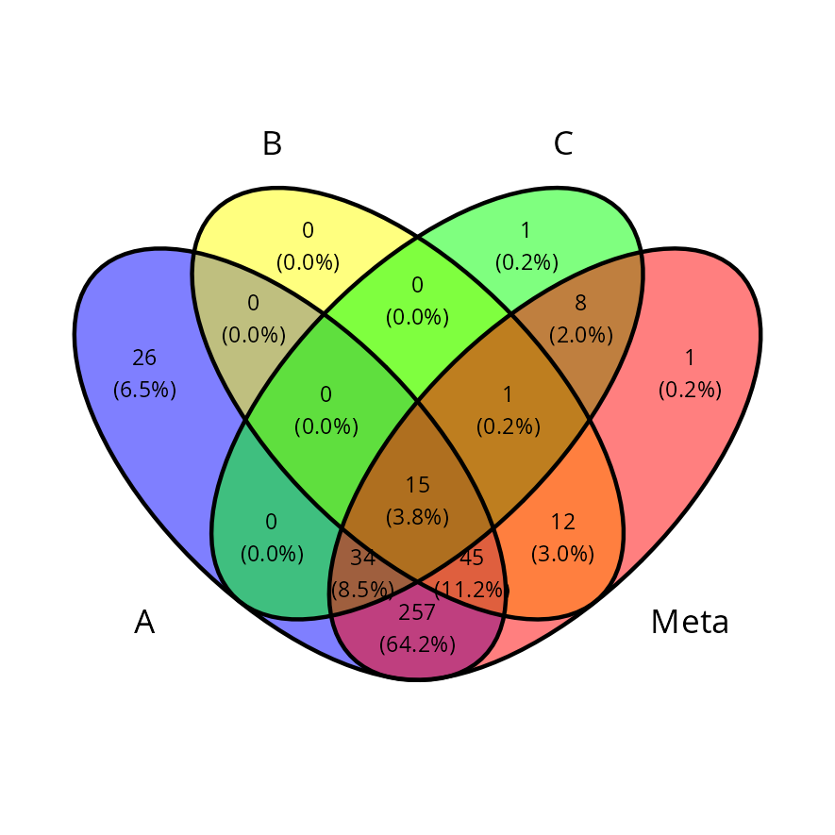
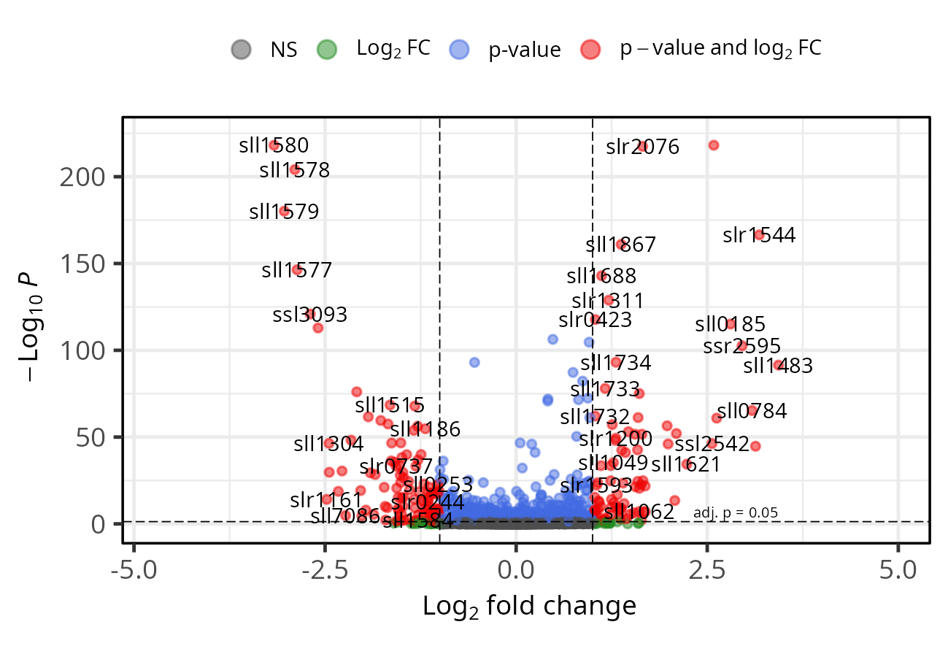
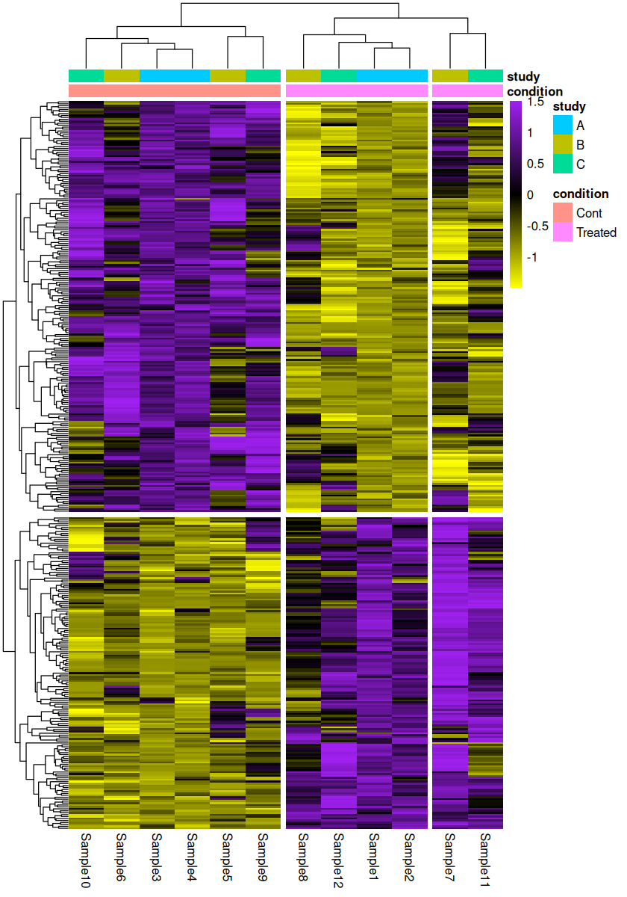
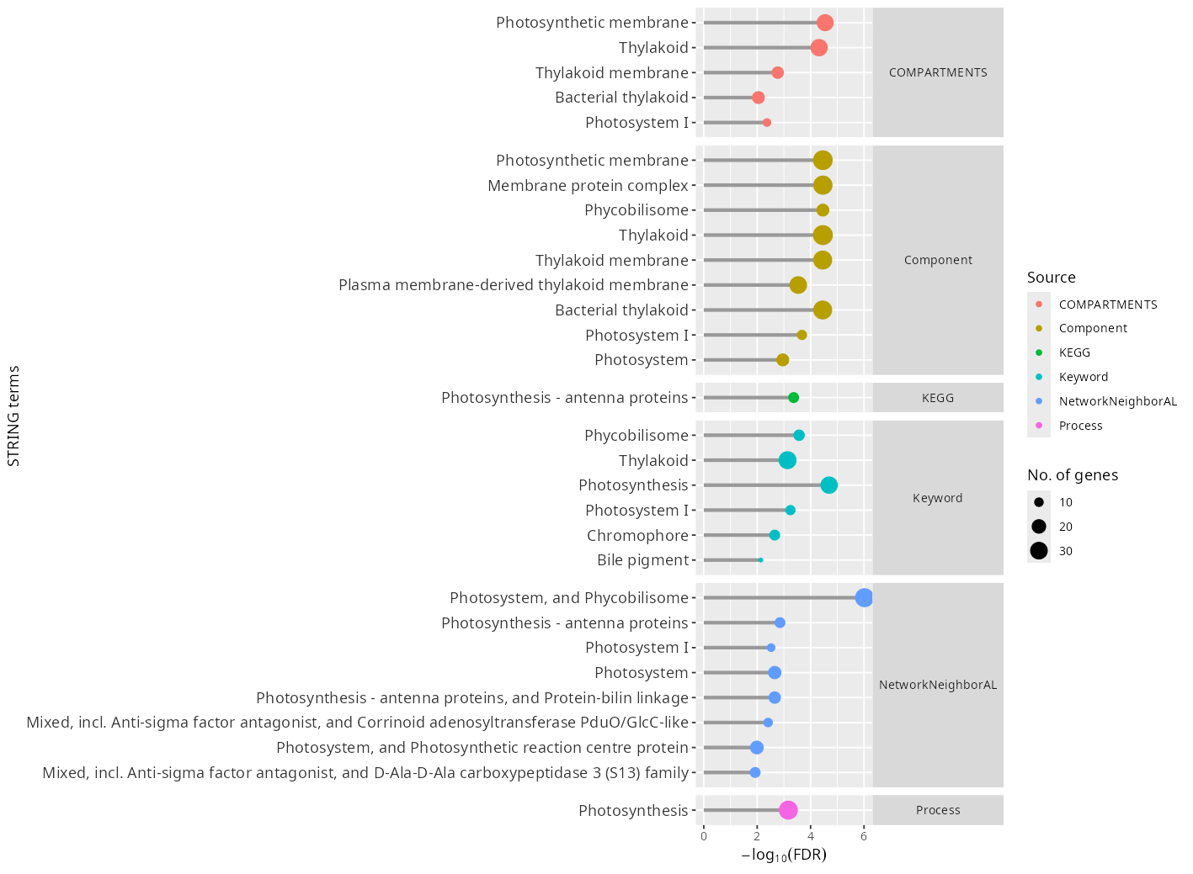
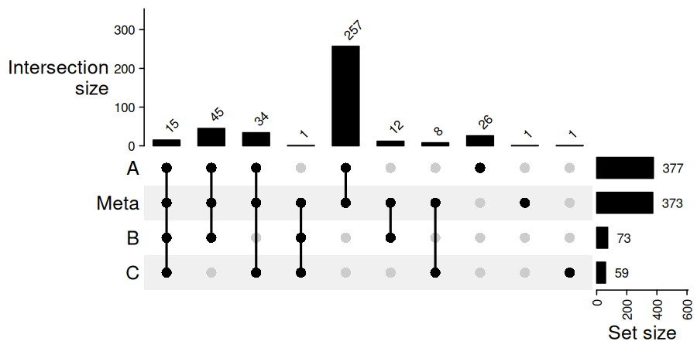
TranscriptMetaAnalyst (TMA)
Democratizing Transcriptomic Meta-Analysis
for Robust Biological Discovery
A user-friendly Shiny application that combines several RNA-Seq or microarray studies into one gene-level meta-analysis, from upload to interpretation.
Simplified Workflow
Data Input
RNA-Seq counts or microarray files, GEO import, or built-in demo data
Automated Analysis
DESeq2, edgeR or limma; Fisher or inverse-normal; batch handling
Visual Insights
Interactive plots and tables, plus a reproducible R script
Core Capabilities
Robust DEGs
Find genes that change consistently across studies, for every condition versus a reference, with batch effects checked and handled.
Comprehensive Visualizations
Publication-ready volcano plots, heatmaps, PCA, Venn and UpSet diagrams, in PDF, PNG or TIFF.
Functional Insights
GO (PANTHER), KEGG and STRING enrichment of the DEGs against all tested genes, with an ID-mapping report.
New in this Version
Microarray meta-analysis
GEO import
edgeR & limma-voom
Inverse-normal method
Batch-effect check & correction
Multiple conditions
STRING enrichment
Reproducible R script
Methods Guide
Accessible. Powerful. Reproducible.
Explore TranscriptMetaAnalyst (TMA) today!
Source code available on GitHub @Eabdelsalam

