Slide 1



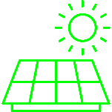






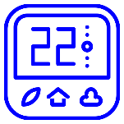
Building N
Electricity Source
Building 1
Heat Supply
Grid
Power
Electric heater
Heat pump
Solar PV
Energy Storage
Charge/
Discharge
Control Agent
Battery
Domestic hot water and/or space heating storage
Cooling storage
End Use
Setpoint
Occupant Model
Non-shiftable plug loads
Domestic hot water heating
Space cooling & heating
Observations

Slide 2
Environment
Building 1
Building N
Energy Storage
Battery
Domestic hot water heating storage
Cooling storage
Building 1 Observations
Control Agent 1
Actions
Control Agent N
Optional Information Sharing

Slide 3
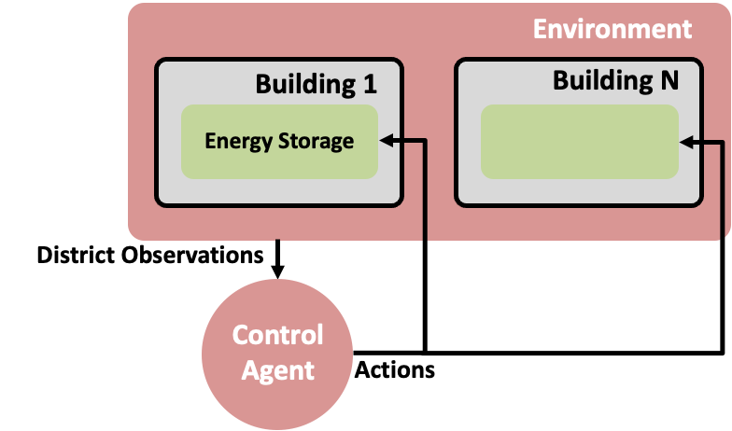
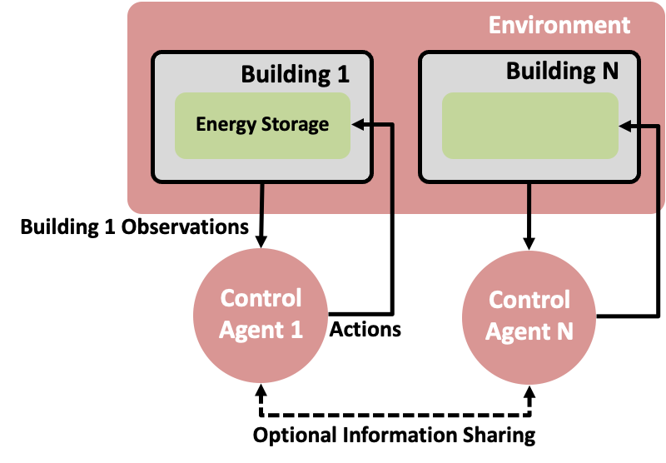
Environment
Environment
Building 1
Building N
Building 1
Building N
Energy Storage
Energy Storage
Building 1 Observations
District Observations
Control Agent 1
Control Agent N
Control Agent
Actions
Actions
Optional Information Sharing

Slide 4
Building 1
Electricity Source
Heat Supply
Building N
Electricity Source
HVAC
Grid
Electric heater
Heat pump
Solar PV
Electric heater
Heat pump
Solar PV
Energy Storage
Energy Storage
Battery
Domestic hot water heating storage
Cooling storage
Battery
Domestic hot water heating storage
Cooling storage
End Use
End Use
Non-shiftable plug loads
Domestic hot water heating
Space cooling & heating
Non-shiftable plug loads
Domestic hot water heating
Space cooling & heating

