Slide 1


Zach Ahearn Pen Trainer Jenny Yue Xuhui Ying
Leo Li
PROSPERITY &
ECONOMIC DEVELOPMENT OF
DEVELOPING COUNTRIES
Notes:
Jenny

Slide 2
Agenda
Problem Statement
Context and Data
Regression Analysis
Data Cleansing
Models
Recommendations
Impact
Notes:
Jenny
After we found out our business objectives, we broke down the dataset with different variables and knew how to approach the problem, which is by using regression model. After we understand our methods, we looked at data and we will introduce how we do data preparation. After everything was cleaned, we built out our models and chose the best one. At the end, we still need to solve real problems so we applied our results into recommendations and impact.

Slide 3
Problem Statement
Our client: World Bank
Situation: Stimulating economic growth in developing countries is always a trigger and we want to improve socioeconomic situation for the population
Goal: We were asked to find ways to predict what factors increase GDP most so we can apply findings to countries
Notes:
Jenny
Create a linear model to predict economic prosperity by determining which variables most affect GDP. Through finding a well-fitting linear model, we can suggest which variables countries should focus on to stimulate economic growth, alleviate poverty, and improve the socioeconomic status of the population.
If you do not know what is linear model, hold on to that, we will explain in a very simple way.

Slide 4
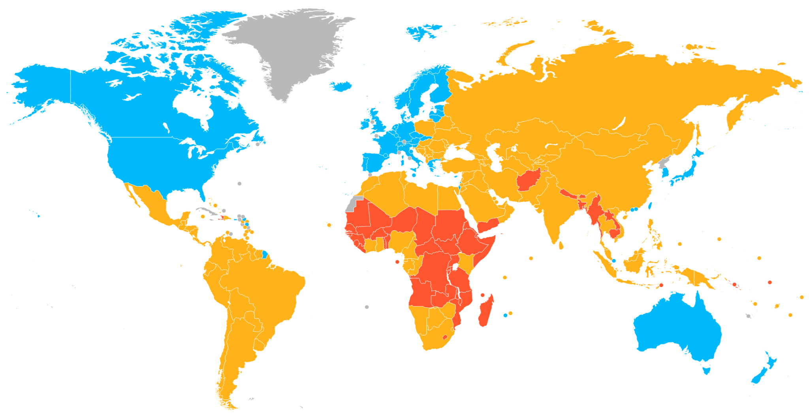
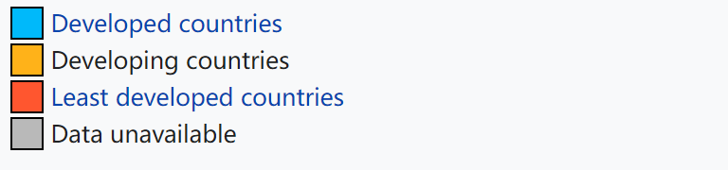
Developing Countries
Notes:
LEO -
So, just to give you more context. Here’s a world map. As you can see, the yellow parts, which are the developing countries, covers way more than half of the map. So we would really like to find a ways to stimulate economic growth in those regions and to improve socioeconomic situation for those population.

Slide 5

Data
Angola
Cameroon
Cape Verde
Central African Republic
Ethiopia
Malawi
…
Gross Domestic Product
Fertility Rate,
Foreign Direct Investment
Imports
Population
Surface Area
…
Notes:
LEO- In order to do that, we used data from World Bank to measure and to predict the prosperity of developing countries. We used data from 47 developing countries, across 31 different attributes, 6 of which are listed on the right side.

Slide 6
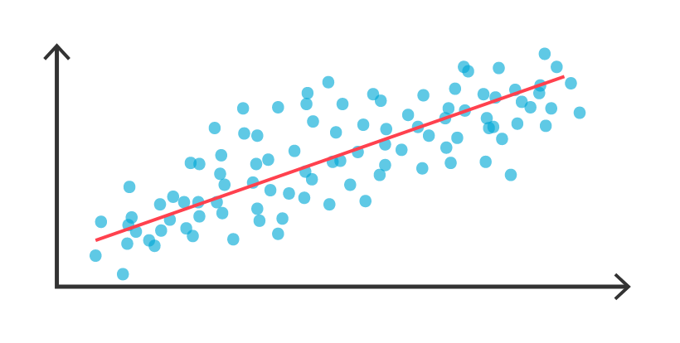
Regression Analysis
Independent variable ('response' variable) :
Fertility Rate,
Foreign Direct Investment
…
Dependent variables (predictor):
Gross Domestic Product
Notes:
LEO - Regression analysis is a set of statistical processes for estimating the relationships between lots of dependent variables ('response' variable) and one independent variables (predictor). In this case, we are trying to predict the level of prosperity of developing countries. So we took GDP as a proxy, and the regression analysis would help us find out which are some important variables that affect GDP the most.

Slide 7
Methods for missing value
Check if any missing values were presented
Deleting variables and countries with many missing values
Using median value for missing values
Initially Removed:
Countries:
Somalia
Variables:
Military Expenditure
# of Personal Computers per 1,000 people
Notes:
Pen - We deleted Somalia which had 34% of the row missing. We also decided to get rid of the military expenditure and the number of personal computers per 1,000 people because those variables had a large portion missing (27.65% and 15% respectively). While the number of personal computers per 1,000 people does not meet the 20% missing requirement, we found that the model was more accurate without the variable as our work progressed. We decided to replace the remaining missing values with the median value for each column because the data for each variable were skewed, most likely getting pulled to the right by super wealthy countries. We decided to keep countries that had an acceptable number of null values so that the model would not be biased towards only predicting the prosperity of affluent countries since data was mostly missing from developing countries.

Slide 8
First Model (Full Model)
Variables: All variables provided by the data (population, imports, foreign direct investment, etc.)
R-squared: 0.9979
Notes:
Zach
Suspiciously high R-Squared => A lot of multicollinearity in the model (variables affecting each other) and this made our initial correlation very high - We were very skeptical about this model.
Adjusted R-Squared: 0.994
Multicollinearity occurs when variables are so highly correlated with each other that it is difficult to come up with reliable estimates of their individual regression coefficients.

Slide 9
Final Model
Removed: Angola, South Africa, and Zimbabwe
Removed: stepAIC, p-value > 0.05, VIF > 5
Variables: fertility rate, foreign direct investment, imports, population and surface area
Use a Log Transformation to improve the normality
R-squared: 0.7774, adjusted R-squared: 0.7473
Notes:
Zach - Removed / Eagle = Rest of Slide
Used a Log Transformation to improve the normality
All have VIF below 5
Removed 3 Countries that were Outliers because they are much more developed than the rest of the countries in the model. Moreover, the 3 countries have undue influence on the model, so we removed them.

Slide 10
Final Model Equation
log10(GDP) = $6.09
- $0.20 (Fertility Rate)
+ $3.2x10⁻¹⁰ (Foreign Direct Investment)
- $0.01 (Imports)
+ $0.67 log10(Population)
- $2.8x10⁻⁸ (Surface Area)
Notes:
Eagle
As the average number of children per woman increases by 1, the log10(GDP) decreases by $0.20 million but as the population increases by 1 person, log10(GDP) increases by $0.67.

Slide 11
Recommendation
Countries looking to improve prosperity should focus on decreasing the fertility rate and imports while also attracting foreign direct investment
Or focus on increasing exports to counter the negative effect of imports on GDP
Notes:
Zach
May be reliant on a lot of imports so increasing exports might be a more viable option

Slide 12
Impact
Allow the World Bank to better predict the prosperity of different nations
Determine where developing countries could dedicate resources to more effectively improve the prosperity of the nation
Measuring Impact:
Assessing the GDP growth rate of each country in the dataset over the next 10 years to see if there is an increase beyond the historic growth rate
Notes:
Pen

Slide 13
Questions?

Slide 14
Thank You

