Slide 1

Investment Portfolio Management Application

Slide 2

What is Investment Portfolio ?

Slide 3

A portfolio is a group of financial assets such as stocks, bonds and cash equivalents.
Large portfolios of investors are professionally managed by financial experts at investment banks. They are responsible for advising the individual investors of the risks and recommend rebalancing of the portfolio based on the life-cycle changes, market risks.

Slide 4

Objective

Slide 5
To Build a model to optimize the portfolio of investor by matching the customer risk tolerance level with the risk of the stocks that he/she holds.
Recommend Alternate Investment opportunities based on the stock holdings of other investors who have similar portfolio.

Slide 6
Methodology :
Assess the risk of each stocks
Identify the risk metrics
Calculate the Risk metrics
Source or gather the Risk Metrics from various financial APIs
To segment the investors based on their psychographic and demographic profiles
To calculate the customer’s risk tolerance level
To generate a common risk scale which matches both risk tolerance level of investor and risk of the stocks.
To estimate the difference between the investor’s risk tolerance level and the risk of the stocks that the investor holds.
To recommend alternative investment opportunities if the difference is huge.
We might recommend stocks that investor with similar portfolio holds.
We might recommend stocks which minimizes the risk difference.

Slide 7



Technology Stack :
Tools :
Python, JavaScript, TypeScript
Pandas, Quandl, REST API
Framework
Front-end : Angular
Back-end : Flask
Database :

Slide 8
Keywords :
Returns : A return is the gain or loss of a security in a particular period.
Risk metrics : Different factors that affect the value of a security / assets.
Risk appetite : Capacity of an investor to take risk.
Sharpe Ratio : Average Return earned in excess of the risk-free rate per unit of volatility or total risk.
MPT (Modern Portfolio Theory) : a theory about how investors construct portfolio that maximizes their expected returns for given levels of risk.
RFM Analysis : customer segmentation technique based upon their frequency, monitory value and how recently their have performed transactions.
Diversification : Different combination of securities produce different expected returns. By simply constructing portfolio with different combinations of securities, Investors could achieve a maximum expected return given their risk preferences due to the fact that returns of a portfolio are greatly affected by nature of the relationship between assets and their weights in the portfolio.

Slide 9

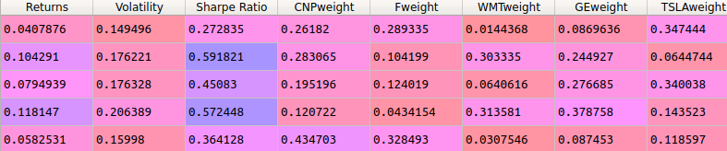
CNP : Center Point Energy F : Ford Motors
WMT : Walmart TSLA : Tesla
GE : General Electric Corporations
Volatility : Risk
Sharpe ratio : Return per excess of risk
Returns : Profit or Loss
%
%
%
%
%

Slide 10
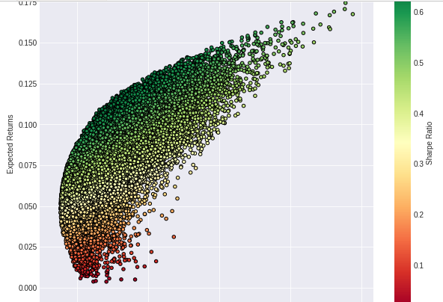
Total 50000 combination of different portfolio

Slide 11
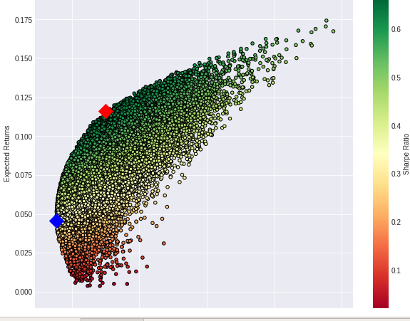
Portfolio with additional risk
Minimum Risk Portfolio

Slide 12
Lets Go with A Case Study

Slide 13
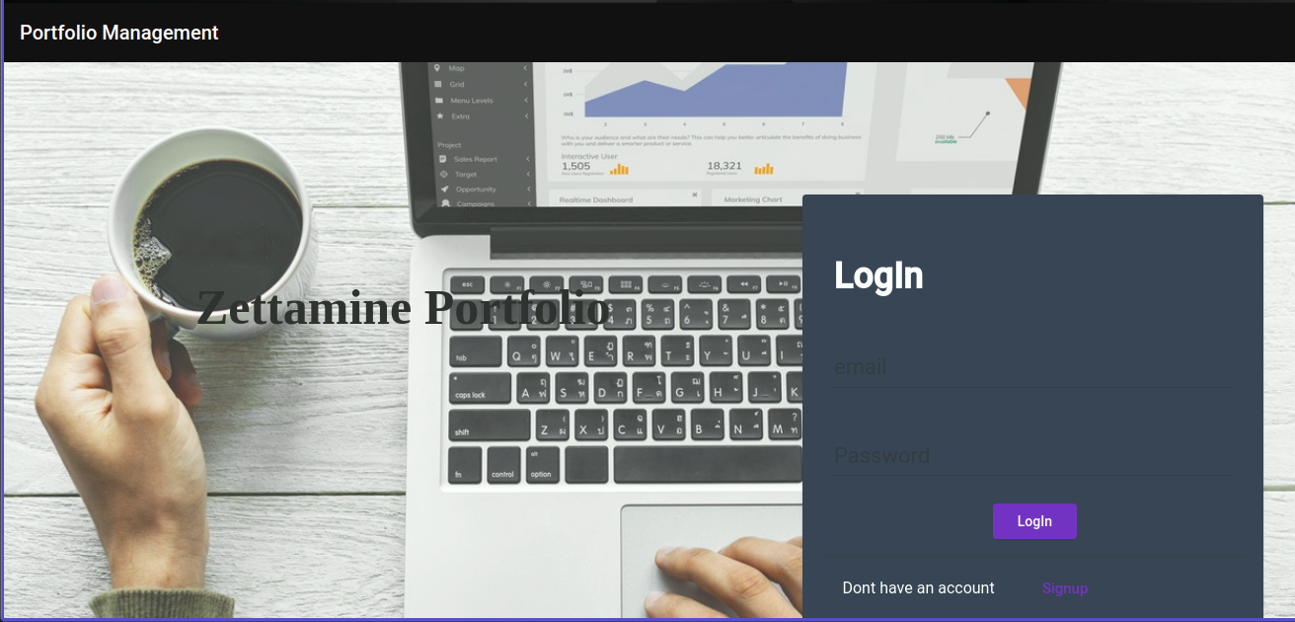

Slide 14
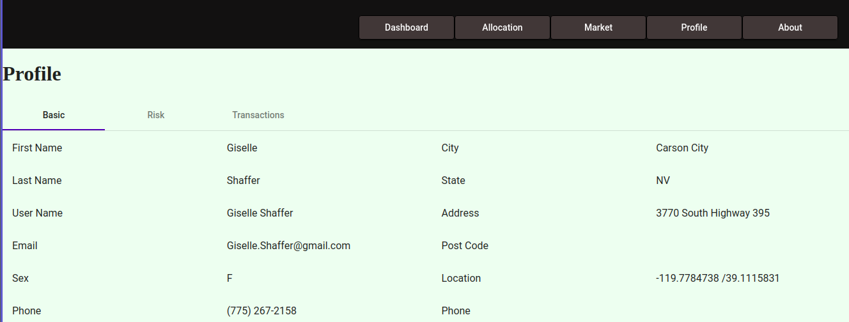

Slide 15
Risk Questionnaire:
For assessing the risk appetite of individual
to suggest stocks according to their preference

Slide 16
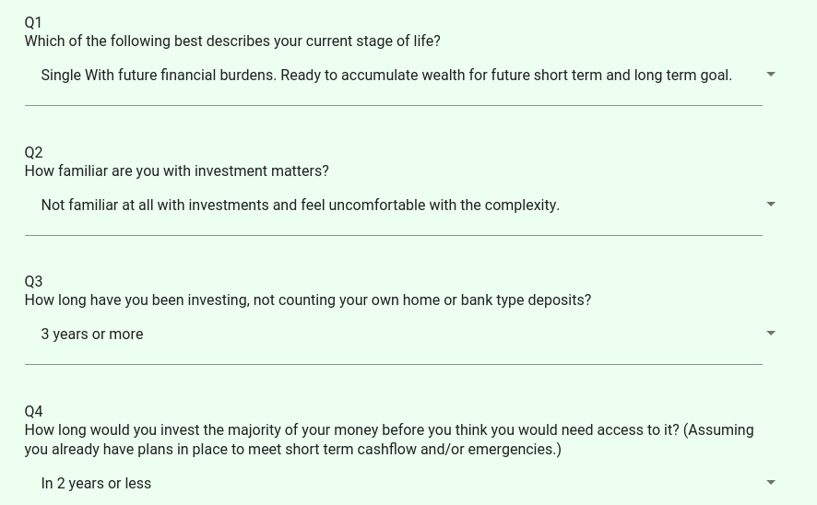

Slide 17

Categories of customer
1. Conservative [0 - 25] points
2. Balanced [26 - 35] points
3. Assertive [35 - 45] points
4. Aggressive [45 - 55] points
5. Very Aggressive [55 – 65.. ] points

Slide 18
NET RETURNS
Net Returns from their individual
stocks in which they have invested
Represented in line chart

Slide 19
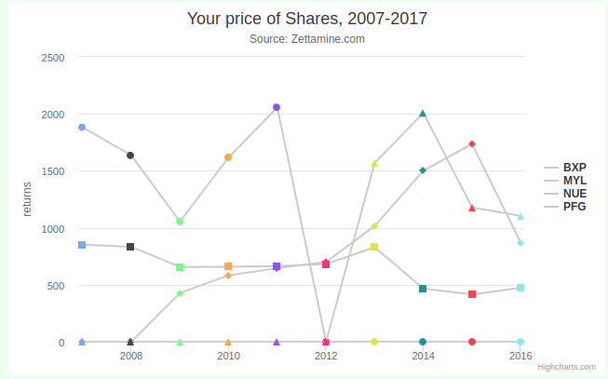

Slide 20
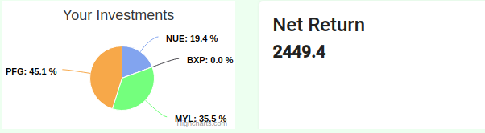

Slide 21
Alternative Portfolio with minimum risk
Alternative portfolio suggested with minimum risk and the same combination of stocks which belongs to their risk categories.

Slide 22
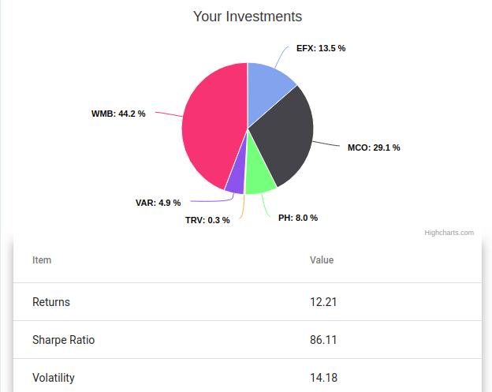

Slide 23
Alternate Portfolio with higher risk
Alternate portfolio with higher risk if investor is interested
As it will give then higher return as well.

Slide 24
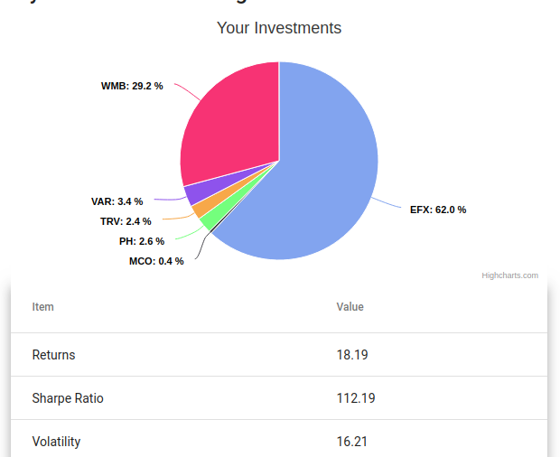

Slide 25


