Slide 1
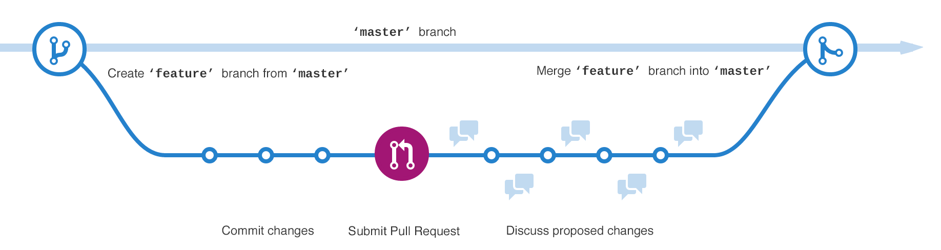
GitHub Workflow

Slide 2
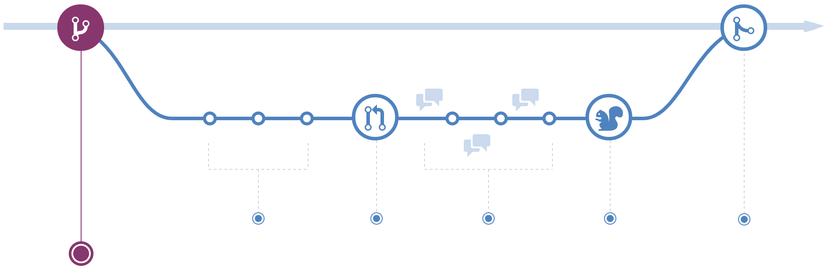
#1 - Create a Branch
GitHub Workflow
$ git checkout -b develop
$ git branch
The code for the live website is in the master branch
Any changes to here will effect the users!
If you want to create a new page, first create a new feature branch.
This is where you will do the development for the new page.
https://guides.github.com/introduction/flow/

Slide 3
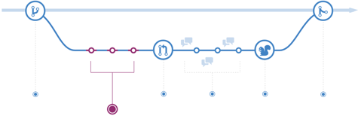
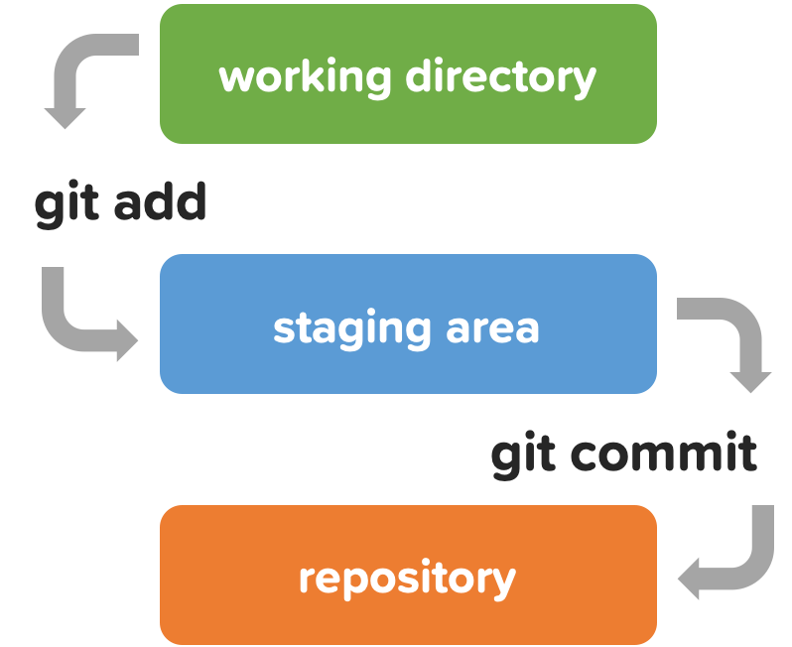
#2 - Making a commit
GitHub Workflow
In your feature branch, you are modifying code.
Each time you want to save a change, make a commit.
This keeps track of changes and provides a transparent history.
Commits allow for roll backs and references.

Slide 4
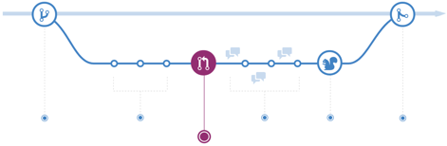
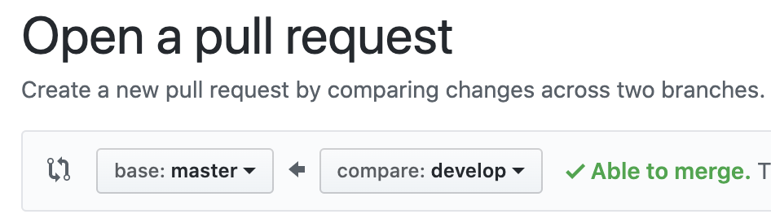
#3 - Open a Pull Request
GitHub Workflow
When you are ready to share your changes to others, open a Pull Request.
Pull Requests are the start of code review.
Make & review comments at the Pull Request tab on GitHub.

Slide 5
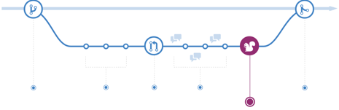
GitHub Workflow - Test
GitHub Workflow
After code review, deploy your code to make sure everything works.
Example: Test if the website looks and acts as expected.

Slide 6
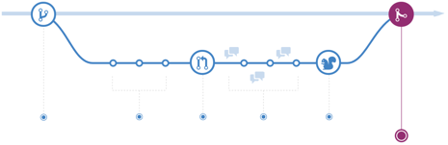
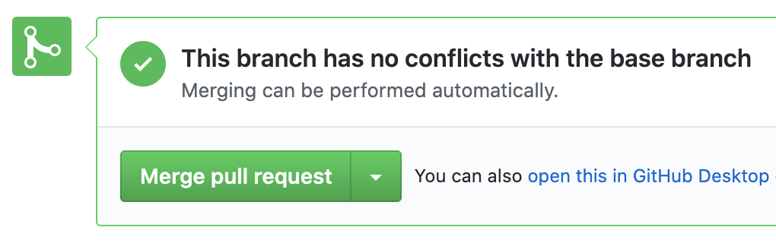
GitHub Workflow - Merge to Master!
GitHub Workflow
Merge your code into the master branch.
Now your changes are live & effects the users.
Once merged, Pull Requests acts as reference points.

Slide 7
GitHub Workflow - Overview
GitHub Workflow
https://commonflow.org/spec/1.0.0-rc.5.html

Slide 8
Revert:
Rewind the Clock
Hands-on D

Slide 9
Preparation for Time Travel
Revert
$ git checkout master
$ git checkout -b timeline
$ touch yr_1.md
$ git add yr_1.md
$ git commit -m "Year 1"
$ …
Create a branch timeline
Create and commit changes three times.
yr_1.md yr_2.md yr_3.md

Slide 10
Check the Past
Revert
$ ls
README.md yr_1.md. yr_2.md. yr_3.md
$ git log --oneline
489ca71 (HEAD -> timeline) Year 3
7470790 Year 2
444b696 Year 1
8766df2 (origin/master, master) …
$ git checkout 444b696
$ ls
README.md yr_1.md.
git log --oneline
Lists out the commits of the branch
Use the commit hash provided for checkout and revert commands
git checkout [commit hash]
Convert the working directory to be the exact state as the [commit].
Check if this is the commit you want to revert back to.
No changes made in this situation will be saved.

Slide 11
Time Travel Back 2 Commits
Revert
$ git checkout timeline
Switched to branch 'timeline'
$ git revert HEAD~2..HEAD
Removing yr_3.md
Removing yr_2.md
$ git log --oneline
d4f441f (HEAD -> timeline) Revert "Year 2"
843f802 Revert "Year 3"
489ca71 Year 3
7470790 Year 2
444b696 Year 1
8766df2 (origin/master, master) …
git revert [commit hash]
Forward-moving undo command
It inverts the changes made by the specified [commit] and appends the result as a new commit.
git revert HEAD
Goes back by 1 commit
git revert HEAD~[#]...HEAD
Goes back by [#] commits

Slide 12
Reset vs Revert
Revert
git reset [commit]
git revert [commit]
Past-deleting undo operation
Goes back to the past [commit] and removes all commits between now till then.
This cleans up everything.
However, the history of the deleted commits are lost.
Forward-moving undo operation
Creates a new commit with the past [commit].
No commits are deleted.
Use for a public/ shared repos
Past [Commit]

