Slide 1
Nexus AI & Studio, and PromptLint
AI Engineering at dbCLM
Java & Kotlin Native, Spring Boot Powered
Akshay Dipta, Senior Engineer, CLM Tech
RCP Engineering Session | Deutsche Bank

Slide 2
The Problem + Vision
THE PROBLEM
THE VISION
▸ Building a new AI agent took 18 to 24 hours of boilerplate
▸ Every team reimplementing auth, retry, model config from scratch
▸ No prompt quality gates, bad prompts reached production silently
▸ No observability, no audit trail of what the AI decided and why
▸ No control over LLM integration, locked into library defaults
▸ What if a new agent took 1 hour, not 24?
▸ What if a 12-agent pipeline was expressible in 20 lines of code?
▸ What if observability, auth, and DB-driven prompts were built in by default?
▸ What if prompt quality was enforced in CI, like code linting?
▸ What if you could see your agents execute live, click any node, inspect state?

Slide 3
What's Inside Nexus AI
Core Engine
Listeners & Observability
Integration
Custom Chat Models
Full control beyond LangChain4j defaults
AgentExecution Listener
Logs every LLM input/output to DB
Bank Authentication
Custom WIF → Azure → JWT chain
Custom Serialization
Supports framework-specific object types
Observability Listener
Correlation IDs for Splunk & Langfuse
Rate Limiter
Custom per-model rate limiting
Auto Checkpoints
Persists graph state to DB automatically
Token Usage Listener
Tracks token consumption per agent
Table Access API
Methods to query framework tables

Slide 4
Two-Tier Architecture
NEXUS AI
TIER 1, Workflow Orchestration (LangGraph4j)
DATABASE
Checkpoints (T1)
Prompts (T2)
Execution Records
Non-AI
Node
AI Node
(Bridge → T2)
Non-AI
Node
→
→
→
Checkpoints | Graph State | Conditional Edges
LLM, GEMINI
Model Calls (via T2)
Responses & Streaming
TIER 2, Agent Pipeline (LangChain4j)
→
AgentFactory | AgentSpec | AgenticScope | Tools | UntypedAgent
sequence() | parallel() | loopUntil()
AZURE AD
WIF Authentication
Token Management
Enterprise Auth | DB-Driven Prompts | Observability

Slide 5
AgentSpec, Declarative Agent Definition
AgentSpec OWNERSHIP_ORG_CHART_AGENT = AgentSpec.of(
OWNERSHIP_ORGANISATION_CHART.getValue(),
OWNERSHIP_ORGANISATION_CHART.getDescription())
.inputs(Map.of(
"deduplicatedEntities", OwnershipResult.class,
"clientEntityName", String.class))
.output("organisationChart", String.class)
.cacheSystemInstruction(true)
.inputGuardrails(inputValidatorGuardrail)
.outputGuardrails(jsonSchemaValidator)
.contentRetriever(ragContentRetriever)
.tools(batchAccumulatorTool)
.async(false)
.cacheTools(true)
.promptVersion(4)
.build();
inputs
Typed bindings from graph state with class mapping
output
Typed output key, available to downstream agents
cacheSystemInstruction
Cache system prompt across calls
inputGuardrails
Team-provided validation before LLM call
outputGuardrails
Team-provided validation after LLM response
contentRetriever
RAG retriever, injects context from documents
tools
LangChain4j-compatible tool bindings
async
Sync or async execution mode
promptVersion
Versioned prompts loaded from database

Slide 6
Spring Boot Agent Configuration
Simple Sequence
With Critic Loop
@Bean
public OwnershipOrganisationChartAgent
ownershipOrganisationChartAgent() {
return agentFactory.sequence(
OwnershipOrganisationChartAgent.class,
"organisationChart",
specs.ownershipOrganisationChartAgent());
}
@Bean
public OwnershipOrganisationChartAgent
ownershipOrgChartAgentWithCritic() {
UntypedAgent initScope = AgenticServices
.sequenceBuilder()
.output(scope -> {
scope.writeState("criticFeedback", "");
scope.writeState("extractedRecords", "");
return "";
}).build();
UntypedAgent extractor = agentFactory.criticLoop(
scope -> scoreParser.parseCriticScore(
scope.readState("criticFeedback")),
buildWithBatchTool(
specs.ownershipOrgChartAgent()),
specs.ownershipExtractionCriticAgent());
return agentFactory.sequence(
OwnershipOrganisationChartAgent.class,
"extractedRecords",
initScope, extractor);
}

Slide 7
Tier 1, Workflow Graph Definition
StateGraph<CsmState> workflow = new StateGraph<>(CsmState::new);
workflow.addNode("document_aggregation", documentAggregatorNode);
workflow.addNode("document_classification_node", documentClassificationNode);
workflow.addNode("named_entity_extraction_node", namedEntityExtractionNode);
workflow.addNode("csm_classification", csmClassificationNode);
workflow.addNode("csm_comparison", csmComparisonNode);
workflow.addNode("de_duplication_node", deDuplicationNode);
workflow.addNode("person_name_normalization_node", personNameNormalizationNode);
workflow.addNode("csm_persistence", csmPersistenceNode);
workflow.addNode("auto_answer_trigger", autoAnswerTriggeringNode);
workflow.addEdge(START, "document_aggregation");
workflow.addEdge("document_aggregation", "document_classification_node");
workflow.addConditionalEdges("document_classification_node",
documentAggregationEdge,
Map.of("named_entity_extraction_node", "named_entity_extraction_node", END, END));
workflow.addEdge("named_entity_extraction_node", "person_name_normalization_node");
workflow.addEdge("person_name_normalization_node", "de_duplication_node");
workflow.addEdge("de_duplication_node", "csm_classification");
workflow.addEdge("csm_classification", "csm_comparison");
workflow.addConditionalEdges("csm_comparison", csmPersistenceTriggeringEdge,
Map.of("csm_persistence", "csm_persistence", END, END));
workflow.addEdge("csm_persistence", "auto_answer_trigger");
workflow.addEdge("auto_answer_trigger", END);
return workflow.compile(
CompileConfig.builder().checkpointSaver(checkpointSaver).build());

Slide 8
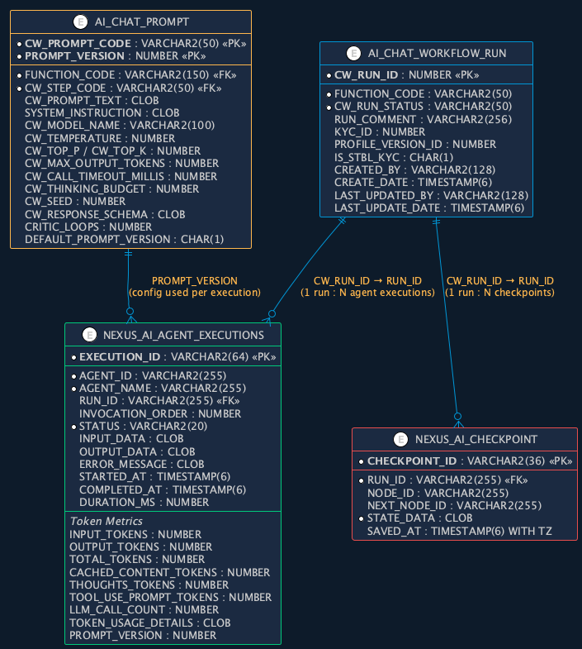
Database Schema, Entity Relationships
Four tables power the framework: config, execution, observability, and state persistence.

Slide 9
DB-Driven Configuration, AI_CHAT_PROMPT
All agent configs defined here. Loaded and validated at application start. Missing input variables throw exceptions before first request.
IDENTITY
CW_PROMPT_CODE
Agent identifier
PROMPT_VERSION
Version number
CW_STEP_CODE
Workflow step ref
FUNCTION_CODE
Function/workflow ref
DEFAULT_PROMPT_VERSION
Active version flag
MODEL CONFIGURATION
CW_MODEL_NAME
Model (e.g. gemini-1.5-pro)
CW_TEMPERATURE
Temperature
CW_TOP_P / CW_TOP_K
Sampling parameters
CW_SEED
Seed for reproducibility
CW_MAX_OUTPUT_TOKENS
Token limit
CW_CALL_TIMEOUT_MILLIS
Call timeout
CW_THINKING_BUDGET
Thinking budget
PROMPT & BEHAVIOUR
CW_PROMPT_TEXT
User prompt template
SYSTEM_INSTRUCTION
System instruction
CW_PROMPT_LANG
Prompt language
CW_RESPONSE_SCHEMA
Expected response schema
CRITIC_LOOPS
Critic loop iterations
AUDIT CREATED_BY | CREATED_DATE | LAST_UPDATED_BY | LAST_UPDATE_DATE
Primary Key: (CW_PROMPT_CODE, PROMPT_VERSION) FK → AI_CHAT_WORKFLOW, AI_CHAT_WORKFLOW_STEP
Change a prompt, model, or temperature without redeployment. Next execution picks up the new config. Full version history via PROMPT_VERSION.

Slide 10
Workflow Metadata, AI_CHAT_WORKFLOW_RUN
Parent table for every workflow execution. CW_RUN_ID links to agent executions and checkpoints tables.
COLUMN
TYPE
DESCRIPTION
CW_RUN_ID
NUMBER
Unique run ID, links to agent executions and checkpoints
FUNCTION_CODE
VARCHAR2(50)
Workflow/function identifier
CW_RUN_STATUS
VARCHAR2(50)
Status: RUNNING → FINISHED / FAILED
RUN_COMMENT
VARCHAR2(256)
Execution comment or description
PROFILE_VERSION_ID
NUMBER
Client profile version
KYC_ID
NUMBER
Client KYC identifier, which client this run is for
IS_STBL_KYC
CHAR(1)
Stable KYC flag
CREATED_BY
VARCHAR2(128)
Who triggered the run
CREATE_DATE
TIMESTAMP(6)
When the run started
LAST_UPDATED_BY
VARCHAR2(128)
Last status updater
LAST_UPDATE_DATE
TIMESTAMP(6)
Last status change timestamp
AI_CHAT_WORKFLOW_RUN.CW_RUN_ID → NEXUS_AI_AGENT_EXECUTIONS.RUN_ID | CHECKPOINTS.RUN_ID
One workflow run → many agent executions + many checkpoints. Full traceability from client to every LLM call.

Slide 11
Automatic Observability, NEXUS_AI_AGENT_EXECUTIONS
Every agent execution automatically persisted by the framework. Zero developer code required.
IDENTITY & EXECUTION
EXECUTION_ID
AGENT_ID / AGENT_NAME
RUN_ID
INVOCATION_ORDER
STATUS
PROMPT_VERSION
TIMING & DATA
STARTED_AT
Execution start
COMPLETED_AT
Execution end
DURATION_MS
Duration in ms
INPUT_DATA
Full input (CLOB)
OUTPUT_DATA
Full output (CLOB)
ERROR_MESSAGE
Error details if failed
TOKEN METRICS
INPUT_TOKENS
OUTPUT_TOKENS
TOTAL_TOKENS
CACHED_CONTENT_TOKENS
THOUGHTS_TOKENS
TOOL_USE_PROMPT_TOKENS
LLM_CALL_COUNT
TOKEN_USAGE_DETAILS
Zero Code
Framework persists every
agent run automatically
Full I/O Capture
Input & output data stored
for debugging & replay
Cost Visibility
Token breakdown per agent
incl. cached & thinking tokens
Compliance Ready
Complete audit trail.
Who ran what, when, how long

Slide 12
State Persistence, NEXUS_AI_CHECKPOINT
Full graph state saved at every node transition. Enables replay, debugging, and resume from any point in the workflow.
COLUMN
TYPE
DESCRIPTION
CHECKPOINT_ID
VARCHAR2(36)
Unique checkpoint UUID
RUN_ID
VARCHAR2(255)
Links to AI_CHAT_WORKFLOW_RUN, tracks which workflow
NODE_ID
VARCHAR2(255)
Current node that just completed
NEXT_NODE_ID
VARCHAR2(255)
Next node to execute, enables resume
STATE_DATA
CLOB
Full graph state snapshot, all scope variables as JSON
SAVED_AT
TIMESTAMP(6) WITH TZ
When checkpoint was saved, defaults to CURRENT_TIMESTAMP
Replay
Re-run from any checkpoint
without restarting the
entire workflow
Debug
Inspect full state at every
node, what went in,
what came out
Resume
NEXT_NODE_ID tracks where
to continue after a failure
or restart
Audit
Complete execution history
tied to RUN_ID. Every
state transition recorded

Slide 13
Nexus AI Studio
Raw execution data is powerful for auditing. But when you're building a 12-agent pipeline, you need to see it.
Today
Vision: Swagger for AI
Graph Visualization
Renders your workflow graph as an interactive UI
Auto-Discover Agents
Scans app context, lists every registered agent
Run Workflows from UI
Trigger and monitor executions in the browser
Run Individual Agents
Test any agent in isolation, pass input, see output
Live Execution Tracking
Agents light up, complete, or fail in real time
Run Full Workflows
End-to-end pipelines with live graph feedback
State Inspection
Click any node for full input/output at that checkpoint
One UI for Everything
Like Swagger gave APIs a face, Studio gives agents a face
React + TypeScript SPA, packaged as a Spring Boot JAR. Add one Maven dependency, get the full UI.

Slide 14
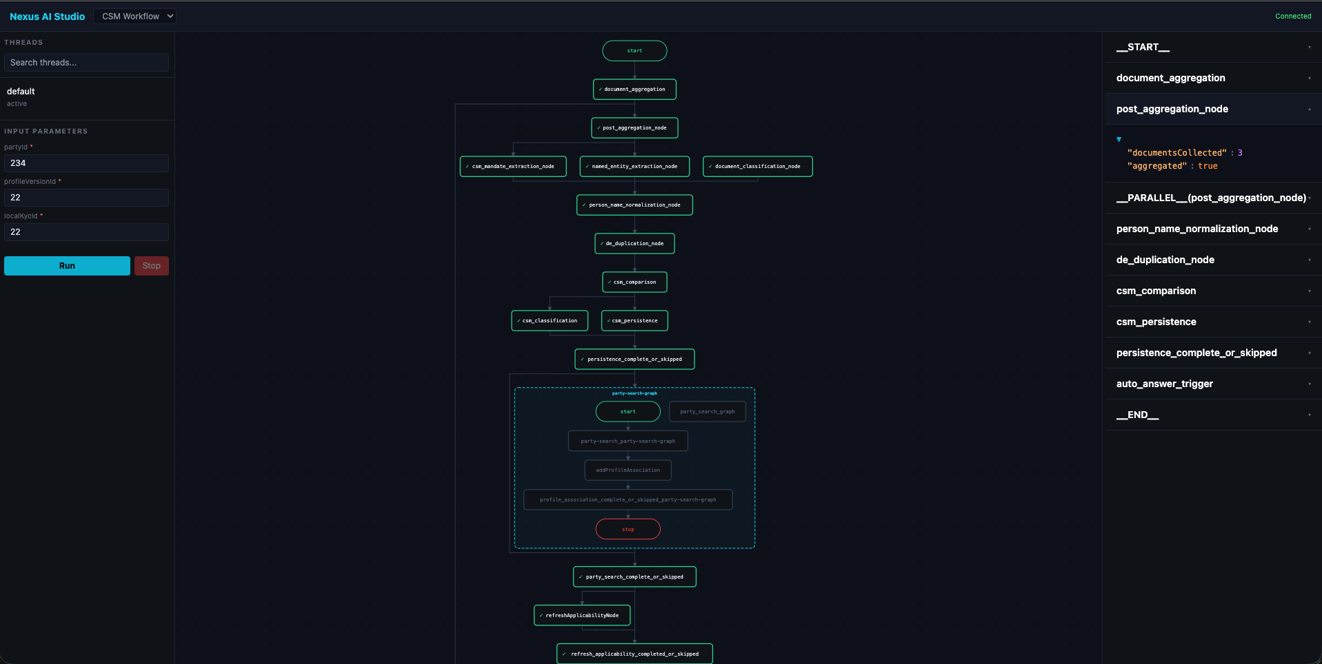
Nexus AI Studio, Live Demo

Slide 15
Prompts Are Code
A prompt that degrades model output doesn't throw an exception. It silently returns worse results.
You won't catch it in unit tests. You may not catch it in integration tests. You catch it when a business user files a ticket.
We treat configuration as code, infrastructure as code. Why not prompts as code?
PromptLint brings static analysis to prompt engineering: the same discipline we apply to Java, applied to the strings we send to models.
"A bad prompt is a bug. PromptLint finds it before it ships."
No LLM calls
Fully deterministic, rule-based analysis
Milliseconds
Fast enough for pre-commit hooks and CI gates
Deterministic
Same prompt always produces the same score

Slide 16
8 Quality Dimensions
CLR
Clarity
Sentence structure, ambiguous pronouns, vague quantifiers
SPC
Specificity
Under-constrained instructions, missing format requirements
GND
Groundedness
Hallucination risk, claims without context anchoring
OUT
Output Format
Missing output schema, ambiguous response format
CON
Constraint Coverage
Does the prompt cover edge cases and failure modes
CST
Consistency
Contradictory instructions within the same prompt
TKN
Token Efficiency
Unnecessary verbosity relative to instruction density
INJ
Injection Risk
Prompt injection surface area, missing delimiters
Each dimension scores 0 to 1. Weighted composite score. Configurable thresholds per dimension or aggregate.

Slide 17
PromptLint in Action
JUnit Assertion API
Test Execution Output
@Test
void shouldFetchAndValidate() {
String agentName = CSM_CLASSIFIER.getValue();
Prompt prompt = nexusStoreProvider
.prompts().lookup(agentName).get();
assertNotNull(prompt);
PromptUnderTest put = new PromptUnderTest(
agentName,
prompt.getSystemInstruction(),
prompt.getPromptText(),
Set.of("gcsFilePath", ...),
"output",
AgentTypeProfile.CLASSIFICATION,
prompt.getResponseSchema());
PromptQualityReport report =
analyzer.analyze(put);
assertThat(report)
.printReport(0.75)
.passesThreshold(0.75)
.hasNoCriticalIssues();
}
PROMPT QUALITY REPORT: document-summarizer
Profile: EXTRACTION
Overall Score: 0.75 / 1.00 PASS (threshold: 0.50)
Dimension Score Weight Contrib
CLARITY 1.00 0.10 0.100
SPECIFICITY 0.58 0.15 0.088
GROUNDEDNESS 0.92 0.25 0.229
OUTPUT_CONTRACT 0.83 0.15 0.125
CONSTRAINT_COVERAGE 0.20 0.15 0.030
CONSISTENCY 1.00 0.10 0.100
TOKEN_EFFICIENCY 1.00 0.05 0.050
INJECTION_RESISTANCE 0.63 0.05 0.031
Weakest: CONSTRAINT_COVERAGE (0.20)
Issues: 9 total (0 critical, 3 warning, 6 info)
WARN [SPC-004] No positive examples found
WARN [CON-001] No instructions for empty input
WARN [INJ-001] No defence against embedded prompts
Suggestions:
1. Add 2+ positive examples
2. Use proper JSON types: "id": 1 not "1"
3. Show nullable fields as null in example
4. Add empty input handling instruction
5. Add ambiguous case guidance
6. Add prompt injection defence
No extra service, no API key, no network call. Just a dependency on the classpath. Runs in milliseconds.

Slide 18
Adopt Nexus AI
Three dependencies. A few properties. You have the whole framework.
<!-- Nexus AI, workflow + agent pipeline -->
<dependency>
<groupId>com.db.clm</groupId>
<artifactId>nexus-ai</artifactId>
<version>LATEST</version>
</dependency>
<!-- Nexus AI Studio, graph viz UI -->
<dependency>
<groupId>com.db.clm</groupId>
<artifactId>nexus-ai-studio</artifactId>
<version>LATEST</version>
</dependency>
<!-- PromptLint, static prompt analyser -->
<dependency>
<groupId>com.db.clm</groupId>
<artifactId>clm-prompt-lint</artifactId>
<version>LATEST</version>
</dependency>
application-local.yaml
clm:
nexus:
ai:
enabled: true
wif:
wif_provider: /path/provider.json
wif_keystore: /path/keystore.json
azure:
tenant_id: ENC(...)
client_id: ENC(...)
scope: api://.../.default
grant_type: client_credentials
google:
project_id: db-dev-daa2-dbclm
location: europe-west4
transport: REST
credentials:
project_number: ENC(...)
workload_identity_pool_id: ENC(...)
service_account_email: ENC(...)
rate-limit:
enabled: true
requests-per-second: 0.5
max-bucket-size: 10
studio:
enabled: true
path: /studio

Slide 19
Thank You
Questions & Discussion
Akshay Dipta, CLM Tech, Senior Engineer

