Slide 1
密码编码学简介* Introduction to Cryptography
郭江凌
暨南大学
* 改编自“Introduction to Cryptography”, Matt Mahoney, Florida Tech.

Slide 2
Definitions
Cryptography
the science (art) of encryption
Cryptanalysis
the science (art) of breaking encryption
Cryptology
cryptography + cryptanalysis

Slide 3
Cryptography Goals
Encryption
Prevent Eve from understanding message
Authentication
Prevent Eve from impersonating Alice
Integrity
Prevent Eve from tampering message
Eve
Alice
Bob
Insecure Channel

Slide 4
Cryptographic Attacks
Ciphertext only
Attacker has only ciphertext.
Known plaintext
Attacker has (random) plaintext and corresponding ciphertext.
Chosen plaintext
Attacker has chosen plaintext and corresponding ciphertext.
Distinguishing attack
Attacker can distinguish your cipher from an ideal cipher (random permutation).
A cipher must be secure against all of these attacks.

Slide 5
Computationally Secure
Definition
The best known attacking algorithm requires N operations to break it
N is too large for the attack to be feasible
Pratical consideration
Currently, N > 2⁸⁰ is good enough
Expect the encryption to be broken
at some point in the future
through an improvement in computing power
through an algorithmic breakthrough

Slide 6
Unconditionally Secure (Perfectly Secure)
Definition
It cannot be broken even with infinite computing power
The only unconditionally secure encryption
One Time Pad: C = P + K
where K is as long as P, and K is never reused
Pratical consideration
Nearly impossible to efficiently distribute K
Used in military and diplomatic contexts

Slide 7
Kerckhoffs’ Principle (Shannon's Maxim)
The security of an encryption depends
Only on the key
Not on the secrecy of the algorithm
Nearly all proprietary encryption have been broken
Enigma, DeCSS, zipcrack...
Secure systems use published algorithms
PGP, OpenSSL, Truecrypt...

Slide 8
Provable Security
Proof of unbreakable encryption
≠ Proof of the system's security
Systems are believed secure
only when many people try and fail to break them
Provably secure system
Does NOT exist

Slide 9
Cryptographic Algorithms
Block ciphers (symmetric/secret key)
Encryption (one-to-one) + Authentication + Integrity
Public key encryption
Encryption (many-to-one)
Digital signature
Authentication + Integrity
Secure Hashes
Integrity
MAC (keyed hashes)
Authentication + Integrity

Slide 10
Block Cipher (Symmetric/Secret Key Encryption)
Workflow
Alice: C = E(K_{ab}, P)
Alice sends C to Bob
Bob: P = D(K_{ab}, C)
Only Alice and Bob have K_{ab}, thus
Encryption: Eve cannot properly decrypt C
“one-to-one”: must use differnt K for each pair
Authentication: Eve cannot properly encrypt P
Integrity: Eve cannot properly modify C

Slide 11
Block Ciphers
AES
DES
3DES
Twofish
Blowfish
Serpent
RC4
IDEA
etc.
Plaintext
E
Key
Ciphertext
D
Plaintext

Slide 12
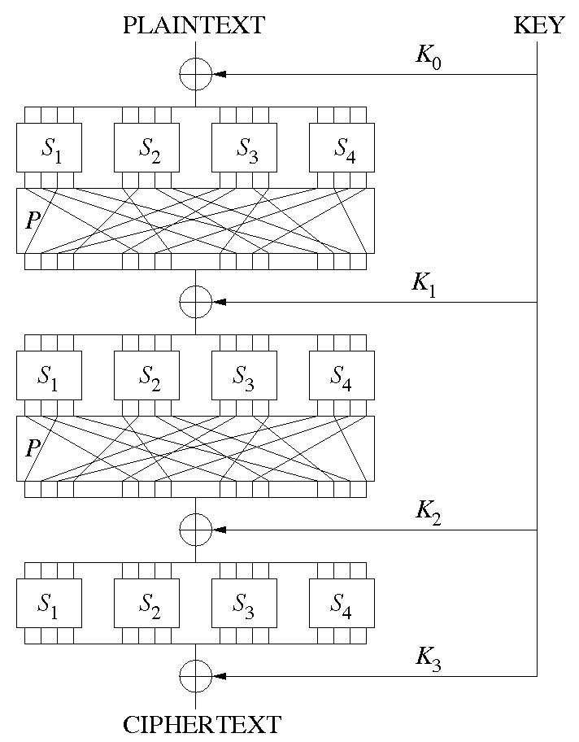
Block Cipher - SP-Network
Substition stage: S-boxes
invertible lookup tables
change one input bit → change half output bits
Purpose: Shannon confusion
Permutation stage: P-boxes
one S-box's output bits → many S-boxes' input
Purpose: Shannon diffusion
SP-Network
Many rounds
Invertible (for decrpytion)
Parallelizable

Slide 13
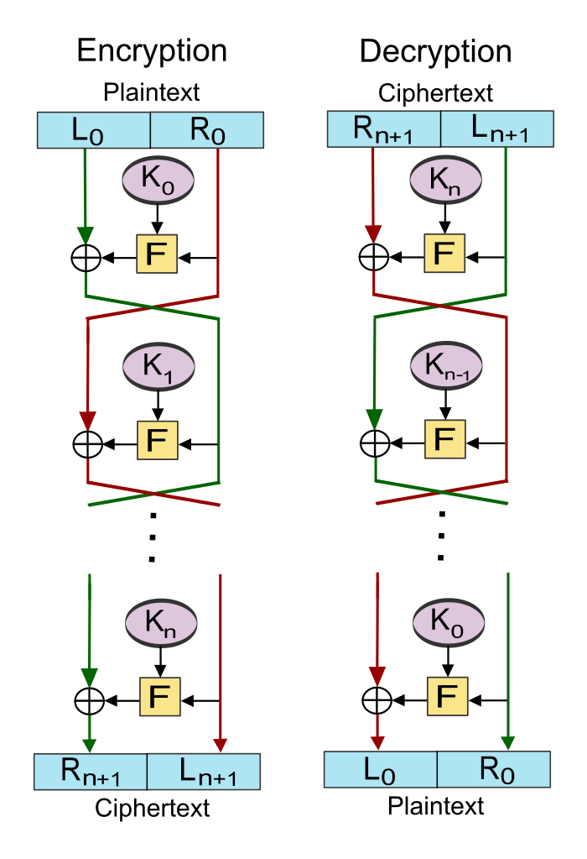
Block Cipher - Feistel Network
Round function F
invertible NOT required
Sub-keys K_{i}
reverse order for decryption
Pseudorandom permutation
3 rounds
4 rounds (strong)

Slide 14
Block Cipher - Encryption Modes
Problem
How to encrypt a very long message?
Solution: encrytion modes
ECB – Electronic Code Book
CBC – Cipher Block Chaining
OFB – Output Feedback
CTR – Counter

Slide 15
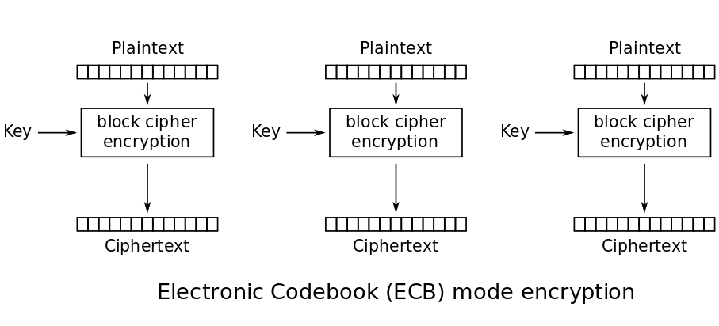
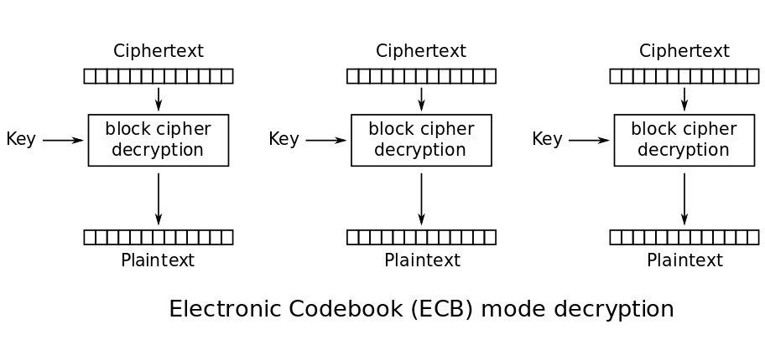
ECB - Electonic Code Book
C_{i} = E(K, P_{i})
Encryption parallelizable | Yes
Decryption parallelizable | Yes
Tamper resistant | No
Others | Insecure
P_{i} = D(K, C_{i})

Slide 16
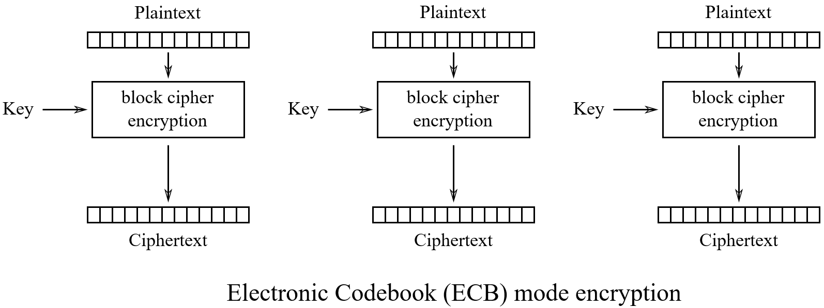



ECB - Insecure!
Identical planetext blocks → identical ciphertext blocks
Patterns between plantext blocks → patterns between ciphertext blocks
Original image
Encrypted using ECB mode
Encrypted using CBC mode

Slide 17
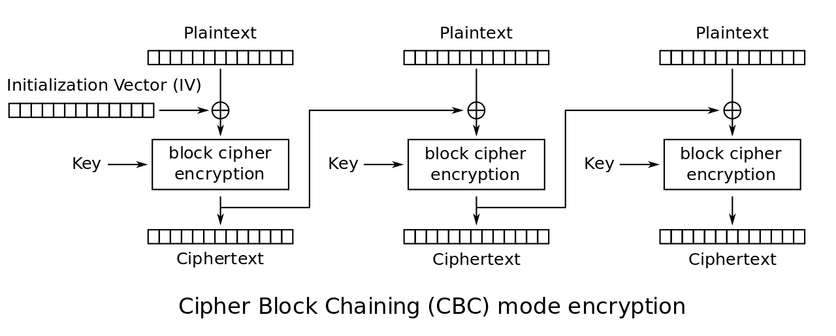
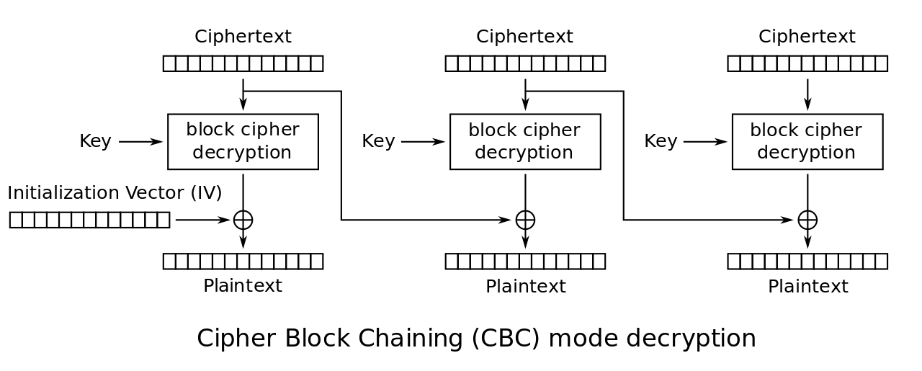
CBC - Cipher Block Chaining
C_{i} = E(K, P_{i} + C_{i-1})
C₀ = IV
Encryption parallelizable | No
Decryption parallelizable | Yes
Tamper resistant | Partial
Others | Popular
P_{i} = D(K, C_{i}) + C_{i-1}
C₀ = IV
Initialization Vector (IV): fixed, random, counter, or nonce
Nonce: number used only once

Slide 18
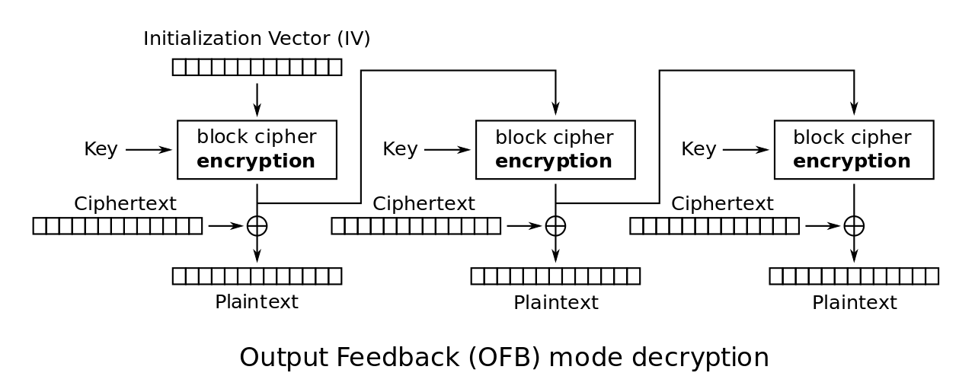
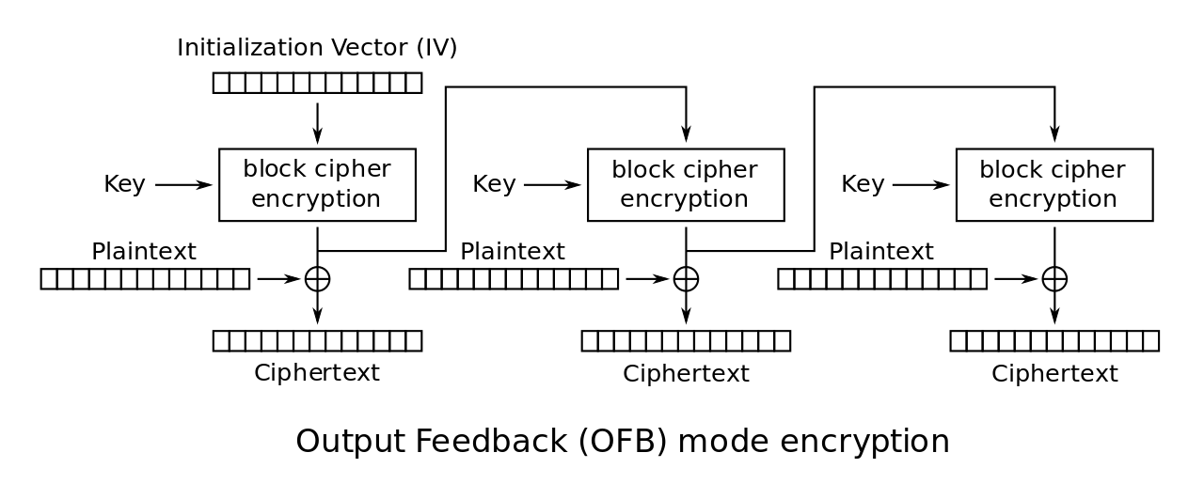
OFB - Output Feedback
K₀ = IV
K_{i} = E(K, K_{i-1})
C_{i} = P_{i} + K_{i}
Encryption parallelizable | Partial
Decryption parallelizable | Partial
Tamper resistant | No
Others | Encrytion = Decrytion
K₀ = IV
K_{i} = E(K, K_{i-1})
P_{i} = C_{i} + K_{i}

Slide 19
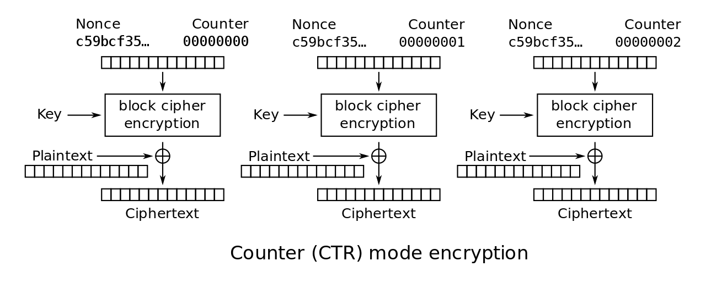
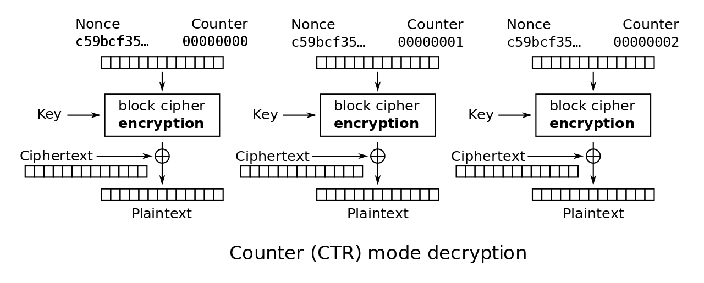
CTR - Counter
K_{i} = E(K, nonce || i)
C_{i} = P_{i} + K_{i}
Encryption parallelizable | Yes
Decryption parallelizable | Yes
Tamper resistant | No
Others | Popular
K_{i} = E(K, nonce || i)
P_{i} = C_{i} + K_{i}

Slide 20
Public Key Encryption
Workflow
Bob generates 2 keys, K_{eb} and K_{db}
Bob publishes K_{eb} (public key)
Alice encrypts: ciphertext C = E(K_{eb}, plaintext P)
Bob decrypts: P = D(K_{db}, C)
Only Bob has K_{db}
Encryption: only Bob can properly decrypt C
“many-to-one”: everyone can encrypt for Bob
Infeasible: K_{eb}→K_{db}

Slide 21
Digital Signatures
Workflow
Alice generates K_{ea} and K_{da}
Alice publishes K_{ea}
Alice signs plaintext P: (P, S = D(K_{da}, P))
Alice sends (P, S) to Bob
Bob verifies that E(K_{ea}, S) = P
Only Alice has K_{da}
Authentication: Eve cannot properly sign P
Integrity: Eve cannot properly modify P and S
Infeasible: K_{ea}→K_{da}

Slide 22
Public Key Encryption + Digital Signature
Workflow
Alice encrypts with Bob’s public key: C = E(K_{eb}, P)
Alice signs with her secret key: S = D(K_{da}, C)
Alice sends (S, C) to Bob
Bob verifies E(K_{ea}, S) = C
Bob decrypts: P = D(K_{db}, C)
Only Bob has K_{db} and only Alice has K_{da}
Encryption: only Bob can properly decrypt C
“many-to-one”: everyone can encrypt for Bob
Authentication: only Alice can properly sign C
Integrity: Eve cannot properly modify S and C

Slide 23
Secure Hashes
h
Message m
(any size)
n-bit hash h(m)
Goals
Infeasible: h(m) → m
First preimage resistance: given h(m) it takes 2^{n} work to find m.
Infeasible: find m₁≠m₂ where h(m₁) = h(m₂).
Second preimage resistance: given m₁ it takes 2^{n} work to find m₂ such that h(m₁) = h(m₂).
Collision resistance: it takes 2^{n/2} work to find any m₁, m₂ such that h(m₁) = h(m₂).
a small change to m → significant changes to h(m)

Slide 24
Hash Applications
Verify message integrity
Faster digital signatures: Alice signs h(P) instead of P.
Password verification (e.g. UNIX) without storing passwords.
Strong pseudo-random number generation.
Message Authentication Code (MAC).

Slide 25
Hash Examples
MD2, MD4, MD5 – 128 bits (broken, http://eprint.iacr.org/2004/199.pdf
http://eprint.iacr.org/2006/105.pdf)
SHA-1 – 160 bits
SHA-256, 384, 512 bits
http://csrc.nist.gov/publications/fips/fips180-2/fips180-2.pdf
Whirlpool – 512 bits
Tiger – 192 bits
Many proposed hashes have been broken.
http://paginas.terra.com.br/informatica/paulobarreto/hflounge.html

Slide 26
Hash Construction from a Block Cipher
Whirlpool uses a cipher called W, based on AES but with a 512 bit block and 512 bit key.
m₁
m₂
m_{k}, size, pad
C_{i-1}
E
Key = m_{i}
C₀ = fixed IV
C_{i} = E(m_{i}, C_{i-1})
h(m) = C_{k}
C_{i}

Slide 27
Random Number Generation
Random = not guessable by an attacker.
Requires a hardware source of entropy.
System clock
Mouse movements
Keystroke timing
Network packets
Thermal noise
Audio input
Video input
Radioactive source
Hash
Random
Numbers

Slide 28
Message Authentication Code (MAC)
Protects a message's integrity and authenticity
Example: HMAC
HMAC(K, m) = h(K xor 0x5c5c…|| h(K xor 0x3c3c… || m))
h() = SHA-1 or MD5
K = key
m = message
Can only be generated if you know K.

Slide 29
Secure Sockets Layer (SSL)
https protocol (secure channel)
Version 3.0 developed by Netscape in 1996
Also known as TLS 1.0 (Transport Layer Security)
Supports many algorithms
Public Key: RSA, DH, DSA
Symmetric Key: RC2, RC4, IDEA, DES, 3DES, AES
Hashes: MD5, SHA
Public keys are signed by CA (Certificate Authority) using X.509 certificates.

Slide 30
SSL Example
Client
I know RSA, DH, 3DES, AES, MD5, SHA-1
Server
Use RSA, AES, SHA-1. My public key is (n,e)
Session key: RSA((n,e), K)
AES(K, P || HMAC(K, P))

Slide 31
Summary
Cryptography is hard
Security can not be proven.
Even expertly designed systems have weaknesses.
Designing your own encryption algorithm would be foolish.
Cryptography is not the answer
Most attacks do not involve breaking encryption.
Prevent, Detect, Recover
Cryptography is only for prevention

Slide 32
Question
Source
Coding
Channel
Coding
Souce
Channel
?
?
?
Noise
Encryption
Where should we put the Encryption box?

