Slide 1
Using Economic/Financial Macroeconomic indicators to predict/correlate with the NASDAQ market index
By Nicholas Eames

Slide 2
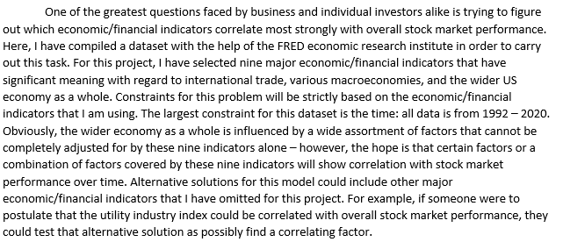
Project Goal

Slide 3
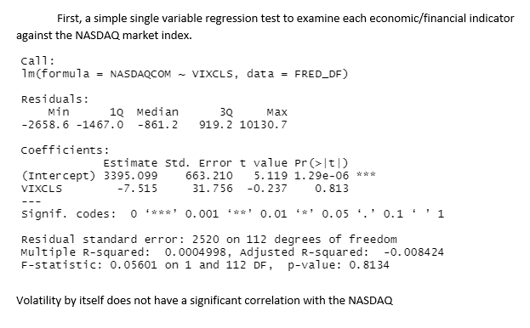
Volatility regressed on NASDAQ

Slide 4
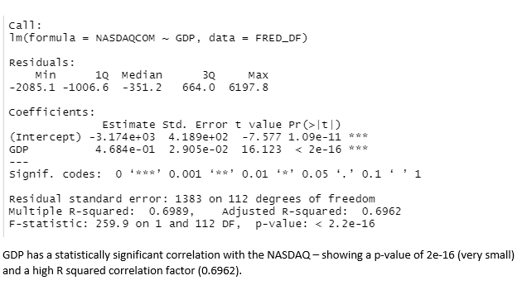
GDP regressed on NASDAQ

Slide 5
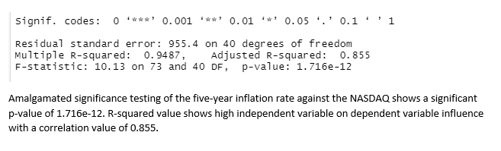
5 Inflation rate regressed on NASDAQ

Slide 6
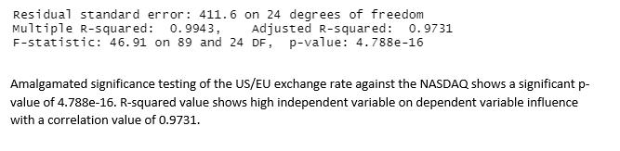
US/EU exchange rate regressed on NASDAQ

Slide 7
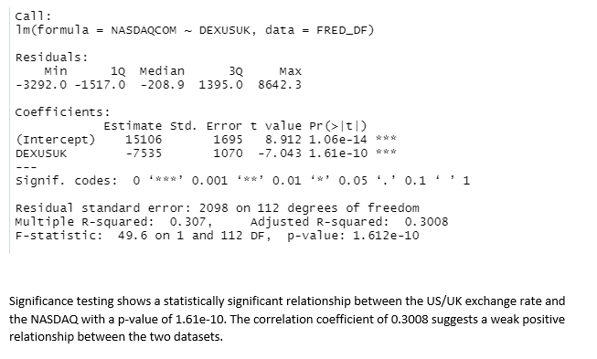
US/UK exchange rate regressed on NASDAQ

Slide 8
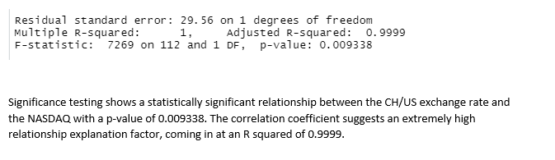
CH/US exchange rate regressed on NASDAQ

Slide 9
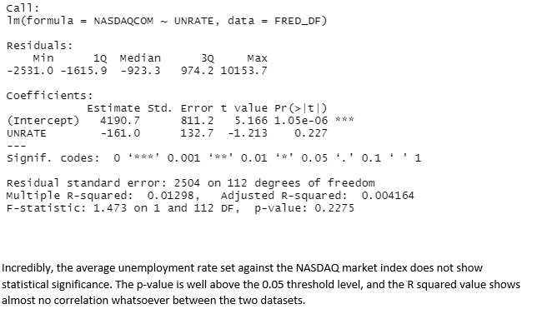
Unemployment rate regressed on NASDAQ

Slide 10
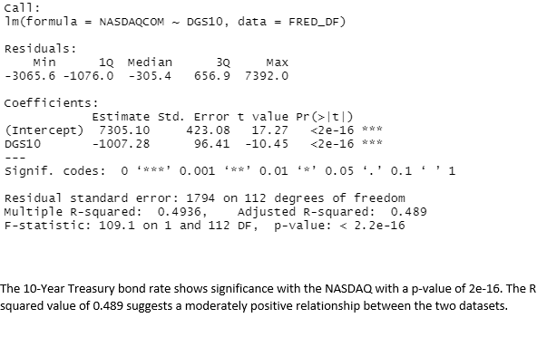
10-Year Treasury Bond regressed on NASDAQ

Slide 11
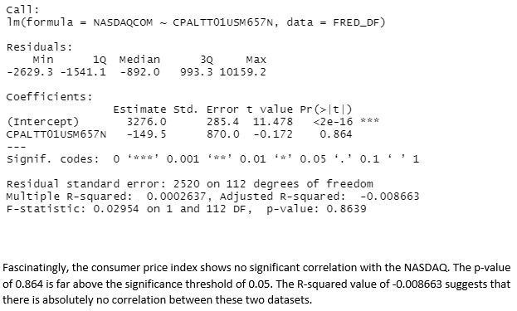
Consumer Price Index regressed on NASDAQ

Slide 12
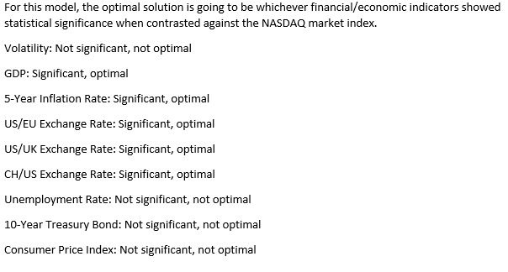
Initial Significance

Slide 13
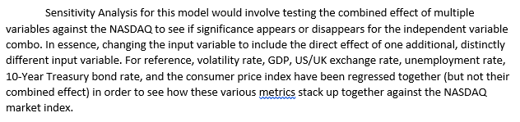
Sensitivity Analysis

Slide 14
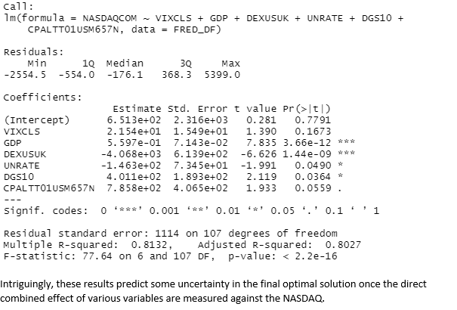
Baseline Comparison

Slide 15
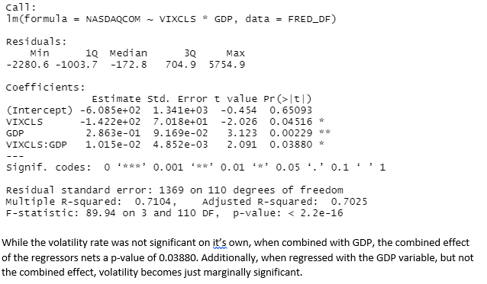
Volatility combined with GDP

Slide 16
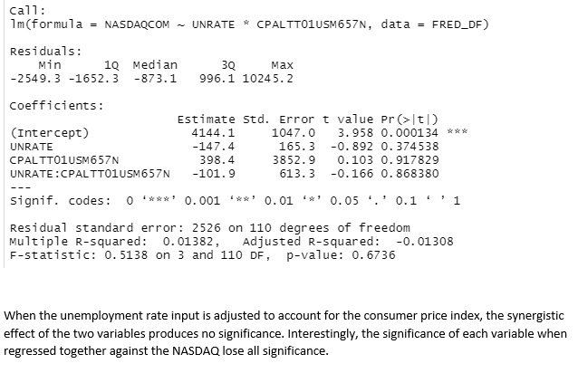
Unemployment rate with consumer price index

Slide 17
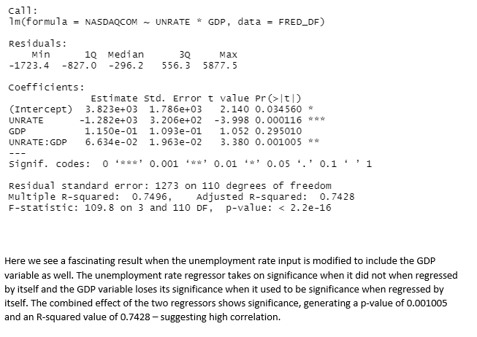
Unemployment rate with GDP

Slide 18
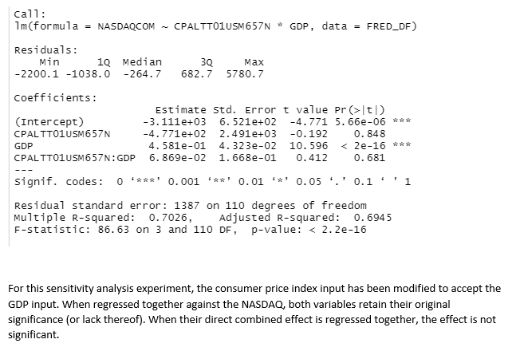
Consumer Price Index with GDP

Slide 19
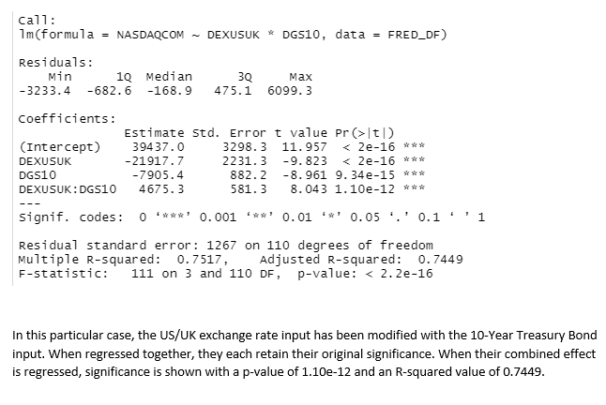
US/UK exchange rate with 10-Year T-Bond

Slide 20
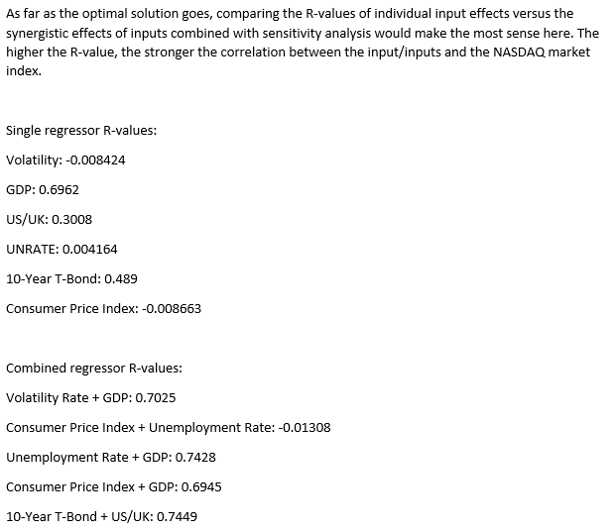
New Optimal Solutions?

Slide 21
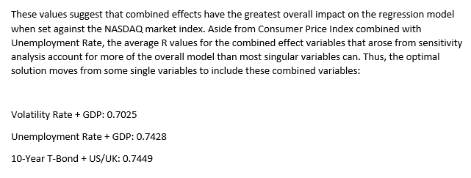
Revised Optimal Solutions

Slide 22

Note on Regression

Slide 23
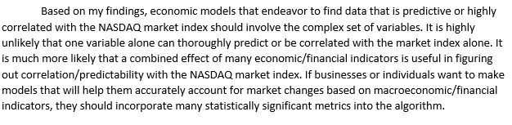
Recommendations

Slide 24
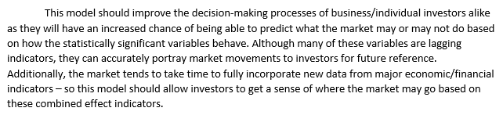
Decision-Making process implications

Slide 25
The End
Thank you for watching
Hope everyone has a great summer, and best of luck to those who are graduating

