Slide 1






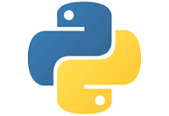
Phrase1: Issue collect
rule-based
ai-based
Issue-Pr Pair
github repo
agent repo
agent issue-pr
1-1 pair
Phrase 2+3: Dockerbuild and TestGen
small iteration
docker runnable
small iteration
test accurate
m
n
issue
pr
patch
expand
mocking unitest guide
mock api resources
docker gen
docker build
test gen
test varify
iteration context（not enough space）
typical complexity：m+n
with big iteration：（m+n）*big loop
co repair gate
set a high threshold
gate agent: Given context to a yes/no
judgement(eg whether docker build successful or test satisfy requirements)
SWE agent: have full scarffold(default: claude-code with gpt4.1)

Slide 2
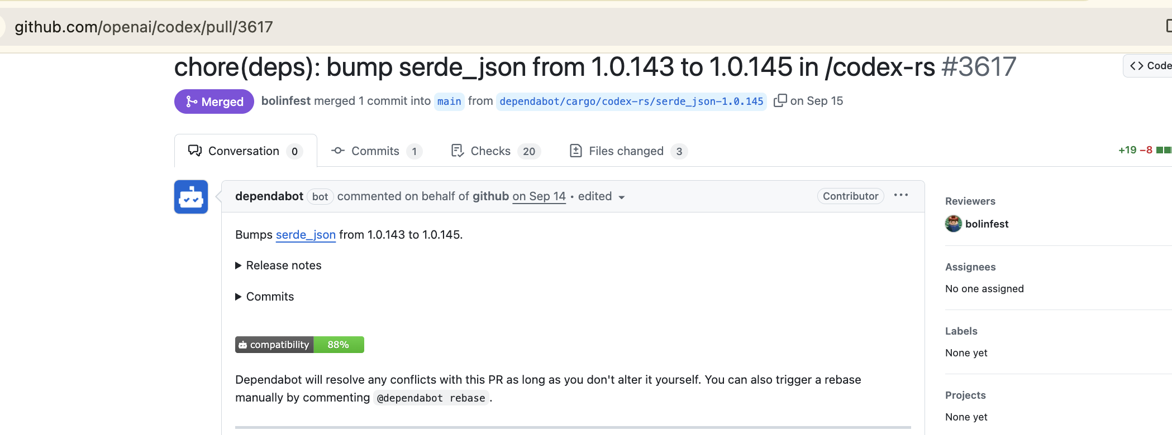
Bug
Phrase1: Issue collect
rule-based
ai-based
github repo
agent repo
agent issue-pr
1-1 pair
previous： only form evaluation
openai/codex: issue128 actually has no related pr
but on github: all the dependent bot pr will be automatically linked to the issue before it -》fix：add content filter

Slide 3
Opt
revise docker and test together
small iteration
docker runnable
m
agentless
docker gen
docker build
test gen
on strix13： docker not runnable after 3 iterations -》claude code's ability to build dockerfile is not strong enough now：add a agentless initialization(previously plan B,but surprisingly able to support pass on test)
agentless:from mirror(previous from scratch)
rule based filter and sent to AI(not agent)

