Slide 1
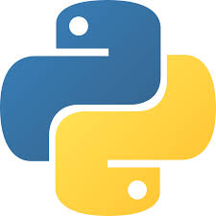




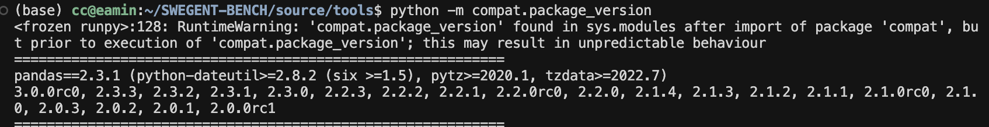
hallucination of dependency
single language checker
request: package==version
PYPI
（parser）
no
package existence
z
v0： package==x’.y’.z’
≈ç
1.dependency tree (recursively)
2.latest m versions
3.nearest n versions
x’.y’.z’
x
y

Slide 2




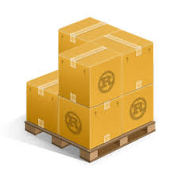




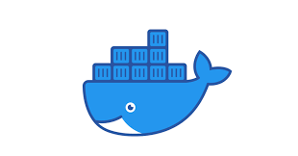


multi language checker
python: pandas==1.1.1
PYPI
dependency tree
Go:k8s.io/kubernetes@v1.27.1
Go Proxy
single language checker
dependency
request
Rust:tokio==1.28.0
crates.io
package correction
language
router
Java:org.apache.hadoop:hadoop-common:3.3.6
Maven
C/C++:fmt==10.0.0
vcpkg
version correction
find scattered
dependencies
fix
dependencies
python
pandas
1.1.1
dockerfile
with potential
hallucination
on dependencies
go
k8s
1.27.1
multi
language
checker
dockerfile
with fixed dependencies
Rust
tokio
1.28.0

