Slide 1






rule-based
ai-based
github repo
agent repo
agent issue-pr
1-1 pair
agent docker build
previous
expand
issue
pr
patch
mocking unitest guide
mock api resources
issue_128
test128.py
agent repo
buggy repo
bug reproduced
diliverable issue set
test128.py
bug fixed
buggy repo
fix patch

Slide 2
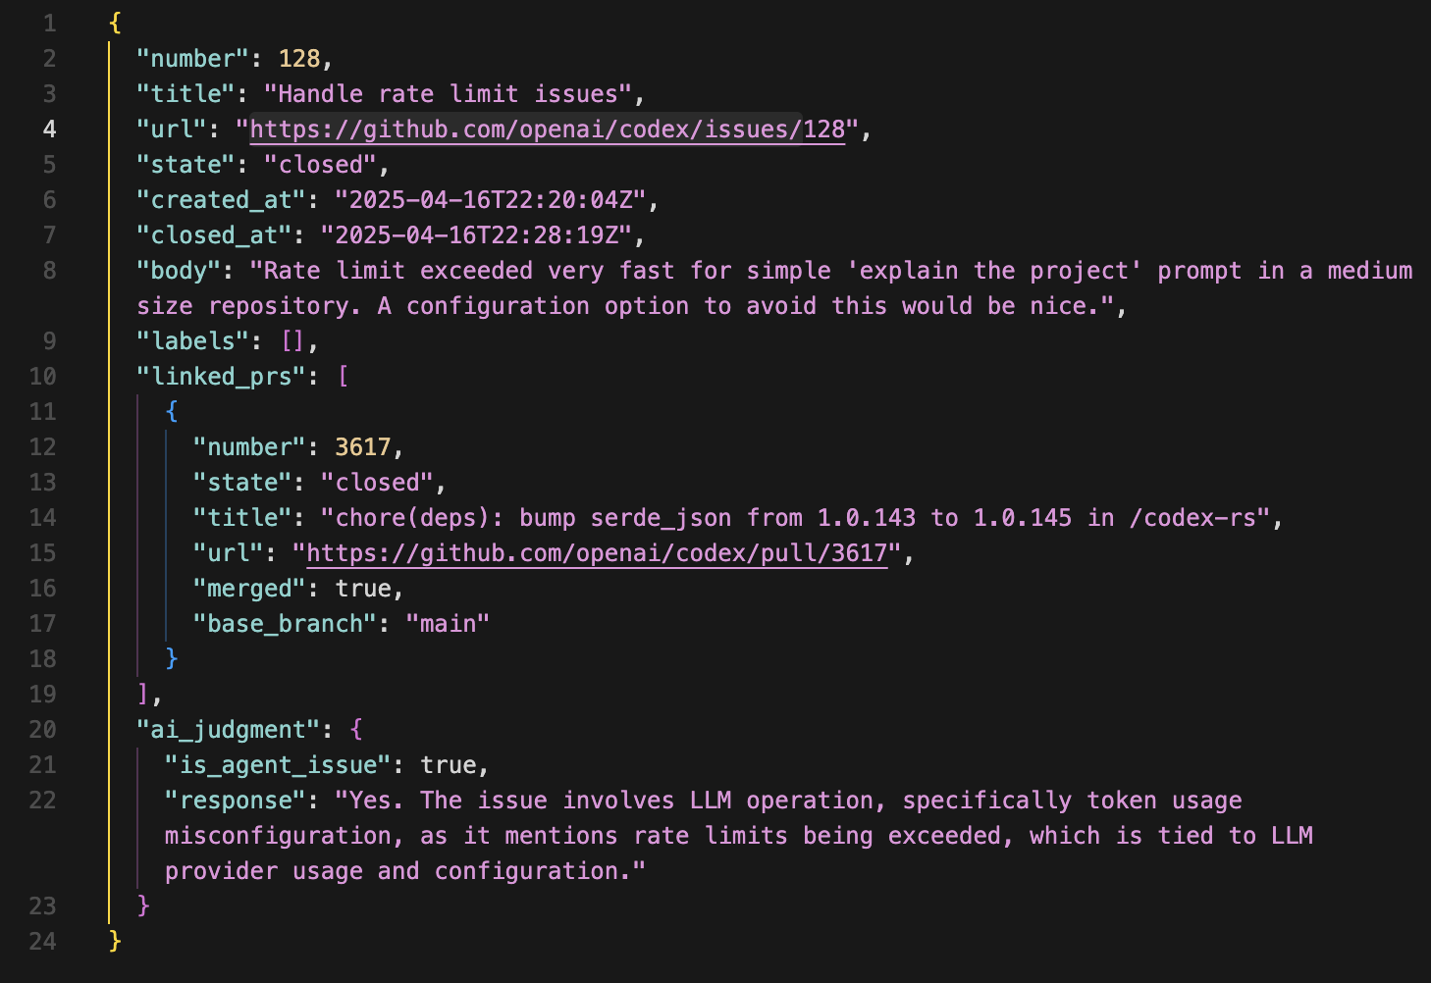
example issue 128

Slide 3
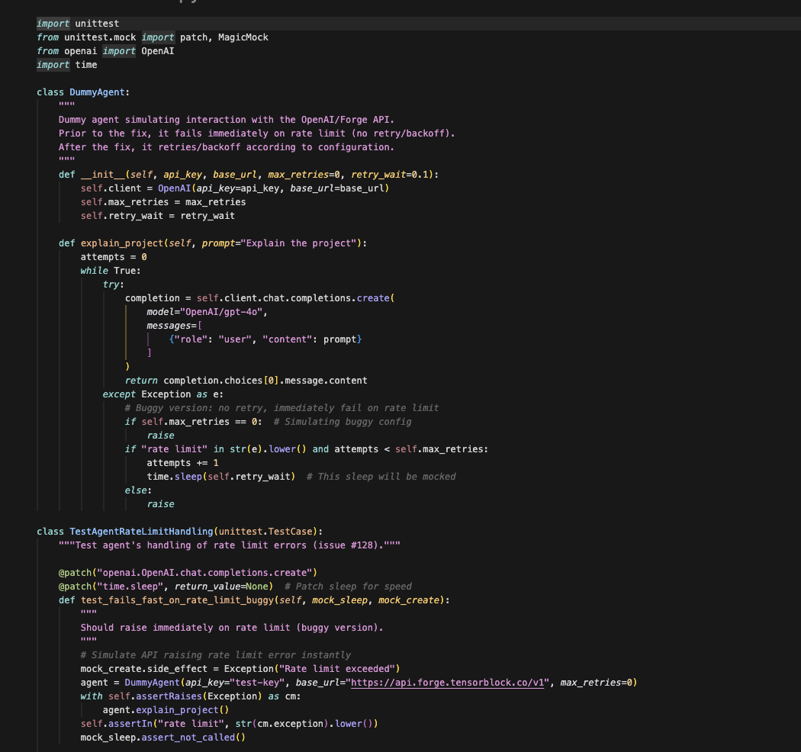
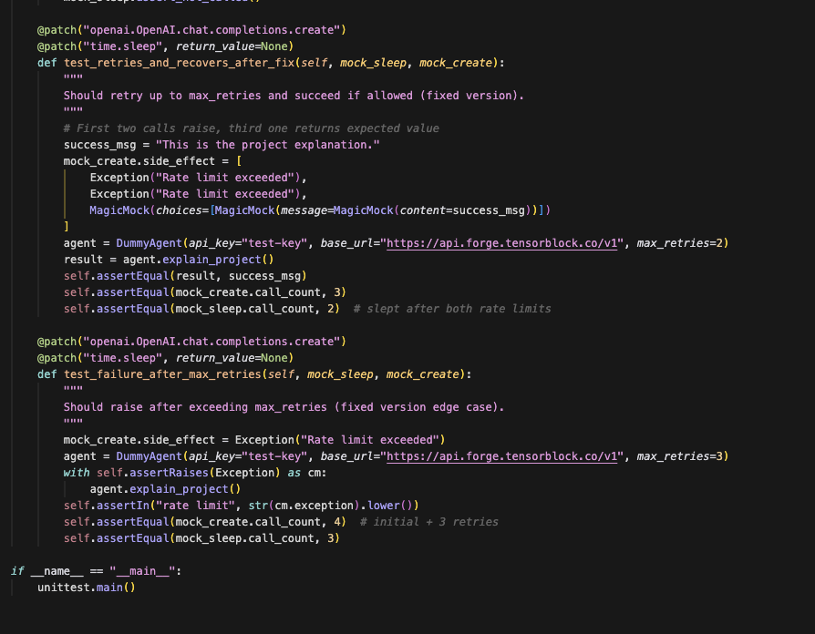
example test 128

Slide 4
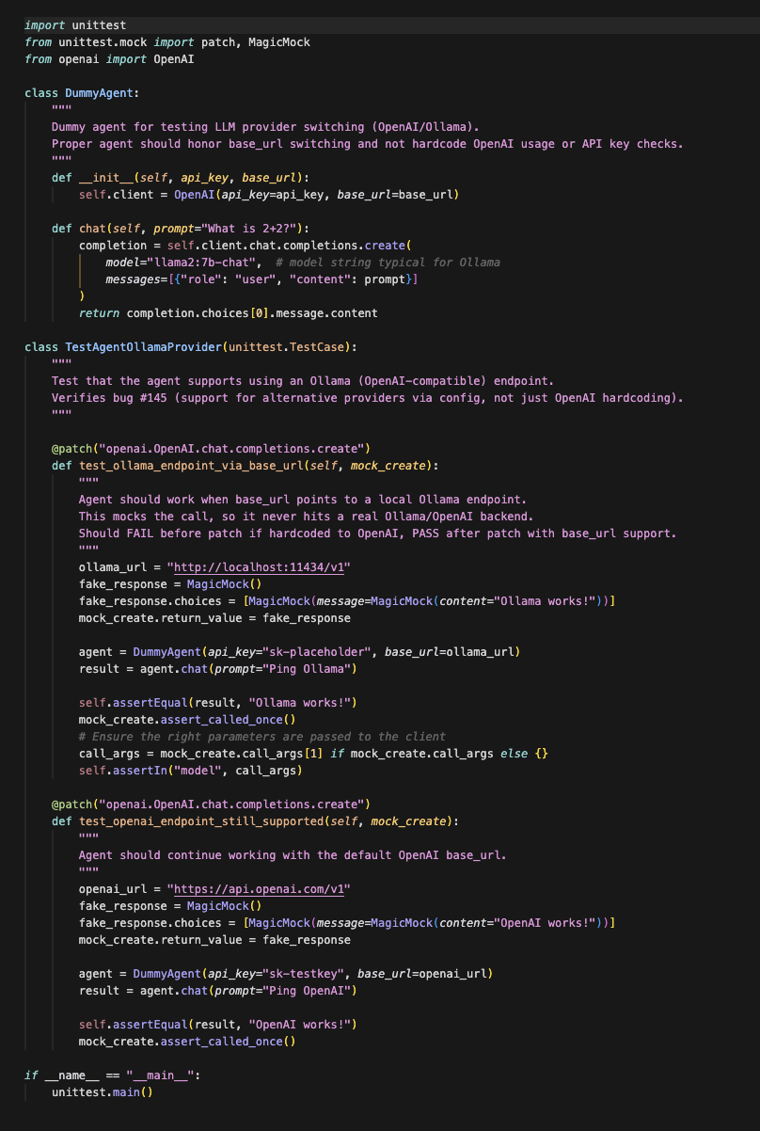
example test 145

