Slide 1
Non agent repo
Agent issue
Agent Repo
Non-Agent Issue
1
Agent repo issue
Agent repo
2
Non-Agent Repo
Non agent issue
mining from existing database
Agent Repo
Agent Issue
1.Find Agent Repo
1
2.Find Agent Issue
continuous detect latest active/merging repos
2

Slide 2
Github Archive
event1..
event2..
event3..
(for continuous growing)
hooked
repo
set
hooked
issue
set
Github
repo1..
awesome
-agent...
repo2..
1.Find Agent Repo
2.Find Agent Issue
1
2
repo3..
awesome
-llm...
awesome
-...
(for mining exsisting huge database)
rule based filter
llm based filter

Slide 3
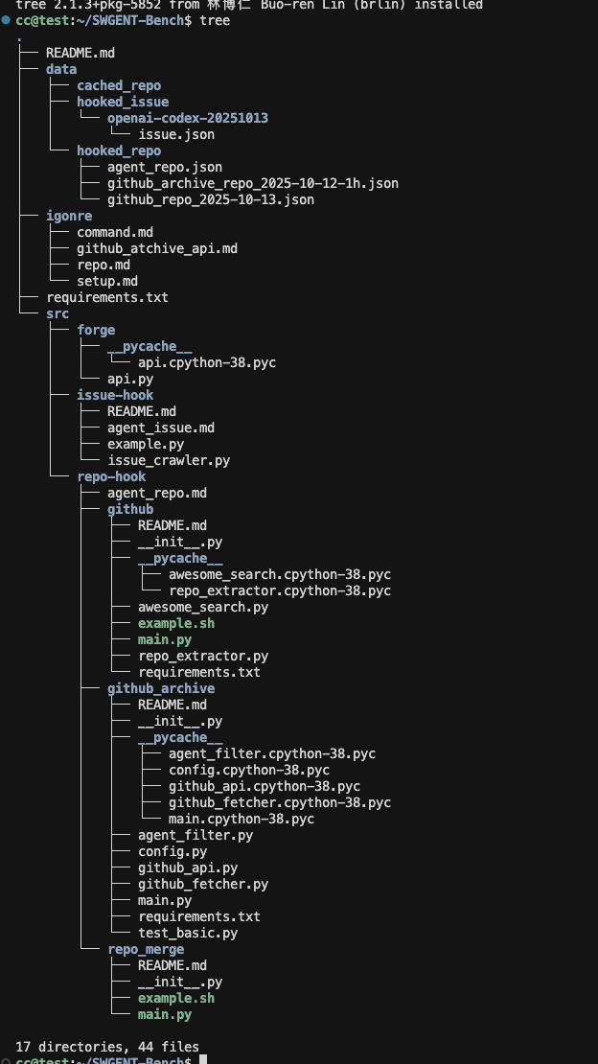
hooked issues
hooked repos
candidate
repo/issue
repo/issue.md
for human to read
unified llm interface
llm:
yes/no
⬅️agent issue definition
⬅️agent repo definition
yes
agent repo/issue

Slide 4
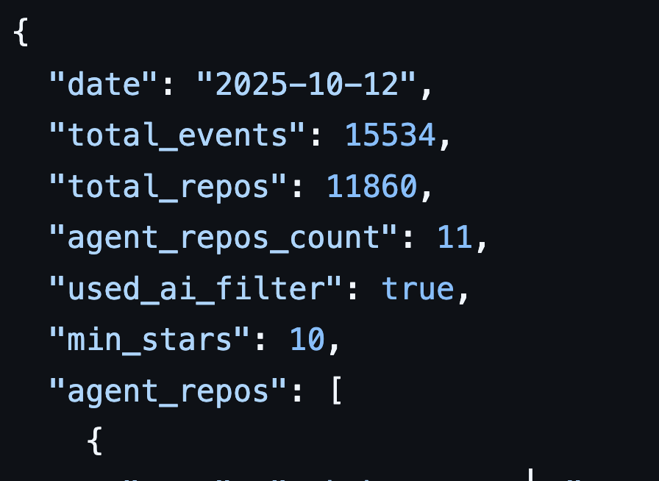
1.Find Agent Repo
1
Initial Strategy
15534
total events
11860
total repos
rough filter:
key words (from GHA description)
min star
255
agent filter:
Agent_Repo.md(standards of agent repo)
agent give yes/no
11
only yield 11 repo from the whole day -> too strict
most filtering comes from “including key words in repo name” ,because the info from GHA is too little -> take readme into account as well

Slide 5
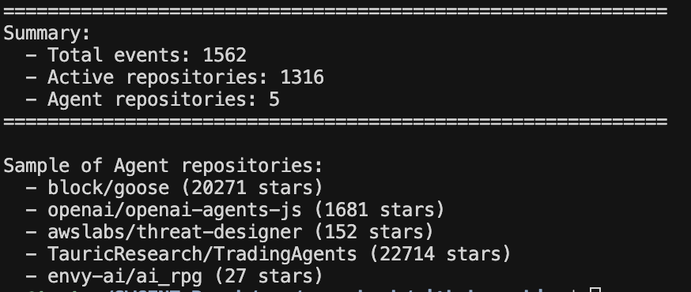
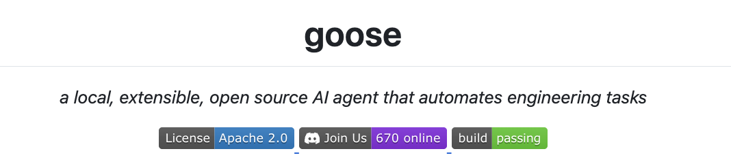
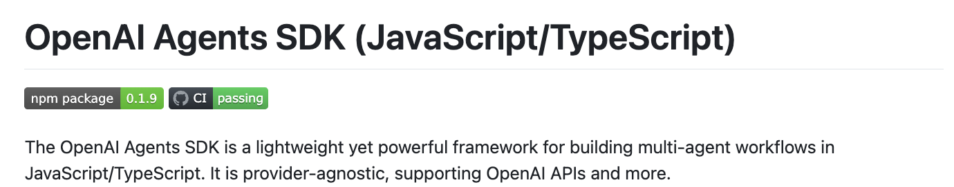

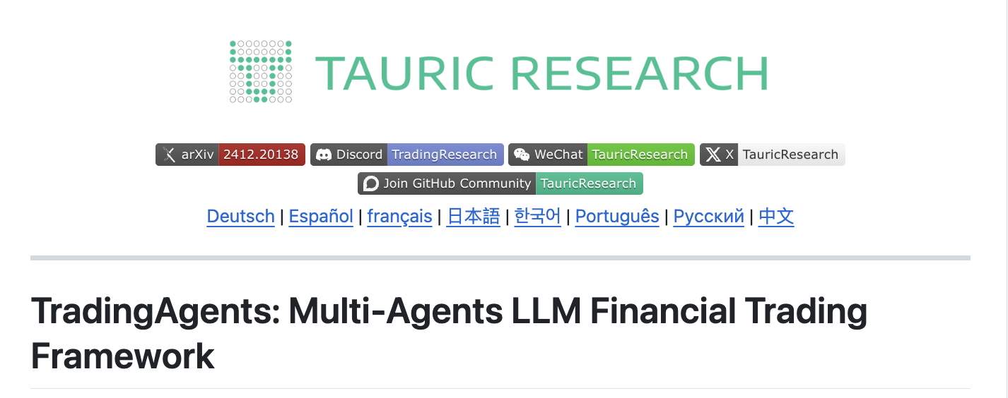
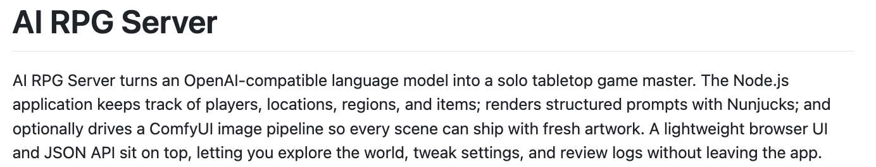
1.Find Agent Repo
1
Optimized Strategy
1562
total events
1316
total repos
rough filter:
key words (from GHA description)
min star and repo readme
133
agent filter:
Agent_Repo.md(standards of agent repo)
agent give yes/no
5
yield 5 repo from single hour -> moderate ,but can only update every hour due to api limit

Slide 6
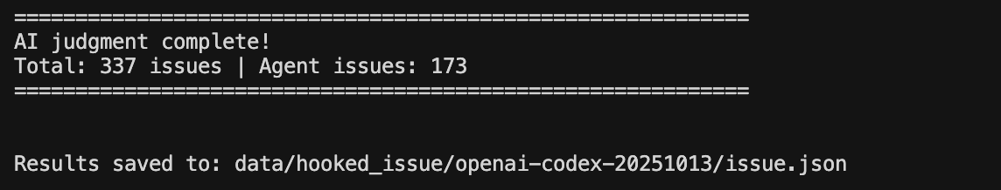
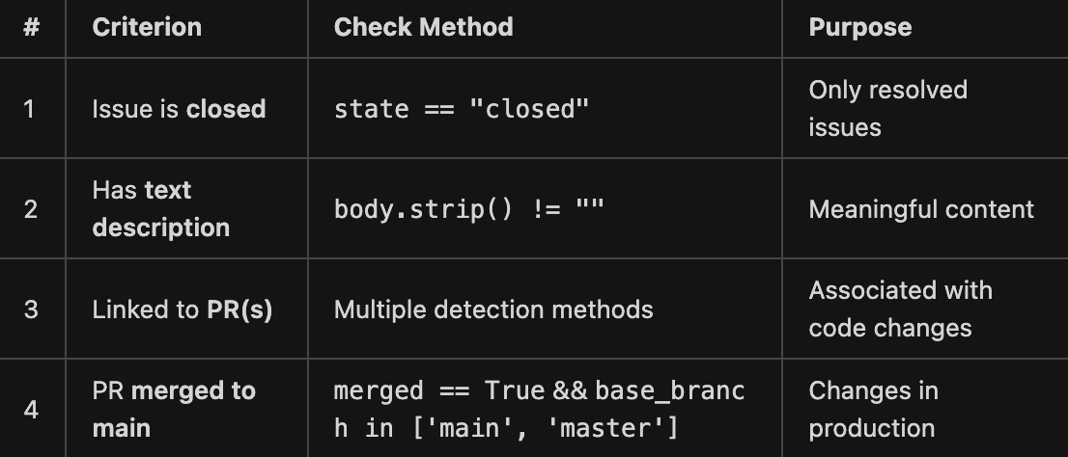
2.Find Agent Issue
2
eg Openai/Codex
1145
total issues
337
issues satisfied rules*
ai filtered issue
173
rules:

Slide 7
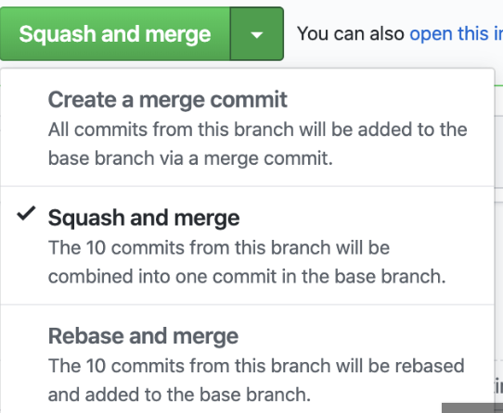
Issue-Pr Key
disk
local git
remote
issue
dev
commit
commit
commit
commit
commit
commit
push
commit
push
commit
pr
commit

Slide 8
github
commit
commit
squashedcommit
issue
pr
commit
commit
issue
pr
commit
commit
commit
commit
issue
pr
issue
pr
“logically” one issue: n issue and m pr with their commit
to simplify: 1 issue related with 1 pr as a key,all their commits and patch to be value

