Slide 1
Env-Build-up
1.Codebase build up
2. api build up

Slide 2
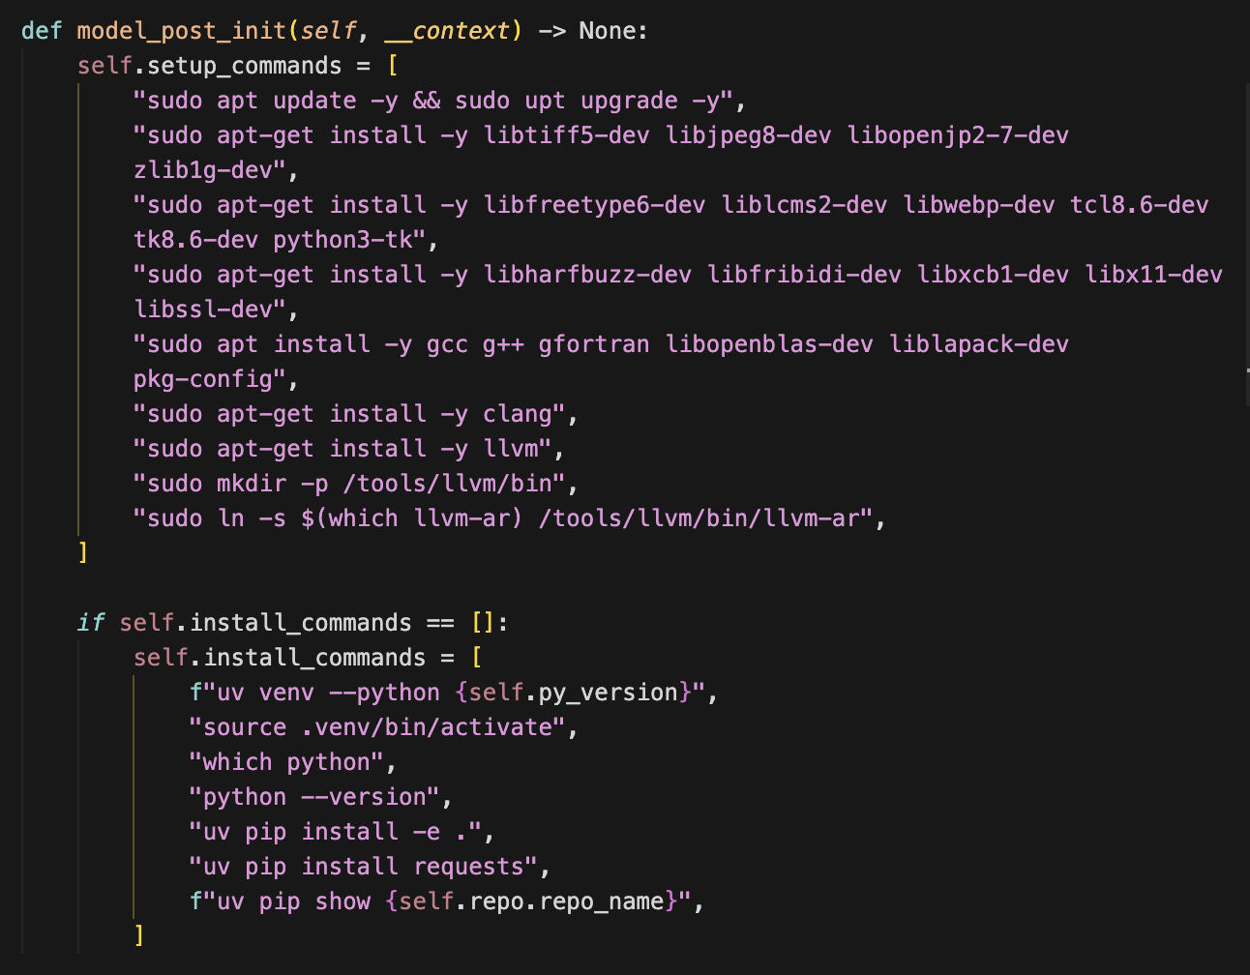
Baselines
Paper
Method
Metric
Swe-Rebench(NIPS25)
1.LLM scanning all the building related files
2.LLM produce three jsons
3.validate and recycle
31% successful
GSO
No details
No details

Slide 3
Baselines
Paper
Method
Metric
Sec-Bench
OSS-Fuzz template
+SecBench test
retain 898(81%) instances as candidates.
No details
filter only 80% test pass
Swe-Smith
Swe-Agent
EnvAgent
1.Scan Repo
2.Check hardware
3.Make plans
4.Step by step build and eval
49/54

Slide 4
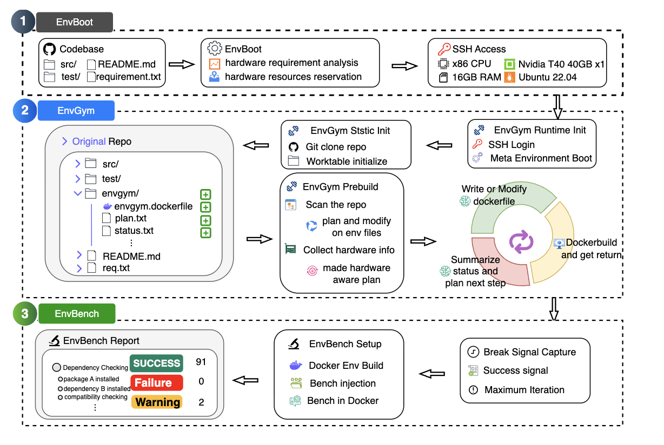
mock integrated api
api build up
interface requirements
scan ai interface
environment variable
integrated api variable pool
codebase build up
add to building plan

Slide 5
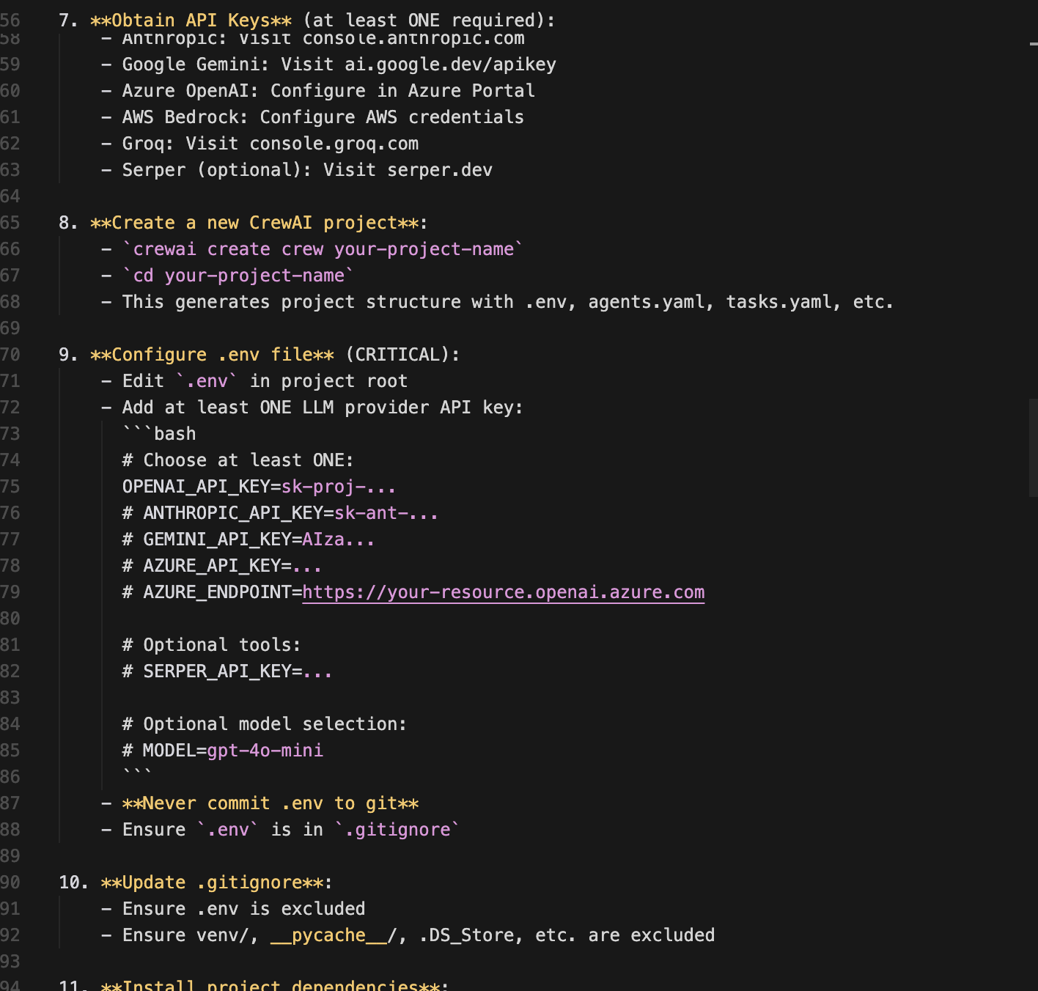
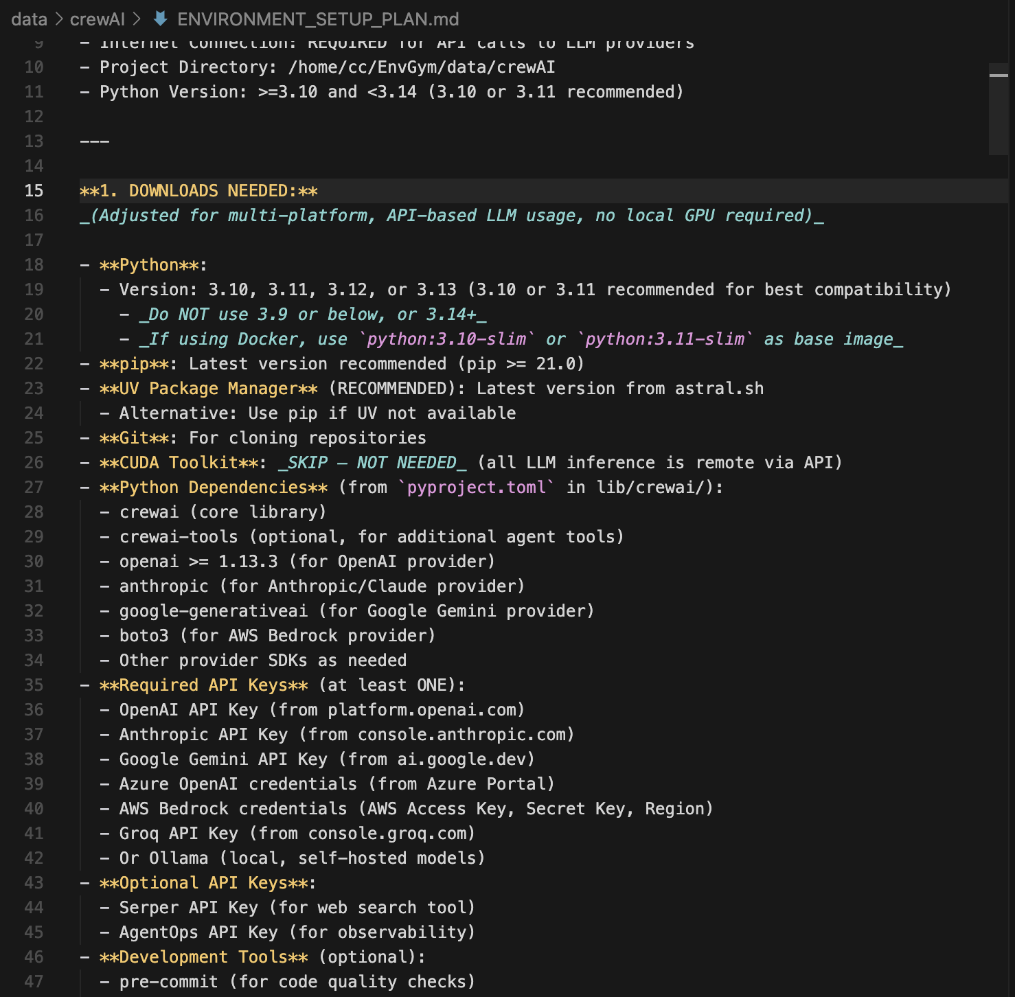
crewAI
problem 1.cost (32min with $2.31)
problem 2.need manual test on built dockerfile(for now i only know the dockerfile is runnable)

Slide 6
api
more easy way：
SWE
Agent
integrated api
model list
env pool
mock
original
api
code
base
few shot learning
api
mock
original
api
repo
hardware
code
base
dockerfile
mock
api
code
base

Slide 7
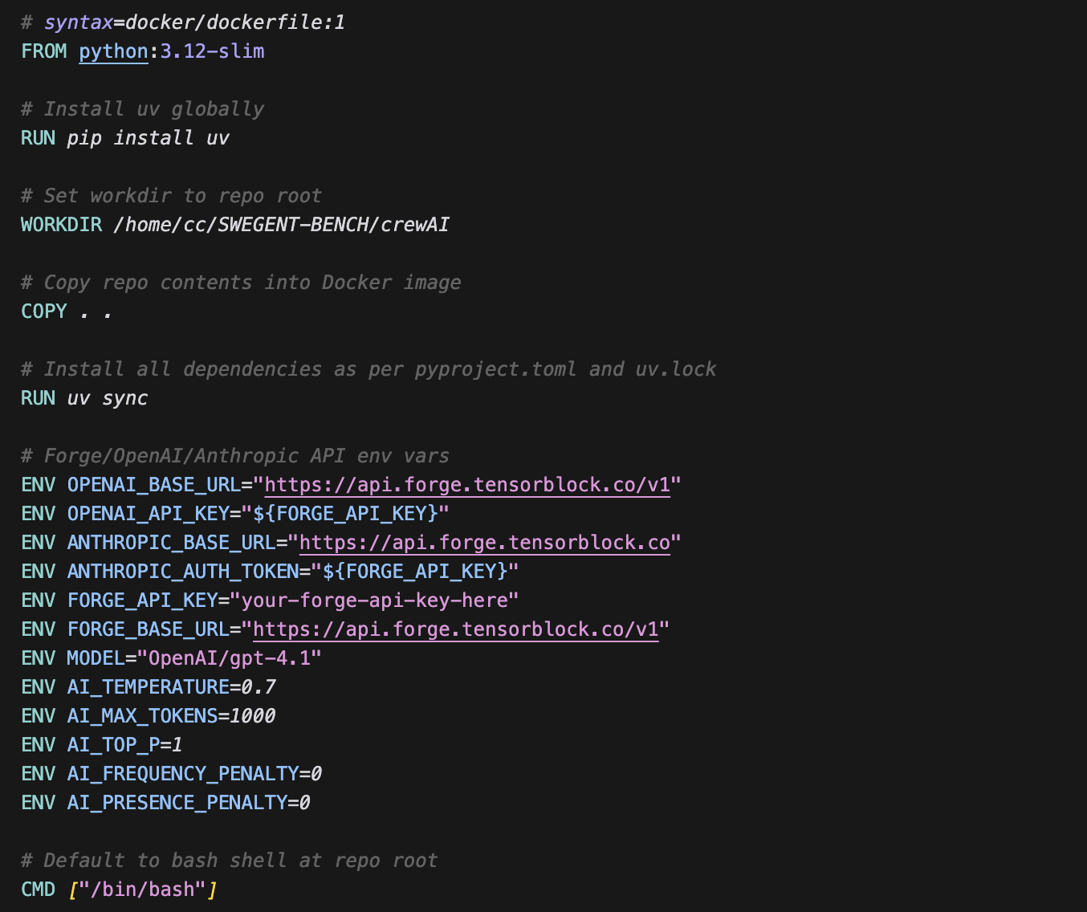
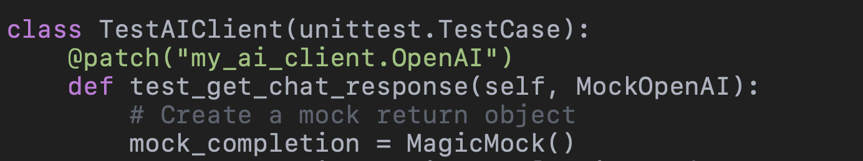
env analysis and
config in dockerfile：☑️
api build up
mock in unitest
mock original OpenAI api or other api

