Slide 1
Done：Overview of system on Agent-Issue Bench
WIP：Github Api OverheadOptimization

Slide 2
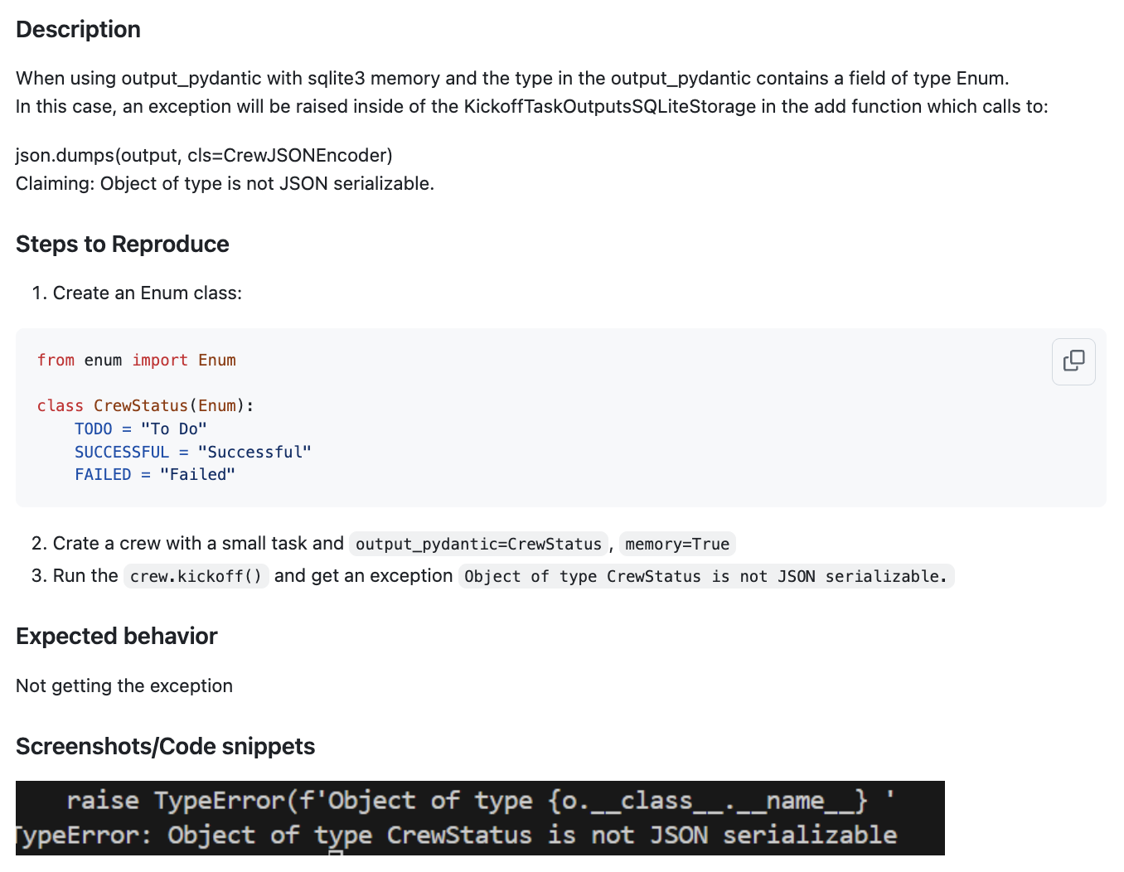
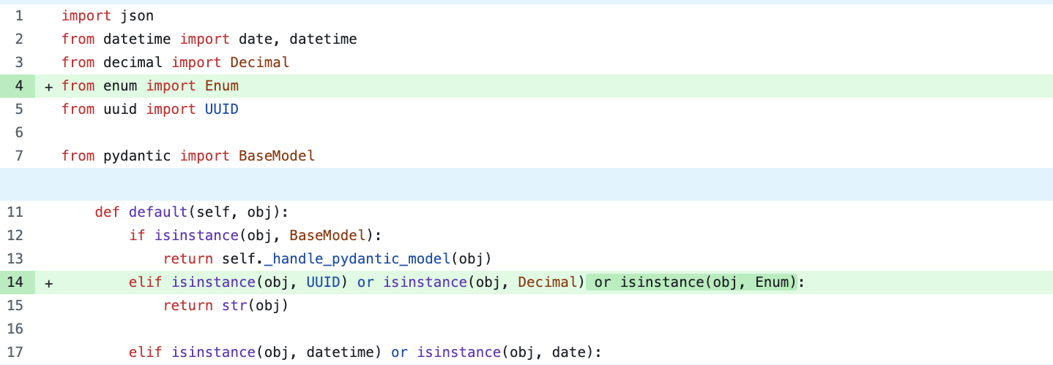
crewAIInc/crewAI/issues/1753
crewAIInc/crewAI/pull/1752
Previous System Output：No Agent Issue
After checking：No Agent Issue
Key fix：Allow serialization for Enum obj
Agent Reasoning
The problem described pertains to JSON serialization of Enum types in a specific storage class, which is not related to LLM provider integration, tool invocation, memory mechanisms, LLM operation, workflows, or utilities unique to agent systems.

Slide 3
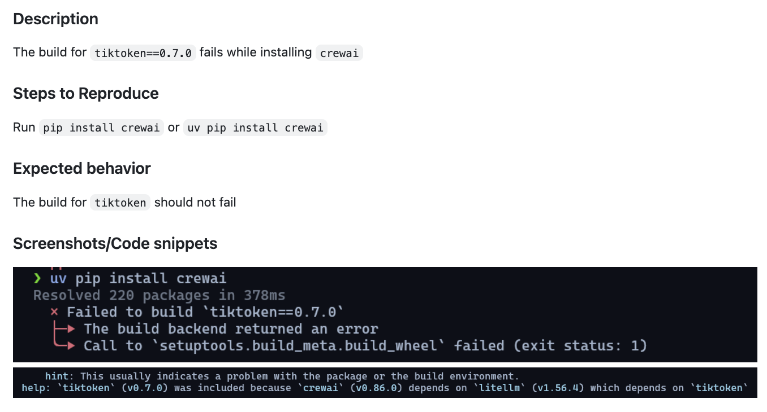
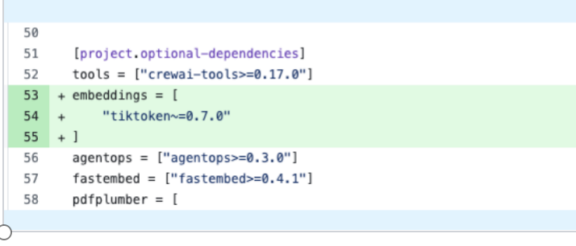
crewAIInc/crewAI/issues/1824
crewAIInc/crewAI/pull/1826
Previous System Output：No Agent Issue
After checking：No Agent Issue
Key fix：Name and build the wheel directly
Agent Reasoning
The problem is related to a failed build of the `tiktoken` library during installation, which is a dependency issue rather than an issue specific to LLM-based agent systems or their unique components.

Slide 4
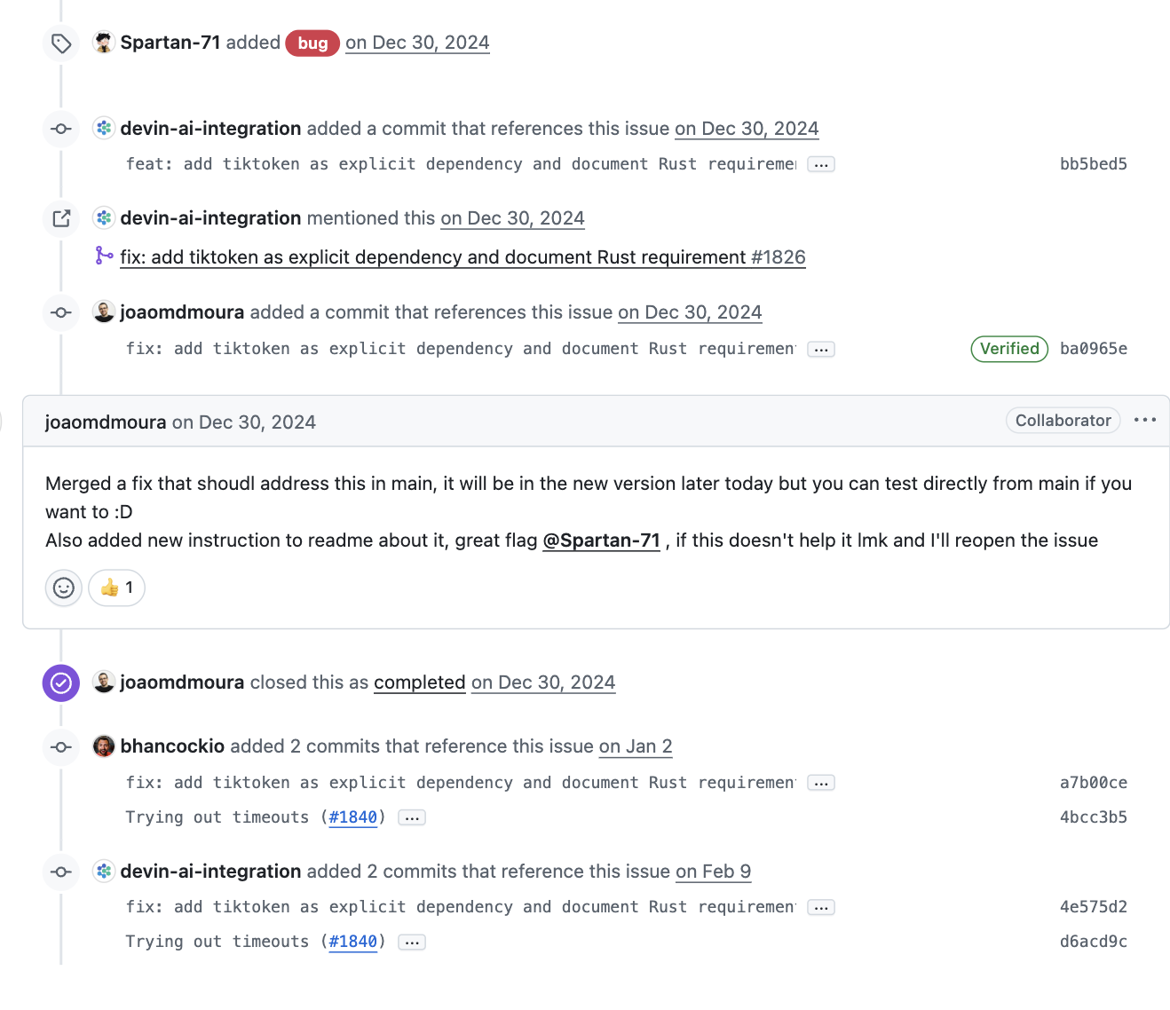
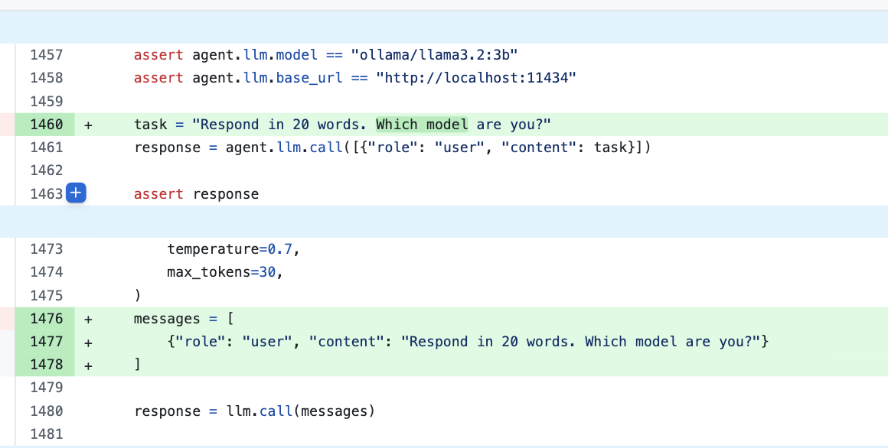
add on of this issue
issue
1824
pr
1826
issue closed
pr 1840
115 other
issues
this is an agent issue They change the prompt and eliminate timeout

Slide 5
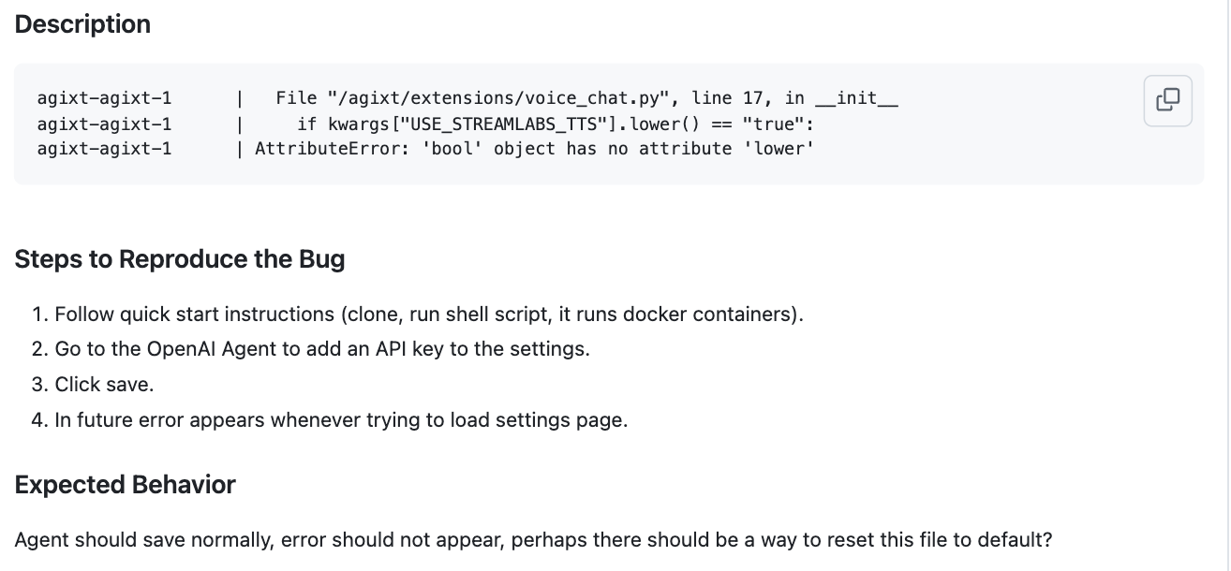
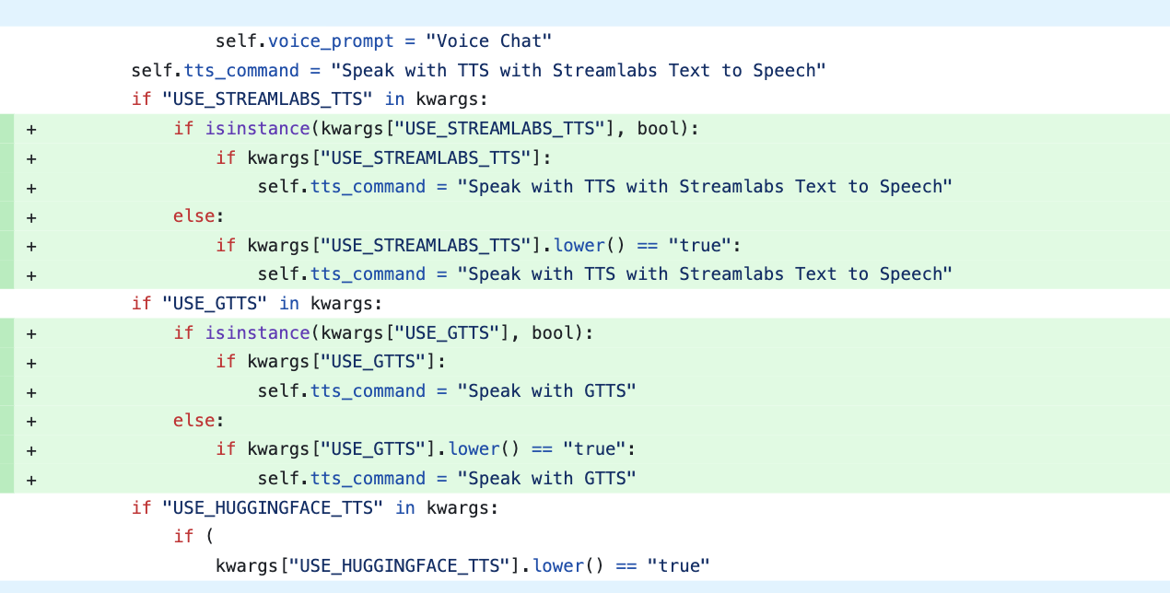
Josh-XT/AGiXT/issues/1026
Josh-XT/AGiXT/issues/1026
Previous System Output：Agent Issue
After checking：No Agent Issue
Key fix：Name and build the wheel directly
Agent Reasoning
The issue involves a tool configuration error where a boolean value is incorrectly handled as a string, causing an AttributeError. This relates to agent-specific components, as it affects the behavior of the LLM-based agent system when saving settings.

Slide 6
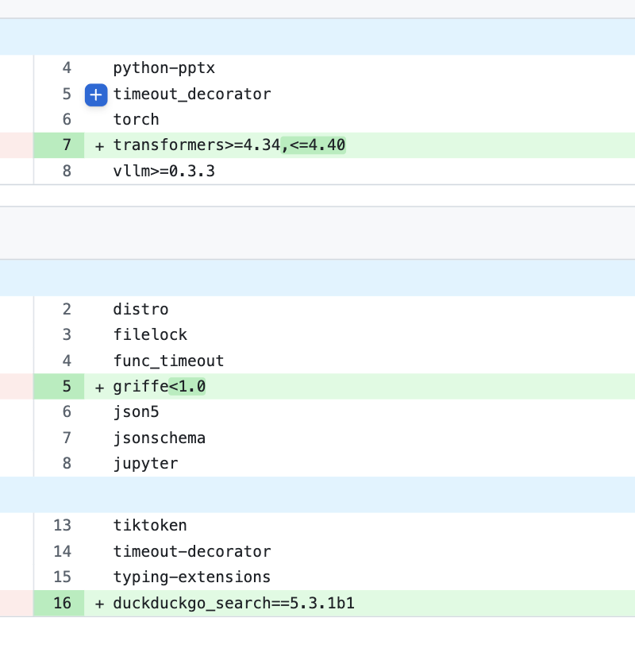
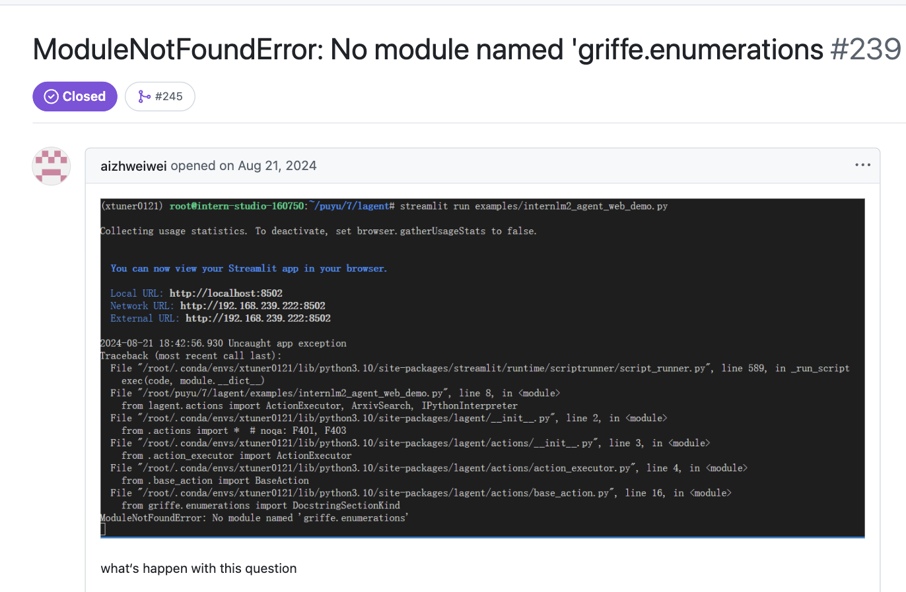
InternLM/lagent/issues/239
InternLM/lagent/pull/245
Previous System Output：No Agent Issue
After checking：No Agent Issue
Key fix：Fix the code according to griffe’s interface changes
issue
239
pr
245
Agent Reasoning
the issue is a generic Python module import error and does not relate to LLM-based agent systems, LLM provider integration, tool invocation, memory mechanisms, or agent-specific workflows.
issue
244

Slide 7
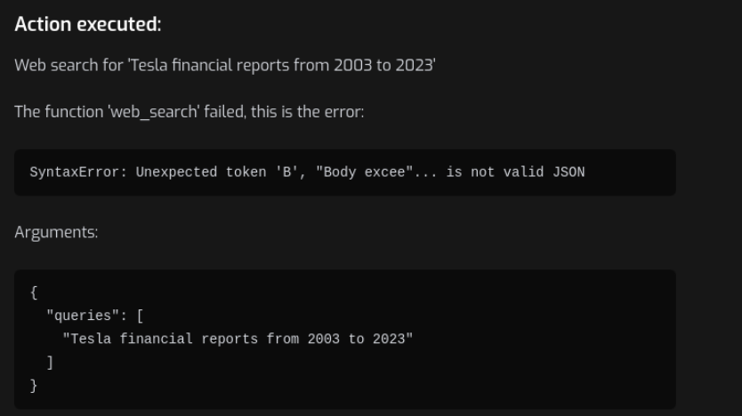
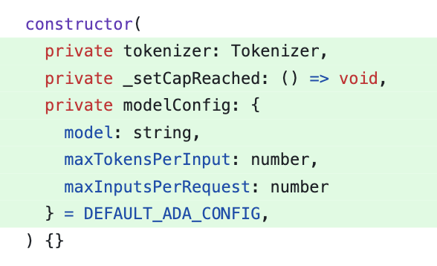
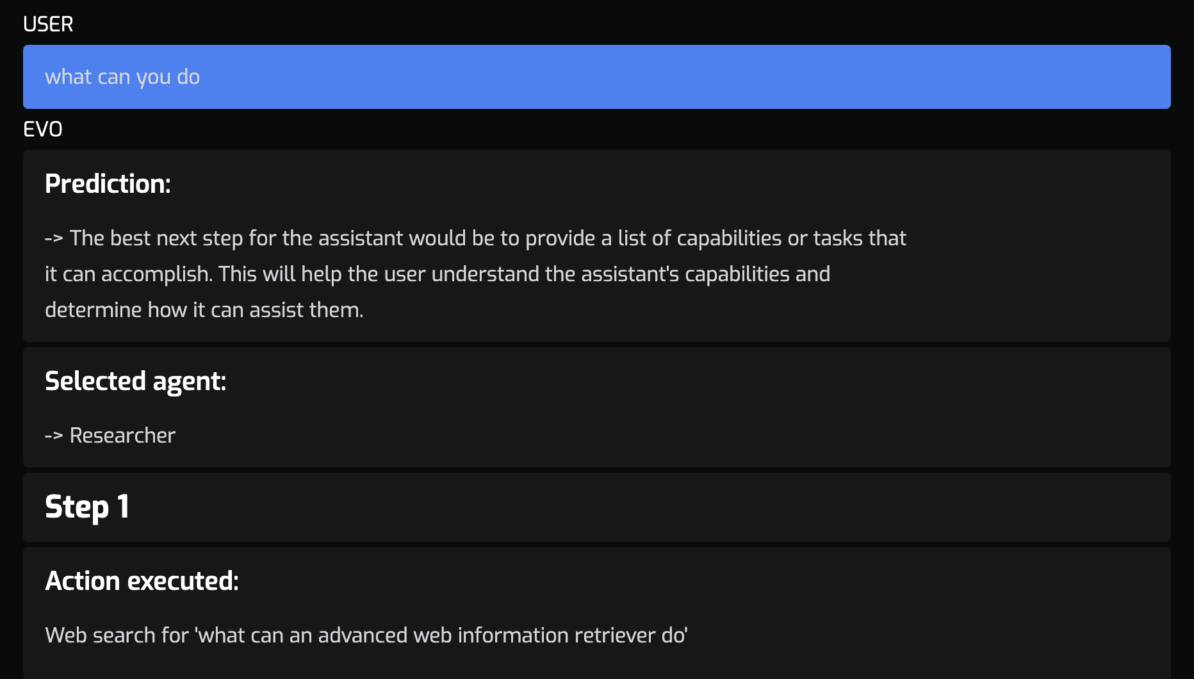
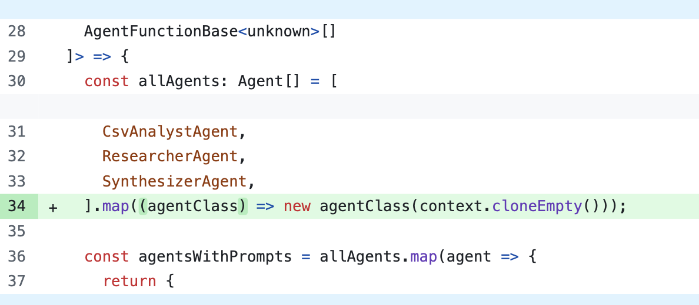
agentcoinorg/evo.ninja/issues/{504,515,525,594,652}
(main branch actully named dev) -> cant forsee,just discard
504 Max token overflow causing embedding err
504 fix:add related args
515:calling sub agent for simple mission is overhead
515 fix add an clone empty agent for shortcut
my opinion: definitely agent issue

Slide 8
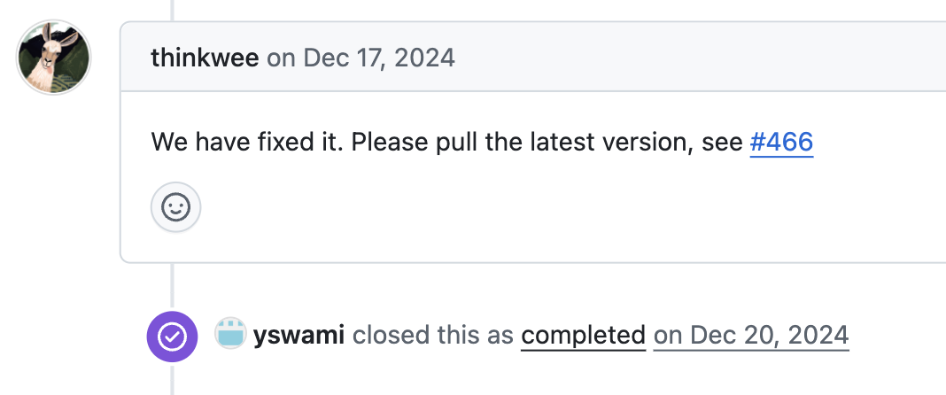
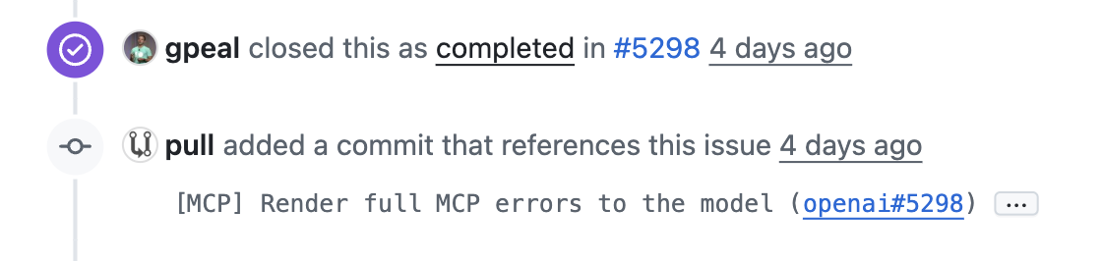
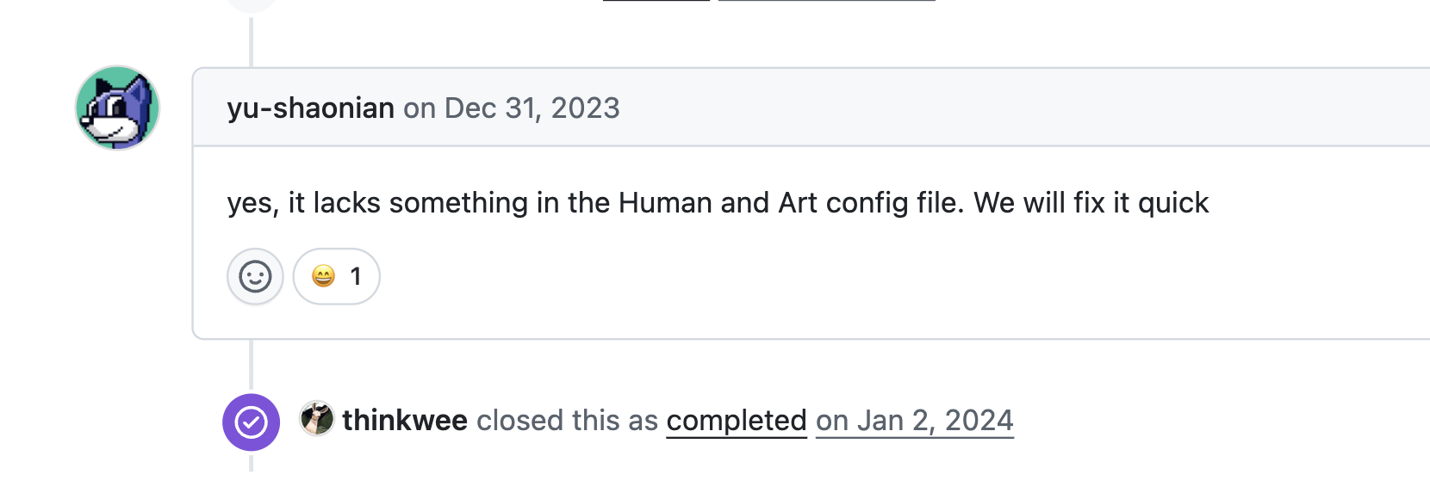
OpenBMB/ChatDev/issues/465
OpenBMB/ChatDev/issues/318
no related pr
465
what it should look like
why no pr related: pr is in comment
then we can not get this relation with sql request,but need ai to read
318
why do you close it without fixing 😂

Slide 9
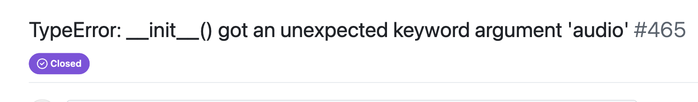
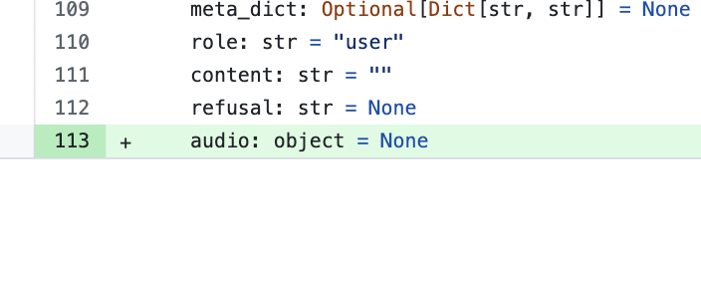
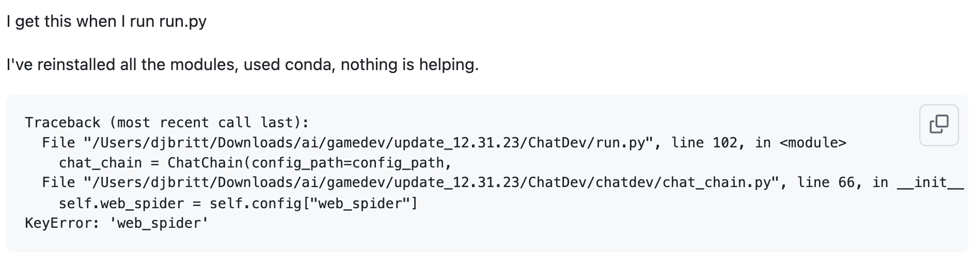
OpenBMB/ChatDev/issues/465
OpenBMB/ChatDev/issues/318
no related pr
465
My opinion: 465 is,318 is not
318: key missing

Slide 10
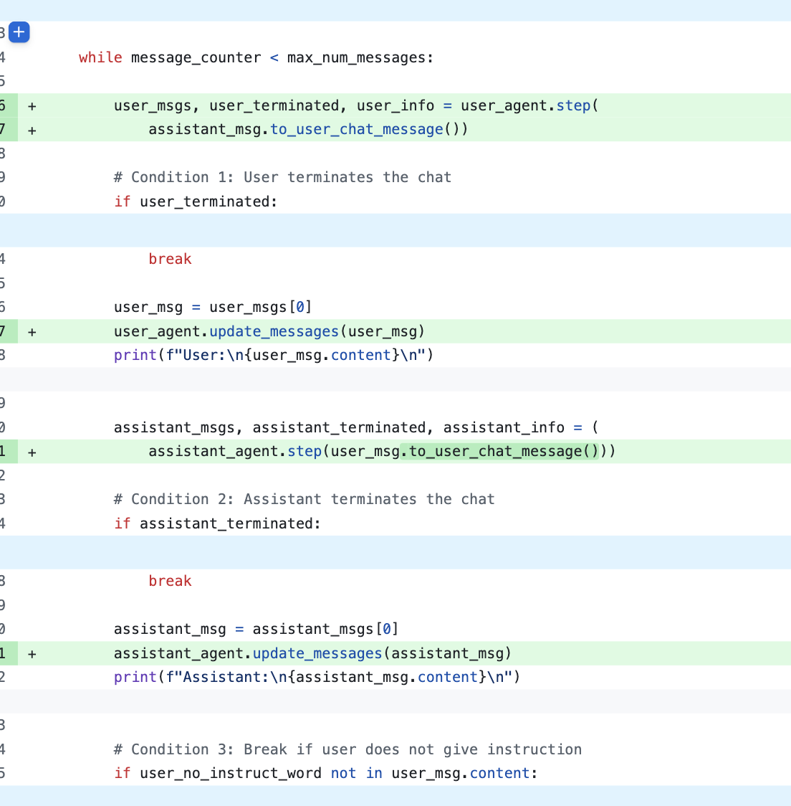
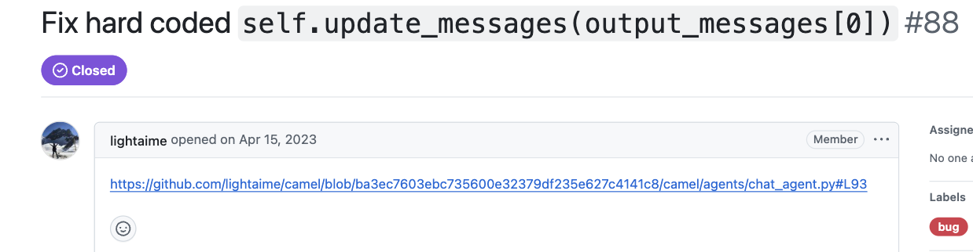
camel-ai/camel/issues/88
only url but no context
Previous System Output：No Agent Issue
After checking： Agent Issue
Key fix：Still hard code,but add logic of msg consumer
Agent Reasoning
The issue description lacks context about LLM provider usage, prompt management, memory behaviors, tool invocation, or workflow anomalies. It appears to be a code-specific issue without clear ties to agent system components or behaviors.

Slide 11
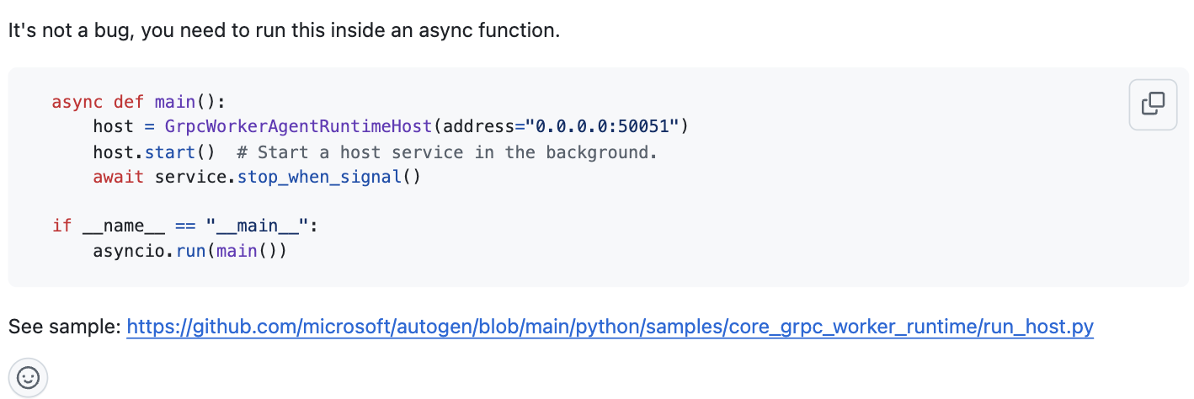
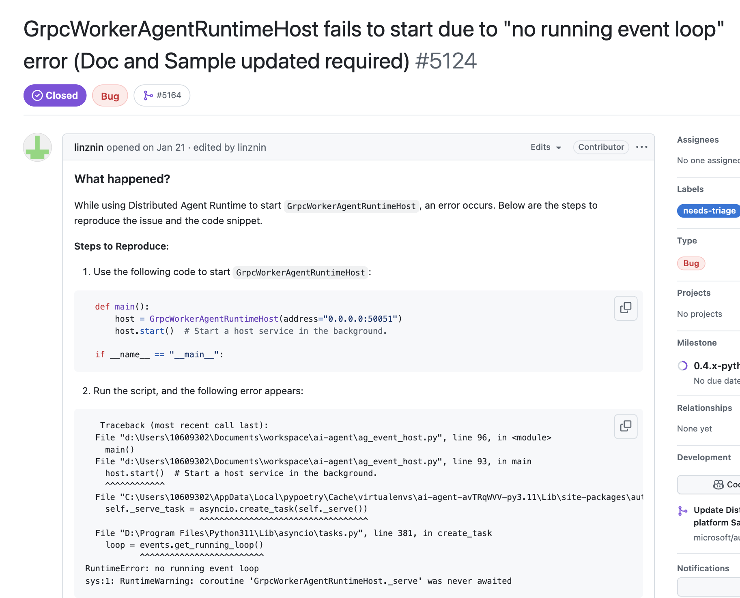
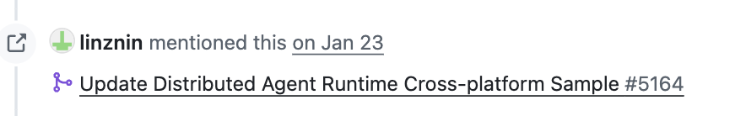
microsoft/autogen/issues/5124
microsoft/autogen/issues/5164
Previous System Output：No Agent Issue
After checking：No even an Issue
Key fix：Add a sample
Agent Reasoning
this is not an agent issue. It focuses on improving service shutdown handling for cross-platform compatibility, which does not involve LLM provider integration, tool invocation, memory mechanisms, LLM operation, workflows, or utilities specific to agent systems.

Slide 12
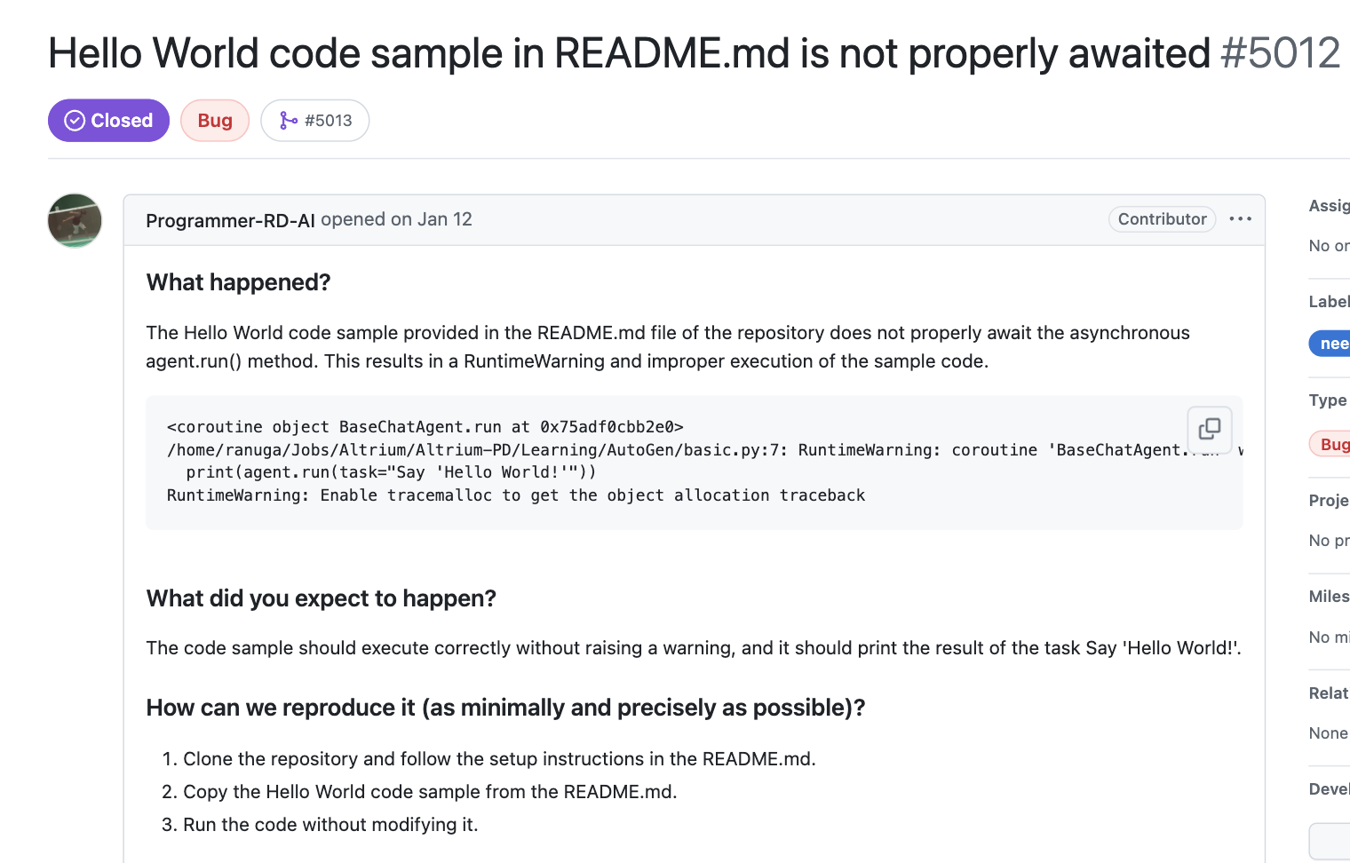
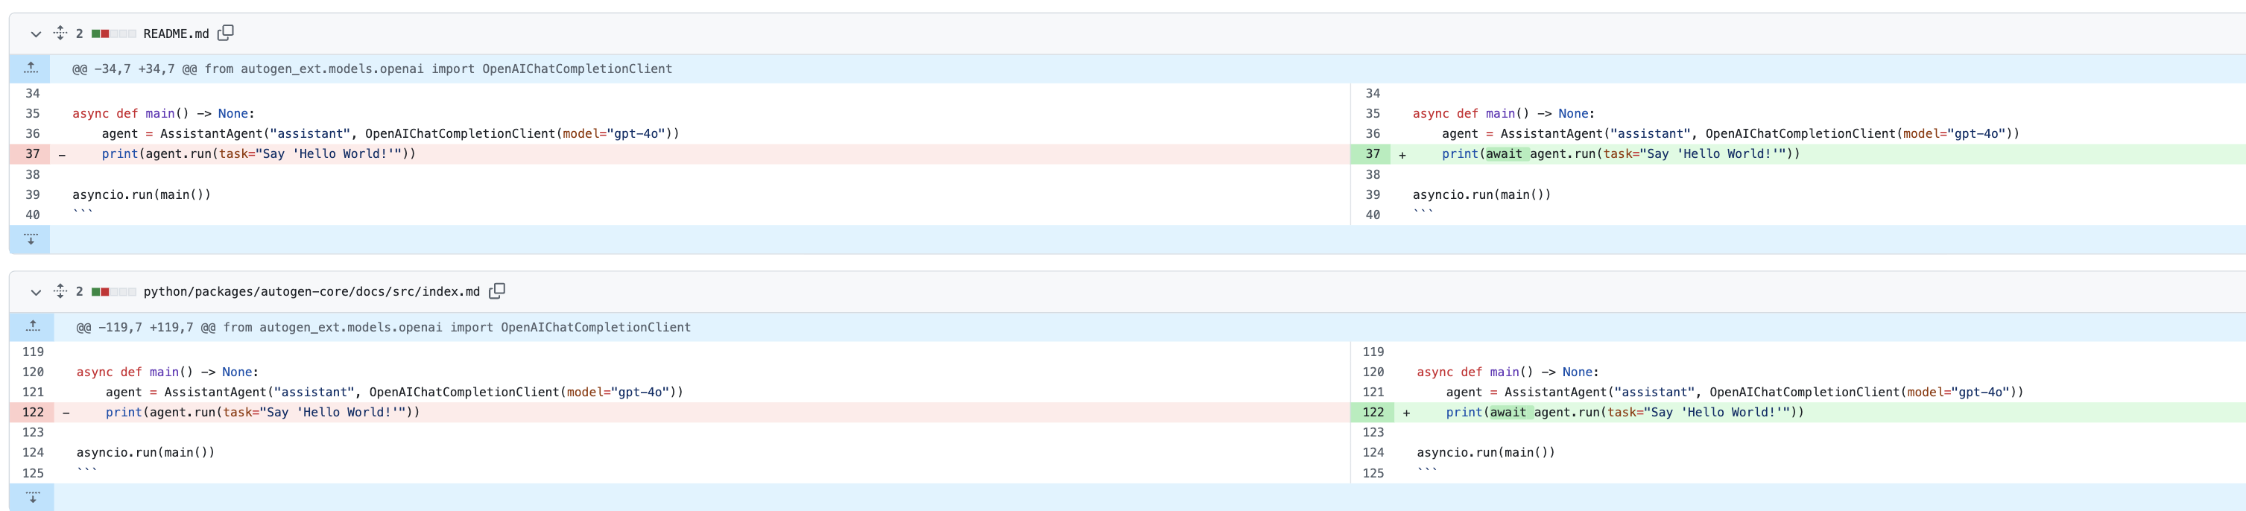
microsoft/autogen/issues/5012
microsoft/autogen/pull/5013/
Previous System Output：No Agent Issue
After checking：No a code Issue
Key fix：fix the example in readme no change to code
Agent Reasoning
this is not an agent issue. The problem is related to incorrect usage of asynchronous code in the README.md, not specific to LLM provider integration, tool invocation, memory mechanisms, or other agent-specific components.

Slide 13
crewAIInc/crewAI/issues/1824
crewAIInc/crewAI/pull/1826
Previous System Output：No Agent Issue
After checking：No Agent Issue
Key fix：Name and build the wheel directly
Agent Reasoning

Slide 14
crewAIInc/crewAI/issues/1824
crewAIInc/crewAI/pull/1826
Previous System Output：No Agent Issue
After checking：No Agent Issue
Key fix：Name and build the wheel directly
Agent Reasoning

Slide 15
crewAIInc/crewAI/issues/1824
crewAIInc/crewAI/pull/1826
Previous System Output：No Agent Issue
After checking：No Agent Issue
Key fix：Name and build the wheel directly
Agent Reasoning

Slide 16
crewAIInc/crewAI/issues/1824
crewAIInc/crewAI/pull/1826
Previous System Output：No Agent Issue
After checking：No Agent Issue
Key fix：Name and build the wheel directly
Agent Reasoning

