Slide 1






rule-based
ai-based
for Alfin: from pipeline to deploy and conitunous growing
github repo
agent repo
agent issue-pr
1-1 pair
agent docker build
for Eamin: Add iteration correction and other agent issue(MCP) and so on
expand
issue
pr
patch
mocking unitest guide
mock api resources
issue_128
test128.py
agent repo
buggy repo
bug reproduced
diliverable issue set
test128.py
bug fixed
buggy repo
fix patch

Slide 2



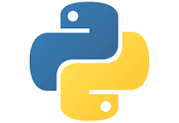
Phrase1: Issue collect
rule-based
ai-based
Issue-Pr Pair
github repo
agent repo
agent issue-pr
1-1 pair
Phrase 2+3: Dockerbuild and TestGen
small iteration
docker runnable
small iteration
test accurate
m
n
issue
pr
patch
expand
mocking unitest guide
mock api resources
docker gen
docker build
test gen
test varify
iteration context（not enough space）
typical complexity：m+n
with big iteration：（m+n）*big loop
co repair gate
set a high threshold
gate agent: Given context to a yes/no
judgement(eg whether docker build successful or test satisfy requirements)
SWE agent: have full scarffold(default: claude-code with gpt4.1)

Slide 3
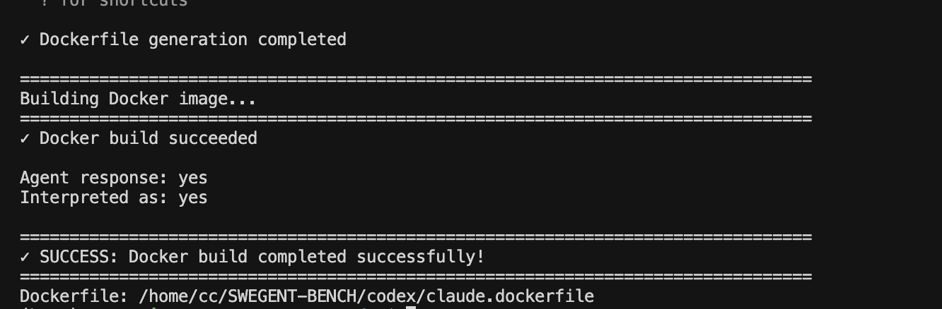
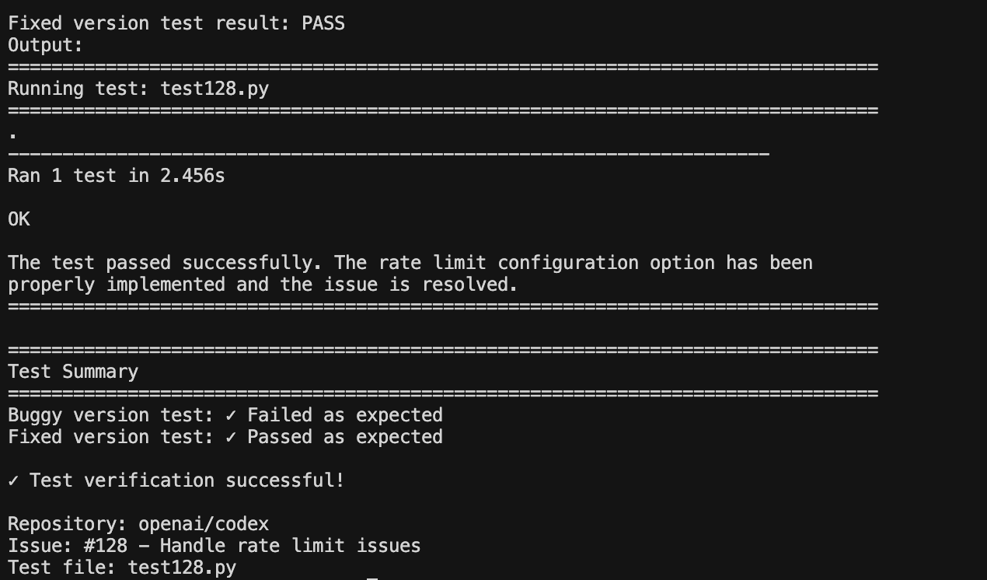
example:codex/128
dockerbuild:2
test gen:2
co repair gate(big iteration)
not triggered

