Slide 1

Mercurial
Group 4
Avalur, Divya
Bekbatyrova, Assel
Nerbonne, Eamon
Sigurjónsdóttir, Sunna
Suharto, Edy

Slide 2






Overview
WHAT IS MERCURIAL?
STAKEHOLDERS & KEY DRIVERS
ARCHITECTUAL VIEWS
ARCHITECTURAL PATTERNS
EVALUATION & RECOMMENDATIONS

Slide 3
What is Mercurial?
Version Control System
Distributed
Fast, Scalable
BitKeeper replacement, like Git

Slide 4
Stakeholders
End user (programmer)
Mercurial project leader (Matt Mackall)
Mercurial software developer
Patch/extension developers

Slide 5
Key Drivers
Performance
Usability
Extensibility
Portability
Reliability

Slide 6
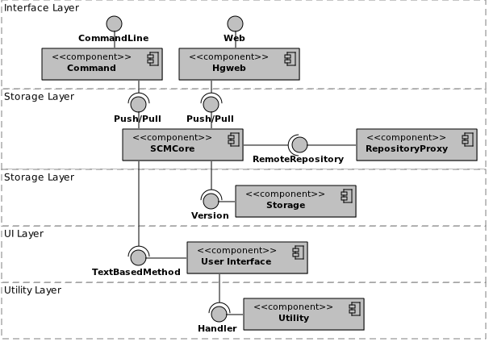
Architectural Views

Slide 7
Architectural Views
Logical view:
common commands
(clone, update, pull, commit, push)
Process view:
(manifest, filelog, changeset, revlog)

Slide 8
Architectural Patterns
Proxy pattern
Extensibility
Interaction with other repositories via proxy object

Slide 9
Architectural Patterns
Peer-to-peer pattern
Reliability, Performance
Repositories are peers (not components)
Communication via Client-Server

Slide 10
Architectural Patterns
Shared Datastore pattern (aka Shared Repository)
Revlogs
Performance, reliability

Slide 11


