Slide 1
Feature
Vendor
Product
Import Product(import to stock)
Set Price of Product(set for kon krom and Ray)
Create screen for table price of kon krom
Customer
Sale To
Report(daily, week, month, year)
Login Screen
Vendor(view, add edit)
Product(view, add edit)
Import Product(view, add, edit)
Set Price of Product
Customer

Slide 2

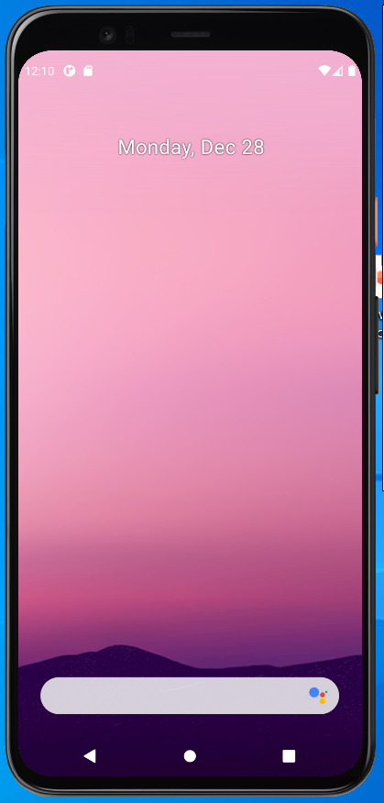

Sign In
Screen
User Name
Sign In

Slide 3
Dashboard
Screen

