Slide 1
PID Ball Balancing
CSCE 462: Eyad Nazir & Hyder Ochsner

Slide 2
Background
The concept of dynamic stabilization, exemplified in our PID Ball Balancing
project, is a significant leap in control engineering. Drawing inspiration
from advanced earthquake stabilization systems used in modern
infrastructure, this project aims to dynamically control the position
of a ball on a flat surface using a Proportional-Integral-Derivative (PID)
controller. The interplay of hardware components, like servo motors,
and sophisticated software algorithms, echoes the principles of seismic
dampers in skyscrapers. These systems counteract disturbances, such as
seismic waves, by adjusting their structure in real-time. Our project,
while on a smaller scale, mirrors this intricate balance of mechanics and
electronics, and serves as an educational tool in understanding the fundamental principles of vibration control and feedback systems in civil engineering.

Slide 3
Project goals
Develop and construct a PID Ball Balancing System to demonstrate the principles of Proportional-Integral-Derivative (PID) control in a hands-on way.
Integrate mechanical, electrical, and software components to create a dynamic system capable of stabilizing a ball on a tilting platform, showcasing real-world engineering applications.
Design and implement custom CAD parts, including Motor and Free Arms, for precise system assembly, fostering practical skills in mechanical design and 3D printing.

Slide 4
System Design
Motor Arm and Free Arm Design
Base Assembly
Motor Bracket Design
Prototype Construction
Circuitry
Software

Slide 5
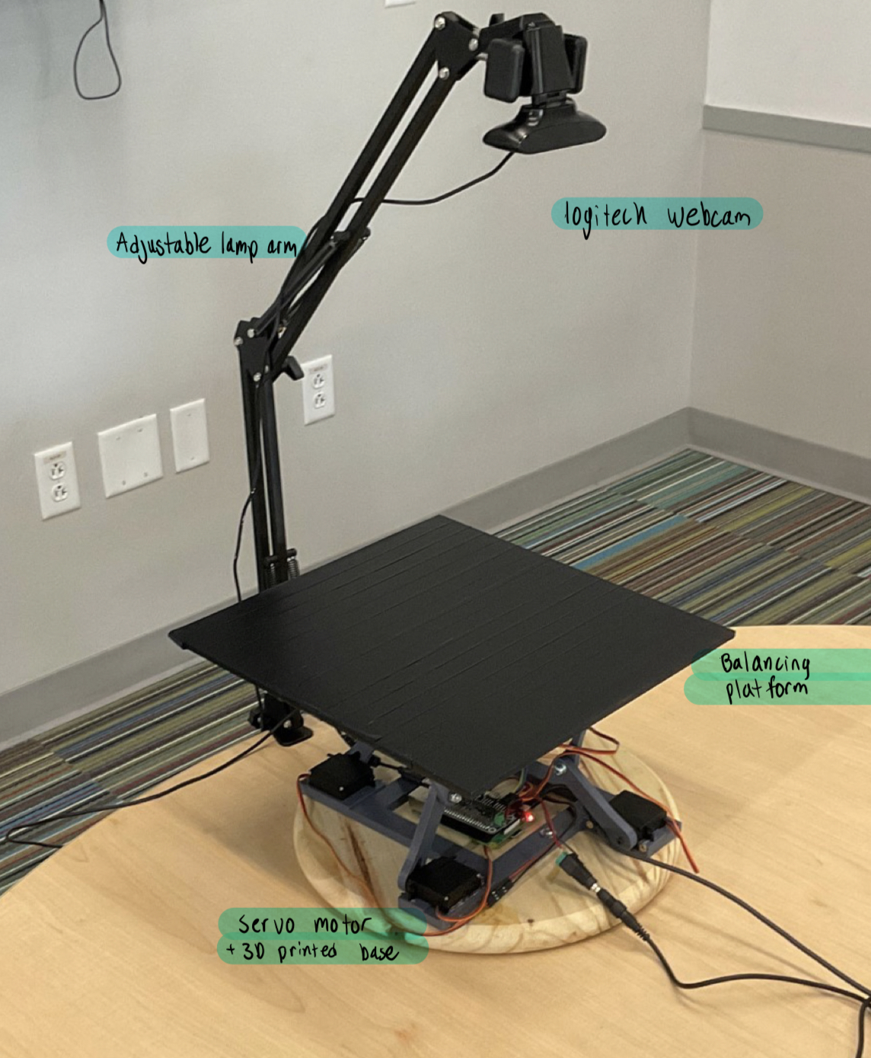
Parts Used
Universal Joint
Control arms
AC power Supply
Raspberry PI 3
Servo Hat
Balancing platform
Servo Motor
3d-printed Base
Adjustable Lamp Arm
Logitech Camera

Slide 6
Construction
Pictures along the process

Slide 7
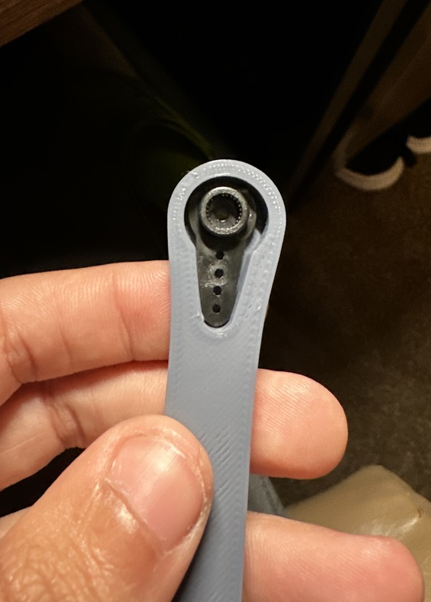
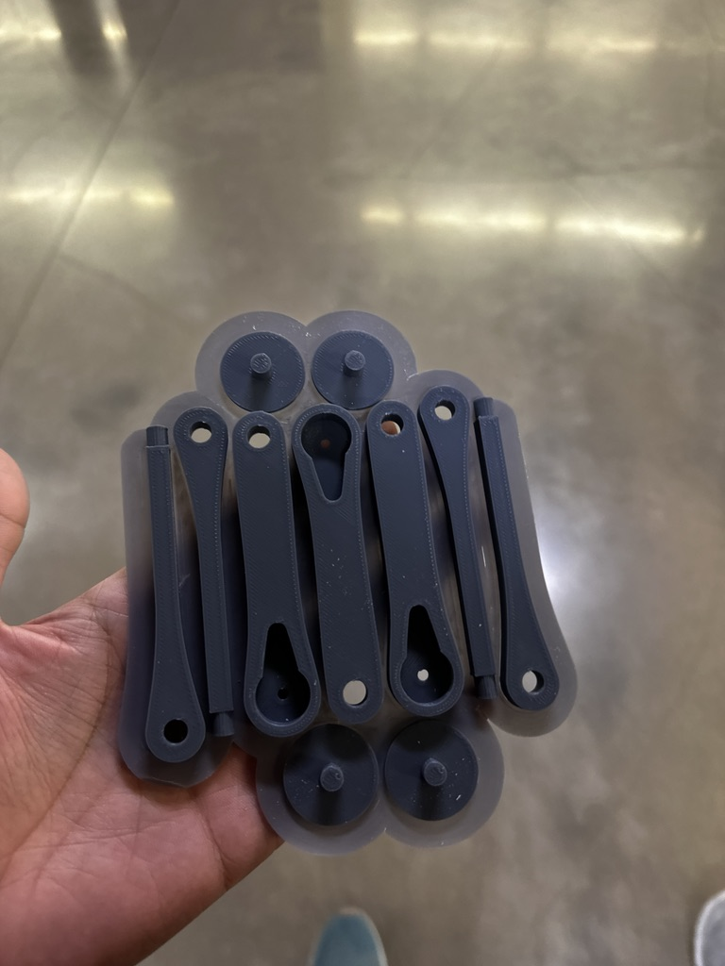

Slide 8
