Slide 1
Exoplanet Clusters
Elijah Andrushenko

Slide 2
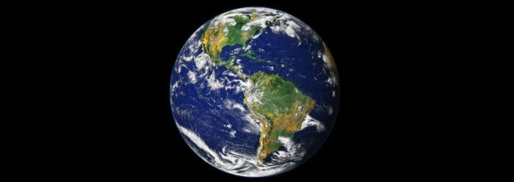
Motivation

Slide 3
Goal

Slide 4
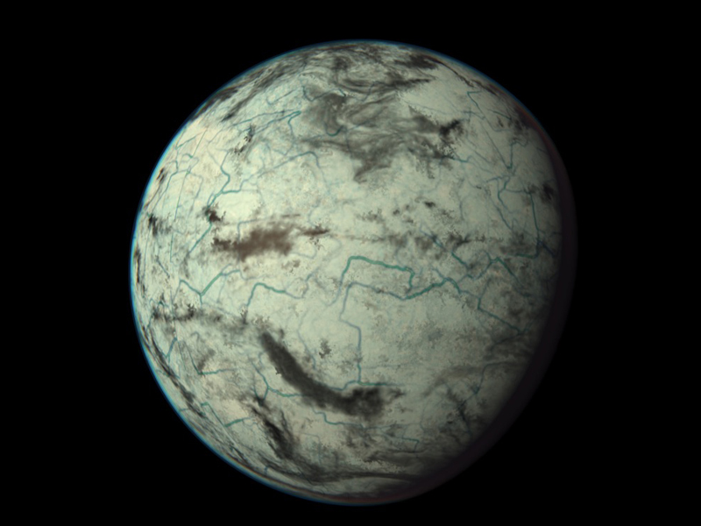
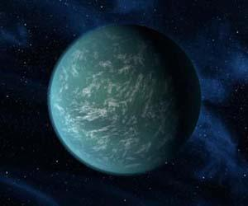
Algorithm

