Slide 1
Boxplots and Outliers
Earl F Glynn
Beginner’s Workshop 4 Oct 2014
Gist: https://gist.github.com/EarlGlynn/a13b651289eff61a2201

Slide 2
Outline
Fivenum quartile summary
Interquartile range (IQR)
Boxplot: visual display of fivenum summary
Outliers
“Notched” boxplots
Examples of using boxplots to identify outliers

Slide 3
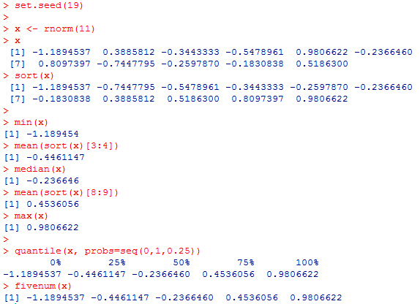
“fivenum” Quartile Summary
IQR = Interquartile Range = Middle 50%

Slide 4
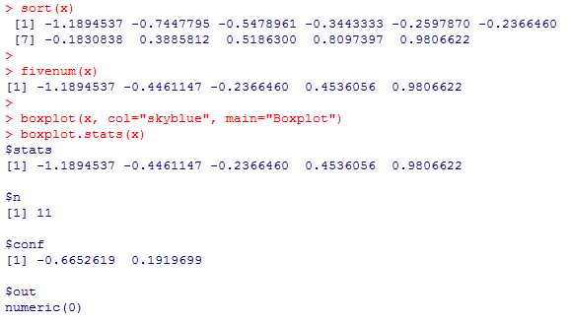
Boxplot: Visual Display of “fivenum” summary
IQR
Tukey, John W., Exploratory Data Analysis, Addison-Wesley Publishing Company, 1977, Section 2B, "Hinges and 5-number summaries."

Slide 5
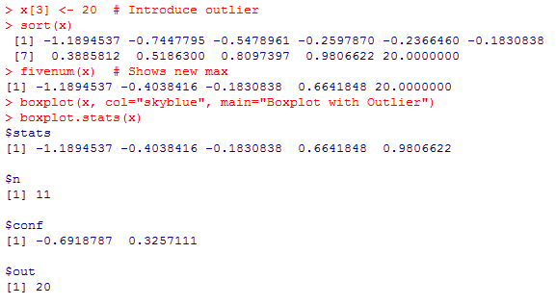
Boxplot with Outlier
What happens if one value is “bad”? Let’s replace x[3] with value 20.
Outlier

Slide 6
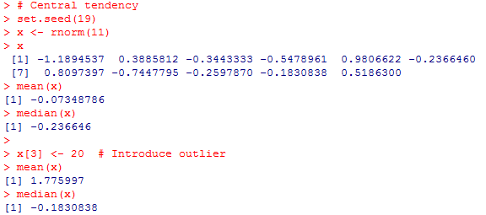
Median is more “robust” measure of central tendency than mean

Slide 7
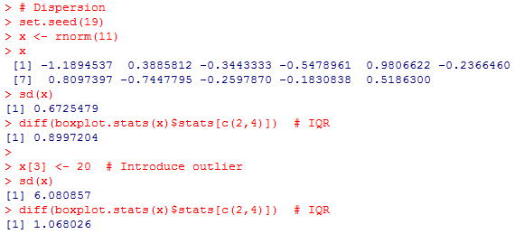
IQR is more “robust” measure of dispersion than standard deviation

Slide 8
Boxplot (median, IQR) vs. Normal Distribution (mean, standard deviation)
Boxplot makes no assumptions about probability distribution.
IQR contains 50% of data.
If normal data, ± 1 standard deviation contains ~68% of data.
Median, IQR more “robust” than mean, standard deviation

Slide 9
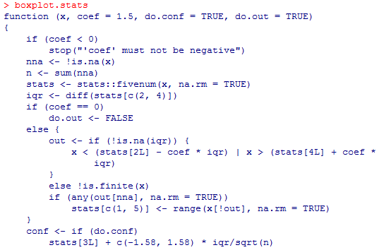
How are Outliers Defined?
Look at the code: boxplot.stats

Slide 10
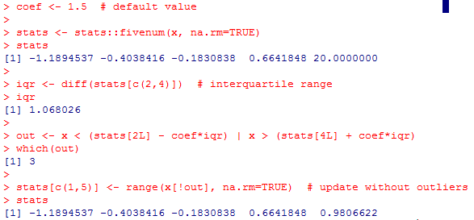
How are Outliers Defined?
Simplified version

Slide 11
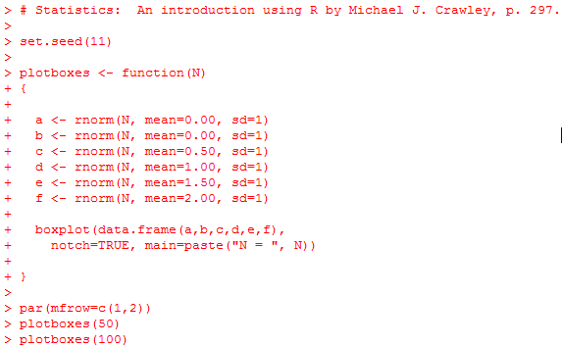
Notched Boxplots

Slide 12
Notched Boxplots
The notch=TRUE option allows significance testing of the difference in medians. Where the notches do not overlap the medians are significantly different at an α = 0.05 significance level. When the notches overlap, there is no significant difference between the medians.

Slide 13
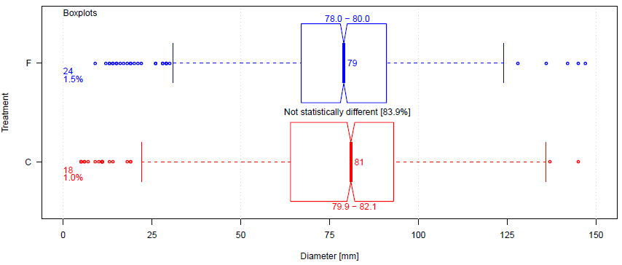
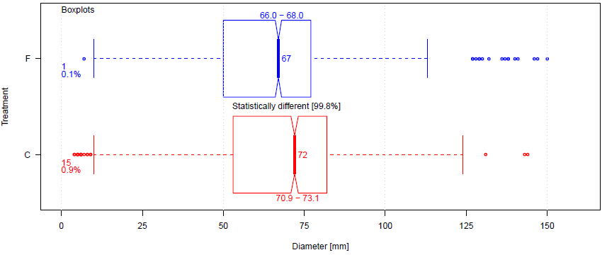
“Notched” Boxplots
From InnoCentive.com submission

Slide 14
Examples of Using Boxplots to Identify Outliers
Identify “problem” images in Kaggle competition facial images
Congressional disbursements
“PULSE” diagrams to study political money
Shawnee County, KS public salaries

Slide 15
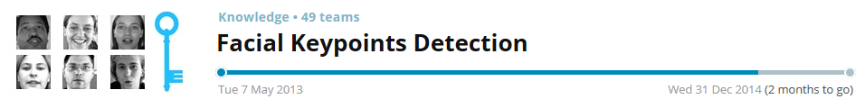
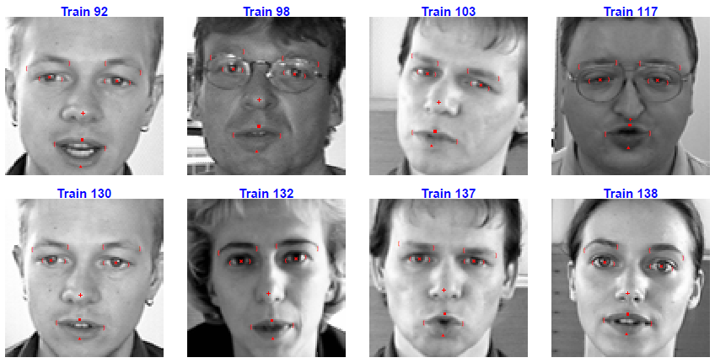
Kaggle Competition: Facial Keypoints Detection
http://www.kaggle.com/
Images:
7049 Train
1783 Test
96 x 96 pixels

Slide 16
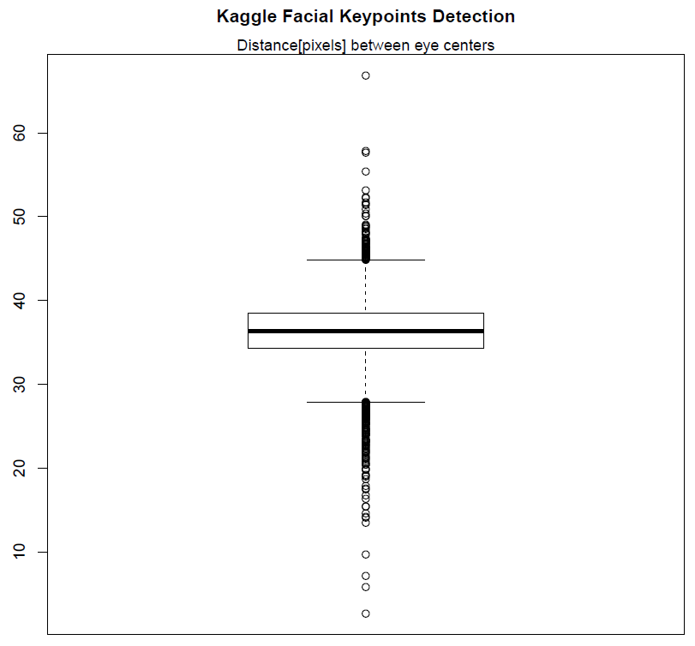
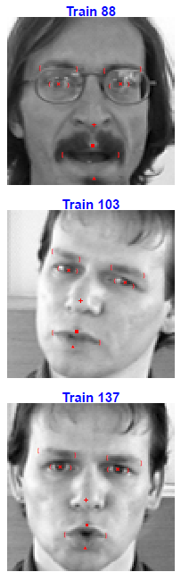
How can “problem” images be identified?
Normal
Eyes Unusually Far Apart
Normal
Eyes Unusually Close Together

Slide 17
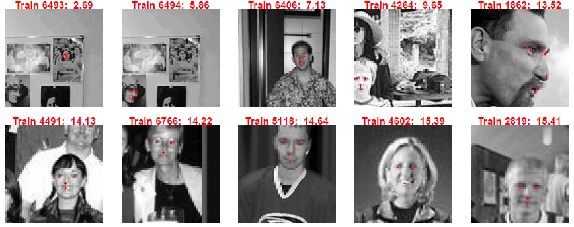
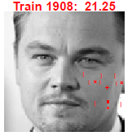
Eyes unusually close together

Slide 18
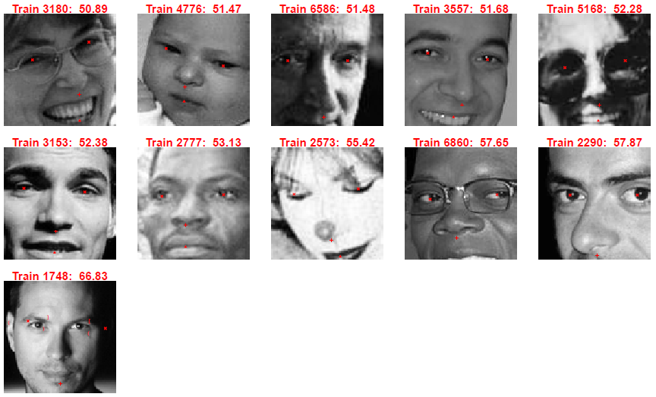
Eyes unusually far apart

Slide 19
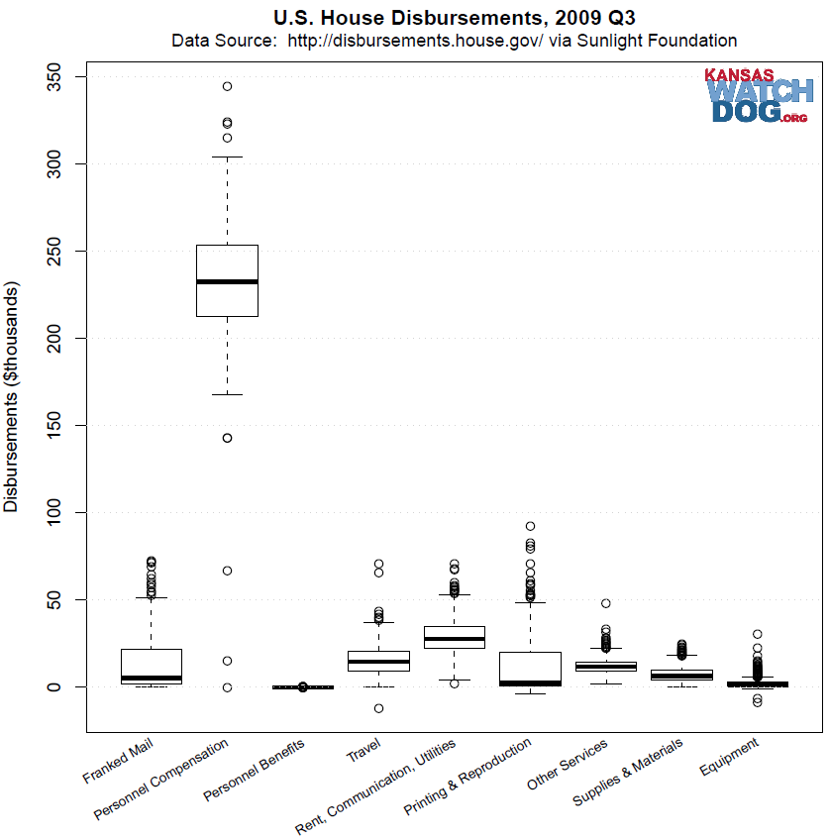
Congressional Disbursements
What expenses are “normal”?

Slide 20
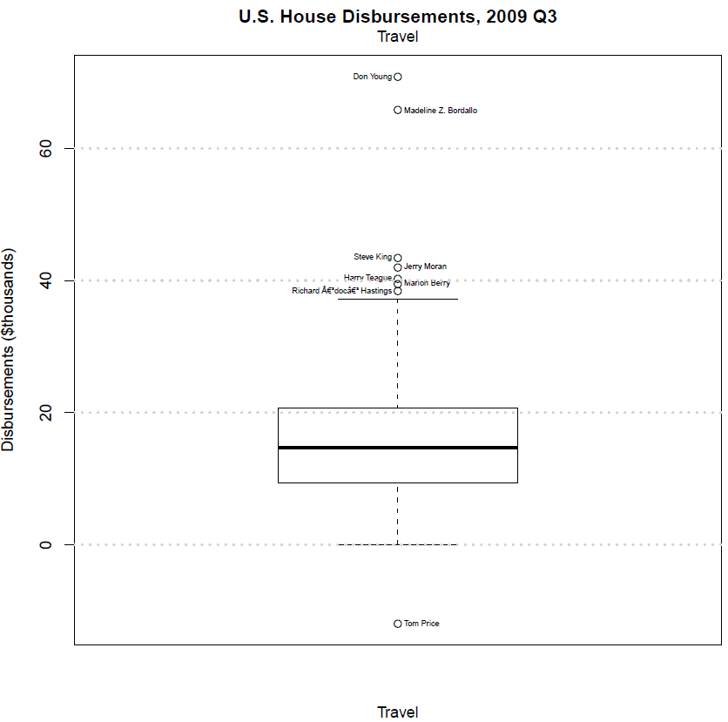
Congressional Disbursements
What expenses are “normal”?

Slide 21
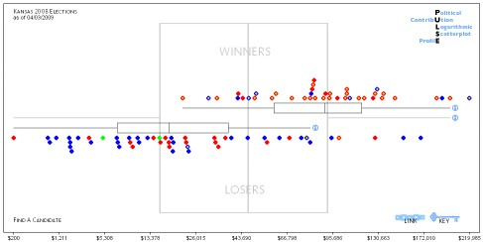
“PULSE” Diagrams to Study Political Money
No longer online at FollowTheMoney.org
PULSE = Political Contribution Logarithmic Scatterplot Profile
Kansas Senate Winners and Losers in 2008

Slide 22
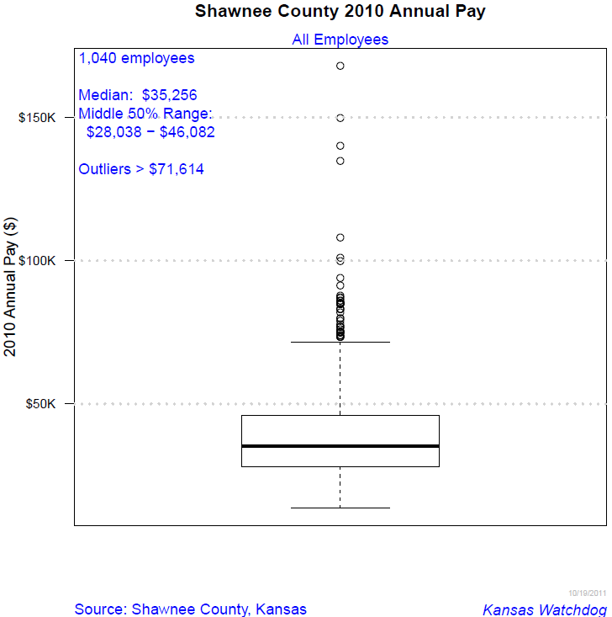
Shawnee County, Kansas Public Salaries

Slide 23
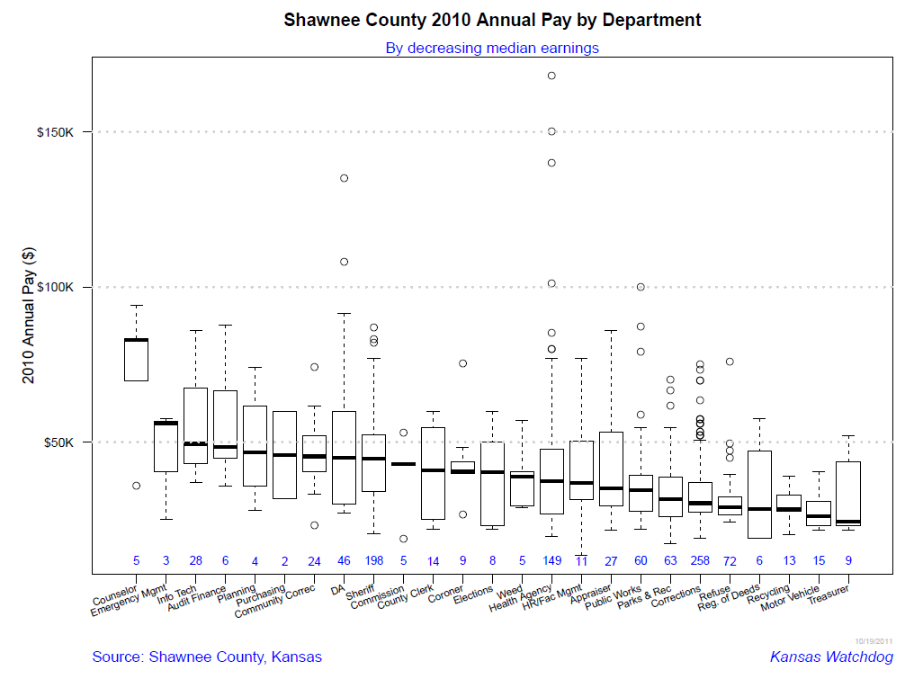
Shawnee County, Kansas Public Salaries

Slide 24
Take Away
Great tools for exploratory data analysis:
fivenum summary (or use quantile function)
boxplot summary
Median and IQR robust statistics for any distribution
Outliers: bad data or possibly something interesting

