Slide 1
Analysis of HAVV Data Technical Details
Earl F Glynn efglynn@gmail.com github.com/EarlGlynn/HAVV-analysis
2024-07-23
Notes:
Jeff O'Donnell (aka The Lone Raccoon) was the pioneer in the analysis of HAVV data
Yearly summary of all states 2018-2024
https://magaraccoon.com/havv.asp
Pierre Omidyar’s Democracy Fund publication: Motor Vehicle Departments: Bedrock of American Democracy https://democracyfund.org/idea/motor-vehicle-departments-bedrock-of-american-democracy/ 2021_DF_MotorVehicleDepartmentReport.pdf
Information Exchange Agreement between [state] and the Social Security Administration 2021-2026
https://www.ssa.gov/dataexchange/documents/SSOLV%20model.pdf SSOLV model.pdf
AAMVA Products & Services Catalog
https://www.aamva.org/getmedia/dfdebfd6-1877-4fba-808c-084013e1ec0a/Products-Services-Catalog-Government-Rate-October-2021.pdf NetworkServices-GovtRateSchedule.pdf

Slide 2
Analysis of HAVV Data
Background: Conceptual Process
Online Data
Excel file with over 700 weekly sheets
Sample sheet for recent week
“First Look” Notebook: Download, Explore, Reformat
Definitions of key terms
Create more usable HAVV data files
Data and Reports by State (parameterized notebook/report)
Online GitHub Resources

Slide 3
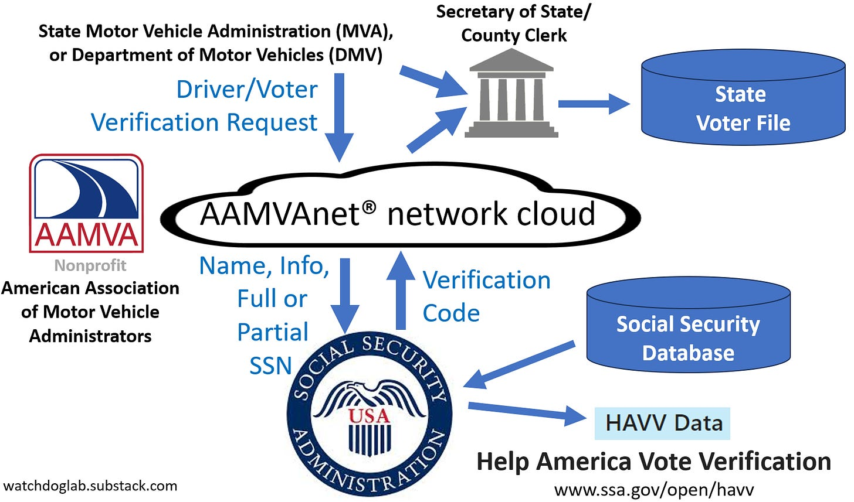
HAVV Background: Conceptual Process
Questions about Help America Vote Verification data in many states https://watchdoglab.substack.com/p/questions-about-help-america-vote

Slide 4
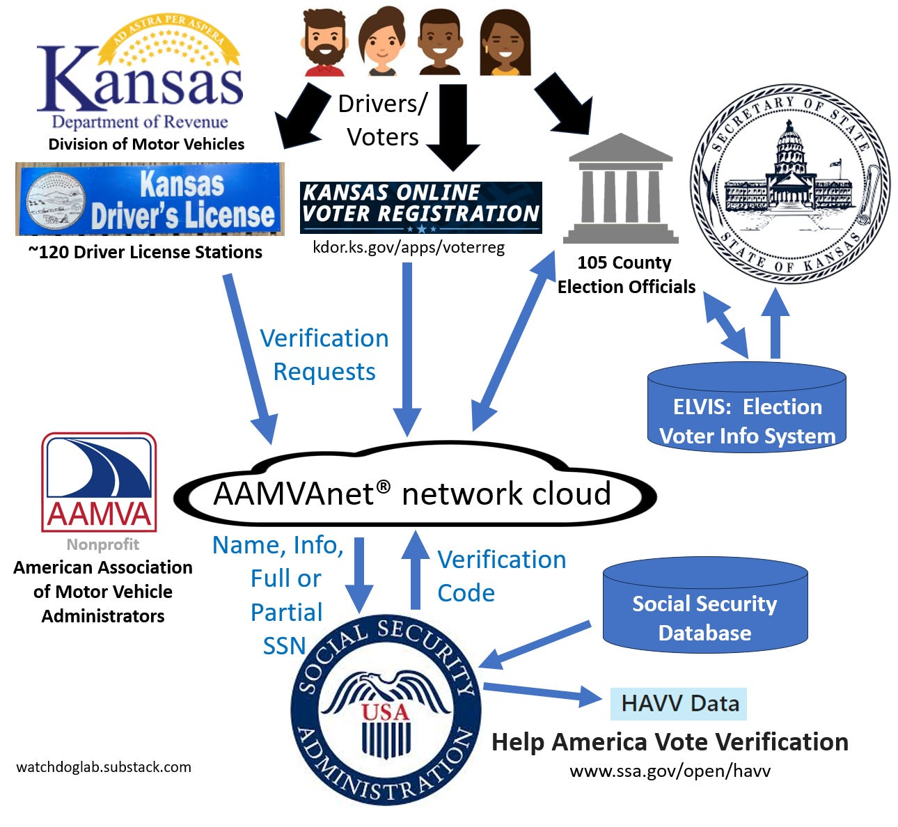
HAVV Background: Conceptual Process
Kansas
Details vary by state
Understanding Kansas Help America Vote Verification data https://watchdoglab.substack.com/p/understanding-kansas-help-america

Slide 5
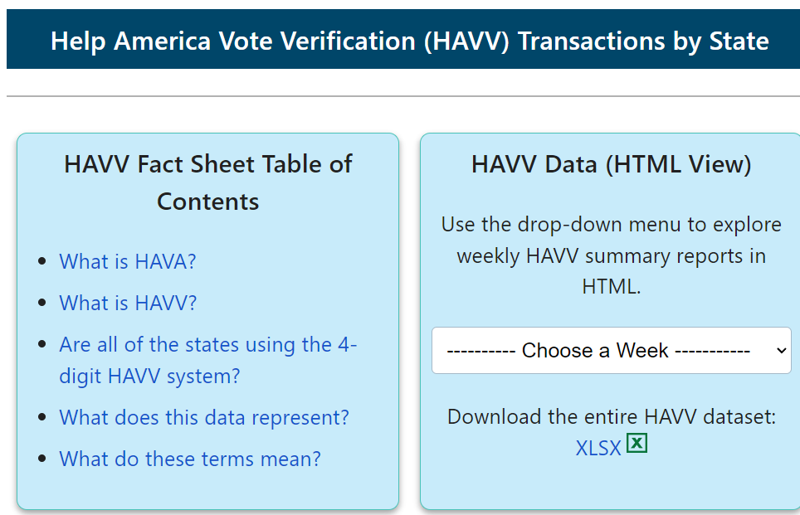
Help America Vote Verification (HAVV) Data
https://www.ssa.gov/open/havv/
Notes:
Weekly data are released by at irregular time intervals.
June 29, July 6 and July 13 were released on July 18.
June 15 and June 22 were released on June 27.

Slide 6
Help America Vote Verification Data “Entire HAVV Dataset”
https://www.ssa.gov/open/havv/havv-weekly-usage.xlsx
Excel file has 721 sheets with data for all states back to Jan. 8, 2011
Each sheet is a week of data (or yearly totals, or overall total)
Very difficult to work with state data across so many Excel sheets!!
Current week of data is the third sheet
. . .

Slide 7
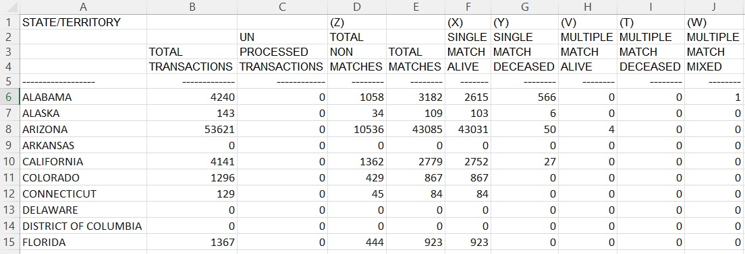
Help America Vote Verification Data Sample HAVV sheet for 2024-07-13 One of 721 sheets
How to find data breakdowns with a state?
. . .
Notes:
I

Slide 8
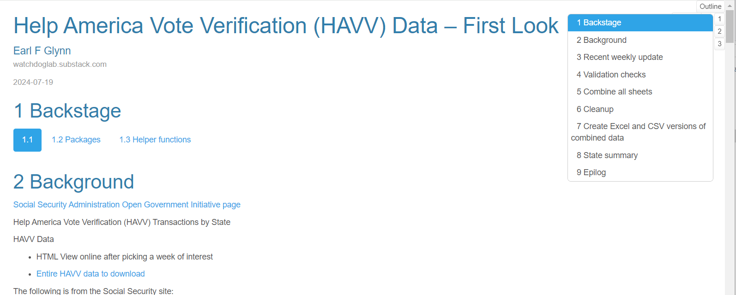


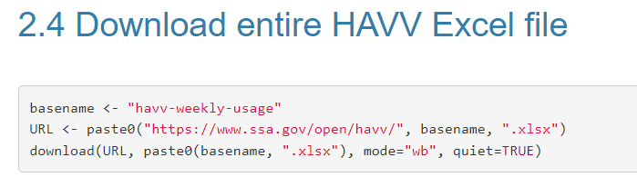
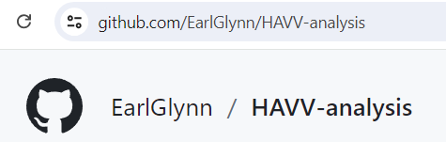
Help America Vote Verification Data “First Look” Notebook: Download, Explore
Download and archive HAVV file using RStudio notebook. Explore data problems.
Free, open source
data science tools
Download code and files:

Slide 9
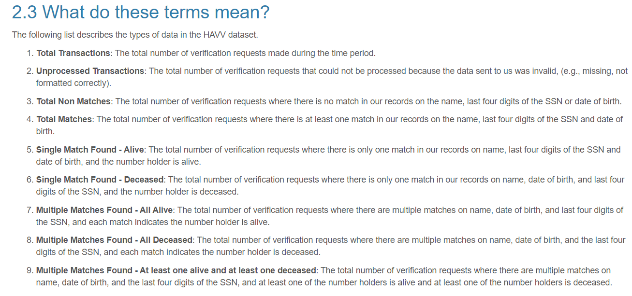
Help America Vote Verification Data Notebook is mix of R code and documentation

Slide 10
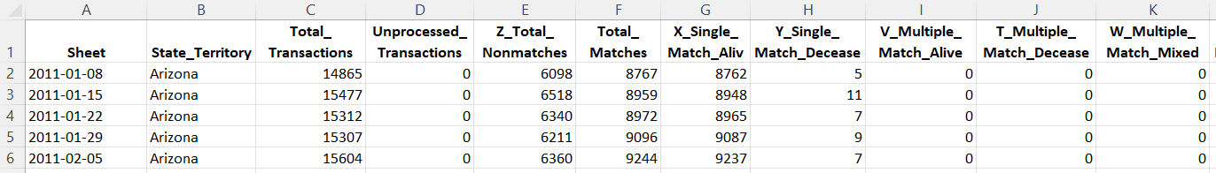
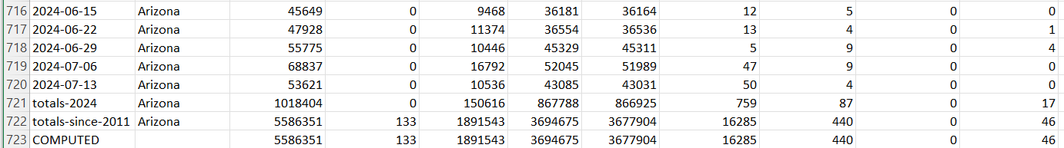
Help America Vote Verification Data More usable state data One data sheet instead of data spread over 721 sheets
. . .
COMPUTED row is sum of all weekly data (excluding totals) and matches totals-since-2011 (except for Alabama)
Notes:
C:\efgArchive\2020s\2024\R\HAVV\2024-07-13\States-Data\Arizona-HAVV-through-2024-07-13.xlsx

Slide 11
Help America Vote Verification Data “First Look” Notebook
Create more usable HAVV data in single Excel files
Filename | Lines | Description
HAVV-by-State-Through-2024-07-13.xlsx | 37,507 | By state, one line by week, with some added fields for filtering. Ordered by state and week in single sheet.
HAVV-Recent-Sheet-2024-07-13.xlsx | 58 | Example of most recent week of data for all states. Column names …1 .. …10.
HAVV-Sheets-Summary-2024-07-13.xlsx | 722 | Metadata: One line per Excel sheet with sheet stats. Sheets should have 57 rows and 10 columns. One very old sheet has 71 rows. Six sheets from 2013 have 16138 columns and must be fixed.
HAVV-State-Summary-2024-07-13.xlsx | 53 | One line per state with some overall HAVV stats. Most sheets had 706 lines.
Notes:
C:\efgArchive\2020s\2024\R\HAVV\notes.docx

Slide 12
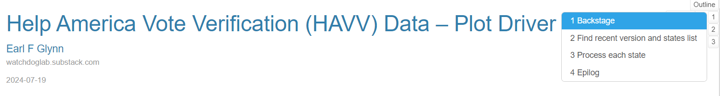
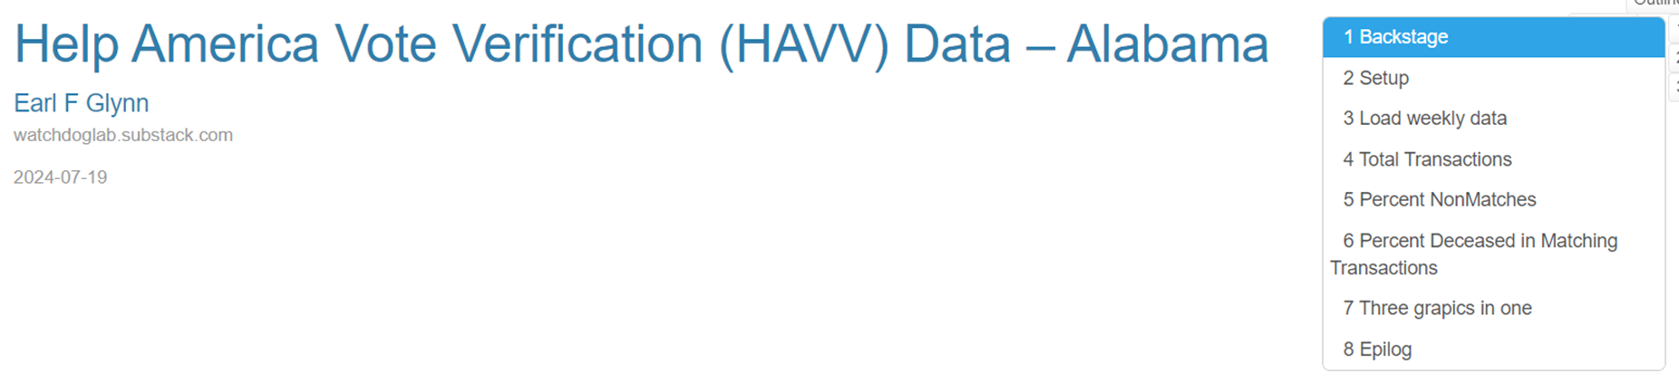
Help America Vote Verification Data Parameterized Reports: Driver & Template
Use “Driver” to process each state with the same “Template”
“Template” extracts state data from master and creates separate file and plot for each state
Create plots and Excel file for each state
Notes:
C:\efgArchive\2020s\2024\R\HAVV\notes.docx

Slide 13
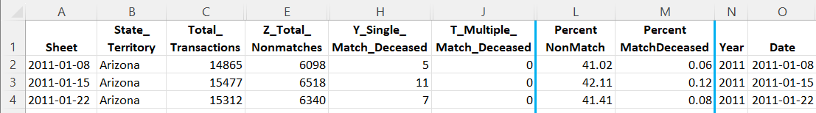
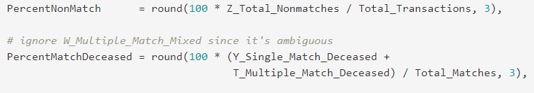
Help America Vote Verification Data HAVV Data File by State: Arizona
Add four columns of computed data
. . .
Arizona-HAVV-through-2024-07-13.xlsx
Notes:
2024/R/HAVV/2024-07-13/HAVV-First-Look.html
Year field is useful for filtering by year.
Sheet and Date are different data types (string and date)

Slide 14
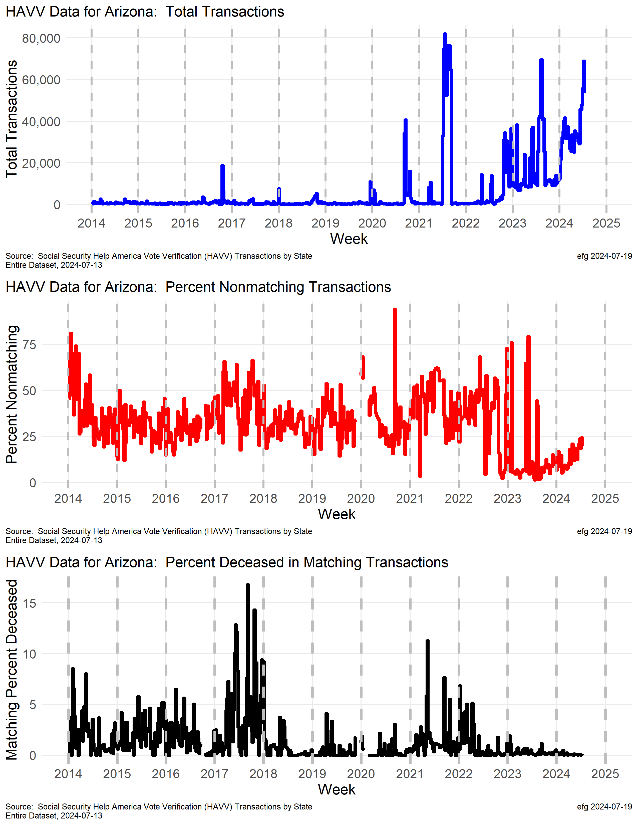
Help America Vote Verification Data HAVV Charts by State
Arizona
Total Transactions (blue line)
Why are total transactions trending upward in 2024?
Percent Nonmatching (red line)
Some large swings in nonmatching rates since mid-2022. Lower in late 2023, but steadily increasing now.
Percent Deceased in Matching (black line)
A very low rate since mid-2022.
Arizona-HAVV-Data-2024-07-13.png
Notes:
2024/R/HAVV/2024-07-13/HAVV-First-Look.html
Year field is useful for filtering by year.
Sheet and Date are different data types (string and date)

Slide 15


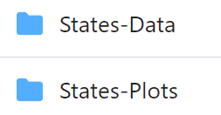

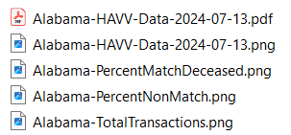
Online GitHub Resources
https://github.com/EarlGlynn/HAVV-analysis
All 50 states + DC; separate Total
Download or View Excel files online
Download or View PNGs/PDFs online

