Slide 1
Congress KS-01
Voter Registration and Turnout Curves efg 2024-01-20

Slide 2
Table of Contents
New Voter Registration 2016-2023
Election Turnout Curves November General By Party 2016 - 2022
Election Turnout Curves August Primary By Party 2016 - 2022

Slide 3
New Voter Registration 2016-2023

Slide 4
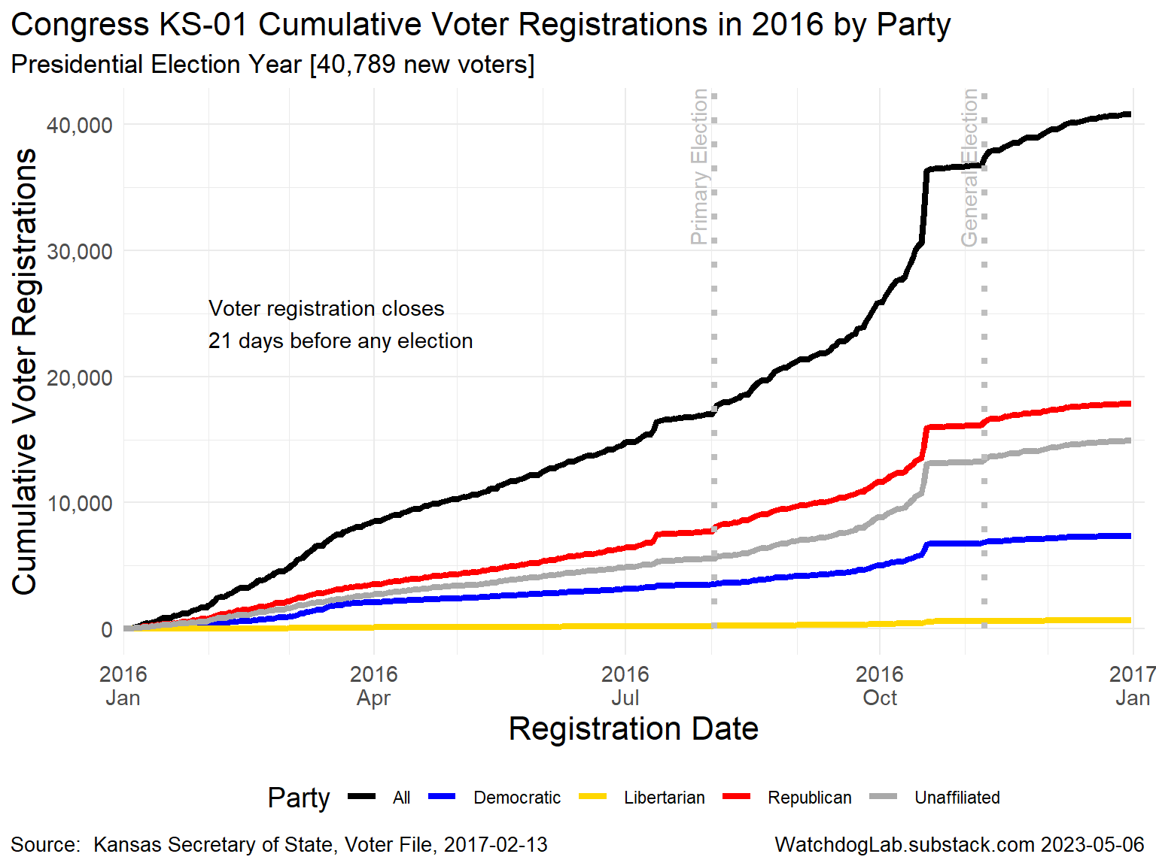
KS-01 2016

Slide 5
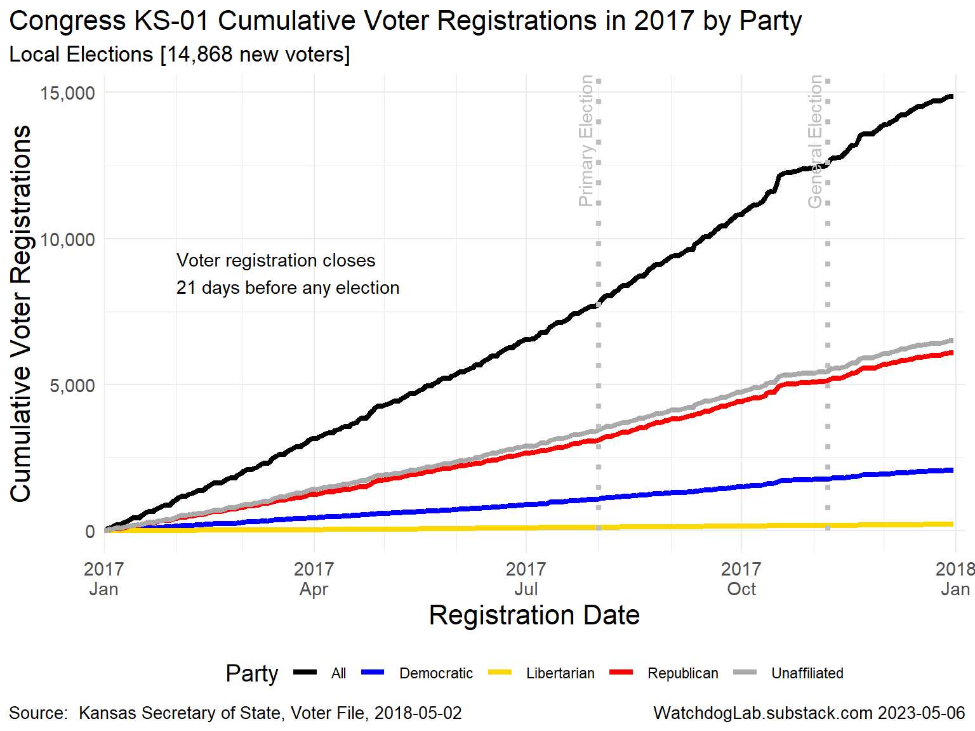
KS-01 2017

Slide 6
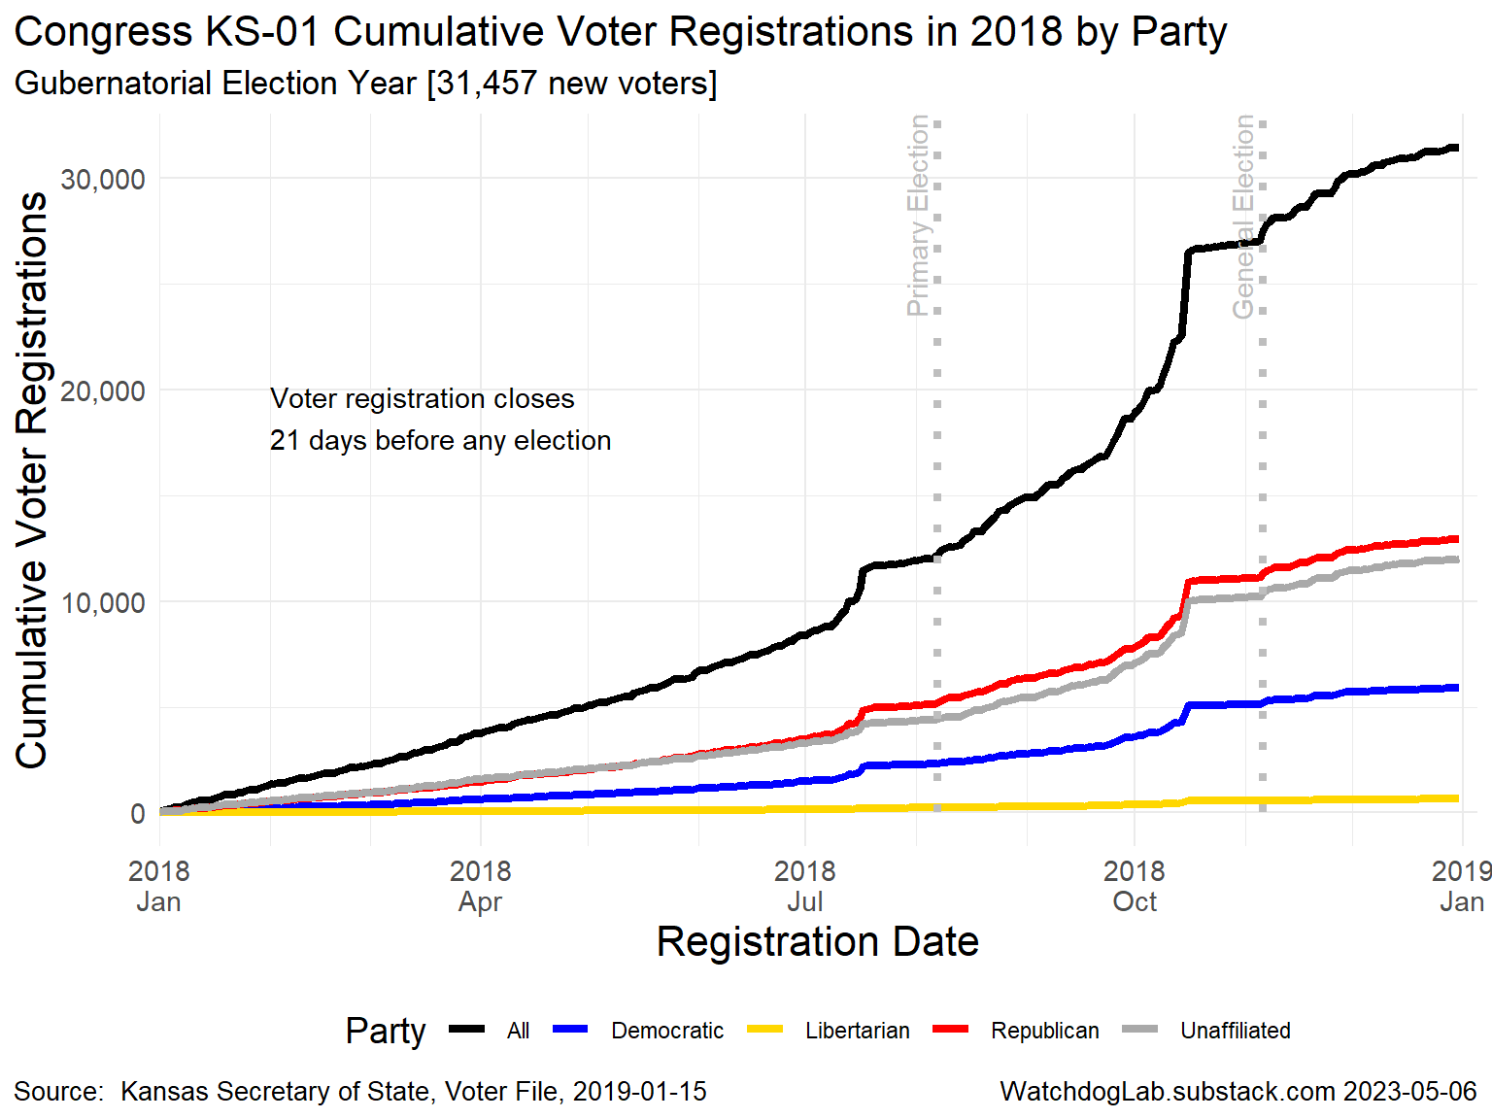
KS-01 2018

Slide 7
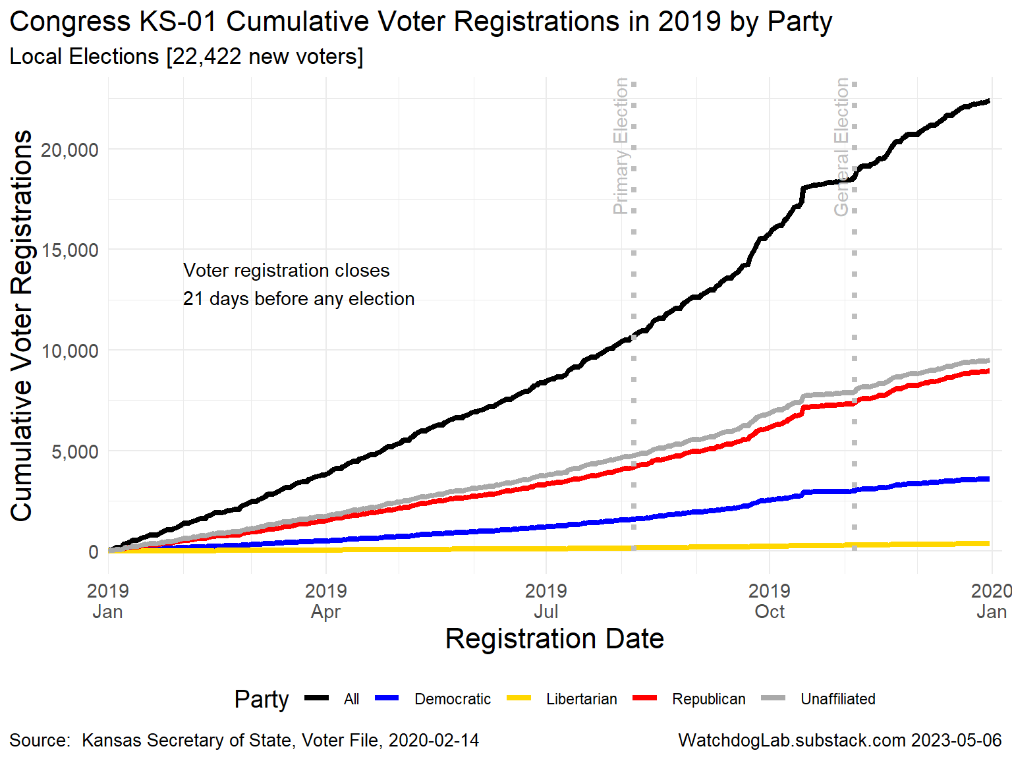
KS-01 2019

Slide 8
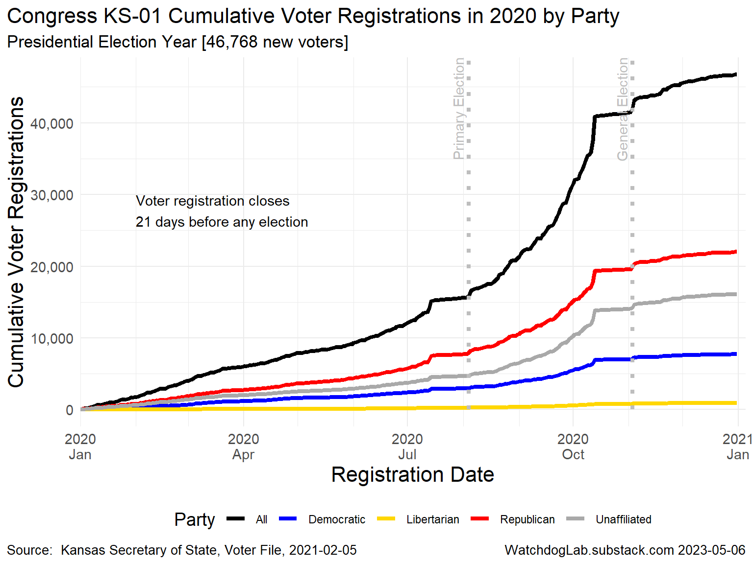
KS-01 2020

Slide 9
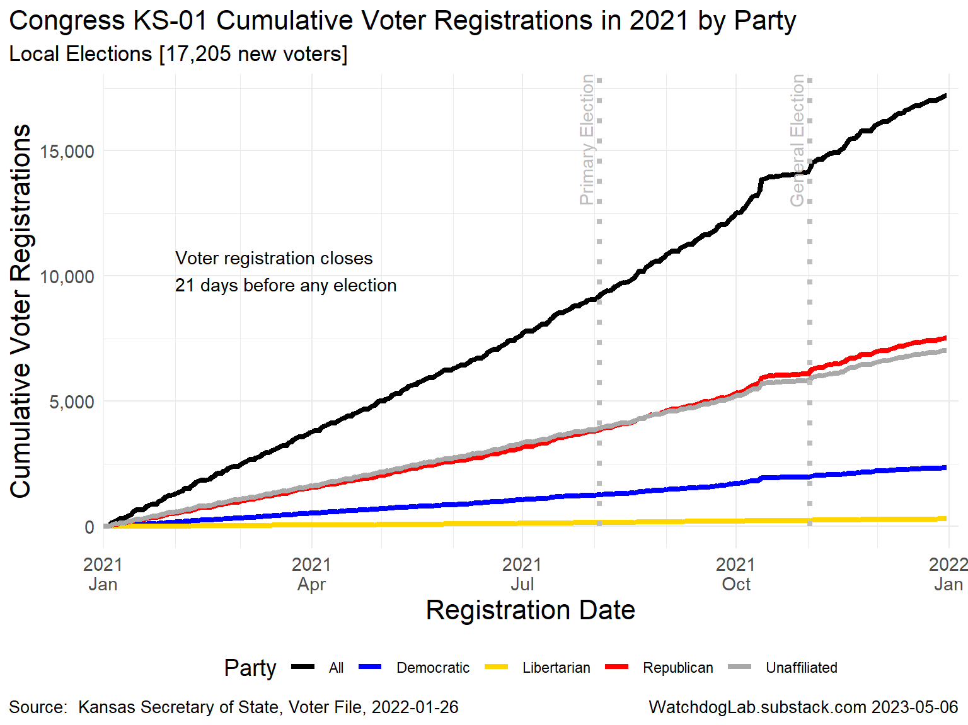
KS-01 2021

Slide 10
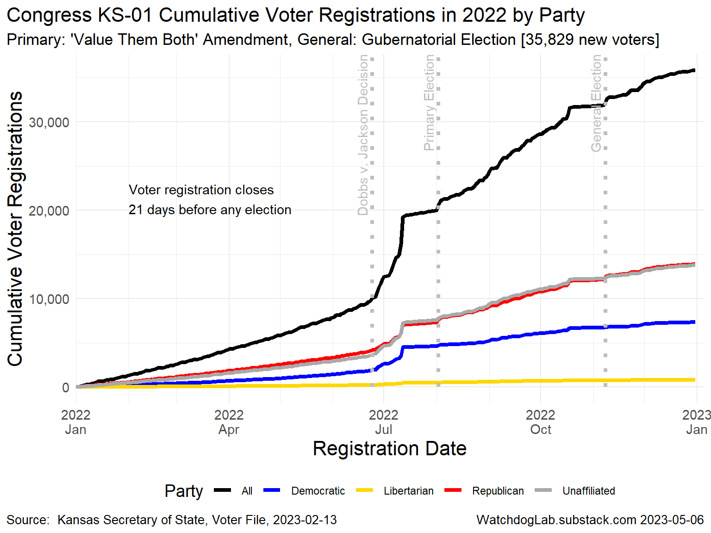
KS-01 2022

Slide 11
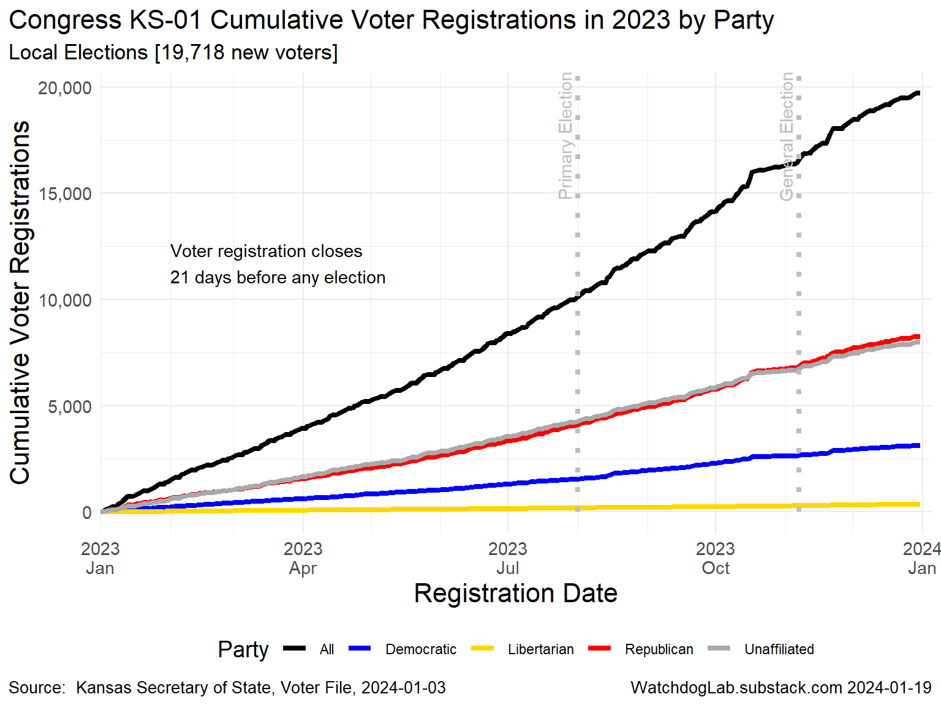
KS-01 2023

Slide 12
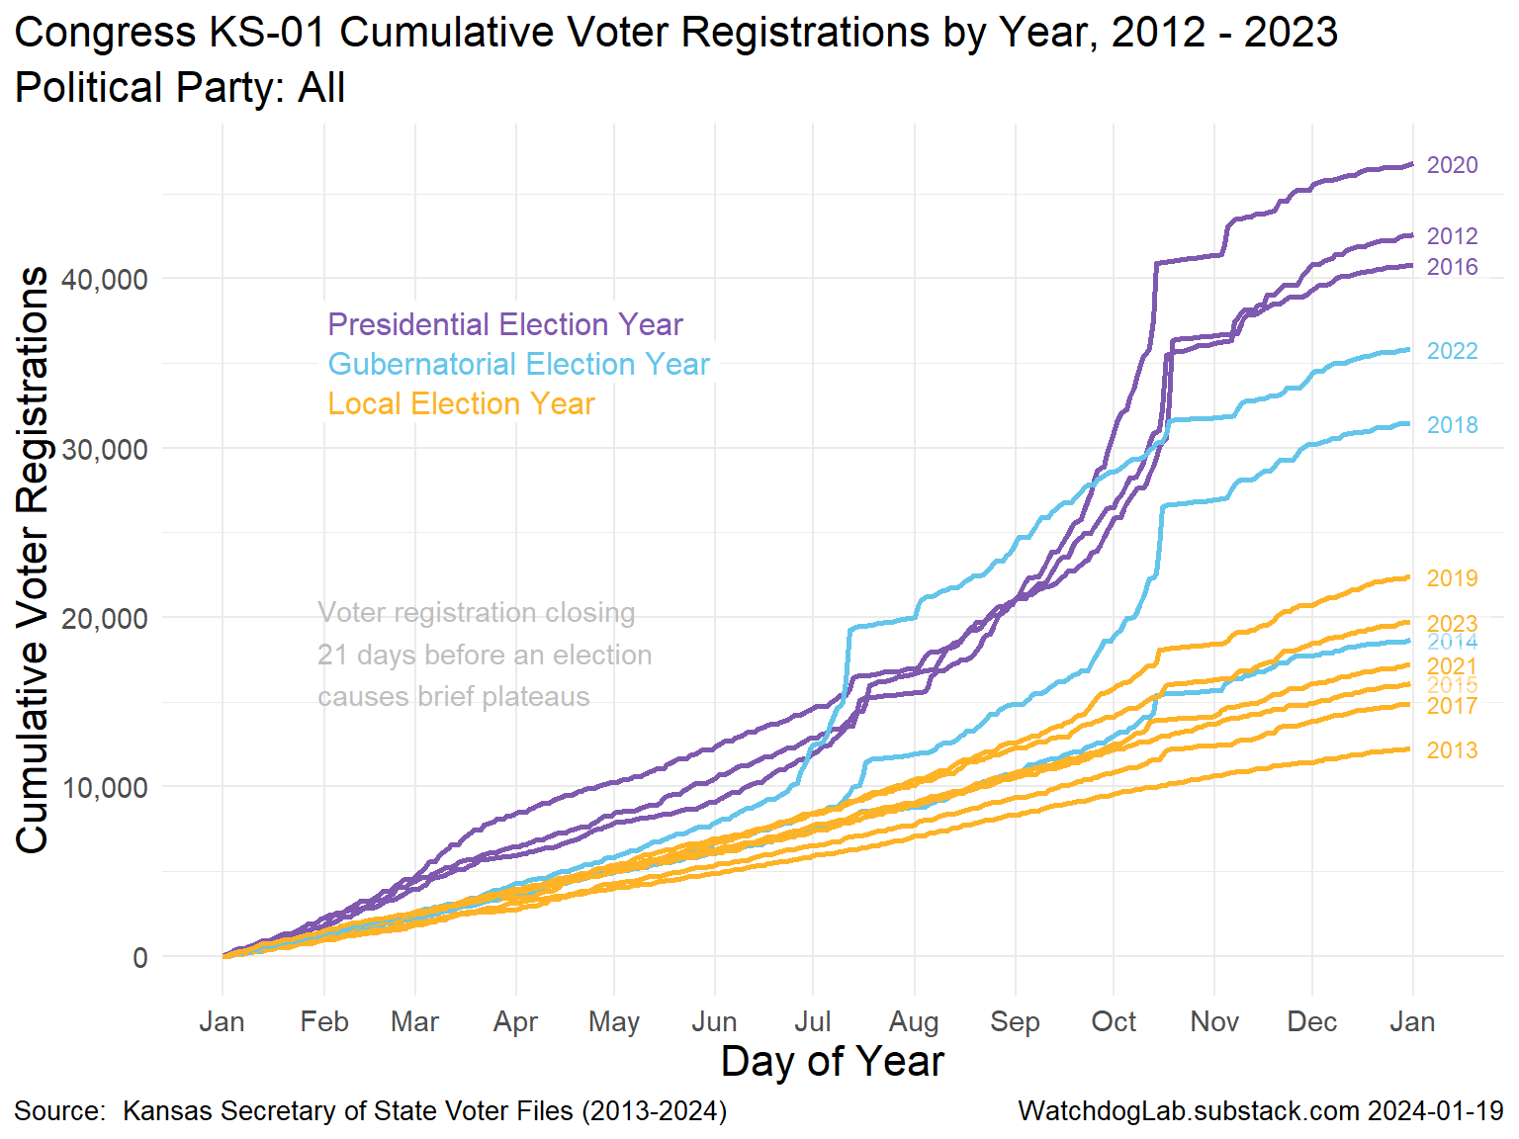
Congress KS-01 Voter Registration 2012-2023

Slide 13
Election Turnout Curves November General By Party 2016 - 2022

Slide 14
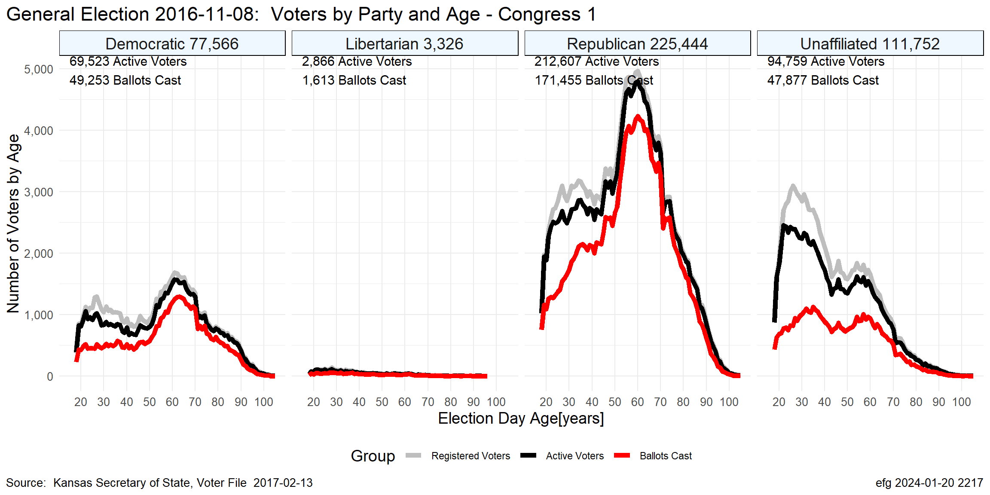
KS-01 Nov. 2016

Slide 15
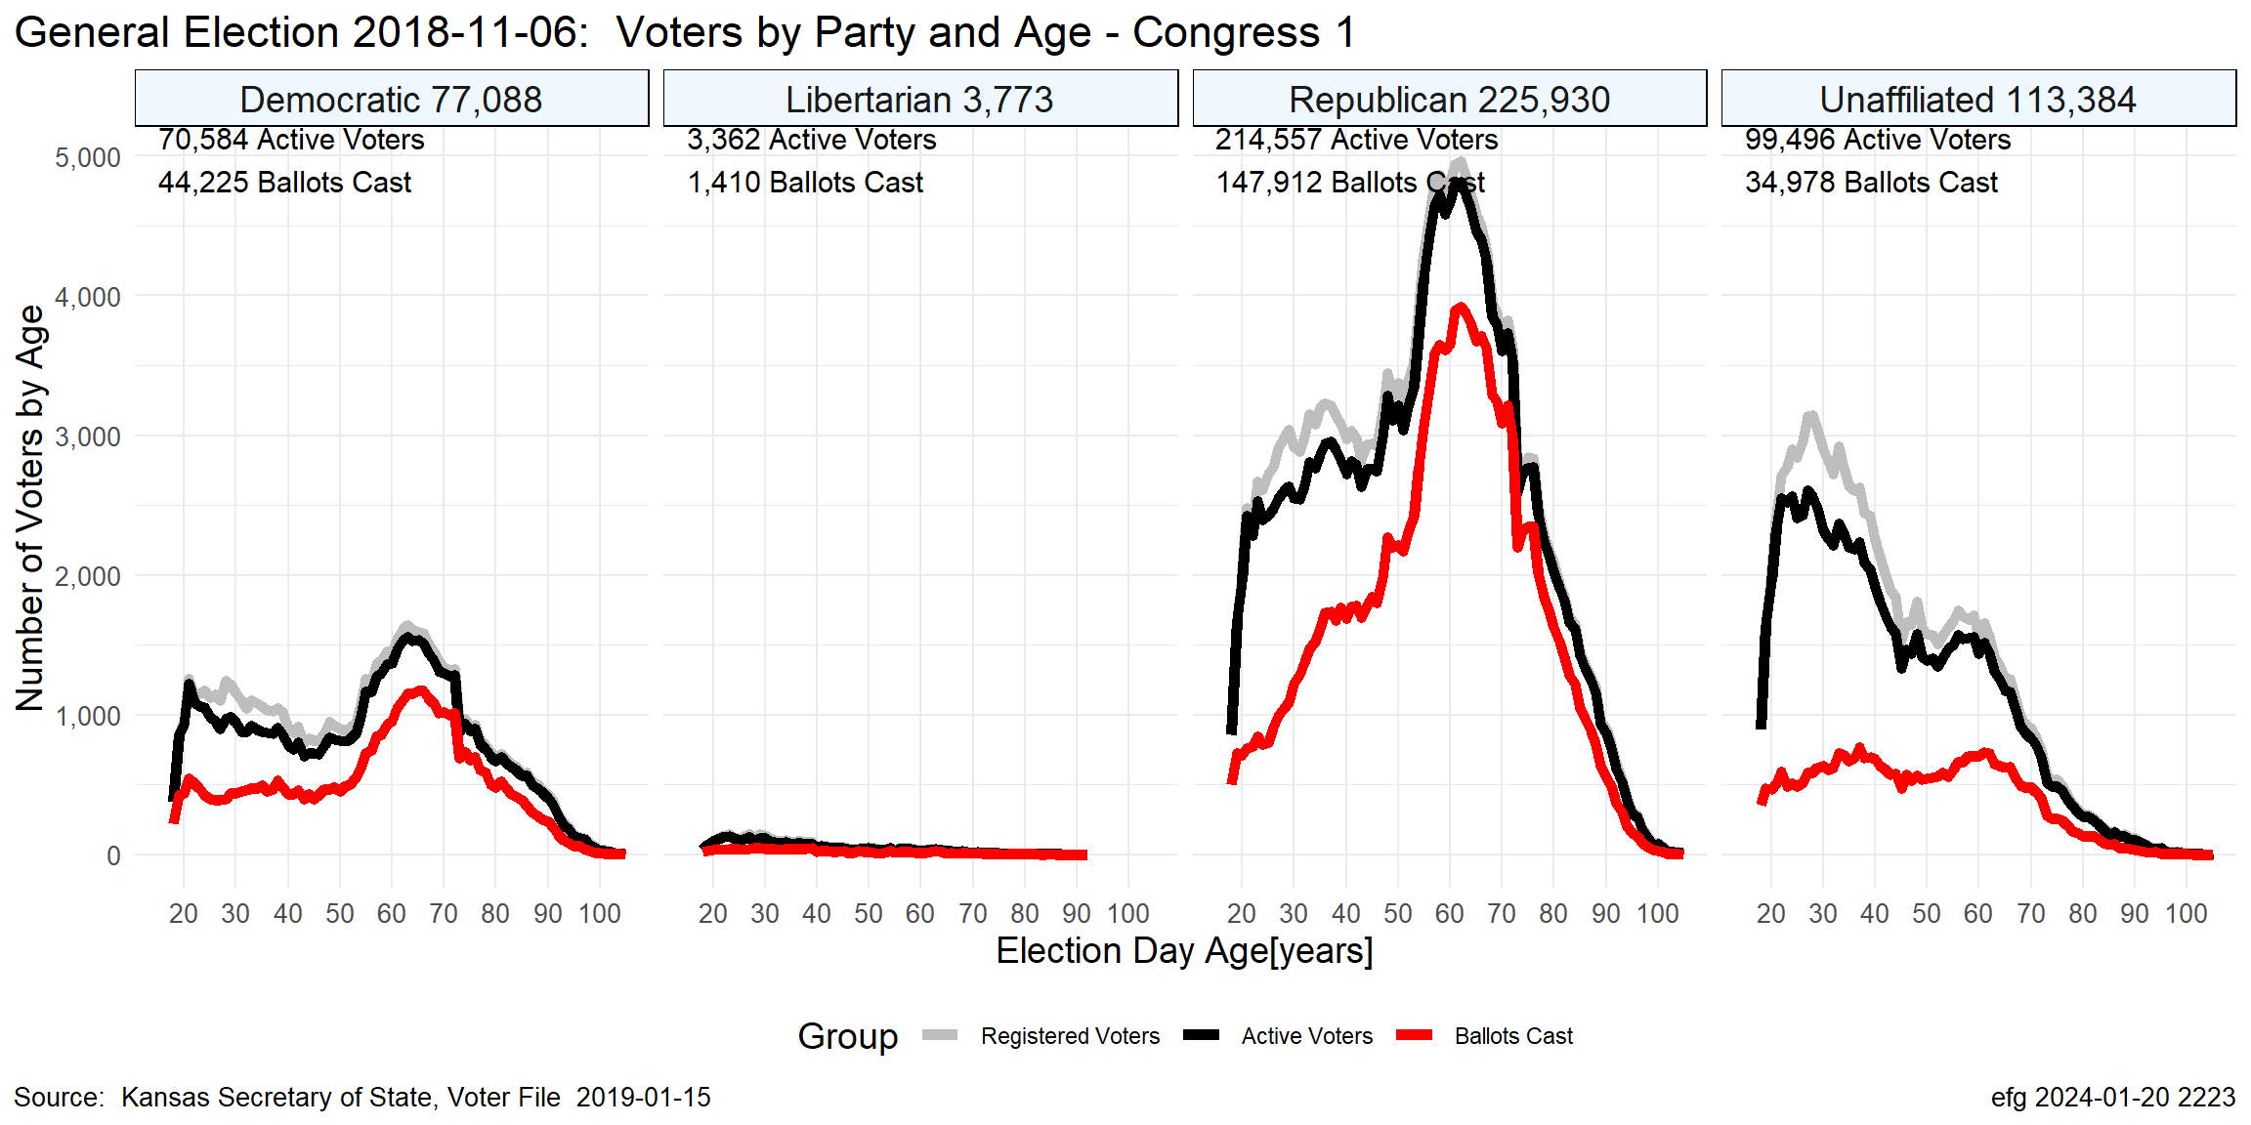
KS-01 Nov. 2018

Slide 16
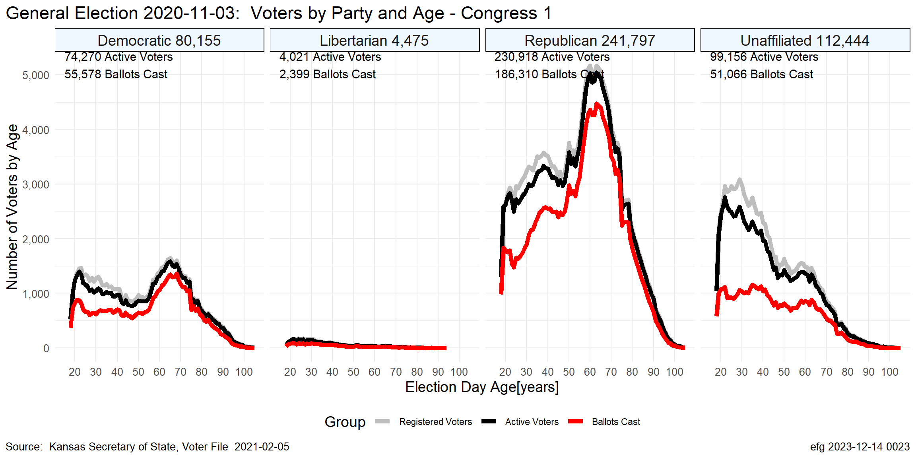
KS-01 Nov. 2020

Slide 17
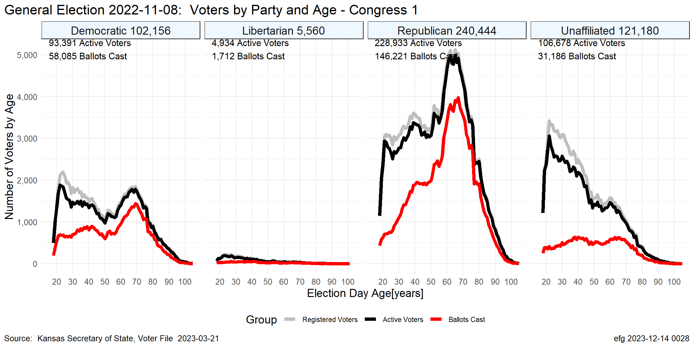
KS-01 Nov. 2022

Slide 18
Election Turnout Curves August Primary By Party 2016 - 2022

Slide 19
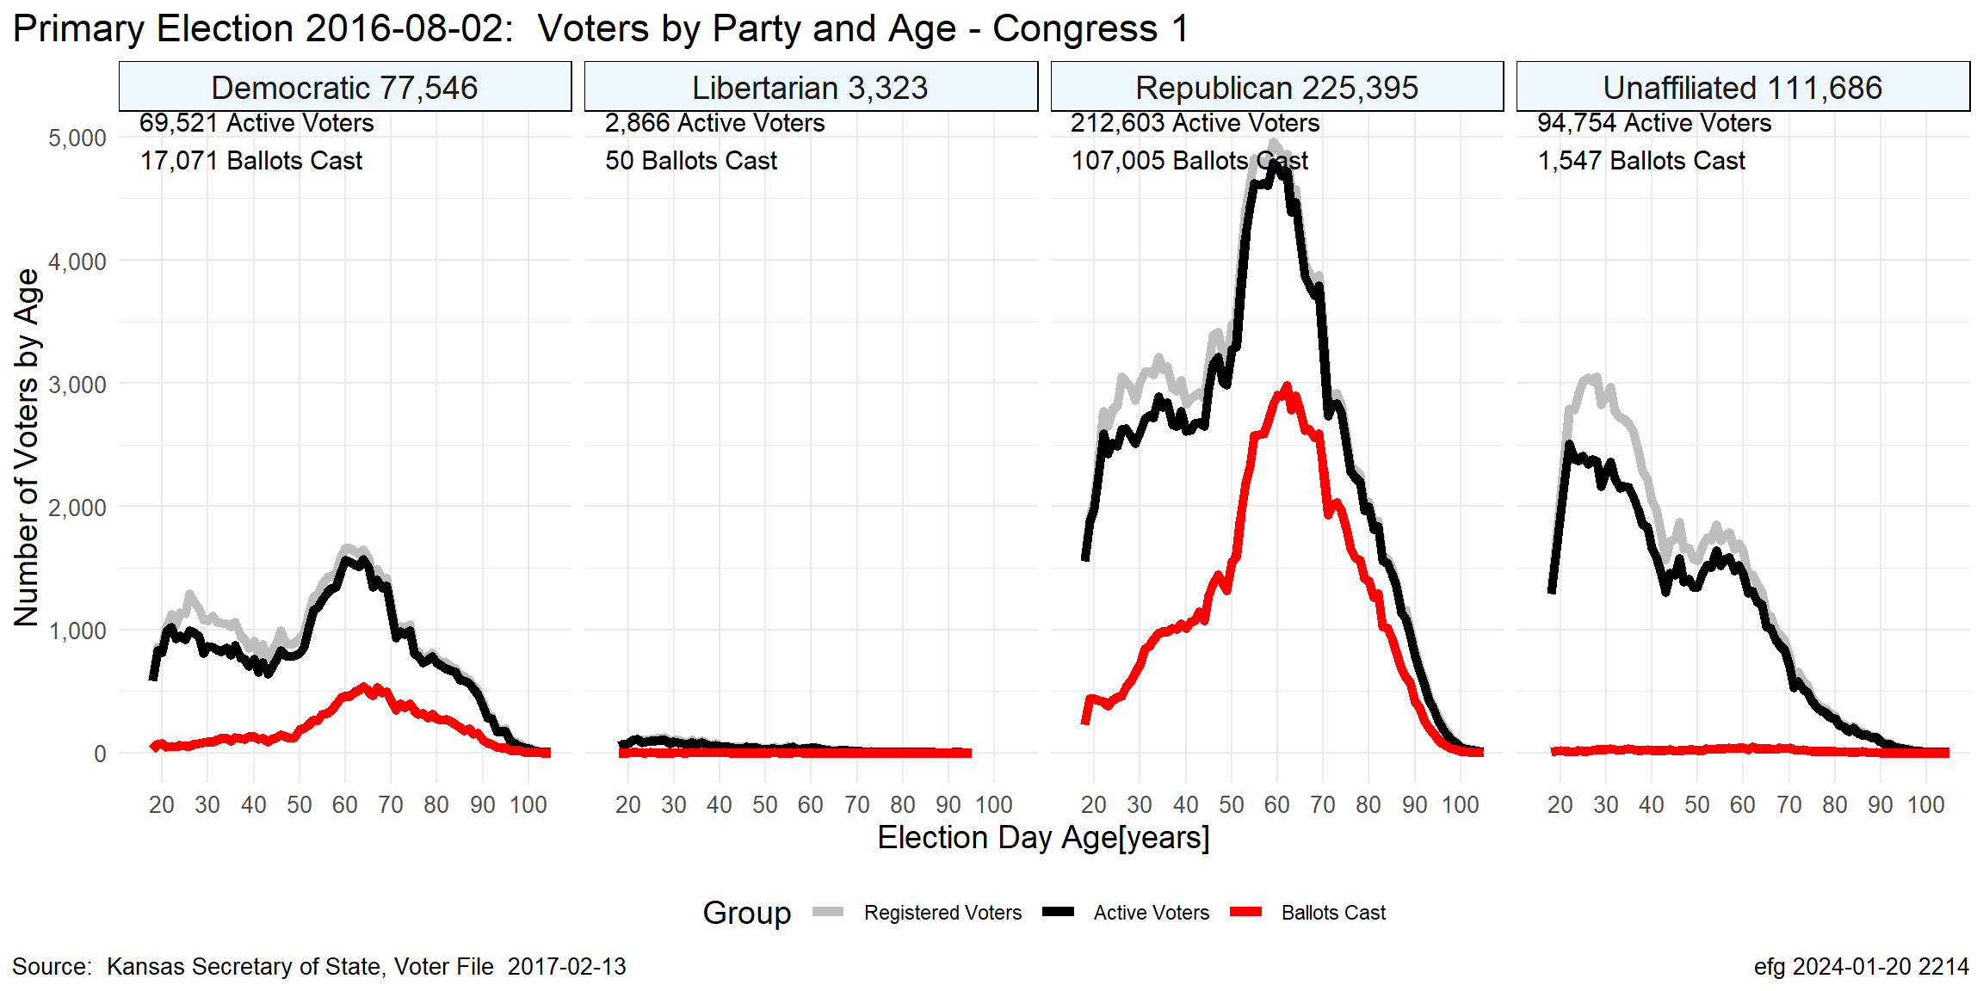
KS-01 Aug. 2016

Slide 20
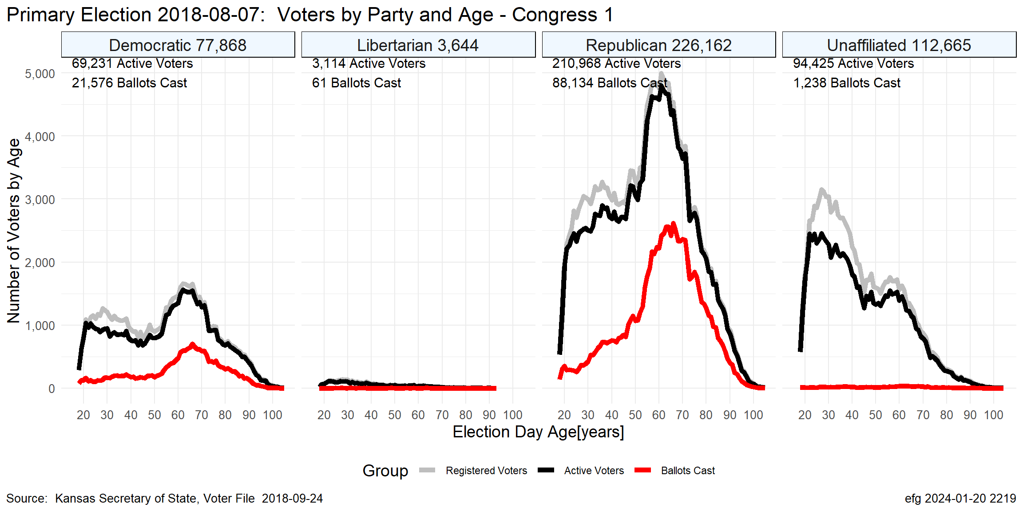
KS-01 Aug. 2018

Slide 21
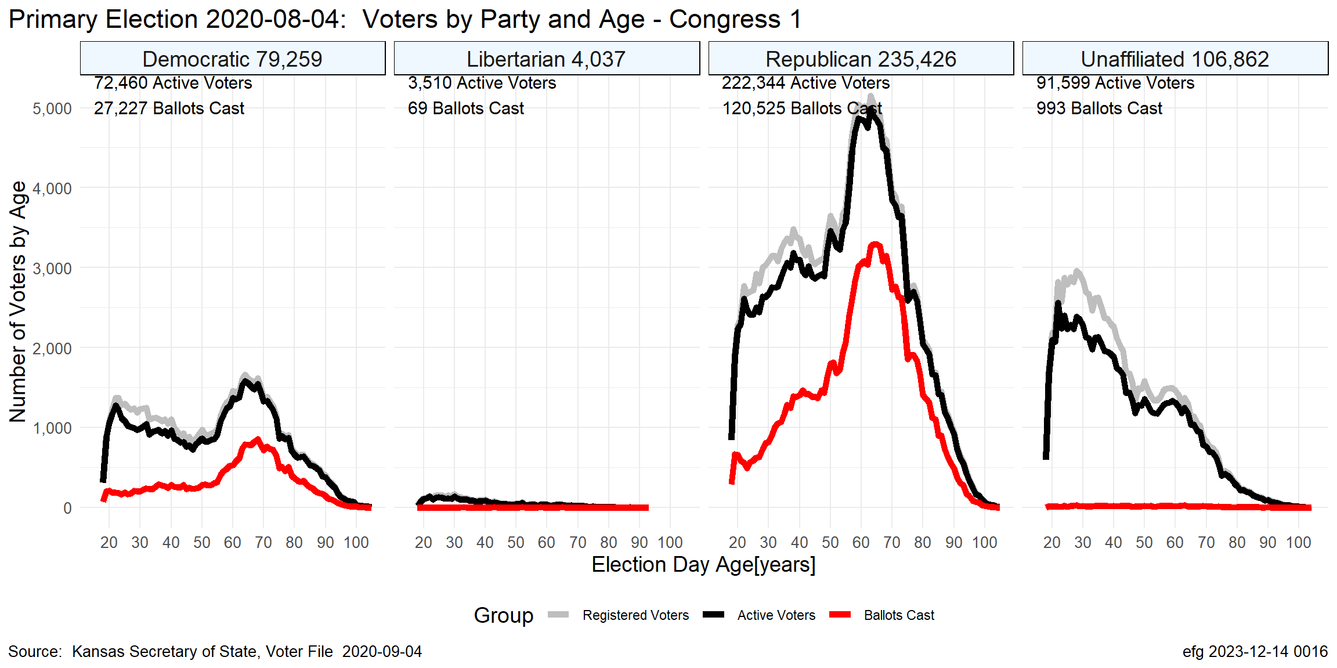
KS-01 Aug. 2020

Slide 22
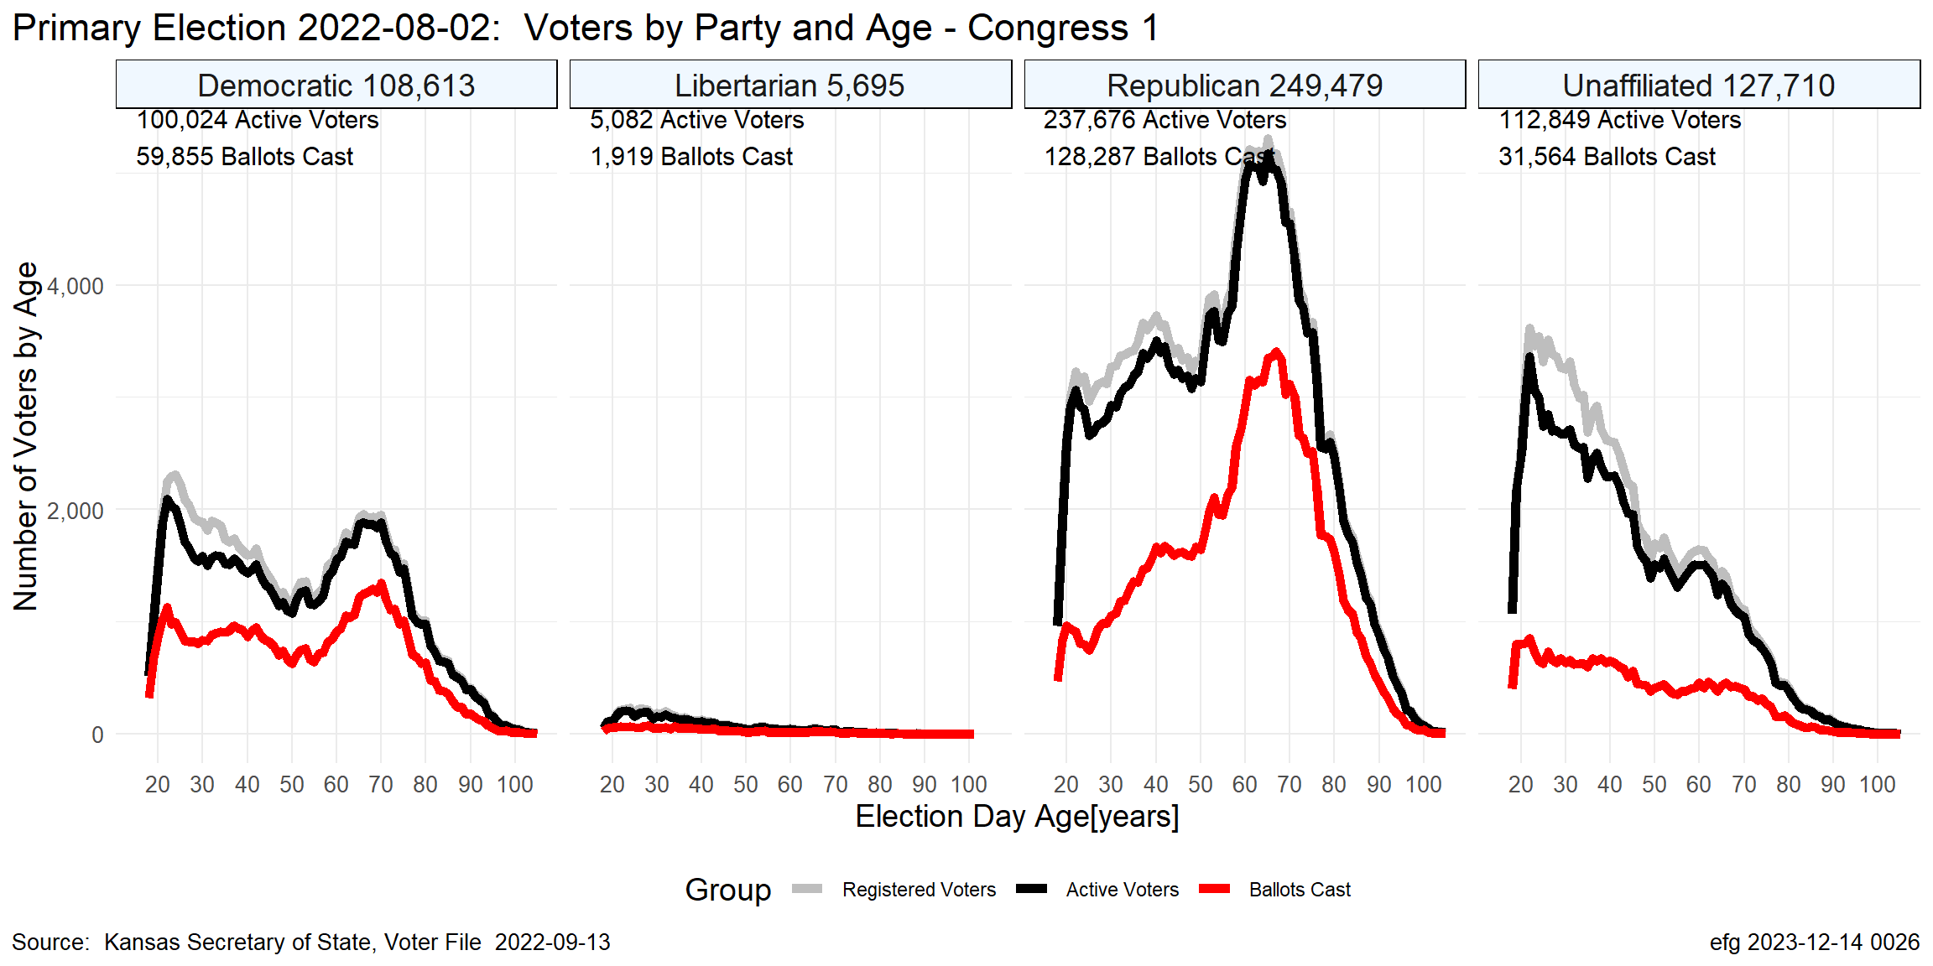
KS-01 Aug. 2022

Slide 23
Questions?
Earl F Glynn
efglynn@gmail.com
Notes:
Slide deck created programatically on 2024-01-20 2356

