Slide 1
Congress KS-04
Voter Registration and Turnout Curves efg 2024-01-20

Slide 2
Table of Contents
New Voter Registration 2016-2023
Election Turnout Curves November General By Party 2016 - 2022
Election Turnout Curves August Primary By Party 2016 - 2022

Slide 3
New Voter Registration 2016-2023

Slide 4
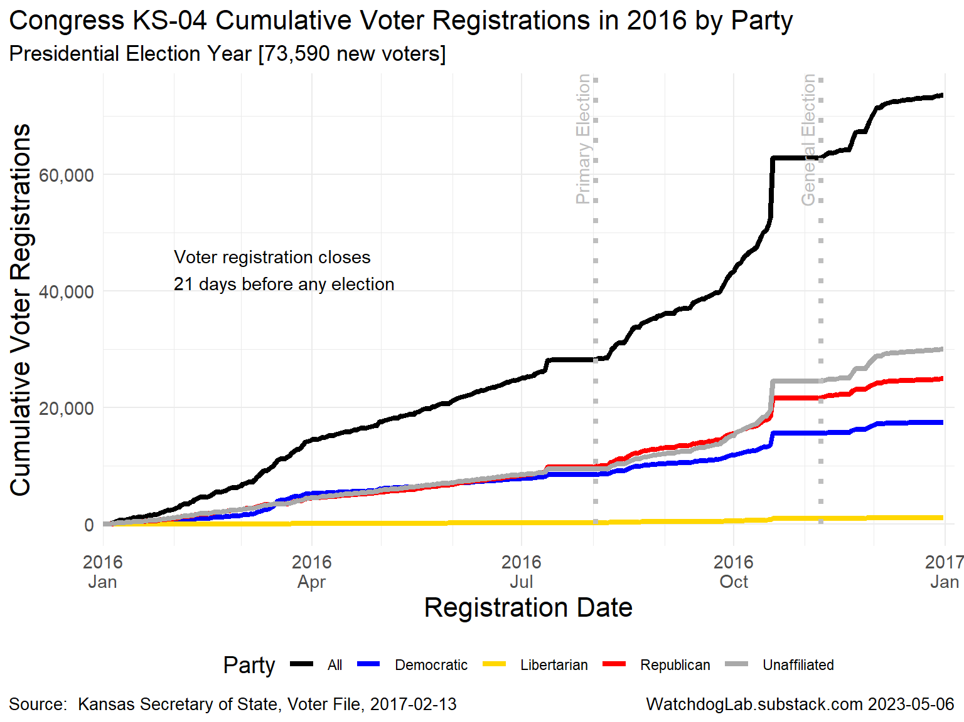
KS-04 2016

Slide 5
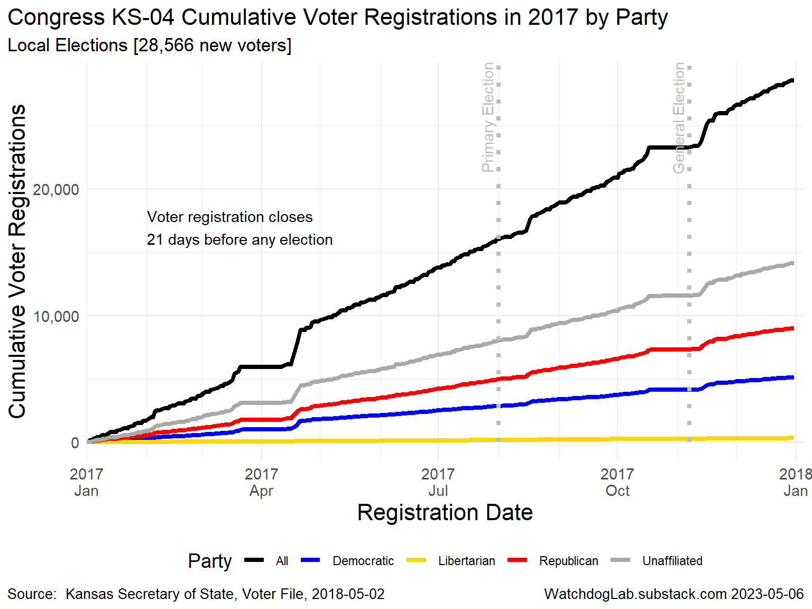
KS-04 2017

Slide 6
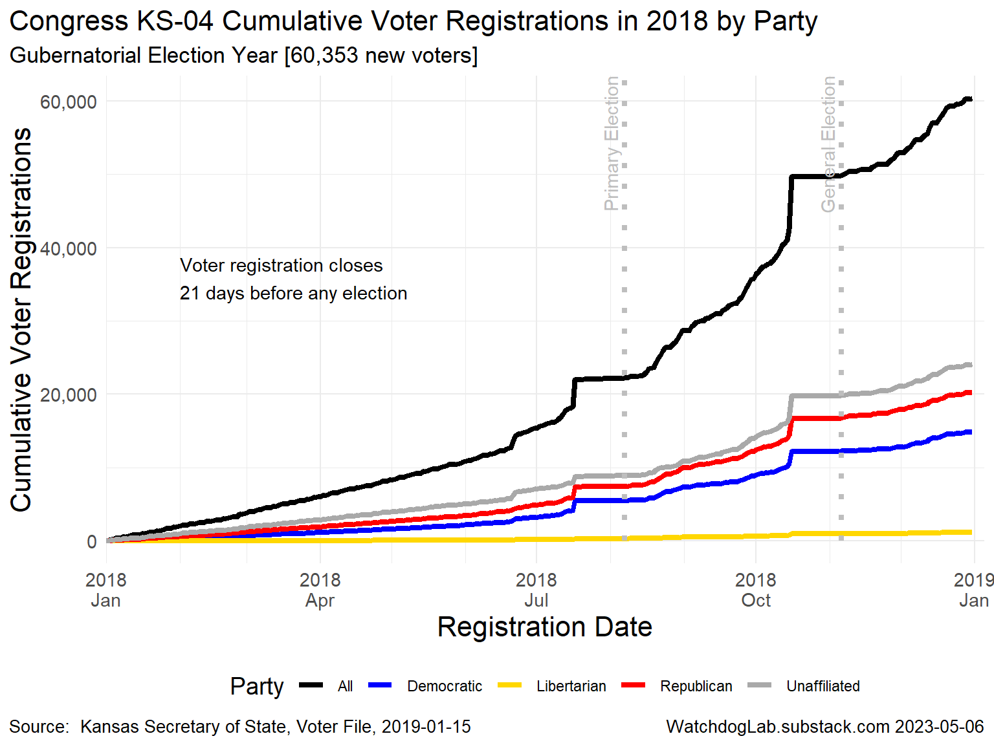
KS-04 2018

Slide 7
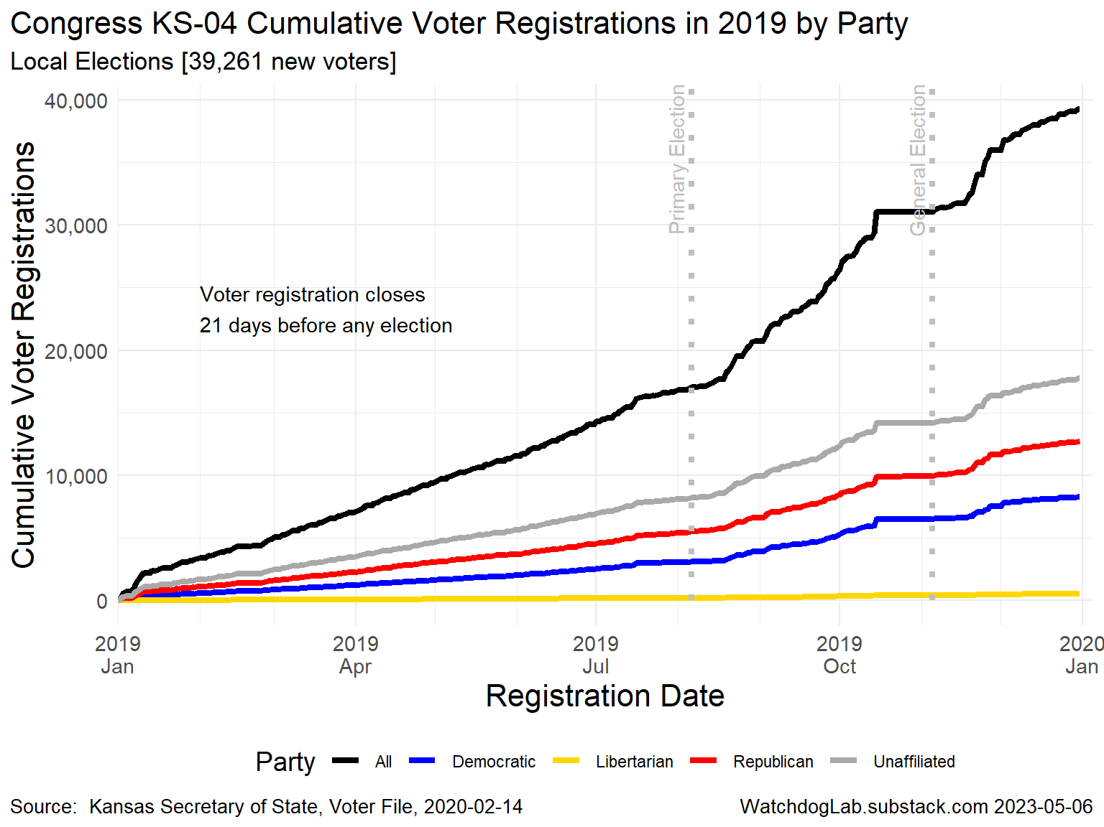
KS-04 2019

Slide 8
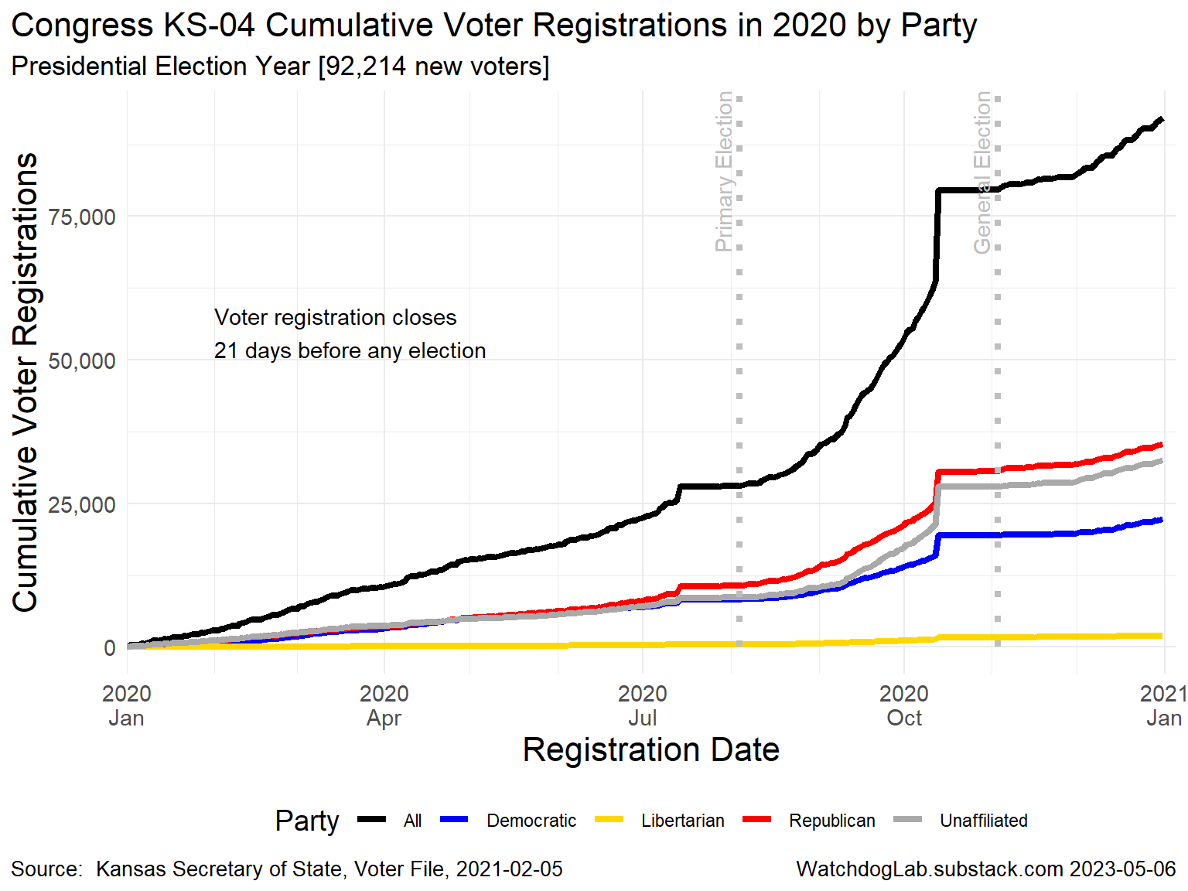
KS-04 2020

Slide 9
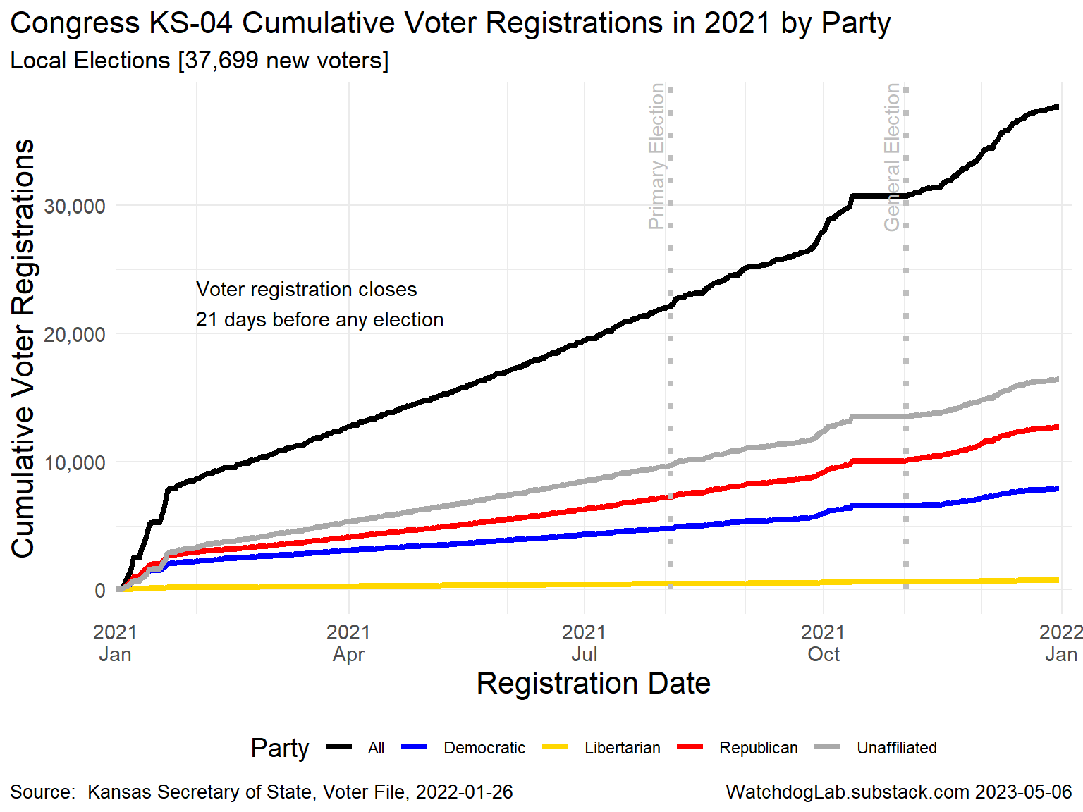
KS-04 2021

Slide 10
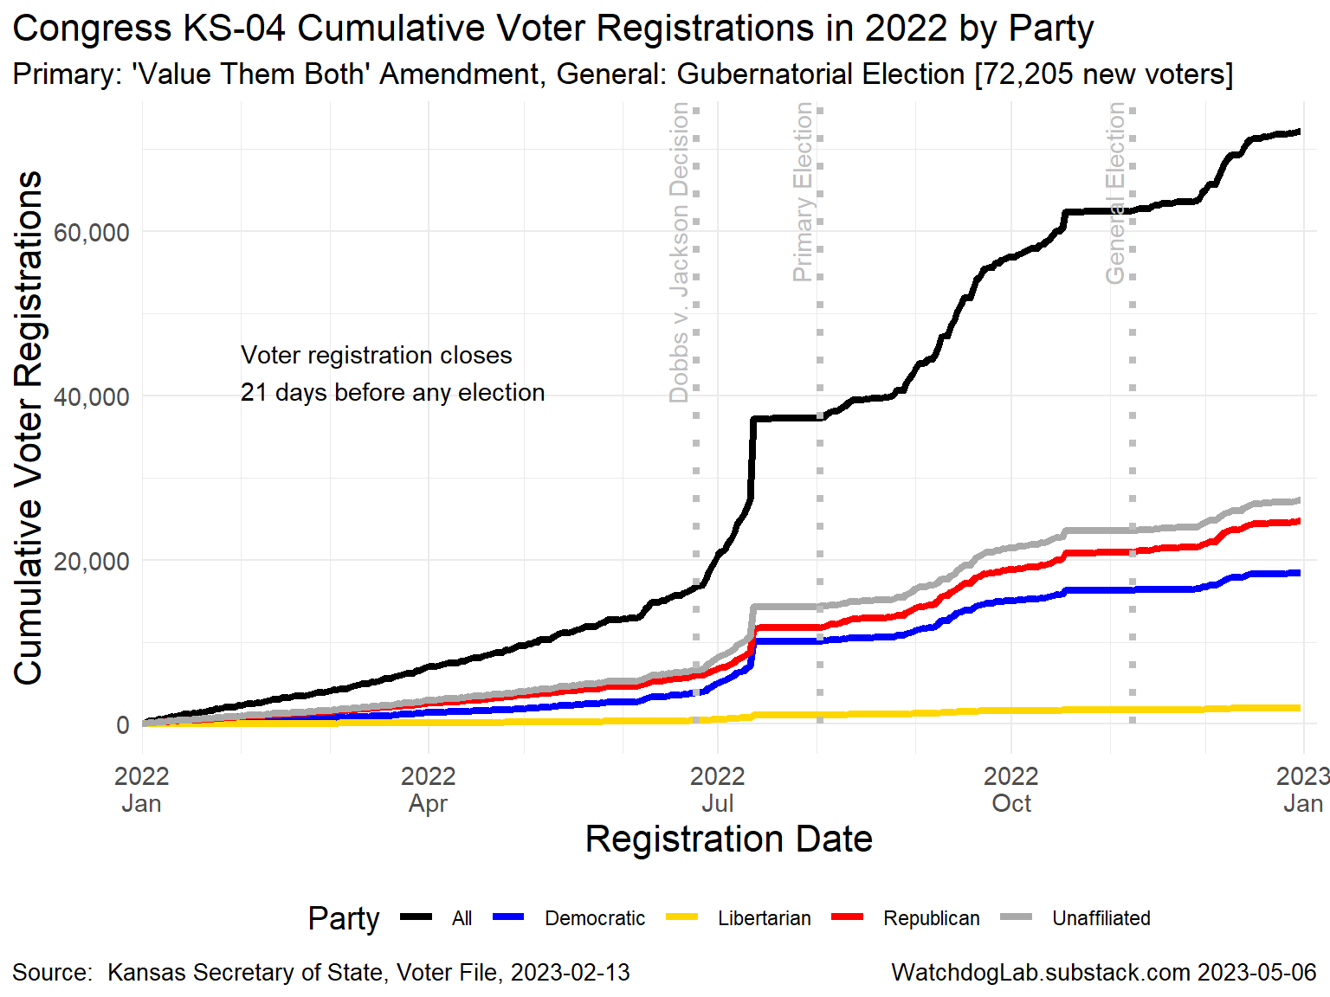
KS-04 2022

Slide 11
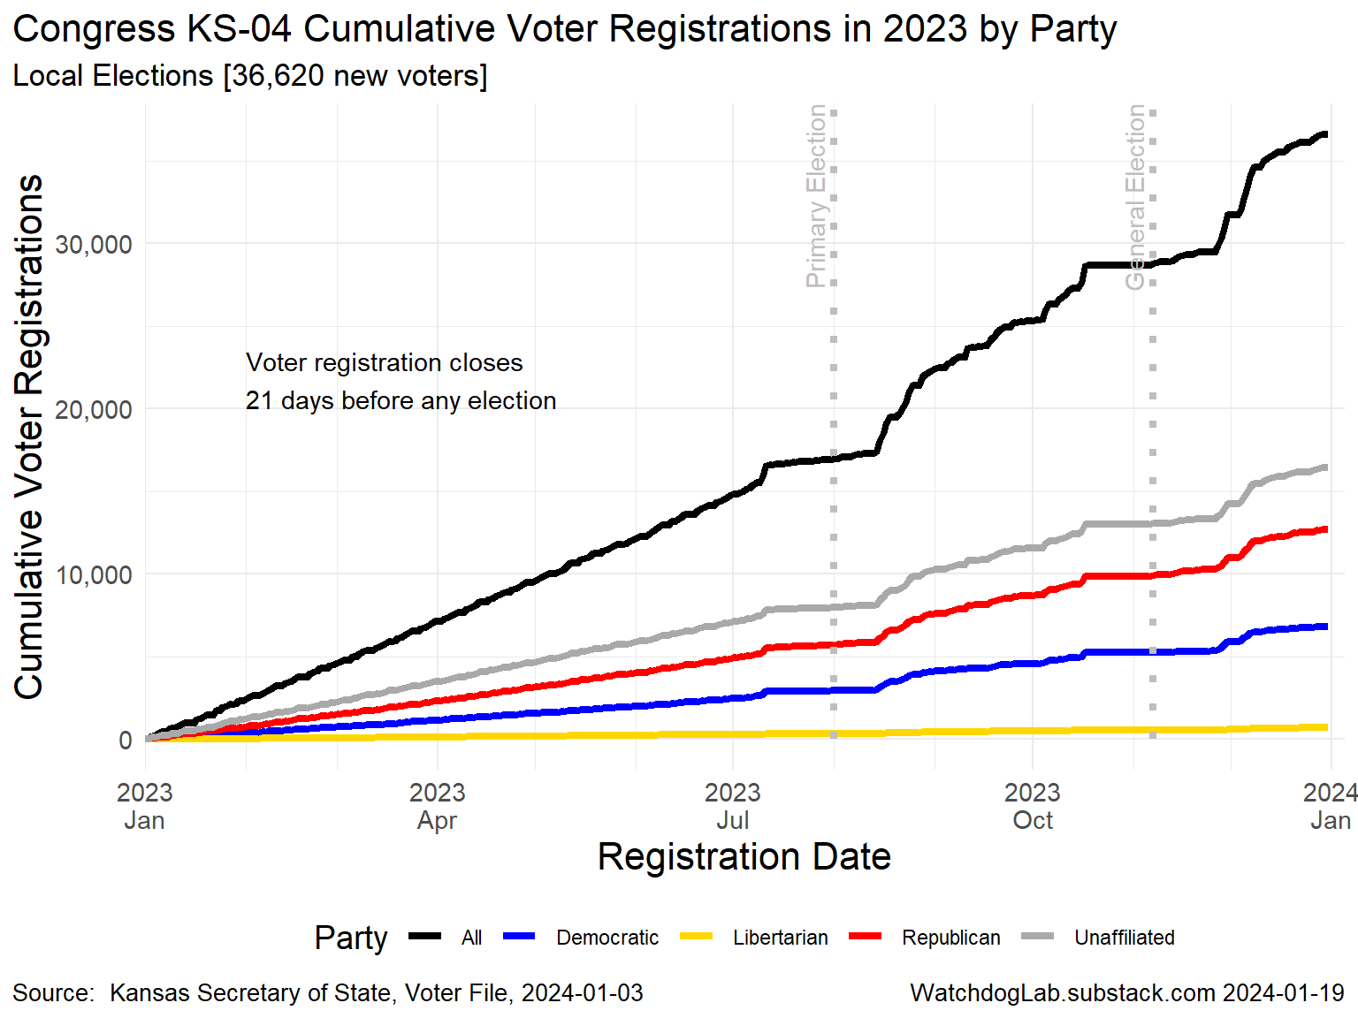
KS-04 2023

Slide 12
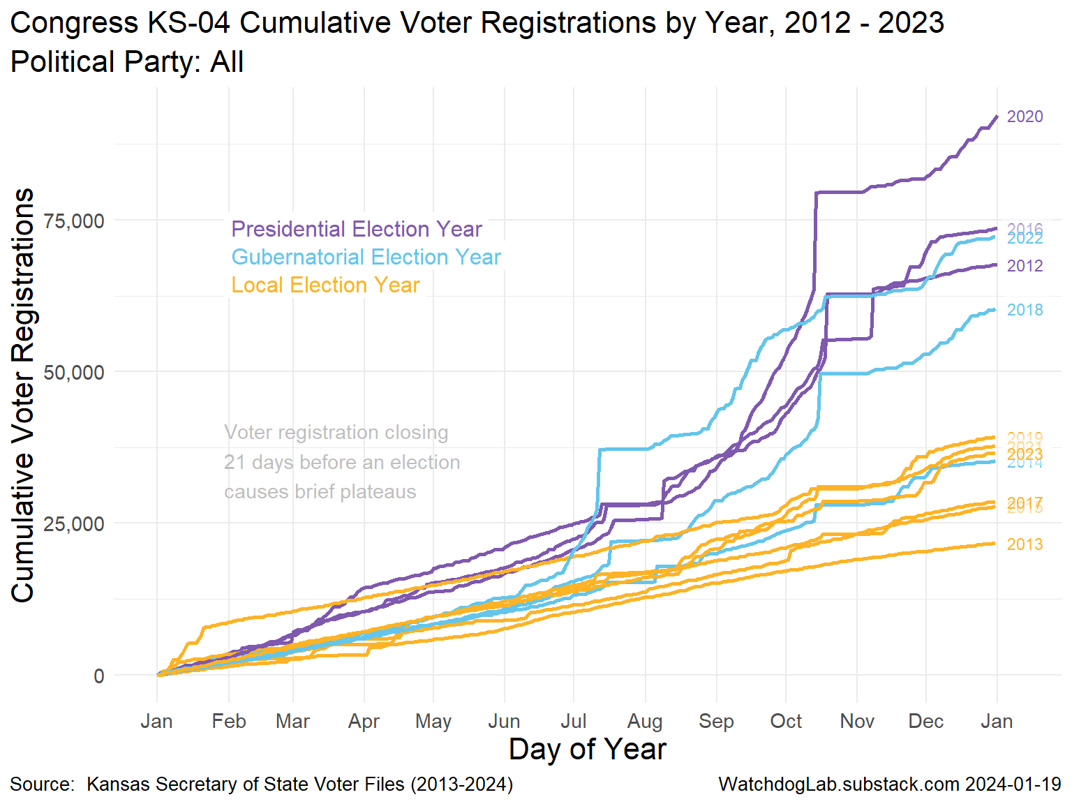
Congress KS-04 Voter Registration 2012-2023

Slide 13
Election Turnout Curves November General By Party 2016 - 2022

Slide 14
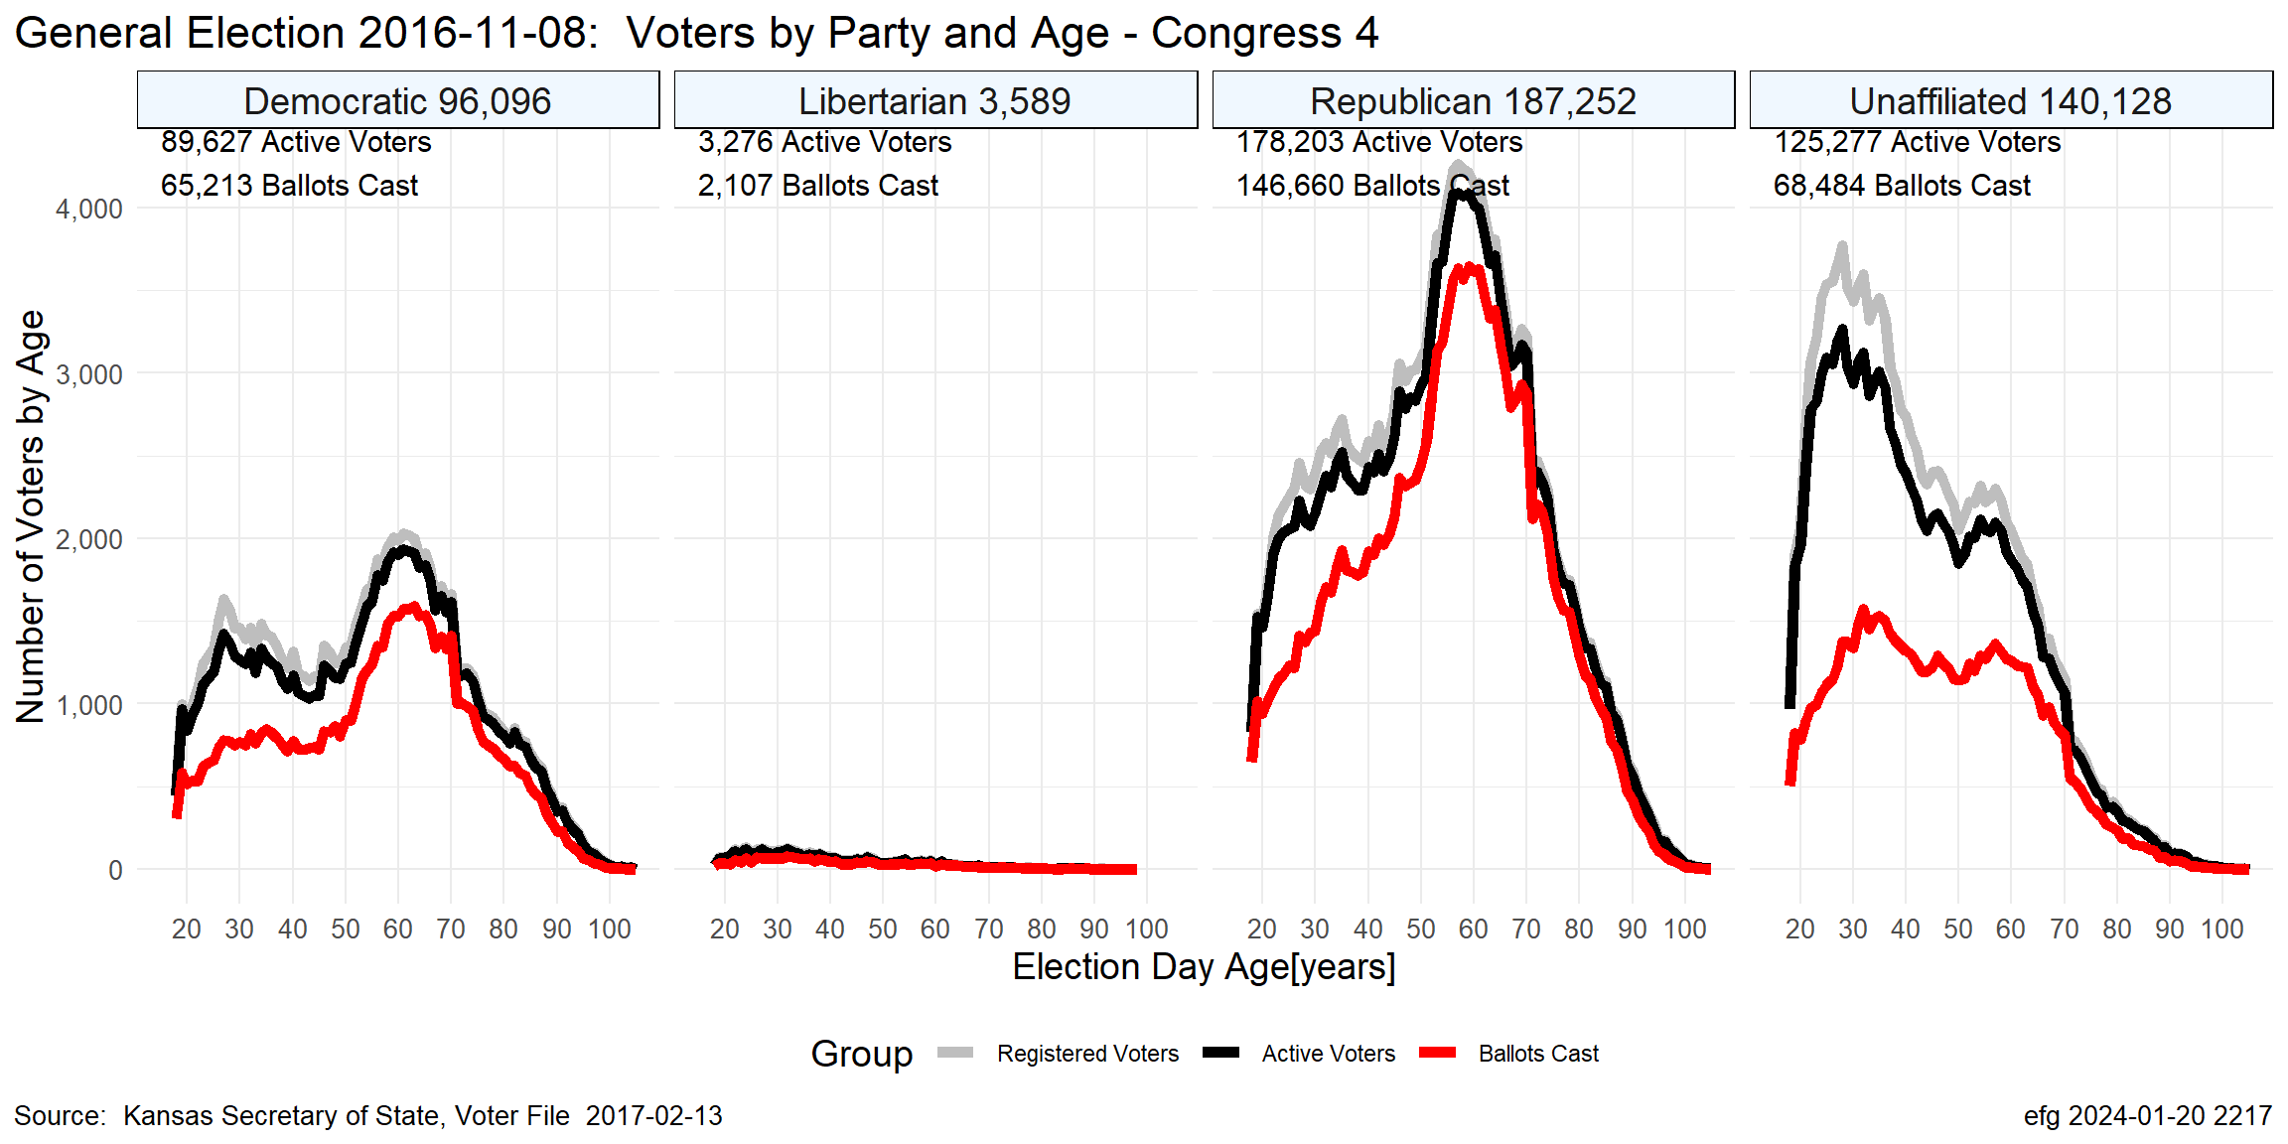
KS-04 Nov. 2016

Slide 15
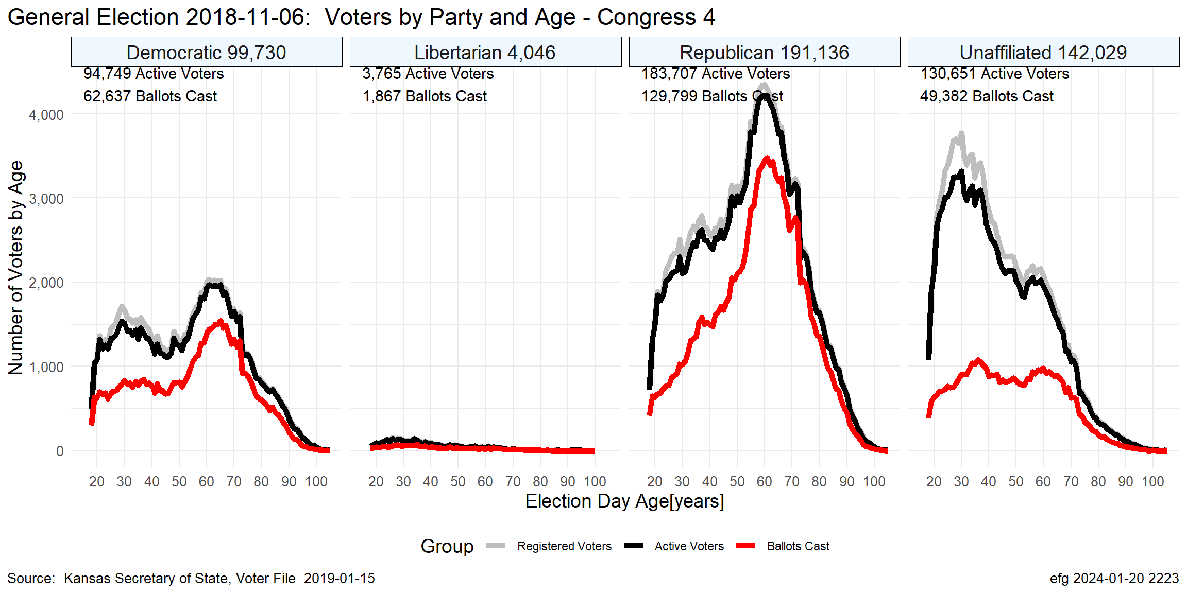
KS-04 Nov. 2018

Slide 16
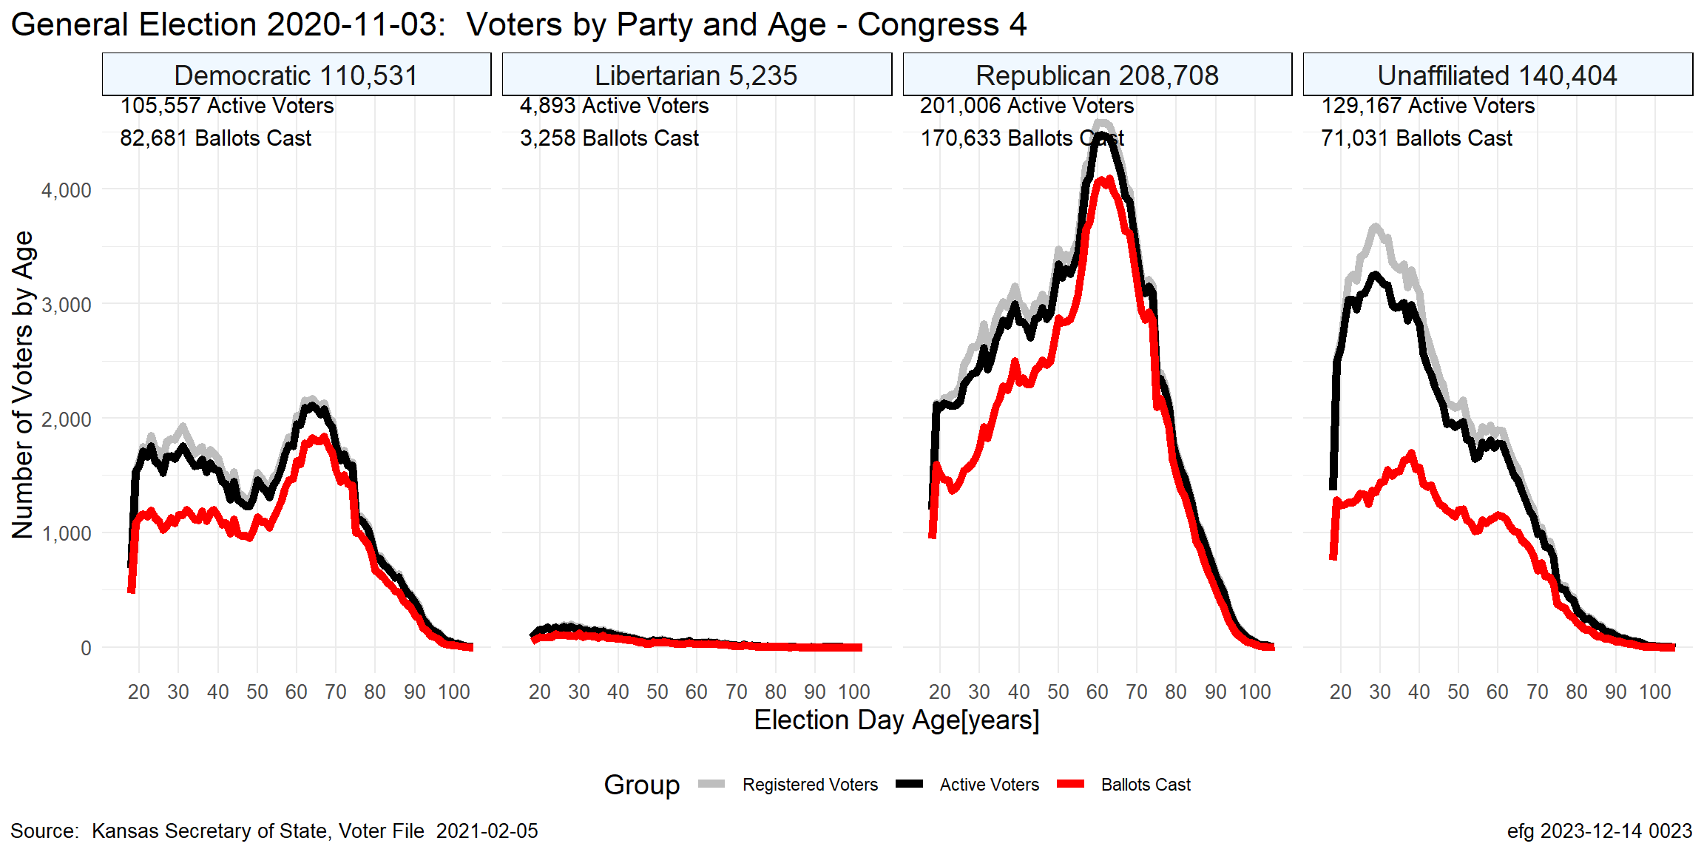
KS-04 Nov. 2020

Slide 17
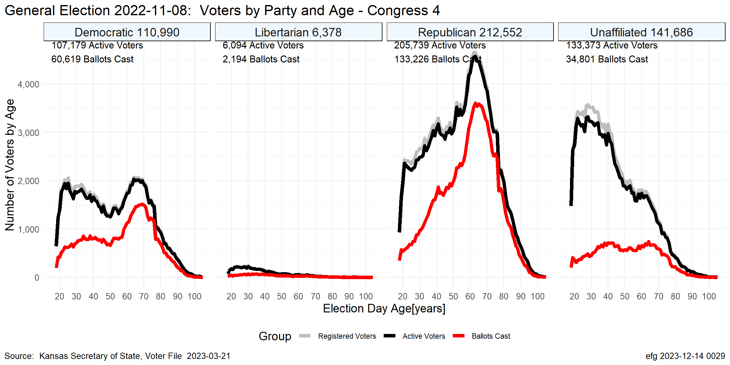
KS-04 Nov. 2022

Slide 18
Election Turnout Curves August Primary By Party 2016 - 2022

Slide 19
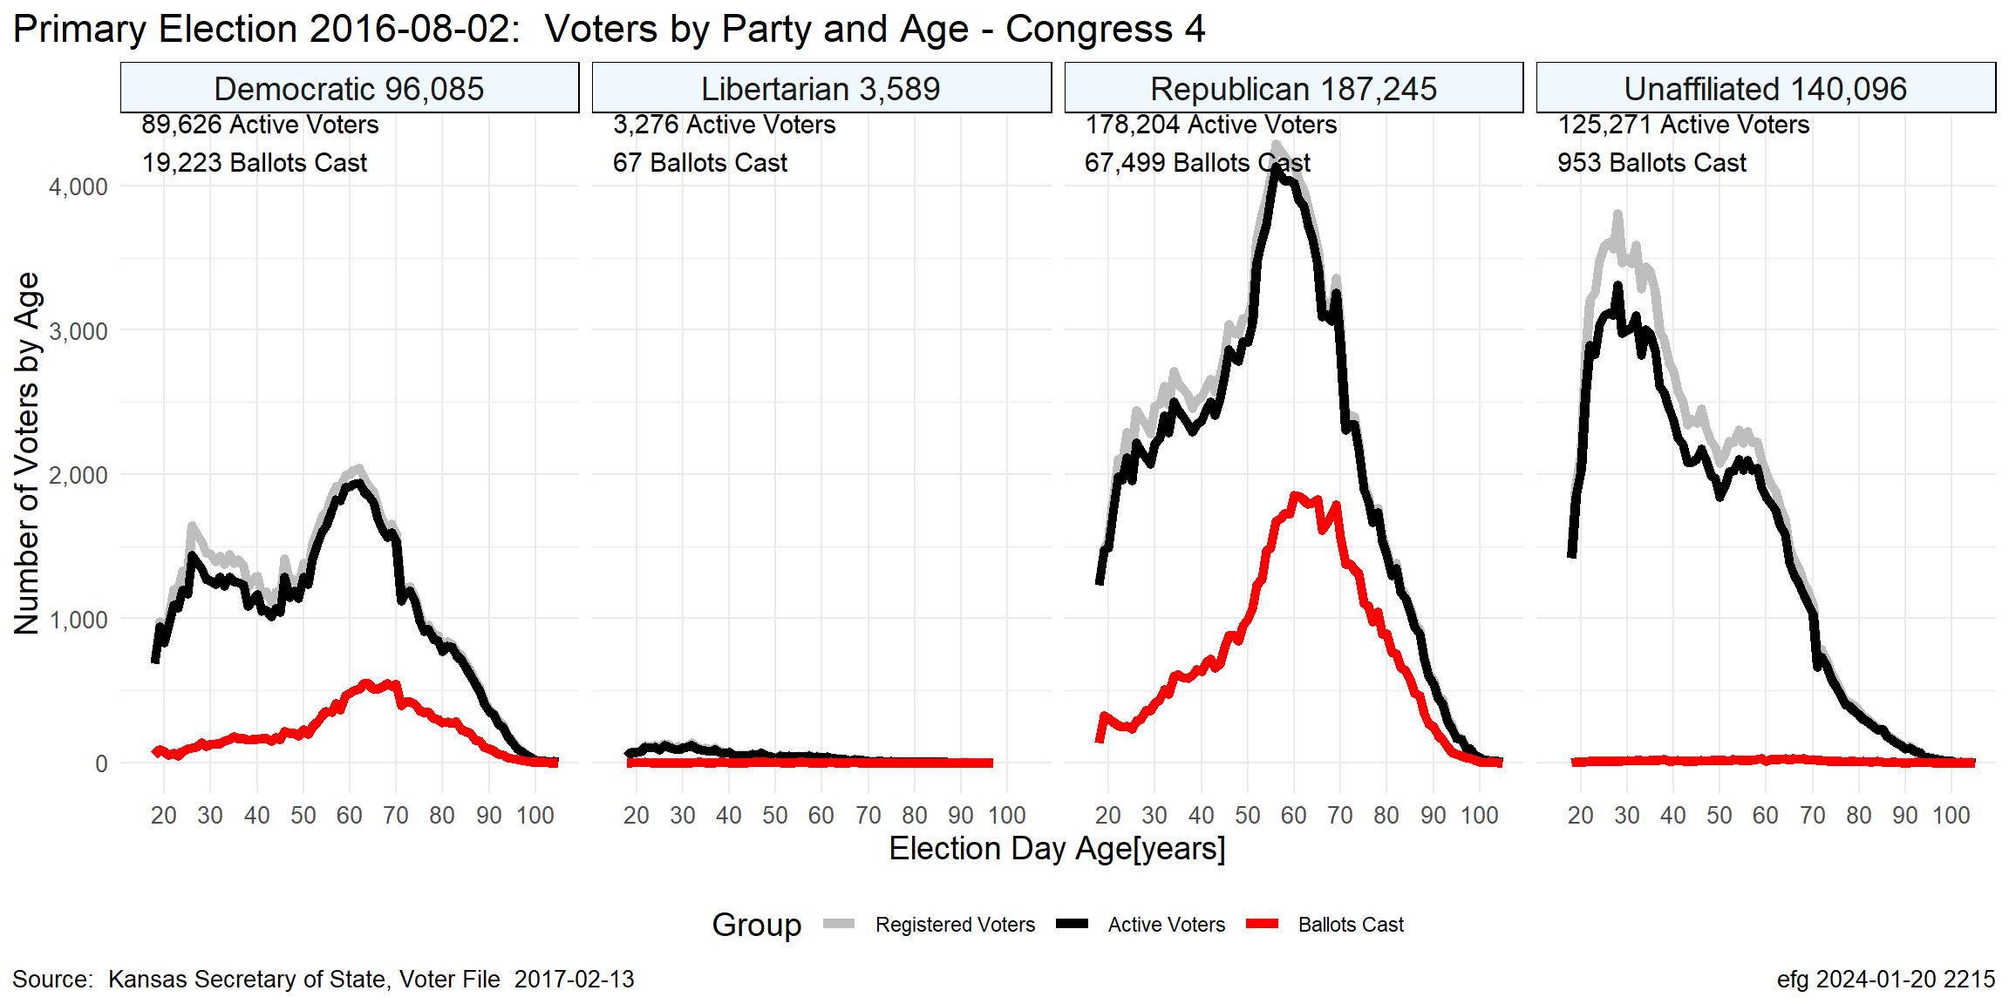
KS-04 Aug. 2016

Slide 20
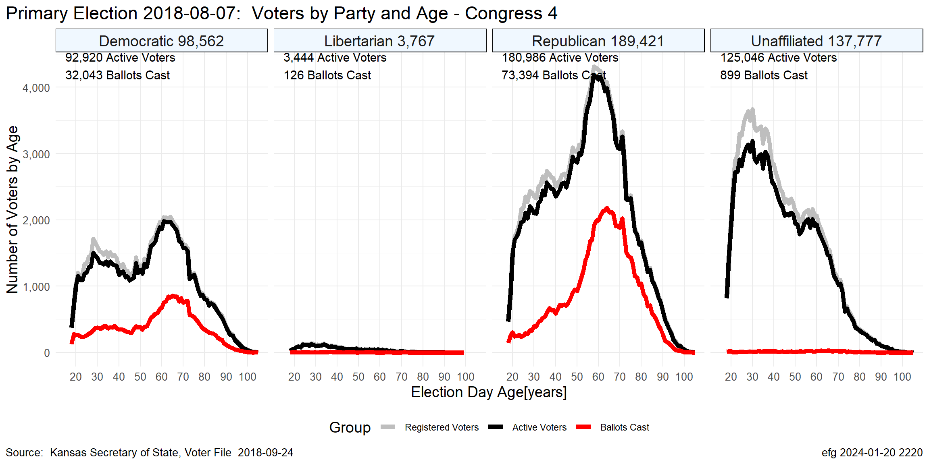
KS-04 Aug. 2018

Slide 21
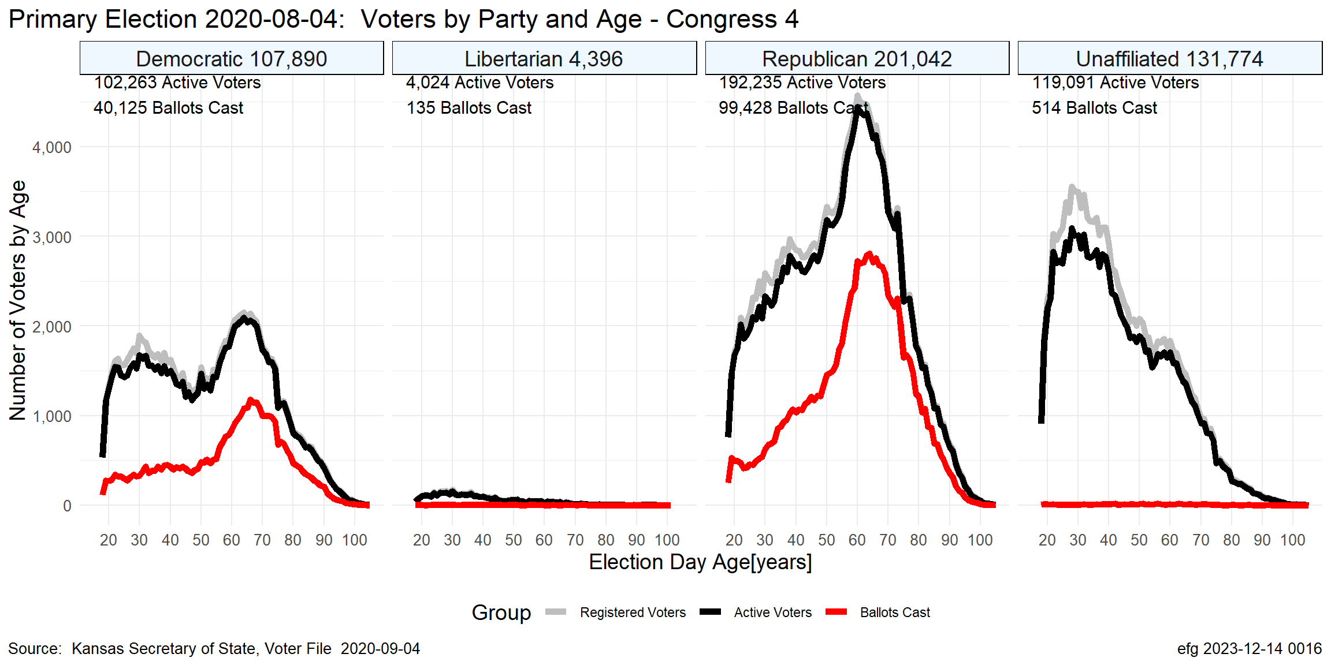
KS-04 Aug. 2020

Slide 22
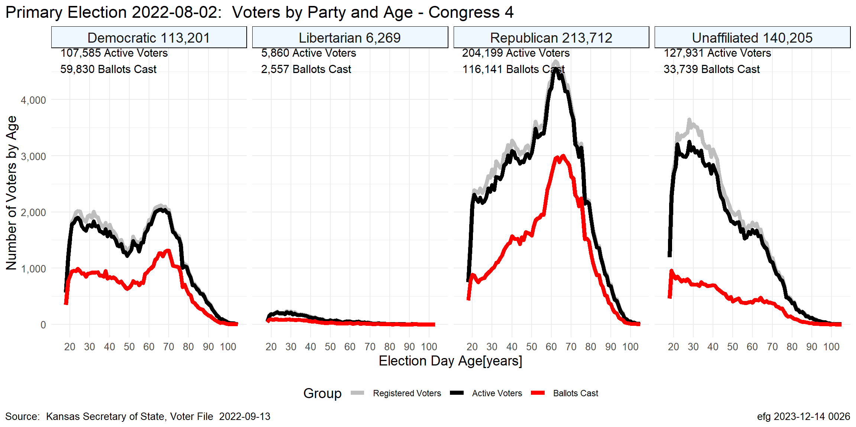
KS-04 Aug. 2022

Slide 23
Questions?
Earl F Glynn
efglynn@gmail.com
Notes:
Slide deck created programatically on 2024-01-20 2356

