Slide 1
Leavenworth County
Voter Registration and Turnout Curves efg 2024-01-20

Slide 2
Table of Contents
New Voter Registration 2016-2023
Election Turnout Curves November General By Party 2016 - 2022
Election Turnout Curves August Primary By Party 2016 - 2022

Slide 3
New Voter Registration 2016-2023

Slide 4
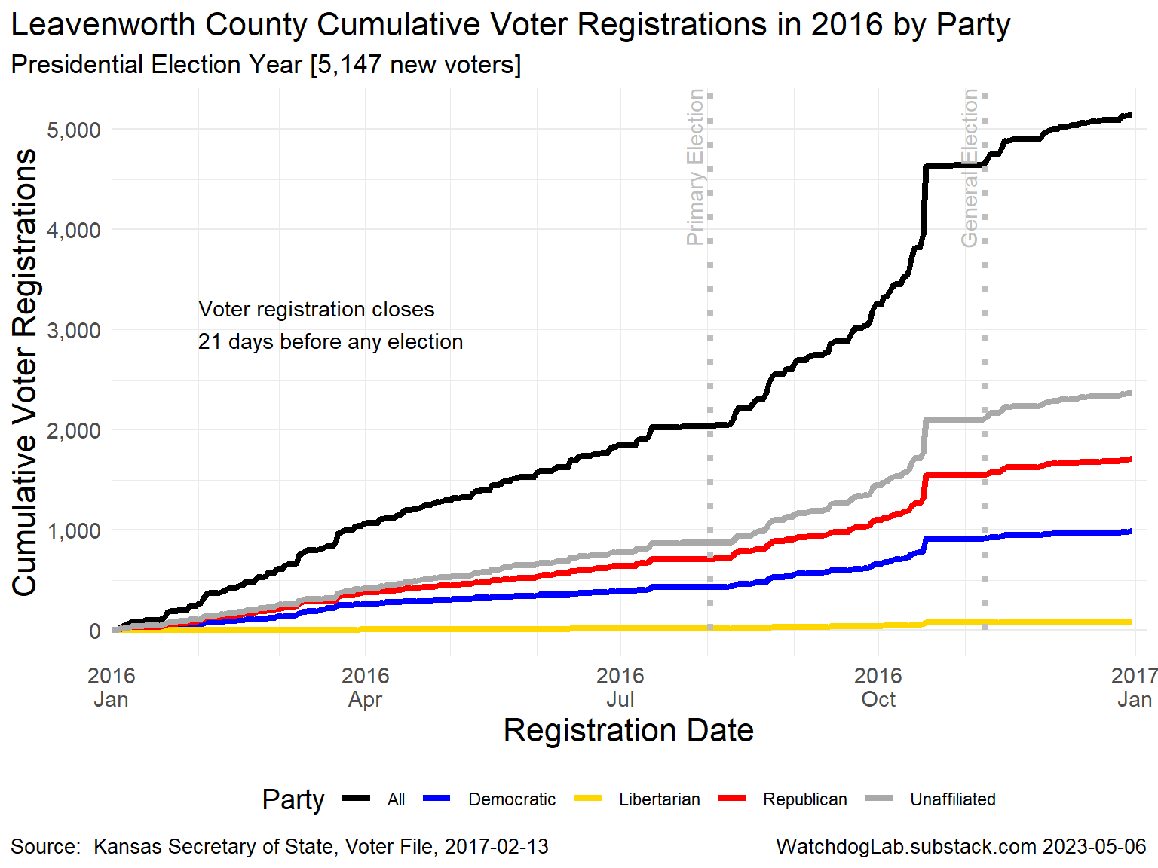
LV 2016

Slide 5
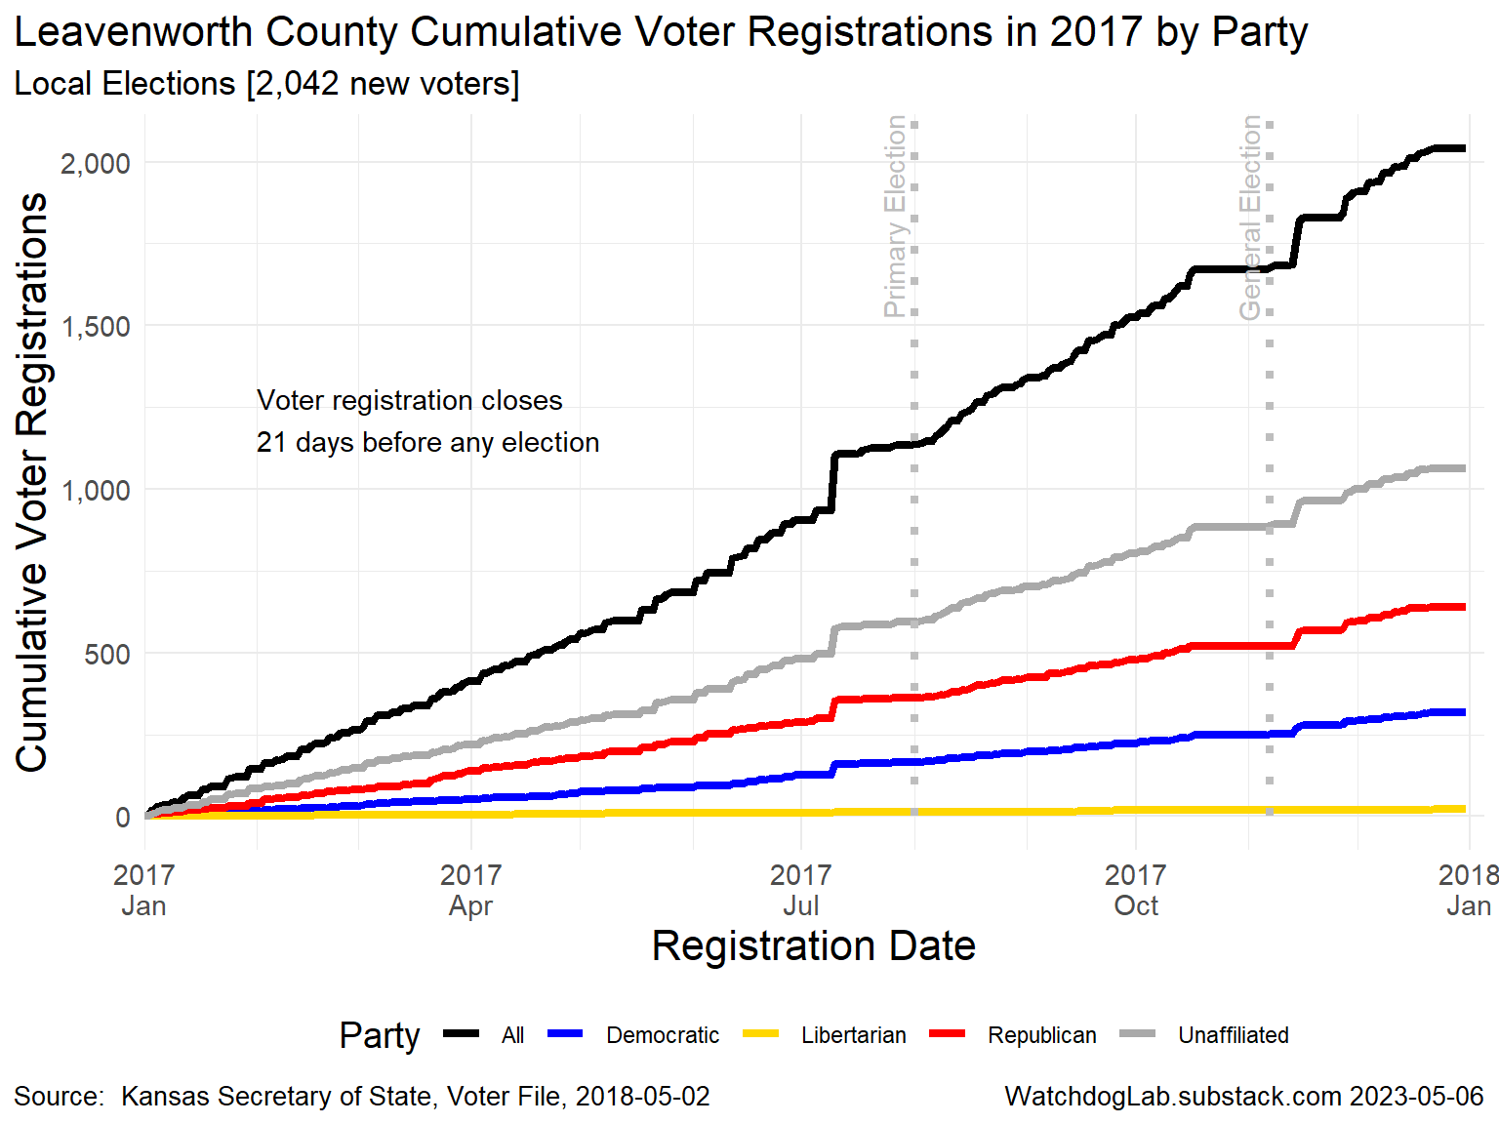
LV 2017

Slide 6
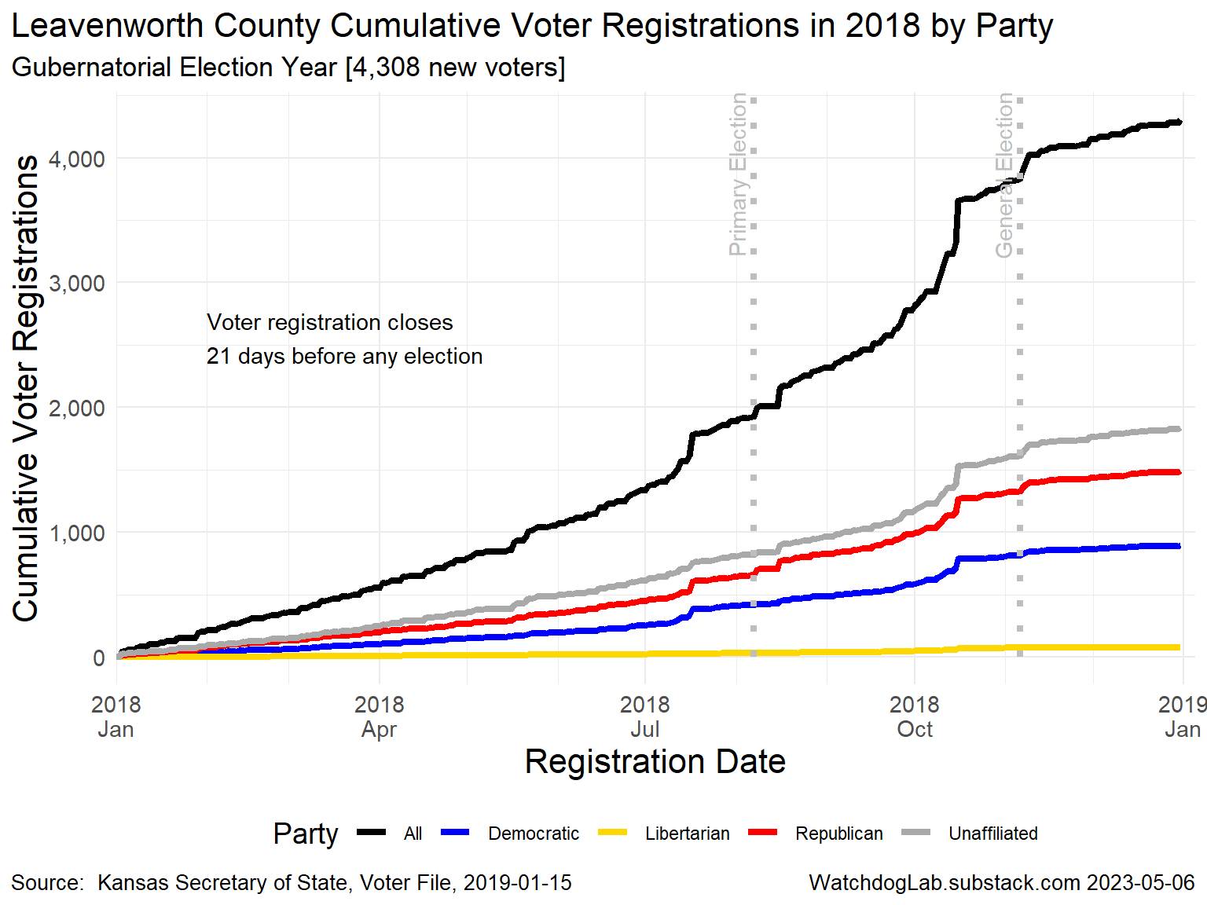
LV 2018

Slide 7
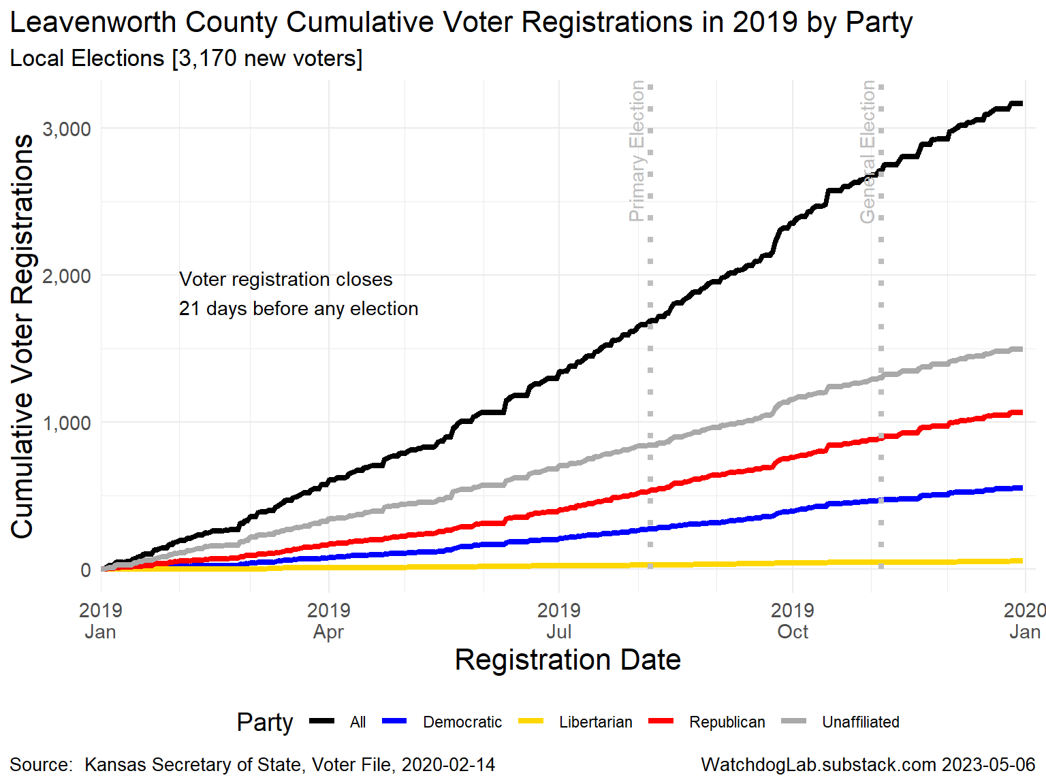
LV 2019

Slide 8
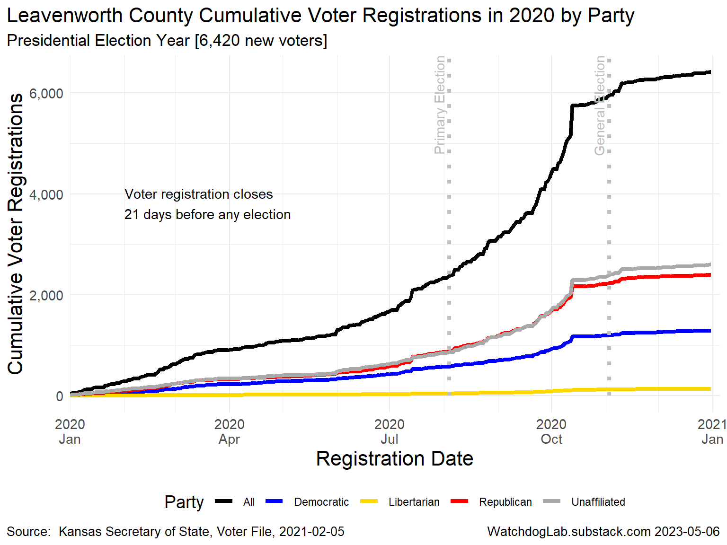
LV 2020

Slide 9
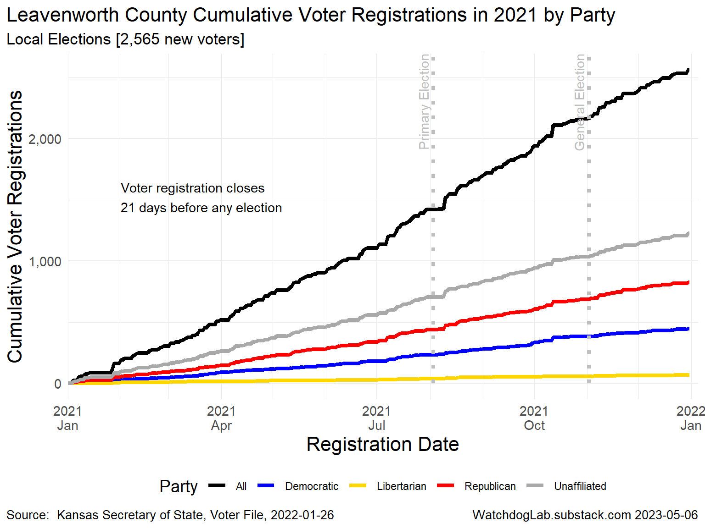
LV 2021

Slide 10
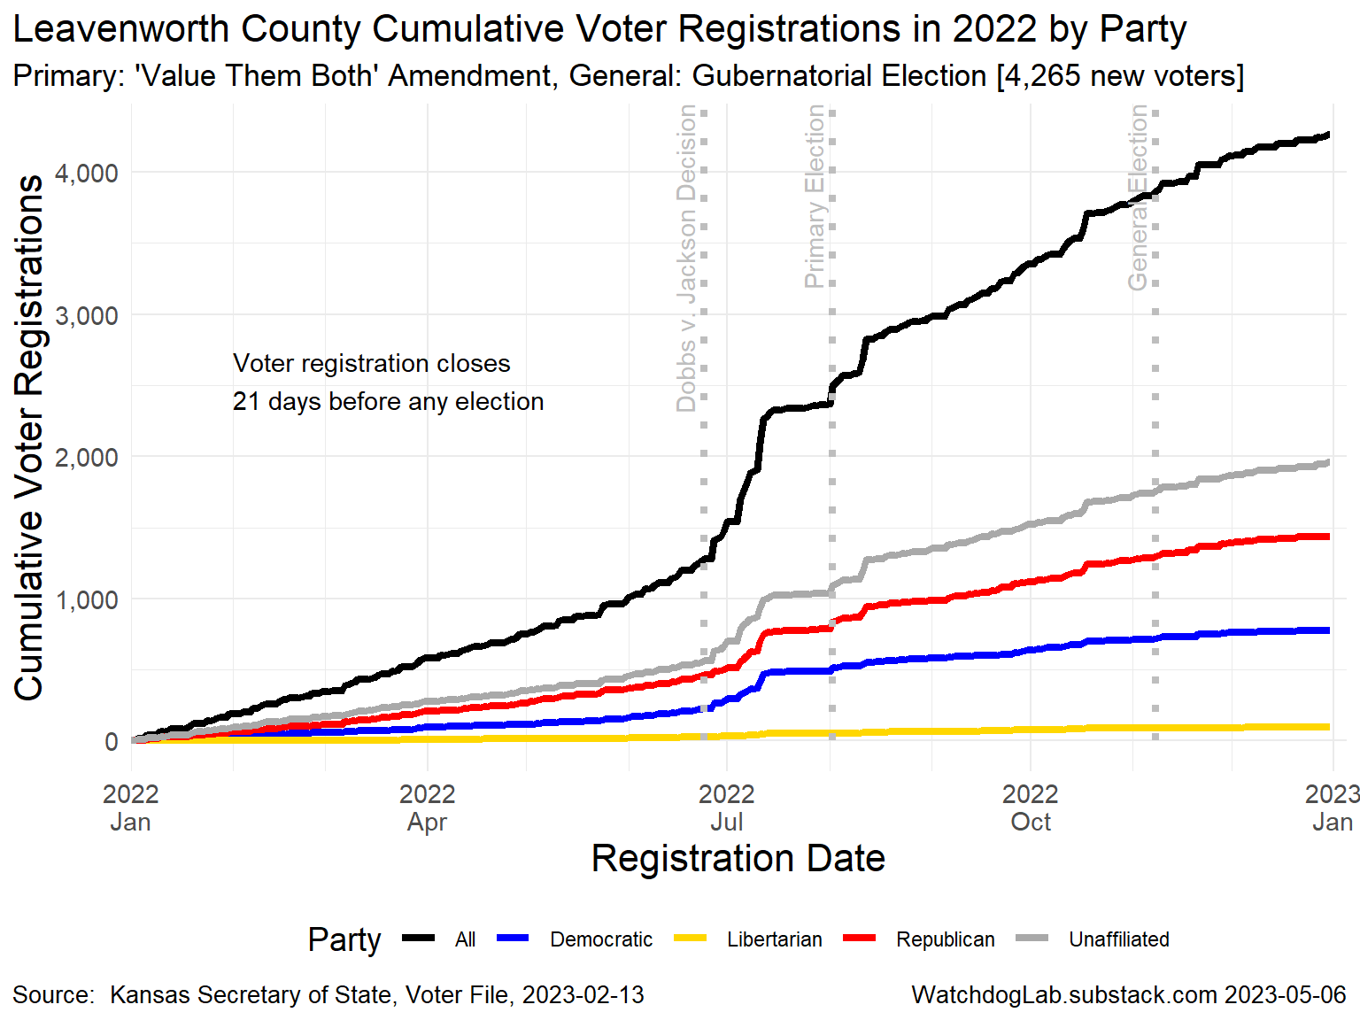
LV 2022

Slide 11
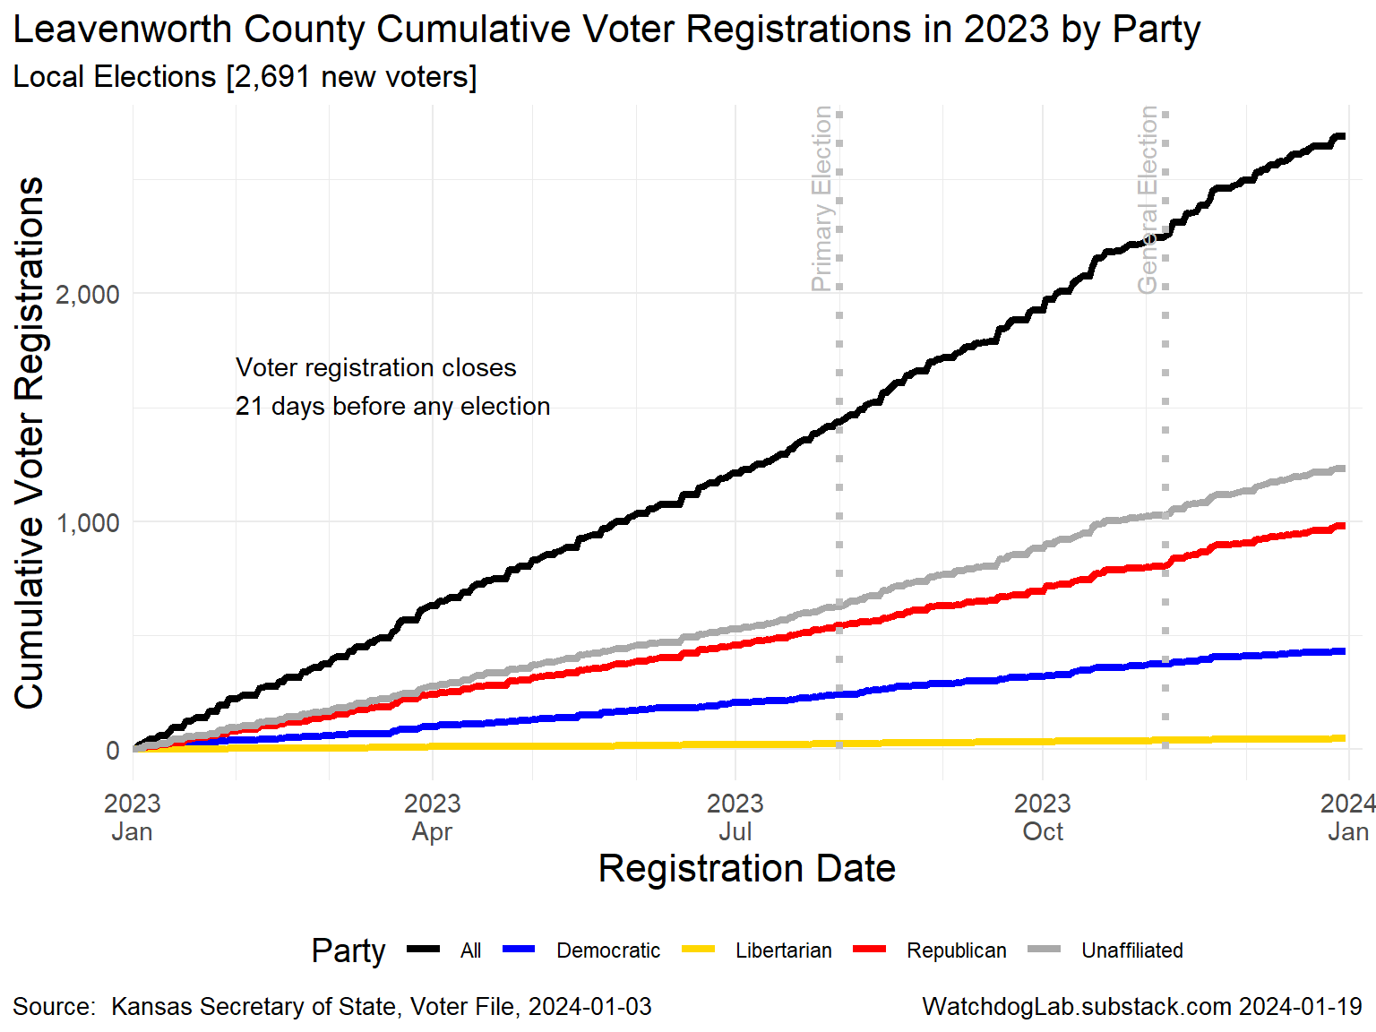
LV 2023

Slide 12
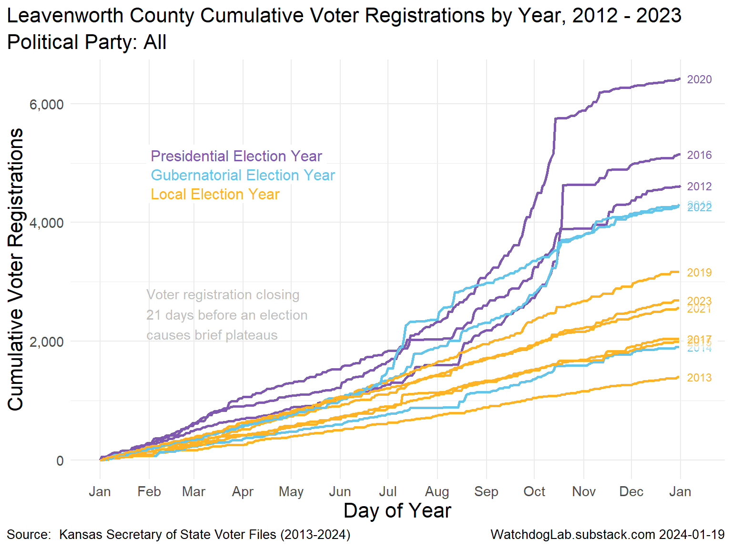
Leavenworth County Voter Registration 2012-2023

Slide 13
Election Turnout Curves November General By Party 2016 - 2022

Slide 14
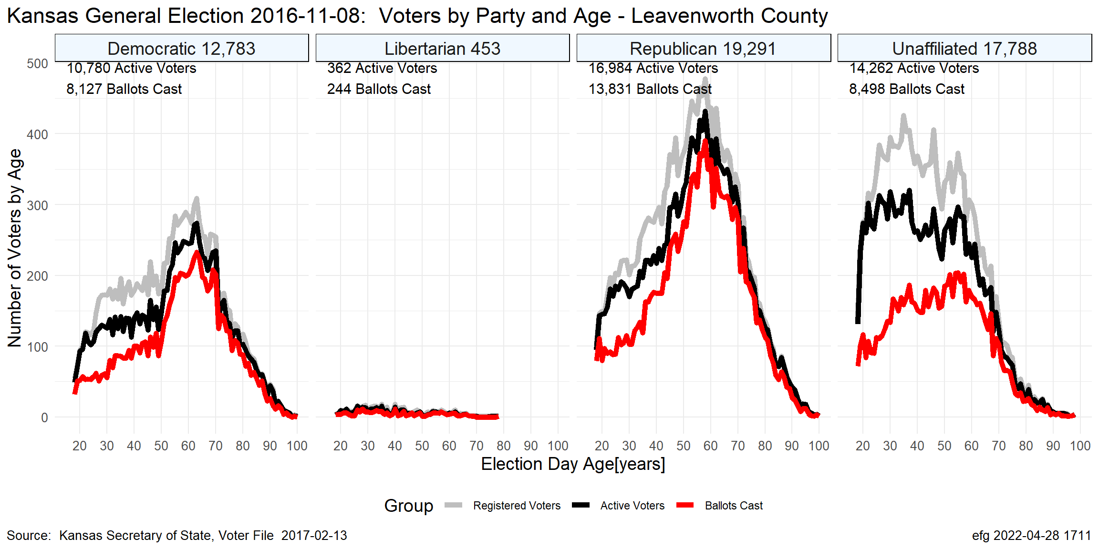
LV Nov. 2016

Slide 15
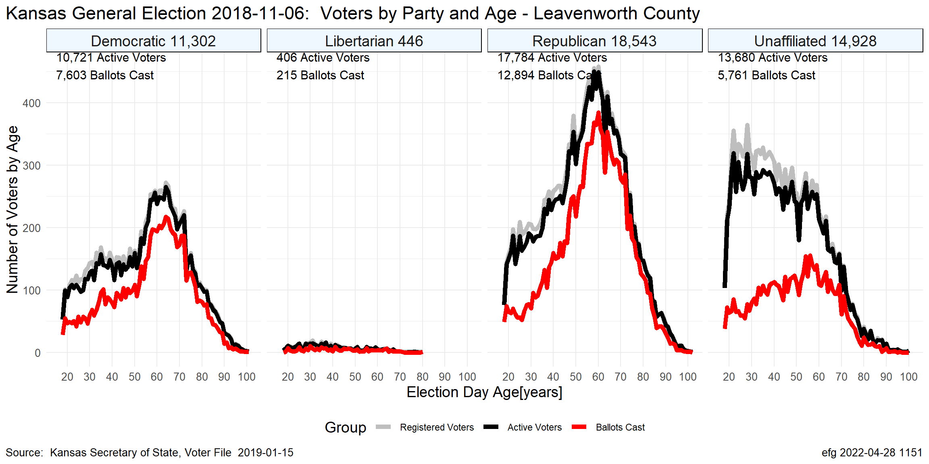
LV Nov. 2018

Slide 16
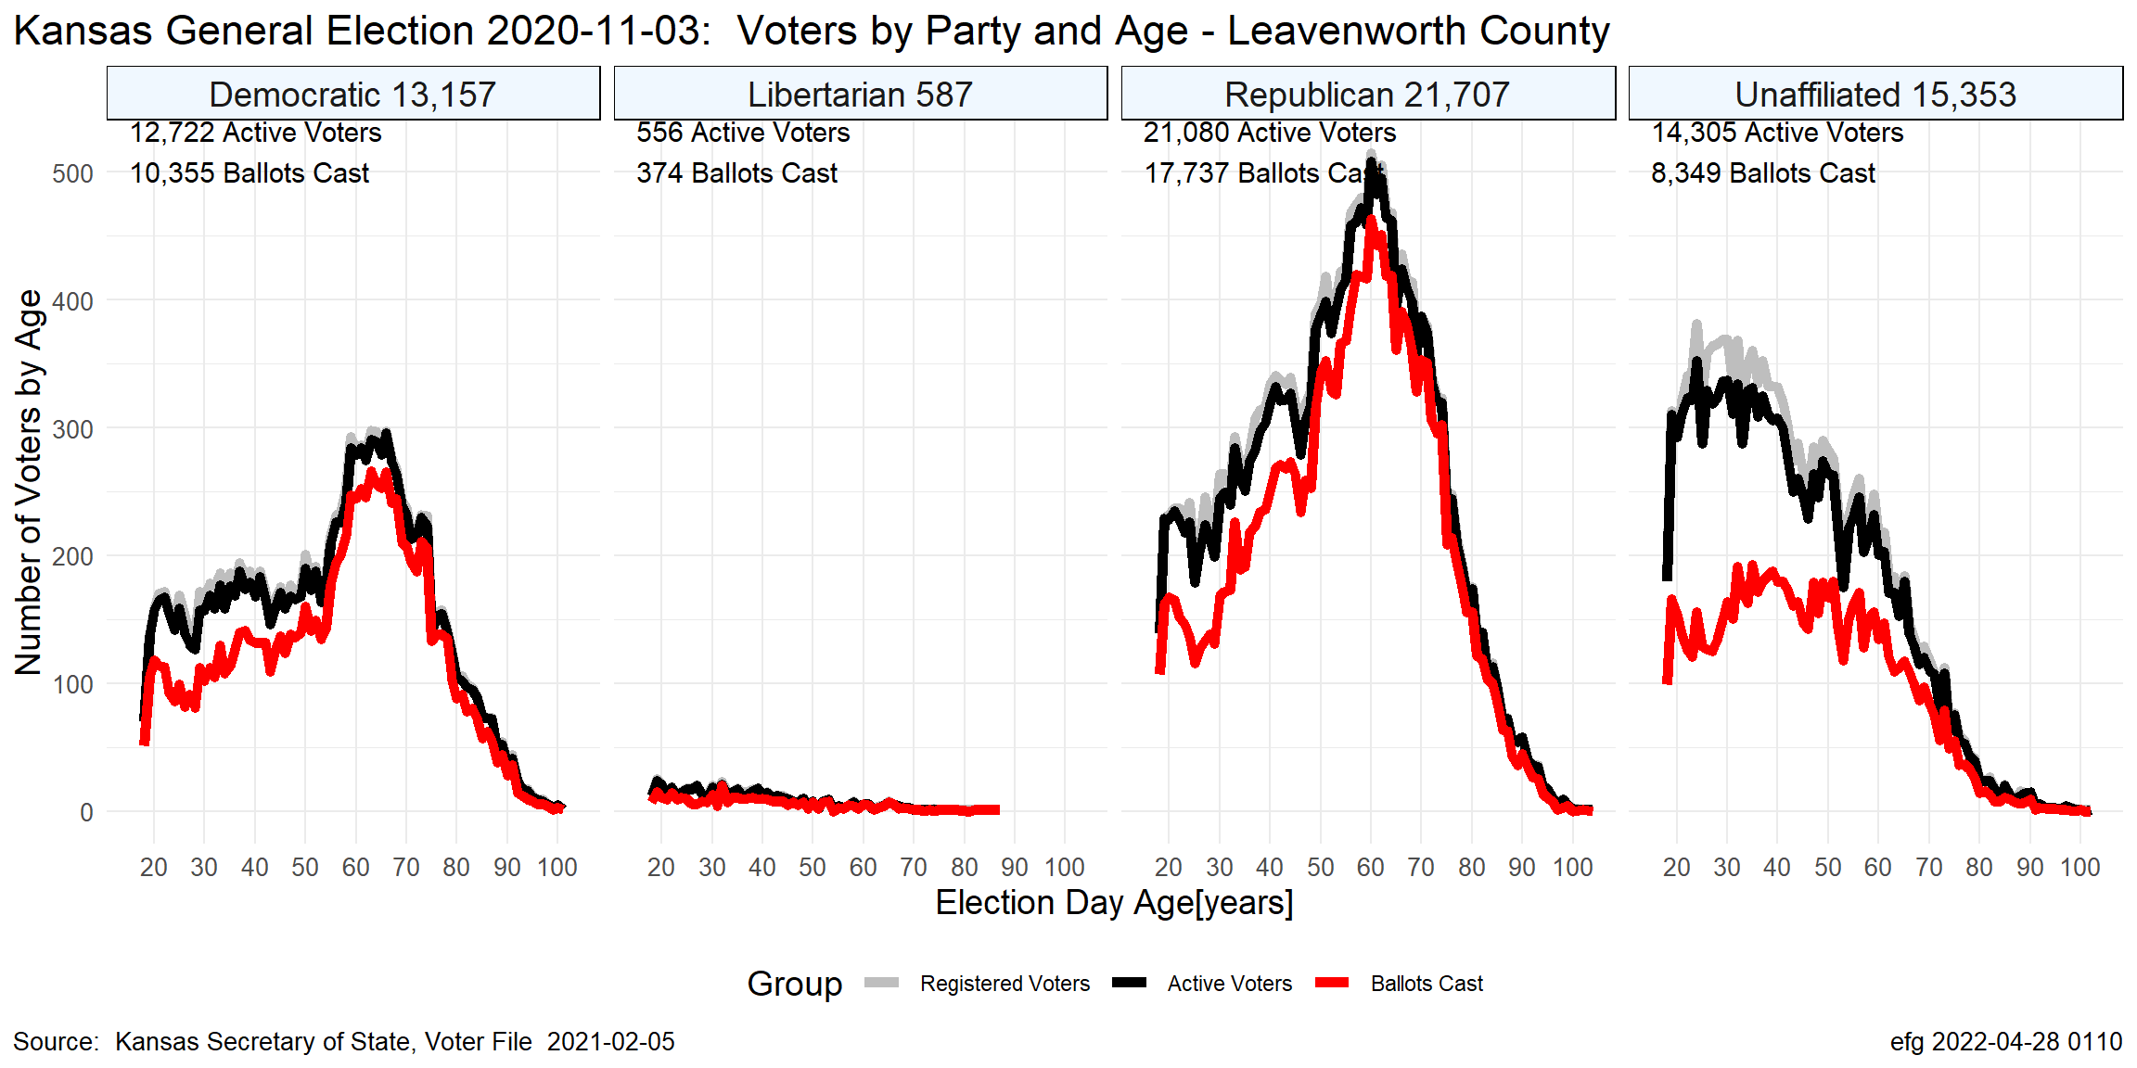
LV Nov. 2020

Slide 17
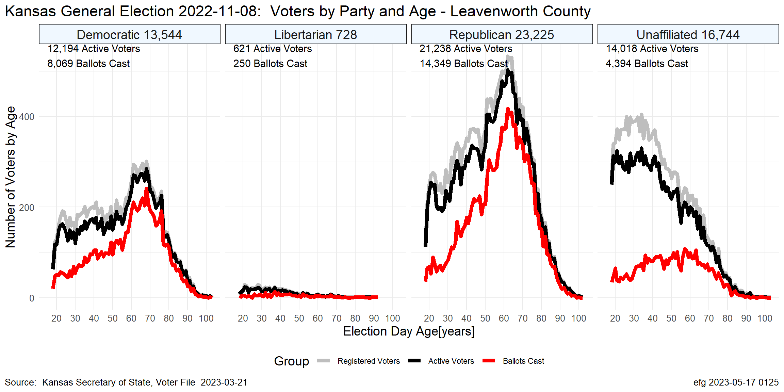
LV Nov. 2022

Slide 18
Election Turnout Curves August Primary By Party 2016 - 2022

Slide 19
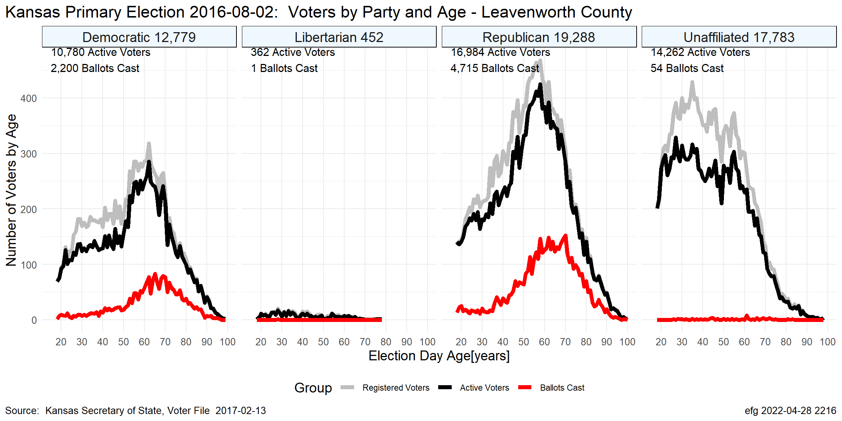
LV Aug. 2016

Slide 20
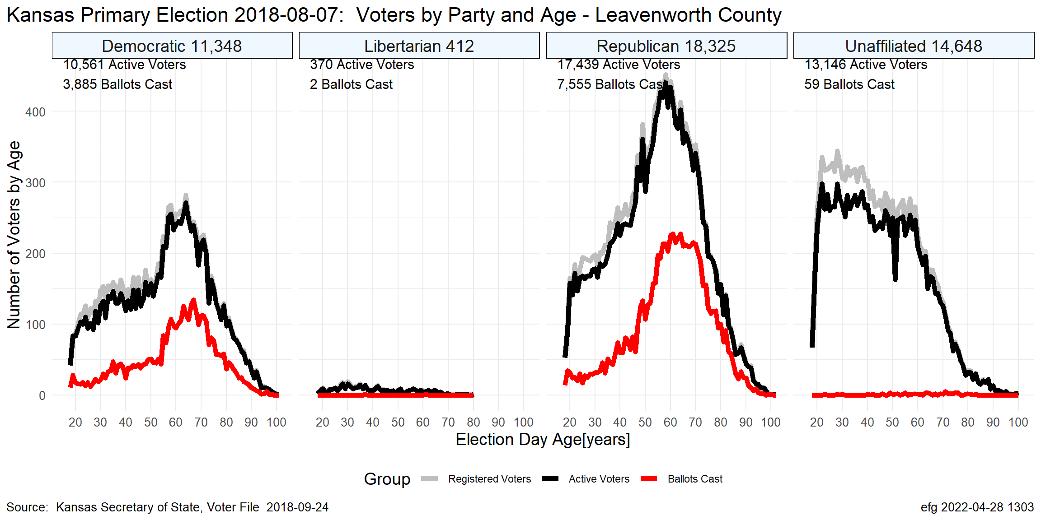
LV Aug. 2018

Slide 21
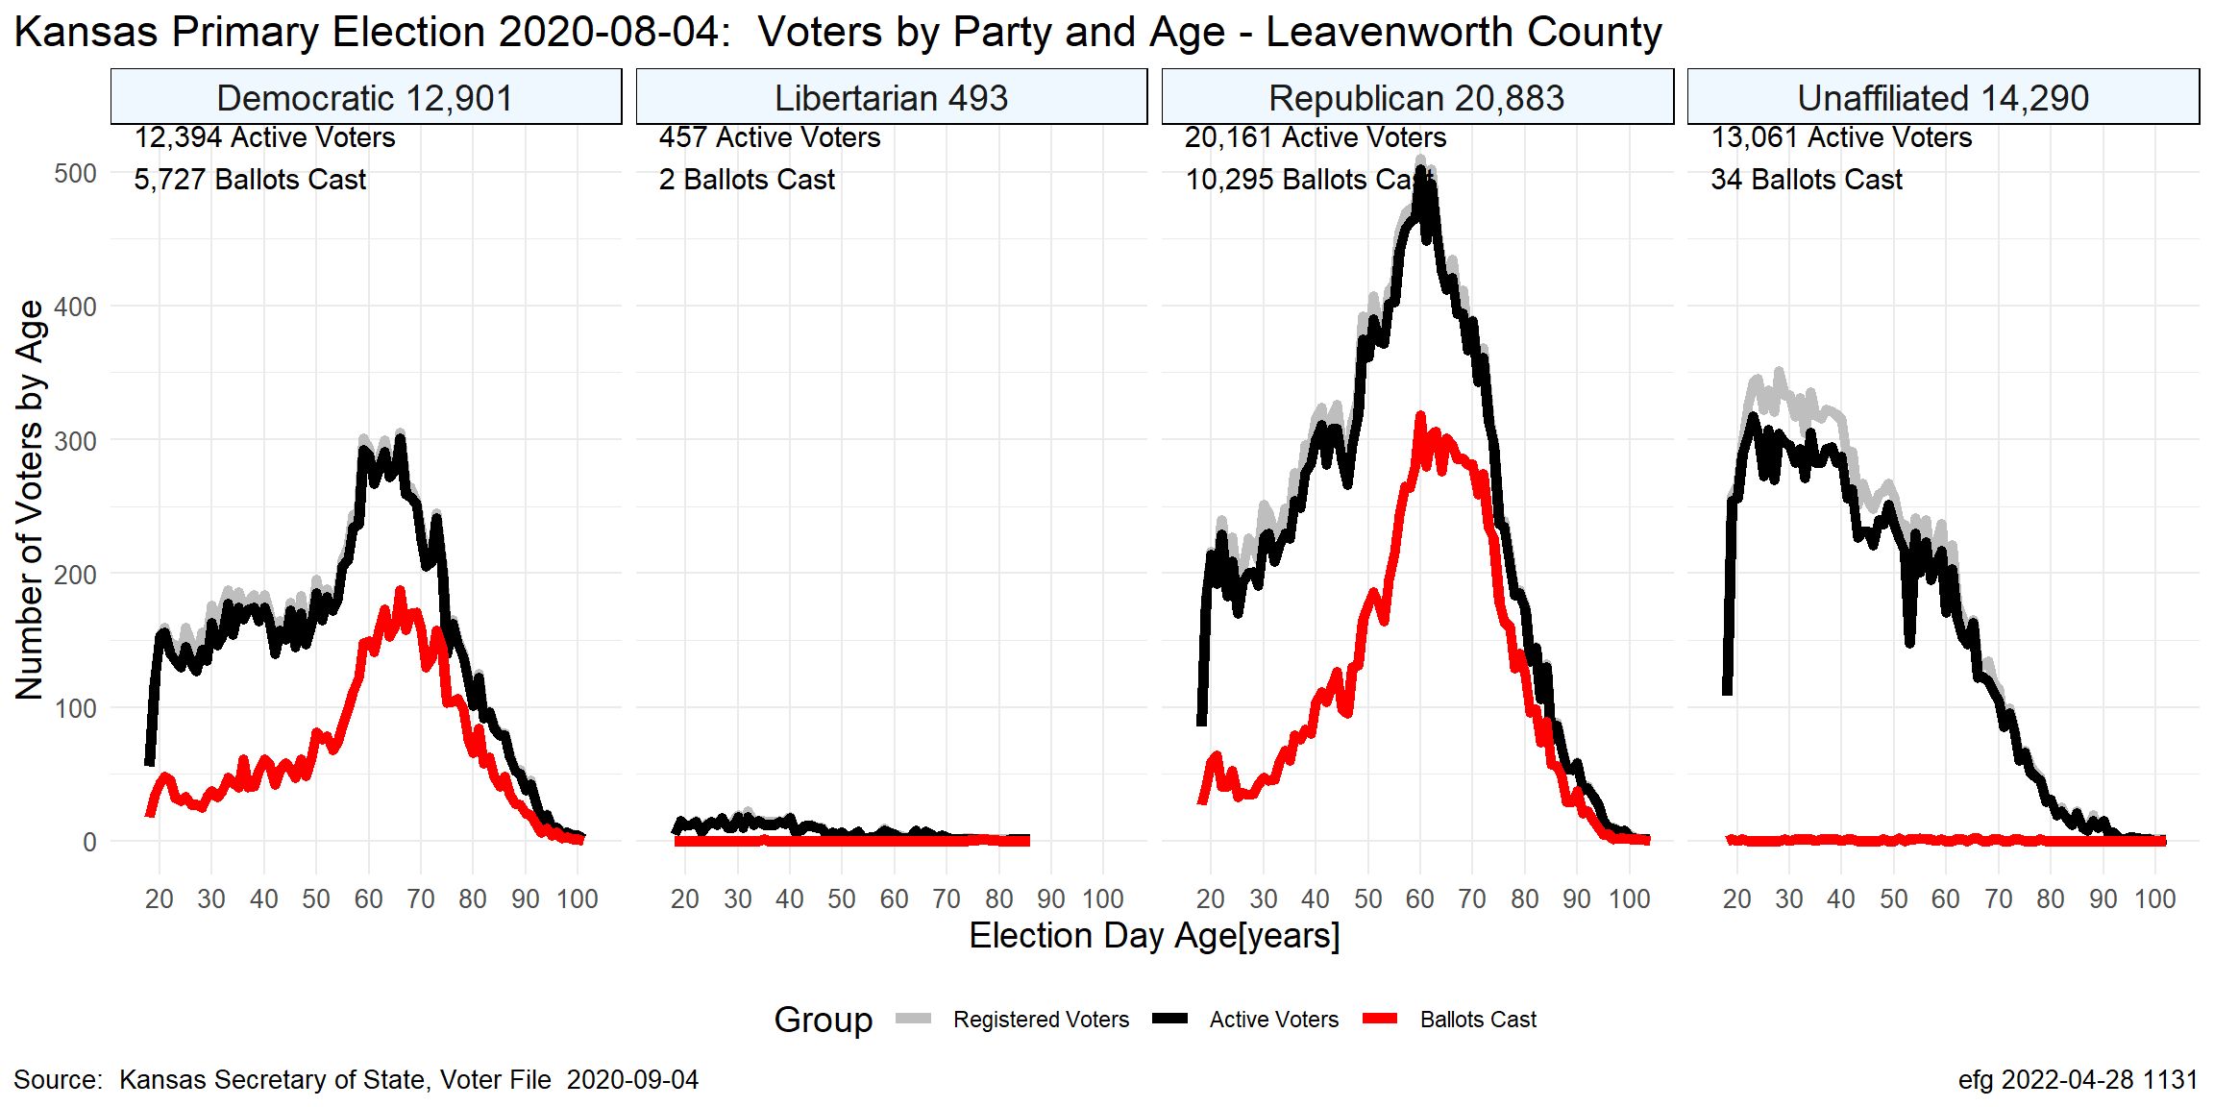
LV Aug. 2020

Slide 22
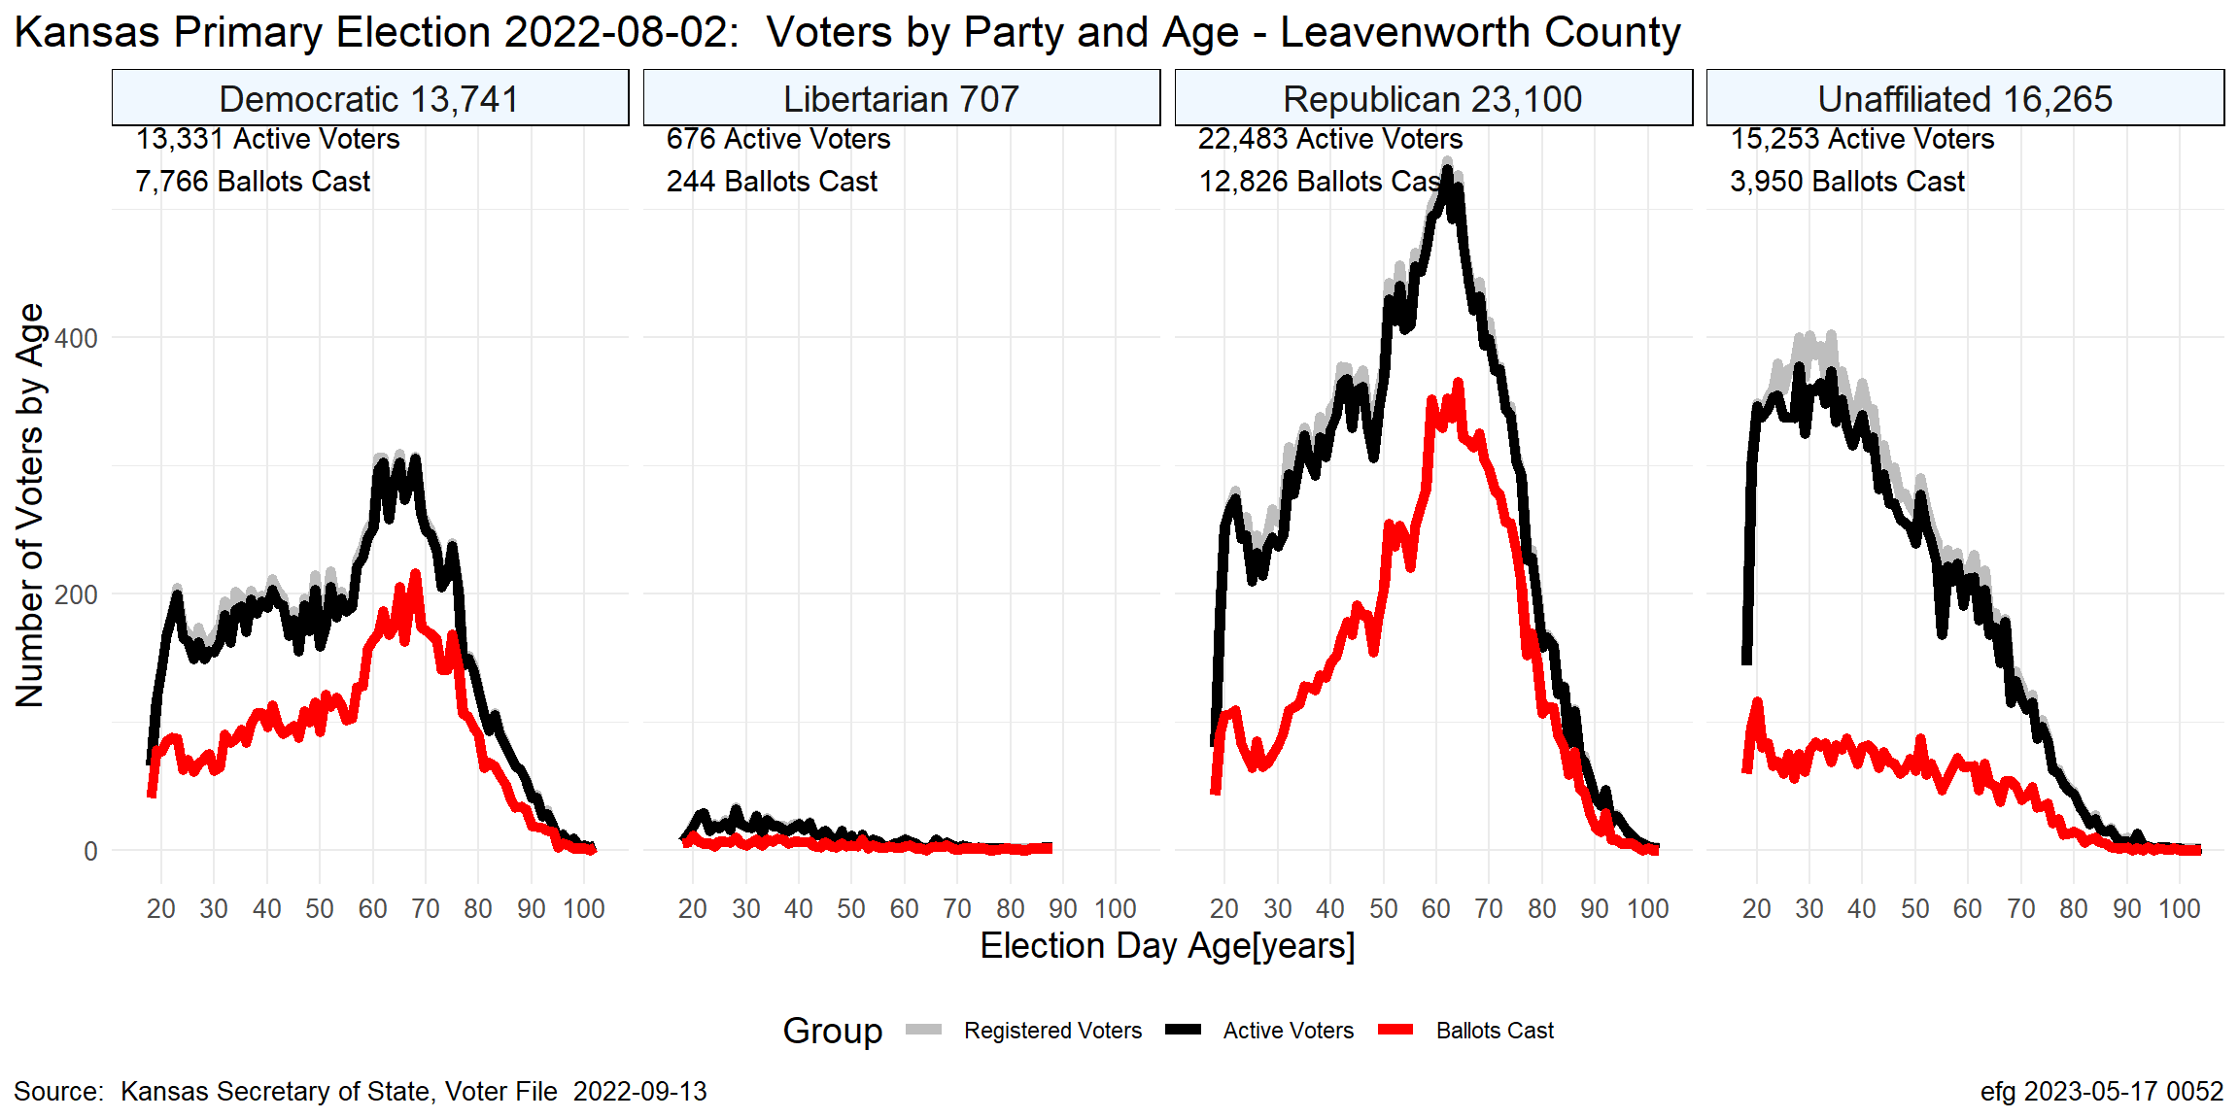
LV Aug. 2022

Slide 23
Questions?
Earl F Glynn
efglynn@gmail.com
Notes:
Slide deck created programatically on 2024-01-20 2355

