Slide 1
Pottawatomie County
Voter Registration and Turnout Curves efg 2024-01-20

Slide 2
Table of Contents
New Voter Registration 2016-2023
Election Turnout Curves November General By Party 2016 - 2022
Election Turnout Curves August Primary By Party 2016 - 2022

Slide 3
New Voter Registration 2016-2023

Slide 4
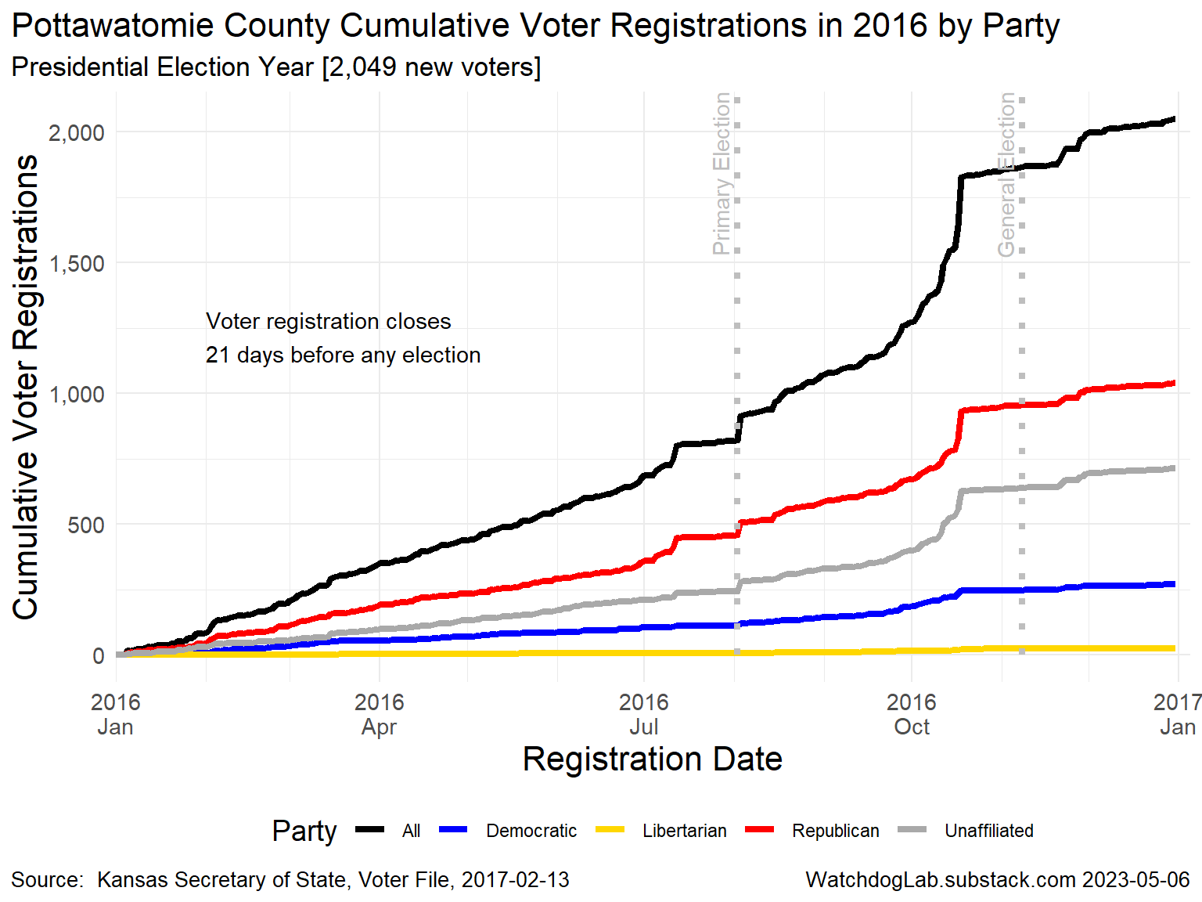
PT 2016

Slide 5
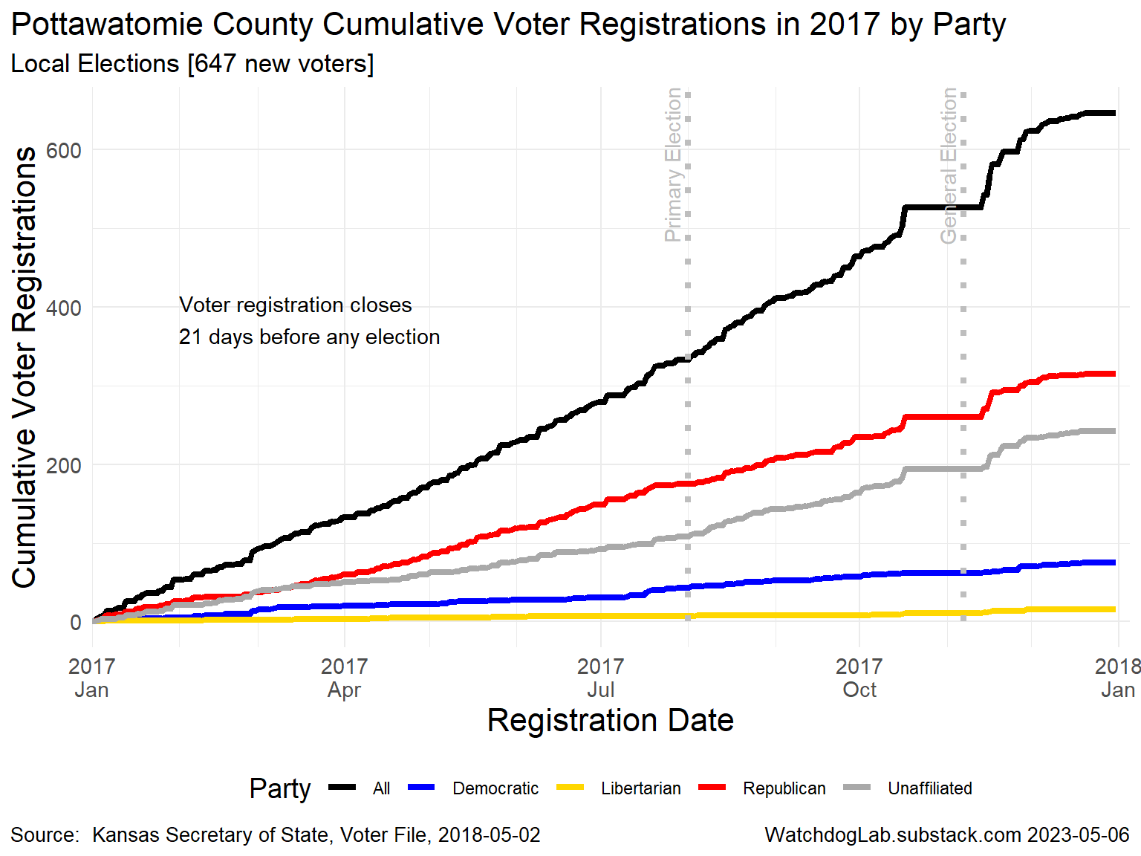
PT 2017

Slide 6
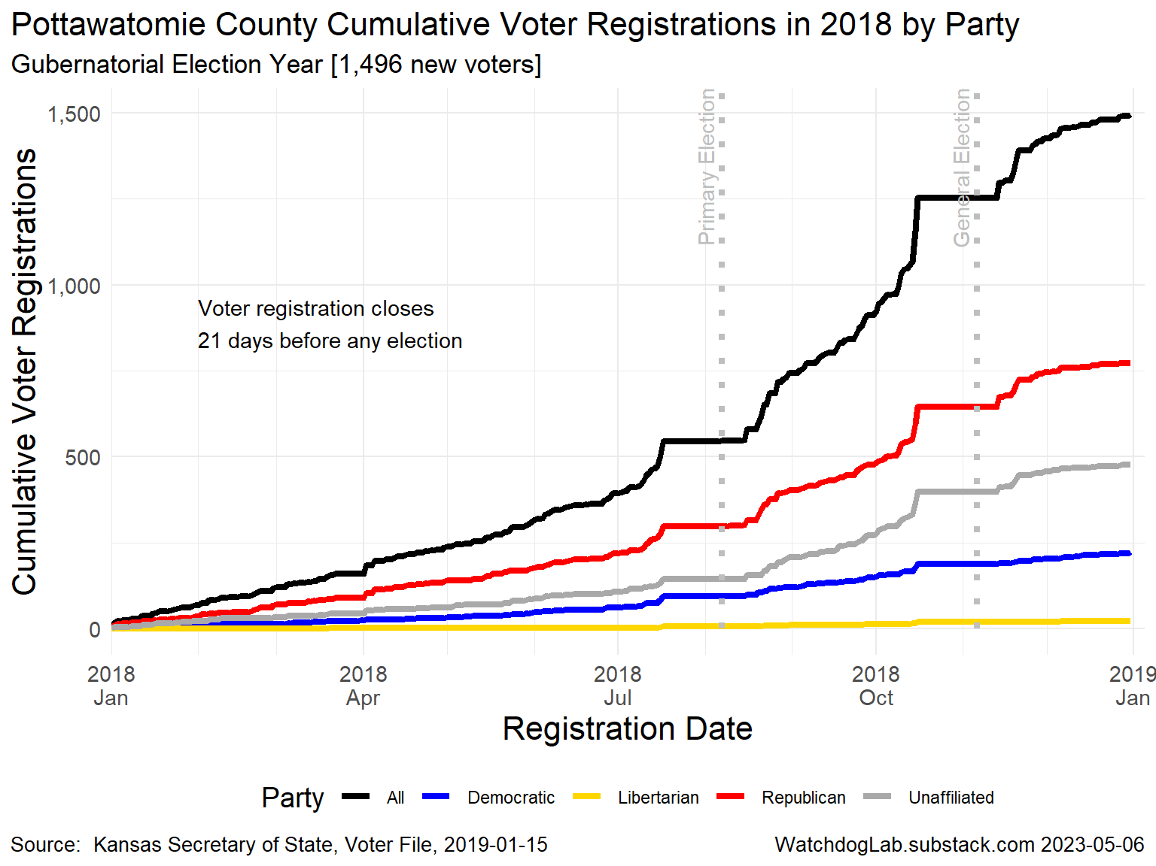
PT 2018

Slide 7
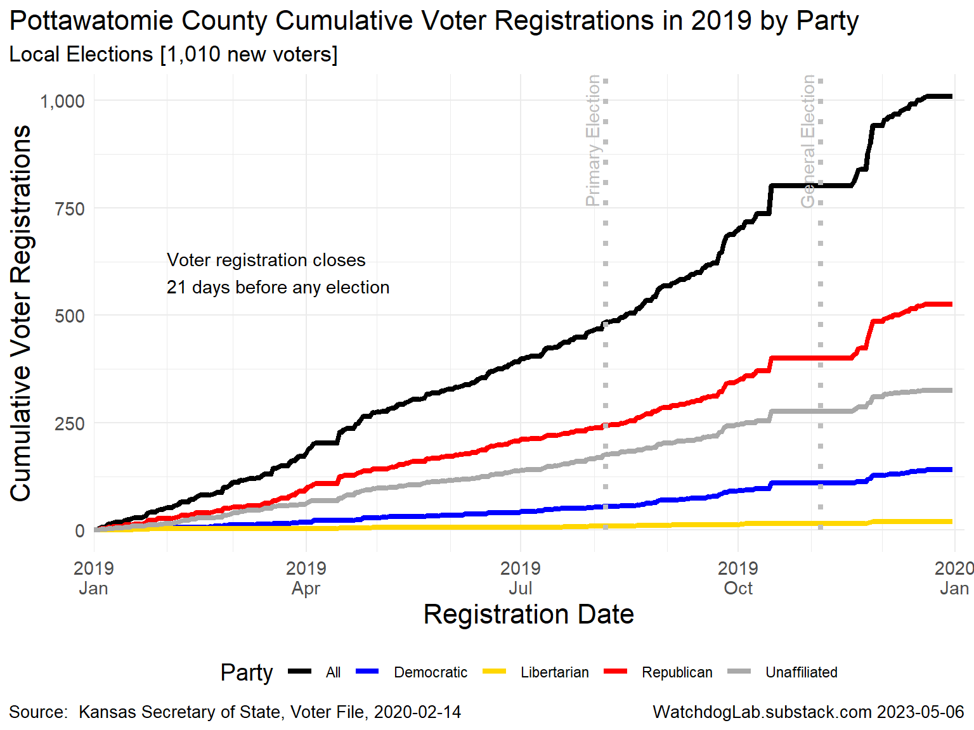
PT 2019

Slide 8
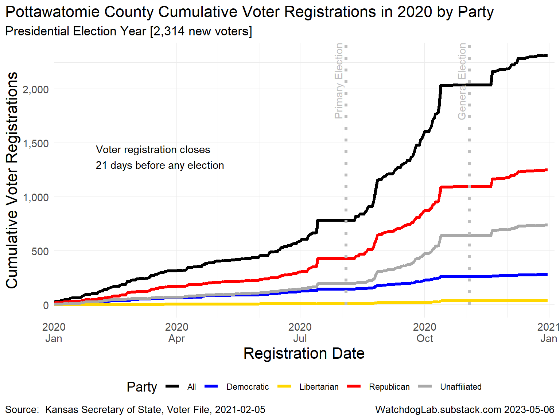
PT 2020

Slide 9
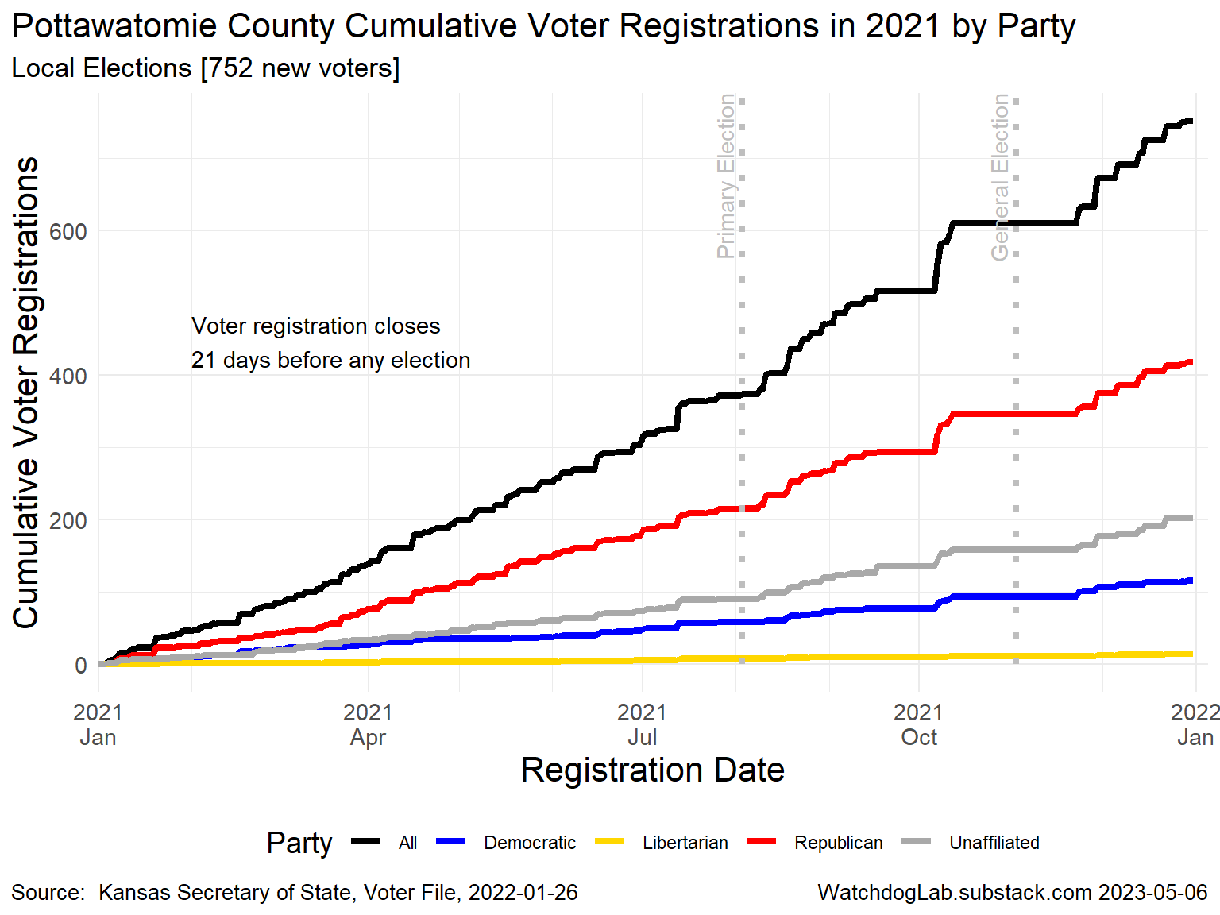
PT 2021

Slide 10
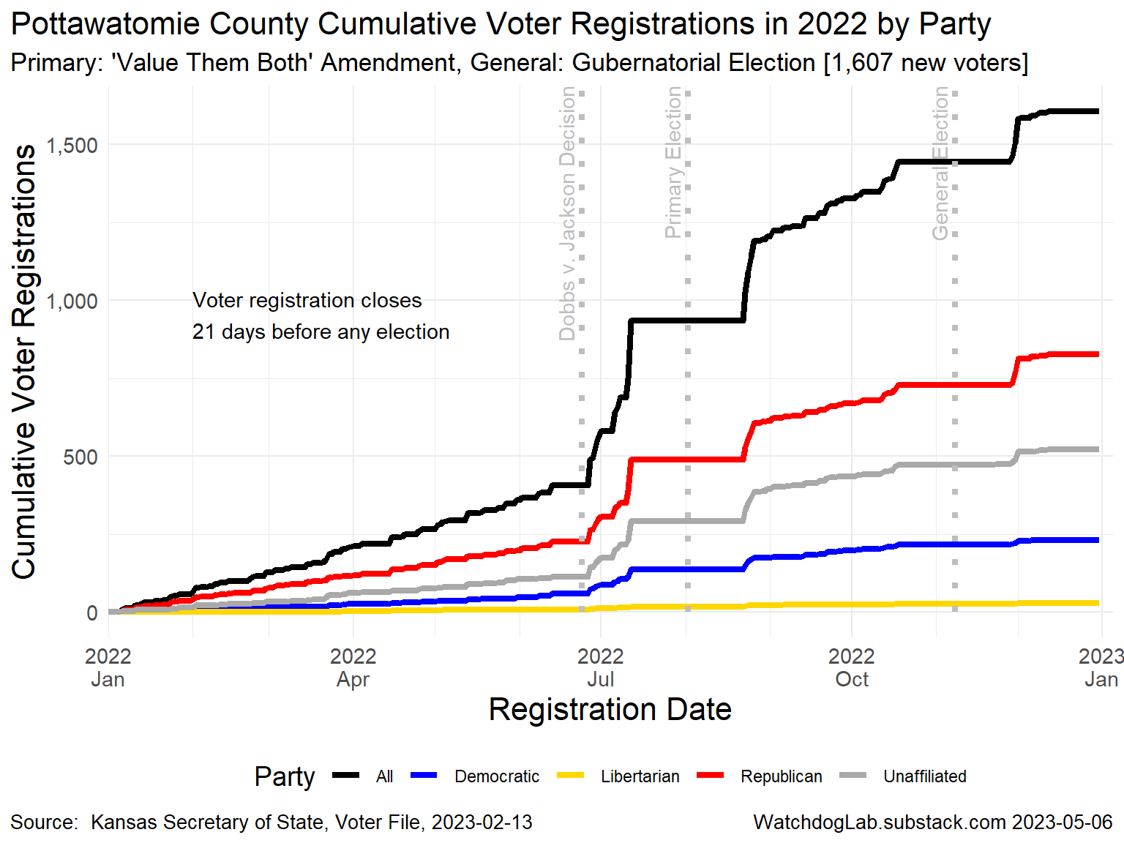
PT 2022

Slide 11
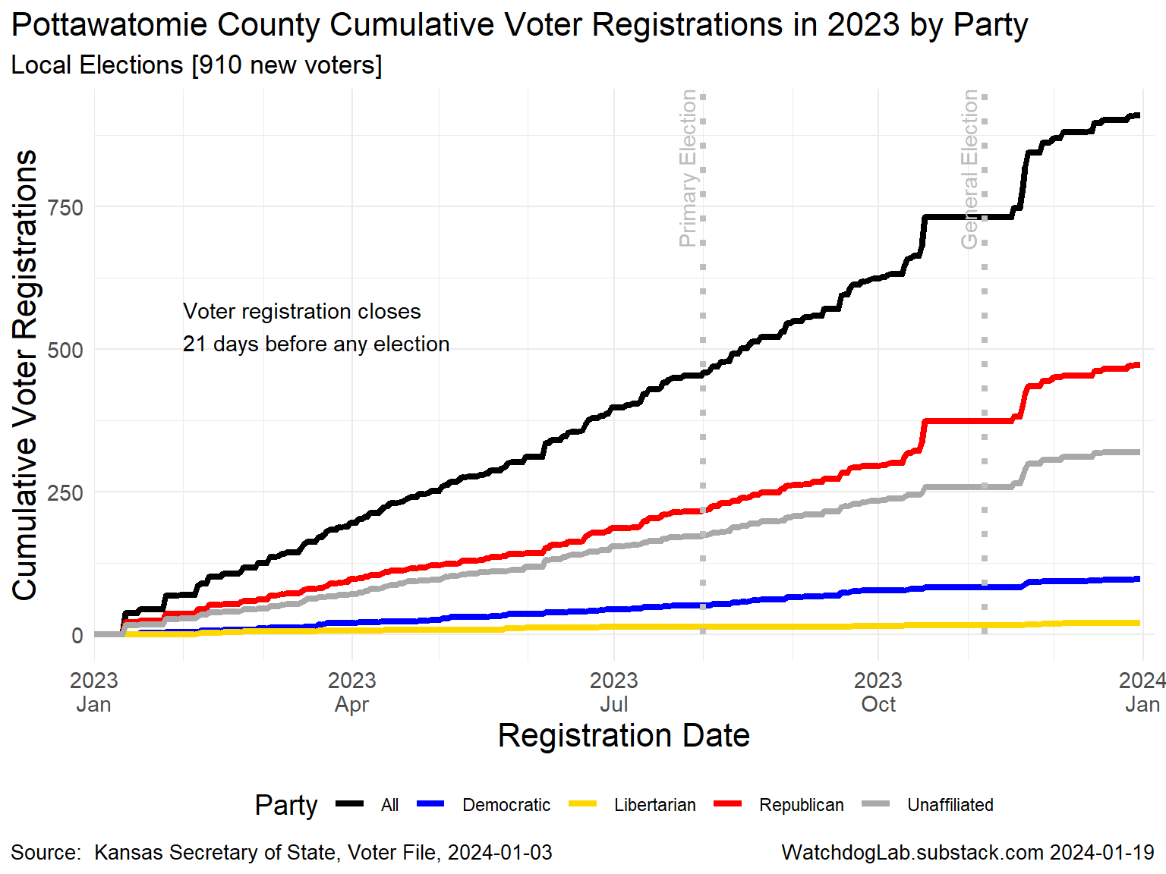
PT 2023

Slide 12
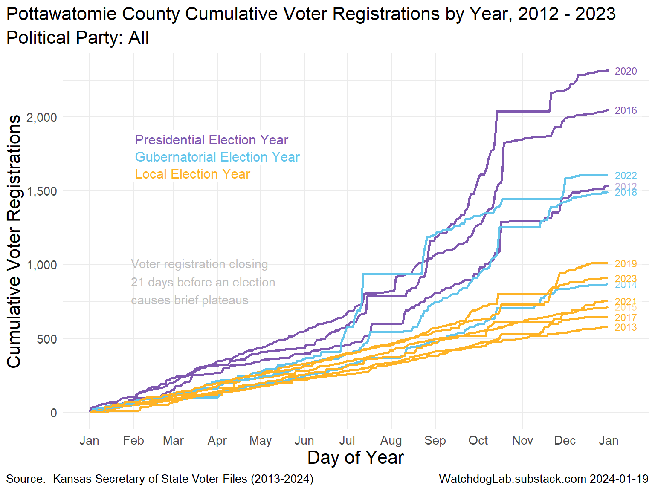
Pottawatomie County Voter Registration 2012-2023

Slide 13
Election Turnout Curves November General By Party 2016 - 2022

Slide 14
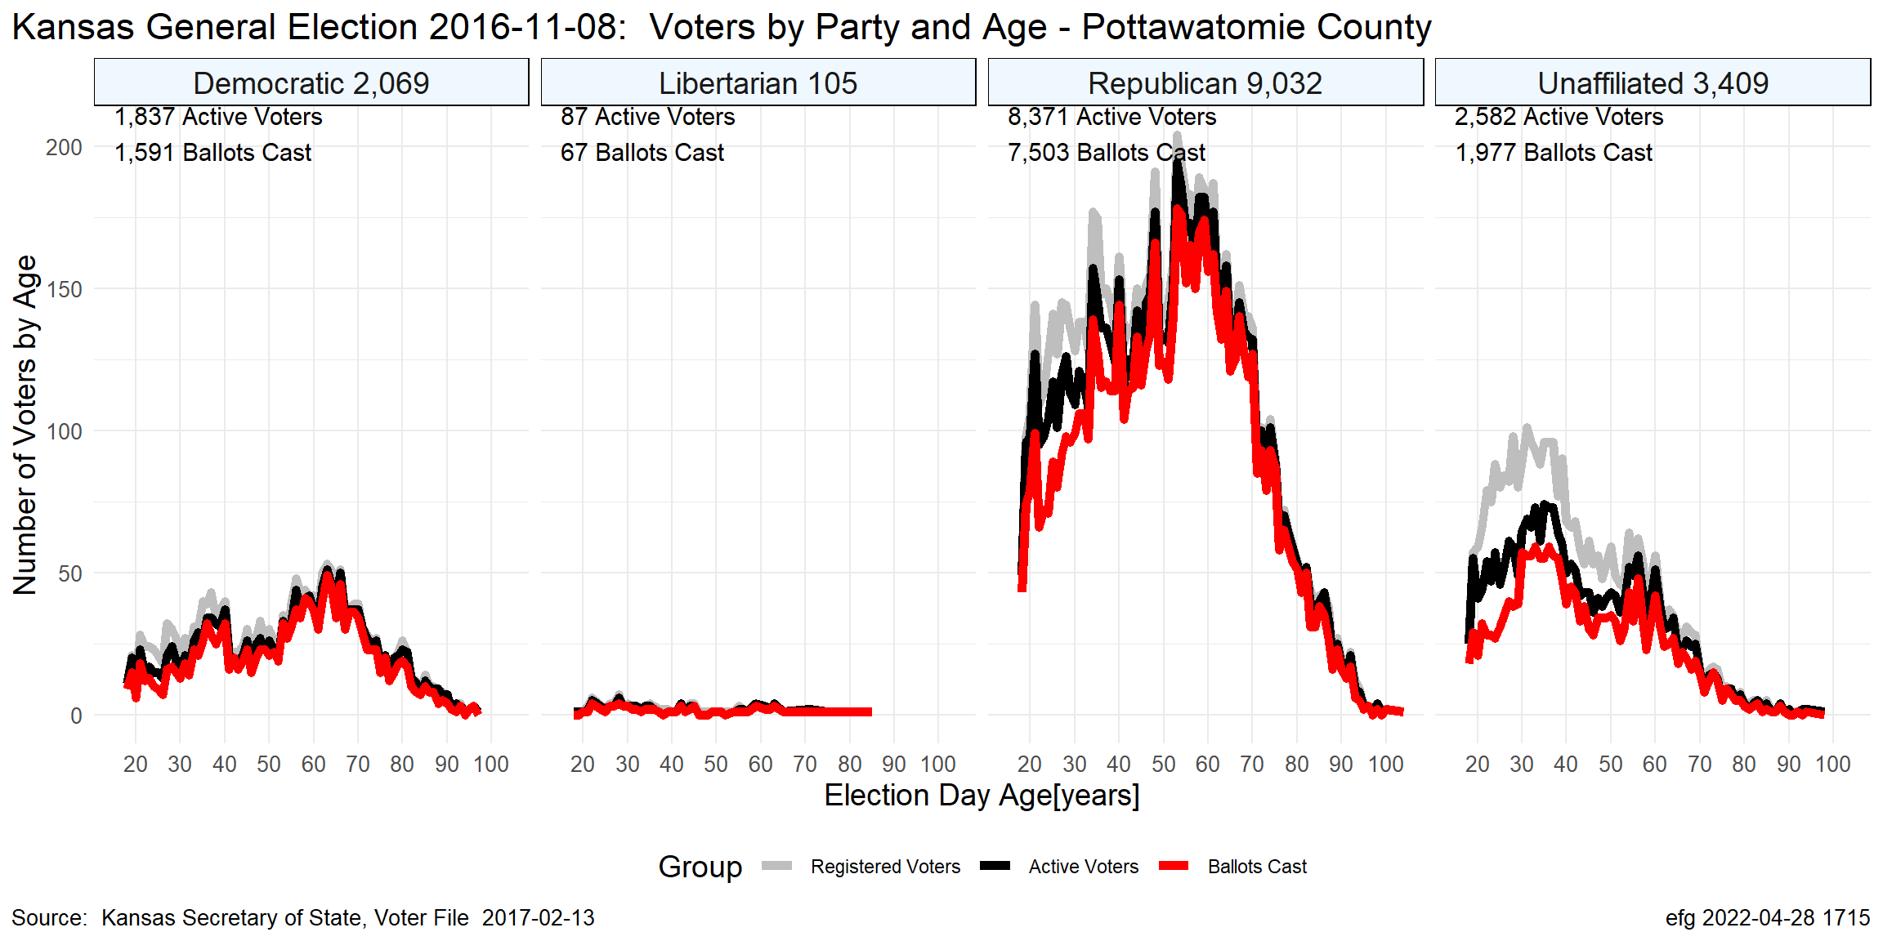
PT Nov. 2016

Slide 15
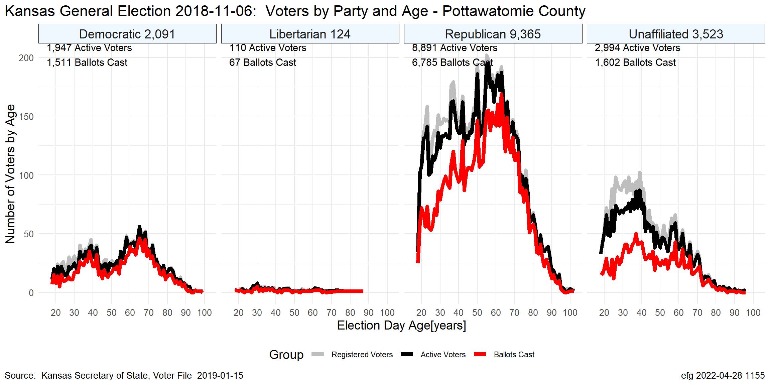
PT Nov. 2018

Slide 16
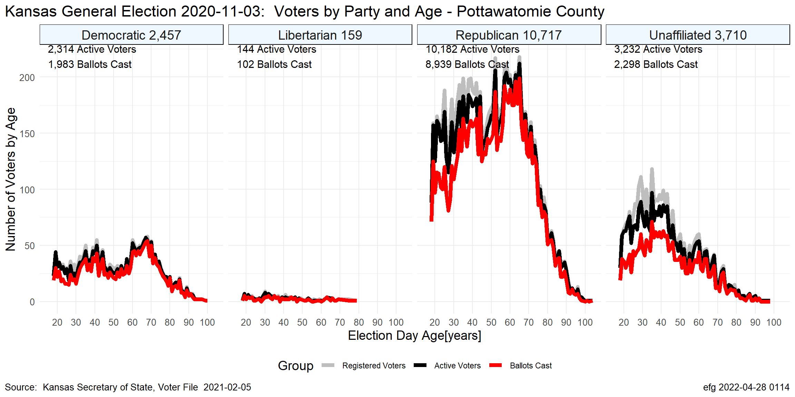
PT Nov. 2020

Slide 17
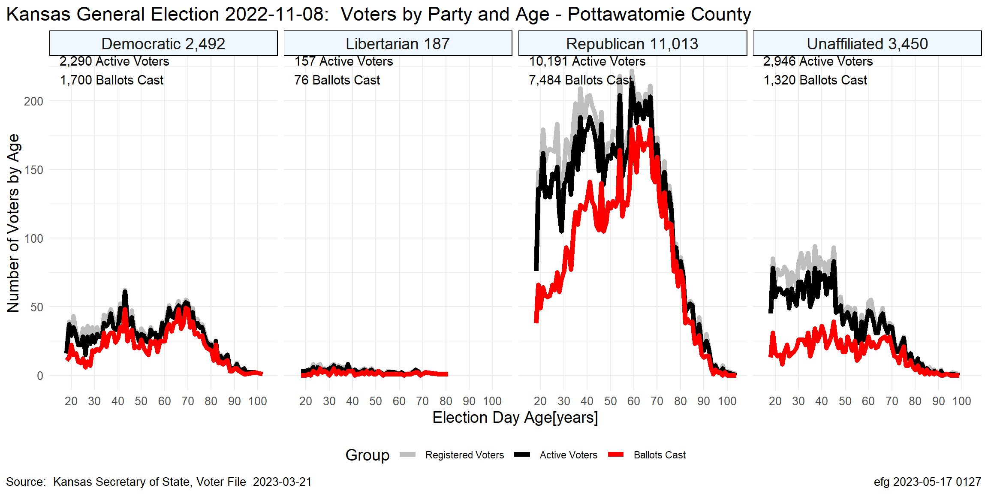
PT Nov. 2022

Slide 18
Election Turnout Curves August Primary By Party 2016 - 2022

Slide 19
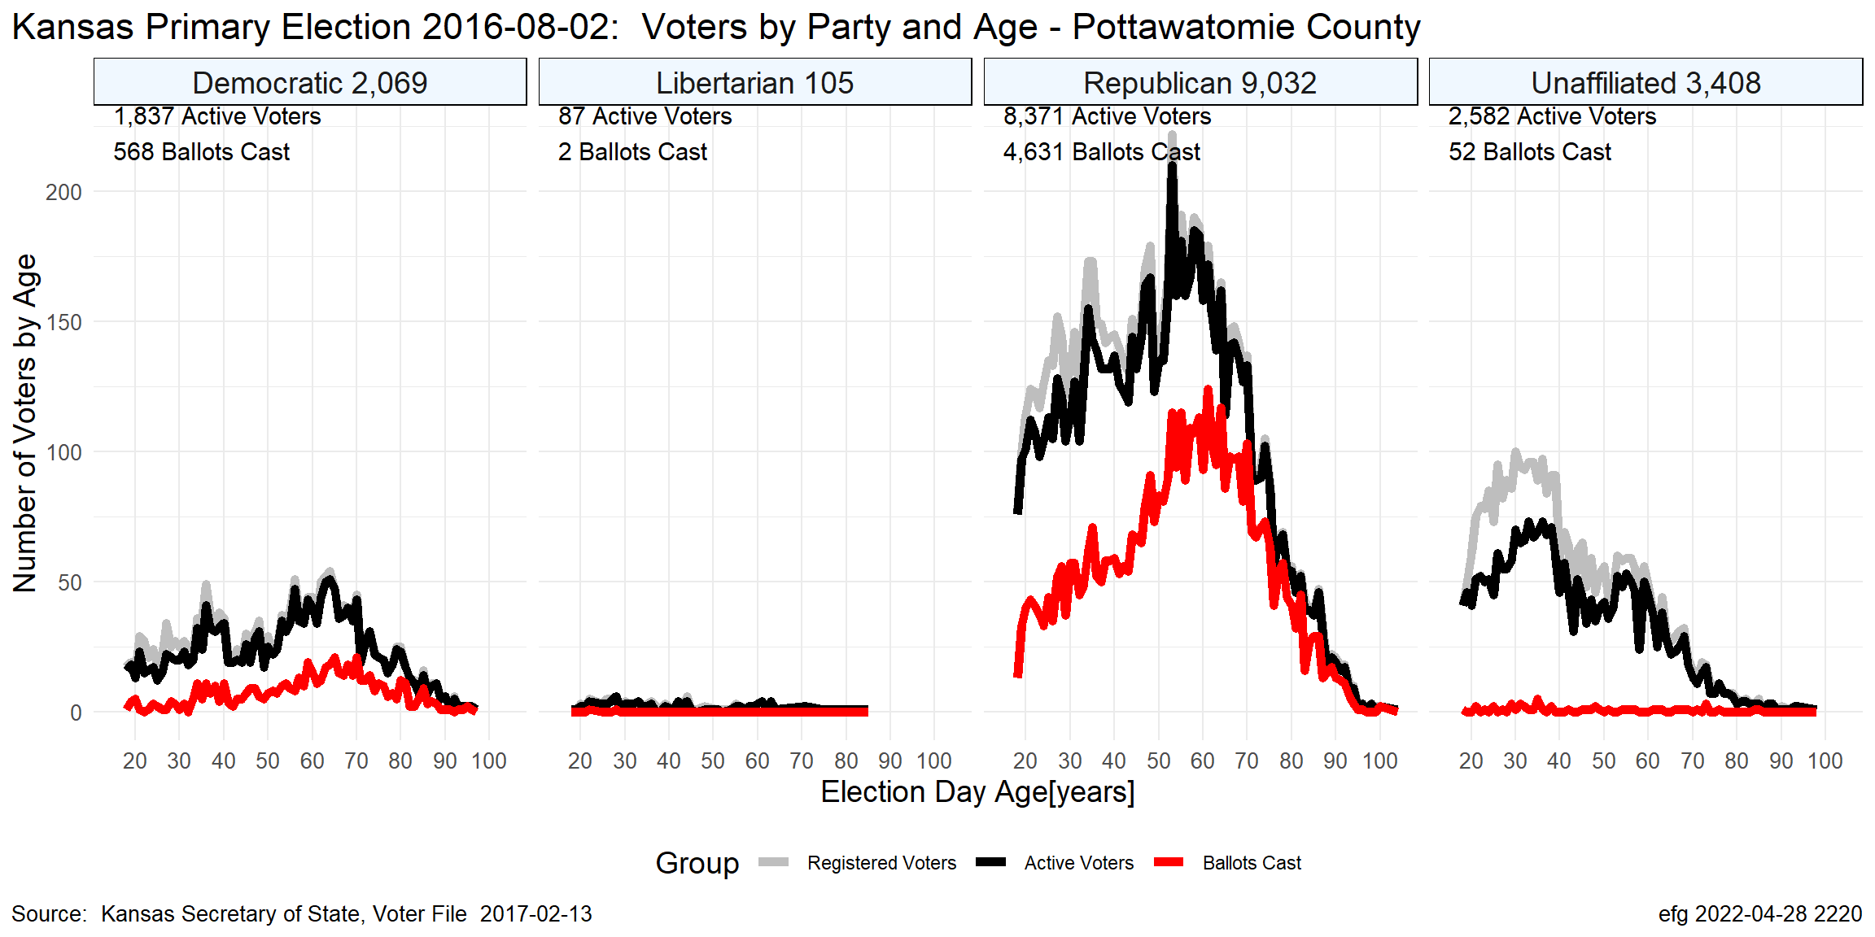
PT Aug. 2016

Slide 20
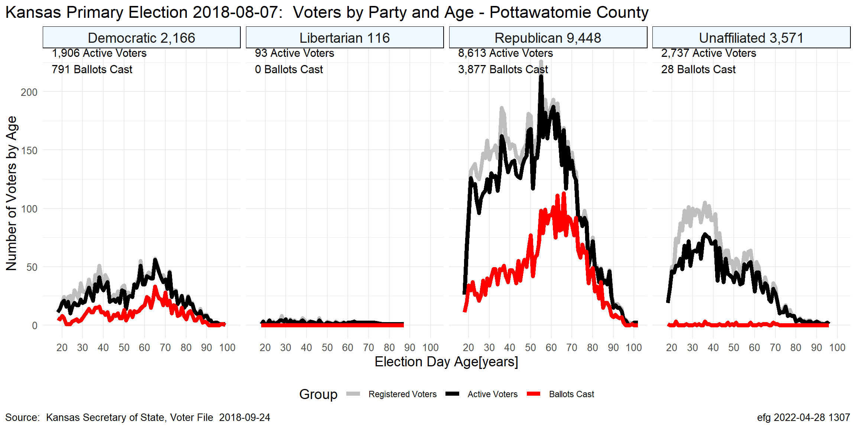
PT Aug. 2018

Slide 21
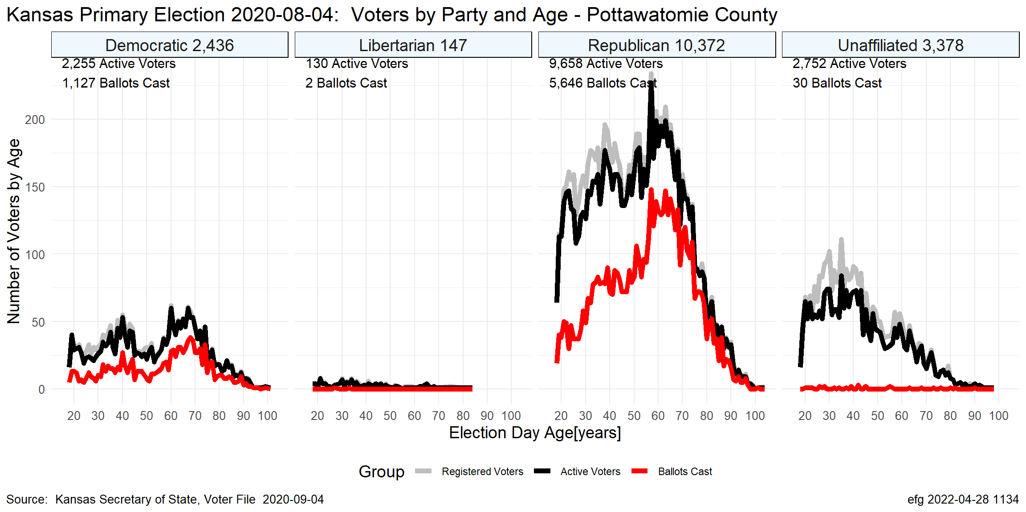
PT Aug. 2020

Slide 22
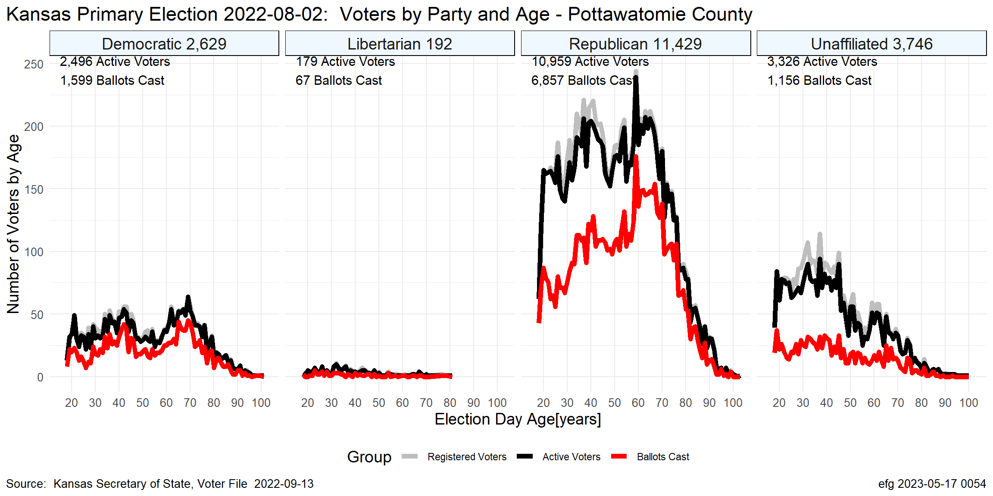
PT Aug. 2022

Slide 23
Questions?
Earl F Glynn
efglynn@gmail.com
Notes:
Slide deck created programatically on 2024-01-20 2355

