Slide 1
Kansas Statewide
Voter Registration and Turnout Curves efg 2024-01-20

Slide 2
Table of Contents
New Voter Registration 2016-2023
Election Turnout Curves November General By Party 2016 - 2022
Election Turnout Curves August Primary By Party 2016 - 2022

Slide 3
New Voter Registration 2016-2023

Slide 4
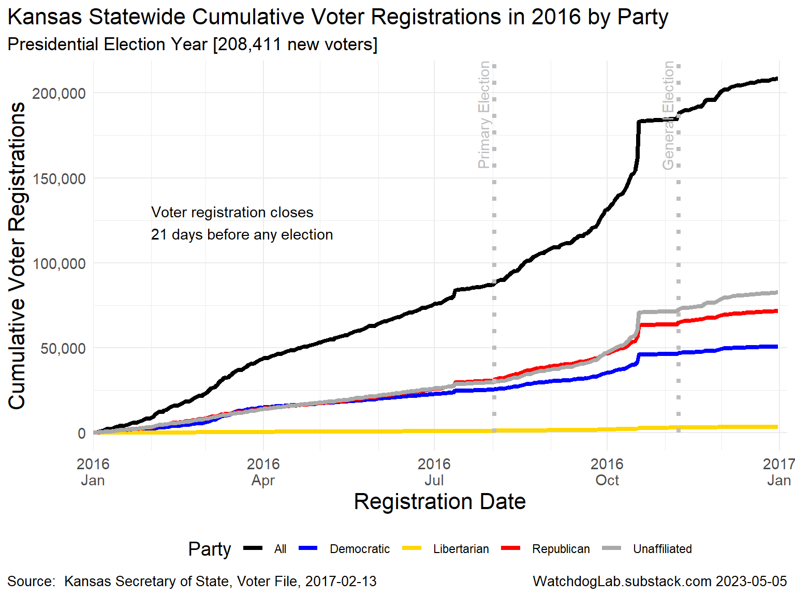
Kansas 2016

Slide 5
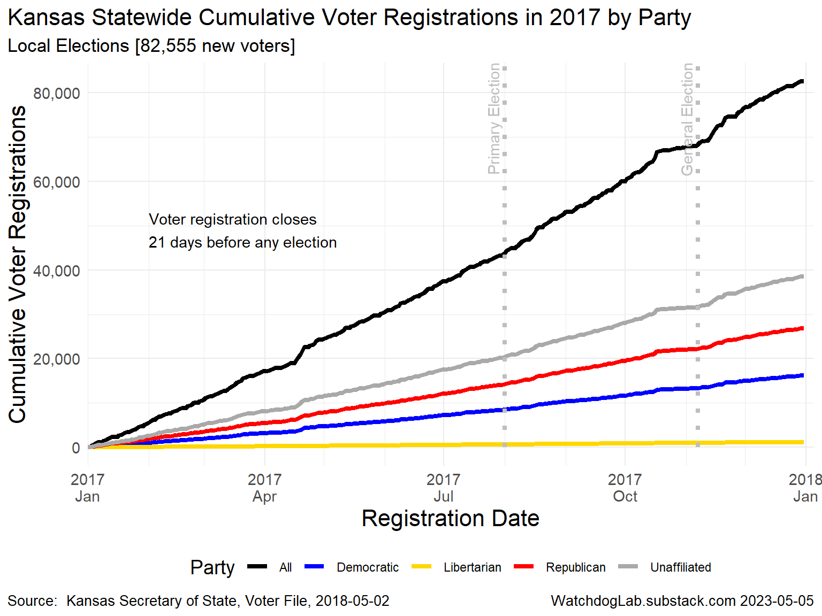
Kansas 2017

Slide 6
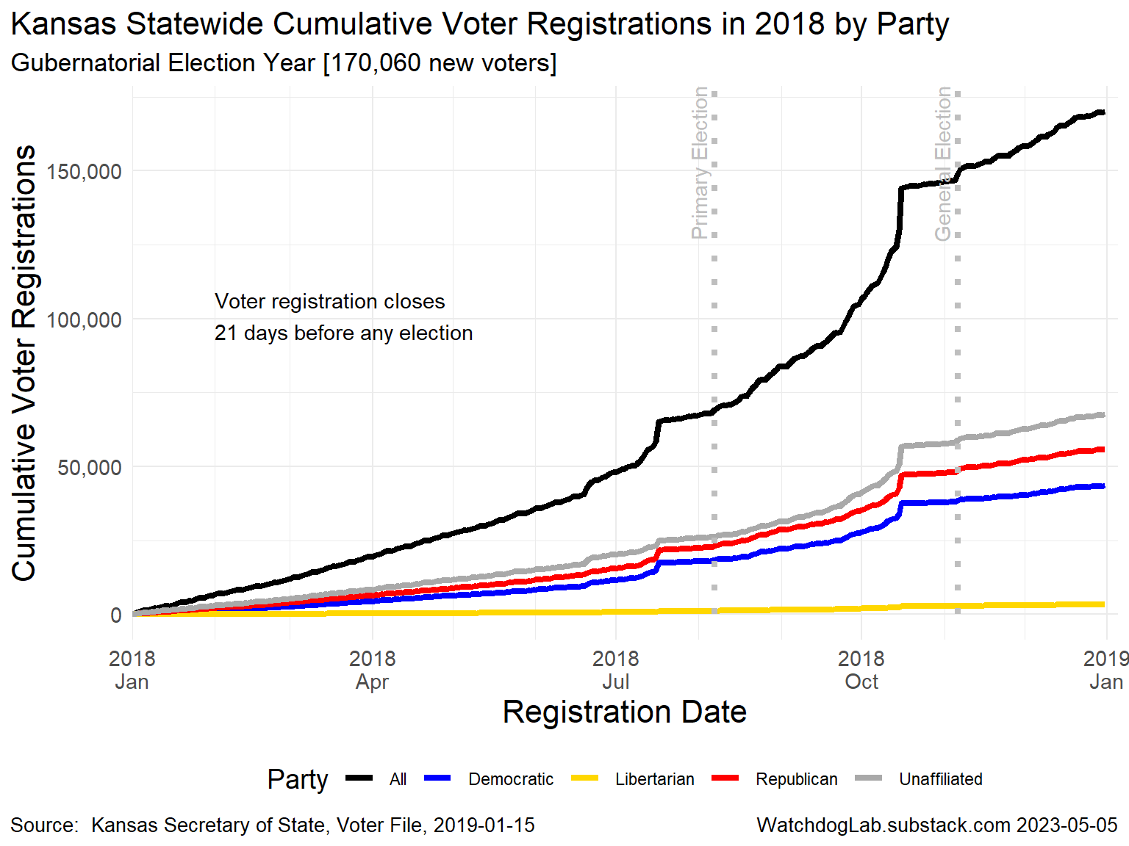
Kansas 2018

Slide 7
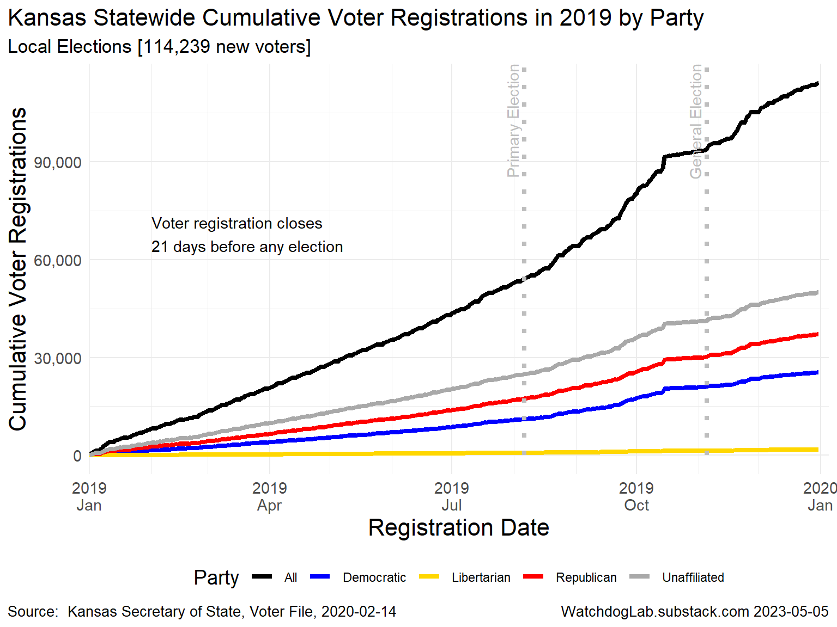
Kansas 2019

Slide 8
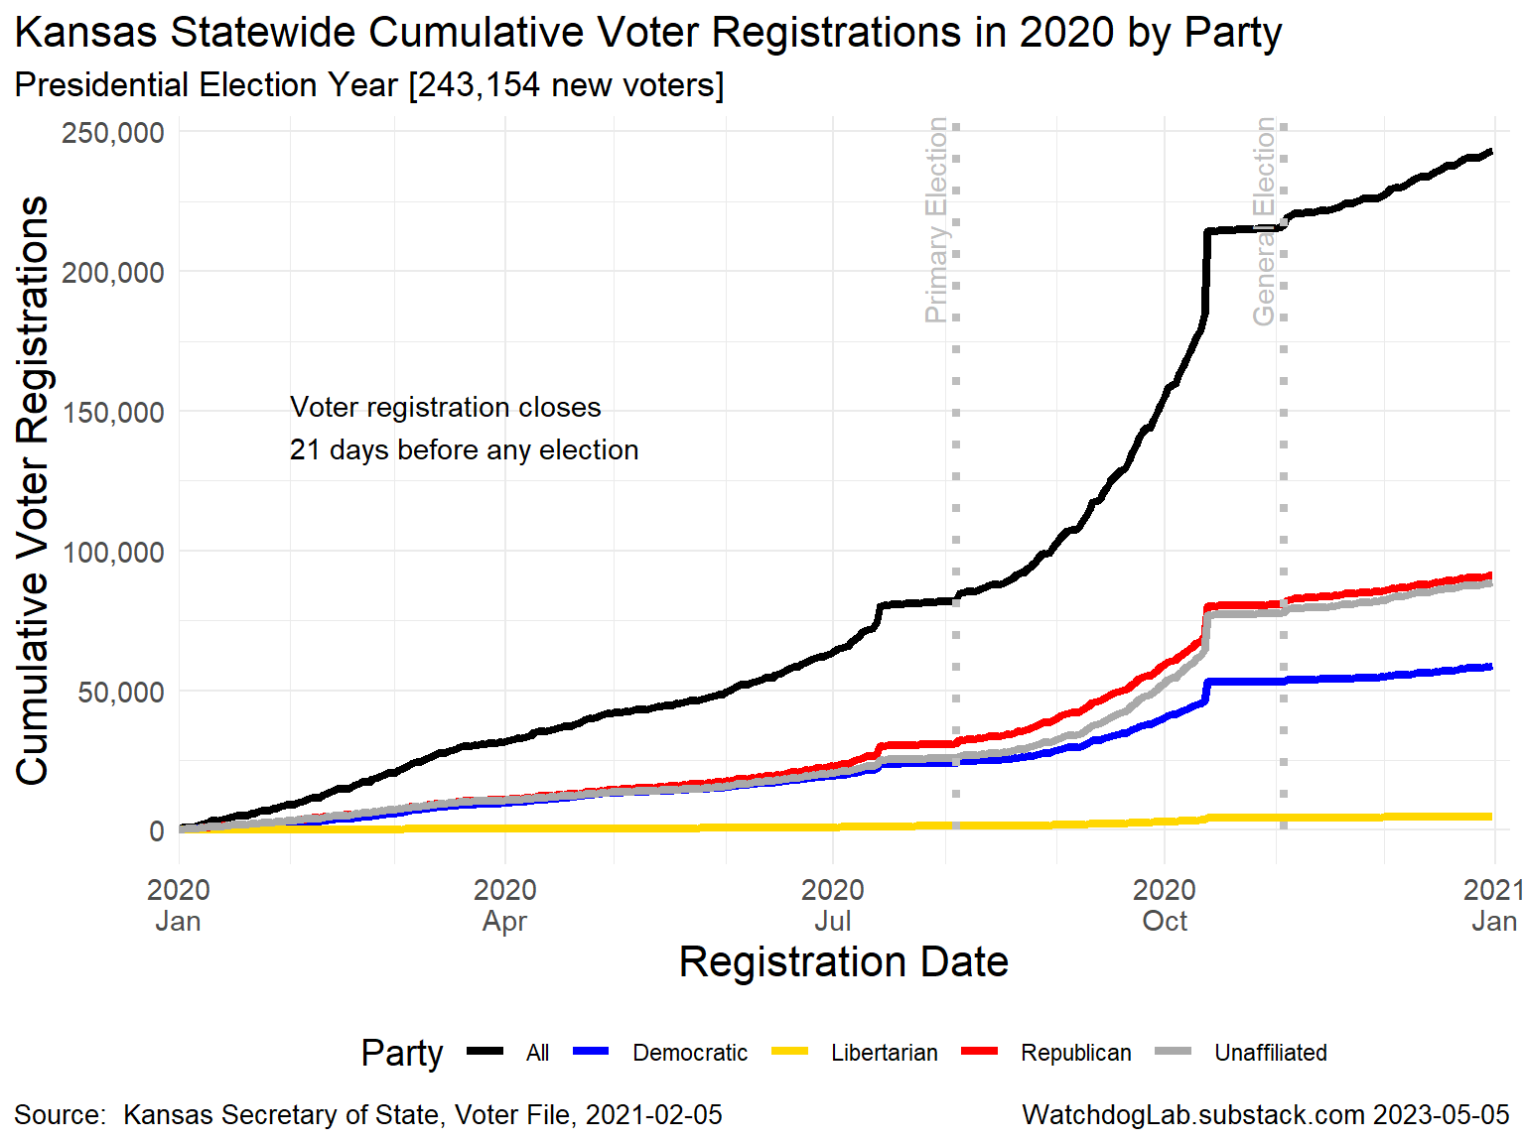
Kansas 2020

Slide 9
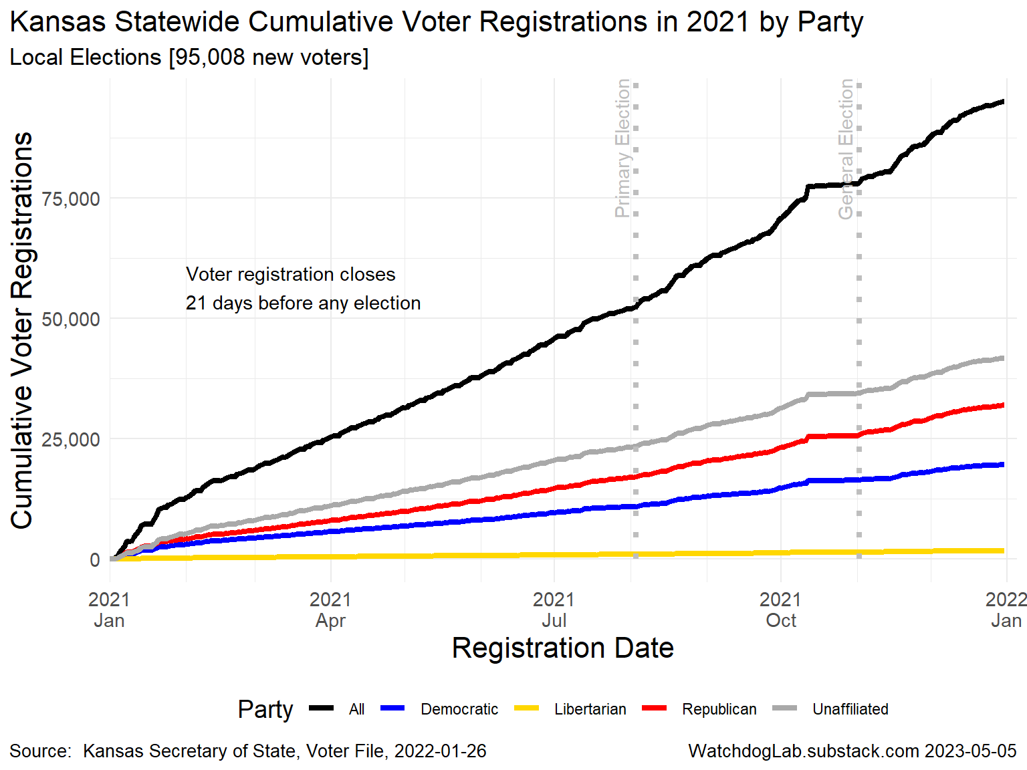
Kansas 2021

Slide 10
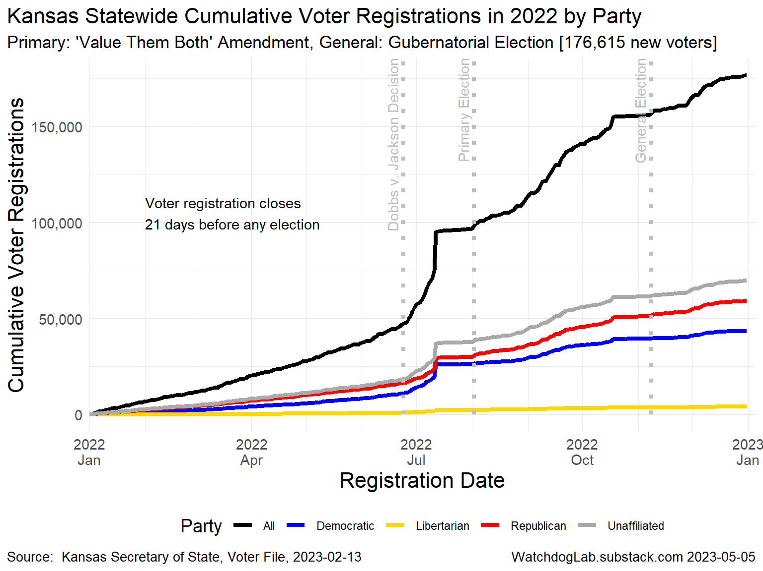
Kansas 2022

Slide 11
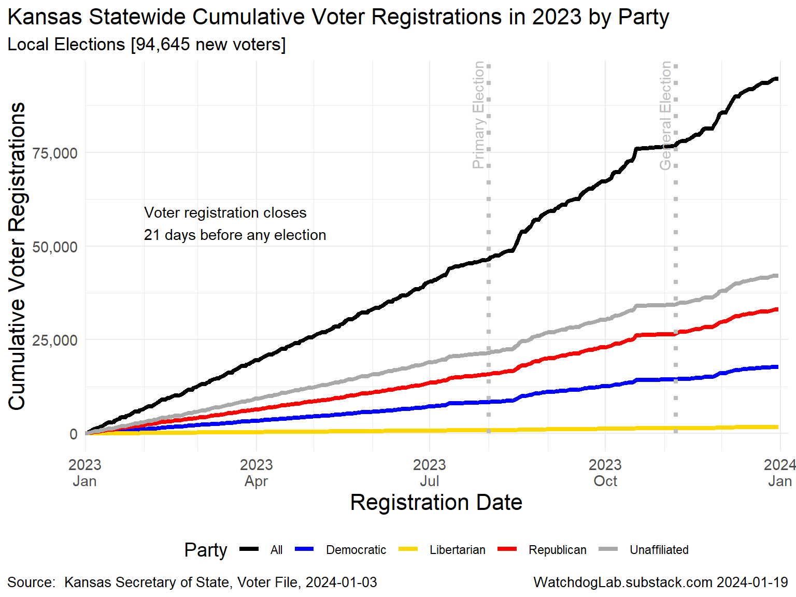
Kansas 2023

Slide 12
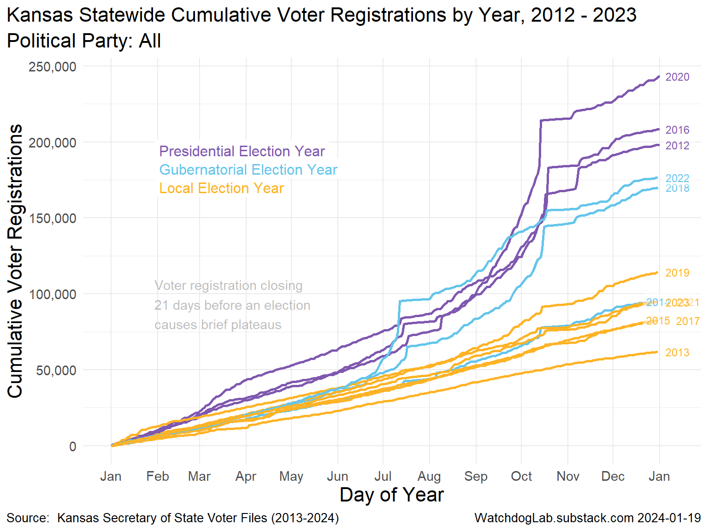
Kansas Statewide Voter Registration 2012-2023

Slide 13
Election Turnout Curves November General By Party 2016 - 2022

Slide 14
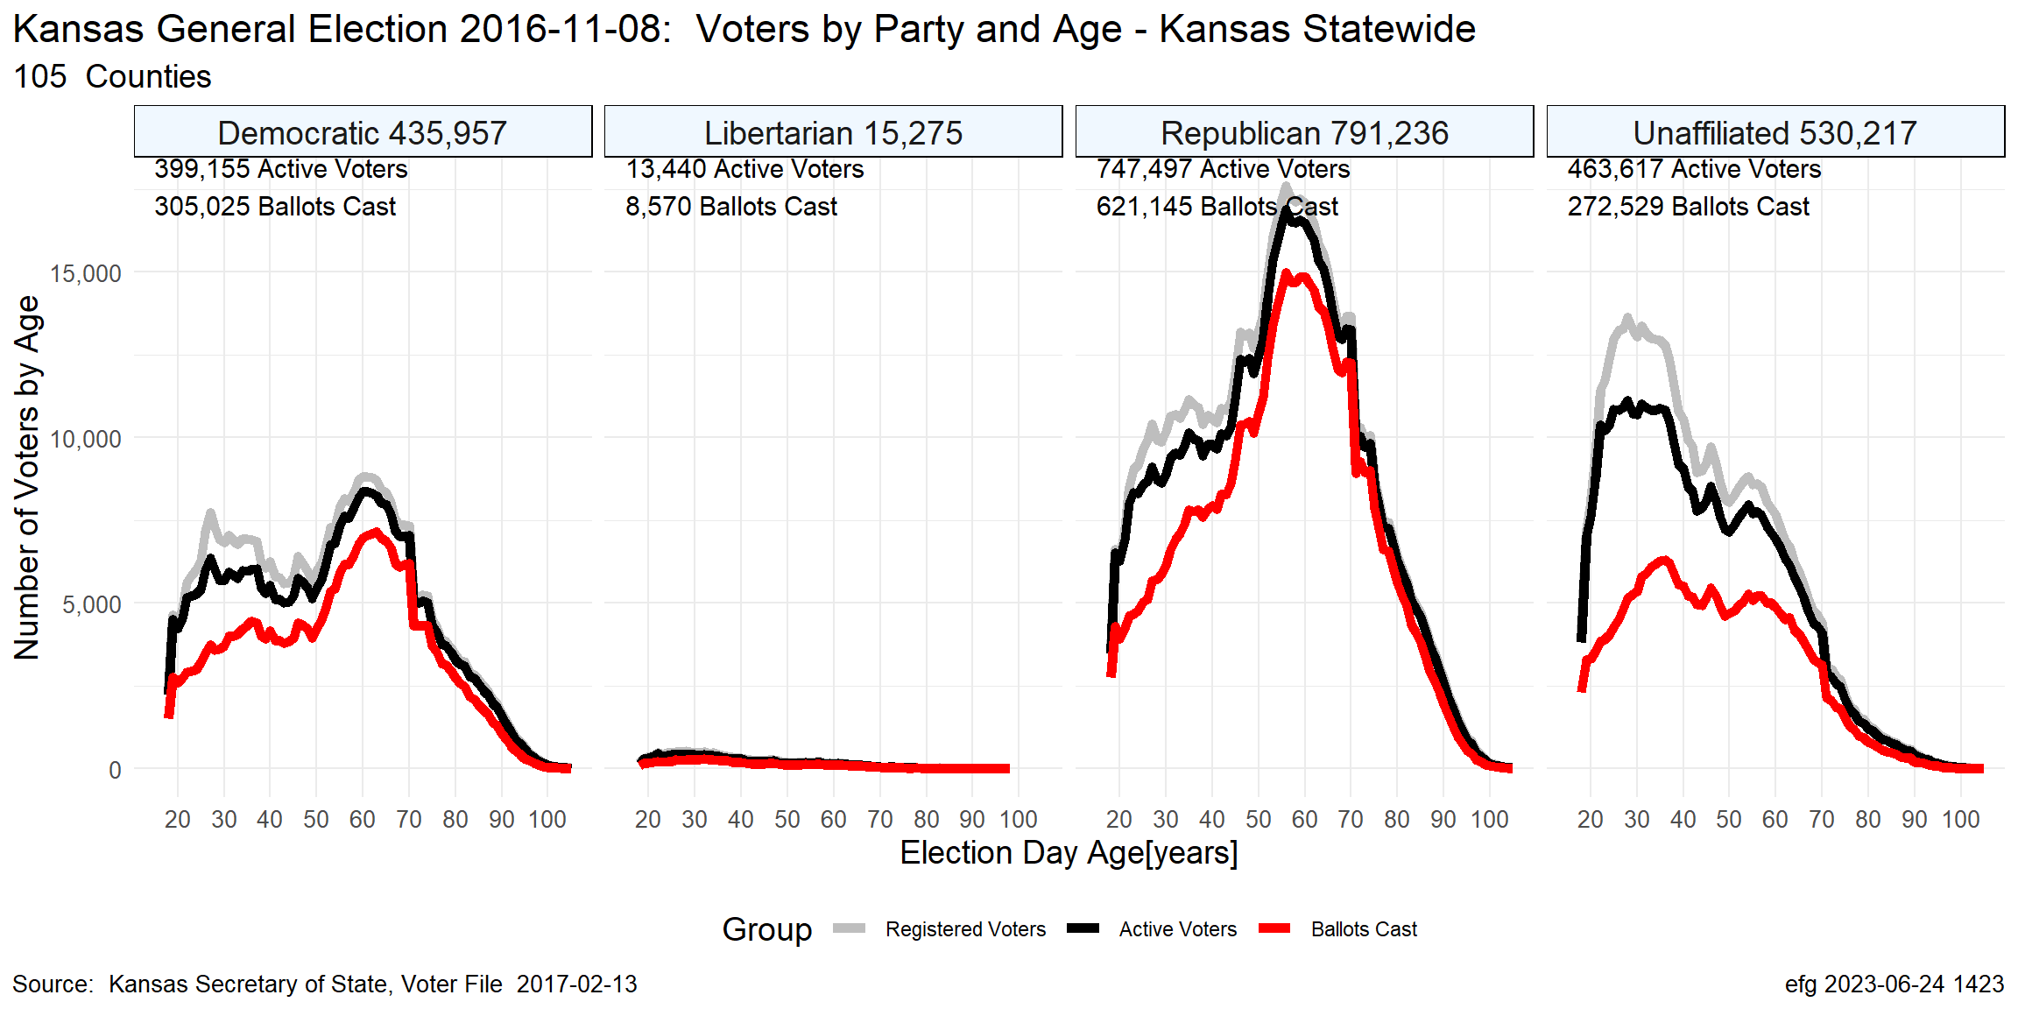
Kansas Nov. 2016

Slide 15
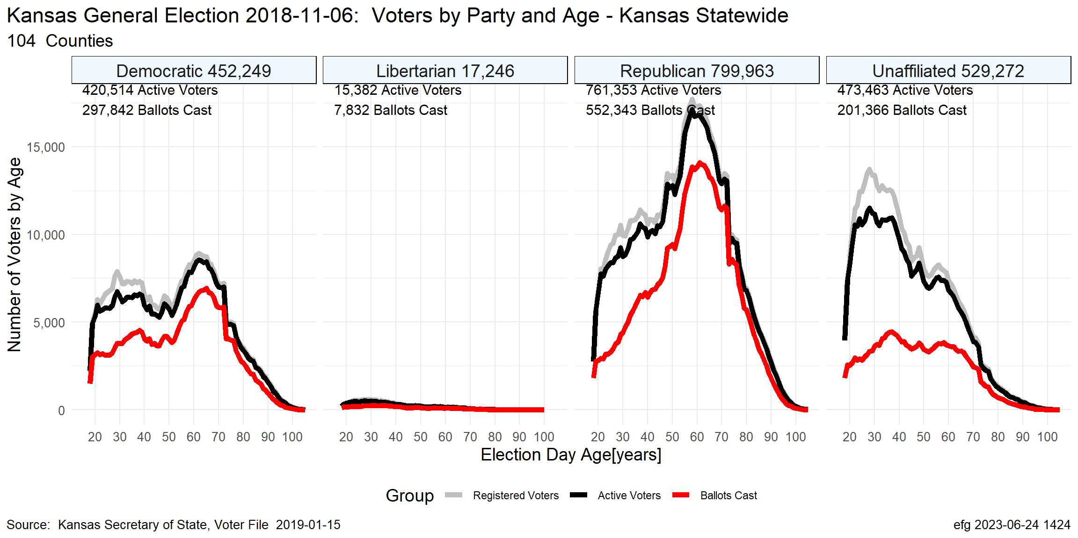
Kansas Nov. 2018

Slide 16
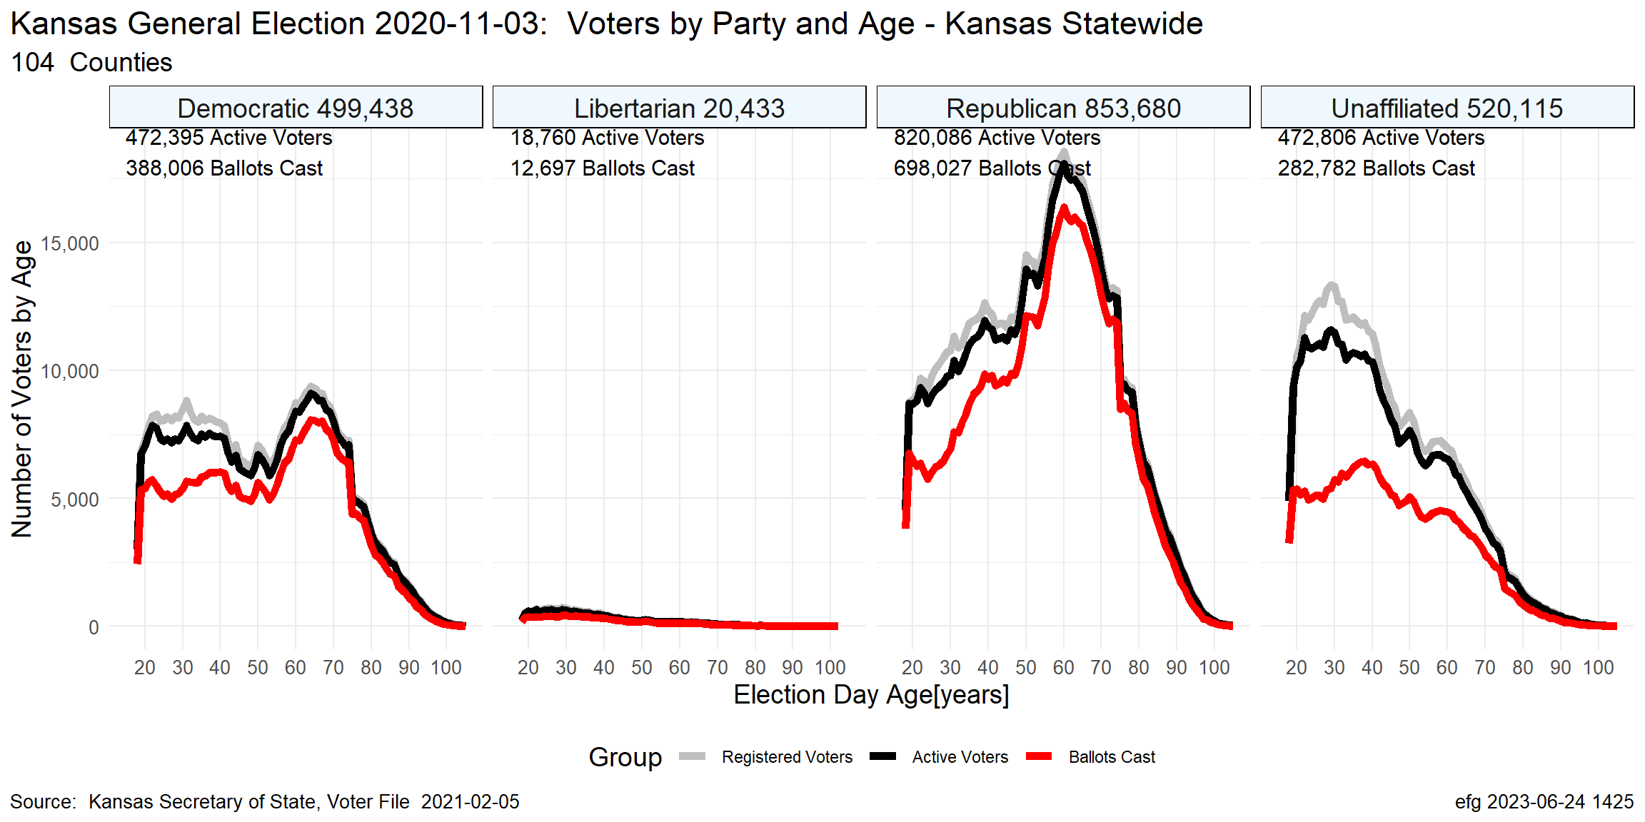
Kansas Nov. 2020

Slide 17
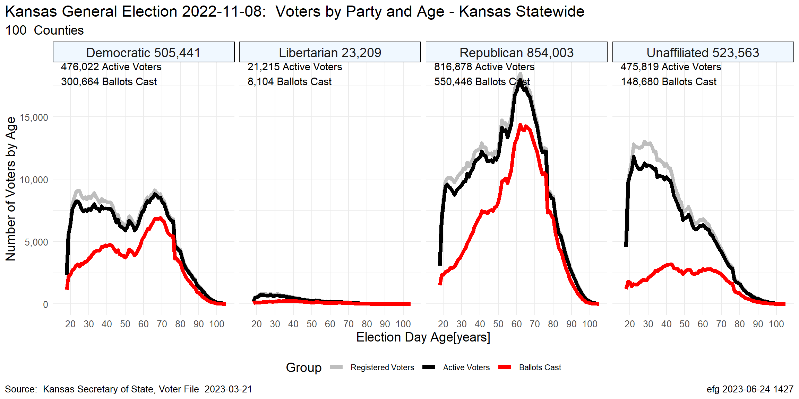
Kansas Nov. 2022

Slide 18
Election Turnout Curves August Primary By Party 2016 - 2022

Slide 19
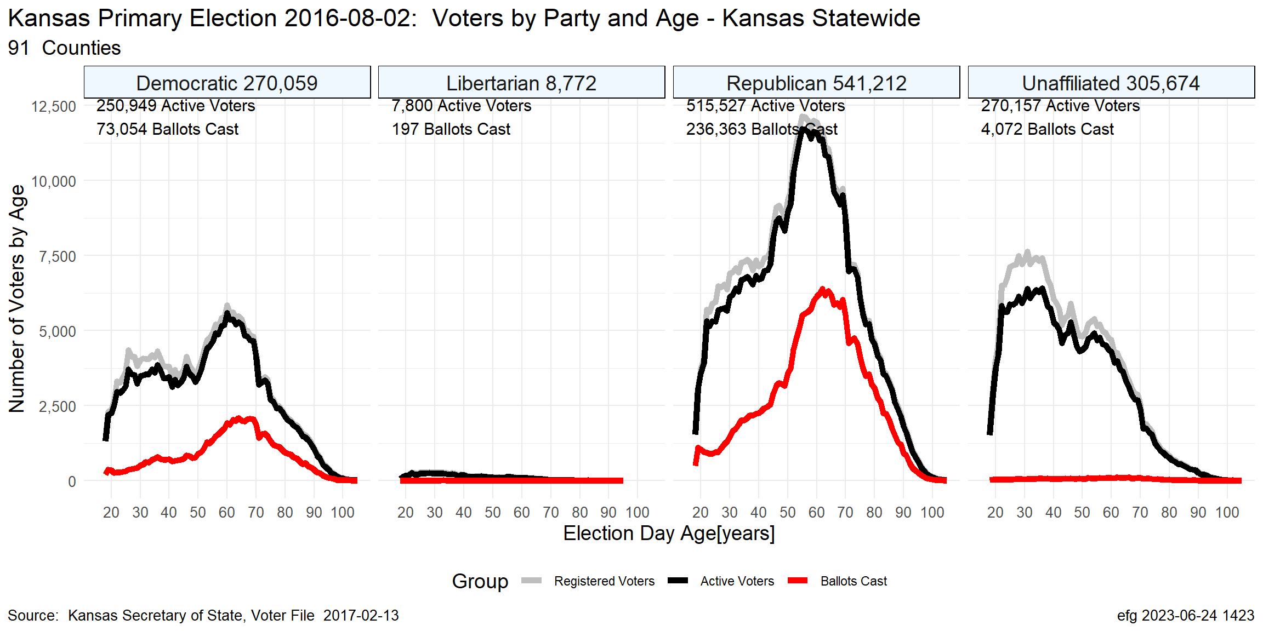
Kansas Aug. 2016

Slide 20
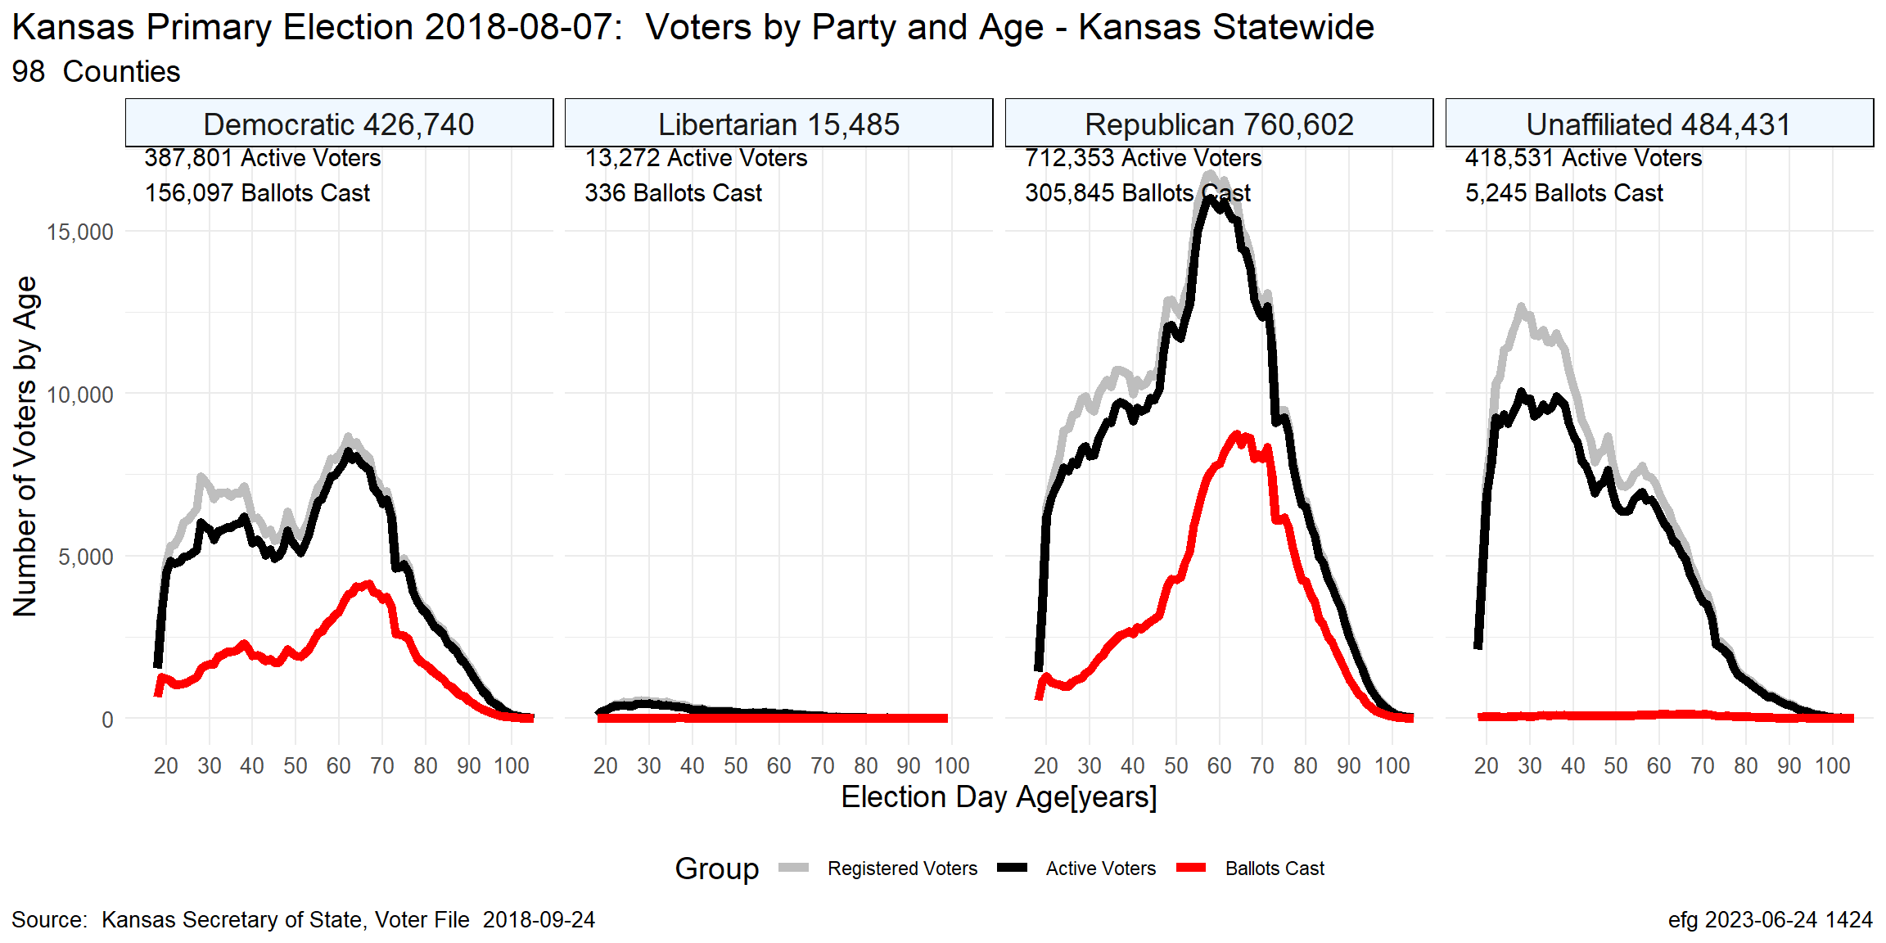
Kansas Aug. 2018

Slide 21
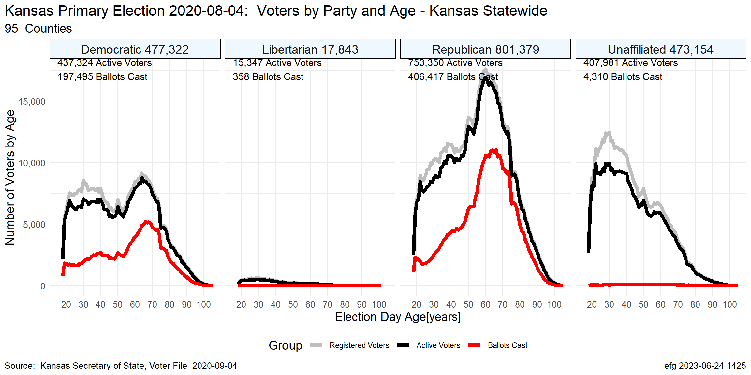
Kansas Aug. 2020

Slide 22
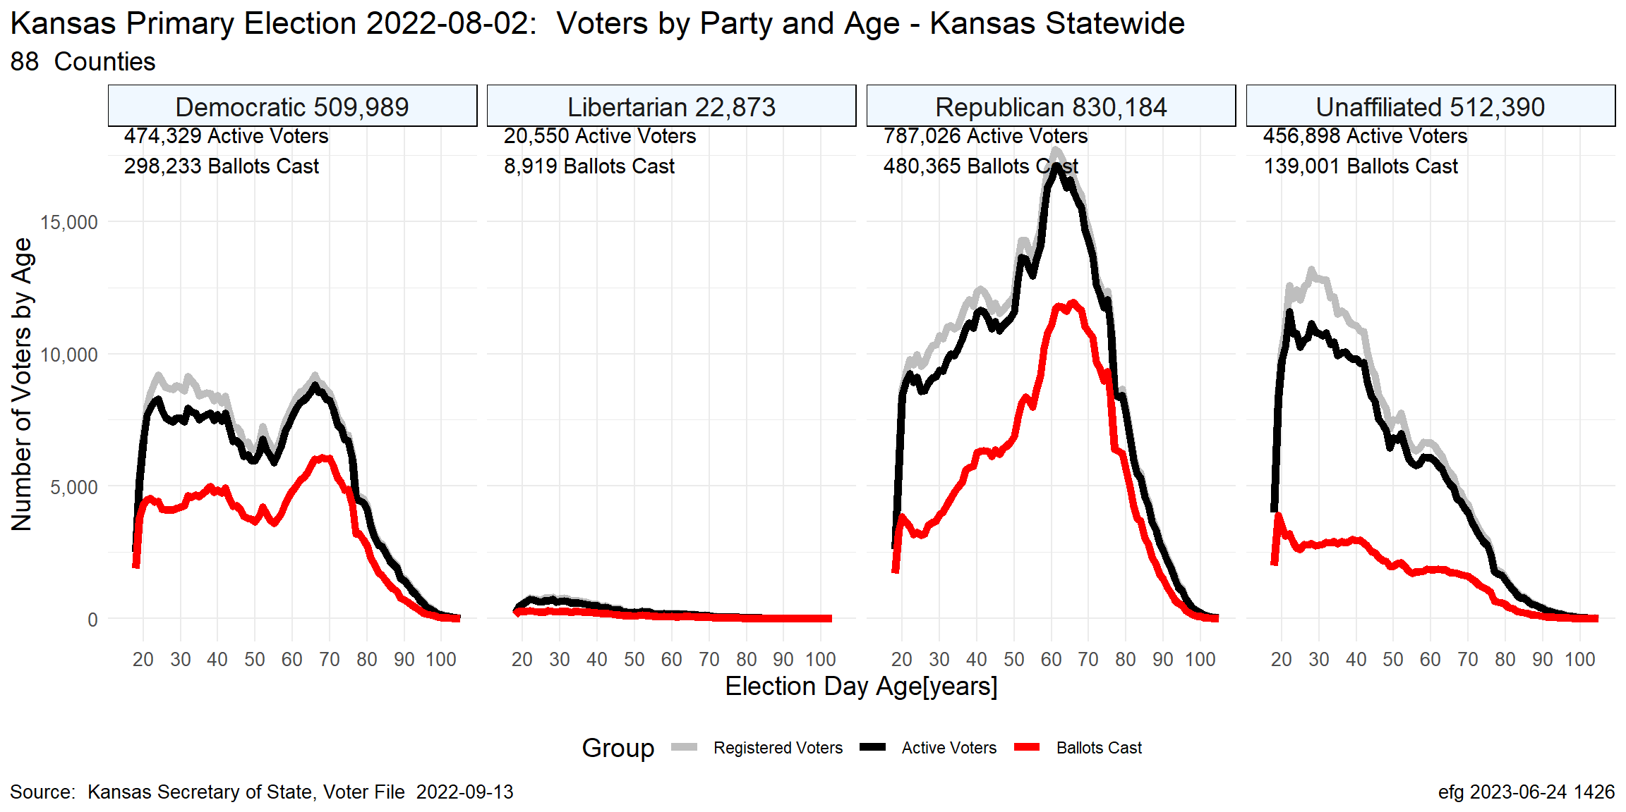
Kansas Aug. 2022

Slide 23
Questions?
Earl F Glynn
efglynn@gmail.com
Notes:
Slide deck created programatically on 2024-01-20 2355

