Slide 1

Exploring MIMIC-III Critical Care Data Using Postgres/tidyverse/dbplyr/dplyr
Earl F Glynn
2019-02-09

Slide 2
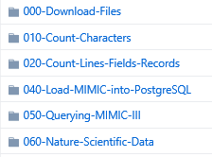
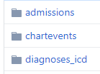

Files on GitHub
https://github.com/EarlGlynn/MIMIC-III-Getting-Started
https://github.com/EarlGlynn/MIMIC-III-Exploration
Future: MIMIC-III-Predictive-Analytics
Quality Checks
count.fields
Loading databse
SQL / dplyr example Jupyter notebook example
Database tables
Others to be added

Slide 3
MIMIC-III Critical Care Data Outline
Getting Started with MIMIC-III
Background / Motivation
Training Requirements
Loading Postgres Database
Querying MIMIC-III with SQL or dplyr
MIMIC-III Exploration with tidyverse/dplyr
Patients Table
Admissions Table
Diagnoses Tables
Take Home

Slide 4
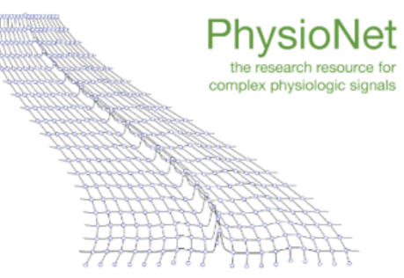
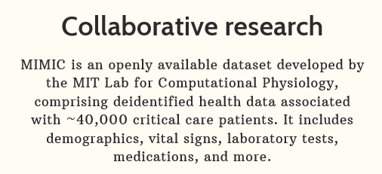
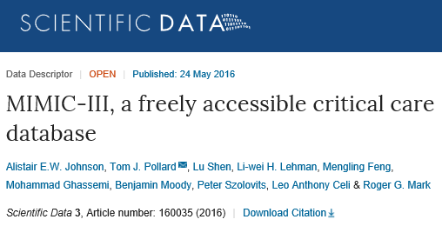
Getting Started with MIMIC-III Background / Motivation
https://mimic.physionet.org/
https://www.nature.com/articles/sdata201635
MIMIC-III supports applications including academic and industrial research, quality improvement initiatives, and higher education coursework.
MIMIC-III is great source for data science experiments, including predictive analytics.

Slide 5
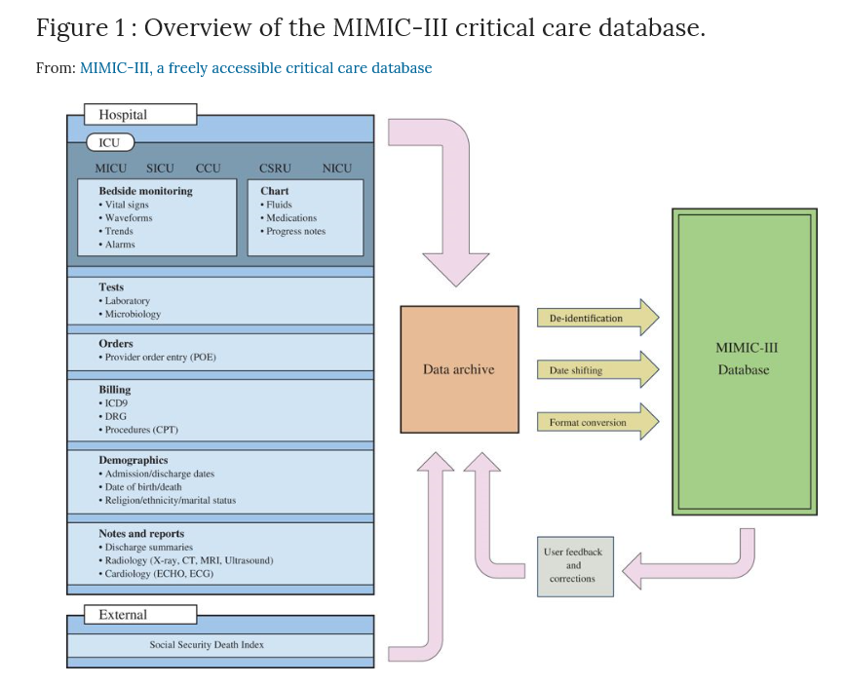
Getting Started with MIMIC-III Background / Motivation
https://www.nature.com/articles/sdata201635

Slide 6
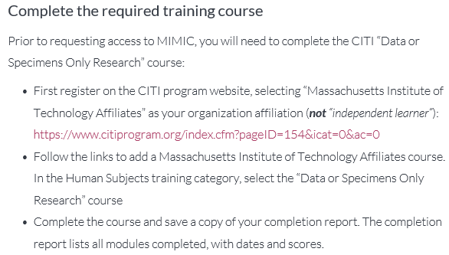
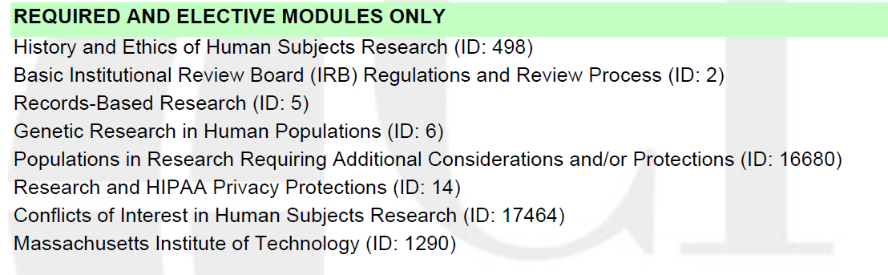
Getting Started with MIMIC-III Training Requirements
https://mimic.physionet.org/gettingstarted/access/
3 to 7
quiz questions
per module

Slide 7
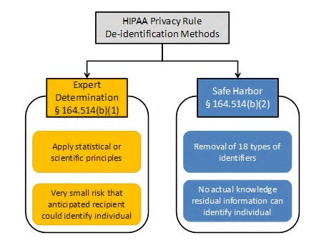
Getting Started with MIMIC-III Training Requirements
Purpose of Training: Protected Health Information (PHI)
https://www.hhs.gov/hipaa/for-professionals/privacy/special-topics/de-identification/index.html
Guidance Regarding Methods for De-identification of Protected Health Information in Accordance with the Health Insurance Portability and Accountability Act (HIPAA) Privacy Rule

Slide 8
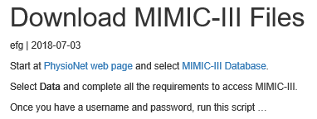
Getting Started with MIMIC-III Loading Postgres Database
https://mimic.physionet.org/gettingstarted/dbsetup/
000-Download-Files/DownloadMIMIC-III.nb.html
Quality checks
010-Count-Characters (see problems in MIMIC-III-character-counts.xlsx)
020-Count-Lines-Fields-Records/MIMIC-III-Will-Files-Parse.nb.html
030-Files-Fields-MetaStats

Slide 9
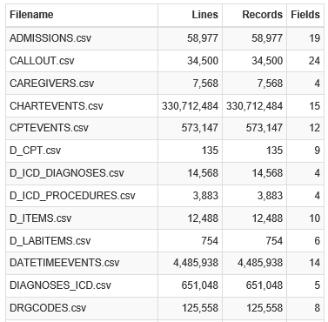
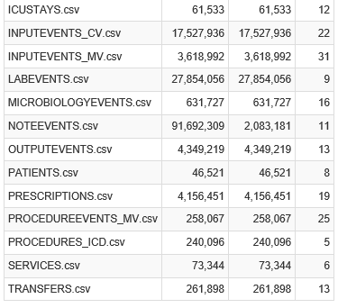
Getting Started with MIMIC-III Loading Postgres Database
MIMIC-III-Will-Files-Parse.nb.html
020-Count-Lines-Fields-Records

Slide 10
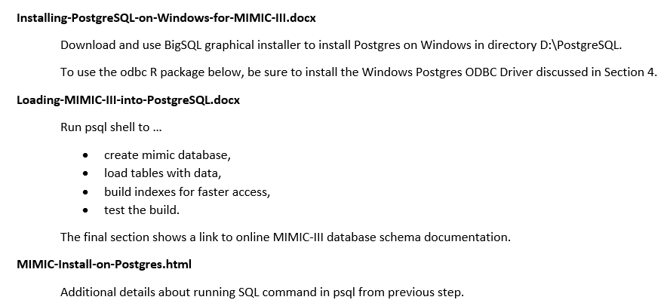
Getting Started with MIMIC-III Loading Postgres Database
040-Load-MIMIC-into-PostgreSQL

Slide 11
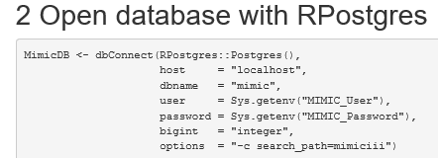
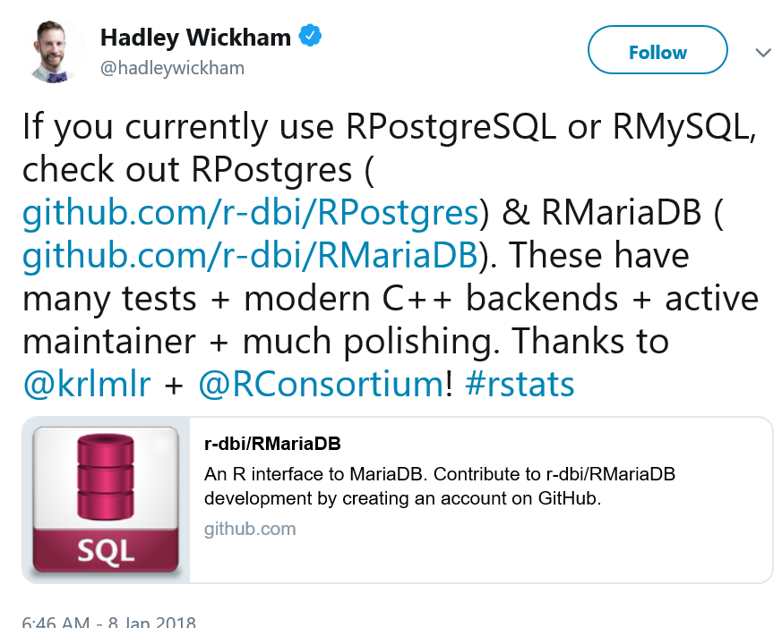




Getting Started with MIMIC-III R Database Driver Packages
“Hide” in file .Renviron
date/time problem (discussed later)
040-Load-MIMIC-into-PostgreSQL/MIMIC-III-First-Look*.html

Slide 12
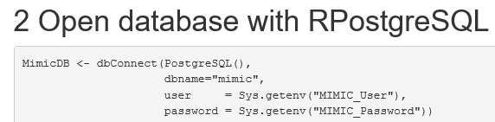
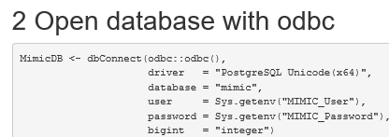
Getting Started with MIMIC-III R Database Driver Packages
Alternative DB Drivers
040-Load-MIMIC-into-PostgreSQL/MIMIC-III-First-Look*.html

Slide 13
Getting Started with MIMIC-III Querying MIMIC-III with SQL or dplyr
050-Querying-MIMIC-III
Reproduce online SQL Examples with dplyr in Rstudio Notebooks
https://mimic.physionet.org/tutorials/intro-to-mimic-iii/
Online examples numbered 3 – 7, plus a tutorial problem in 8 steps
Examples using SQL code chunks
Querying-MIMIC-III-SQL.html
Querying-MIMIC-III-Tutorial-Problem-SQL.html
Equivalent examples with R dplyr code chunks
Querying-MIMIC-III-dplyr.html
Querying-MIMIC-III-Tutorial-Problem-Tidyverse-dplyr.html
These sets of notebooks should help understand equivalent SQL and dplyr solutions

Slide 14

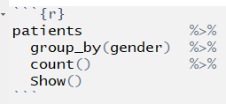
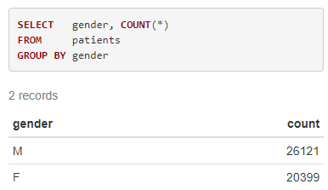
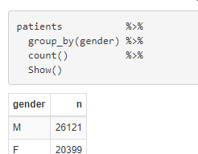
Getting Started with MIMIC-III Querying MIMIC-III with SQL or dplyr
Example 3. Patient Numbers
SQL Chunk
R Chunk
050-Querying-MIMIC-III/Querying-MIMIC-III-SQL.html
050-Querying-MIMIC-III/Querying-MIMIC-III-dplyr.html

Slide 15
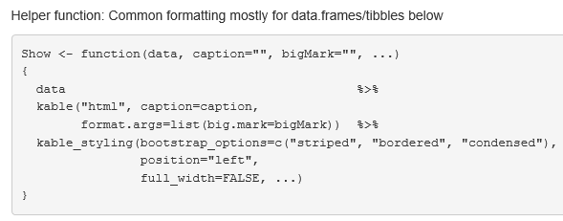

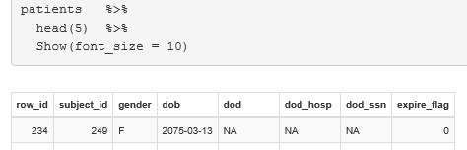
Getting Started with MIMIC-III
Experimental “kable” function to Show results
See “Lazy evaluation” and nonstandard
evaluation (NSE) by
Jenny Bryan at
RStudioConf::2019
~15:00 in video
Also see: Create Awesome HTML Table with knitr::kable and kableExtra
050-Querying-MIMIC-III/Querying-MIMIC-III-dplyr.html

Slide 16
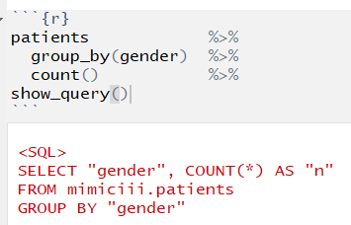
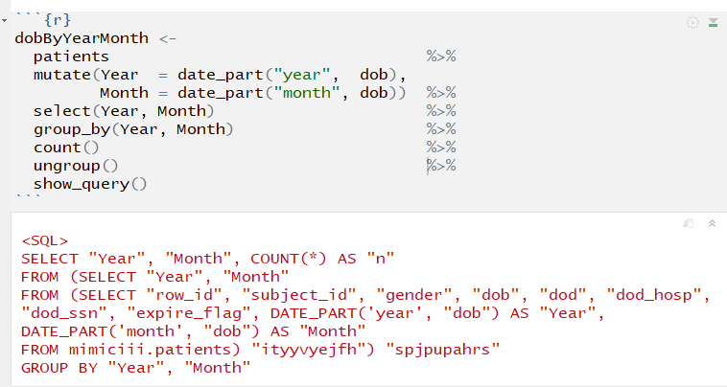
Getting Started with MIMIC-III Querying MIMIC-III with SQL or dplyr
dbplyr “magic” automatically creates SQL
show_query reveals generated SQL
Functions not recognized by dbplyr are passed to database server for evaluation, e.g., date_part is passed to Postgres. (COUNT_BIG can be passed to MS SQL.) Some R functions are translated to SQL (str_flatten but not paste).

Slide 17
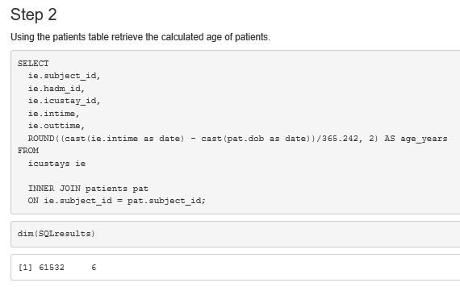
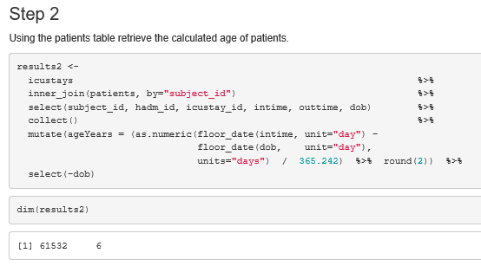
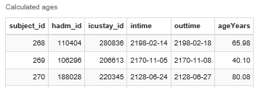
Getting Started with MIMIC-III Querying MIMIC-III with SQL or dplyr
Tutorial. Step 2
SQL
dplyr
DB
R
dbplyr uses “lazy evaluation.” collect forces
computation of database query.
050-Querying-MIMIC-III/Querying-MIMIC-III-Tutorial-Problem-SQL.html
050-Querying-MIMIC-III/Querying-MIMIC-III-Tutorial-Problem-Tidyverse-dplyr.html

Slide 18
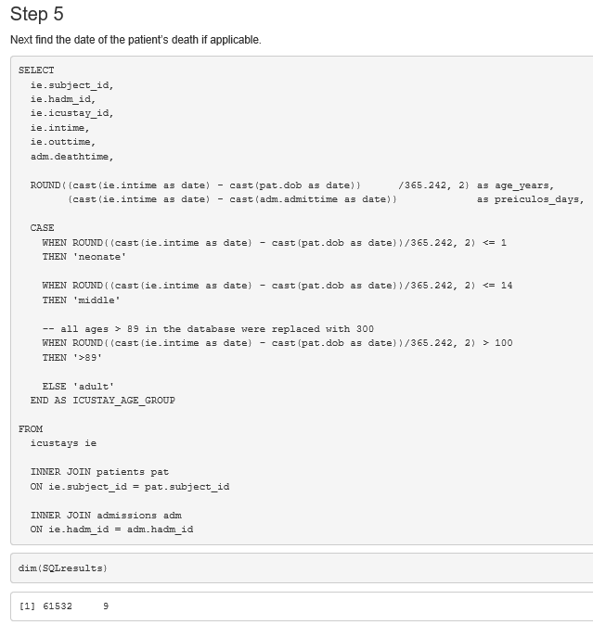

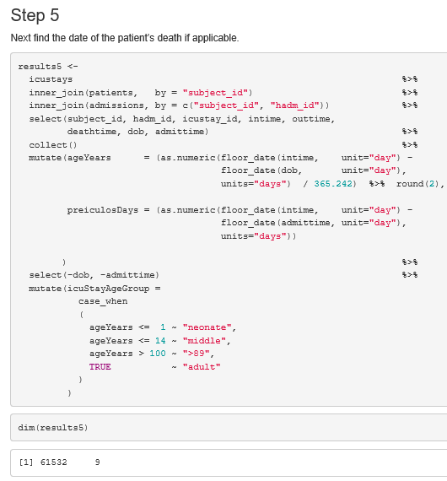
Getting Started with MIMIC-III Querying MIMIC-III with SQL or dplyr
Tutorial. Step 5
SQL
dplyr
DB
R

Slide 19
MIMIC-III Critical Care Data Outline
Getting Started with MIMIC-III
Background / Motivation
Training Requirements
Loading Postgres Database
Querying MIMIC-III with SQL or dplyr
MIMIC-III Exploration with tidyverse/dplyr
Patients Table
Admissions Table
Diagnoses Tables
Take Home

Slide 20
MIMIC-III Exploration
Important to understand data fields before using in analysis projects.
Avoid “garbage in, garbage out.”
A data dictionary or code book can be helpful but often can be inadequate or out-of-date.
Database schema can help with relationships among tables, but provides little information about data fields.
Want a “statistical abstract” of table and fields as a starting point.
Goal is “clean” and understandable data to build predictive models.

Slide 21
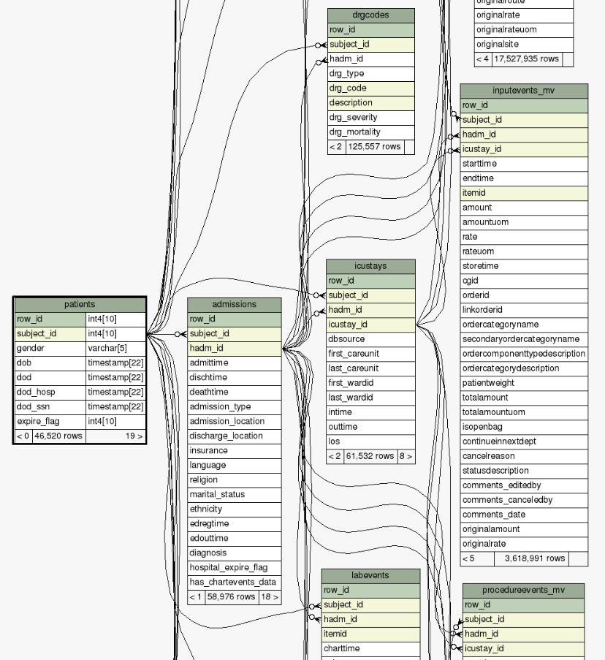
MIMIC-III Exploration
Online Schema Shows Complicated Relationships

Slide 22
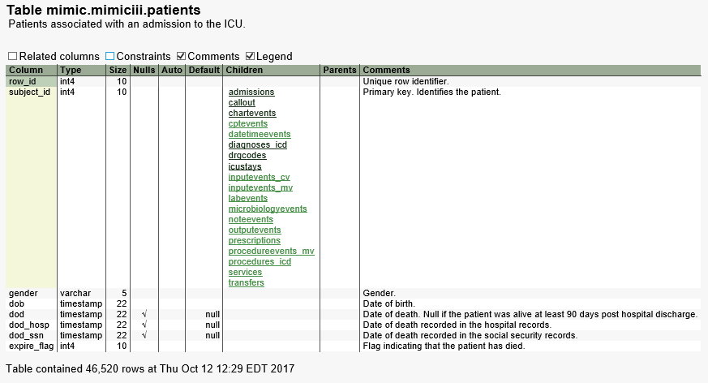
MIMIC-III Exploration
Online Schema Shows Terse Field Information
https://mit-lcp.github.io/mimic-schema-spy/tables/patients.html

Slide 23
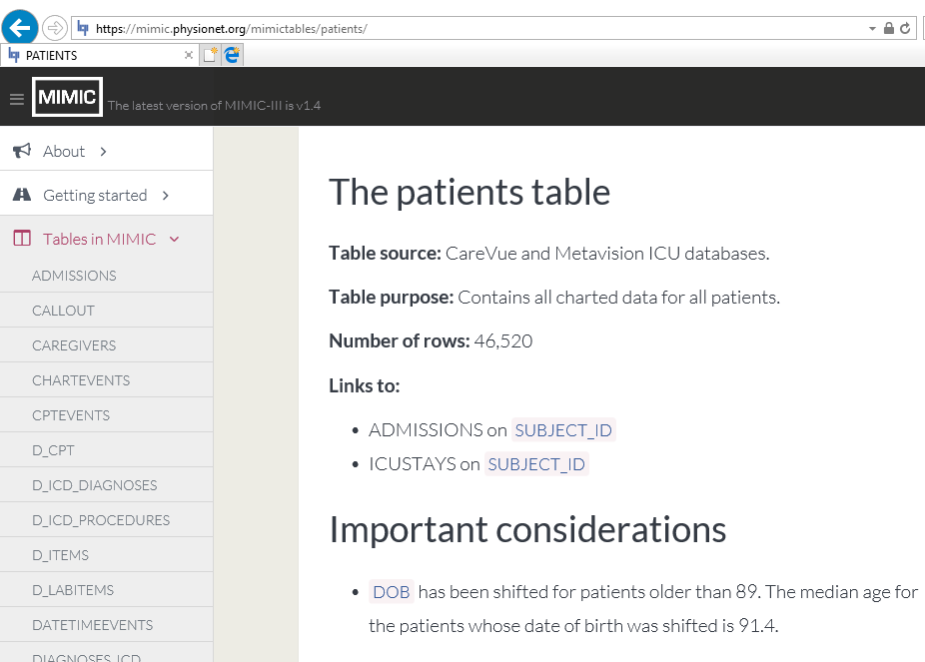
MIMIC-III Exploration
Online info about patients table
DOB ranges from 1800 to 2201!
https://mimic.physionet.org/mimictables/patients/

Slide 24
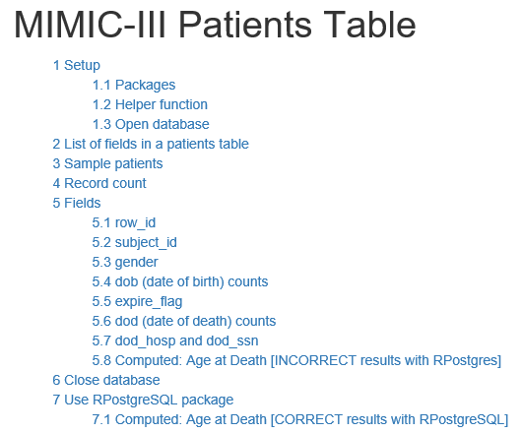
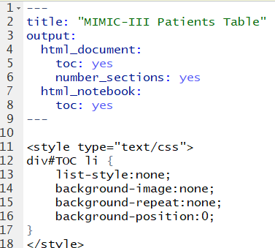
MIMIC-III Exploration Patients Table
RStudio Notebook
YAML Markdown Header
patients/Patients.html

Slide 25
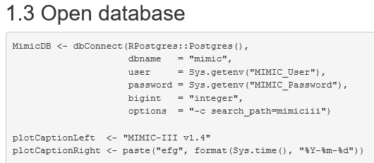
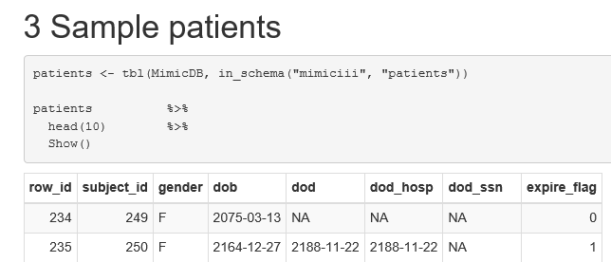
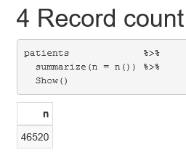
MIMIC-III Exploration Patients Table
patients/Patients.html

Slide 26
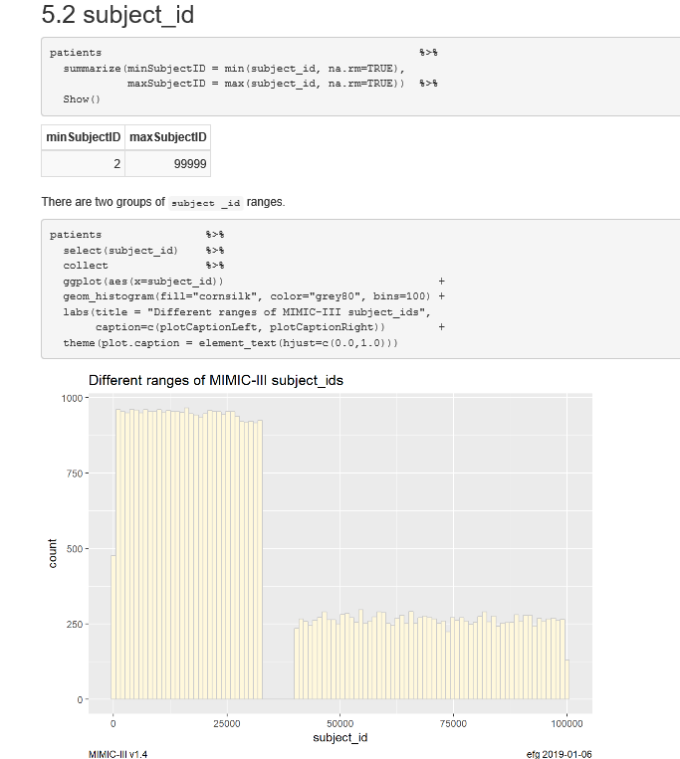
MIMIC-III Exploration Patients Table
What explains this?
dbsource in icustays table?
patients/Patients.html

Slide 27
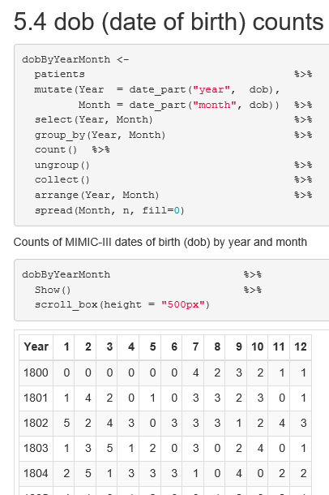
MIMIC-III Exploration Patients Table
To de-identify patients, dates
have been shifted over a 400 year
range. [Unusual convention]
Date-of-birth values range from
1800 to 1901 and 2012 to 2201.
Date-of-death values range from 2100 to 2211.
Year-over-year trends will be impossible to observe, which is often a good self-consistency check.
DB
R
patients/Patients.html

Slide 28
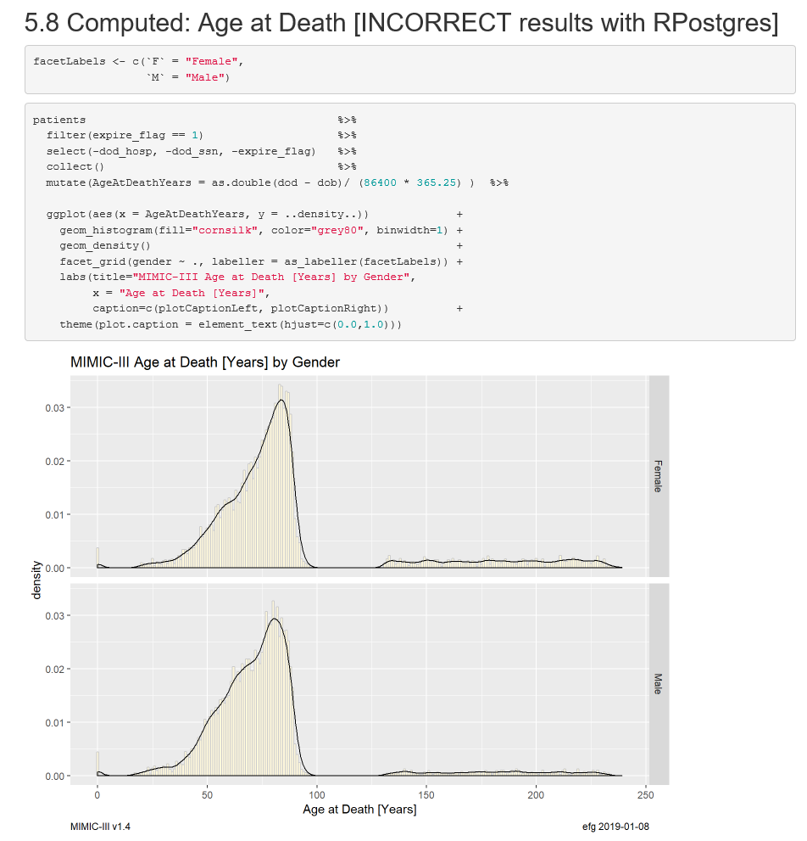
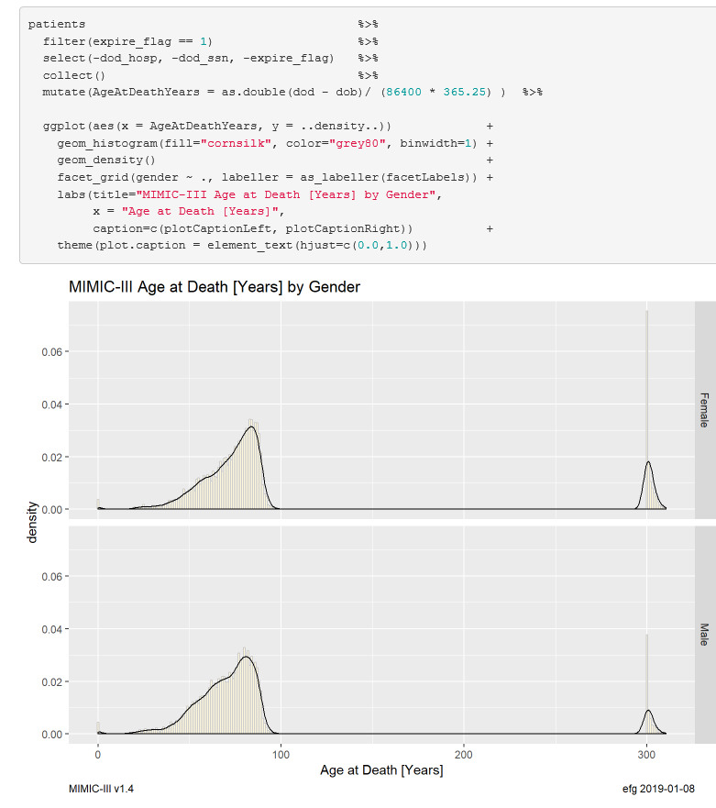
MIMIC-III Exploration Patients Table
patients/Patients.html

Slide 29
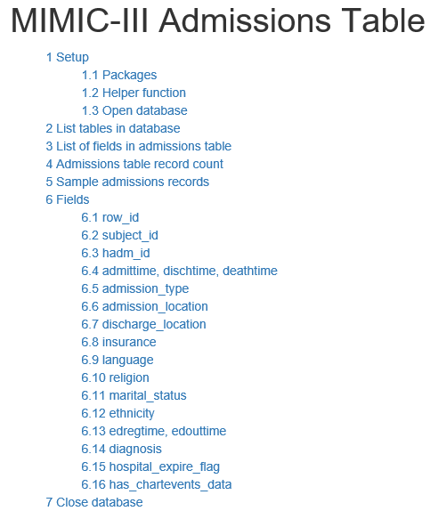
MIMIC-III Exploration Admissions Table
admissions/Admissions.html

Slide 30
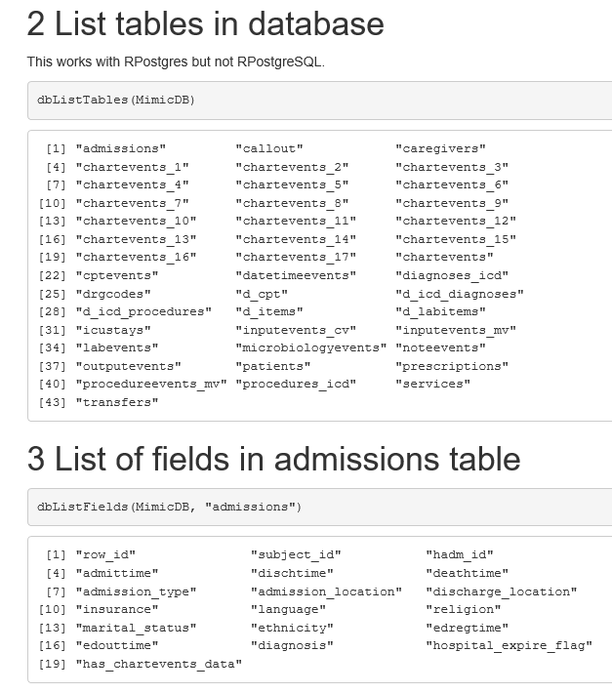
MIMIC-III Exploration Admissions Table
admissions/Admissions.html

Slide 31
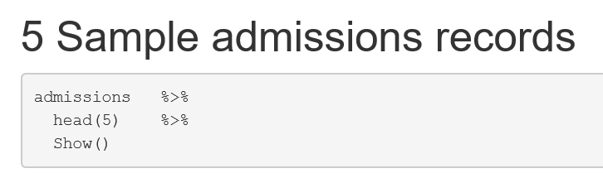
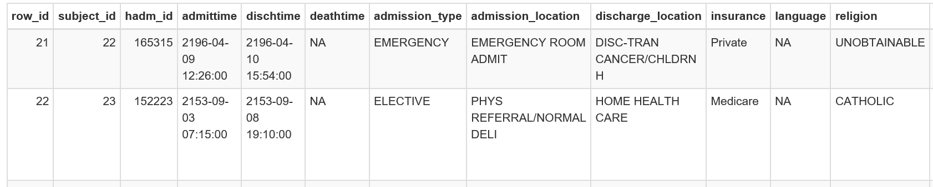
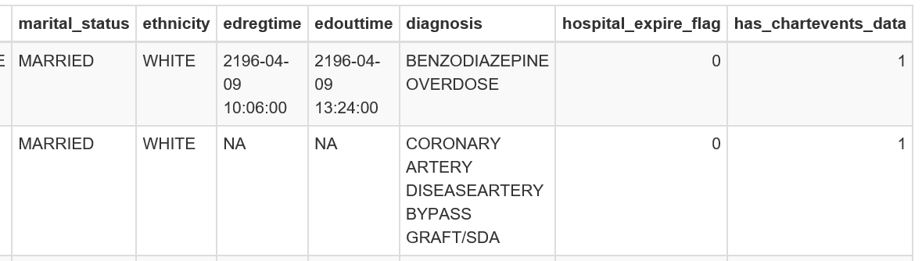
MIMIC-III Exploration Admissions Table
admissions/Admissions.html

Slide 32
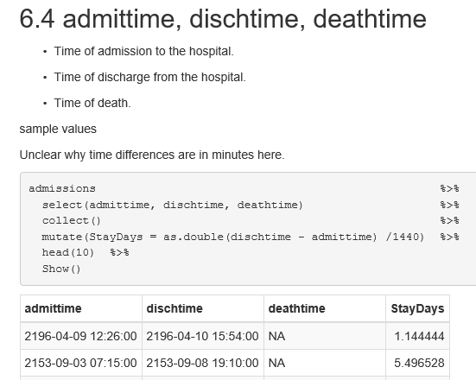
MIMIC-III Exploration Admissions Table
admissions/Admissions.html

Slide 33
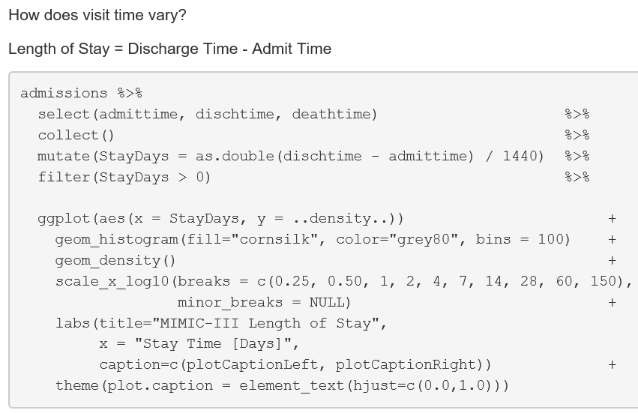
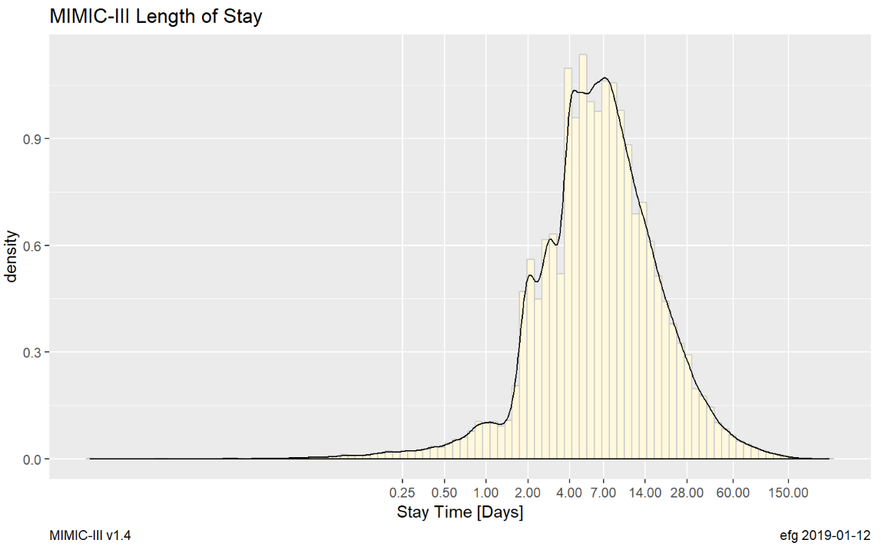
MIMIC-III Exploration Admissions Table
Note log scale
Length-of-Stays often used in predictive modeling
admissions/Admissions.html

Slide 34
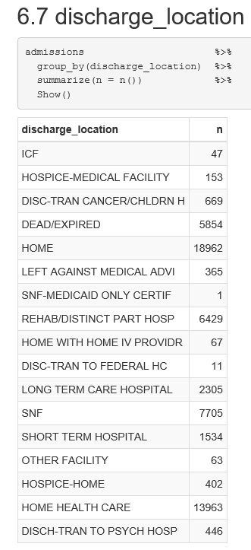

MIMIC-III Exploration Admissions Table
admissions/Admissions.html

Slide 35

MIMIC-III Exploration Diagnoses Tables
diagnoses_icd/Diagnoses.html

Slide 36

MIMIC-III Exploration Diagnoses Tables
“fact”
“dimension”
https://mit-lcp.github.io/mimic-schema-spy/tables/diagnoses_icd.html

Slide 37






MIMIC-III Exploration Diagnoses Tables
Fact Table
Dimension Table
diagnoses_icd/Diagnoses.html

Slide 38

MIMIC-III Exploration Diagnoses Tables
Inner Join
Join dimension table to fact table
diagnoses_icd/Diagnoses.html
Remove with: select(-starts_with("row_id"))

Slide 39

MIMIC-III Exploration Diagnoses Tables
Inner Join
Fact
Dimension
diagnoses_icd/Diagnoses.html

Slide 40


MIMIC-III Exploration Diagnoses Tables
Inner Join: Missing Records?
651,047 – 634,709 = 16,338 missing records
Dimension table does not have entries for ~144 icd9_codes in fact table.
One way to fix: update the dimension table to have all possible codes.
diagnoses_icd/Diagnoses.html

Slide 41


MIMIC-III Exploration Diagnoses Tables
Left Join fills in NULL values
Database NULLs become NAs
diagnoses_icd/Diagnoses.html

Slide 42

MIMIC-III Exploration Summarize Diagnoses Counts
diagnoses_icd/Diagnoses.html

Slide 43

MIMIC-III Exploration Summarize Diagnoses Counts: Top 10
diagnoses_icd/Diagnoses.html

Slide 44

MIMIC-III Exploration Summarize Diagnoses by Age Intervals
pmin = parallel min
diagnoses_icd/Diagnoses.html

Slide 45

MIMIC-III Exploration Summarize Diagnoses by Age Intervals
MIMIC-III has fairly old patients and very few teenagers
diagnoses_icd/Diagnoses.html

Slide 46


MIMIC-III Exploration Summarize Diagnoses by Age Intervals
diagnoses_icd/Diagnoses.html

Slide 47

MIMIC-III Exploration Summarize Diagnoses by Age Intervals
diagnoses_icd/Diagnoses.html

Slide 48

MIMIC-III Exploration Summarize Diagnoses by Age Intervals
Can be a “shopping” list to identify research cohorts.
diagnoses_icd/Diagnoses.html

Slide 49

MIMIC-III Exploration Summarize Diagnoses by Age Intervals
diagnoses_icd/Diagnoses.html

Slide 50


Take Home
MIMIC-III is a great data source for data science experiments and predictive analytics projects involving electronic health records.
MIMIC-IV to appear in 2019?
Waveform and chest x-ray data are available to explore via separate downloads.

