Slide 1
Concerns about Dr. Frank’s Election Analysis
efg
2022-08-24

Slide 2
Concerns about Dr. Frank’s Election Analysis Outline
“Data leakage” in predictive analytics results in overly good fits.
Normalized turnout curves changed little from 2006-2020.
Normalized turnout for a specific age varies slightly by state, county, precinct, but is highly correlated.
A 6th degree polynomial may not be the “best” fit. Isn’t needed.
Correlation is a weak way to compare predictive models.
Turnout varies by gender and political party.
Inflated voter rolls are not new.

Slide 3
“Data leakage” in predictive analytics results in overly good fits
One way “data leakage” occurs is when the development of a predictive model uses data being predicted to create the model.
I may be mistaken, but Dr. Frank’s voter predictions start with a state “key” or a county “key,” which is a normalized voter turnout curve. All these keys are roughly interchangeable.
How are “predictions” for the 2022 elections possible without having the voter registration numbers and actual numbers of voted by age that are not known until after the election?

Slide 4
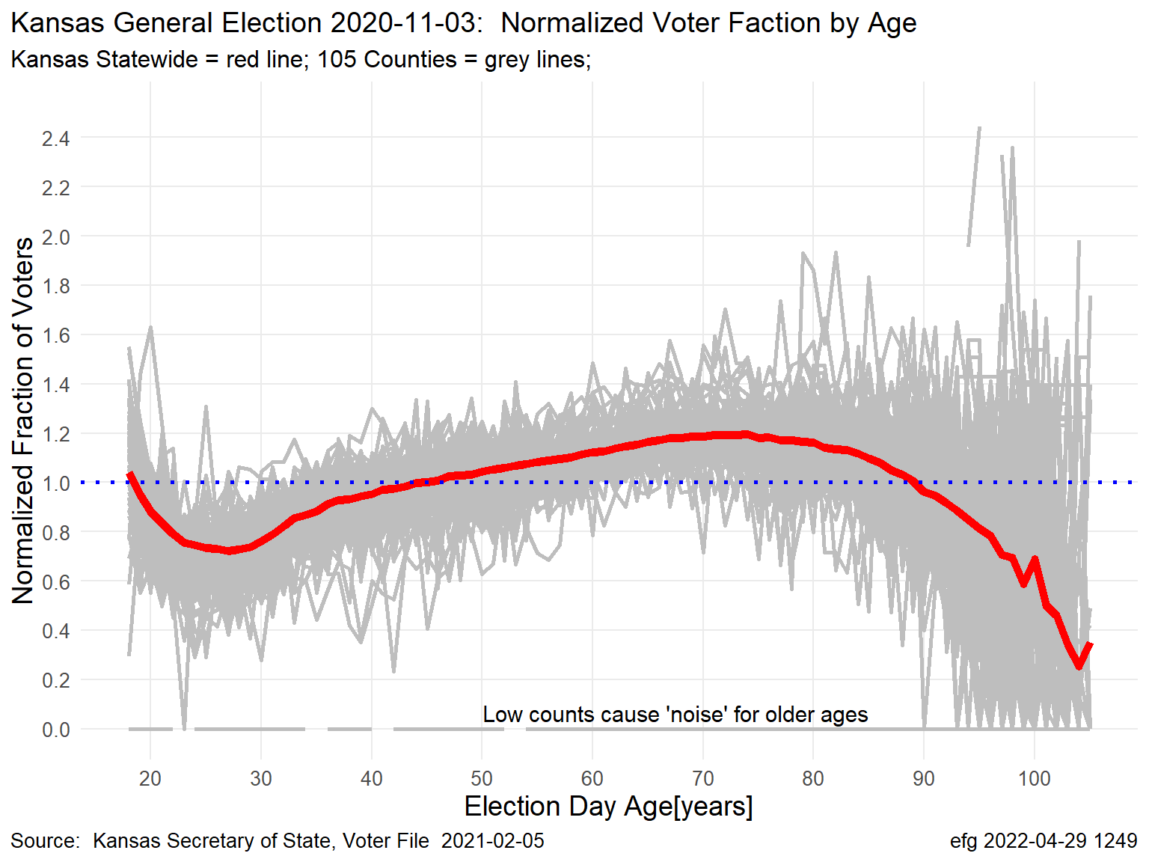
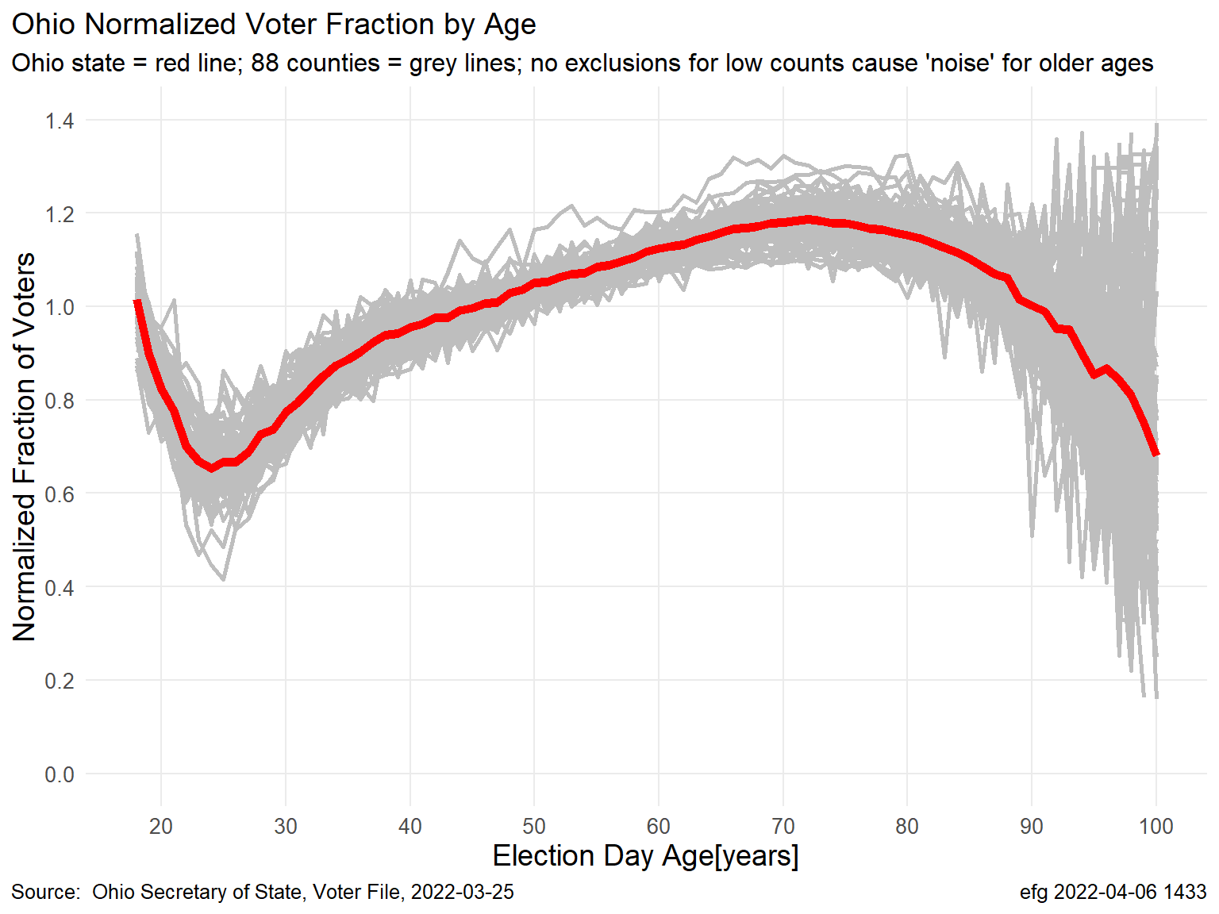
“Data leakage” in predictive analytics results in overly good fits
A statewide “key” or a county “key” is a normalized turnout curve.
The state key and counties keys are so correlated that predictions can be made with any of them, i.e., the state key or any county key.
Notes:
K:\Election-Integrity\Kansas-Normalized-Fraction-of-Voters\Kansas-2020-November-General.pptx
K:\Election-Integrity\Ohio\Ohio-Election-Analysis-Nov-2020.pptx, slide 16
K:/Election-Integrity/Ohio/rlee32/Analysis/Ohio-Key-Heatmap.html, Section 3.1

Slide 5
“Data leakage” in predictive analytics results in overly good fits
But how is this “key” (normalized turnout curve) computed?
For each age interval, 18 to 105 years:
where
Predicted Ballots[age] = Overall Voted Fraction * Turnout Key[age] * Registered[age]
Using Nov 2020 voters in the key computation is DATA LEAKAGE when used for predictions.
Normalized Fraction Voted[age] = $\frac{\frac{Nov 2020 voters [age]}{Registered voters[age]}}{Overall Voted Fraction}$ = Turnout Key[age] fitted with polynomial
Overall Voted Fraction = Overall Turnout = $\frac{\sum_{age}{Nov 2020 voters}}{\sum_{age}{Registered voters}}$
Notes:
K:\Election-Integrity\Ohio\Ohio-Election-Analysis-Nov-2020.pptx, slide 13
See example in Correlation is a weak way to compare predictive models section

Slide 6
“Data leakage” in predictive analytics results in overly good fits
After computing the “key” (normalized turnout curve) using the actual counts of Nov 2020 voters, the prediction of ballots cast is based on the original numbers of registered voters.
This is predictive analytics “data leakage” and explains the overly good prediction fits that have been observed everywhere.
The “key” contains information about the relative turnout by age for the specific election being predicted, which is why the predictions are so close.
Using the 6th degree polynomial adds some “fuzz” to the computations.
Notes:
K:\Election-Integrity\Ohio\Ohio-Election-Analysis-Nov-2020.pptx, slide 13
See example in Correlation is a weak way to compare predictive models section, and specifically the page Accuracy Better than Correlation for Assessing Predictions

Slide 7
Normalized turnout curves changed little from 2006-2020
Raw Turnout
Percentage Turnout
Normalized Turnout for State
Normalized Turnout for Each County

Slide 8
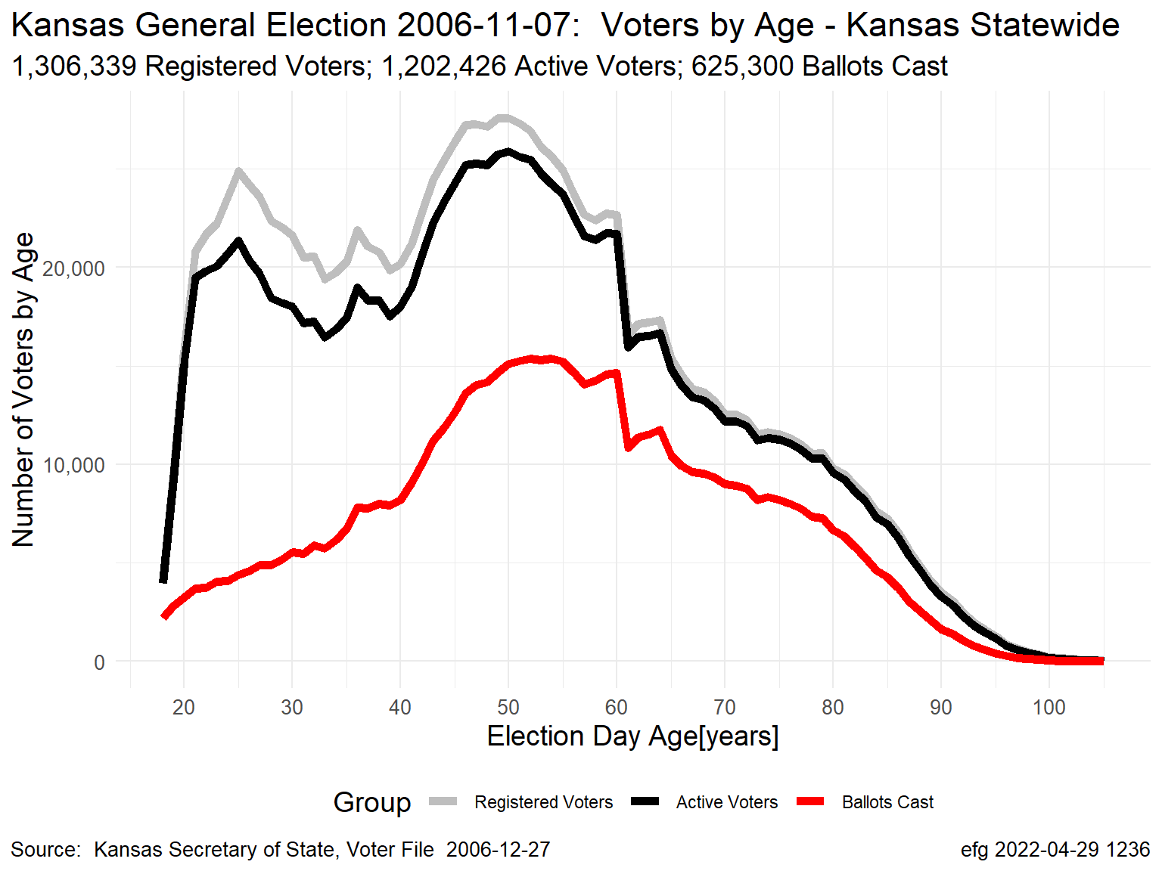
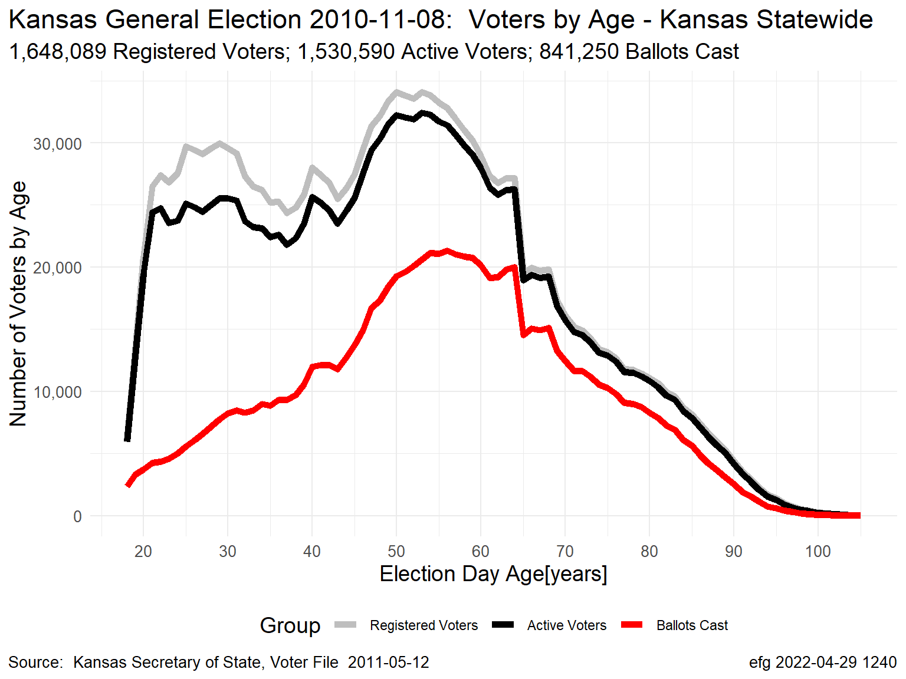
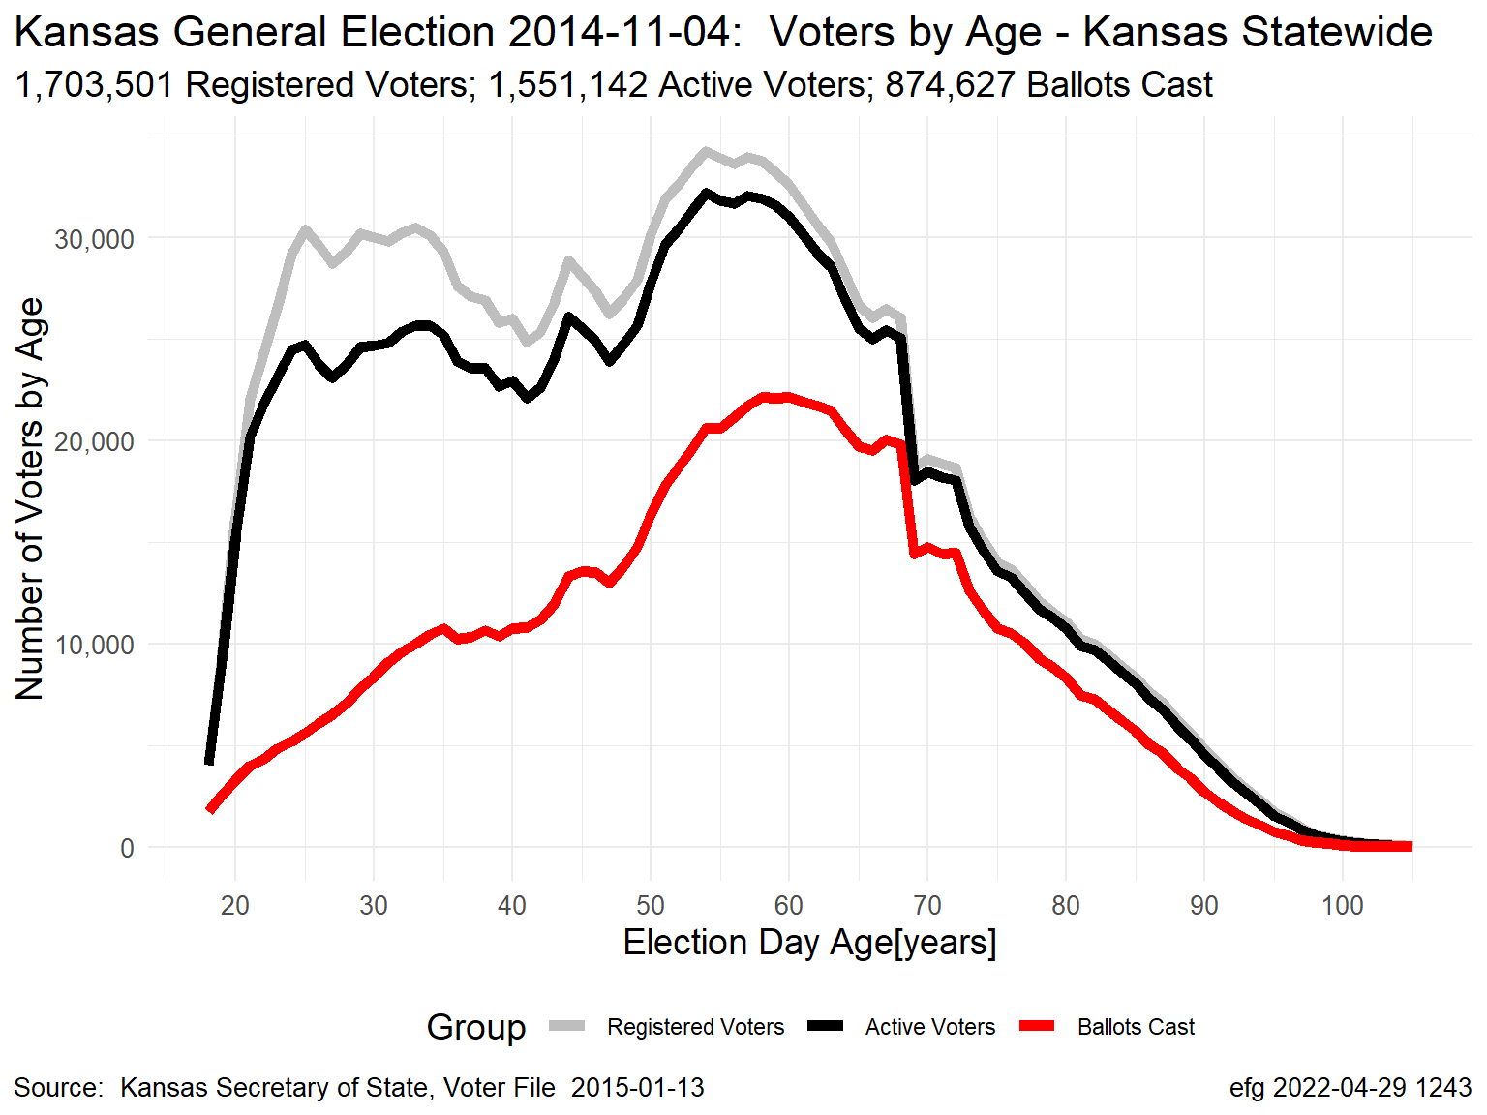
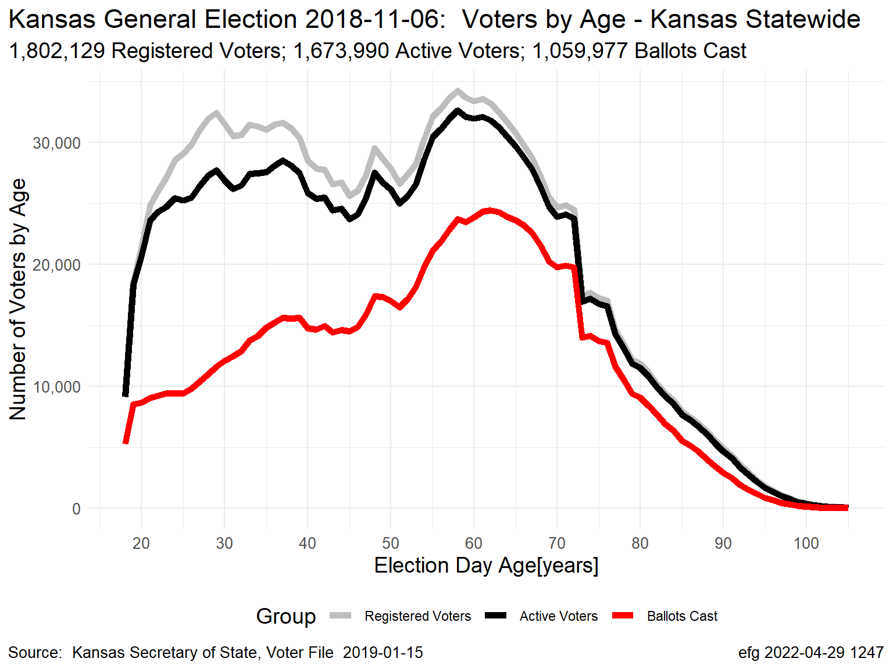
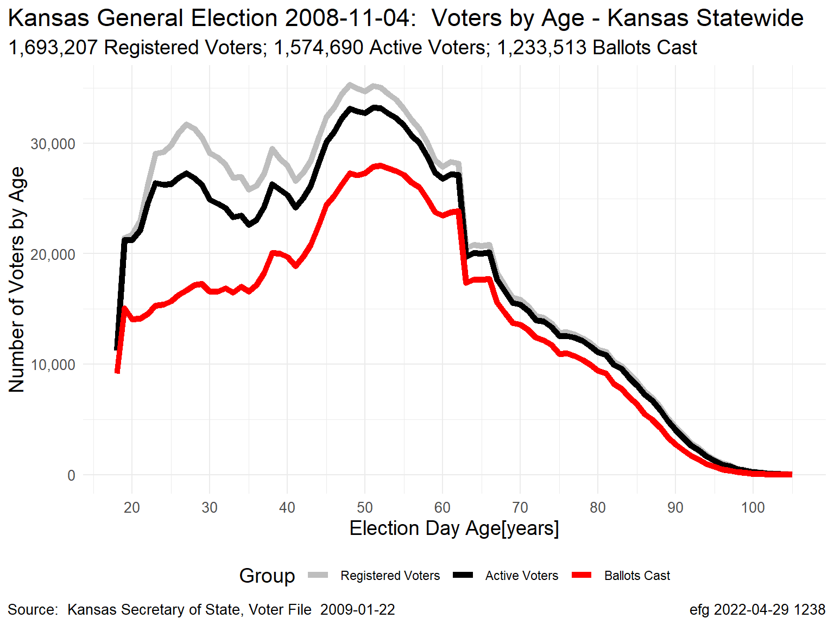
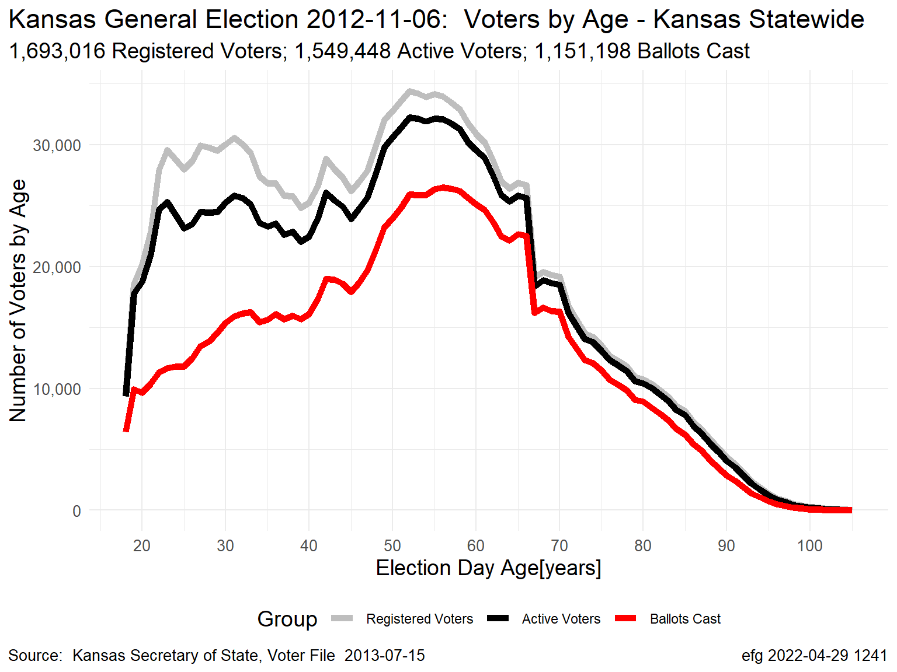
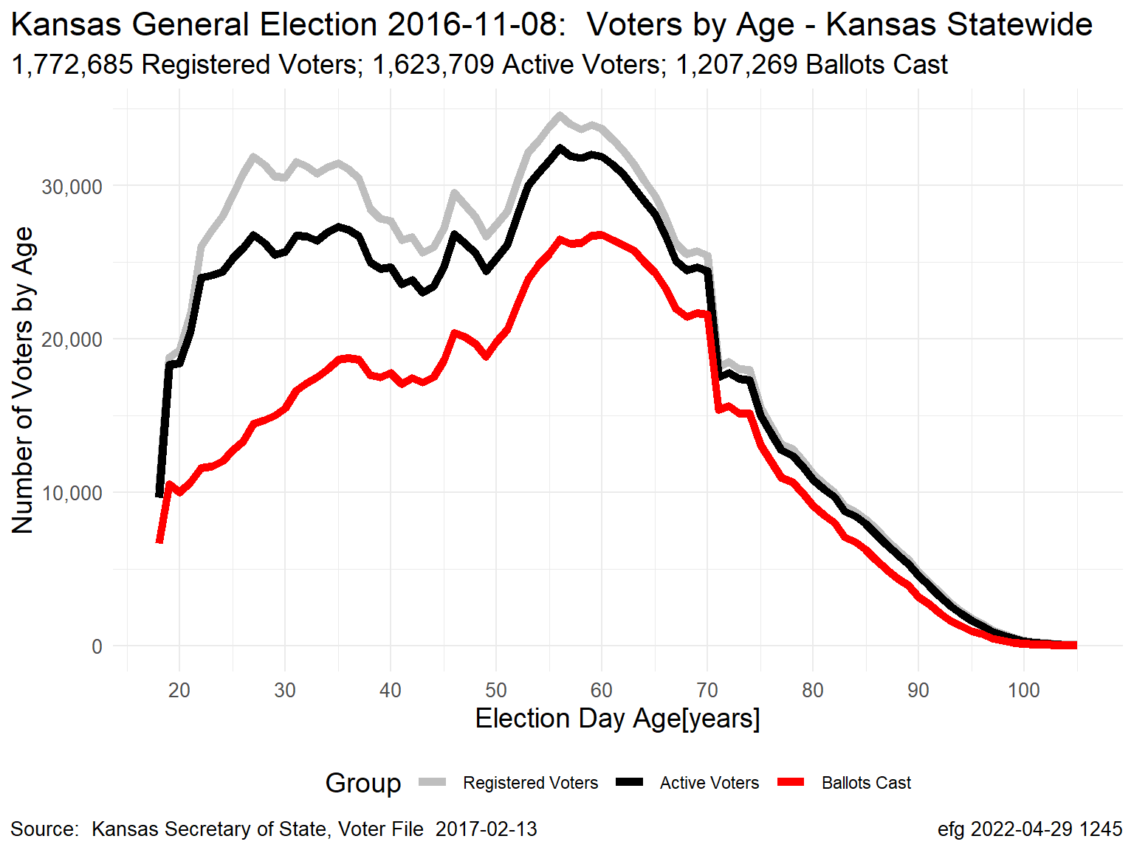
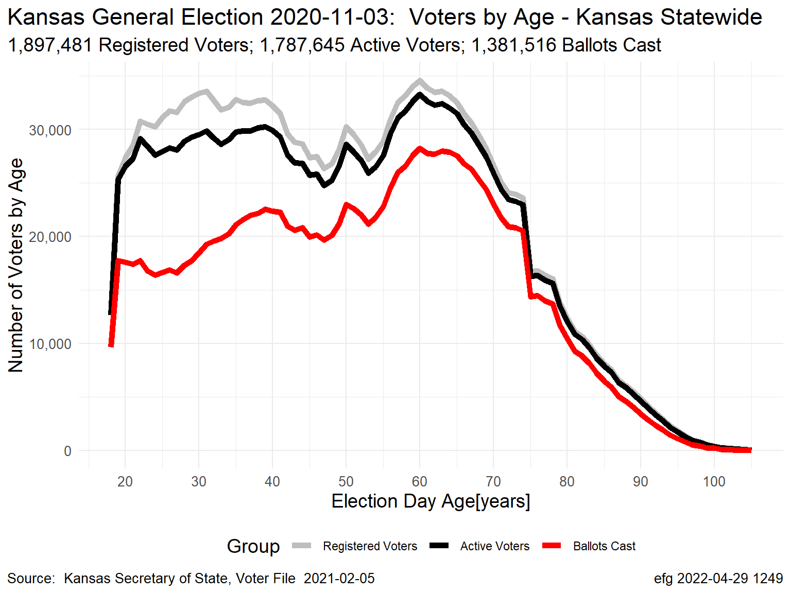
Kansas November General Elections: Voter Counts by Age
Raw Turnout
Grey Line = Registered Voters; Black Line = “Active” Voters; Red Line = Ballots Cast
Gubernatorial Election Years
2006
2010
2014
2018
Presidential Election Years
2008
2012
2016
2020
Notes:
Kansas-2006-2020-November-General-Normalized-Voter-Turnout.pptx, slide 2
K:\Election-Integrity\Kansas-Normalized-Fraction-of-Voters

Slide 9
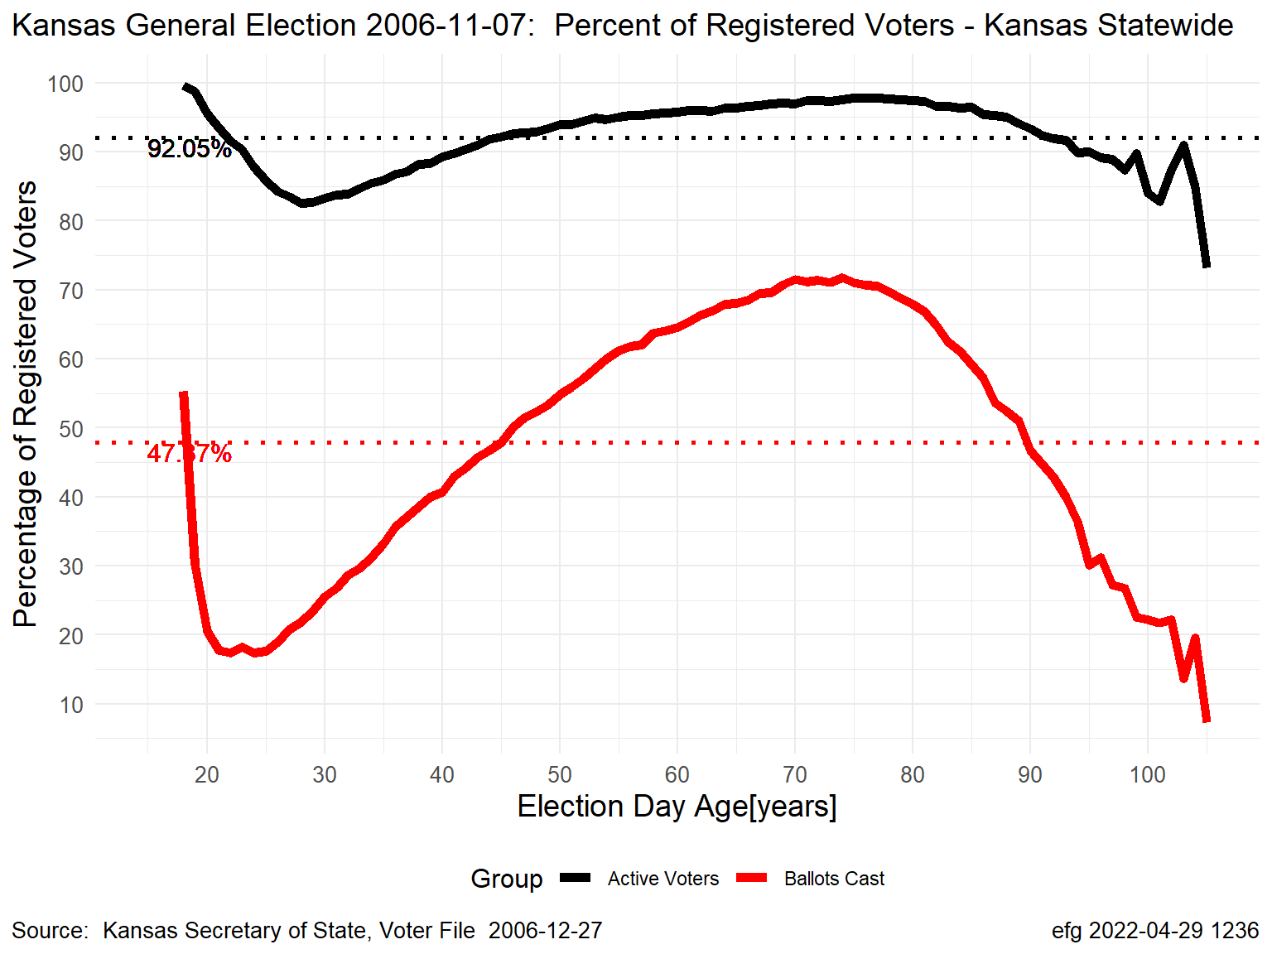
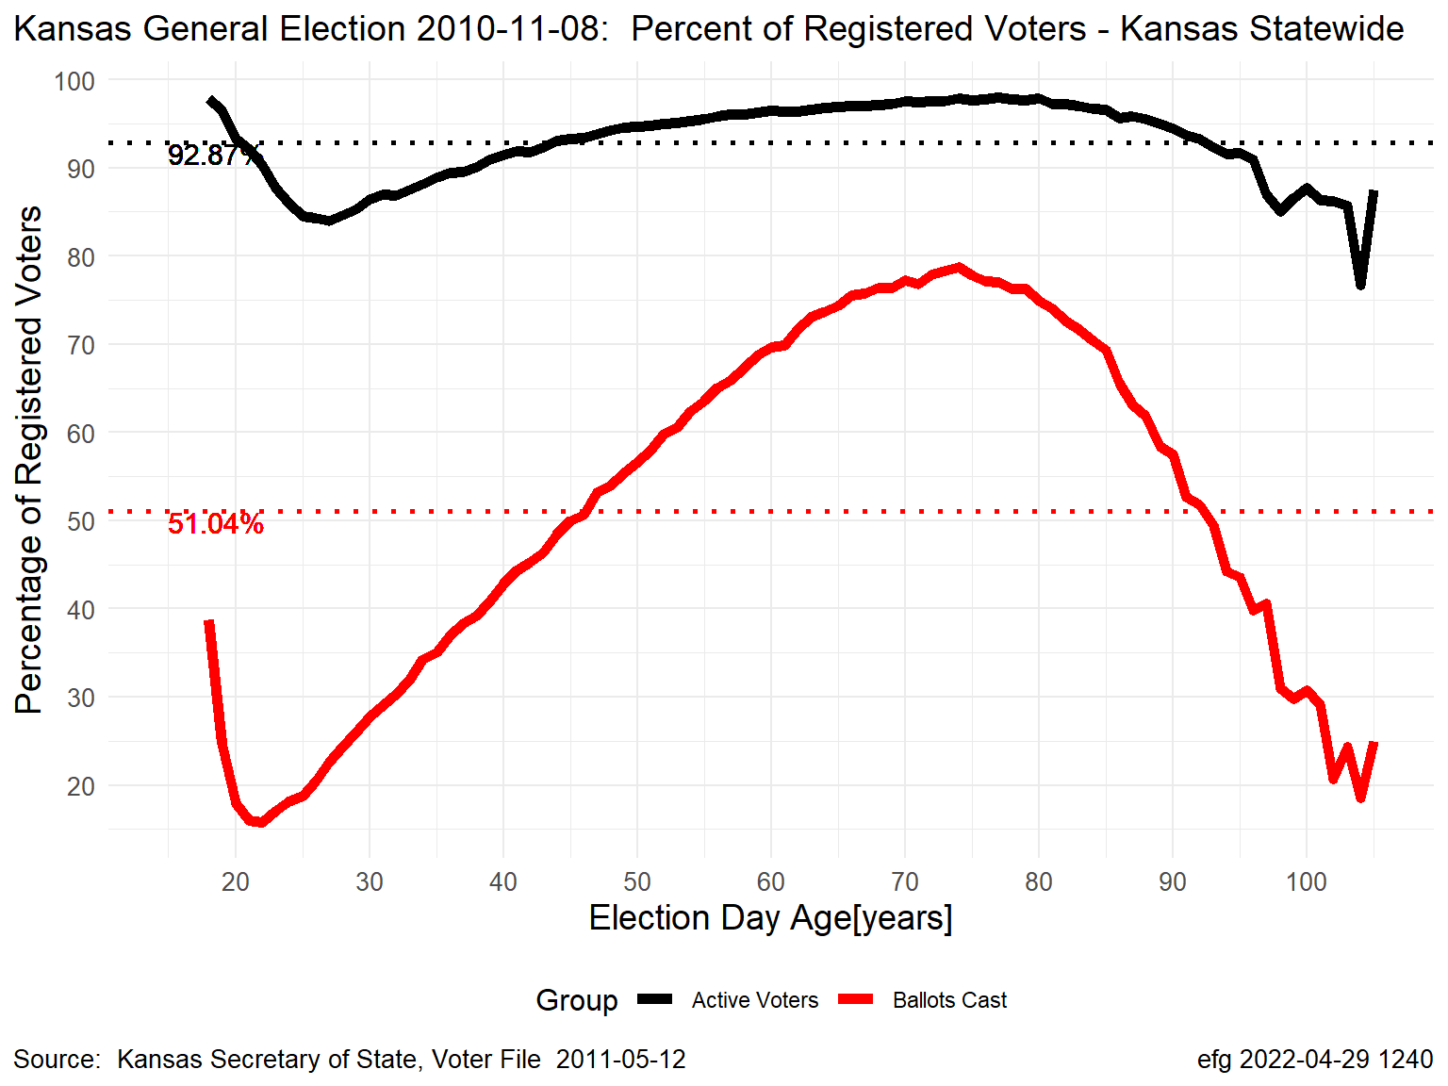
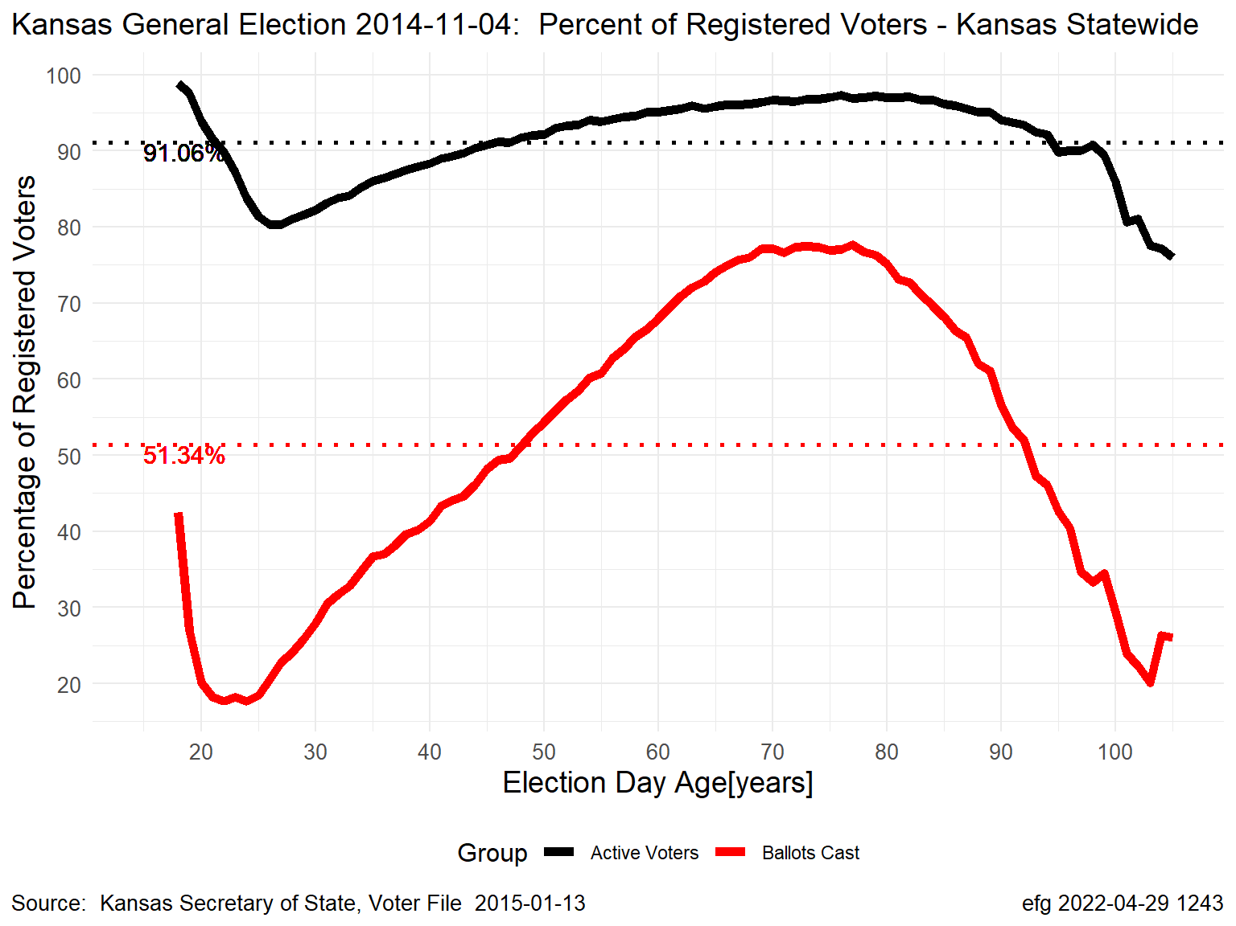
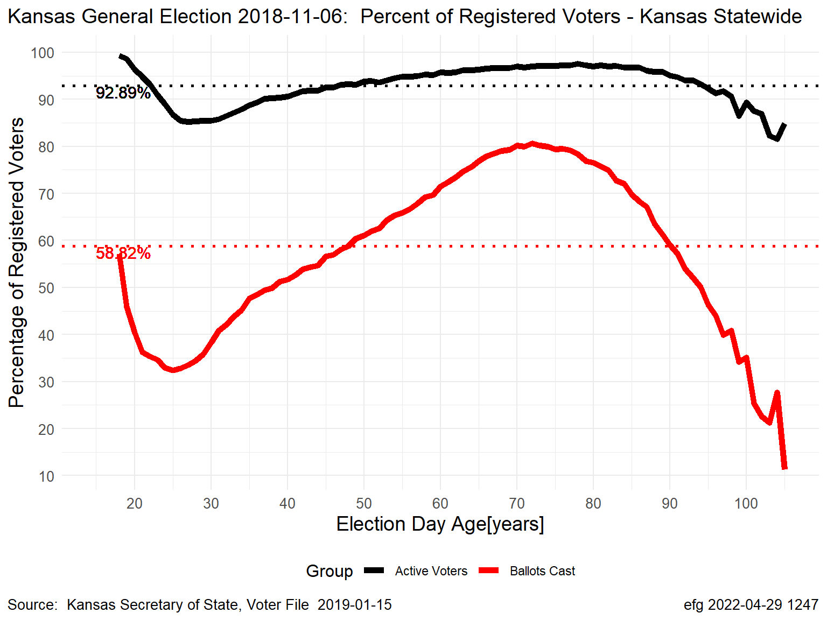
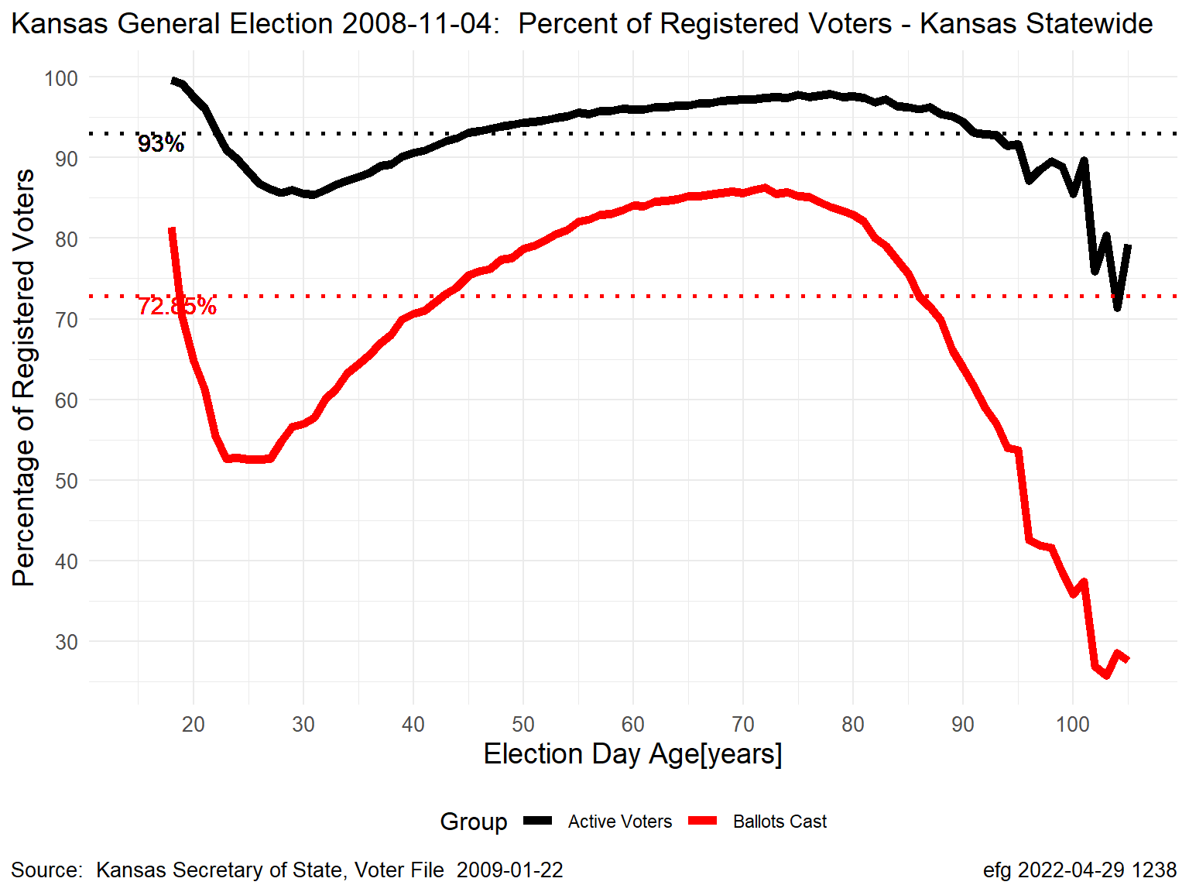
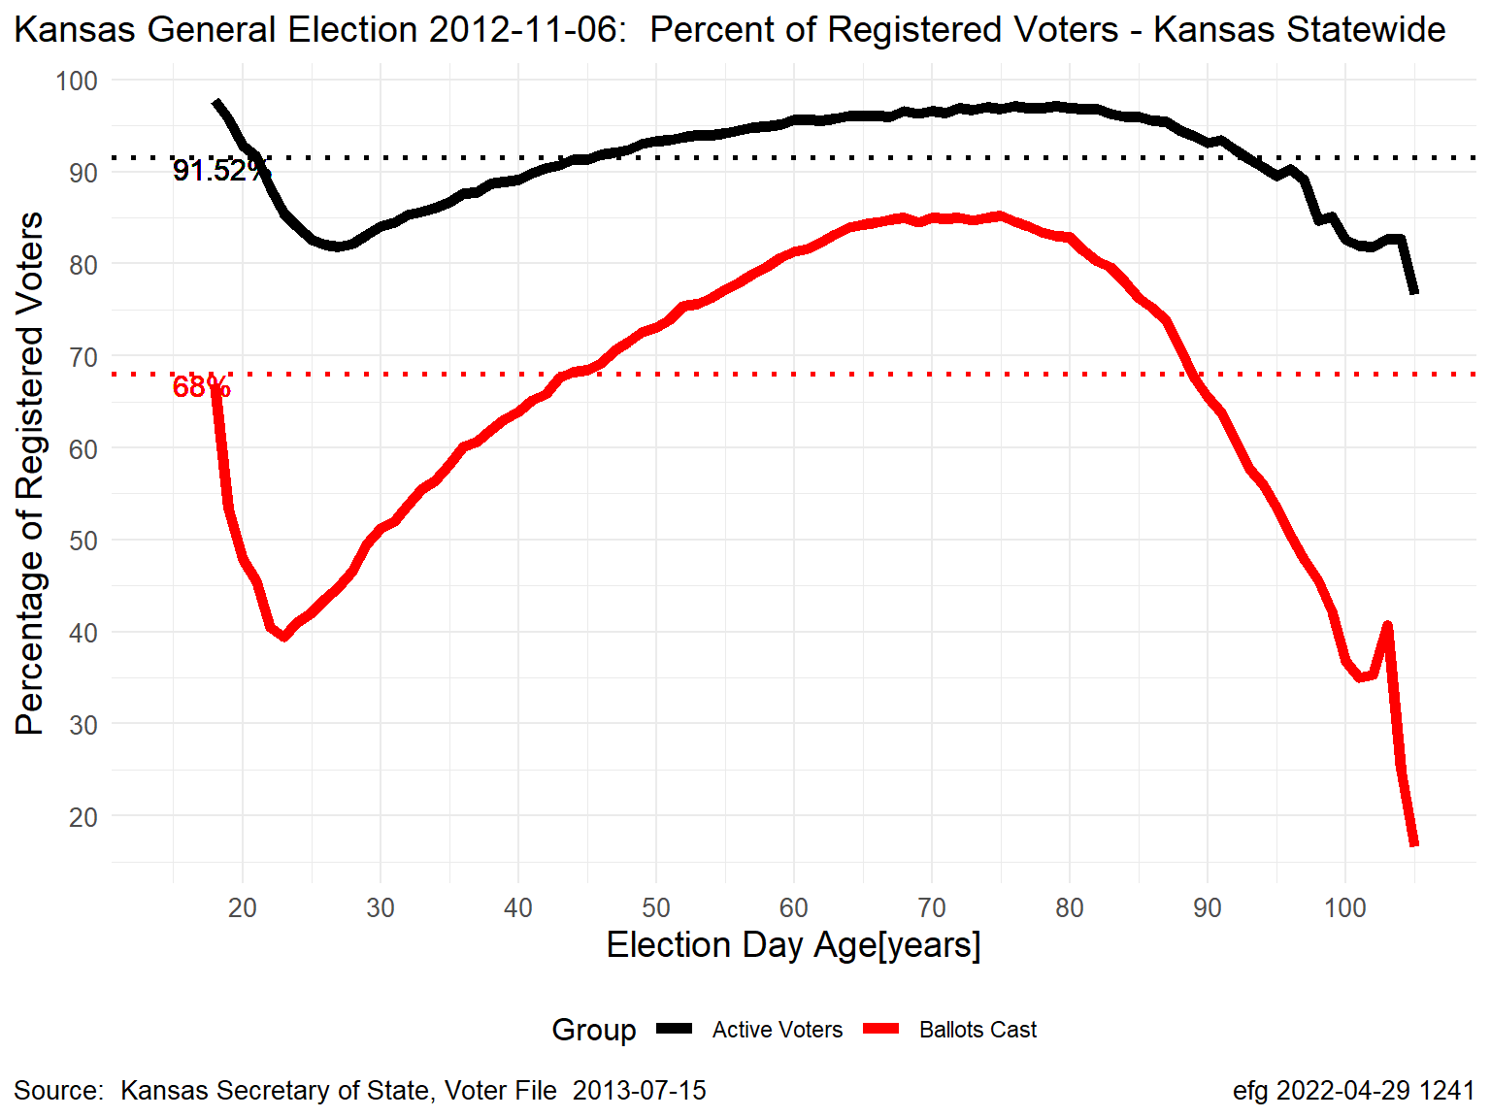
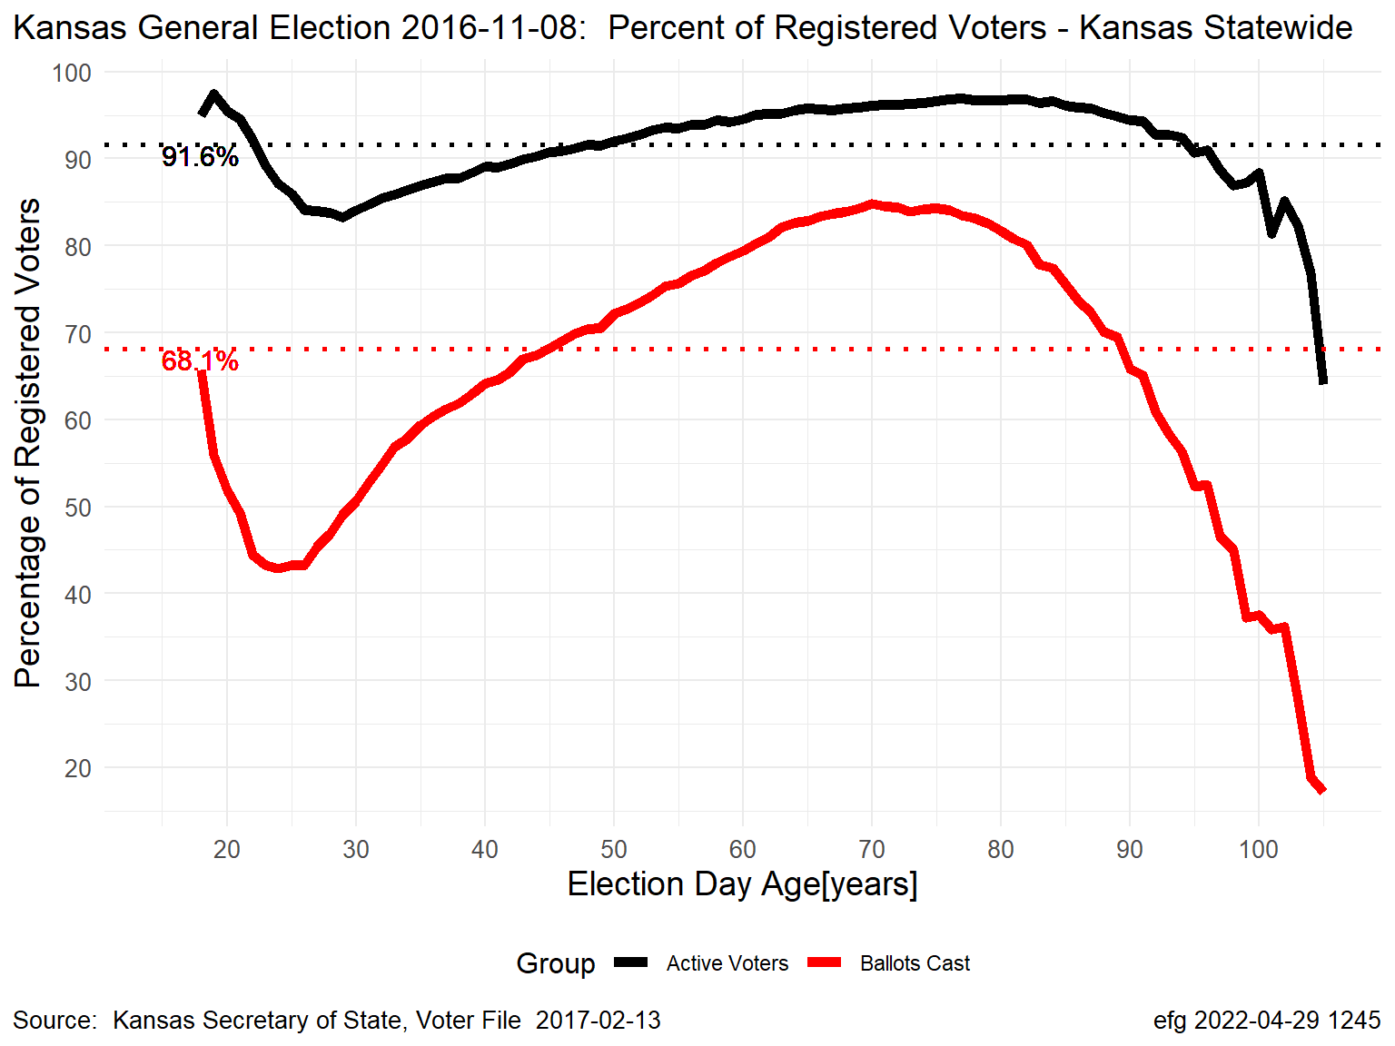
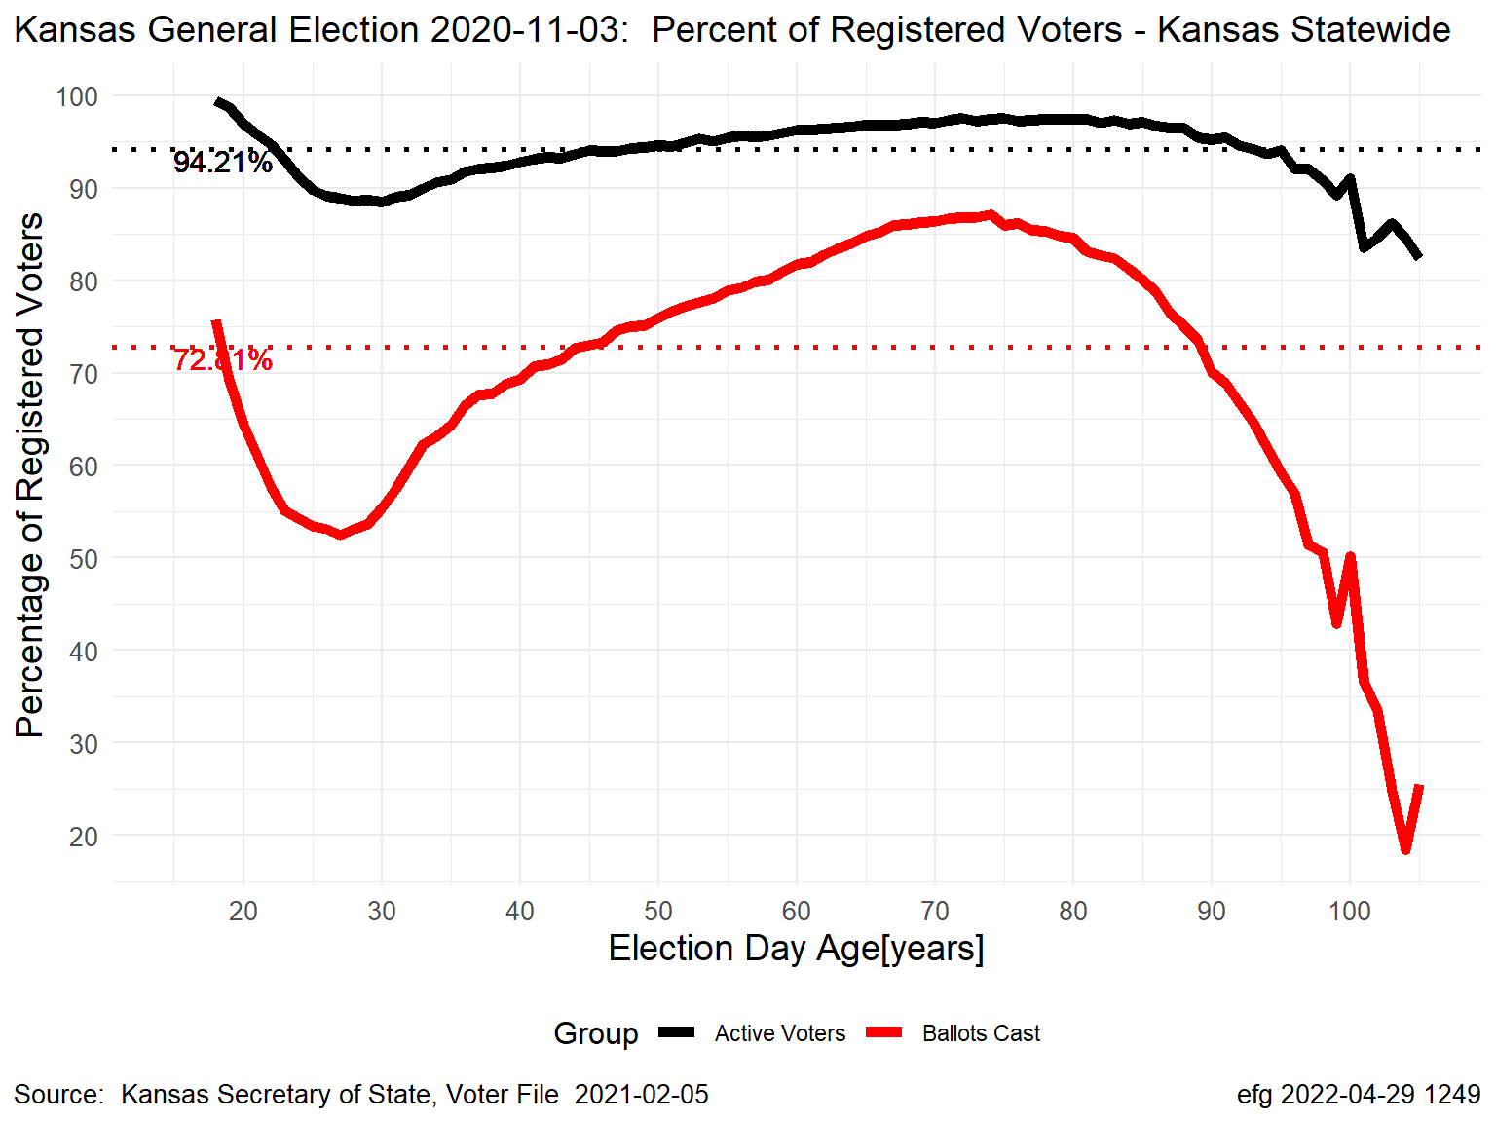
Kansas November General Elections: Percentages by Age
Percentage Turnout
Black Line = “Active” Voters; Red Line = Ballots Cast
Gubernatorial Election Years
2006
2010
2014
2018
Presidential Election Years
2008
2012
2016
2020
Notes:
Kansas-2006-2020-November-General-Normalized-Voter-Turnout.pptx, slide 3
K:\Election-Integrity\Kansas-Normalized-Fraction-of-Voters

Slide 10
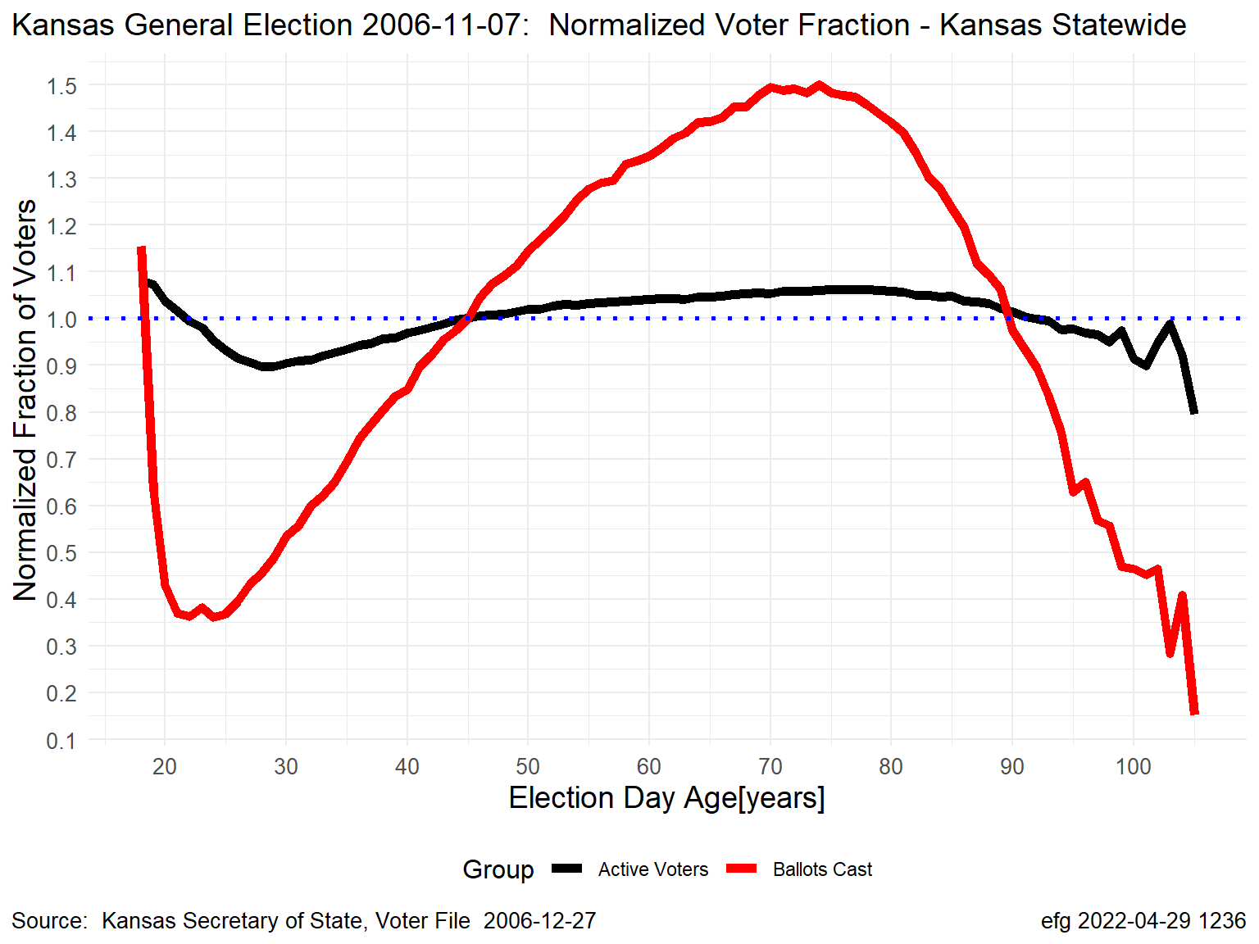
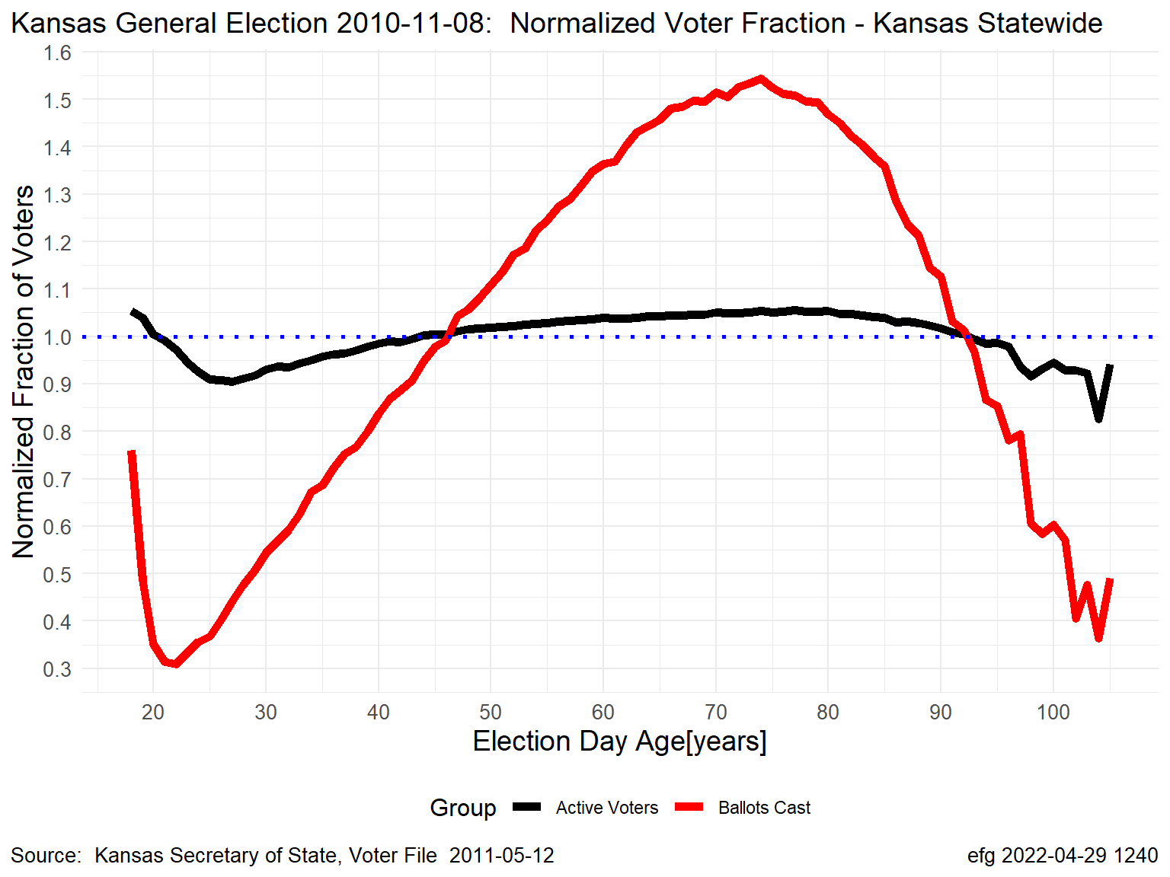
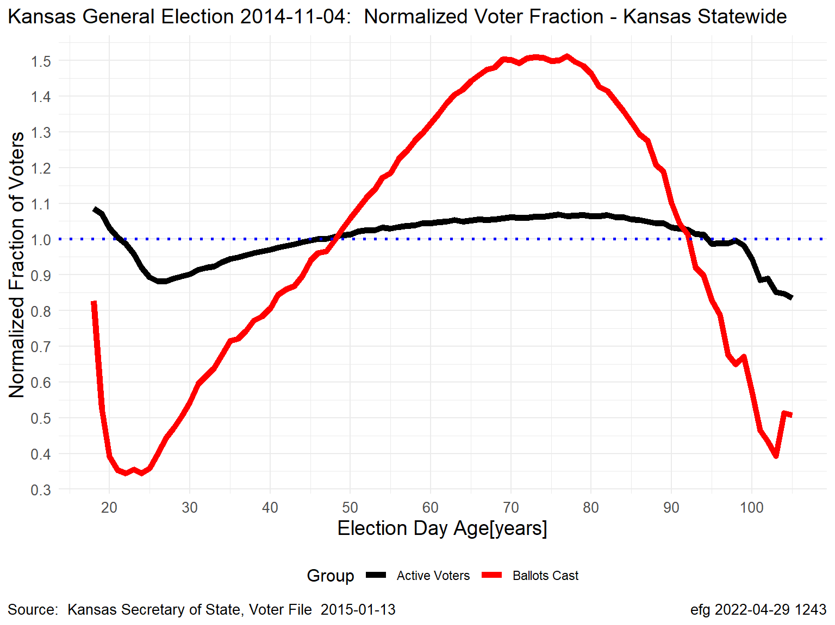
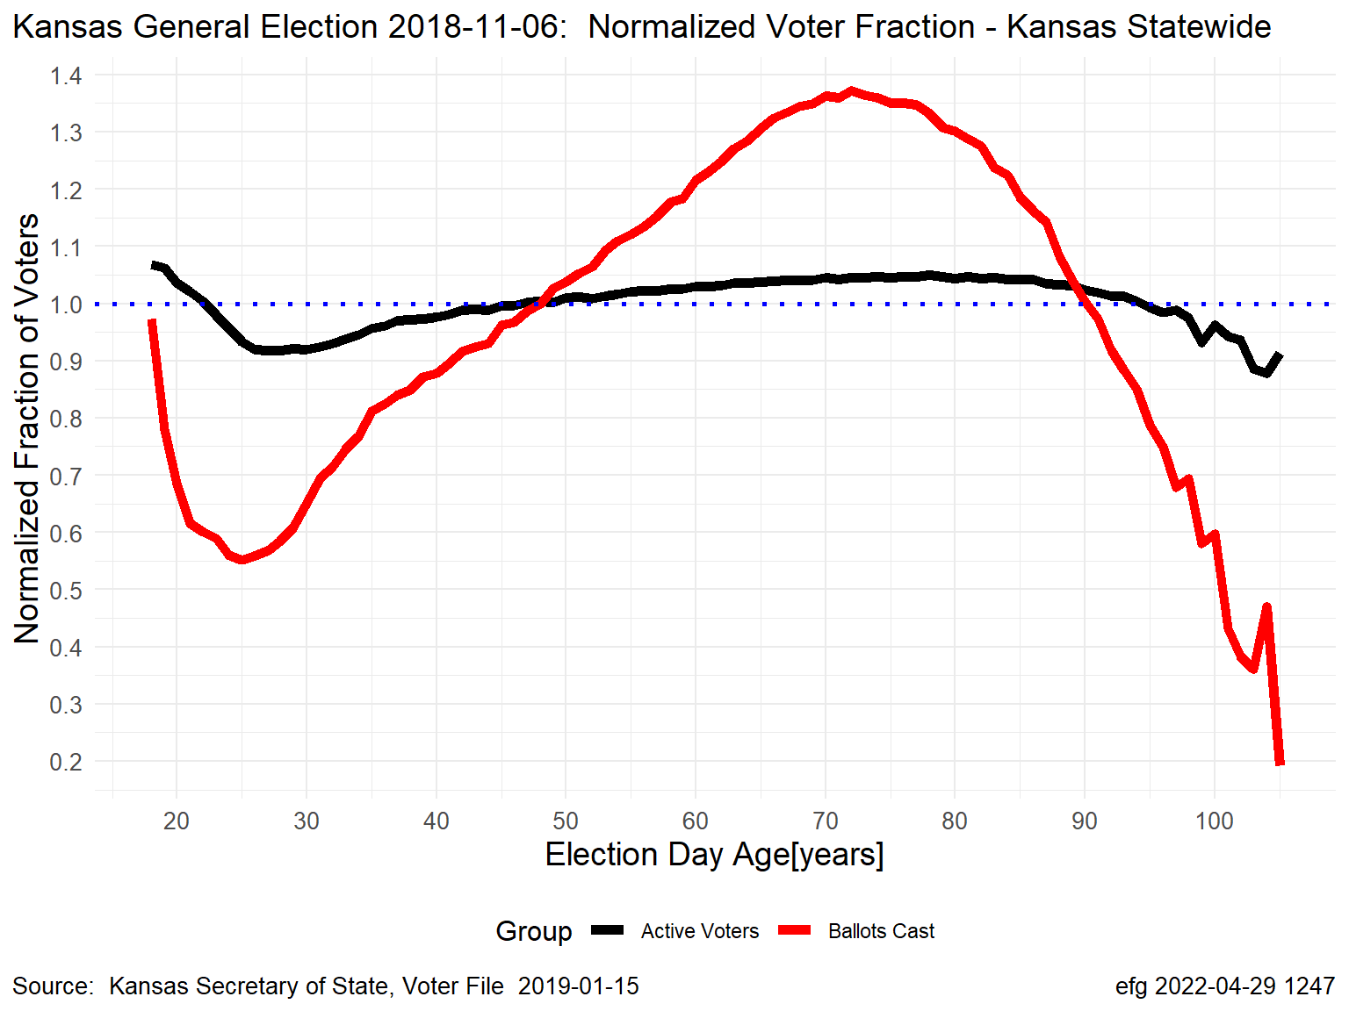
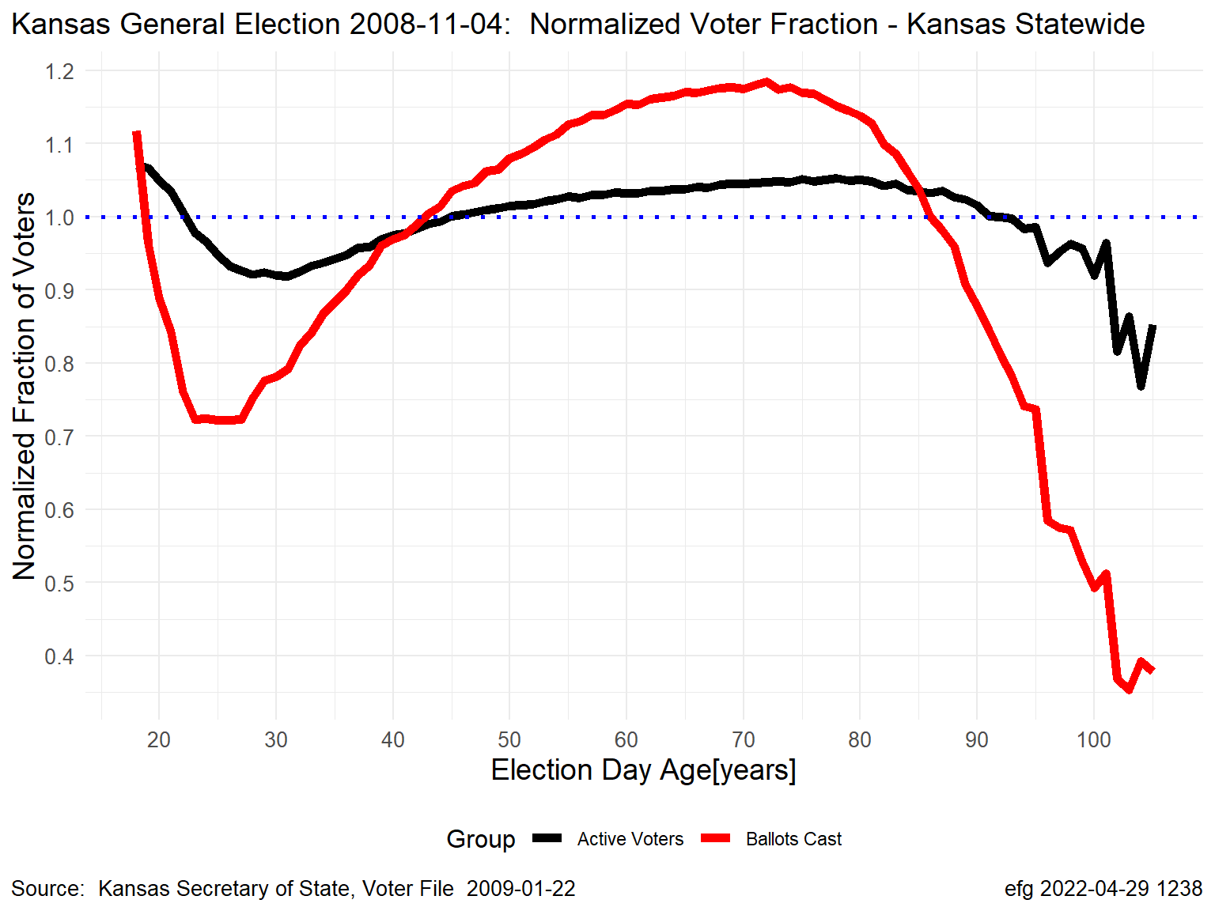
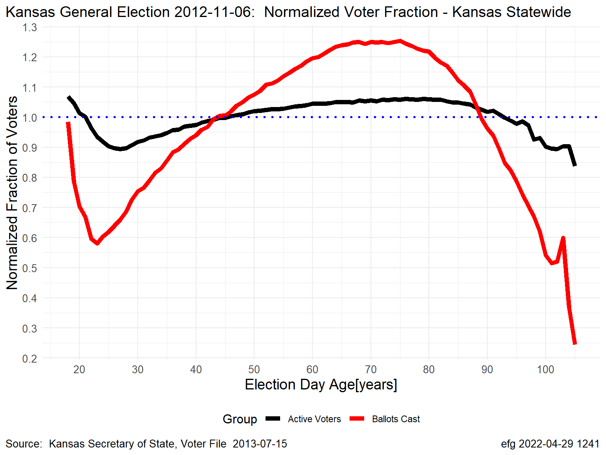
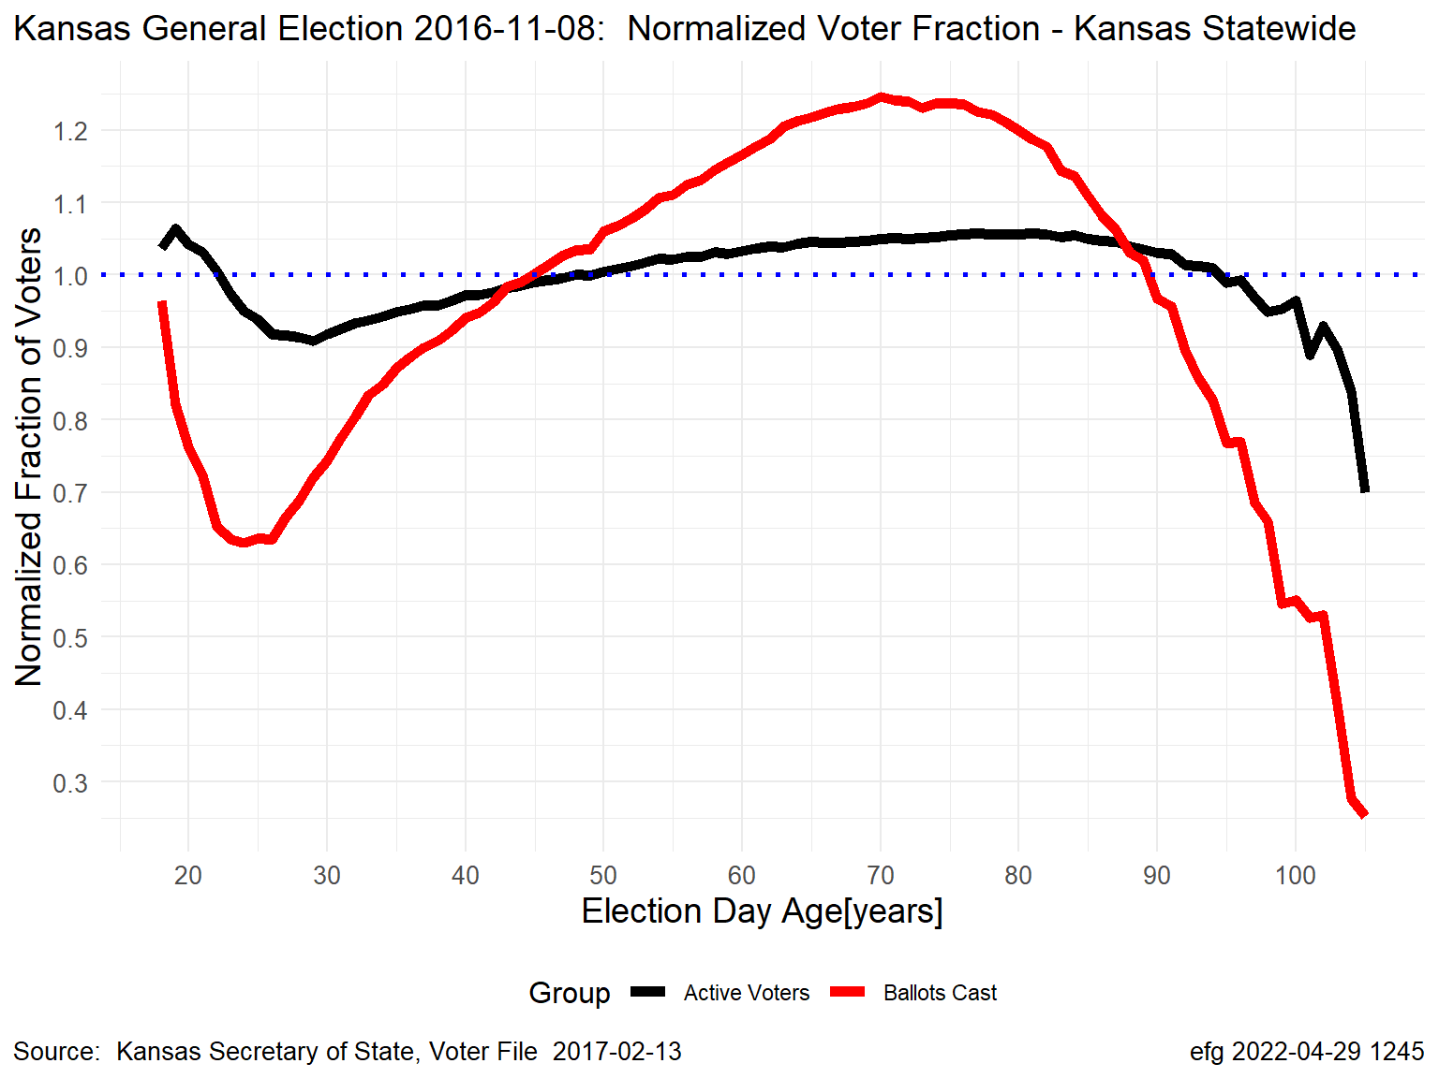
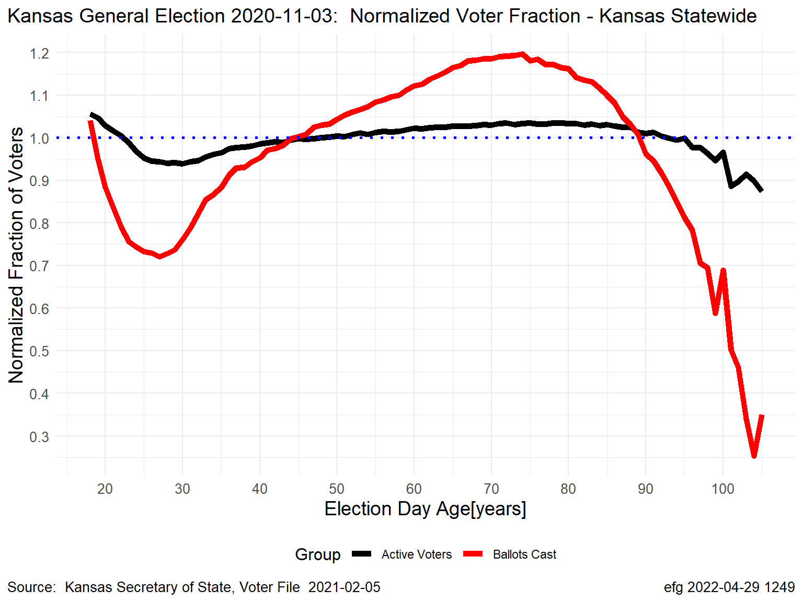
Kansas November General Elections: Normalized by Age
Normalized Turnout for State
Black Line = “Active” Voters; Red Line = Ballots Cast, Statewide Turnout
Gubernatorial Election Years
2006
2010
2014
2018
Presidential Election Years
2008
2012
2016
2020
Notes:
Kansas-2006-2020-November-General-Normalized-Voter-Turnout.pptx, slide 4
K:\Election-Integrity\Kansas-Normalized-Fraction-of-Voters

Slide 11
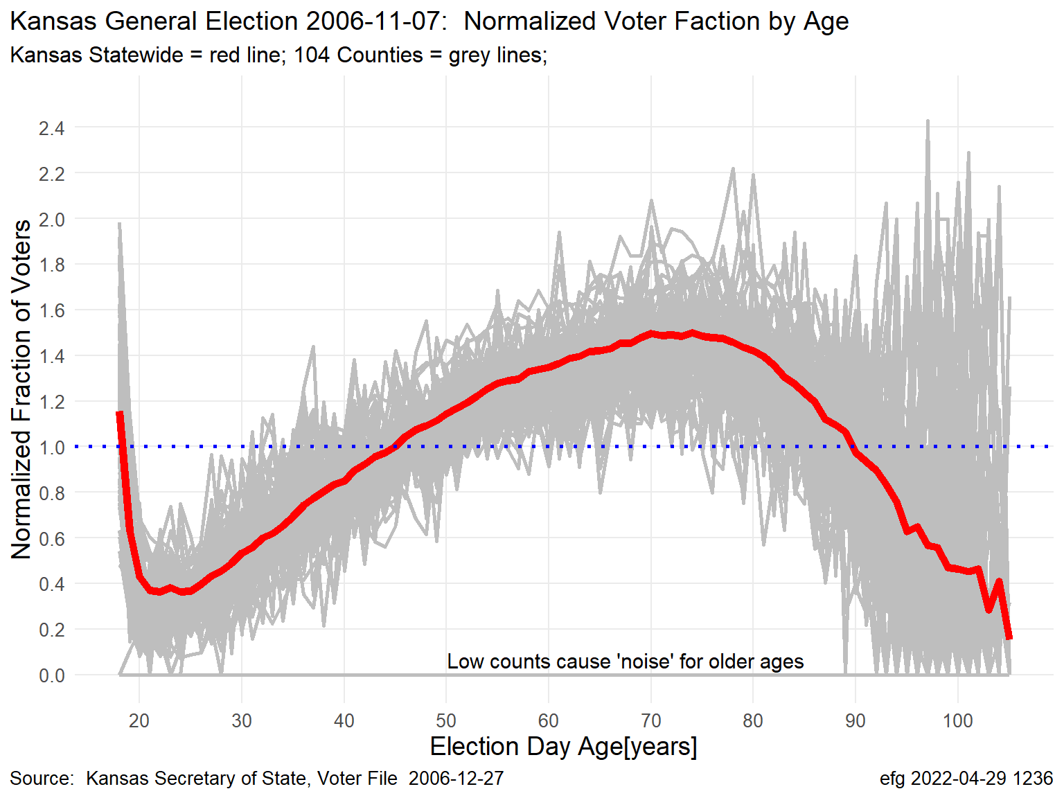
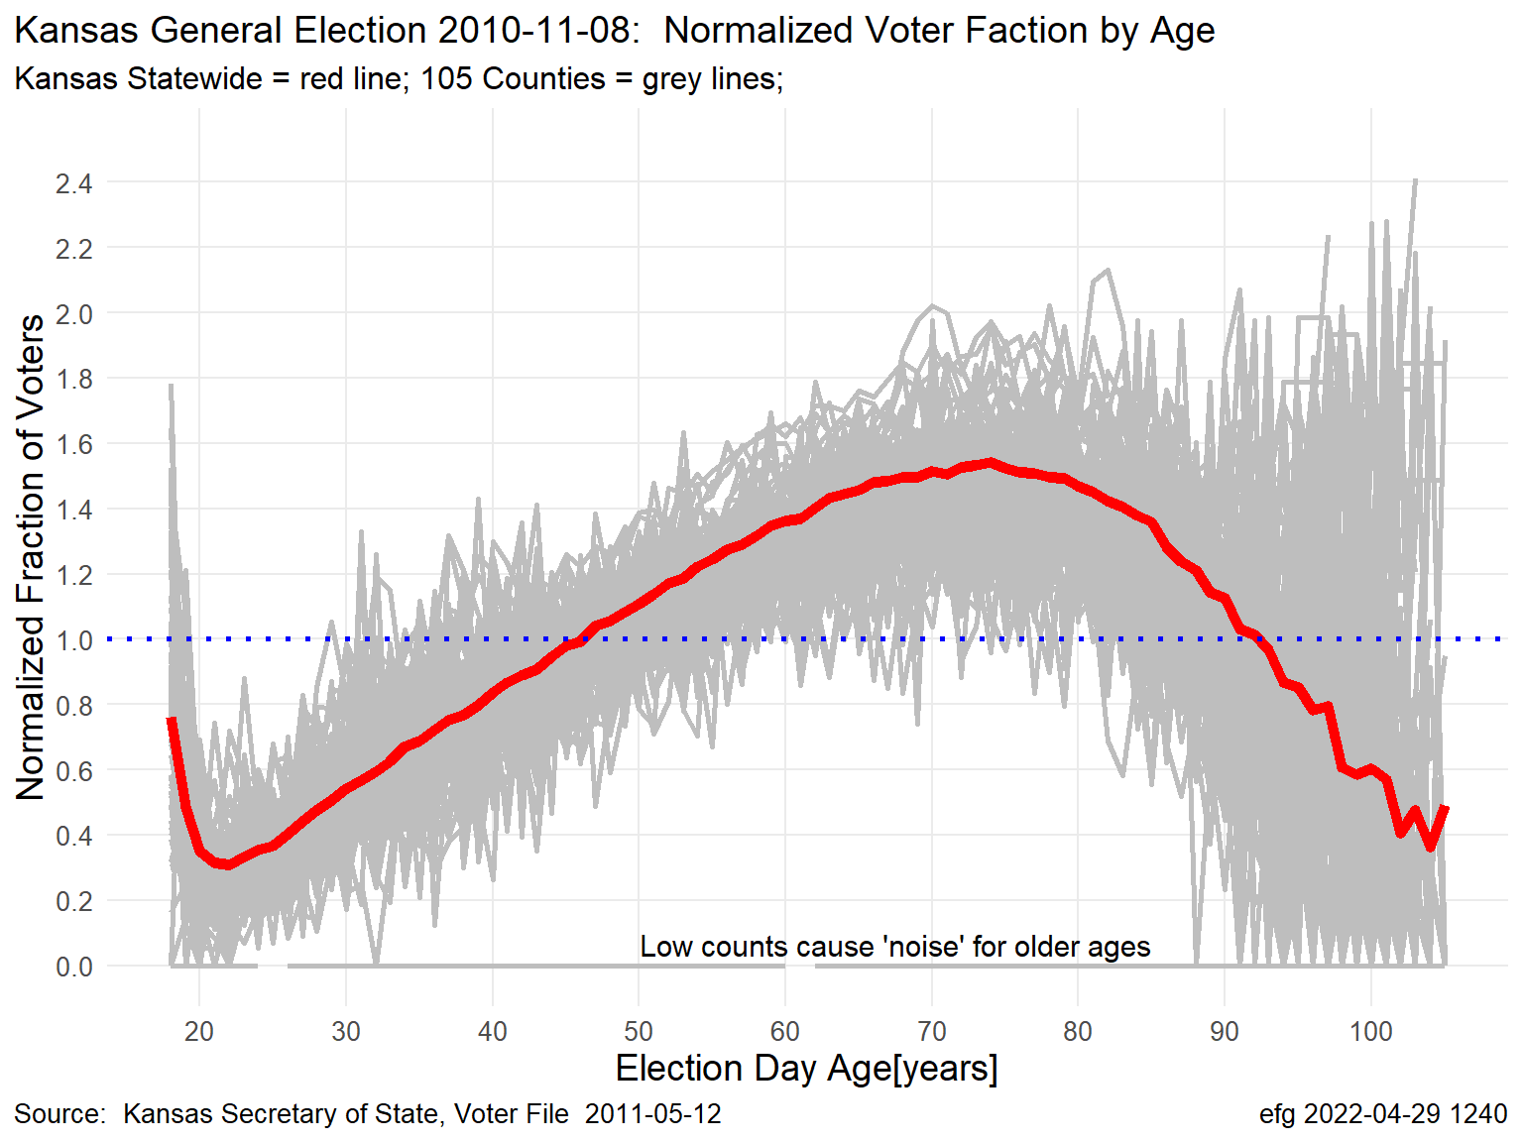
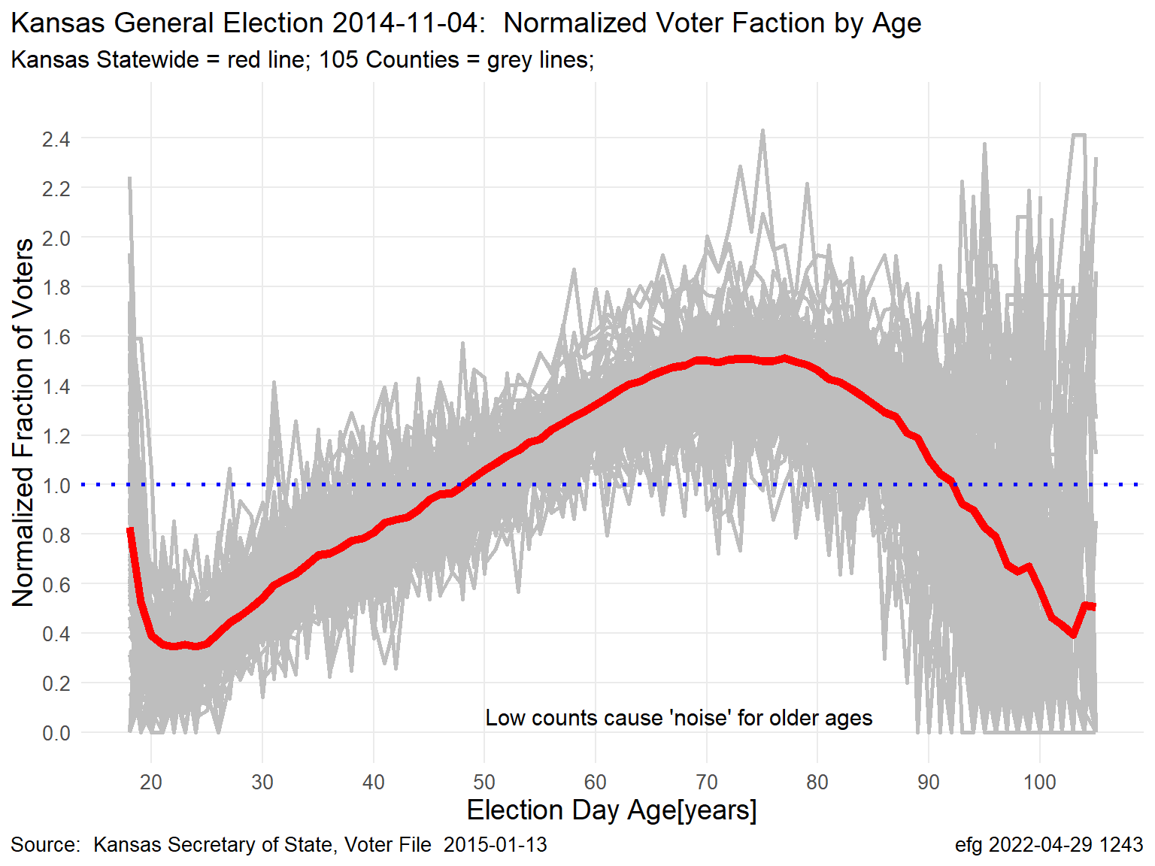
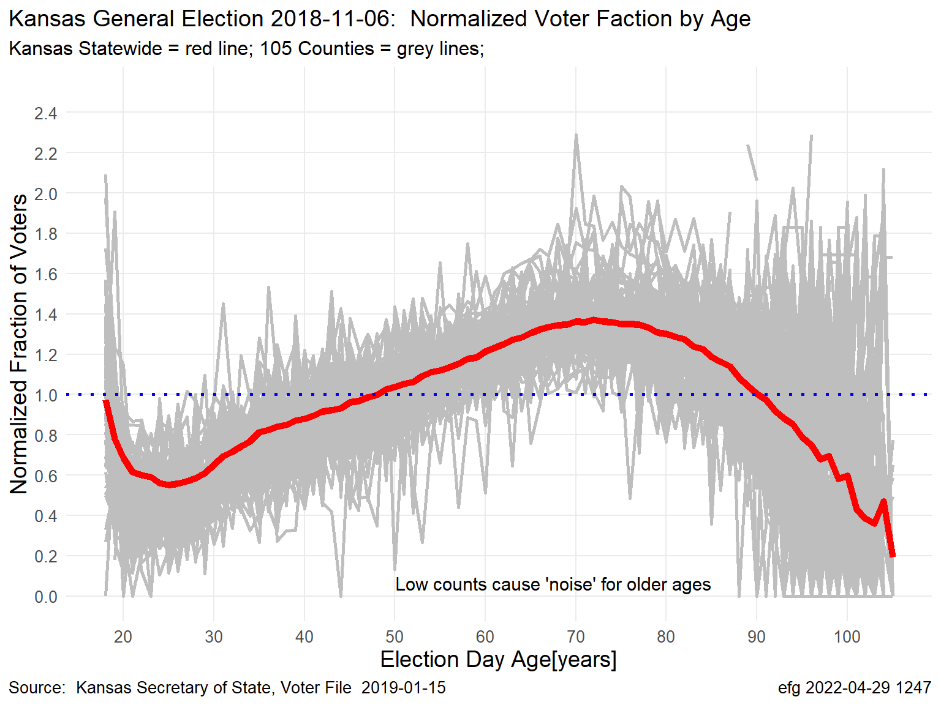
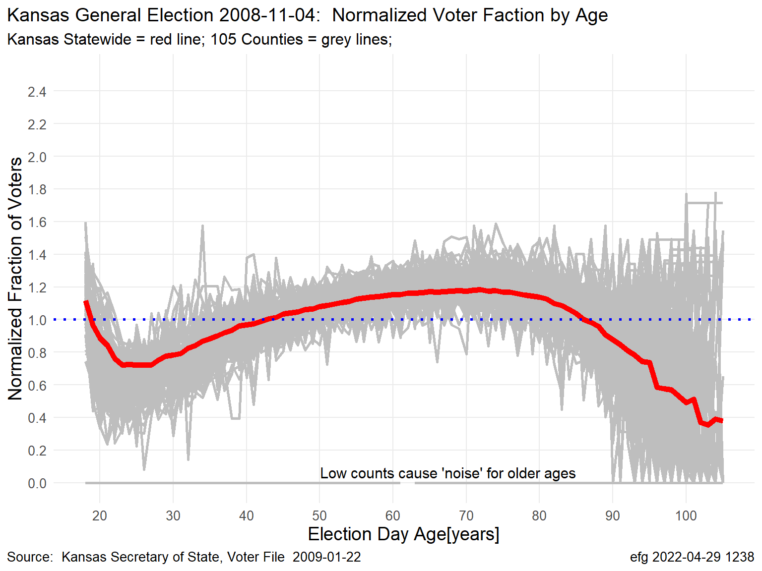
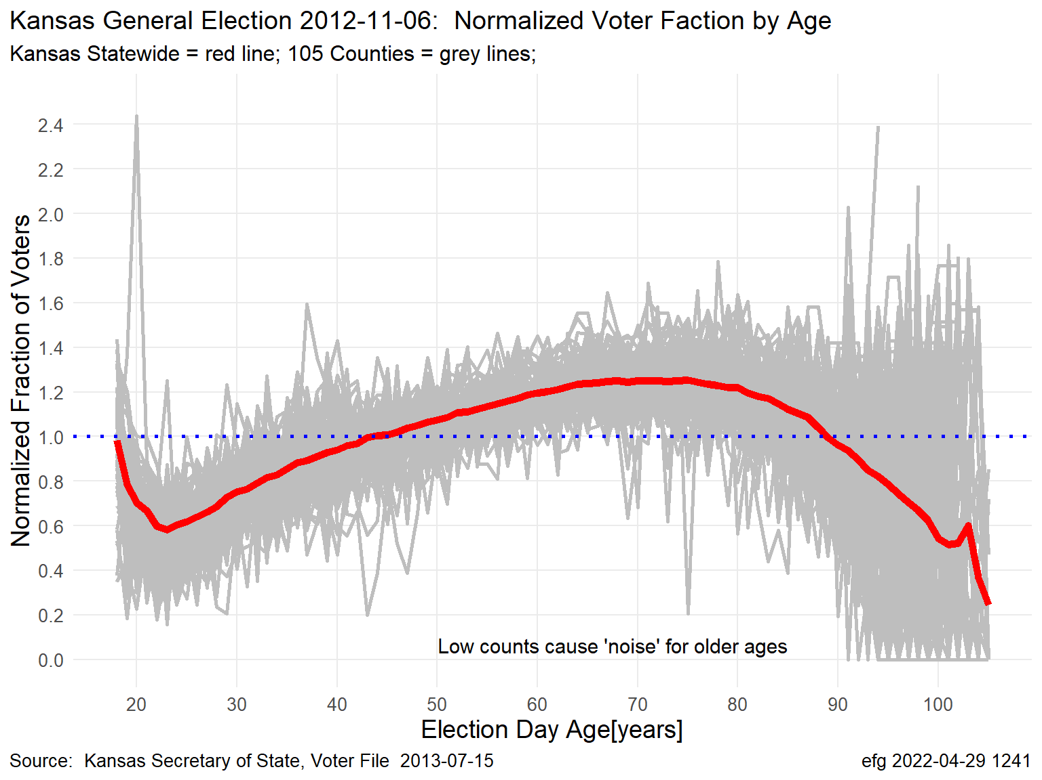
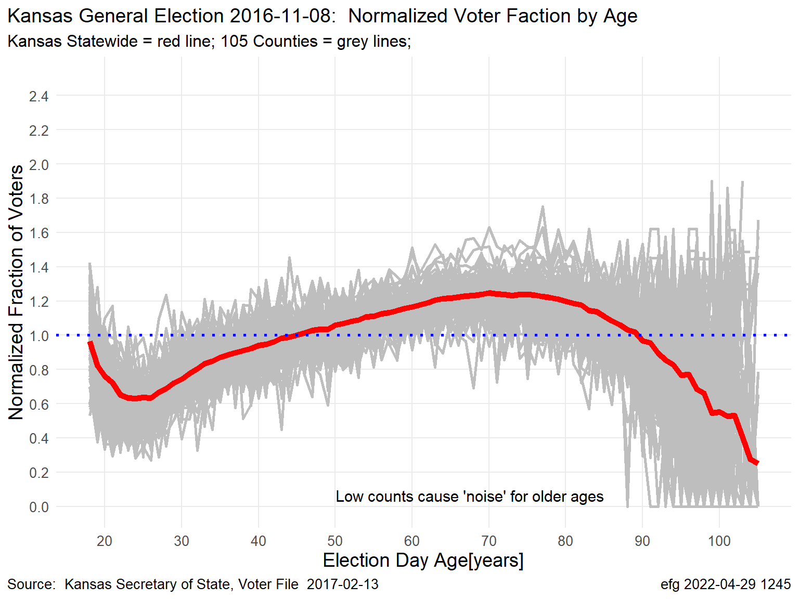
Kansas November General Elections: Normalized Voter Turnout by Age
Normalized Turnout for State and Counties
Red Line = Statewide Turnout; Grey Lines = Turnout for Each of 105 Counties
Gubernatorial Election Years
2006
2010
2014
2018
Presidential Election Years
2008
2012
2016
2020
Notes:
Kansas-2006-2020-November-General-Normalized-Voter-Turnout.pptx, slide 5
K:\Election-Integrity\Kansas-Normalized-Fraction-of-Voters

Slide 12
Normalized turnout for a specific age varies slightly by state, county, precinct, but is highly correlated The numbers show turnout is not constant by age within a state when viewed by county or precinct.
State and Counties
Johnson County and Precincts

Slide 13
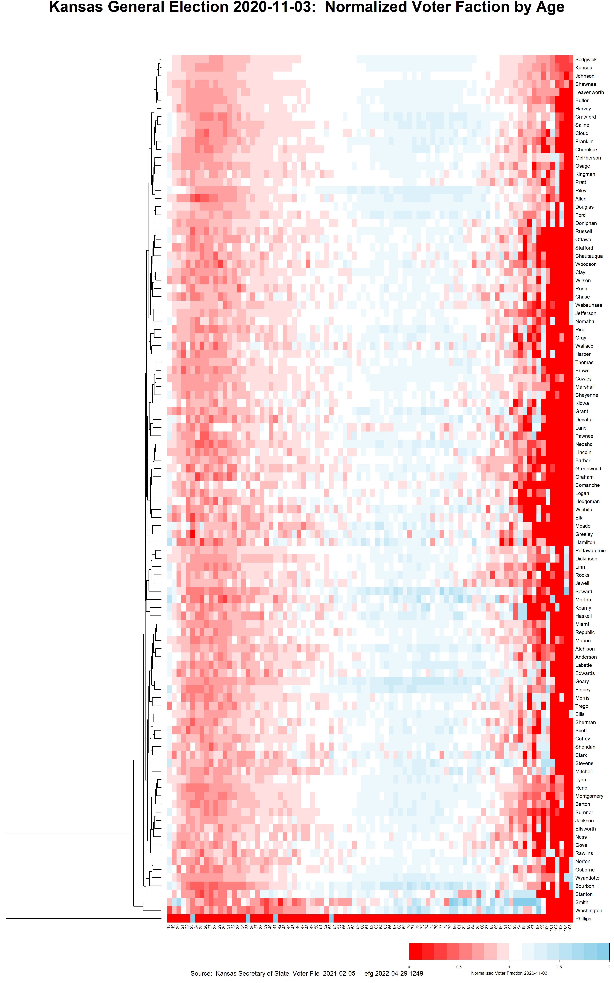
Kansas November General Elections: Normalized Voter Turnout by Age
Normalized Turnout for State and Counties
Red Line = Statewide Turnout; Grey Lines = Turnout for Each of 105 Counties
Kansas
2020
Each county is a grey line
Each county is a row
Represent each county
grey line by color-coded
line in heatmap by showing
normalized turnout fraction
from 0 to 2 by age 18 to 105
If normalized turnout were constant for a given age, the heatmap would be all vertical lines.
Normalized turnout is only “constant” when evaluated using same polynomial curve fit.
Notes:
Kansas-2006-2020-November-General-Normalized-Voter-Turnout.pptx, slide 6
K:\Election-Integrity\Kansas-Normalized-Fraction-of-Voters

Slide 14
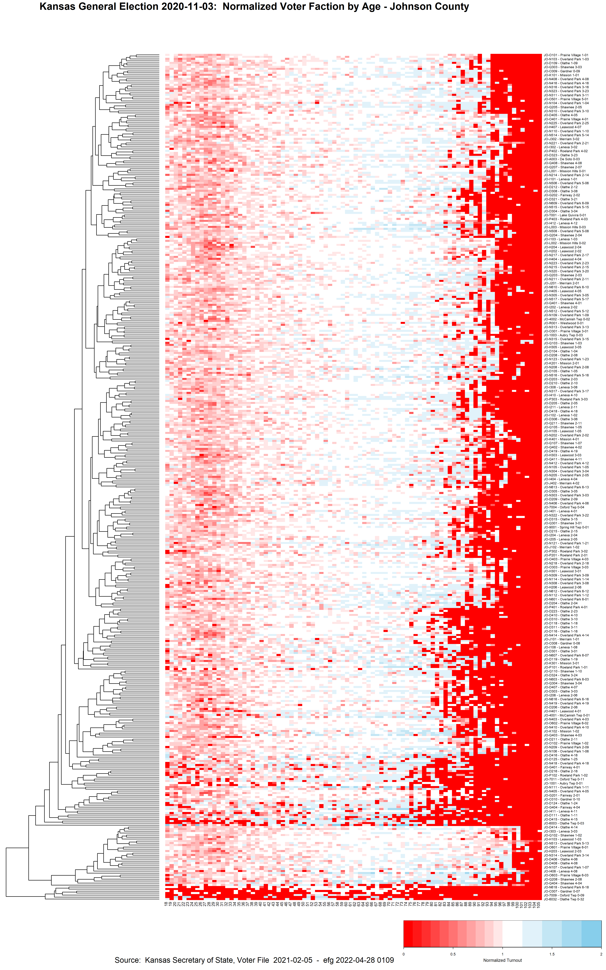
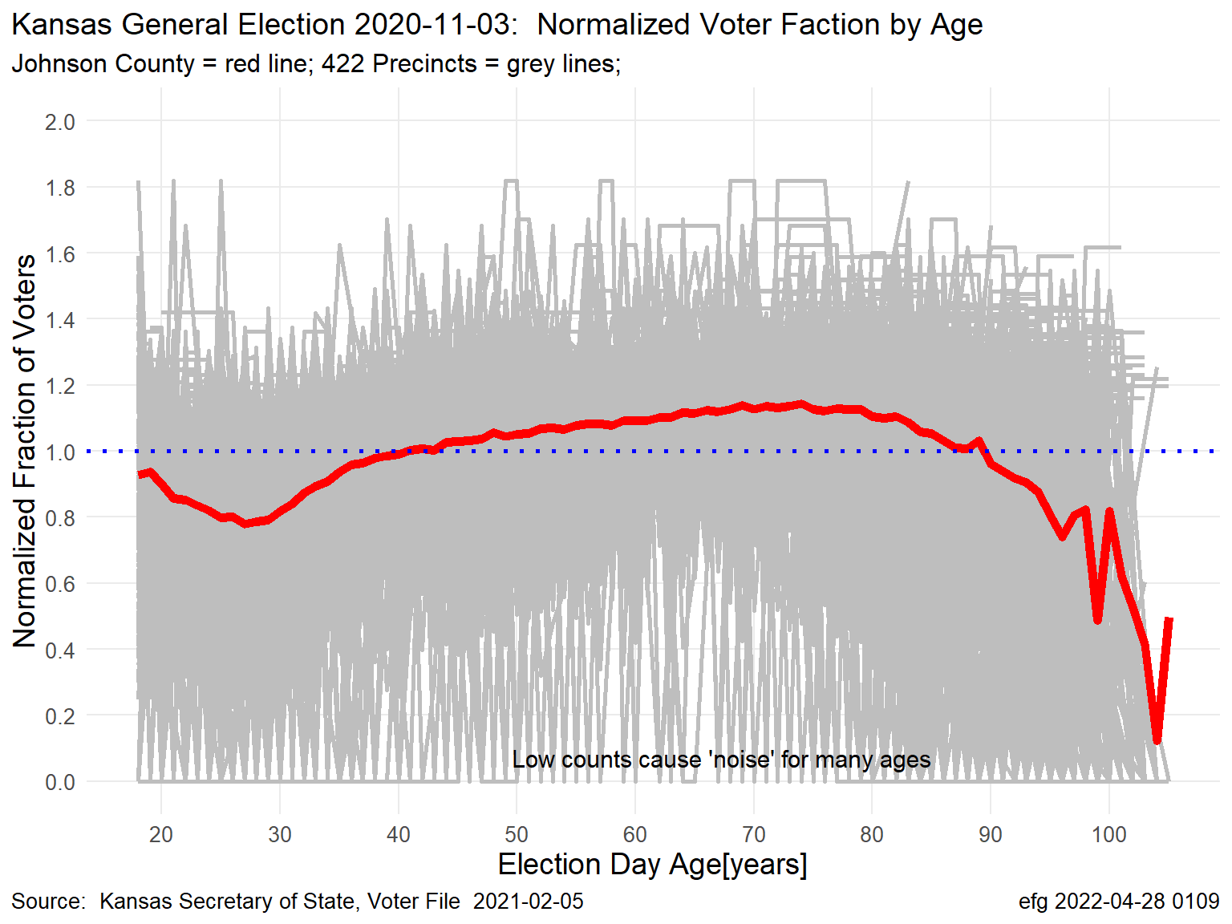
Johnson County Kansas November General Elections: Normalized Voter Turnout by Age
Normalized Turnout for Johnson County and Precincts
Red Line = County Turnout; Grey Lines = Turnout for Each of 463 Counties
Each precinct is a row
Clade of
Older Voting Precincts
Excluding counties with fewer than 25 registered voters
I live in one.
Notes:
K:/Election-Integrity/Kansas-Normalized-Fraction-of-Voters/County/2020-11-03/Johnson/2020-11-03-Johnson-County.html
Section 7.3 Scatterplot of County Overall with All Precincts
2020-11-03-Johnson-NormalizedVotedTurnout-1.png
NOTE: Precincts generally do not survive a census and redistricint.

Slide 15
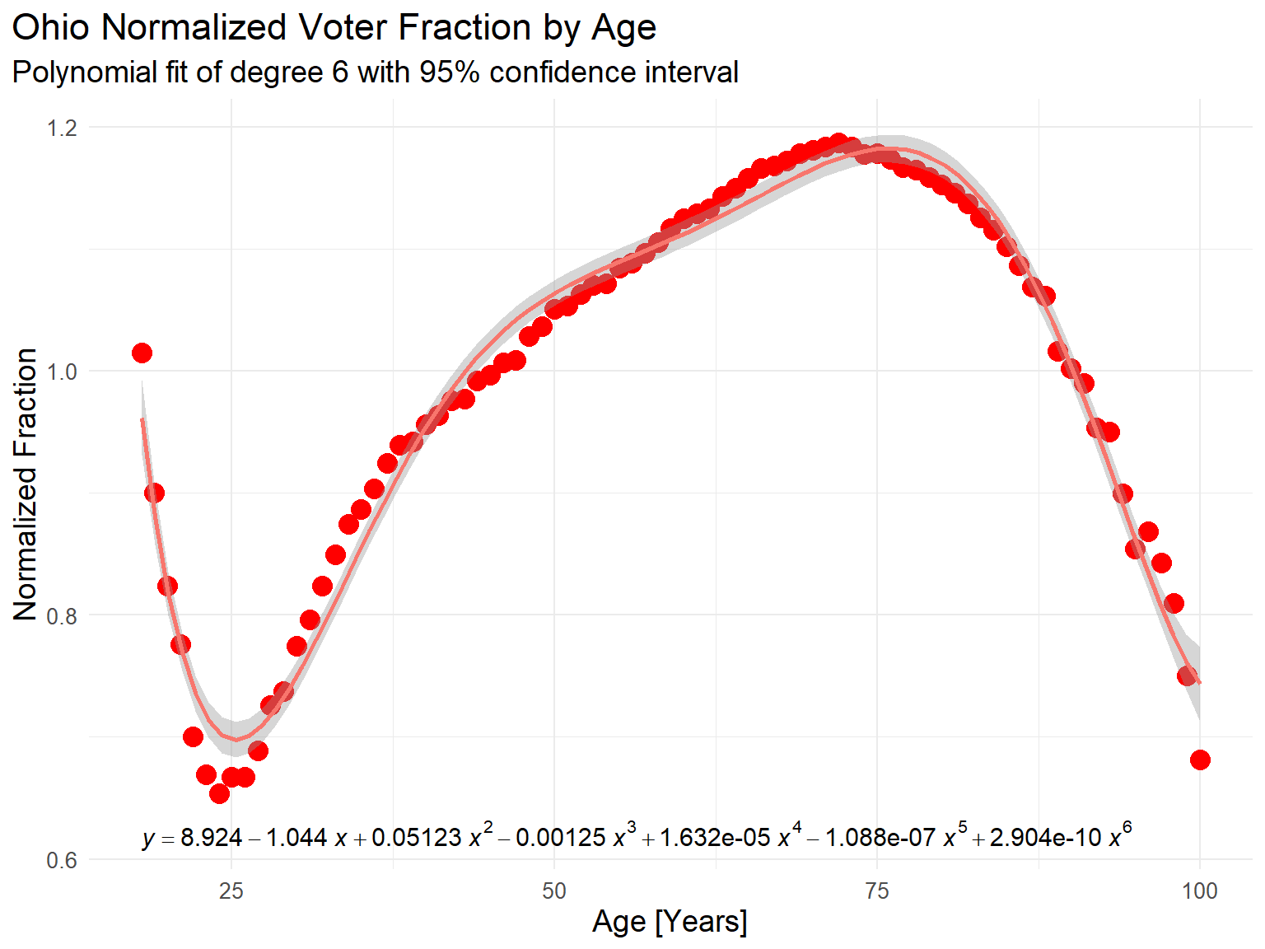
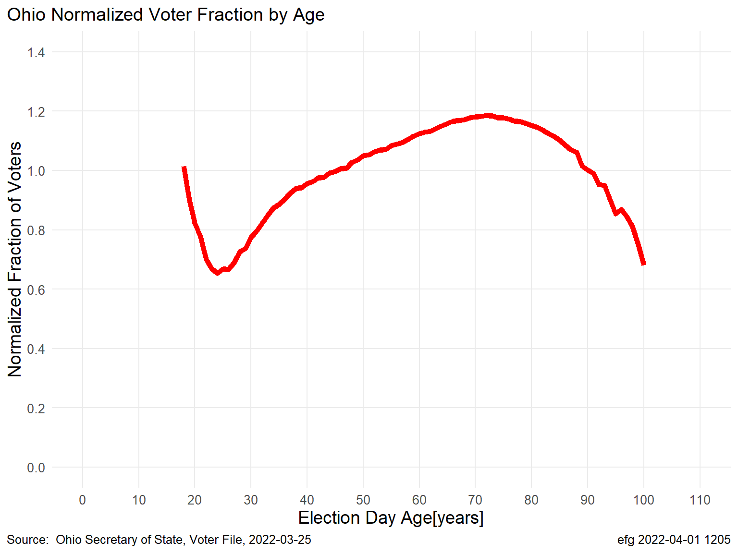
A 6th degree polynomial may not be the “best” fit. Isn’t needed. Ohio Turnout “Key”
Key: 6th Degree Polynomial Fit to Data (7 numbers)
Key: Based on Yearly Data (83 numbers)
Scaling is different between plots but both are based on the same data
Notes:
Ohio-Election-Analysis-Nov-2020.pptx, Slide 21
K:\Election-Integrity\Ohio

Slide 16
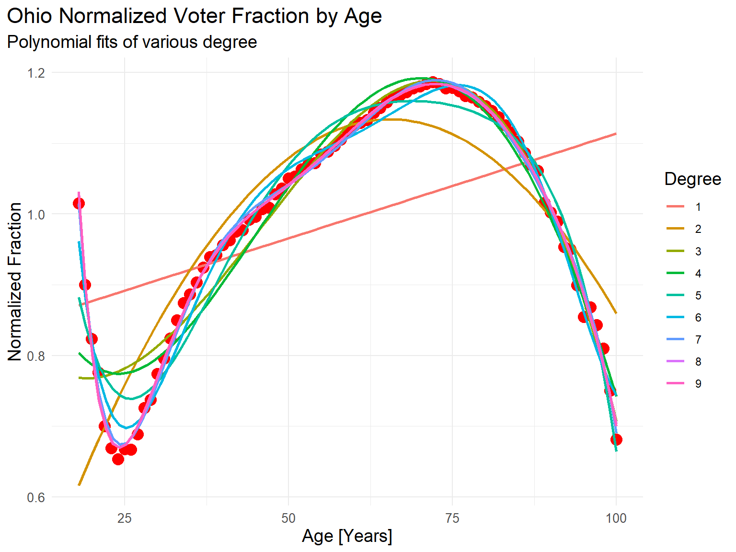
A 6th degree polynomial may not be the “best” fit. Isn’t needed.
Here age range limited to [18, 100].
Fit Ohio Normalized Turnout curve (red dots) to polynomials of various degrees
Higher degree provides curvature/ “wiggliness”, but too high can lead to overfitting.
Akaike Information Criterion (AIC) indicates highest degree over range 1 to 9 was the “best” model.
R² approaches 1 as degree increases.
There is nothing “remarkable” about these curve fits.
Curve fits offer few insight about data but provide good numerical interpolation.
RStudio Notebook: Ohio-Key-Polynomials.html, Section 5.1 (AIC), Section 5.2 (R²), polyfitsMany-1.png
Notes:
Ohio-Election-Analysis-Nov-2020.pptx, Slide 18
K:\Election-Integrity\Ohio
K:\Election-Integrity\Ohio\rlee32\Analysis

Slide 17
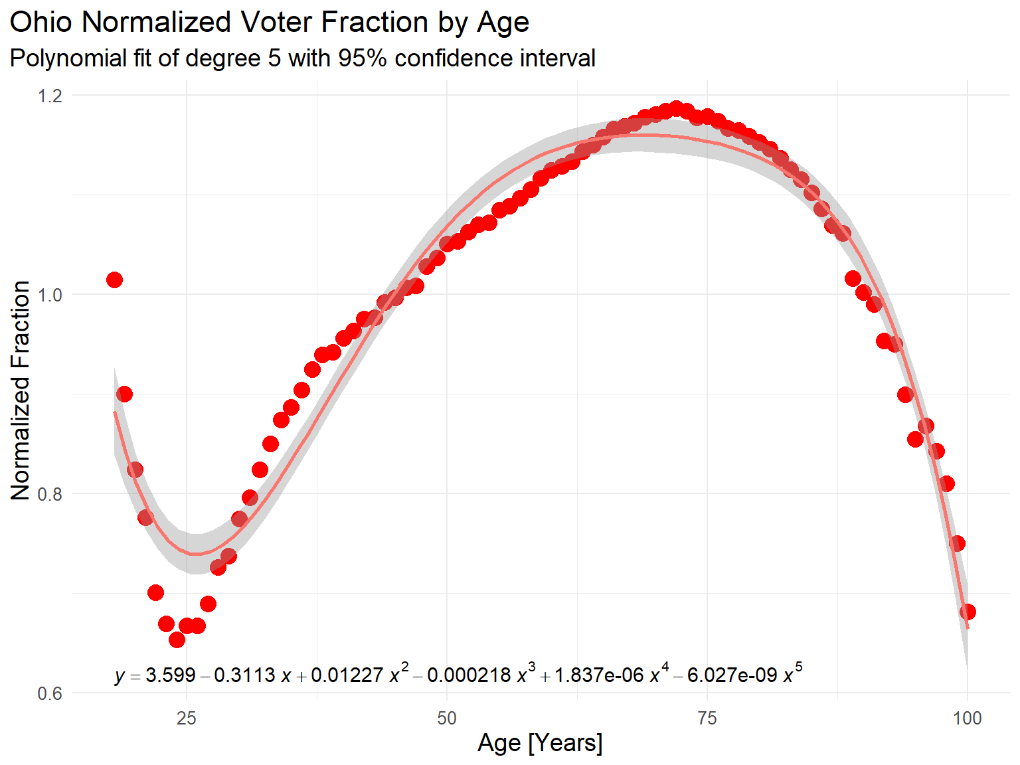
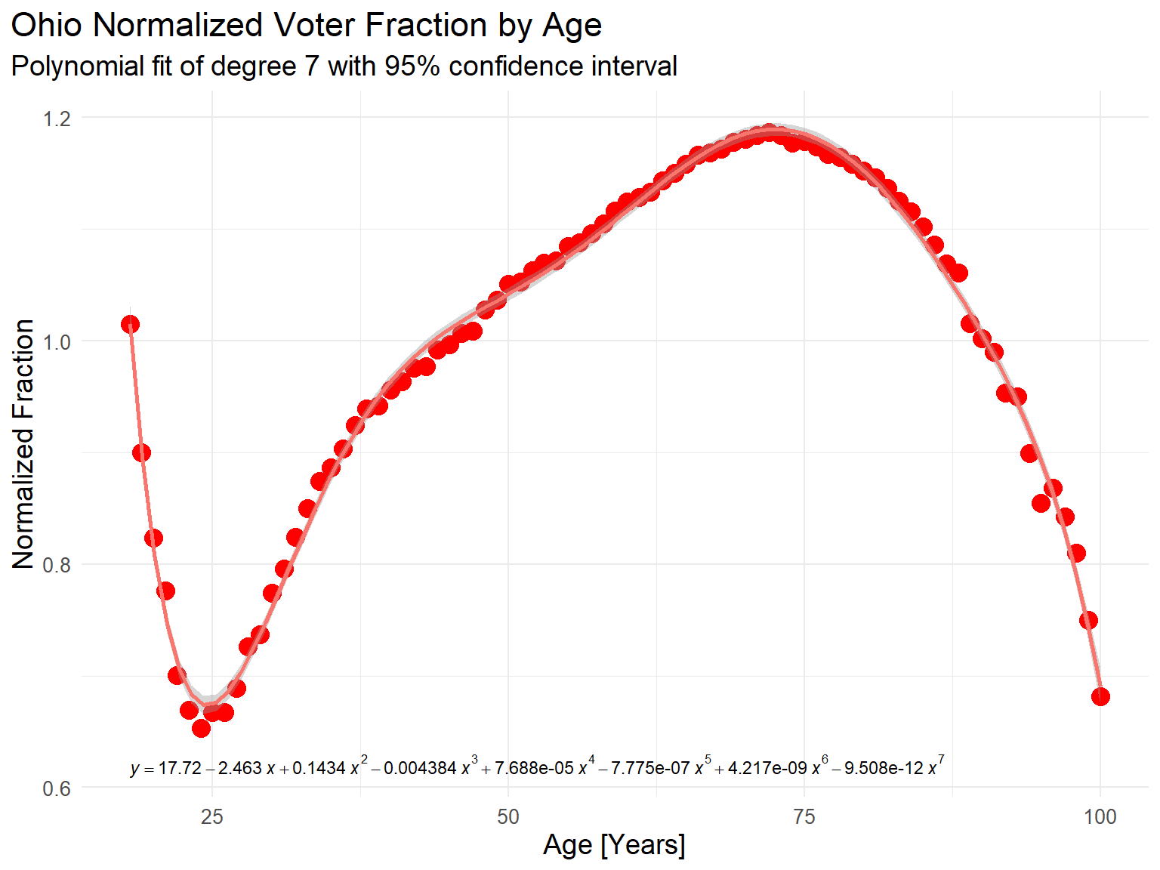
A 6th degree polynomial may not be the “best” fit. Isn’t needed.
Degree 5
Degree 6
Degree 7
In polynomial equations above, x = Age, y = Normalized Fraction
Largest residual over range: 0.132 (5th), 0.062 (6th), 0.038 (7th)
But, there is no need for polynomial fit if original normalized turnout curve is used directly!
RStudio Notebook: Ohio-Key-Polynomials.html, Section 6, polyfit5-1.png, polyfit6-1.png, polyfit7-1.png
Notes:
Ohio-Election-Analysis-Nov-2020.pptx, Slide 19
K:\Election-Integrity\Ohio
K:\Election-Integrity\Ohio\rlee32\Analysis

Slide 18
Correlation is a weak way to compare predictive models
Let’s use correlation to measure similarity between number of registered voters and the number casting ballots by age.
Examples: Ohio Statewide, Franklin County

Slide 19
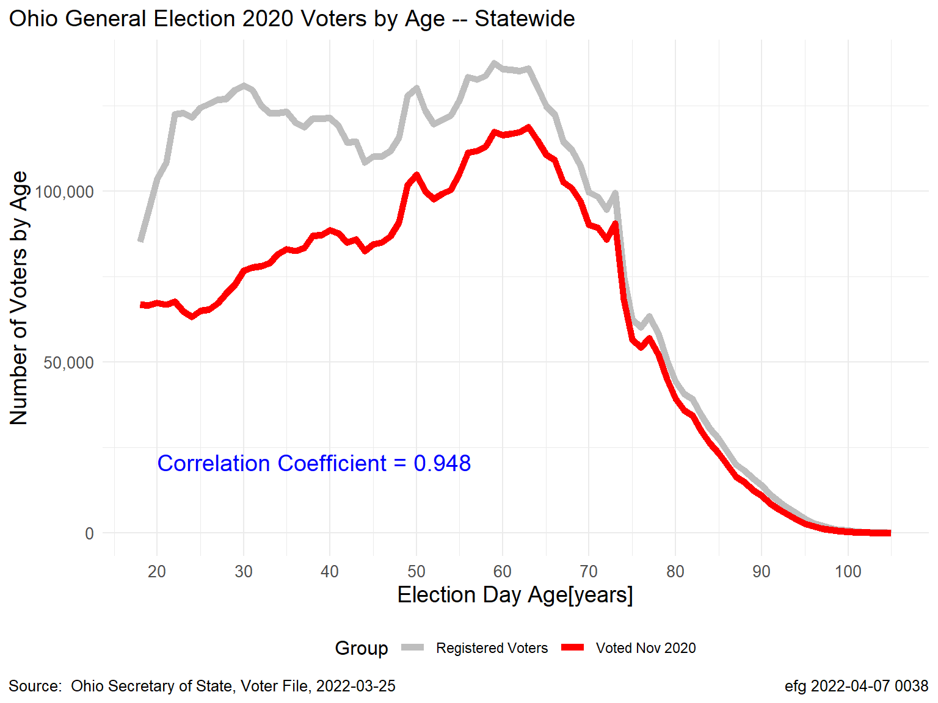
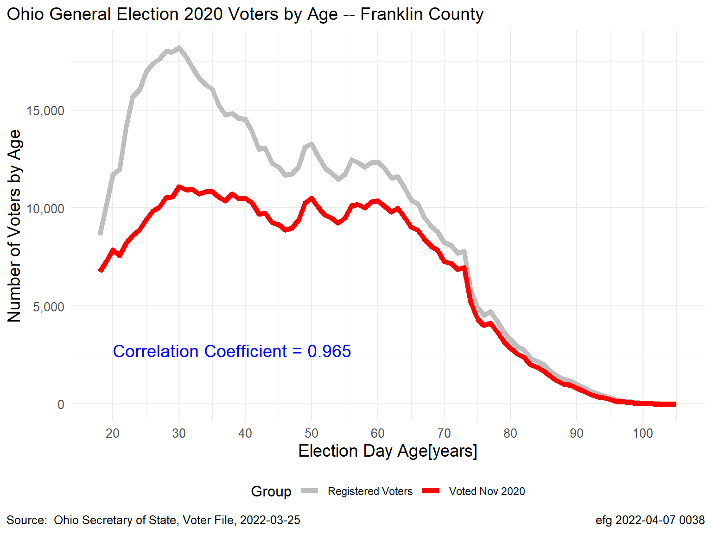
Correlation is not a good comparison metric for predictions
Most population and voter turnout curves are highly correlated
Ohio-Correlations.html, Statewide-1.png, FranklinCounty-1.png
Notes:
K:\Election-Integrity\Ohio\Ohio-Election-Analysis-Nov-2020.pptx, slide 27

Slide 20
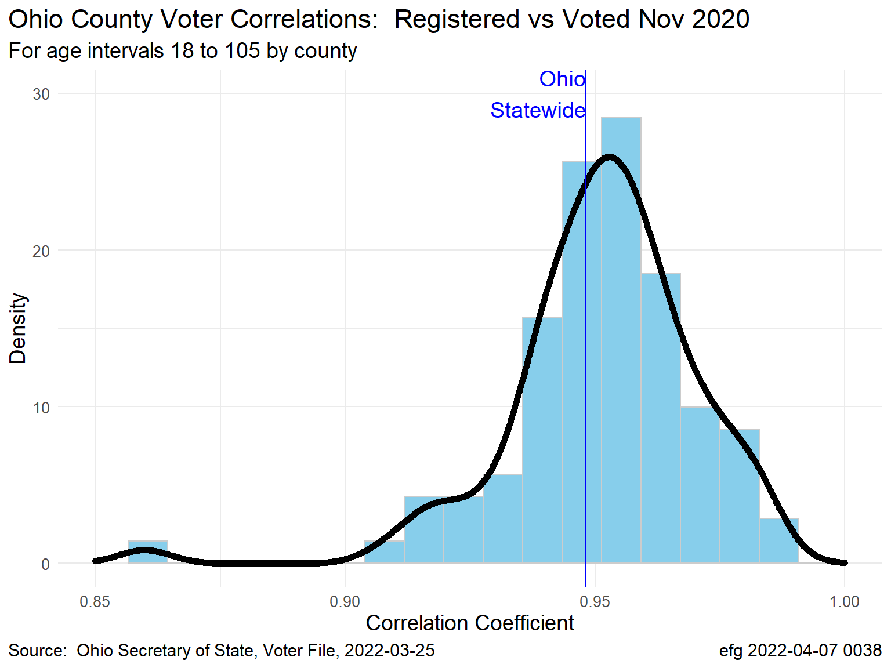
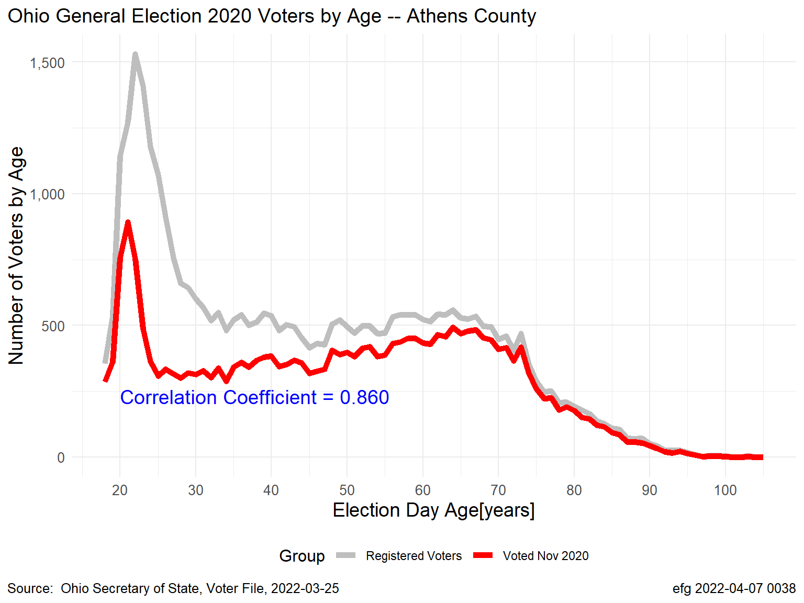
Ohio-Correlations.html, CorrelationsPlot-1.png, AthensCounty-1.png
Correlation is not a good comparison metric for predictions
Athens County
In most counties the correlation between the number of
registered voters and the number voting in Nov 2020 over
age intervals 18 to 100 was between 0.90 and 1.00 with a
an overall state value of about 0.95.
Athens County was the outlier in the density plot.
Notes:
K:\Election-Integrity\Ohio\Ohio-Election-Analysis-Nov-2020.pptx, slide 28

Slide 21

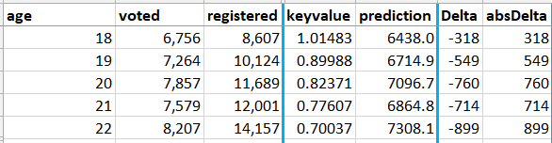
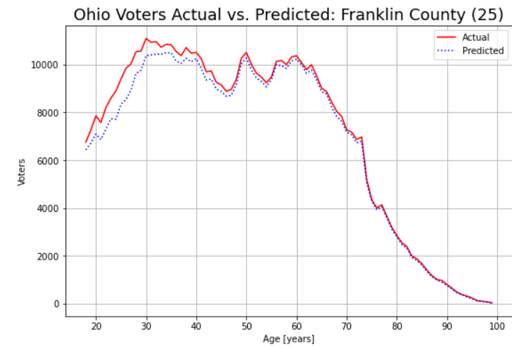
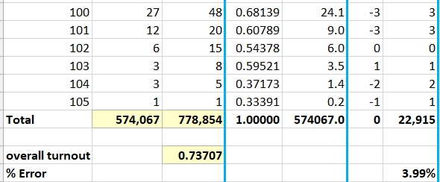
Accuracy Better than Correlation for Assessing Predictions Ohio-Analysis-5-Predictions-vs-Acutal-Votes.ipynb
Prediction = overall turnout * registered * keyvalue
Ohio Key
Franklin County
. . .
Accuracy Metric
Adapted from Lee’s script: predict.py
Ohio-Analysis-2-Single-County-Franklin.html
Ohio-Analysis-5-Predictions-vs-Acutal-Votes-Franklin.html, Compare-Franklin-25.xlsx
Notes:
K:\Election-Integrity\Ohio\Ohio-Election-Analysis-Nov-2020.pptx, slide 31
K:\Election-Integrity\Ohio\rlee32\Analysis
NOTE: Use unsigned absolute error, otherwise “errors” will sum to 0.

Slide 22
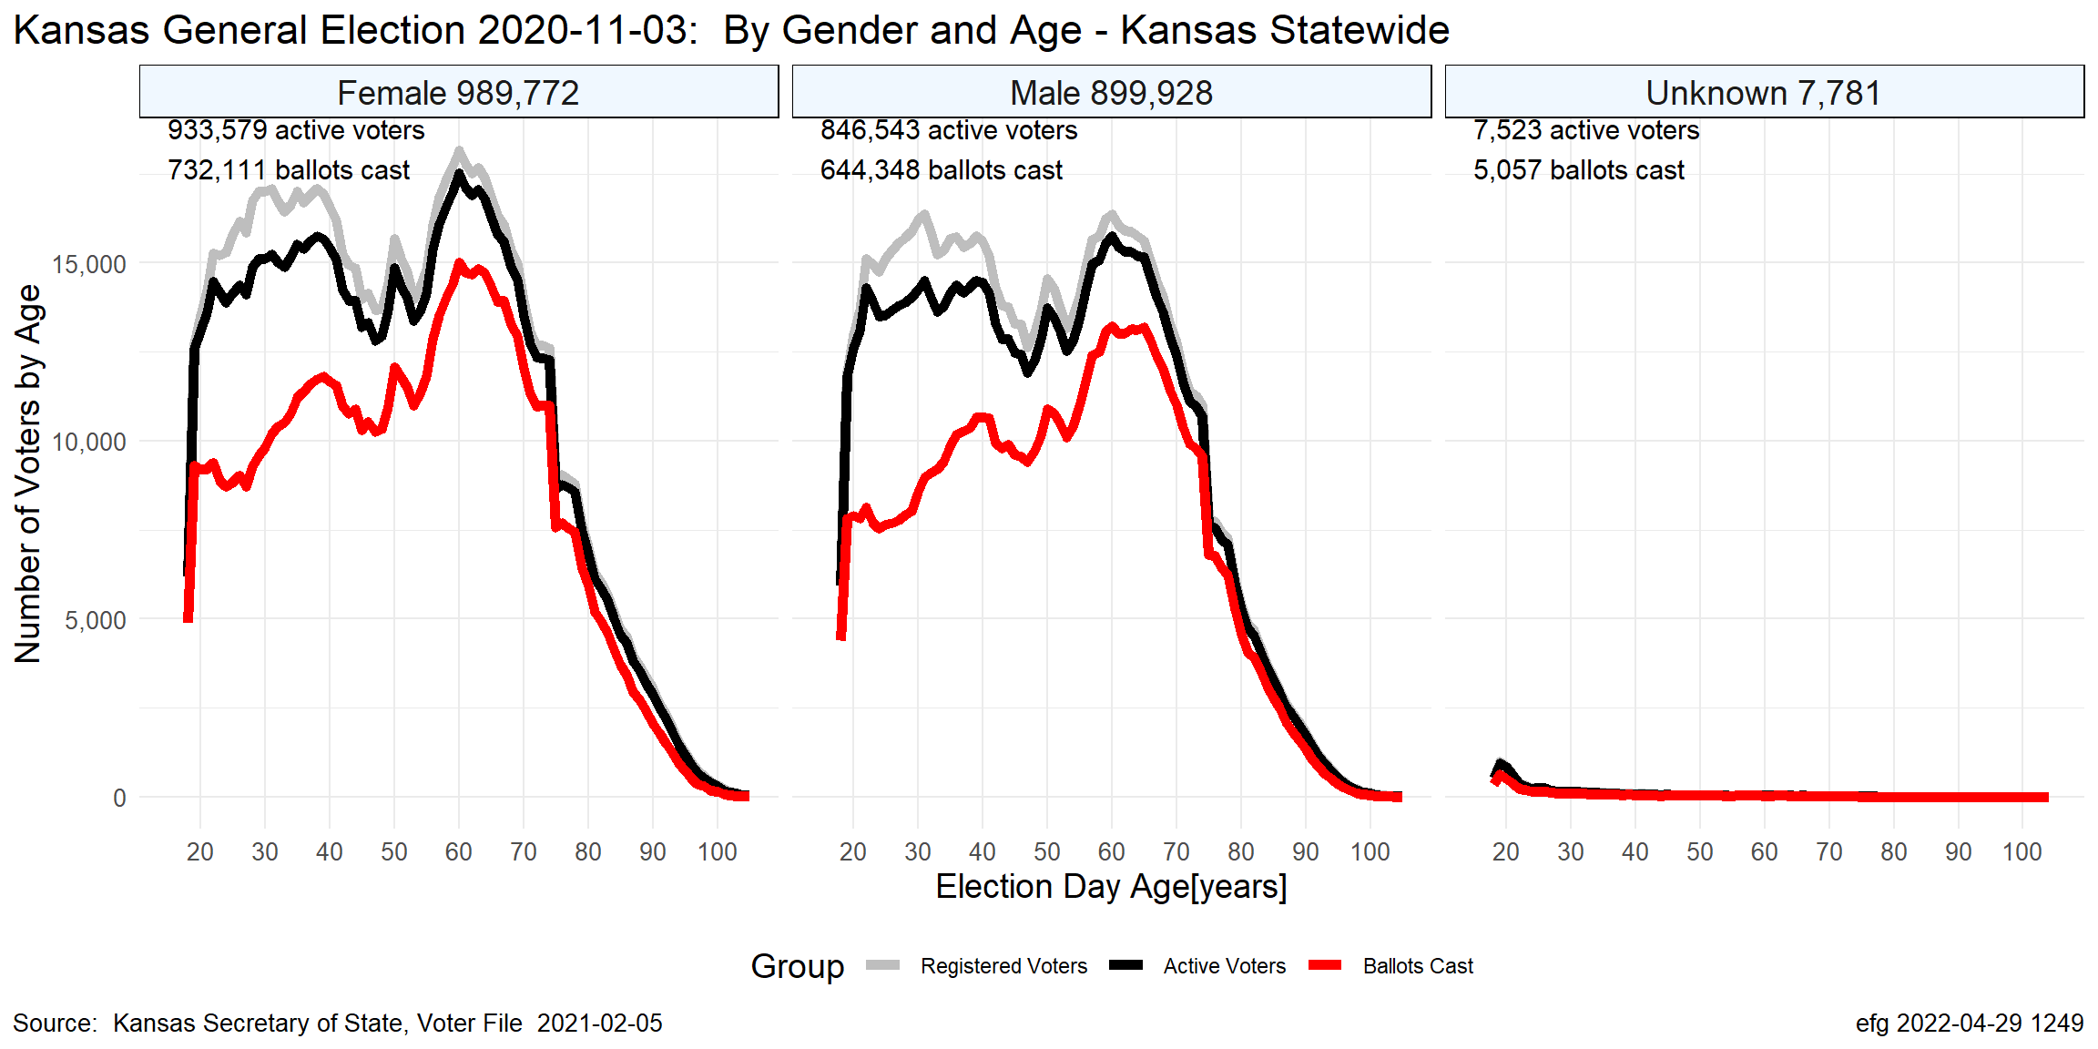
Turnout varies by gender (but party not available in all states)
Notes:
K:\Election-Integrity\Kansas-Normalized-Fraction-of-Voters\Statewide\2020-11-03
2020-11-03-RegisteredActiveVotedByGender-1.png

Slide 23
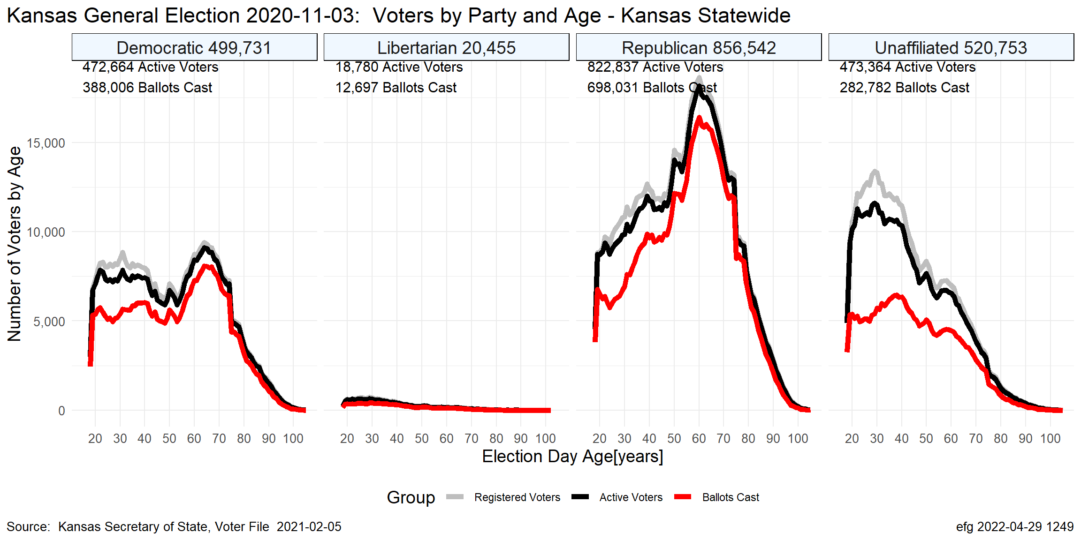
Turnout varies by political party (but party not available in all states)
Notes:
K:\Election-Integrity\Kansas-Normalized-Fraction-of-Voters\Statewide\2020-11-03
2020-11-03-RegisteredActiveVotedByParty-1.png

Slide 24



Inflated voter rolls are not new but may be worse
Oct. 24, 2012
93 counties in 17 states with voter registration ≥ 100% 132 counties in 17 states with registration ≥ 95%
Write a story about it and some counties fix the problem!
The cost to monitor all the states is prohibitive, but is affordable for many states, e.g., OH, MI, NJ, DC, FL.
Oct. 16, 2020 359 counties in 29 states with voter registration > 100%
Notes:
https://web.archive.org/web/20130509141050/http://watchdoglabs.org/blog/2012/10/24/michigan-lost-55000-people-but-gained-500000-voters-between-2000-and-2010-census/
https://www.judicialwatch.org/new-jw-study-voter-registration/
https://frankspeech.com/video/dr-frank-displays-his-evidence-day-1-cyber-symposium-0, 29:29

