Slide 1
Kansas Normalized Voter Turnout November General Elections 2006 - 2020
efg
2022-04-29

Slide 2
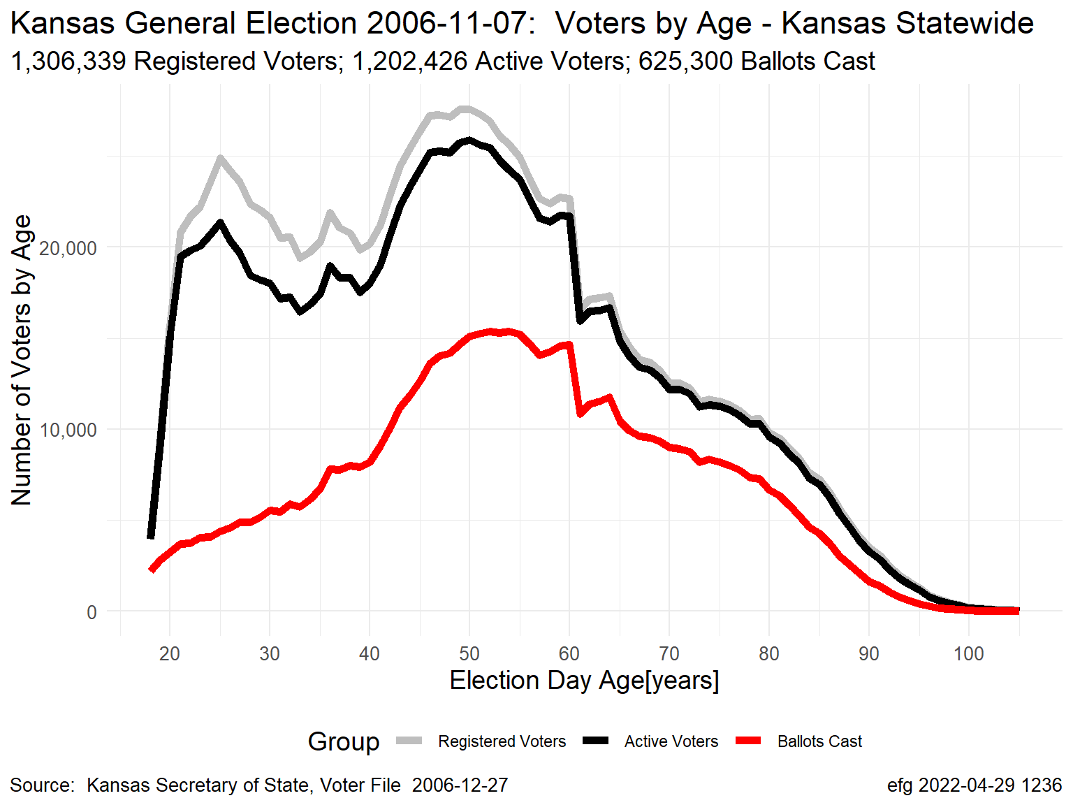
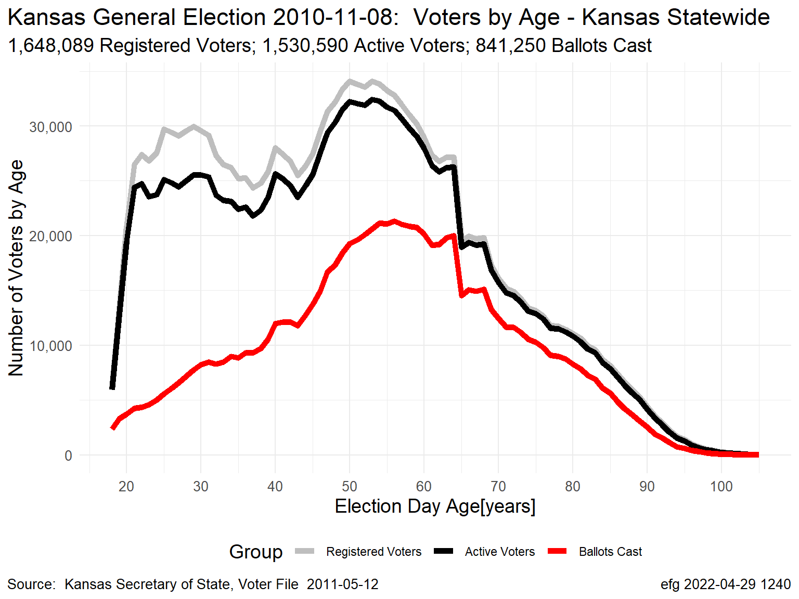
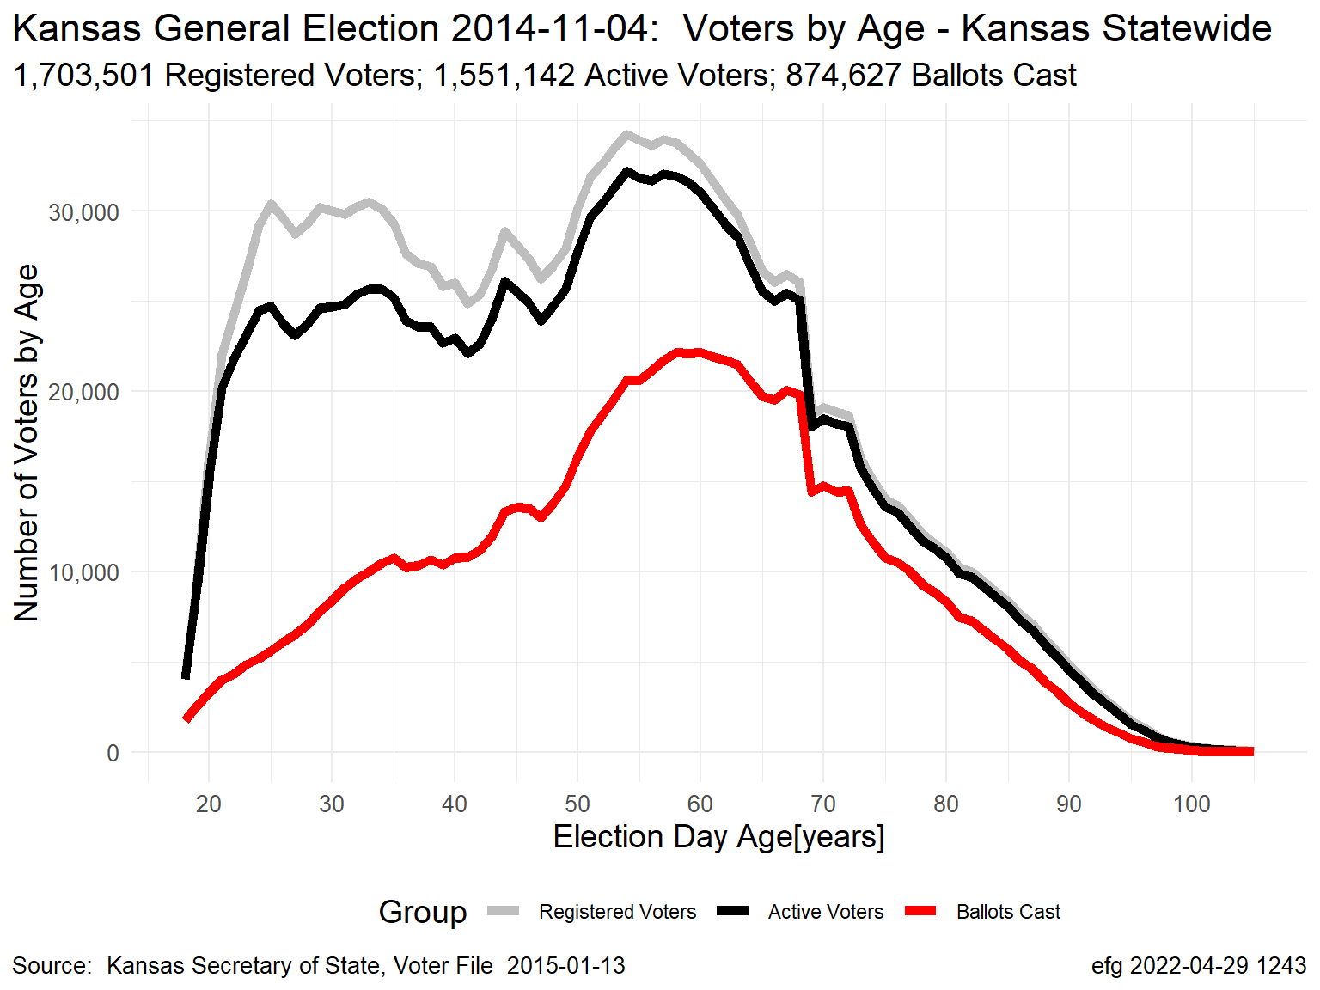
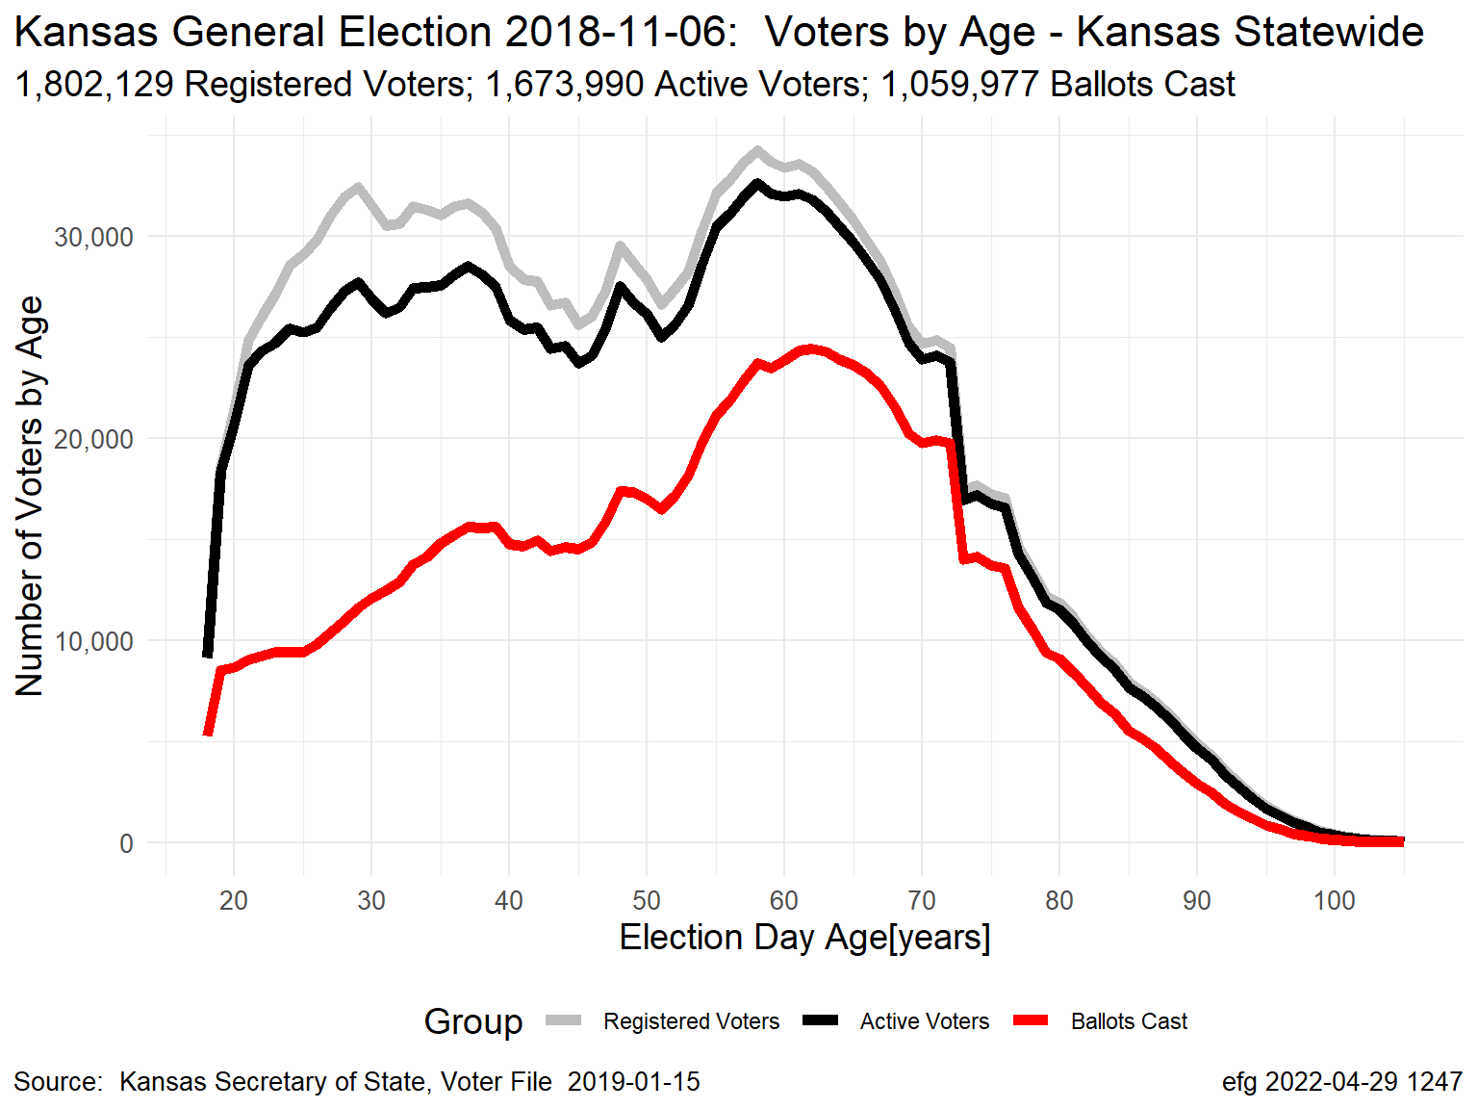
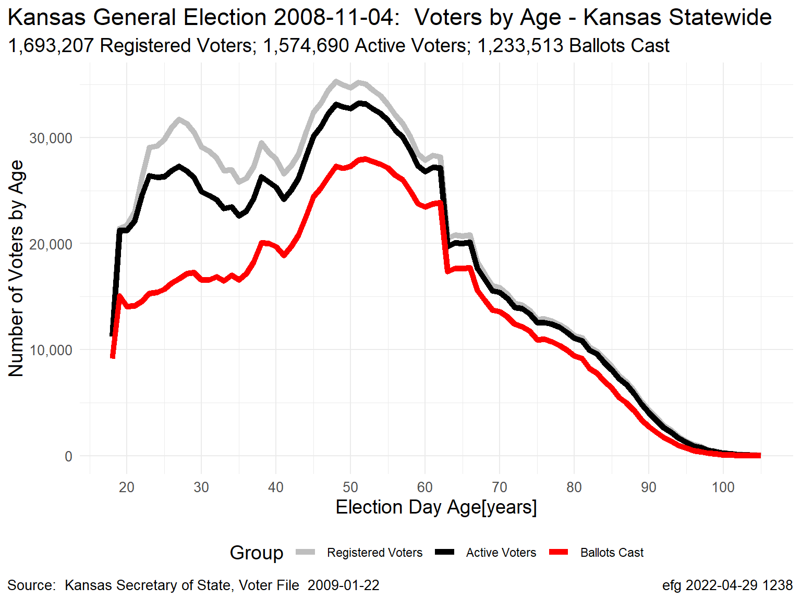
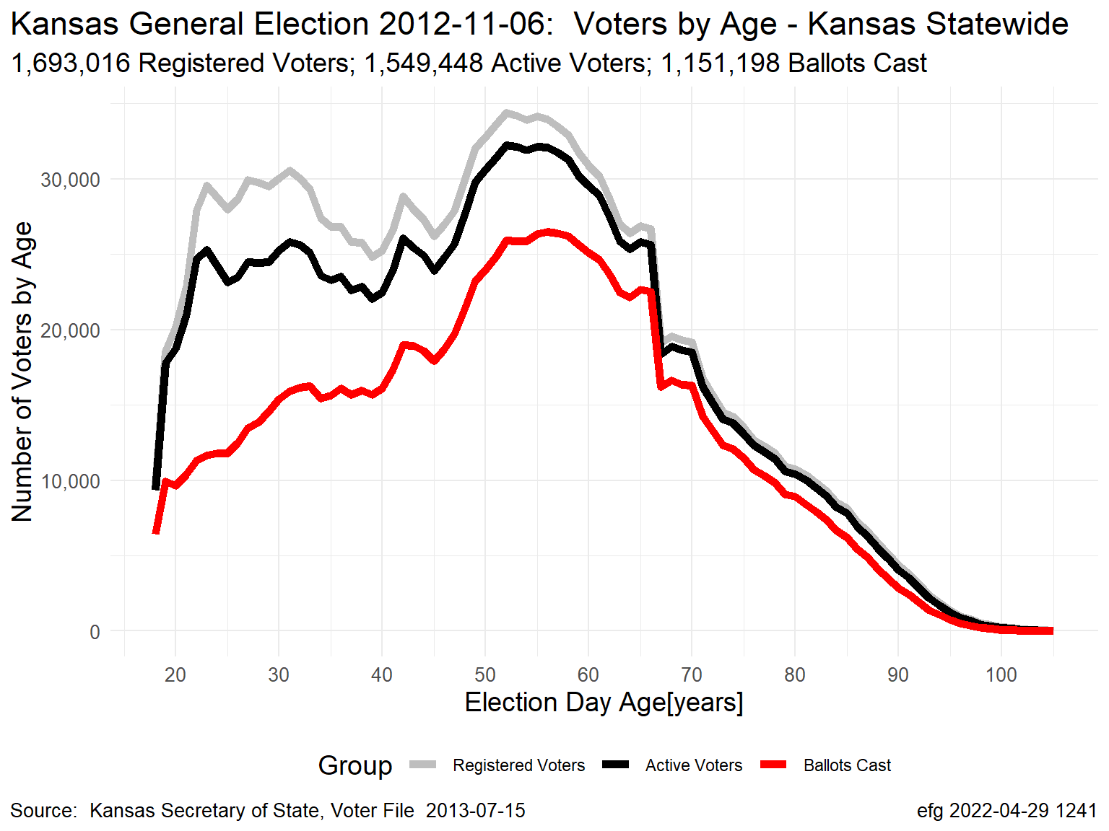
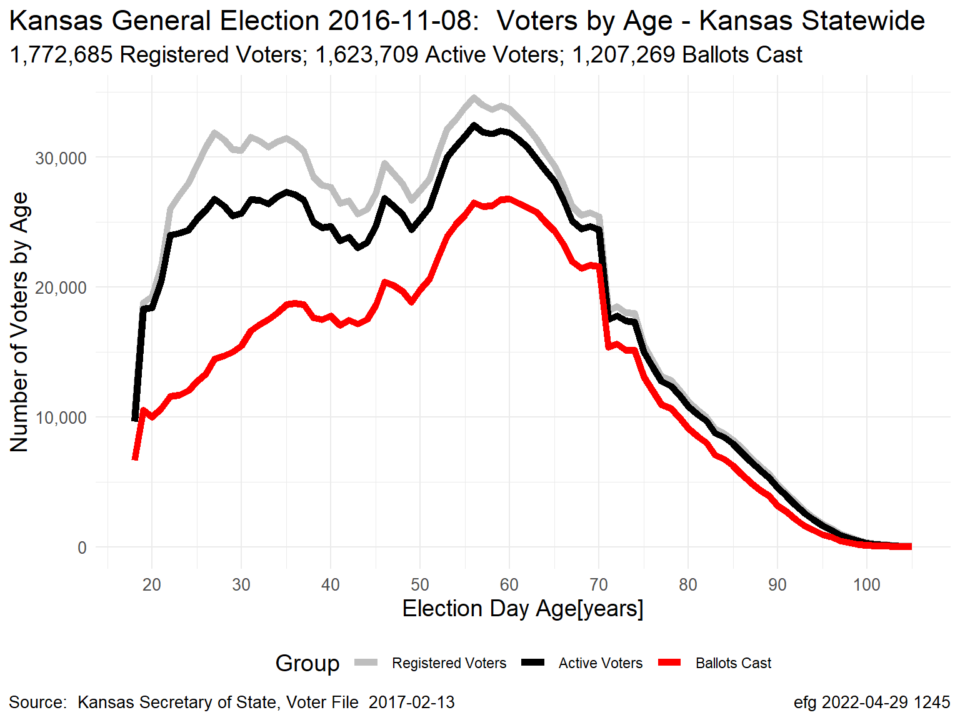
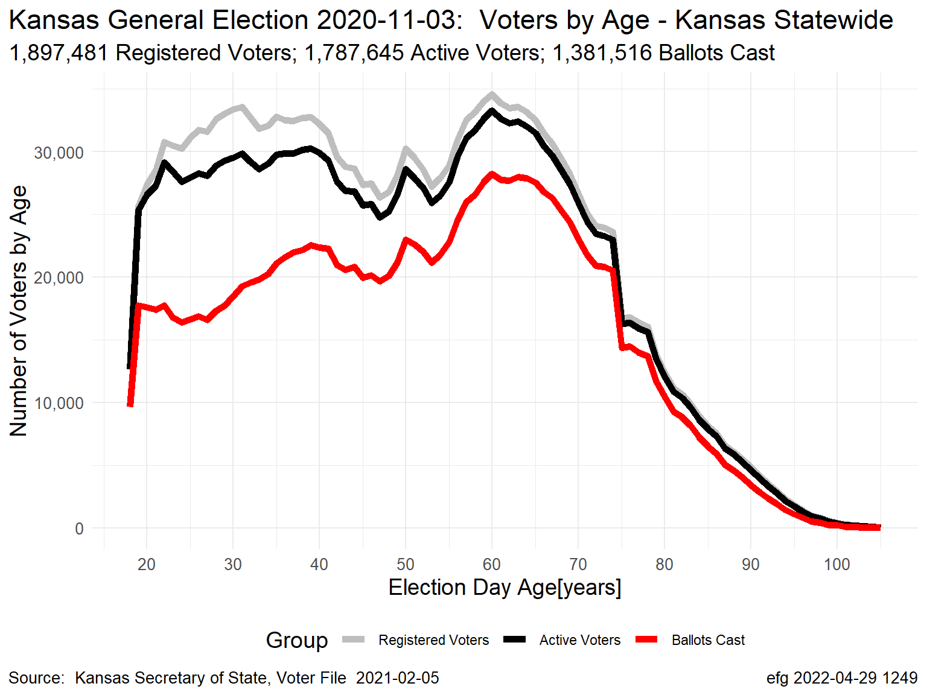
Kansas November General Elections: Voter Counts by Age
Grey Line = Registered Voters; Black Line = “Active” Voters; Red Line = Ballots Cast
Gubernatorial Election Years
2006
2010
2014
2018
Presidential Election Years
2008
2012
2016
2020

Slide 3
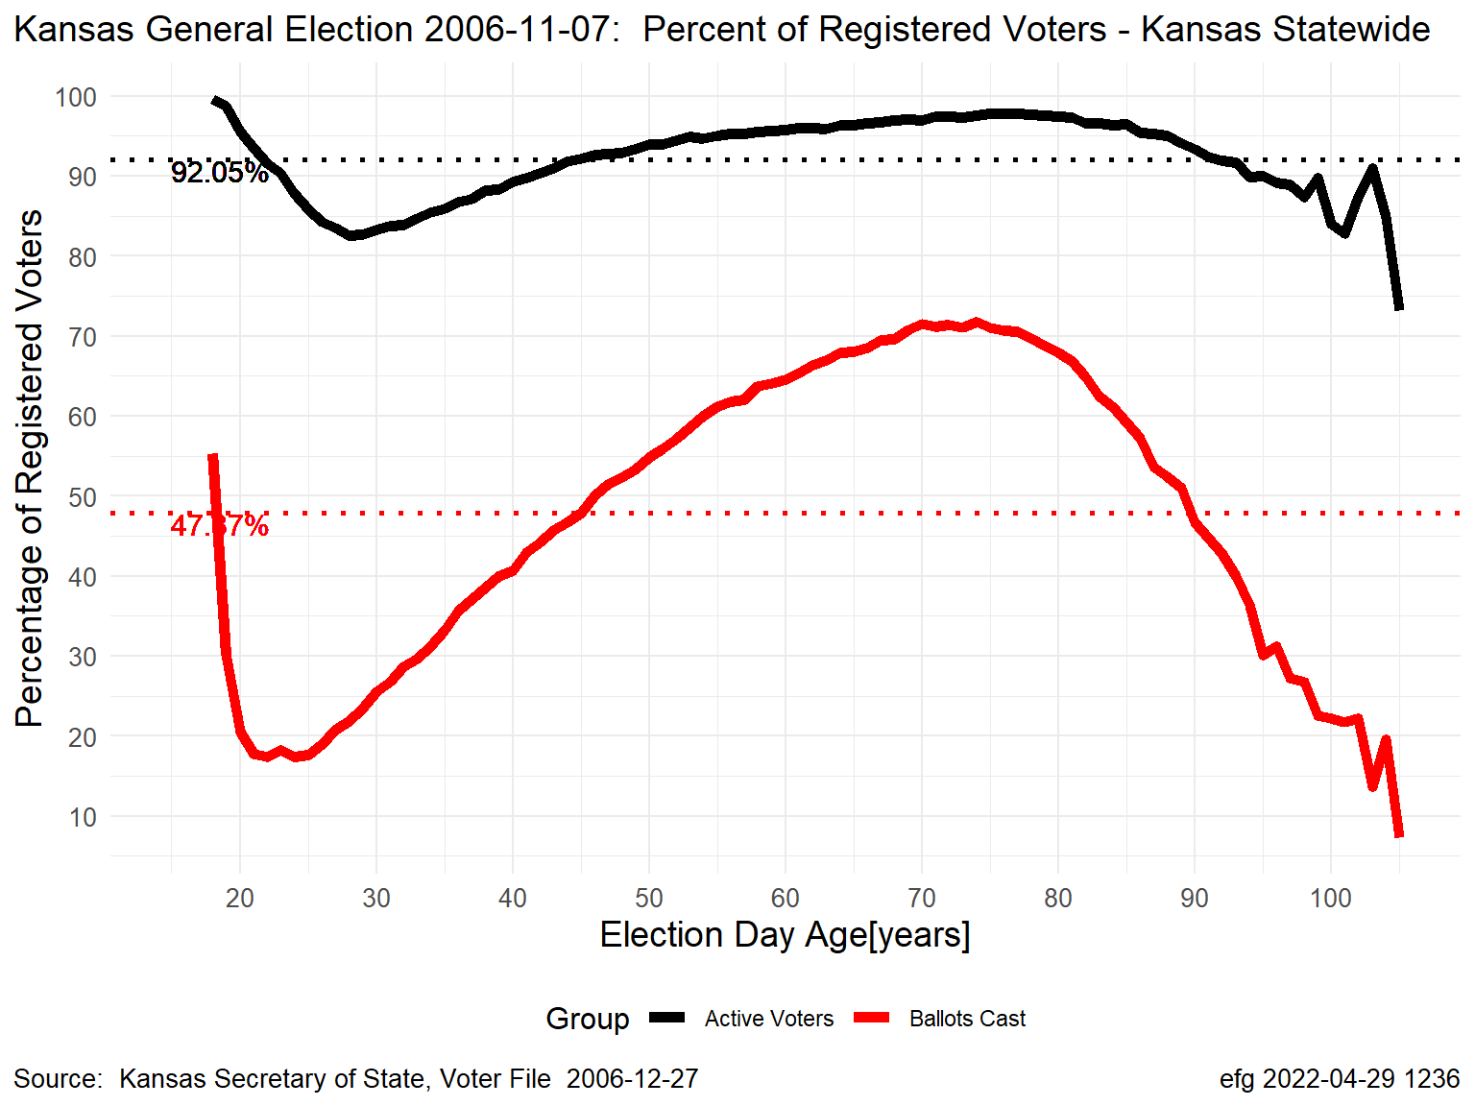
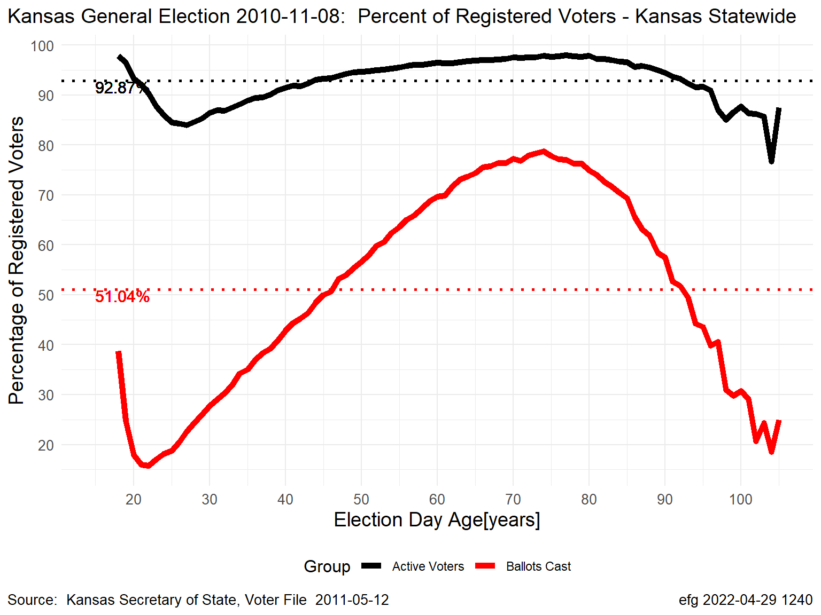
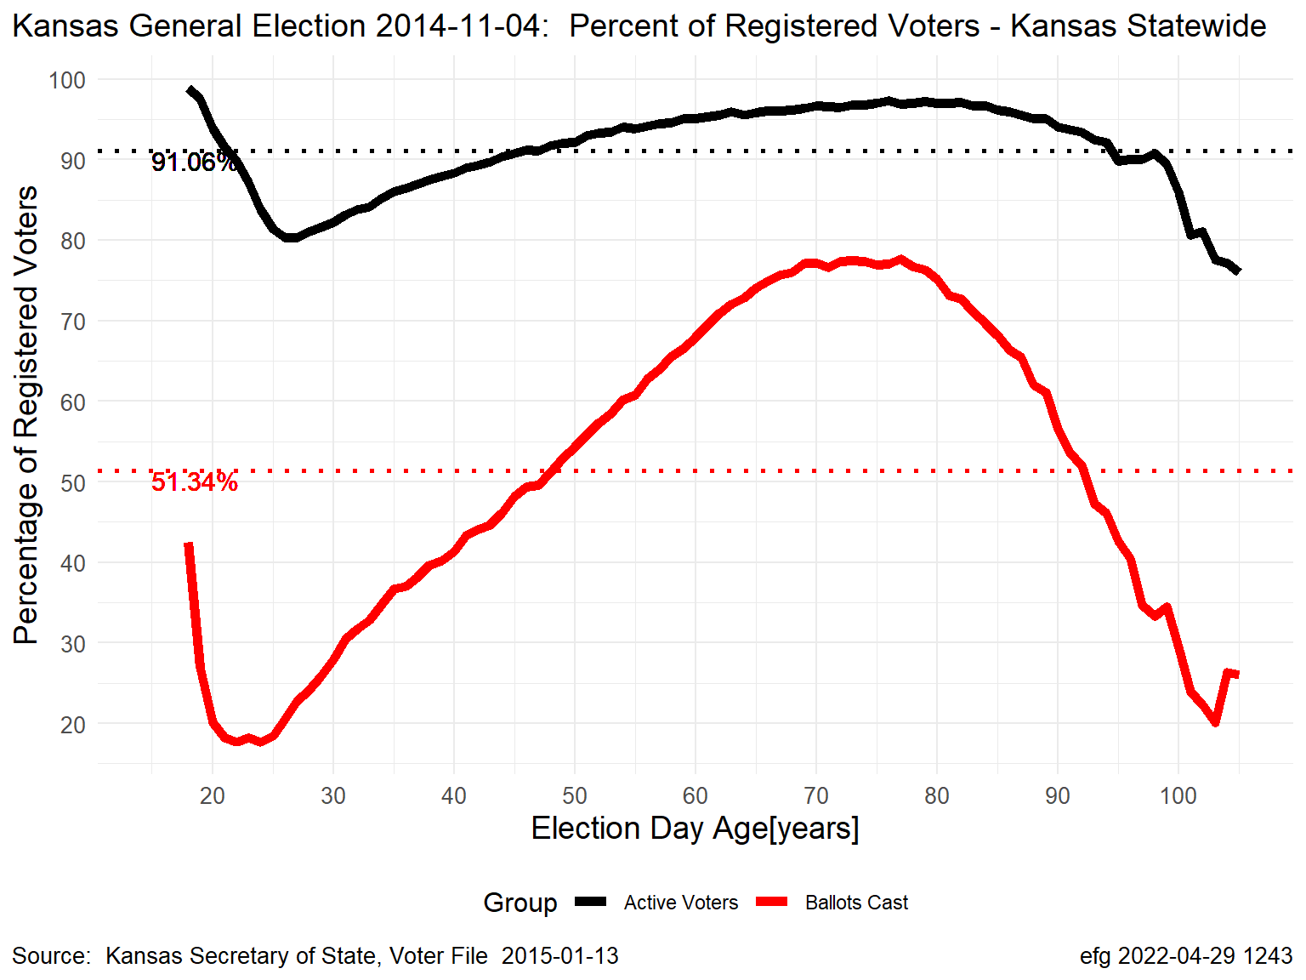
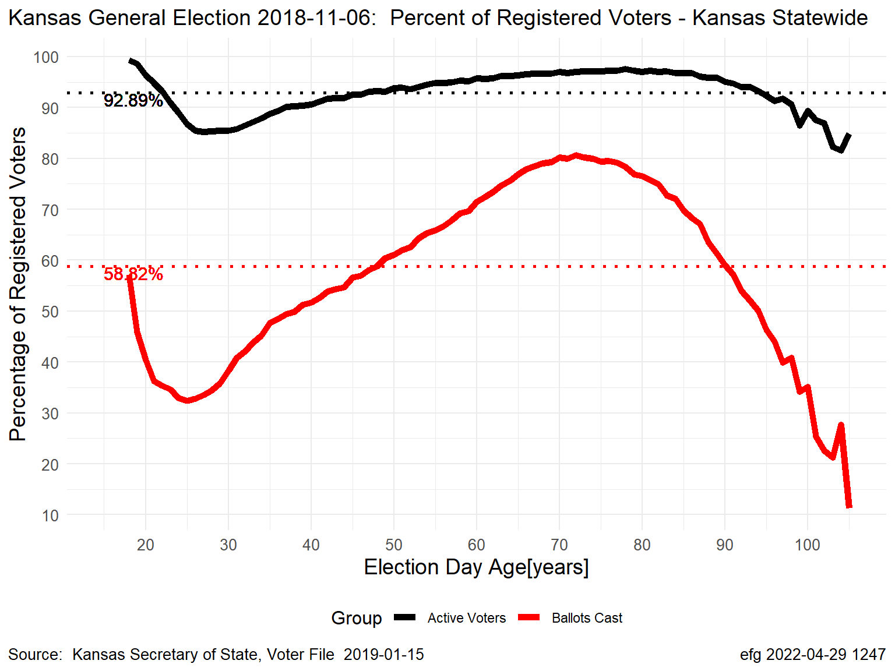
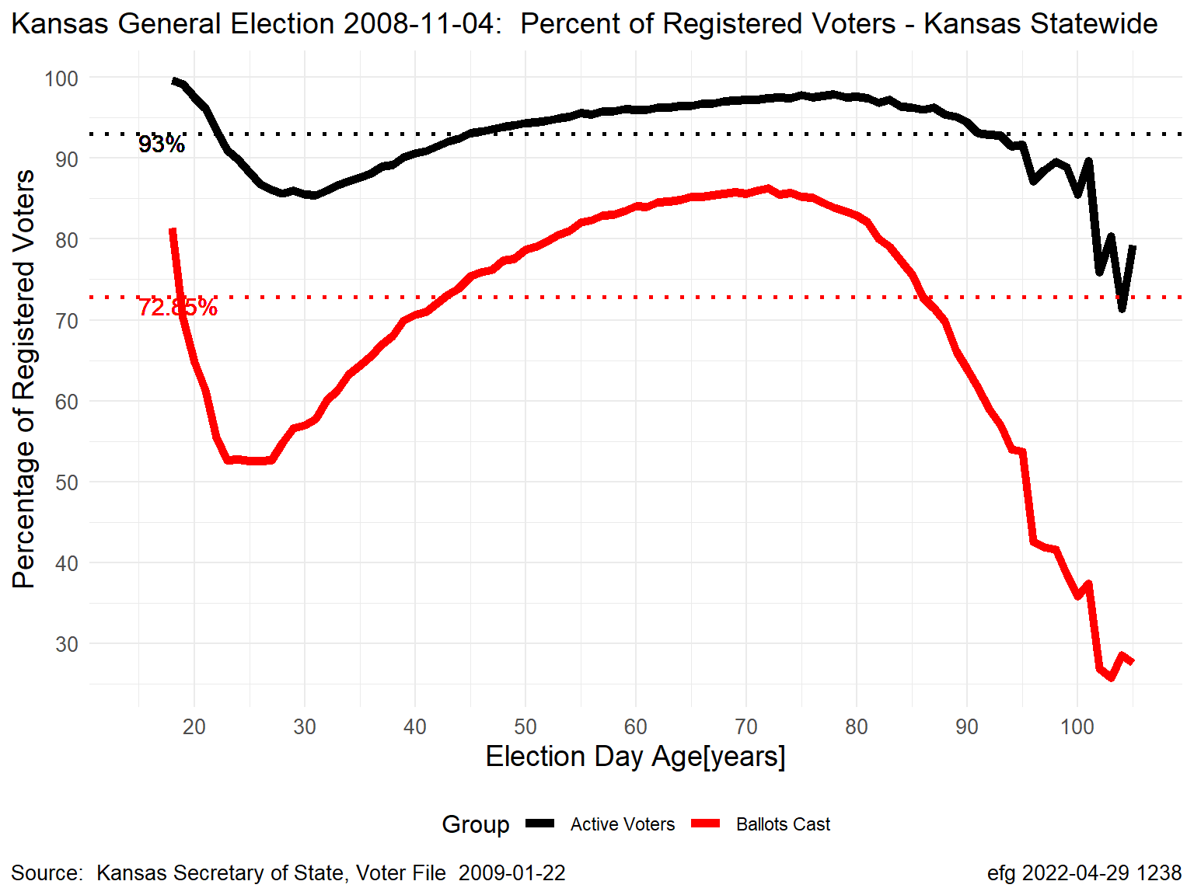
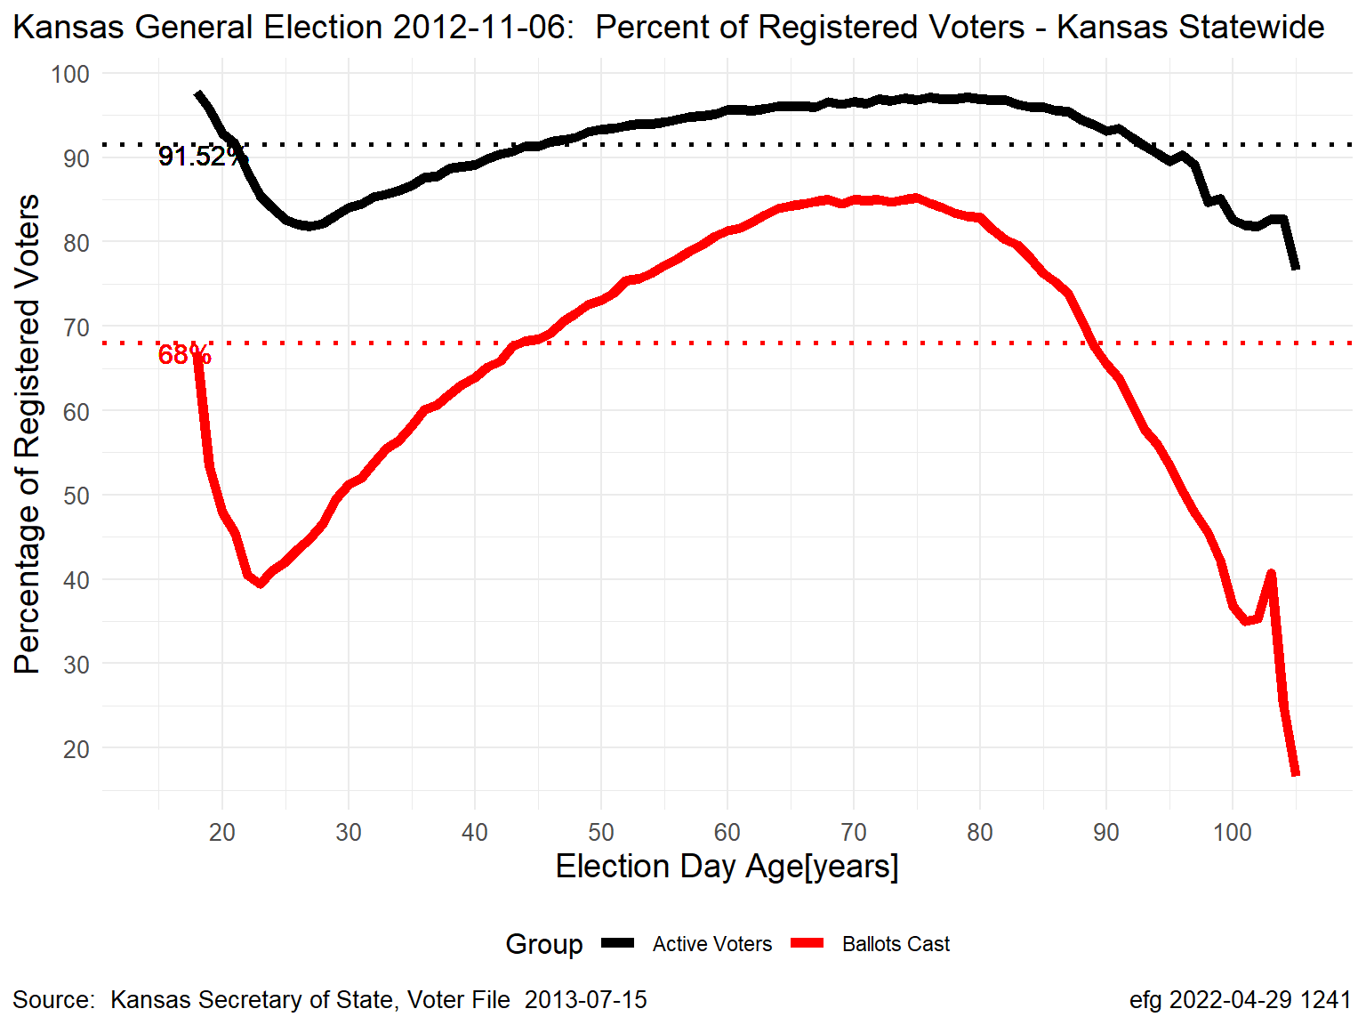
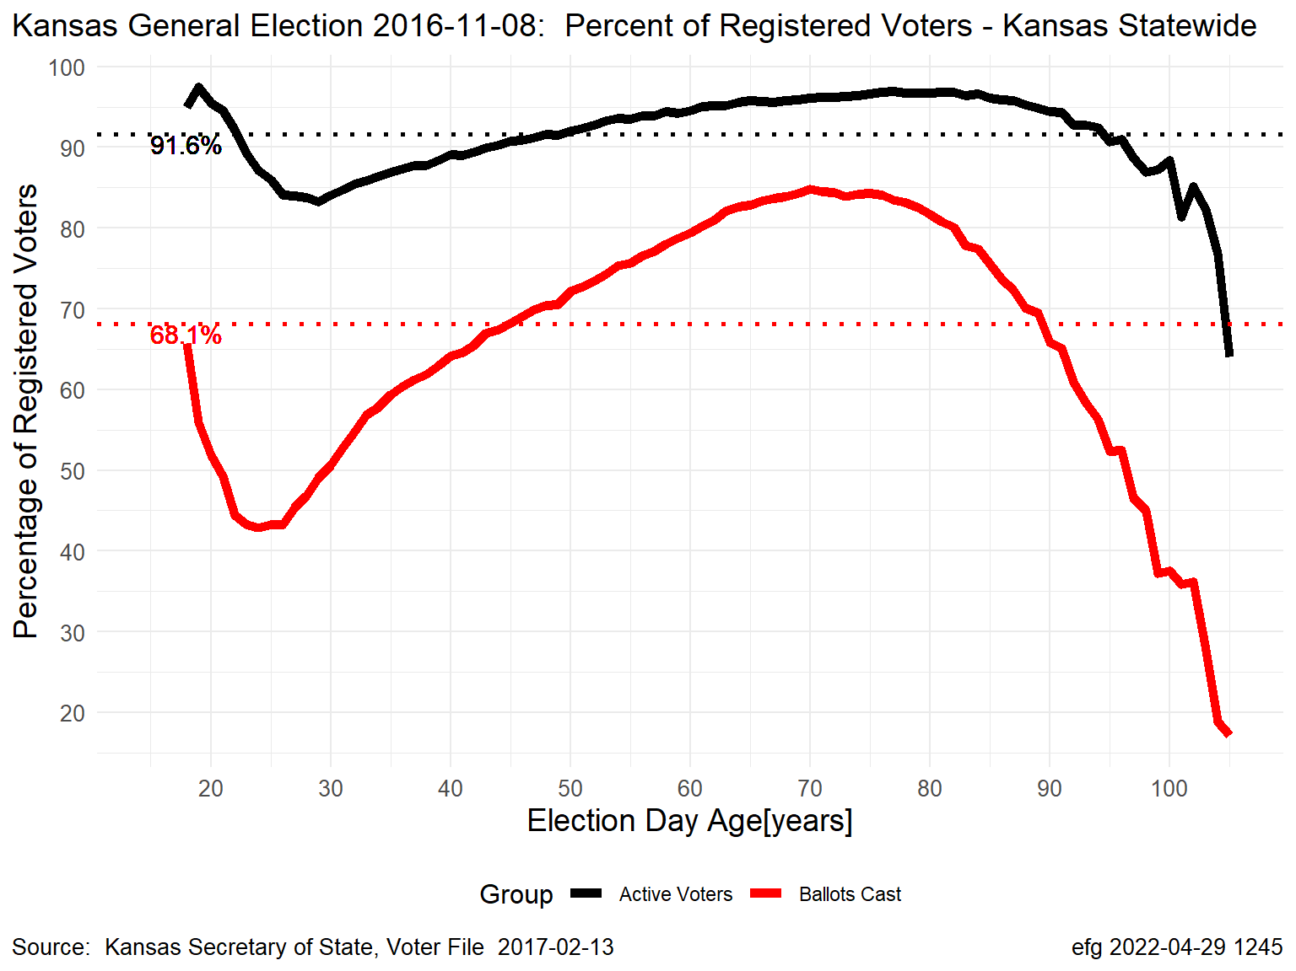
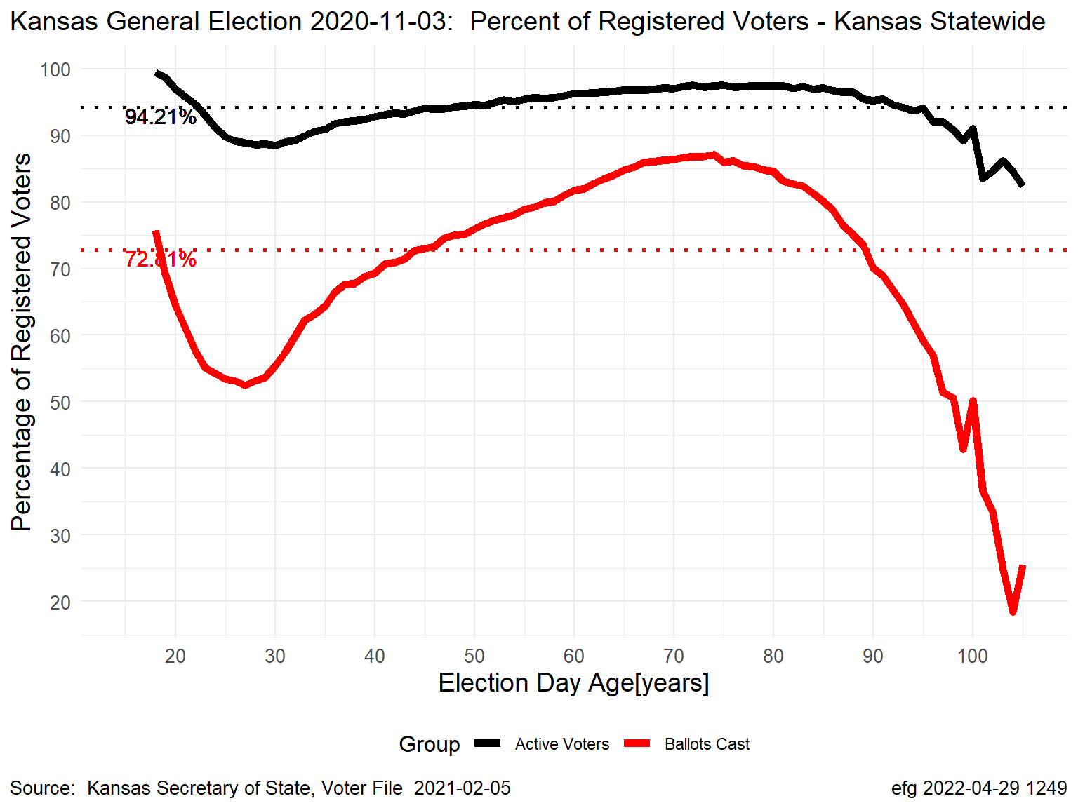
Kansas November General Elections: Percentages by Age
Black Line = “Active” Voters; Red Line = Ballots Cast
Gubernatorial Election Years
2006
2010
2014
2018
Presidential Election Years
2008
2012
2016
2020

Slide 4
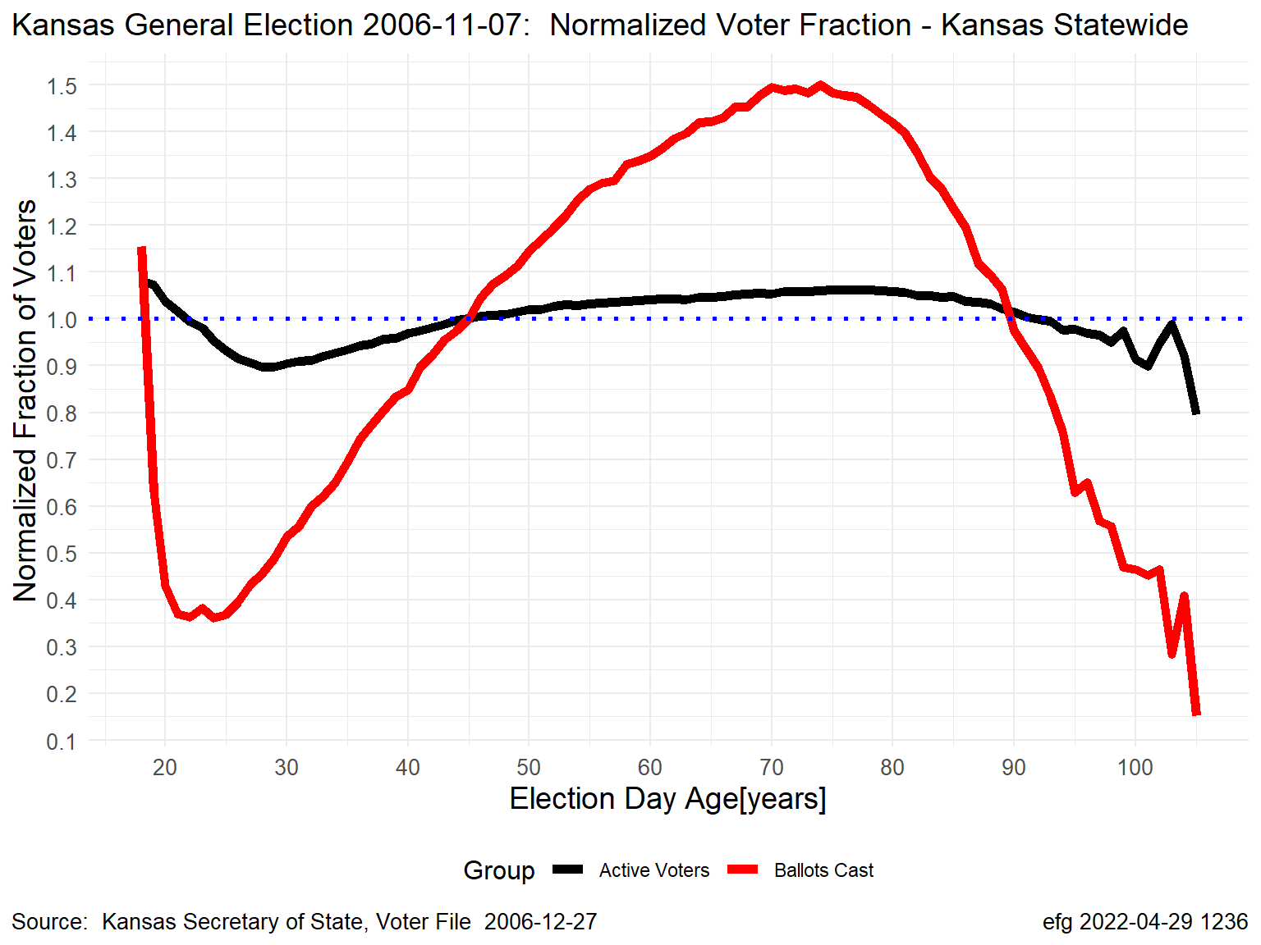
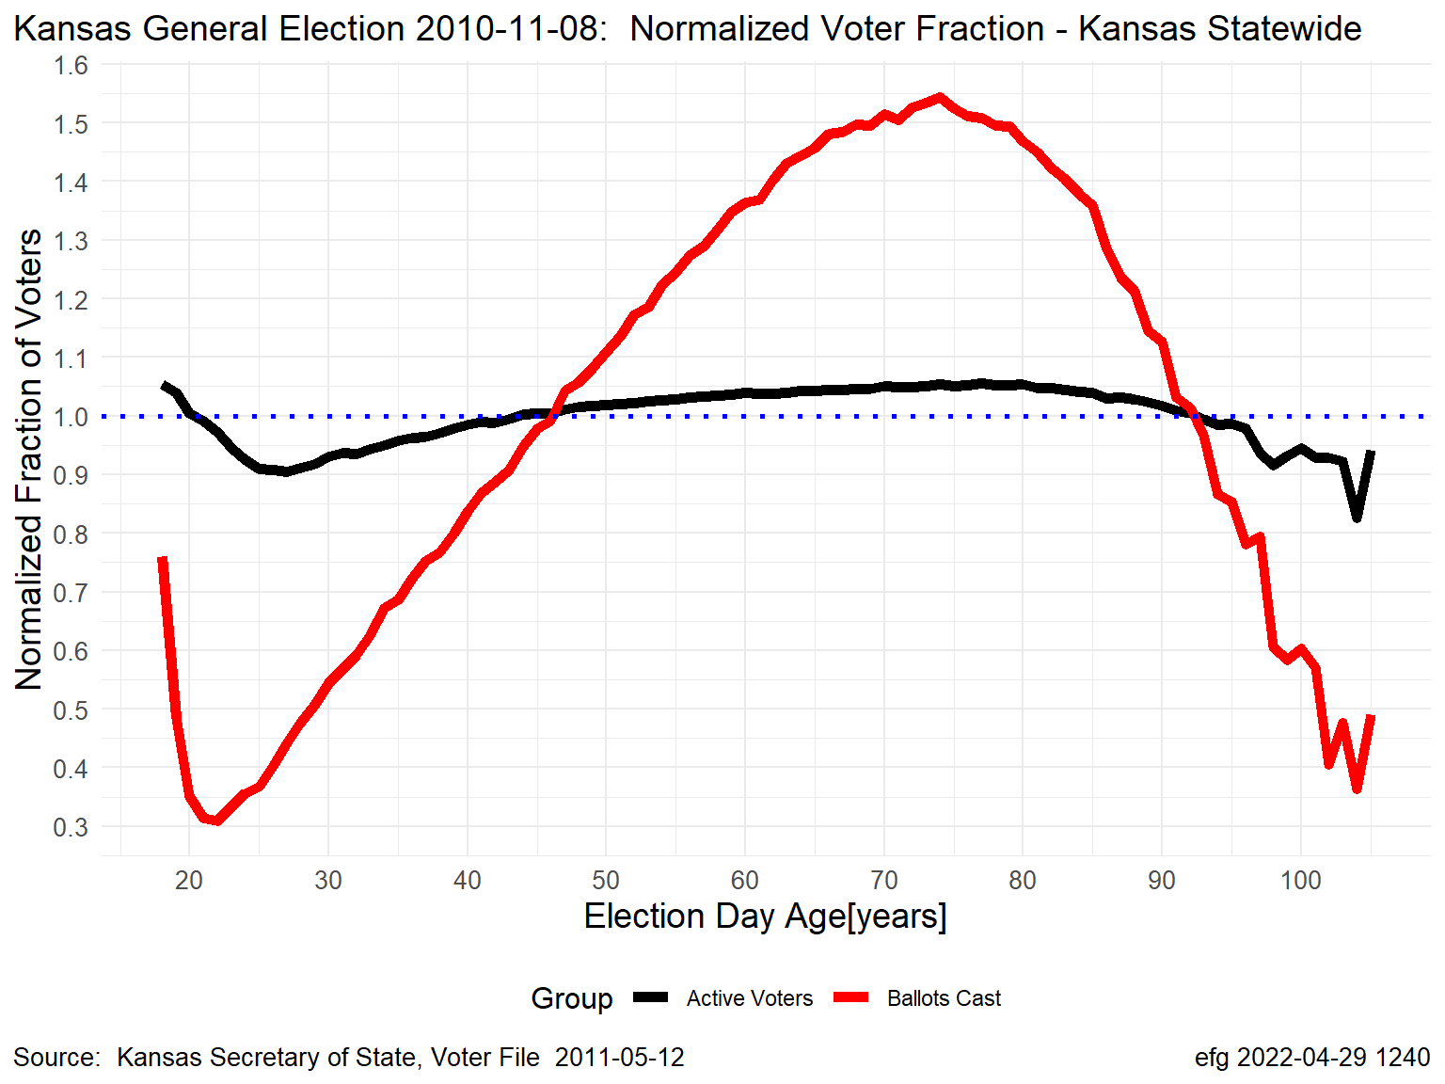
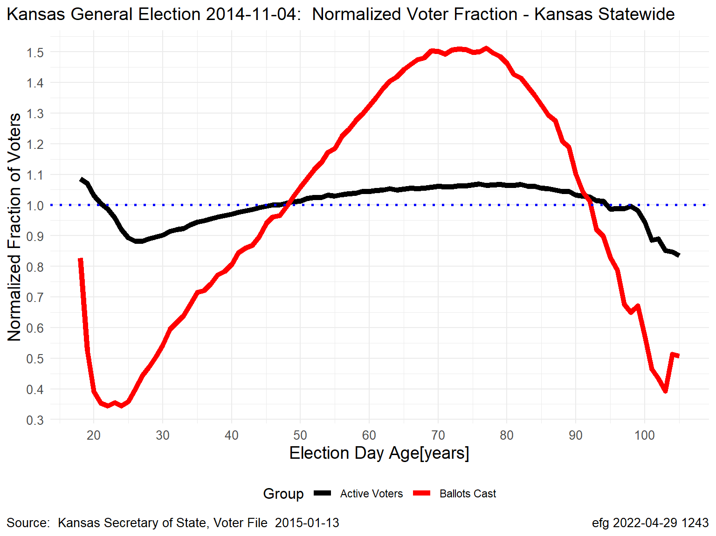
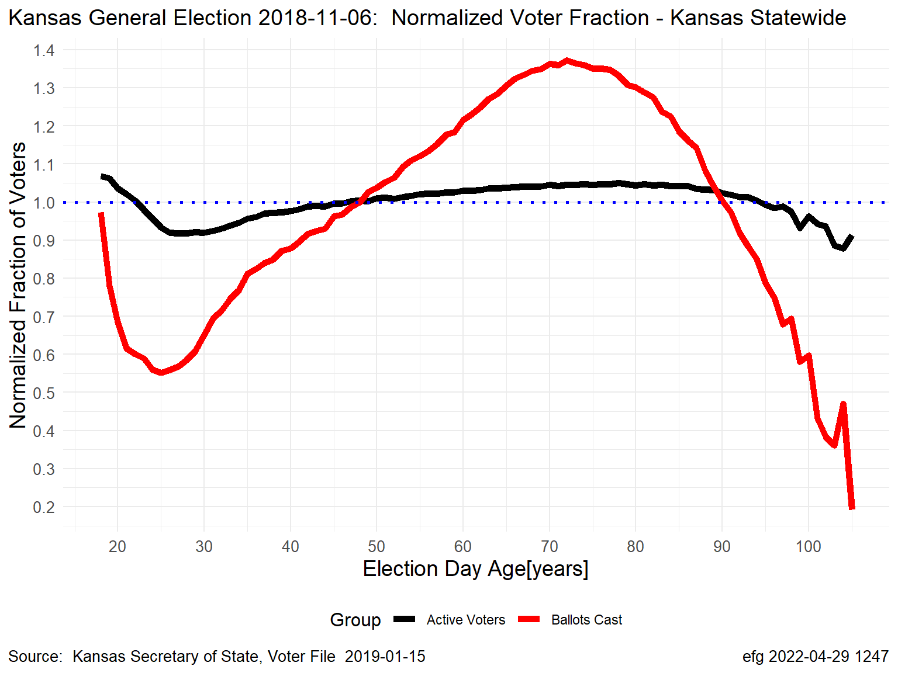
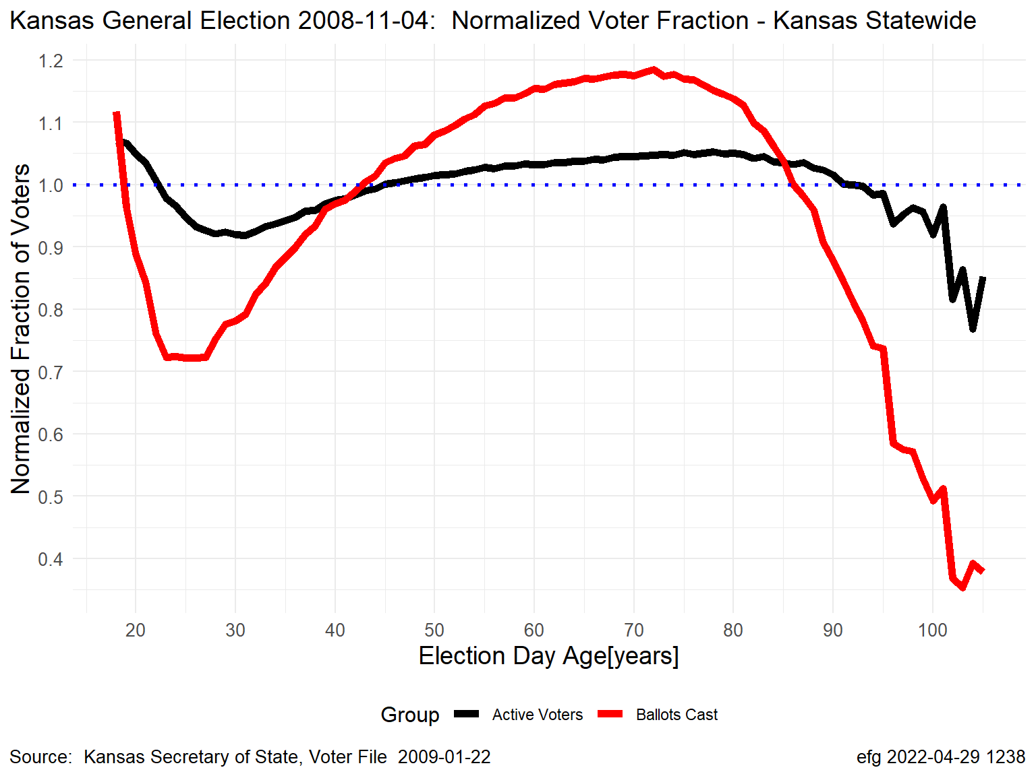
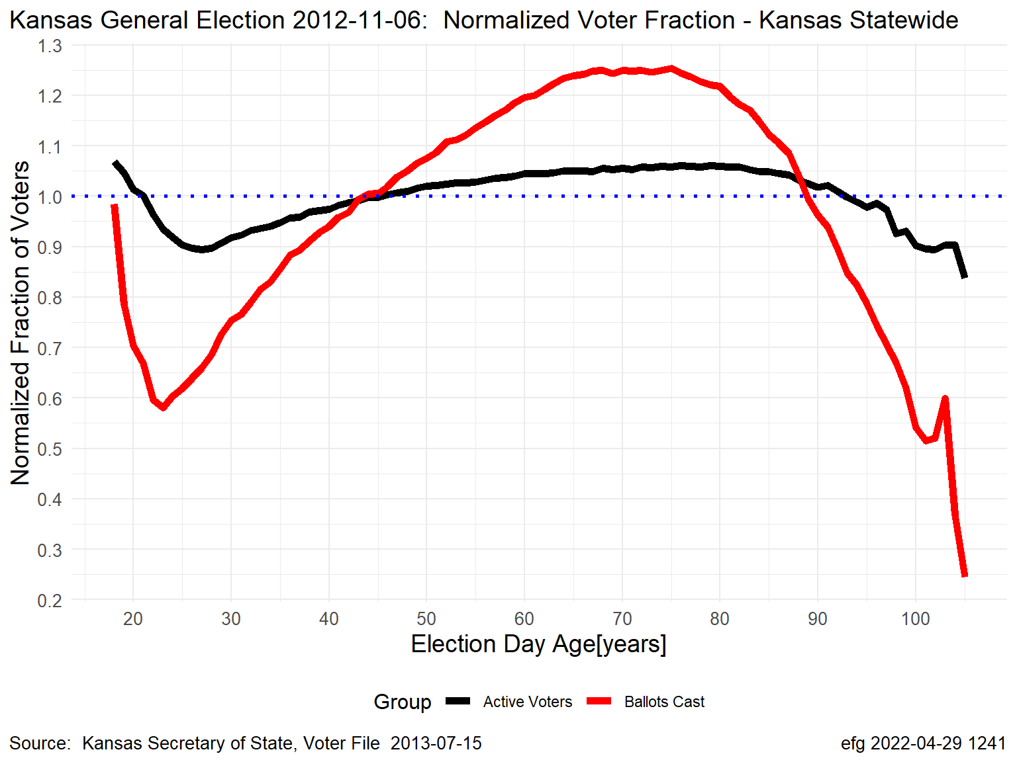
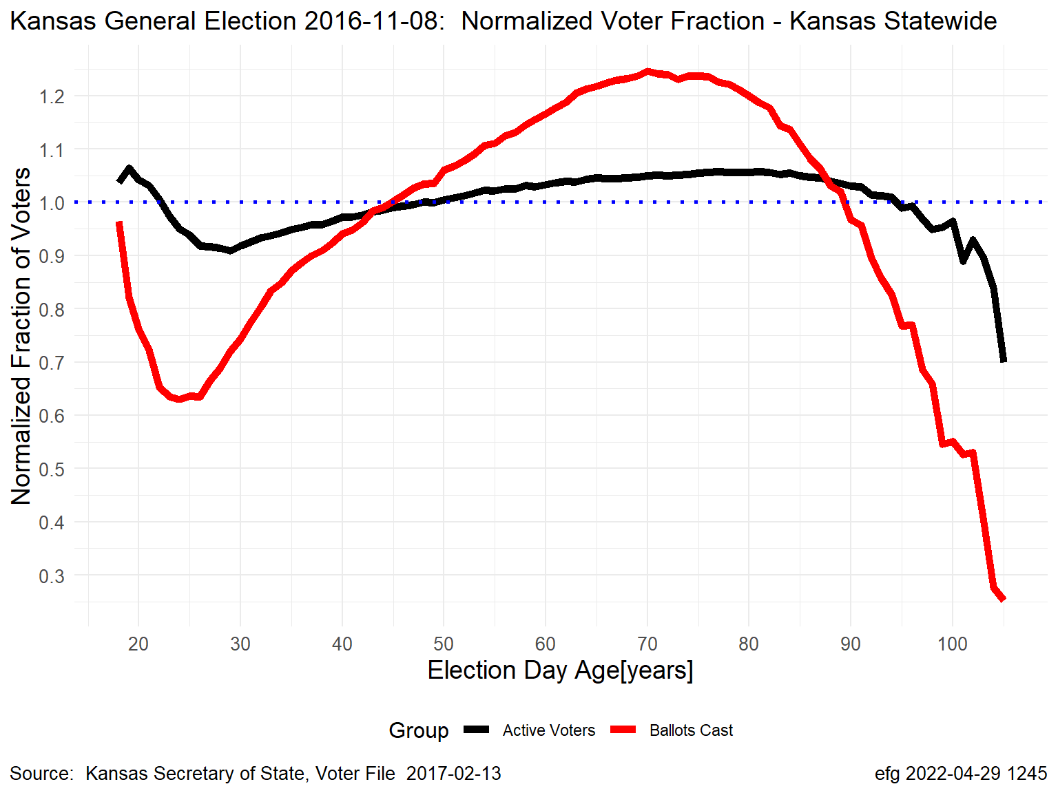
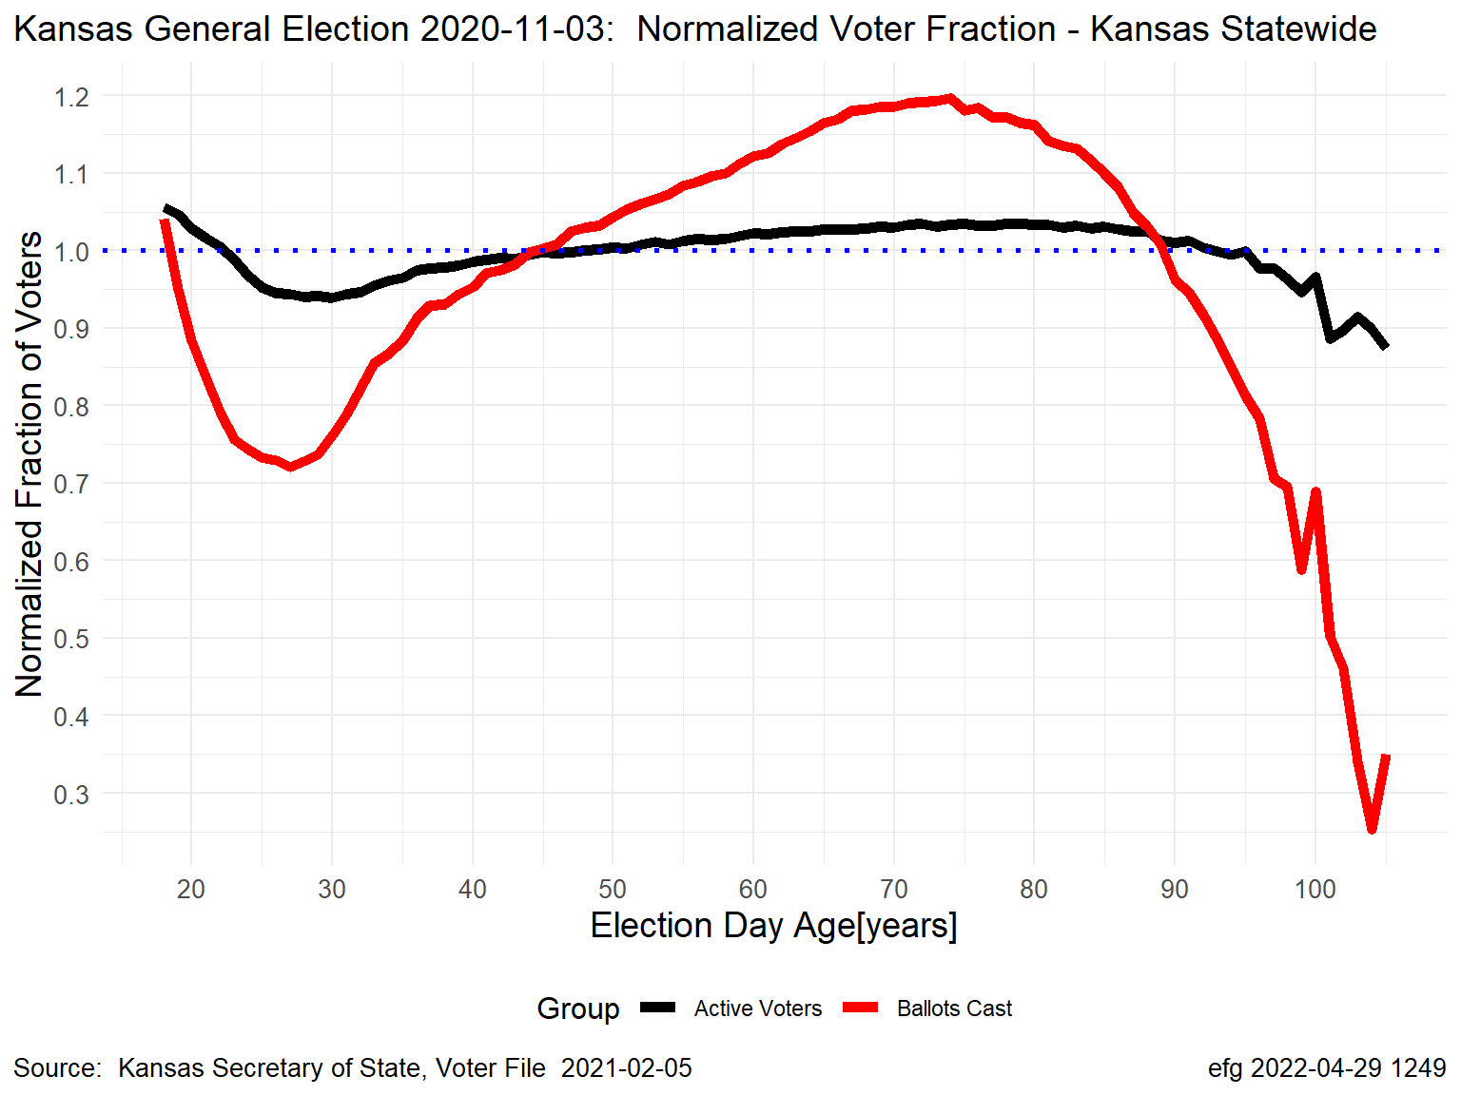
Kansas November General Elections: Normalized by Age
Black Line = “Active” Voters; Red Line = Ballots Cast
Gubernatorial Election Years
2006
2010
2014
2018
Presidential Election Years
2008
2012
2016
2020

Slide 5
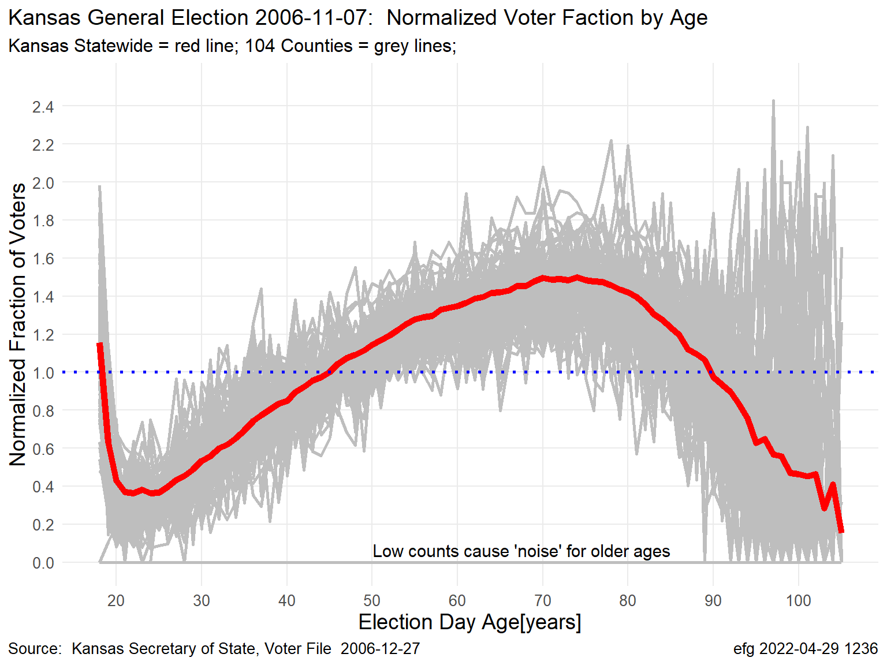
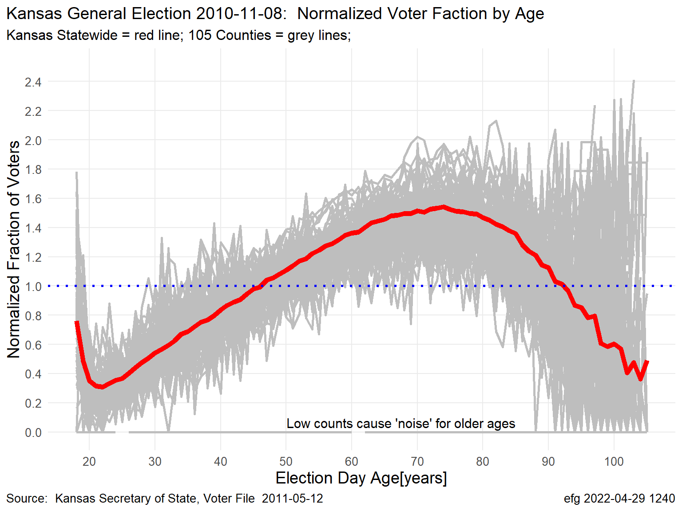
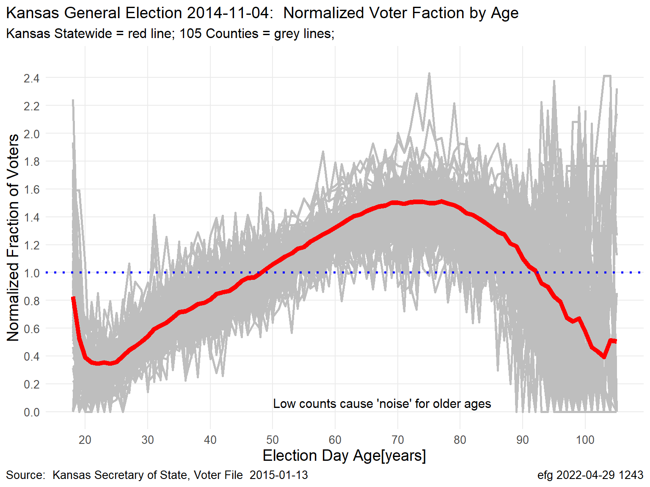
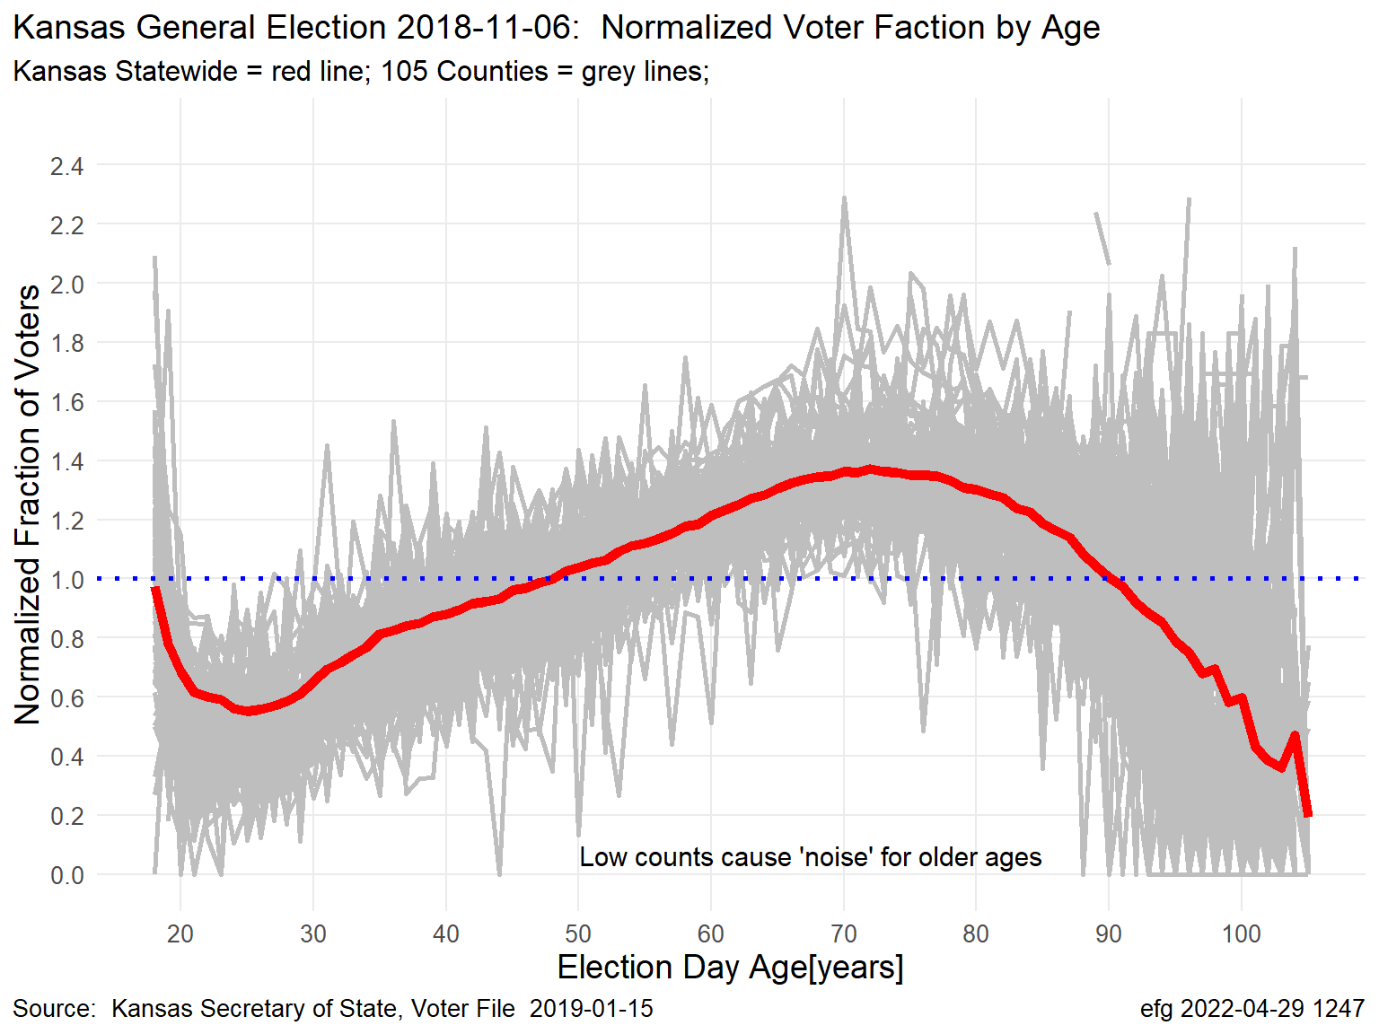
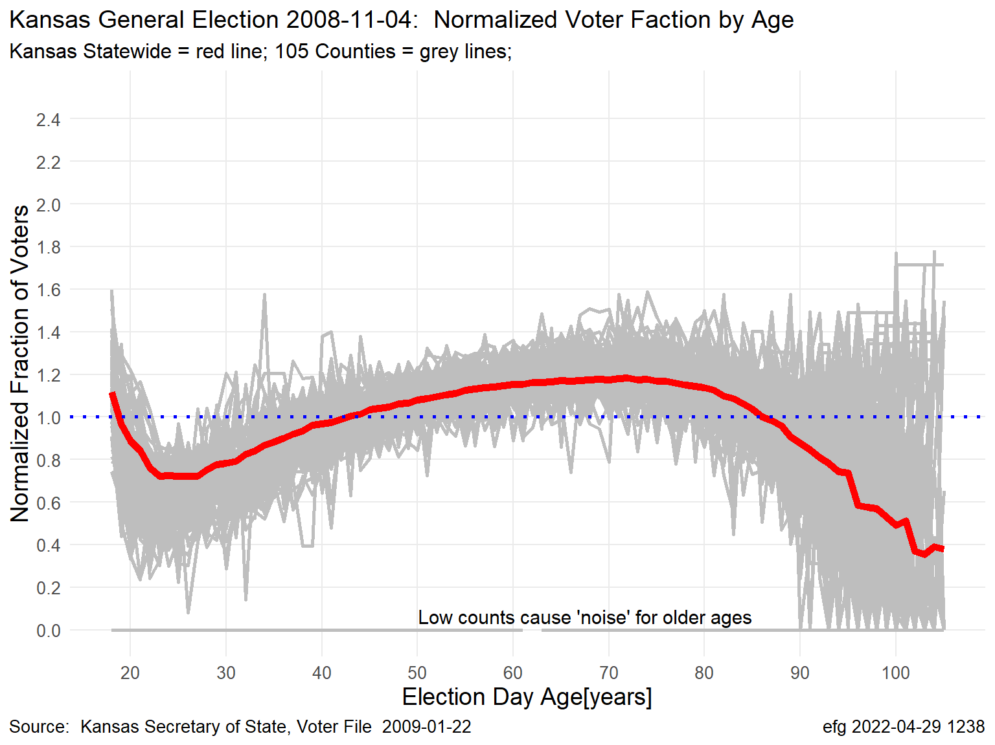
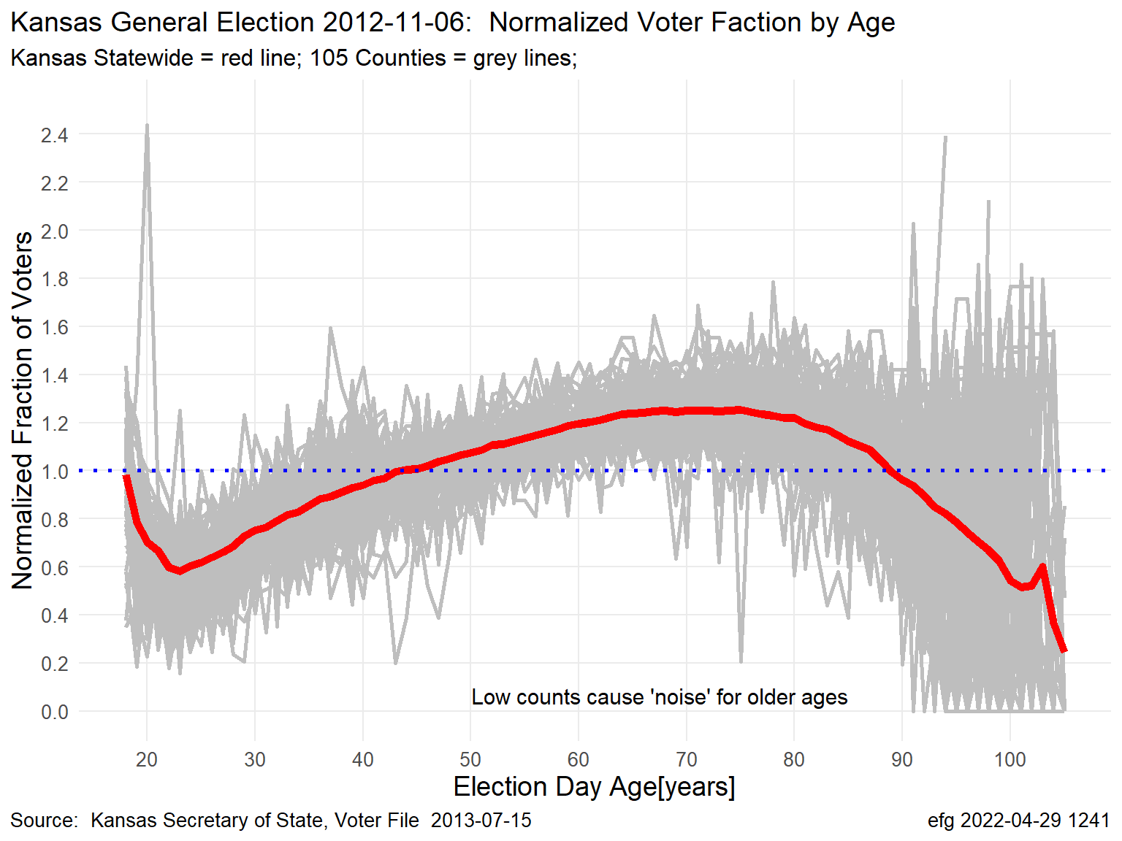
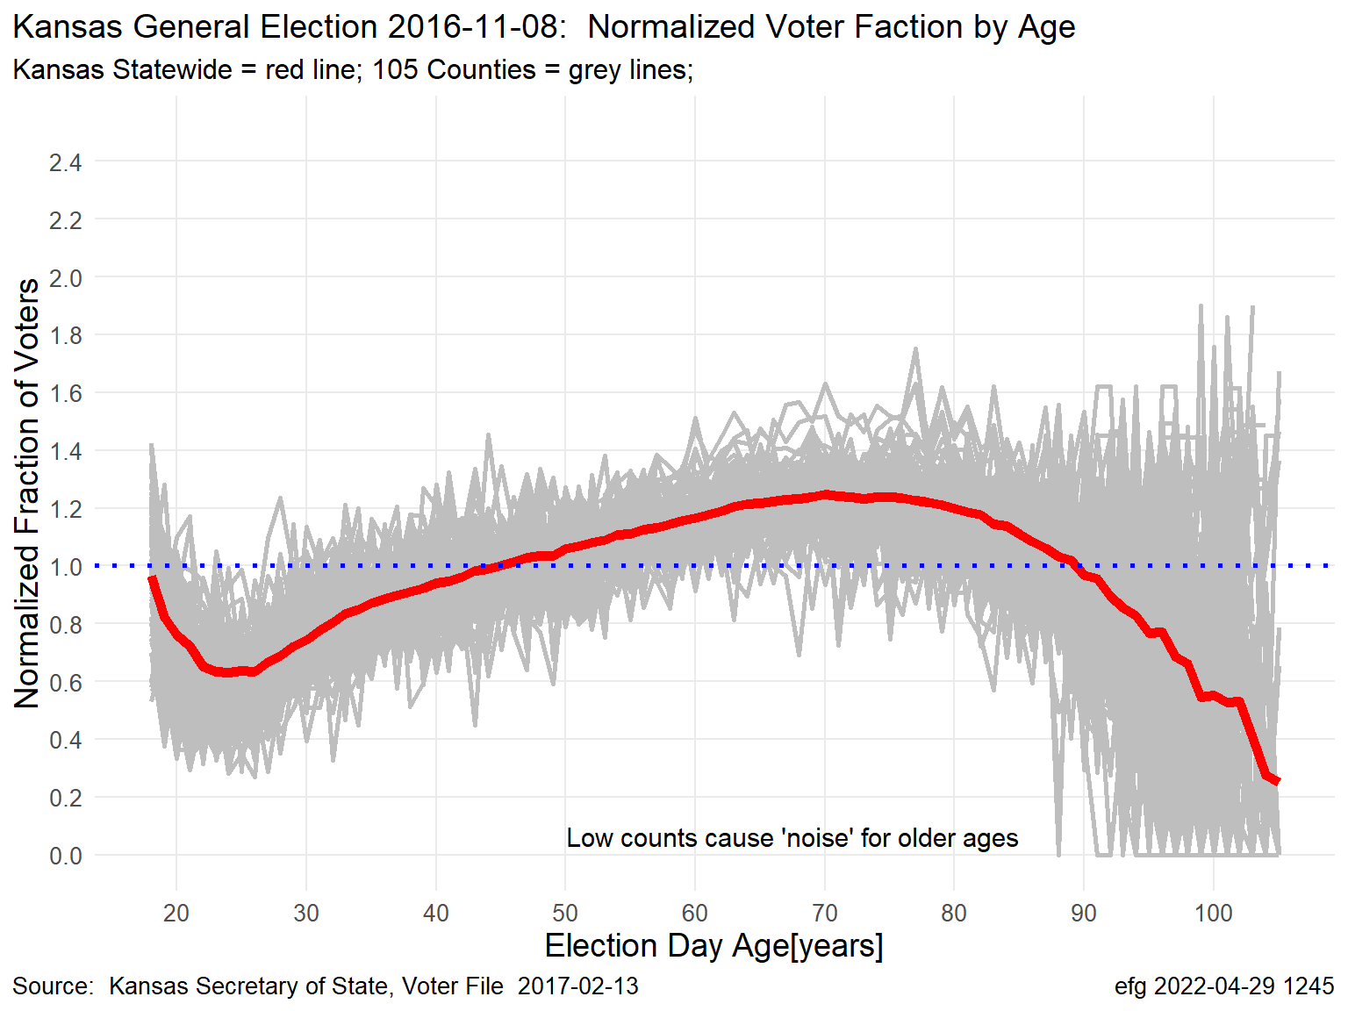
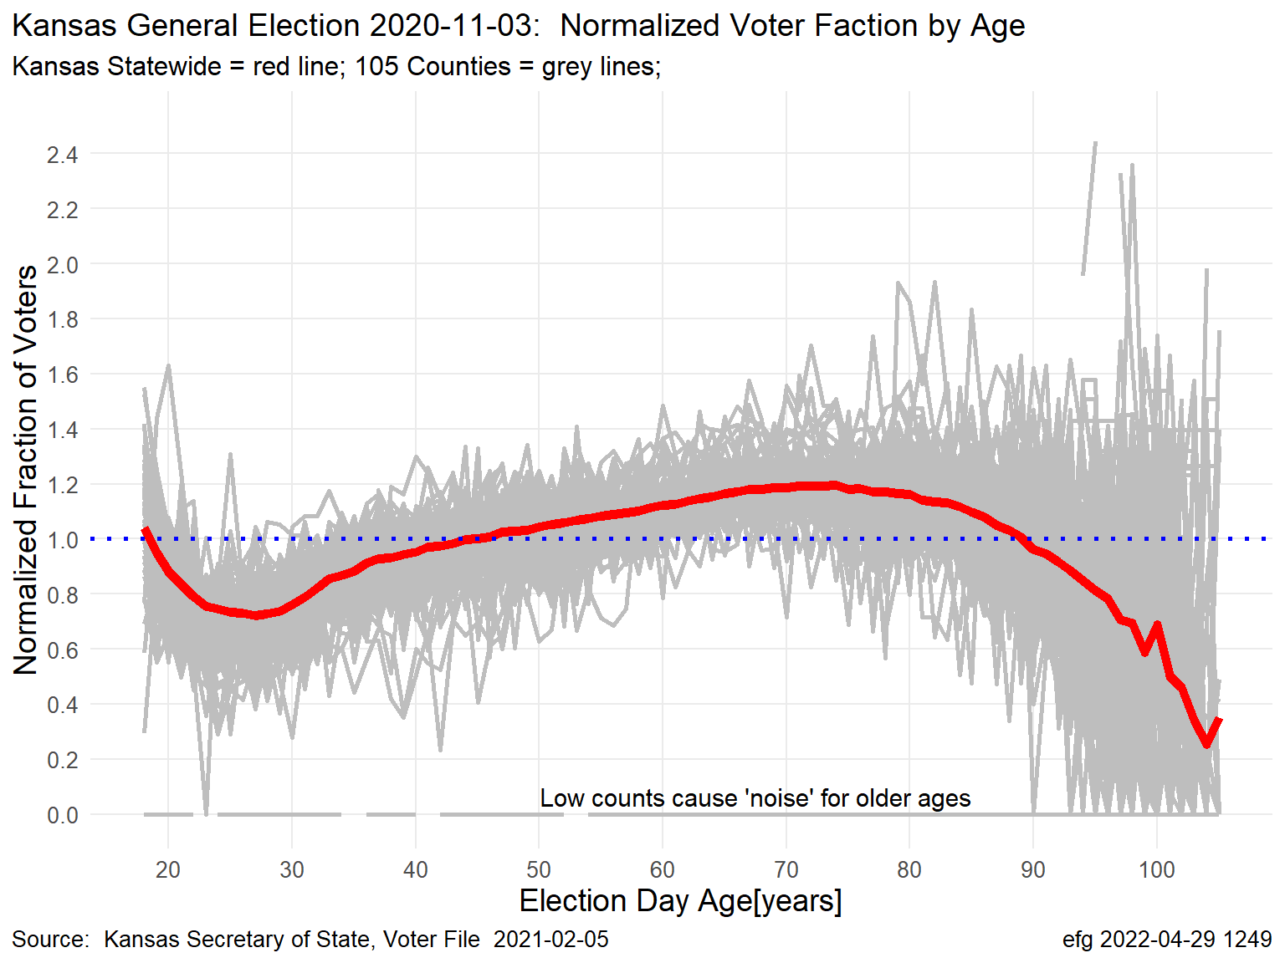
Kansas November General Elections: Normalized Voter Turnout by Age
Red Line = Statewide Turnout; Grey Lines = Turnout for Each of 105 Counties
Gubernatorial Election Years
2006
2010
2014
2018
Presidential Election Years
2008
2012
2016
2020

Slide 6
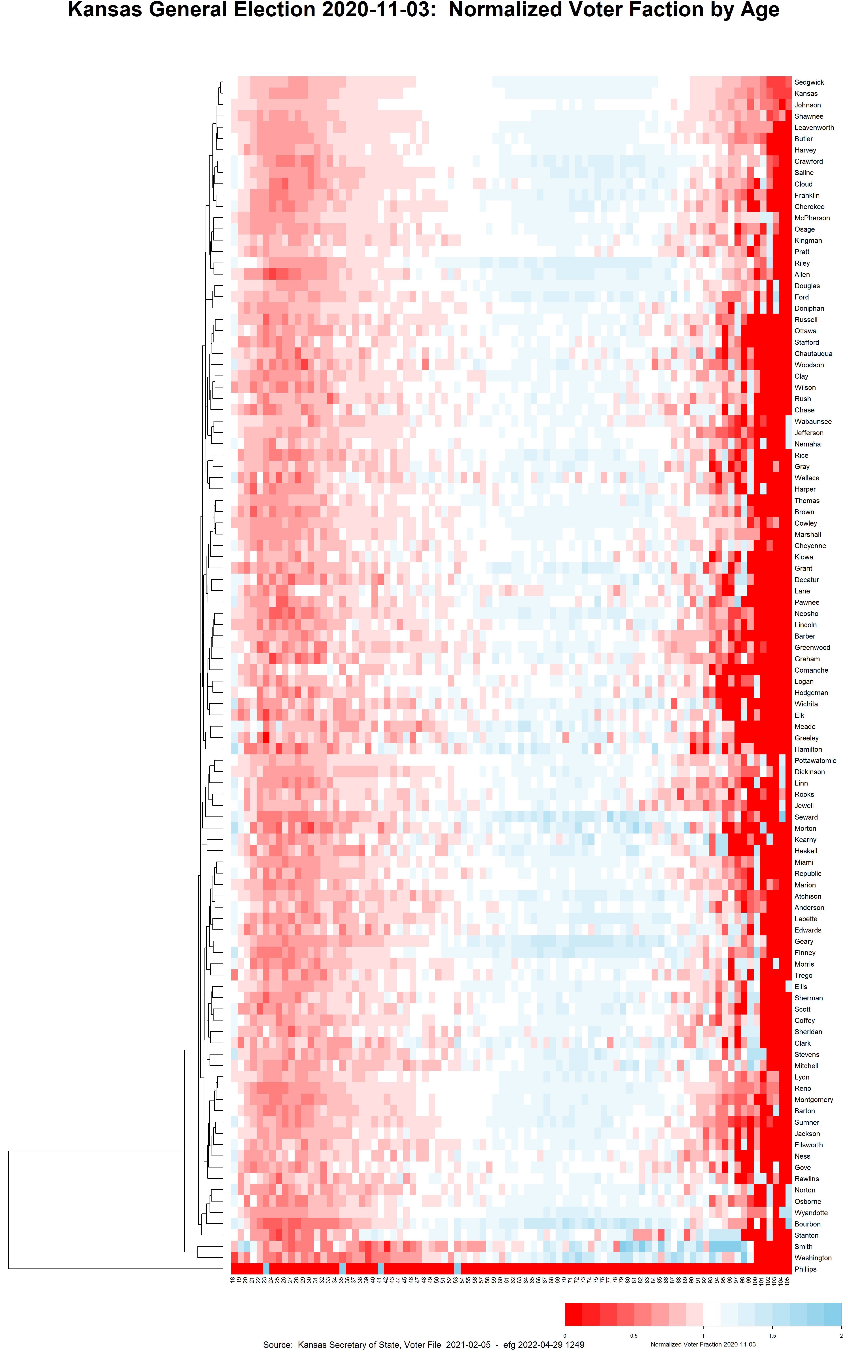
Kansas November General Elections: Normalized Voter Turnout by Age
Red Line = Statewide Turnout; Grey Lines = Turnout for Each of 105 Counties
Kansas
2020
Represent each county
grey line by color-coded
line in heatmap by showing
normalized turnout fraction
from 0 to 2 by age 18 to 105
Notes:
Sedgwick County is most like Kansas statewide profile
Phillips County has mostly missing data.

Slide 7
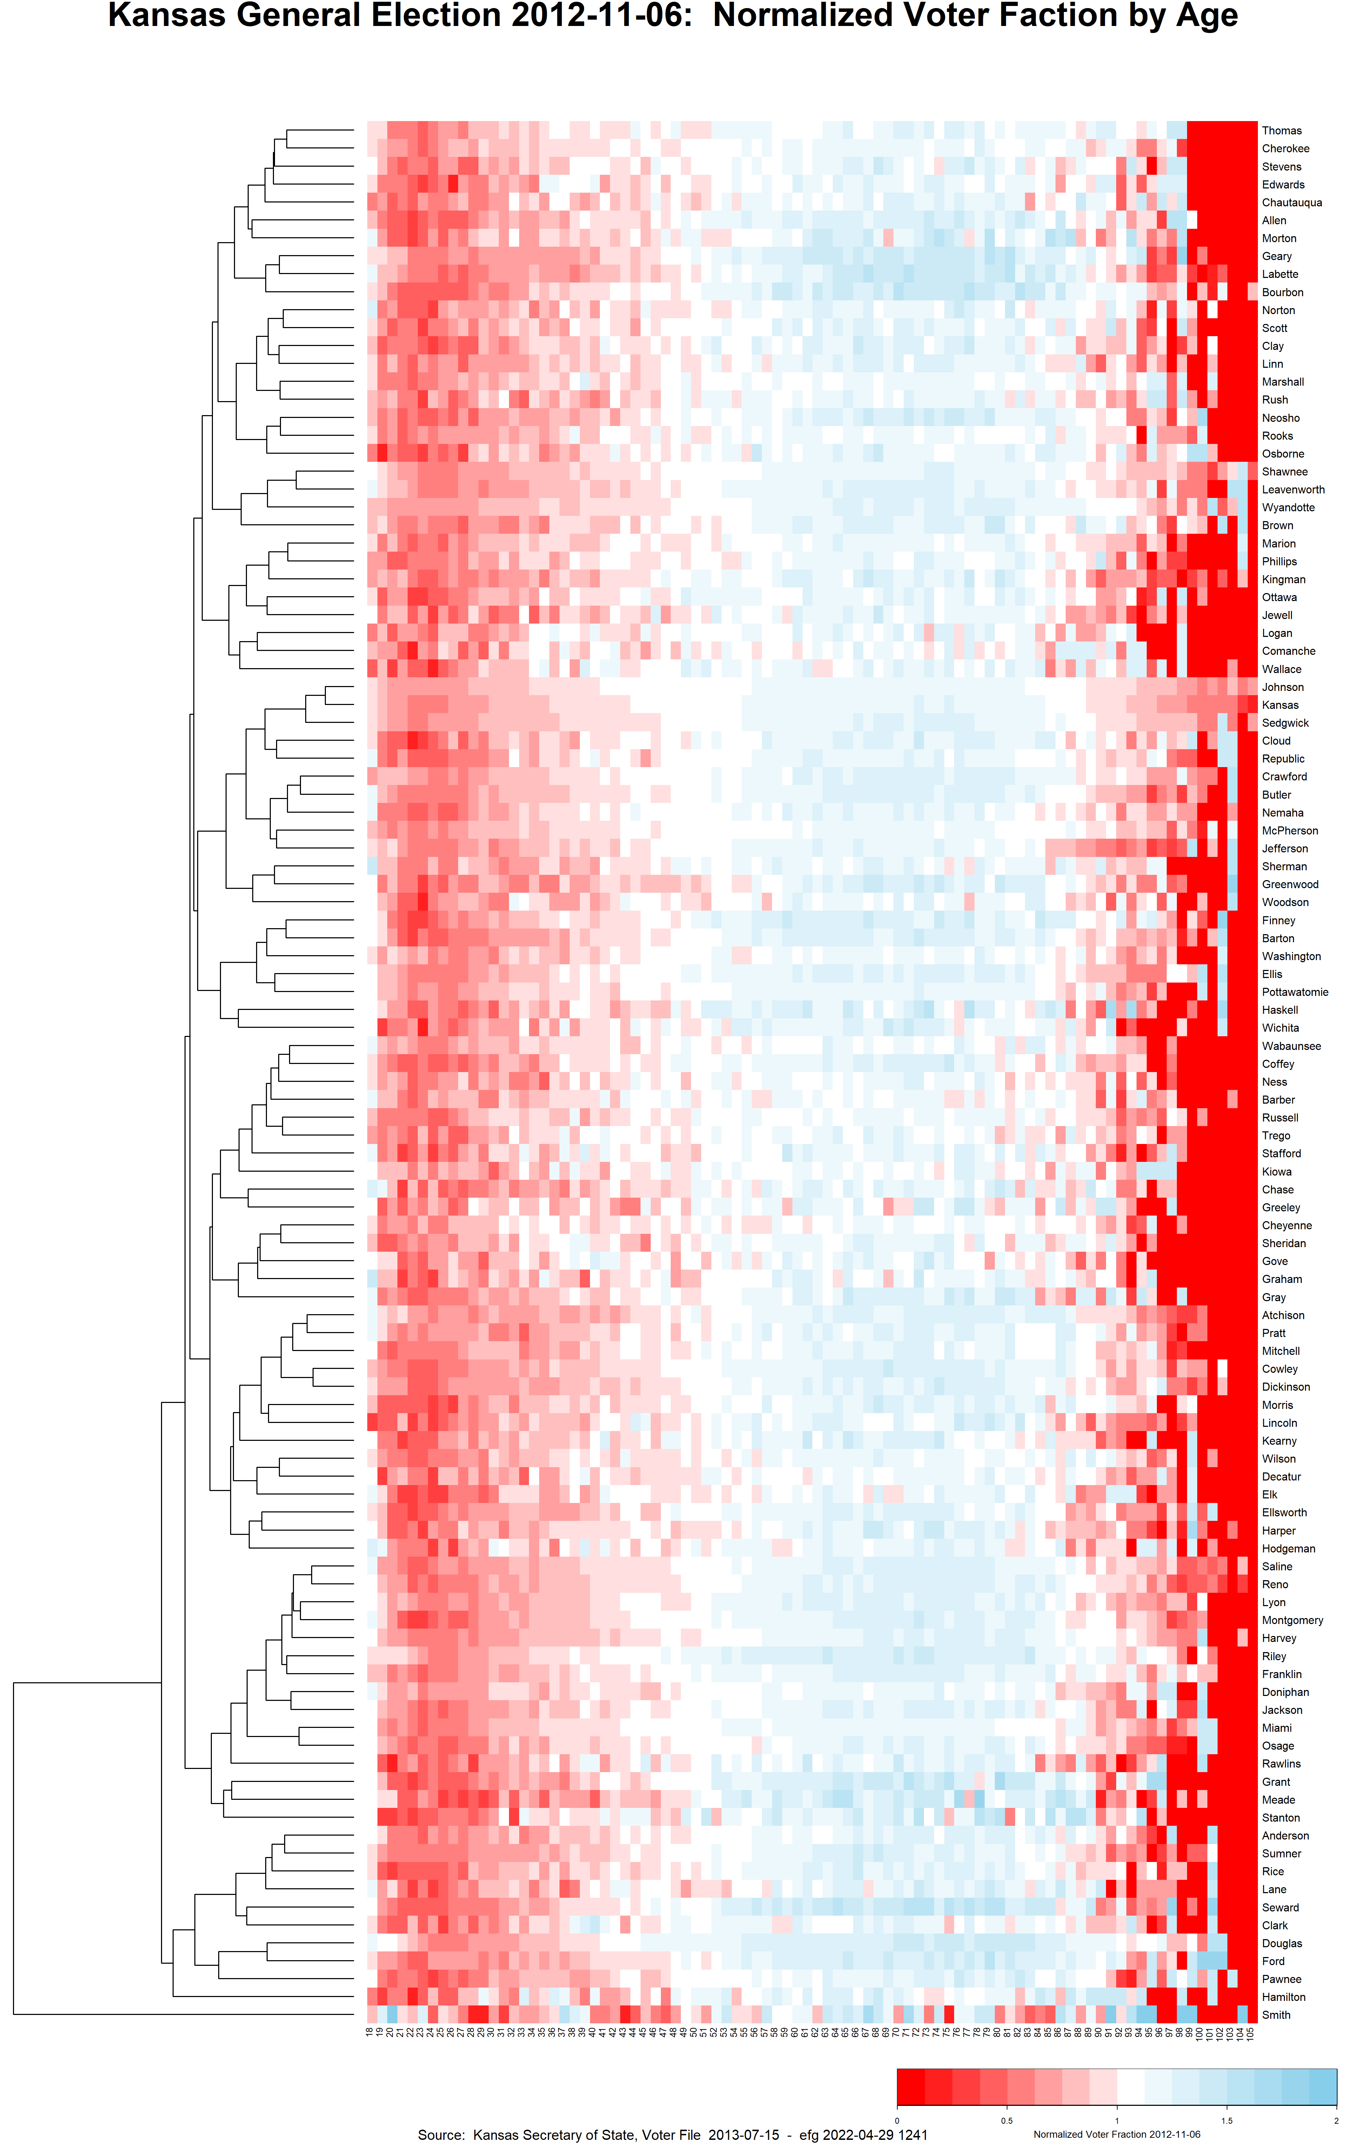
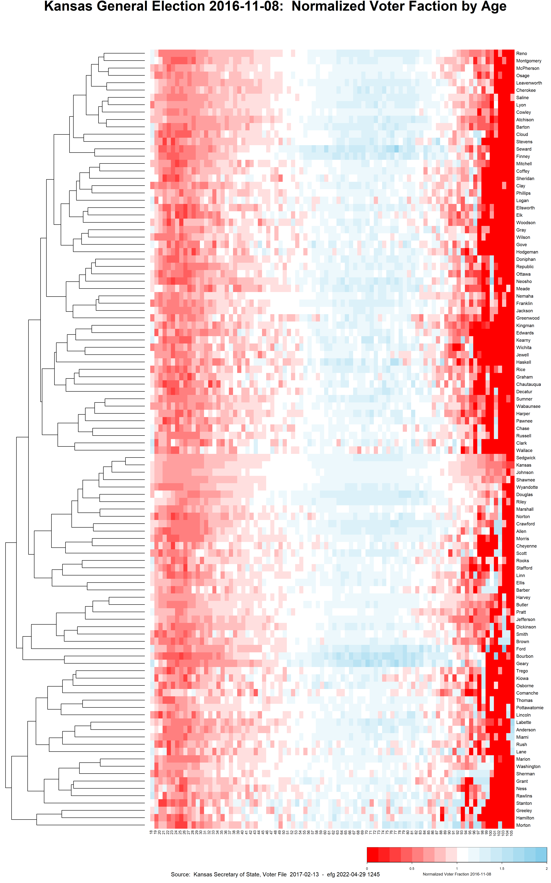
2012
2016
2020

