Slide 1
Kansas August Primary Election Turnout 2020-08-04
efg
2022-04-30

Slide 2
Outline
Registered Voters, Active Voters, Ballots Cast
Percentages of Registered Voters
Normalized Voter Fraction (Turnout)
Kansas Statewide Turnout vs 105 Counties
Party Differences
Gender Differences
County-Precinct Differences: JO, SG, SN, WY, DG Counties

Slide 3
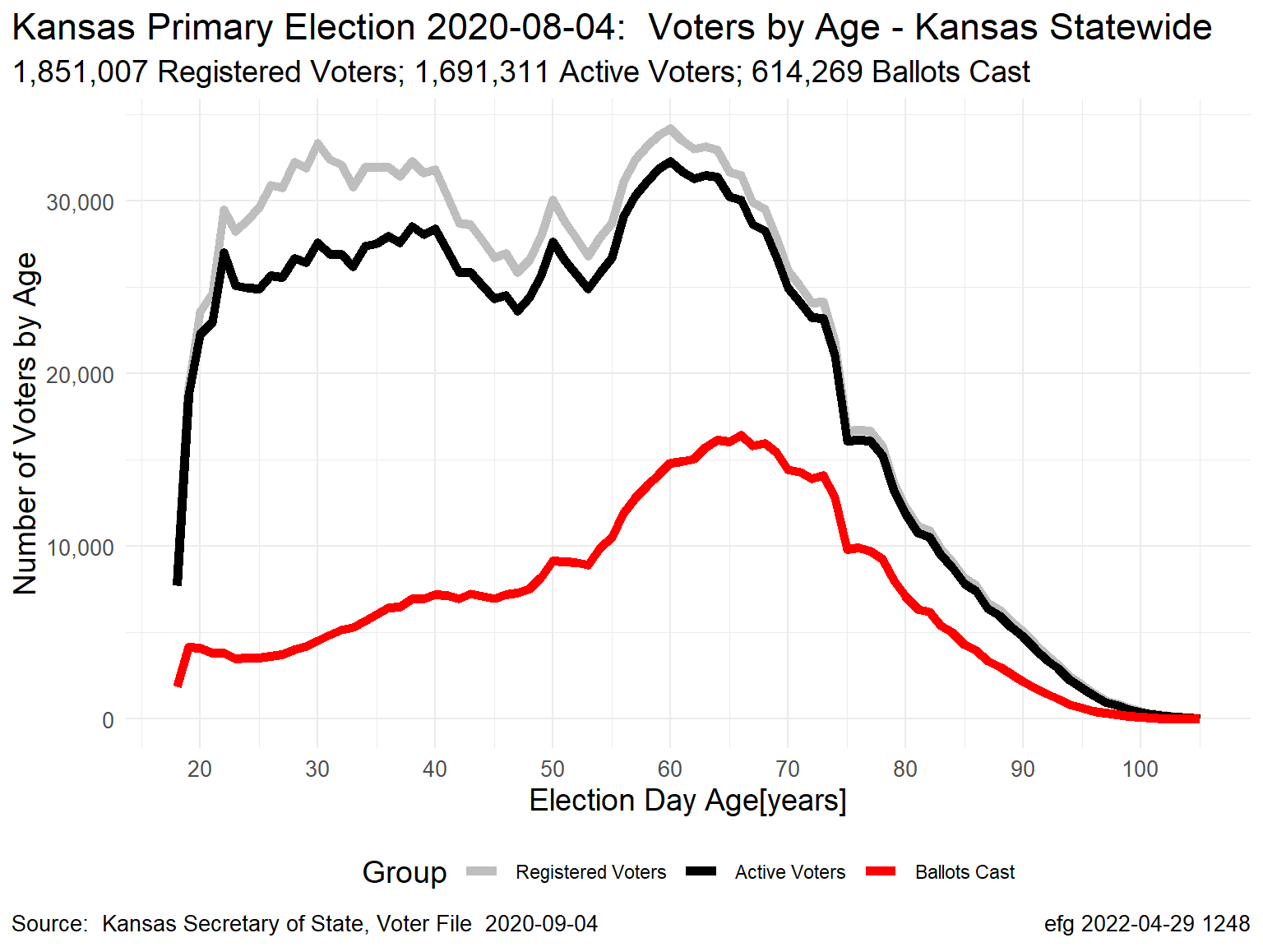
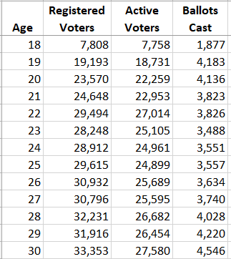
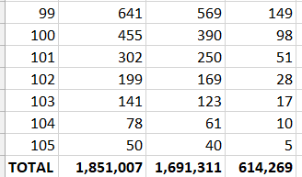
Registered Voters, Active Voters, Ballots Cast
. . .
Notes:
2020-08-04-Voter-Counts-by-Age-Edited.xlsx

Slide 4
Registered Voters, Active Voters, Ballots Cast
Area between grey and black
lines represents “inactive” voters, mostly who have unknown street addresses
Area between black and red
lines represents voters who did not participate in election
Area between red line and x-axis represents voters casting ballots

Slide 5
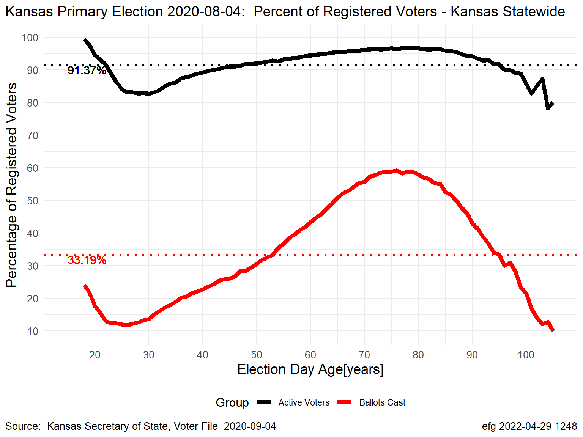
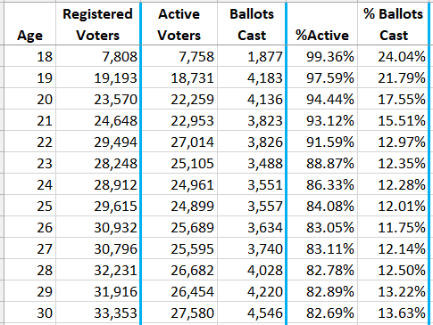
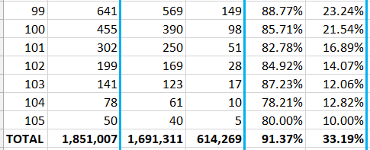
Percentages: Active Voters, Voters Casting Ballots
. . .
Notes:
2020-08-04-Voter-Counts-by-Age-Edited.xlsx

Slide 6
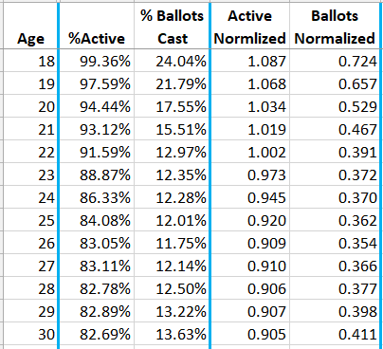
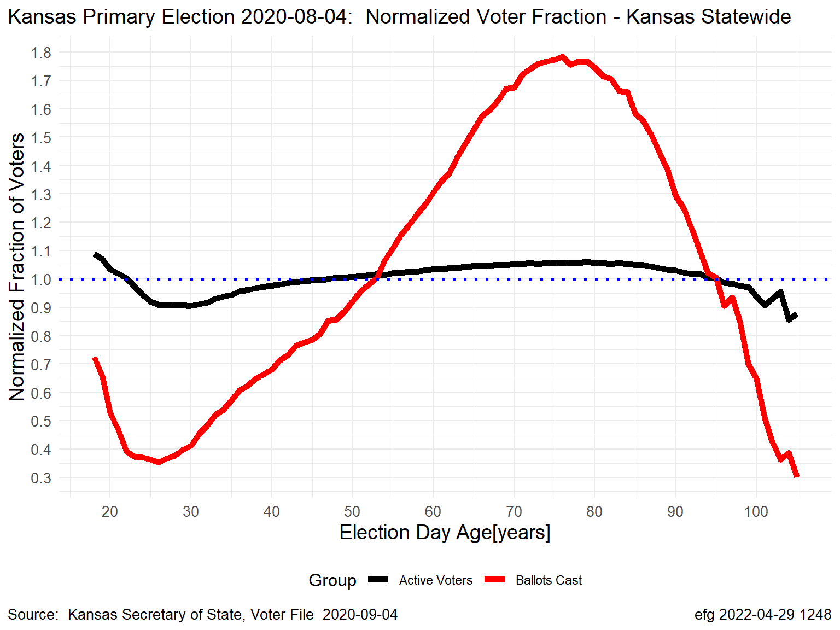
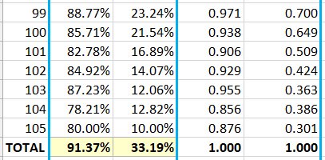
Normalized Voter Fraction (Turnout)
. . .

Slide 7
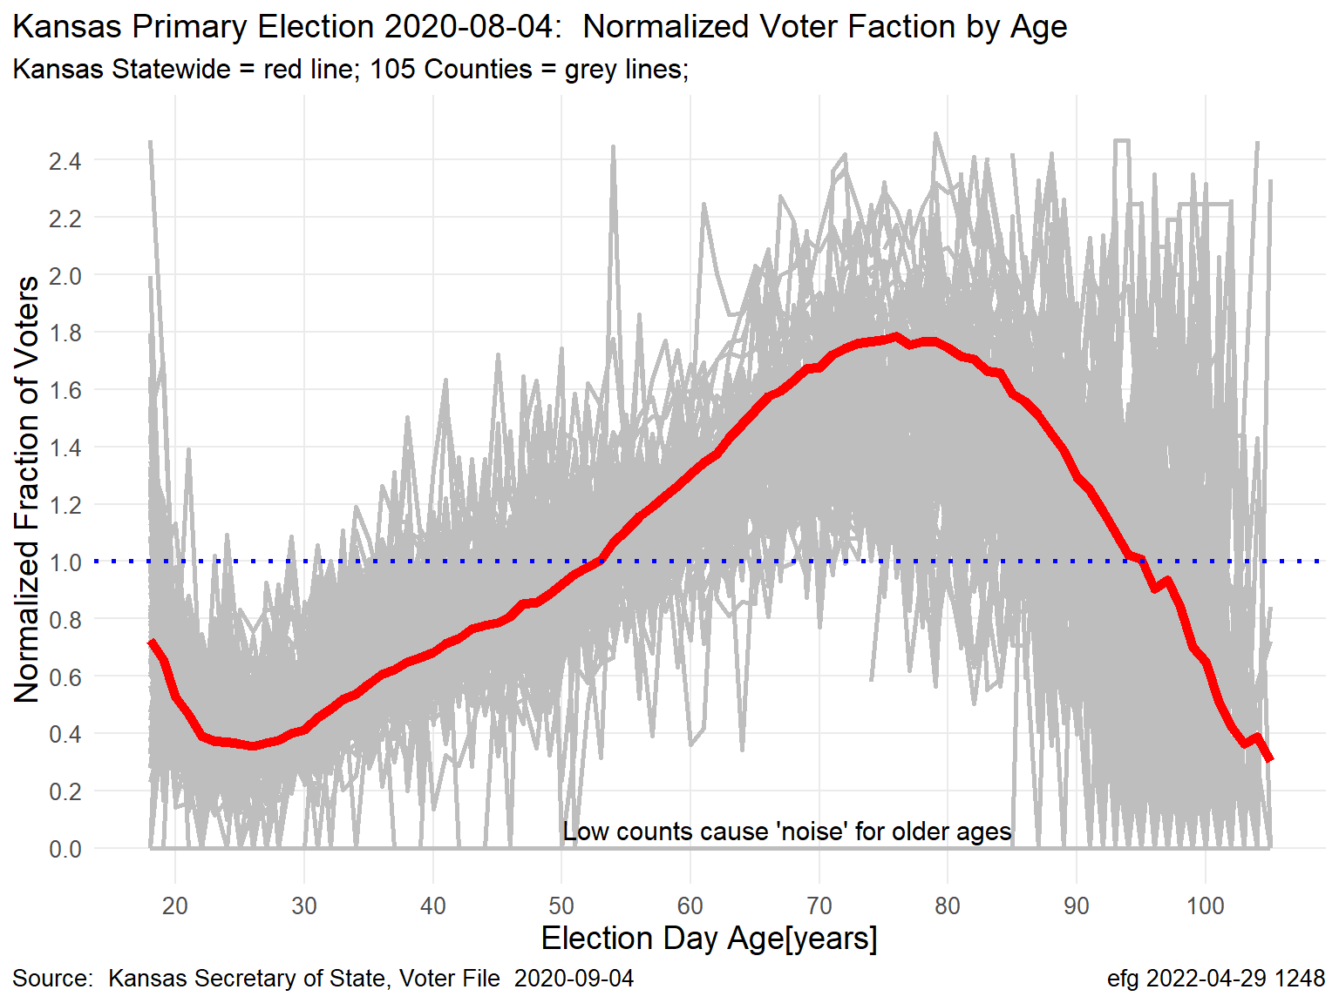
Normalized Turnout: Kansas vs 105 Counties Turnout curves can vary considerably across counties in the state.

Slide 8
Advantages of Normalized Turnout
Ratios > 1 show age ranges with turnout better than overall, e.g., 53 - 95
Ratios < 1 show age ranges with turnout worse than overall, ≤ 52 or ≥ 96
Turnout curves can be compared among state and counties, or other districts, especially using “heatmaps”

Slide 9
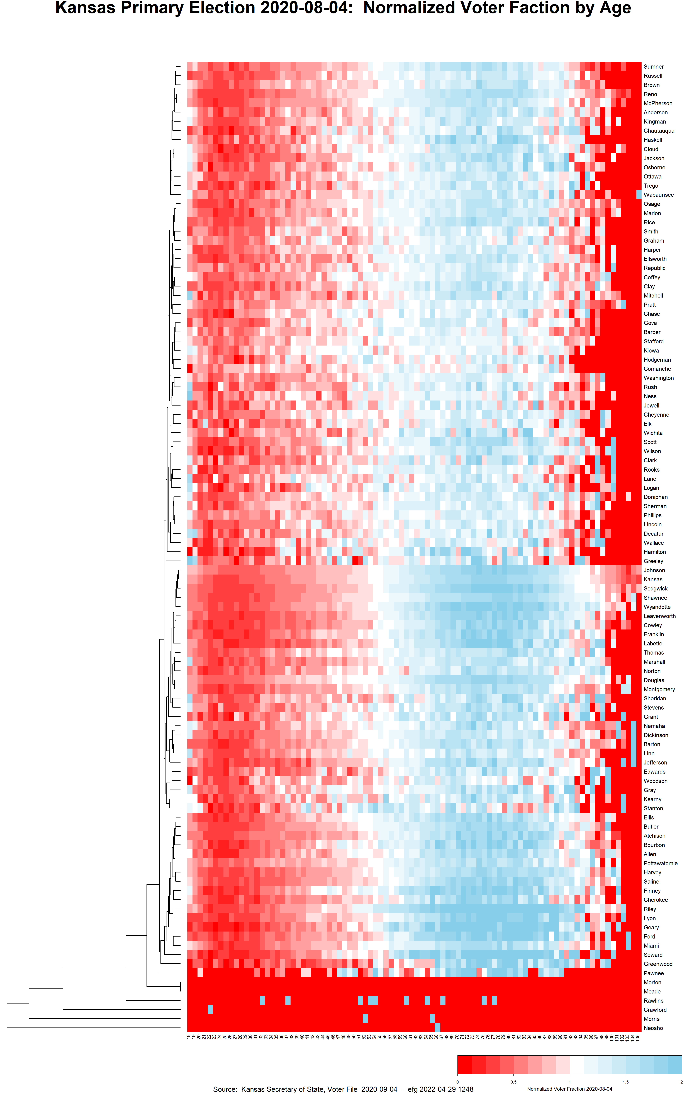
Kansas August Primary Election: Normalized Voter Turnout by Age
Red Line = Statewide Turnout; Grey Lines = Turnout for Each of 105 Counties
Kansas
Represent each county
grey line by color-coded
line in heatmap by showing
normalized turnout fraction
from 0 to 2 by age 18 to 105
Notes:
Sedgwick County is most like Kansas statewide profile
Several counties have mostly missing data in the heatmap.

Slide 10
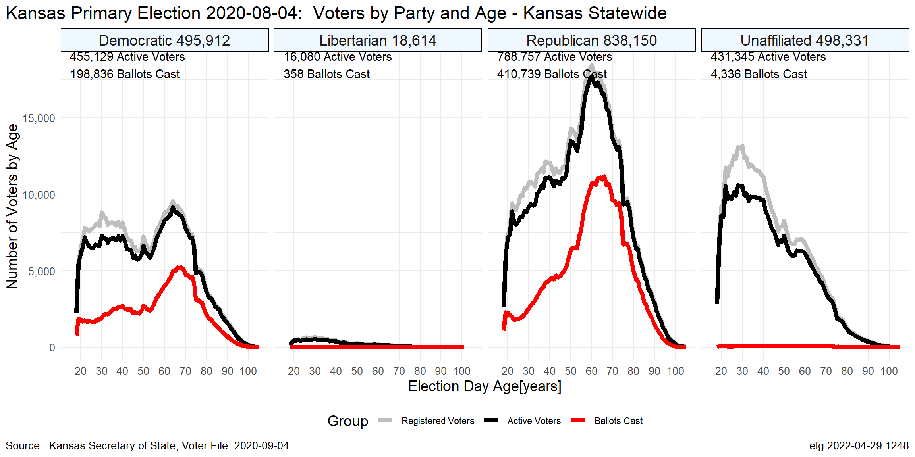
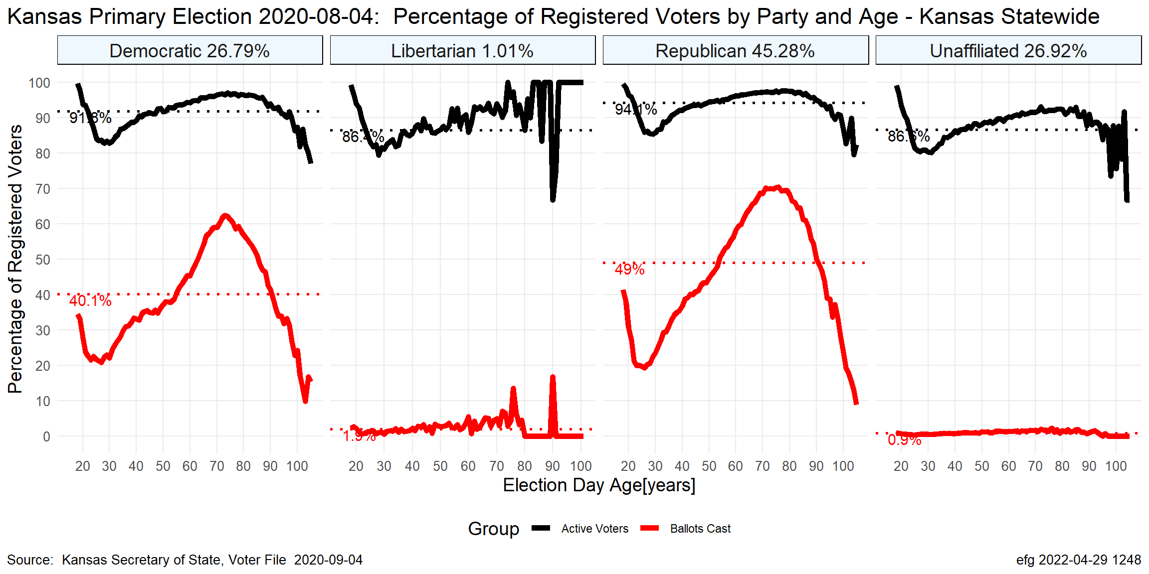
Party Differences
Aug 2020
Notes:
Few unaffiliated and Libertarian voters cast ballots in primary elections.

Slide 11
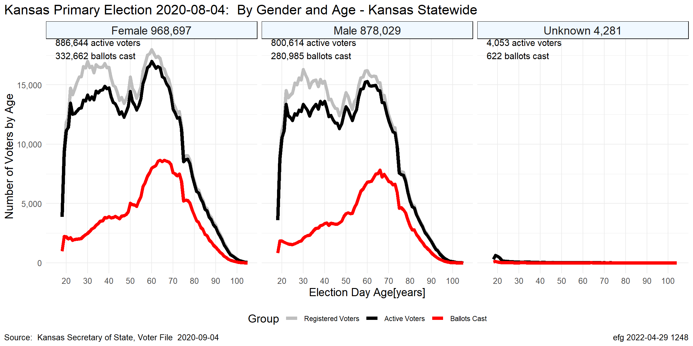
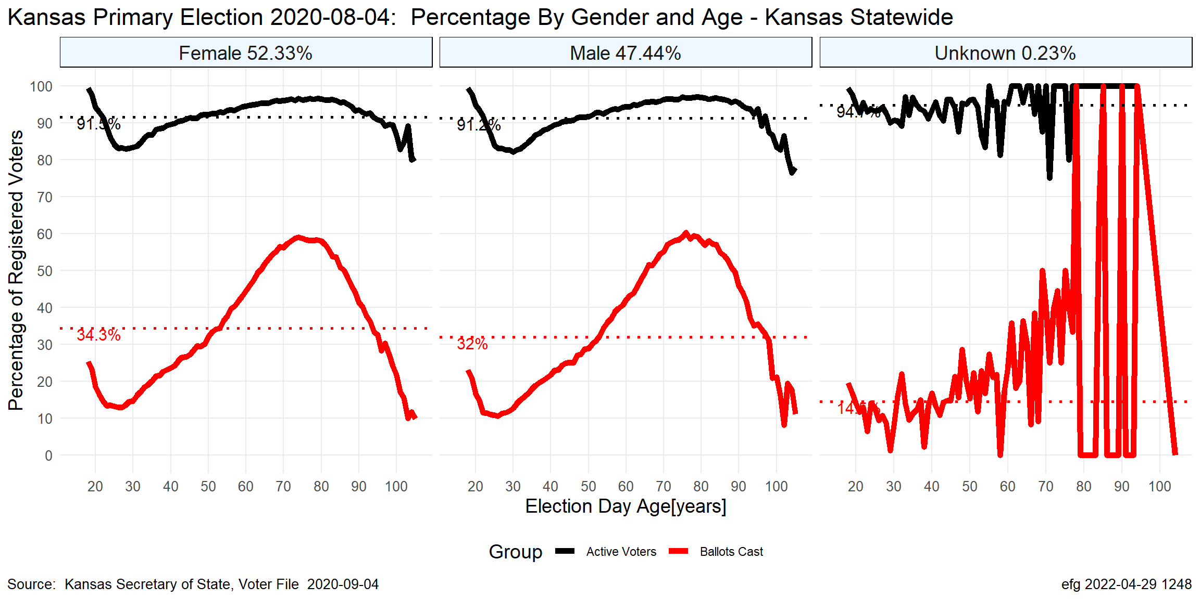
Gender Differences
Aug 2020

Slide 12
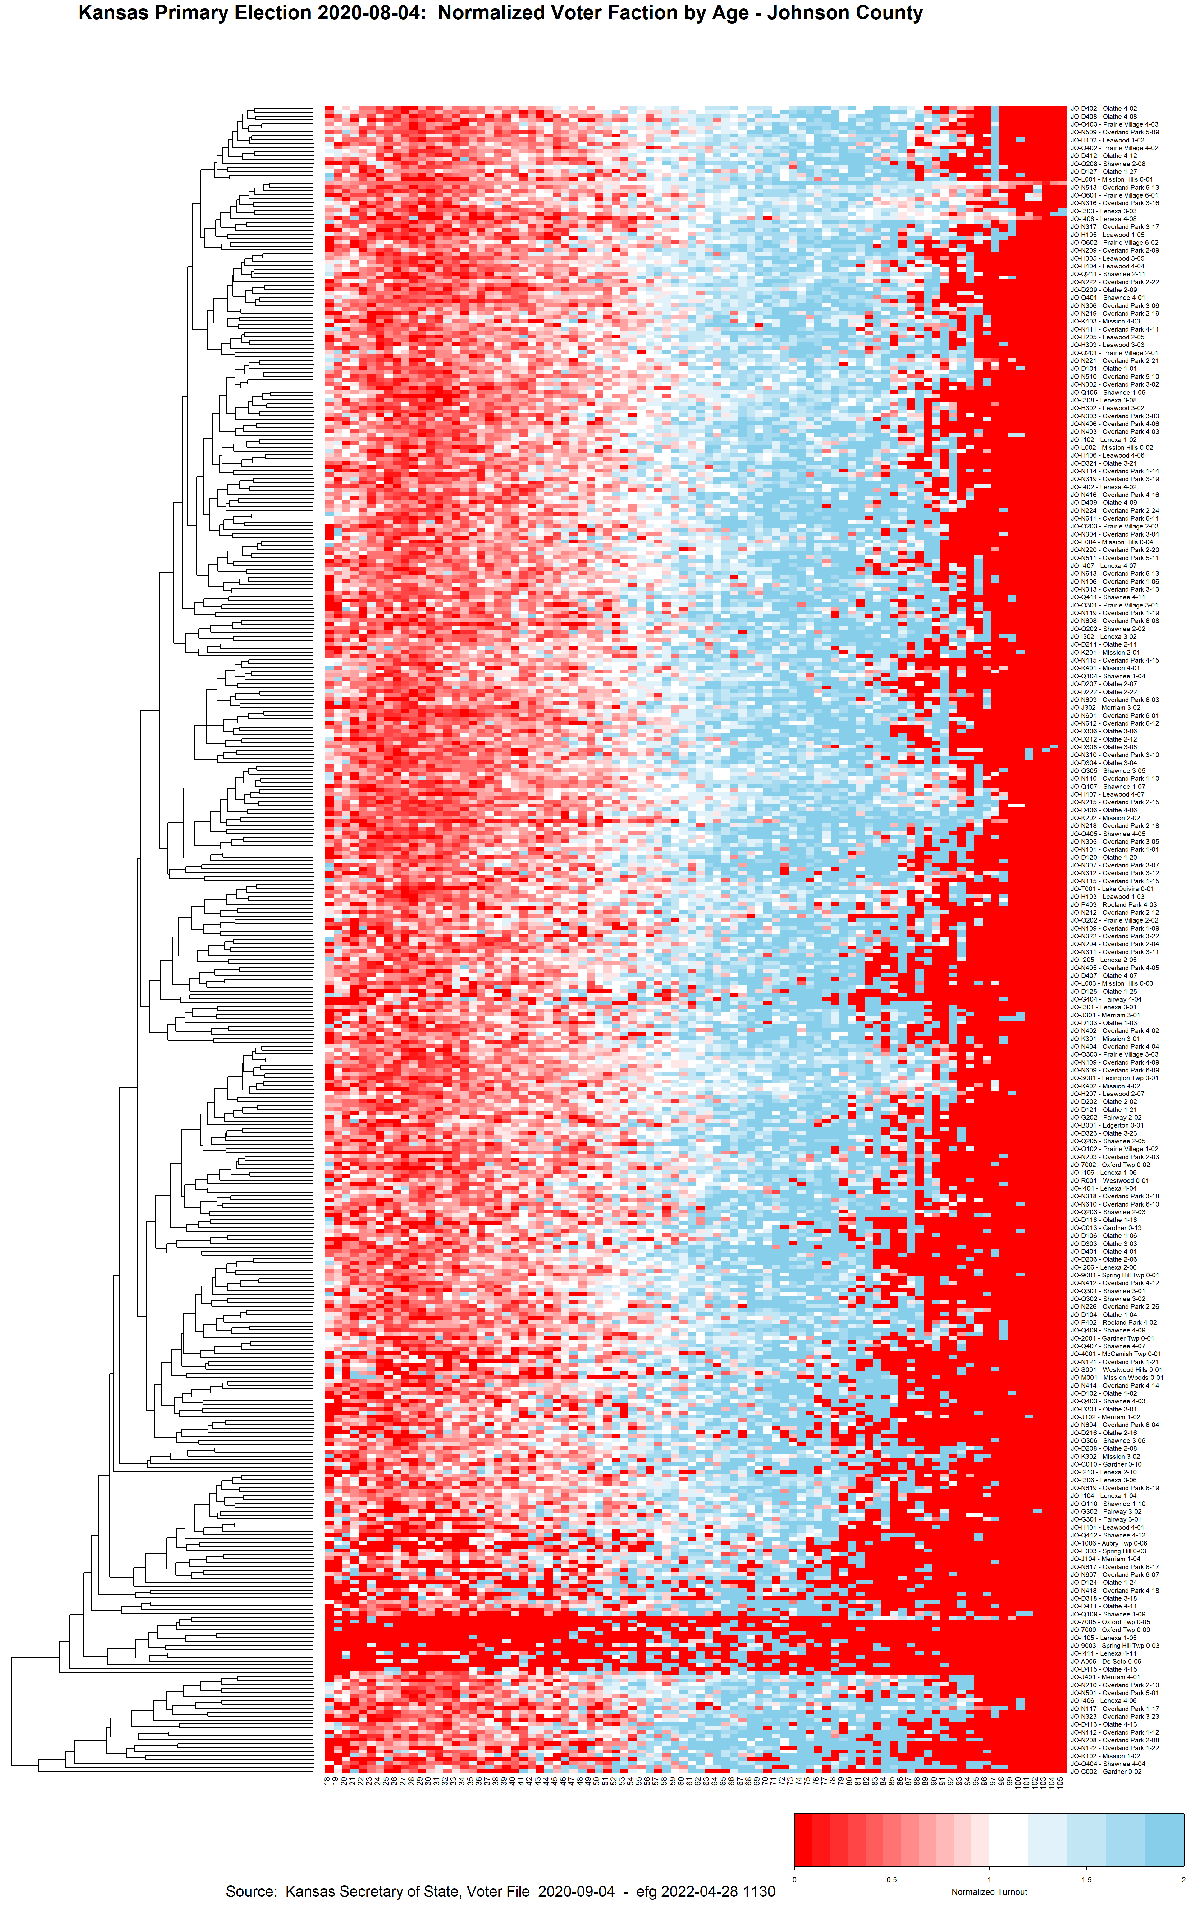
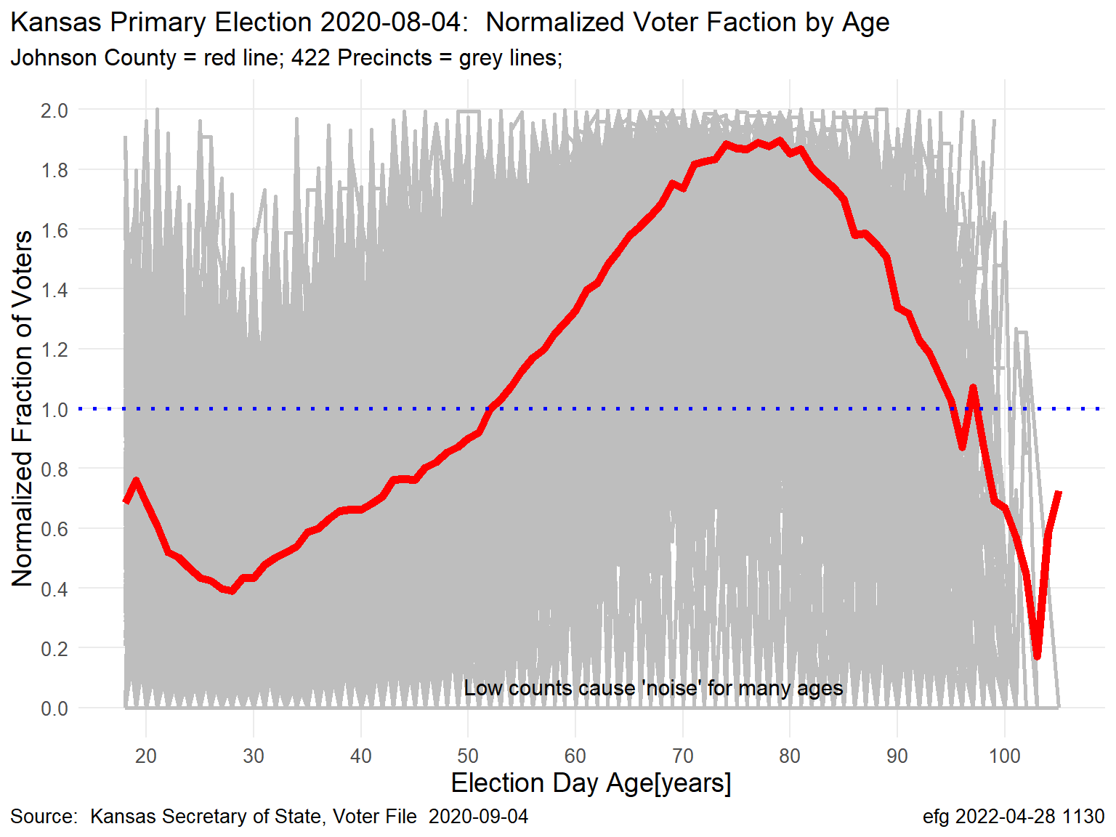
Normalized Turnout: Johnson County vs Precincts Turnout curves can vary considerably by precincts within a county.

Slide 13
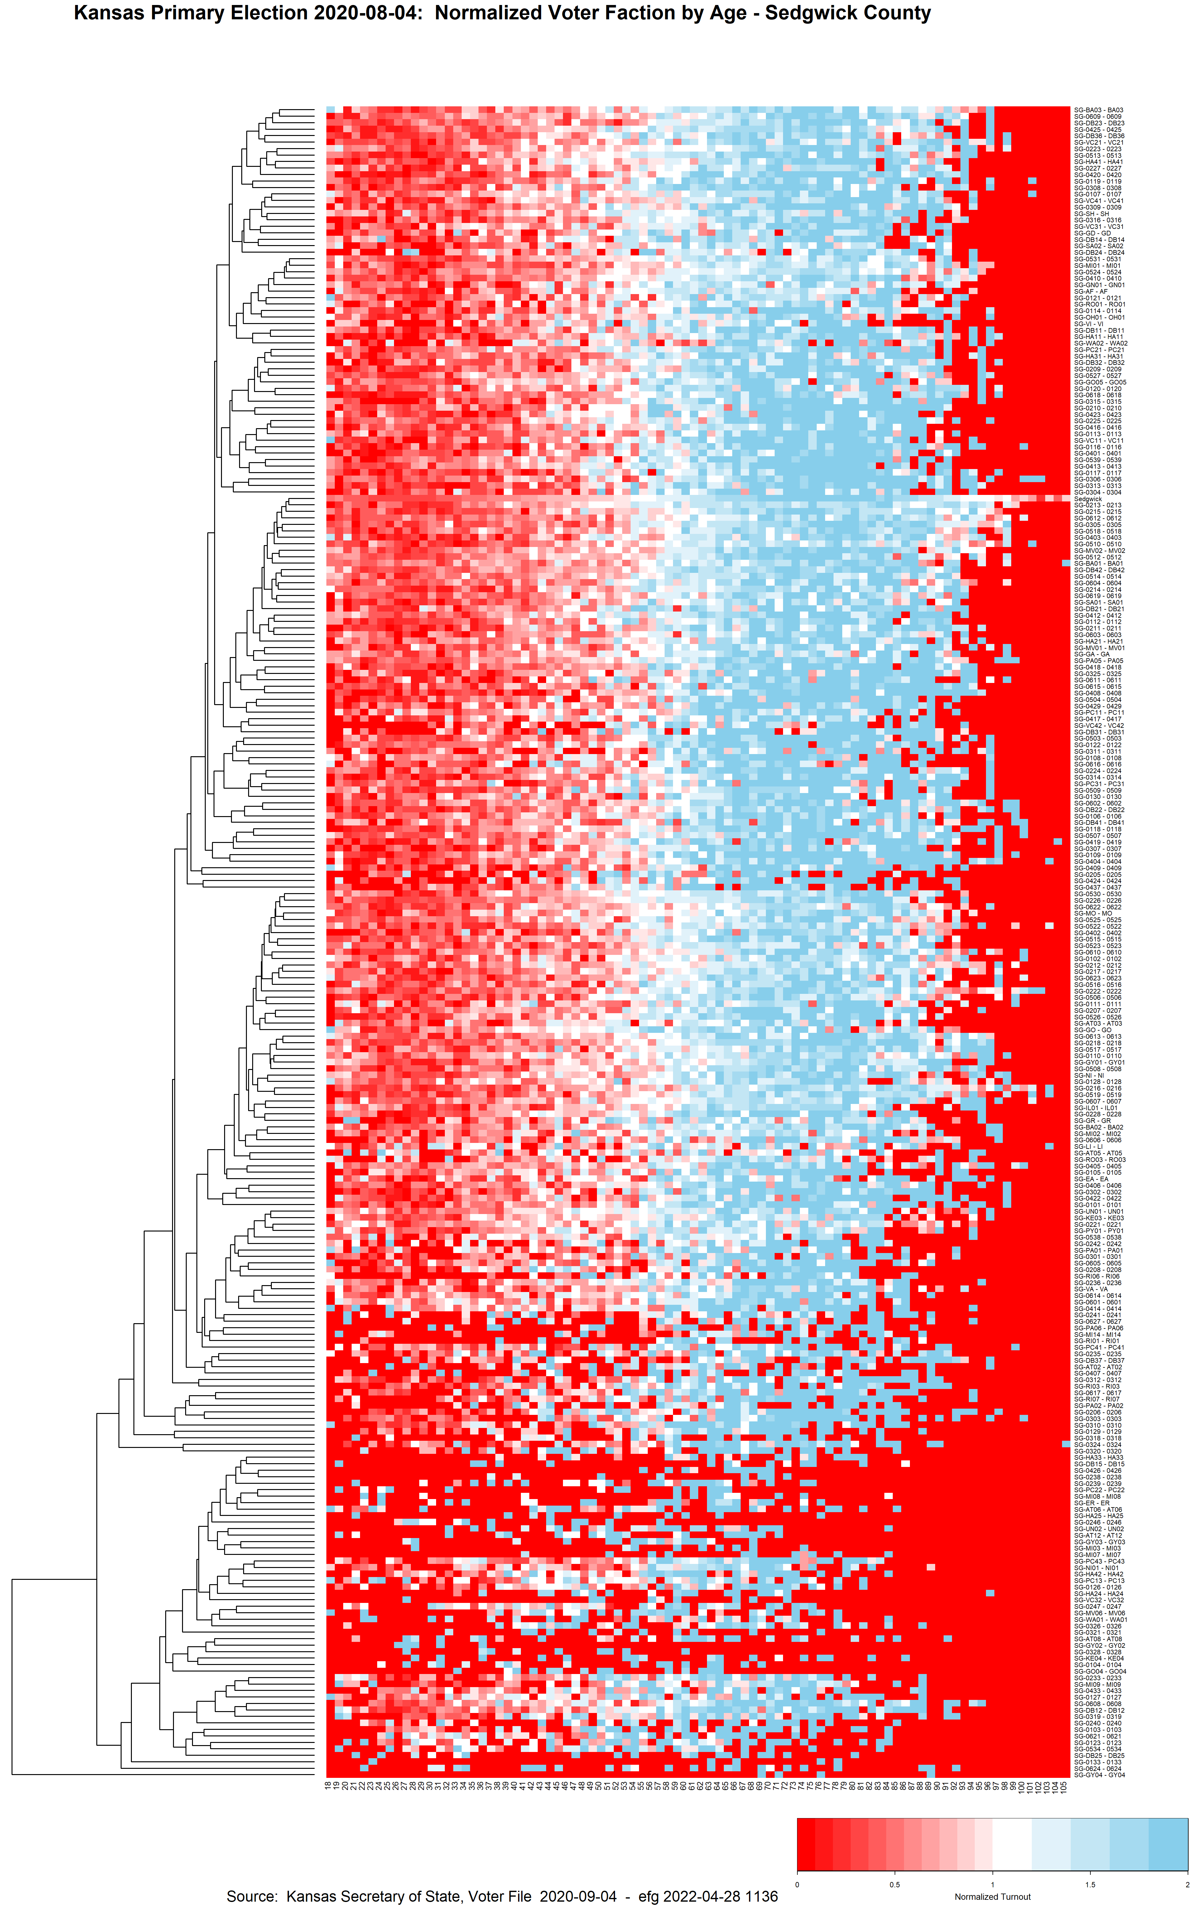
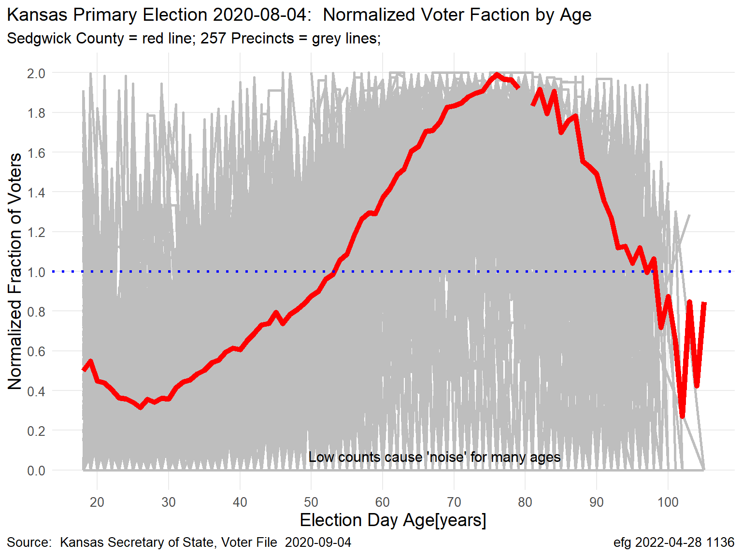
Normalized Turnout: Sedgwick County vs Precincts Turnout curves can vary considerably by precincts within a county.

Slide 14
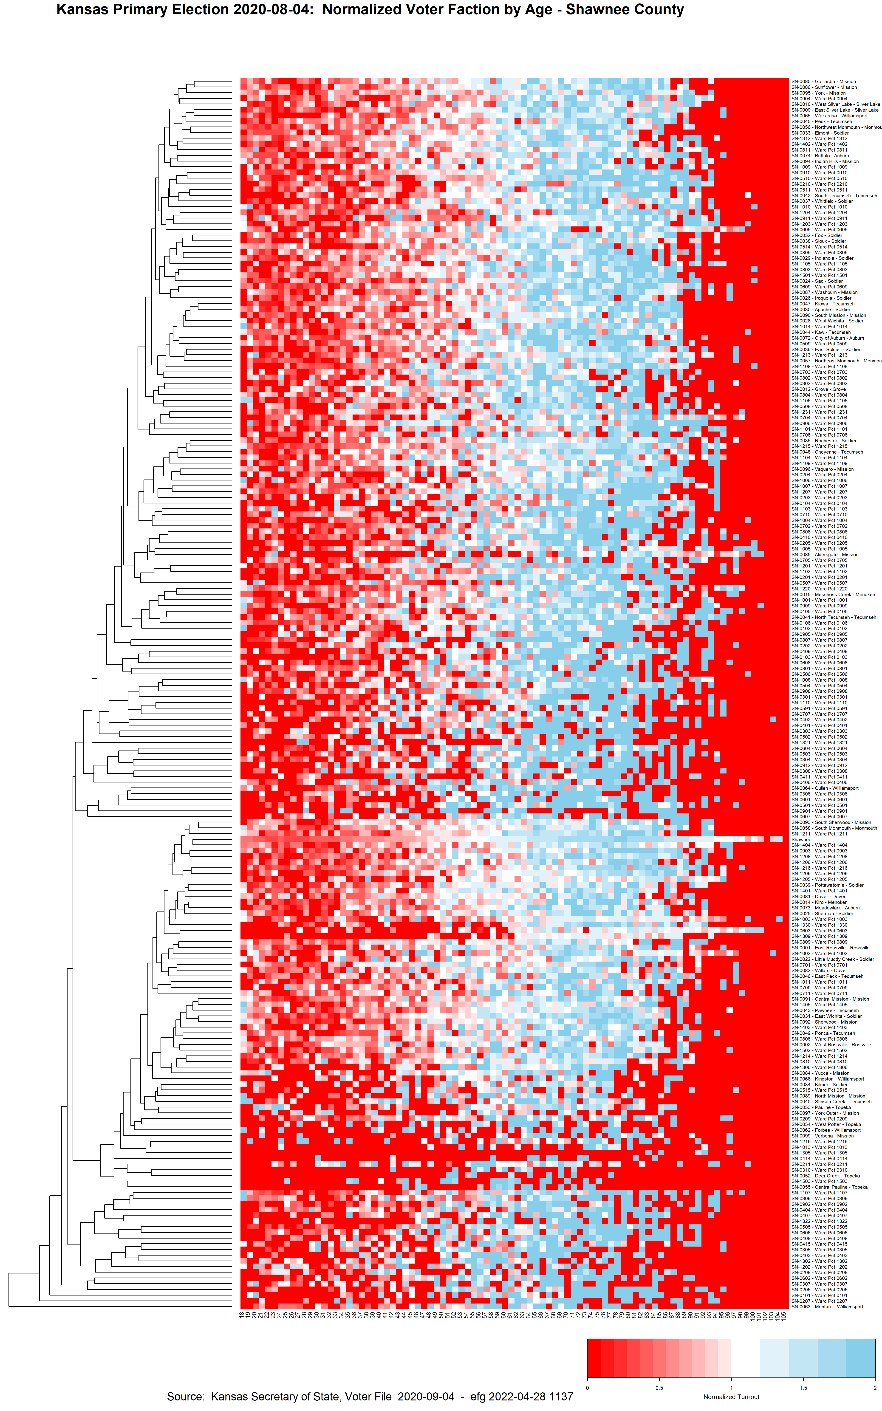
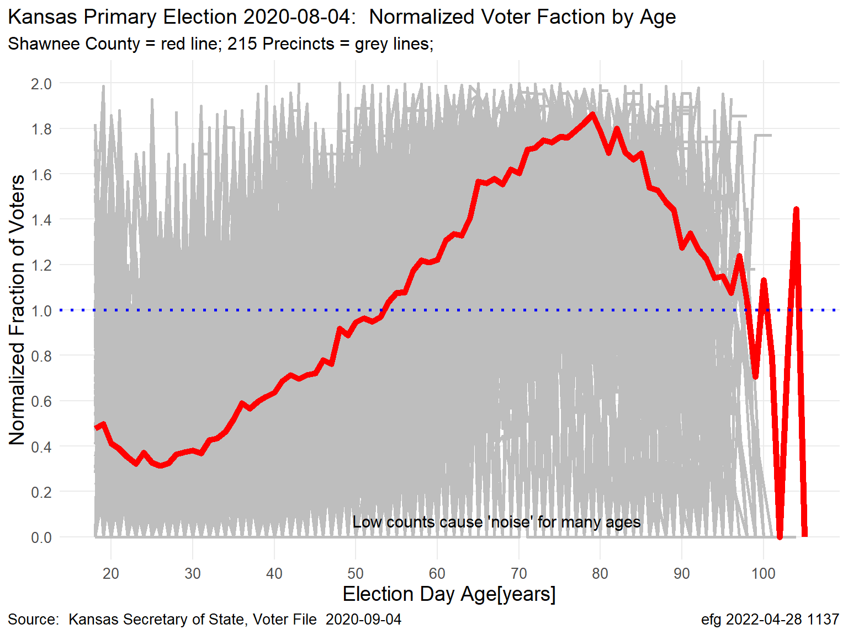
Normalized Turnout: Shawnee County vs Precincts Turnout curves can vary considerably by precincts within a county.

Slide 15
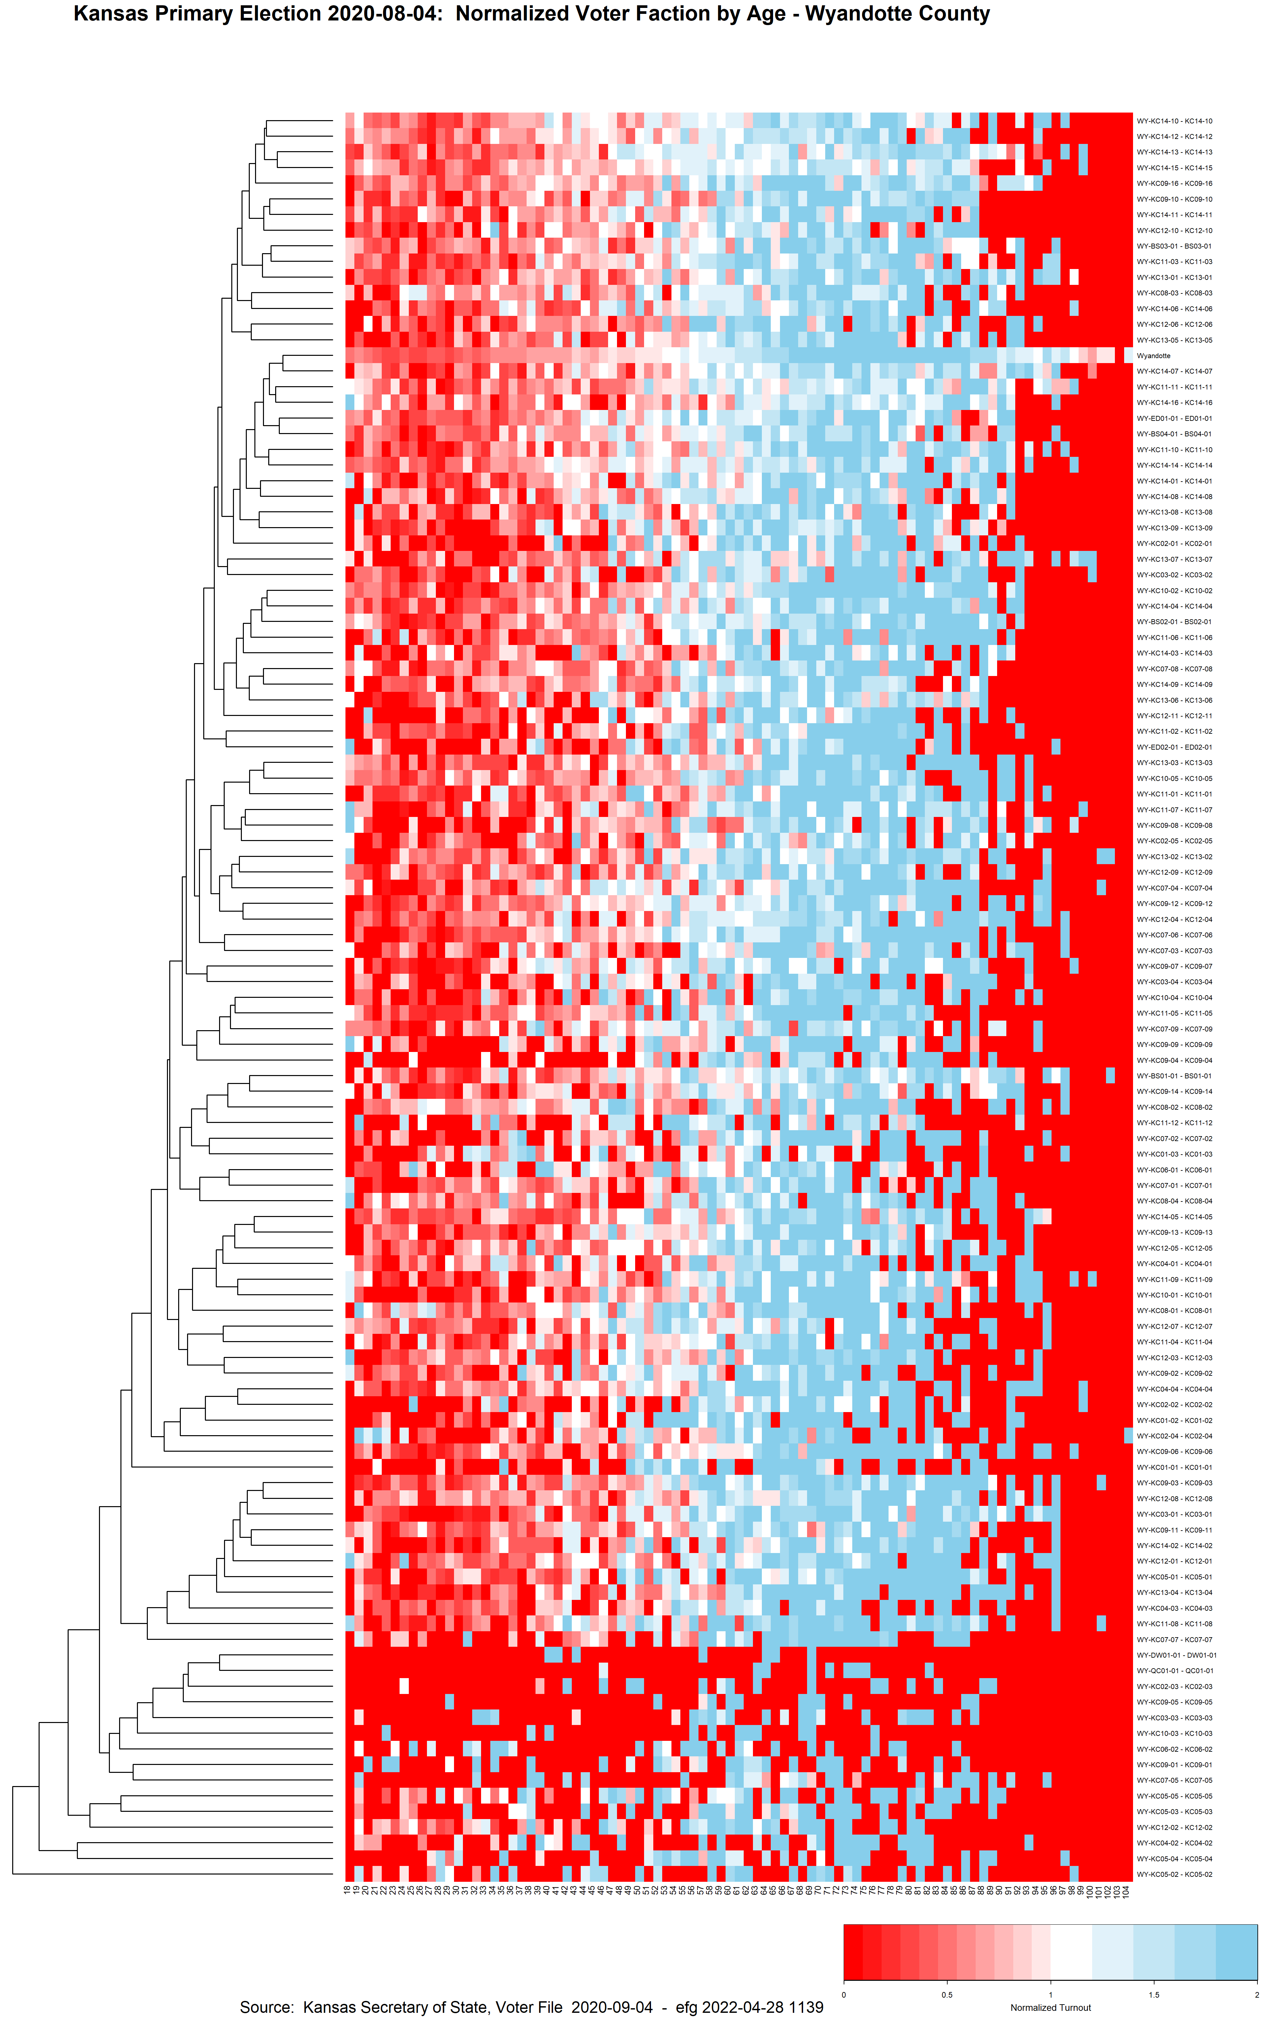
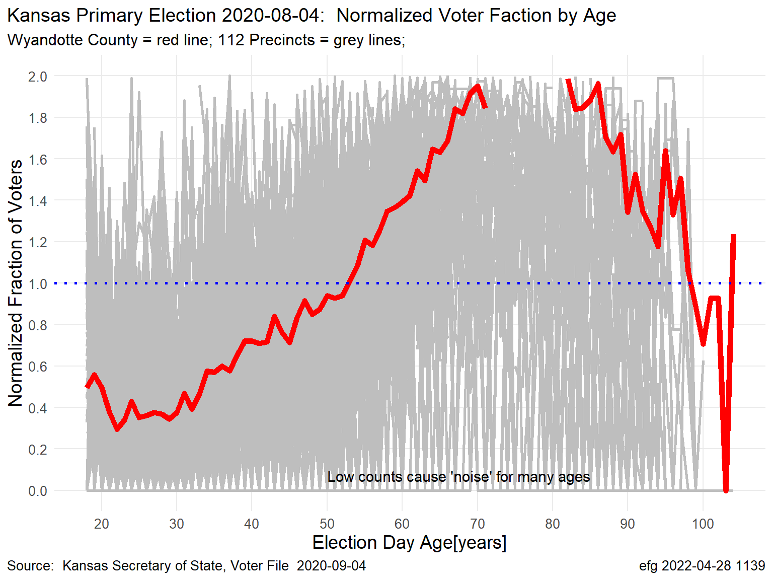
Normalized Turnout: Wyandotte County vs Precincts Turnout curves can vary considerably by precincts within a county.

Slide 16
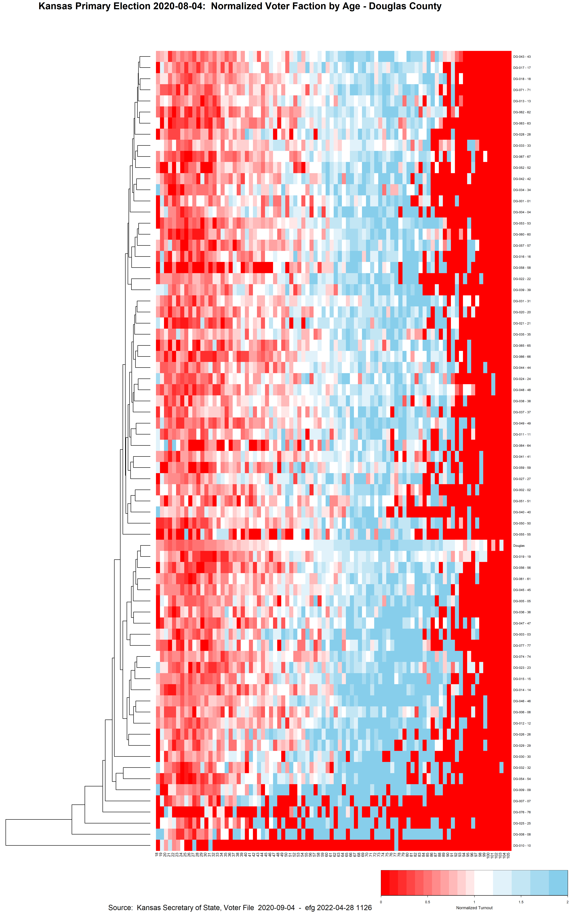
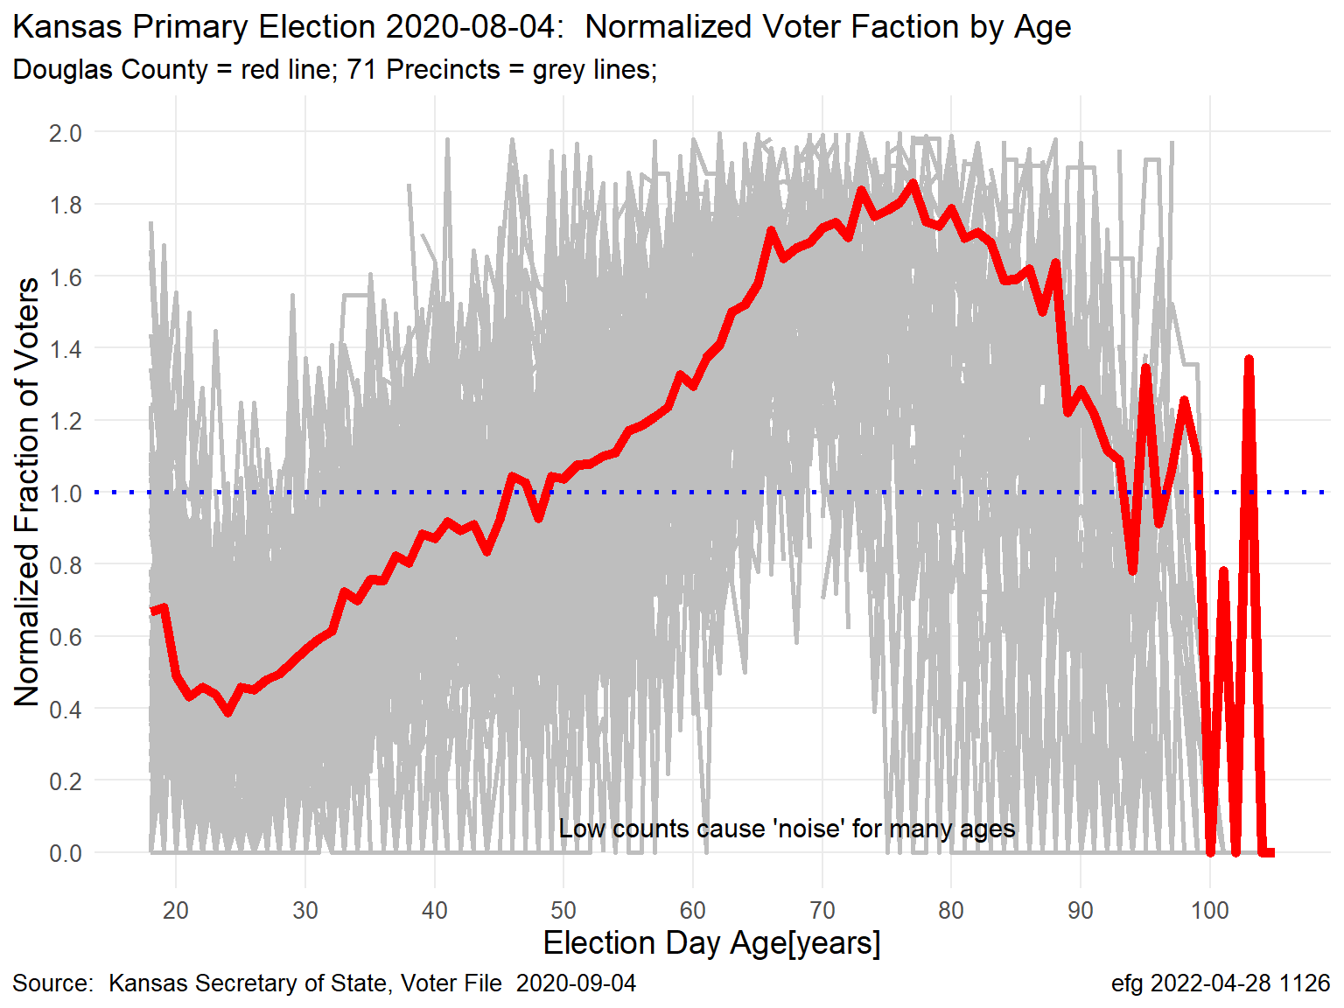
Normalized Turnout: Douglas County vs Precincts Turnout curves can vary considerably by precincts within a county.

