Slide 1
Ohio Election Analysis Verification of Nov 2020 Results: Robert Lee’s Analysis of Ohio Data on GitHub
efg, 2022-05-01

Slide 2
Outline
Reproducible Research
Robert Lee’s GitHub Page, Limitations
Jupyter and RStudio Notebooks
Download Ohio voter data and “jsonify”
Single County analysis: Cuyahoga and Franklin Counties
Registered Voters, Active Voters, and Nov 2020 Voted Counts
Fraction voted (turnout)
“Normalized” fraction voted (“key”)
All Ohio Counties: Normalized voter turnout “keys” for Nov 2020 election
Generate Ohio statewide normalized turnout “key”
Polynomial curve fitting of statewide “key”
Compare county and state normalized turnout keys using “heatmap”
Compare correlations of number of registered voters and number of Nov 2020 voters
Predictions: Predict Hamilton County turnout using Ohio “key”
Technical Questions

Slide 3
Reproducible Research
Criticism of election process should not be another “black box.”
Any proper analysis should …
Document data provenance starting with original government sources.
Provide documented, step-by-step analysis, which can be reviewed and audited.

Slide 4
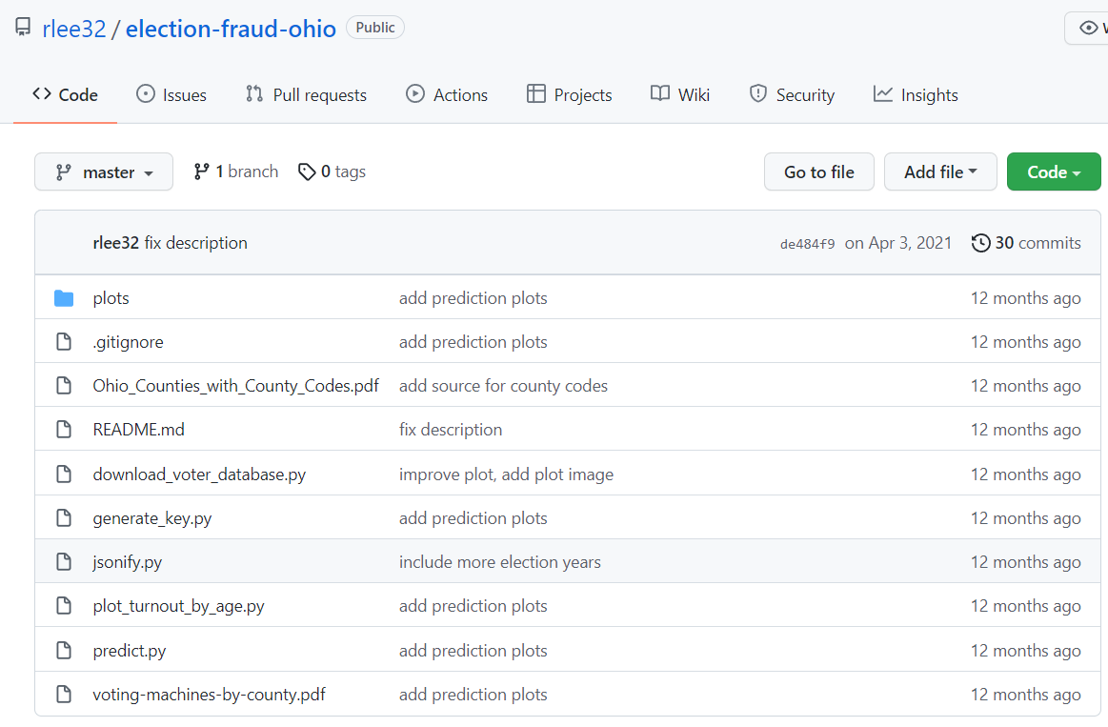
Robert Lee’s Github Page
The page compares the normalized turnout “keys” for several states: https://github.com/rlee32/election-fraud-national
This page show details with python code for Ohio analysis: https://github.com/rlee32/election-fraud-ohio

Slide 5
Robert Lee’s Github Page
I converted Lee’s Python scripts to be part of Jupyter notebooks to show documentation, code, results, graphics and comments in one place.
Modifications to some of Lee’s approaches and assumptions:
Used different file download process since Lee’s approach didn’t work for me.
Added curves for “Active” voters to Lee’s plots of Registered and Nov 2020 Voters. Not necessary to compute key but adds additional insights.
Added county names to numbers. Clarified titles and axes labels.
Jupyter notebooks reject ages > 105 years instead of Lee’s 150 year old limit.
Added legend to identify lines. Added grids to all plots.
Added polynomial fits of statewide “normalized turnout” to reproduce Ohio “key”.
Local directory: Election-Integrity/Ohio/rlee32/Analysis

Slide 6
Robert Lee’s Github Page
Robert Lee’s script | Corresponding Jupyter Notebooks
download_voter_database.py | Ohio-Analysis-1-setup.ipynb → .html
jsonify.py
plot_turnout_by_age.py | Ohio-Analysis-2-Single-County.ipynb Ohio-Analysis-3-All-Counties.ipynb
generate_key.py | Ohio-Analysis-4-Generate-Key.ipynb
predict.py | Ohio-Analysis-5-Predictions-vs-Acutal-Votes.ipynb
Local directory: Election-Integrity/Ohio/rlee32/Analysis

Slide 7
Limitations
I’m using latest Ohio data from 2022-03-25 since older Ohio files from the Nov. 2020 election are not readily available.
Many Ohio voter records have been added, deleted or changed since the Nov. 2020 election.
Analysis here shows 7,431,918 Ohio registered voters with 5,656,585 voting in Nov. 2020.
Official Ohio statewide results for the Nov. 2020 election show 8,073,929 registered voters with 5,974,121 casting ballots.
Ohio-Correlations.html, Section 4.1, Statewide-1.png

Slide 8
Download Ohio voter data and “jsonify” Notebook: Ohio-Analysis-1-setup.html
State of Ohio online databases: https://www.ohiosos.gov/secretary-office/online-databases/
Ohio County voter file download: https://www6.ohiosos.gov/ords/f?p=111:1
Sample link to download county file 1, Adams County: https://www6.ohiosos.gov/ords/f?p=VOTERFTP:DOWNLOAD::FILE:NO:2:P2_PRODUCT_NUMBER:1
Notebook downloaded 88 files 1.csv, 2.csv, …, 88.csv to local directory: Election-Integrity/Ohio/rlee32/Analysis/voter_database
Data was captured from Ohio SOS site on 2022-03-25.
Adapted from Lee’s scripts: download_voter_database.py and jsonify.py

Slide 9
Download Ohio voter data and “jsonify” Notebook: Ohio-Analysis-1-setup.html
Ohio Counties with county number 1 .. 88 https://tax.ohio.gov/static/excise/Ohio%20County%20Listing.pdf
Map of Ohio Counties with county number https://jfs.ohio.gov/PerformanceCenter/FastFacts/Ohio_Counties_with_County_Codes.pdf
Raw data looks like this for Adams County (1.csv; 17,046 records):
. . .
. . .

Slide 10
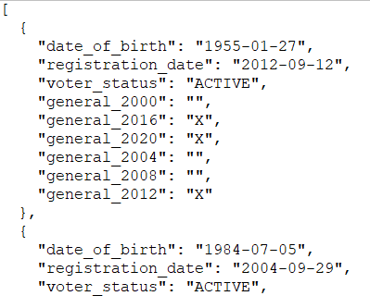
Download Ohio voter data and “jsonify” Notebook: Ohio-Analysis-1-setup.html
Analysis could have been performed using .csv files with Python “pandas” data analysis library, but Lee chose to convert to a “JSON” file format instead. I followed Lee’s script using JSON.
Notebook filtered data and converted files n.csv to n.json in local directory: Ohio/rlee32/Analysis/jsonified
Raw JSON file (1.json; 187,497 records) looks like this:
. . .

Slide 11
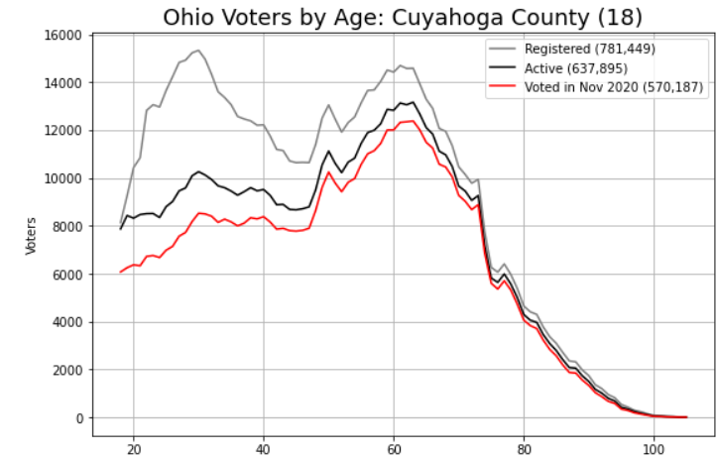
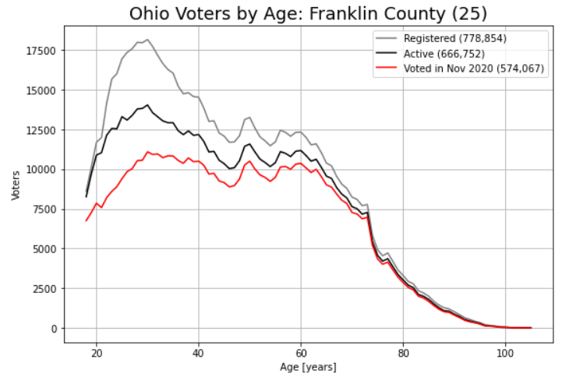
Single County analysis: Cuyahoga and Franklin Counties Ohio-Analysis-2-Single-County-Cuyahoga.html Ohio-Analysis-2-Single-County-Franklin.html
Source: Ohio Secretary of State’s web site; data captured on 2020-03-25.
Profiles of Ohio’s two largest counties are very different based on age.
“Active” voter lines added to Lee’s analysis to explore that factor.
Adapted from Lee’s script: plot_turnout_by_age.py

Slide 12
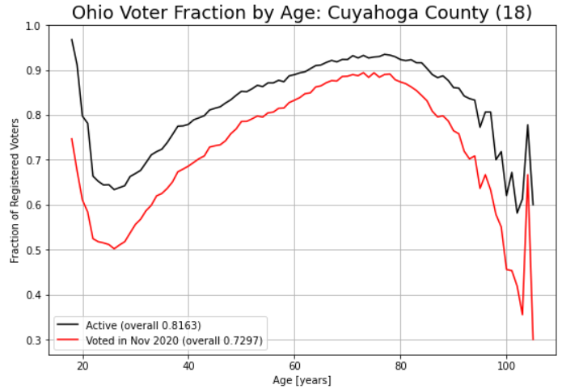
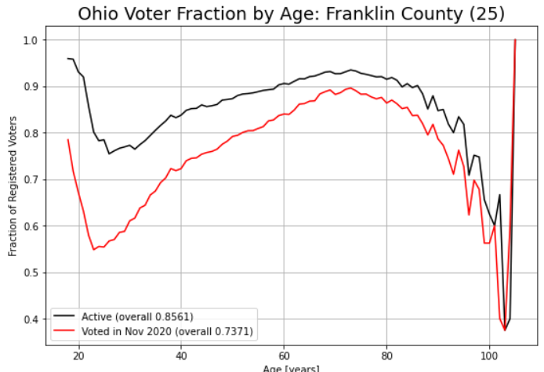




Single County analysis fraction voted (turnout): Ohio-Analysis-2-Single-County-Cuyahoga.html Ohio-Analysis-2-Single-County-Franklin.html
For each age interval, 18 to 105 years:
Fraction Active = $\frac{Active voters}{Registered voters}$
Fraction Voted = $\frac{Nov 2020 voters}{Registered voters}$ = Turnout
Overall values (not averages):
Overall Active Fraction = $\frac{\sum_{age}{Active voters}}{\sum_{age}{Registered voters}}$
Overall Voted Fraction = $\frac{\sum_{age}{Nov 2020 voters}}{\sum_{age}{Registered voters}}$

Slide 13
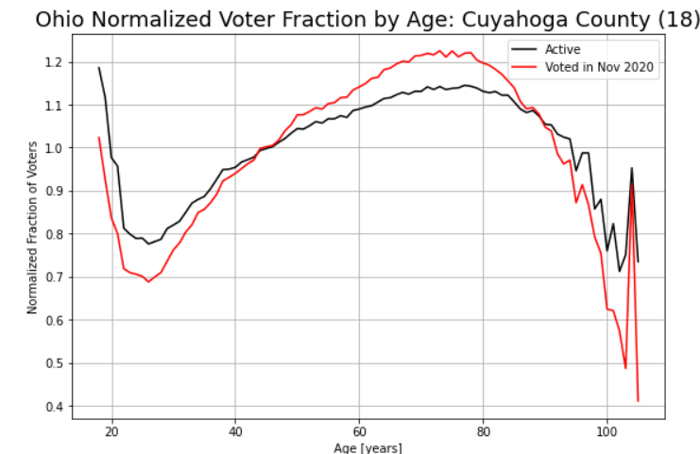
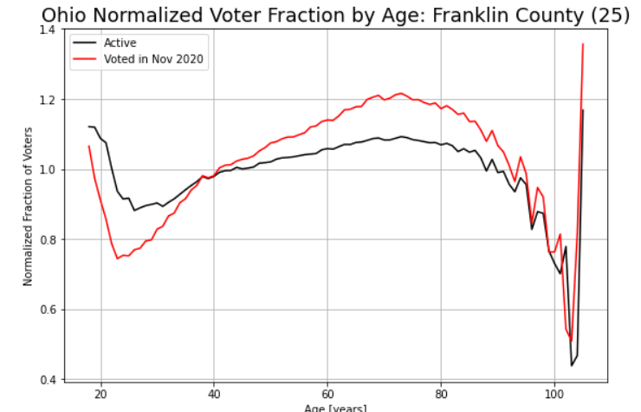
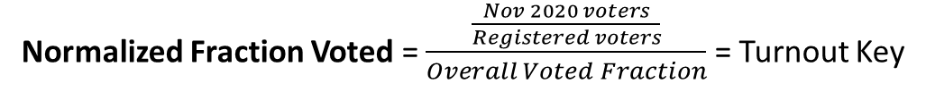
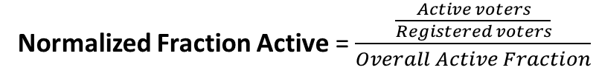


Single County analysis ”normalized” fraction voted (“normalized” turnout): Ohio-Analysis-2-Single-County-Cuyahoga.html Ohio-Analysis-2-Single-County-Franklin.html
For each age interval, 18 to 105 years:
Normalized Fraction Active = $\frac{\frac{Active voters}{Registered voters}}{Overall Active Fraction}$
Normalized Fraction Voted = $\frac{\frac{Nov 2020 voters}{Registered voters}}{Overall Voted Fraction}$ = Turnout Key
where
Overall Active Fraction = $\frac{\sum_{age}{Active voters}}{\sum_{age}{Registered voters}}$
Overall Voted Fraction = $\frac{\sum_{age}{Nov 2020 voters}}{\sum_{age}{Registered voters}}$

Slide 14
Single County analysis ”normalized” fraction voted (“normalized” turnout): Ohio-Analysis-2-Single-County-Cuyahoga.html Ohio-Analysis-2-Single-County-Franklin.html
Comments:
The “normalized” fraction shows age intervals
that are “above” 1 or “below” 1, where 1 is the overall fraction for all ages.
For example, in Cuyahoga County voter turnout was below the overall rate for ages
~18 to ~45 and above 95. Turnout was above the overall rate for ages ~45 to ~95.
“Overall rate” is not the average by age.

Slide 15
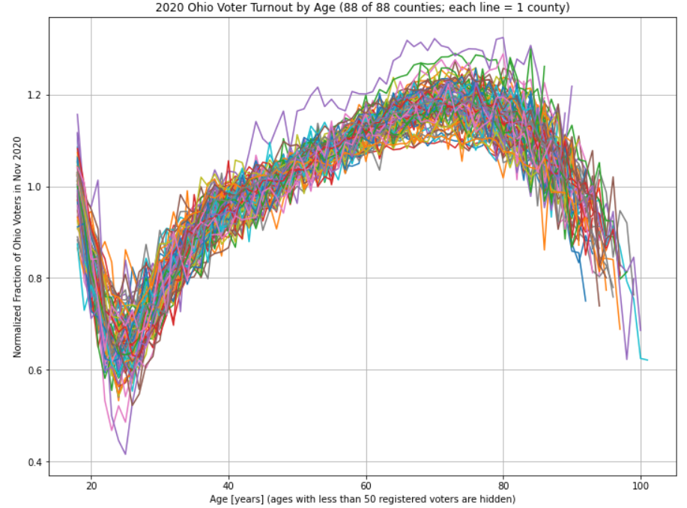
All Ohio Counties: “Normalized” Voter Turnout Keys Ohio-Analysis-3-All-Counties.html
Notes:
These county plots include the red lines in the normalized turnout plots for Cuyahoa and Franklin Counties on the last slide
Variation of normalized turnout varies by 15-20% across all counties for any given age.
All of these county “keys” are highly correlated but not identical.
Adapted from Lee’s script: plot_turnout_by_age.py

Slide 16
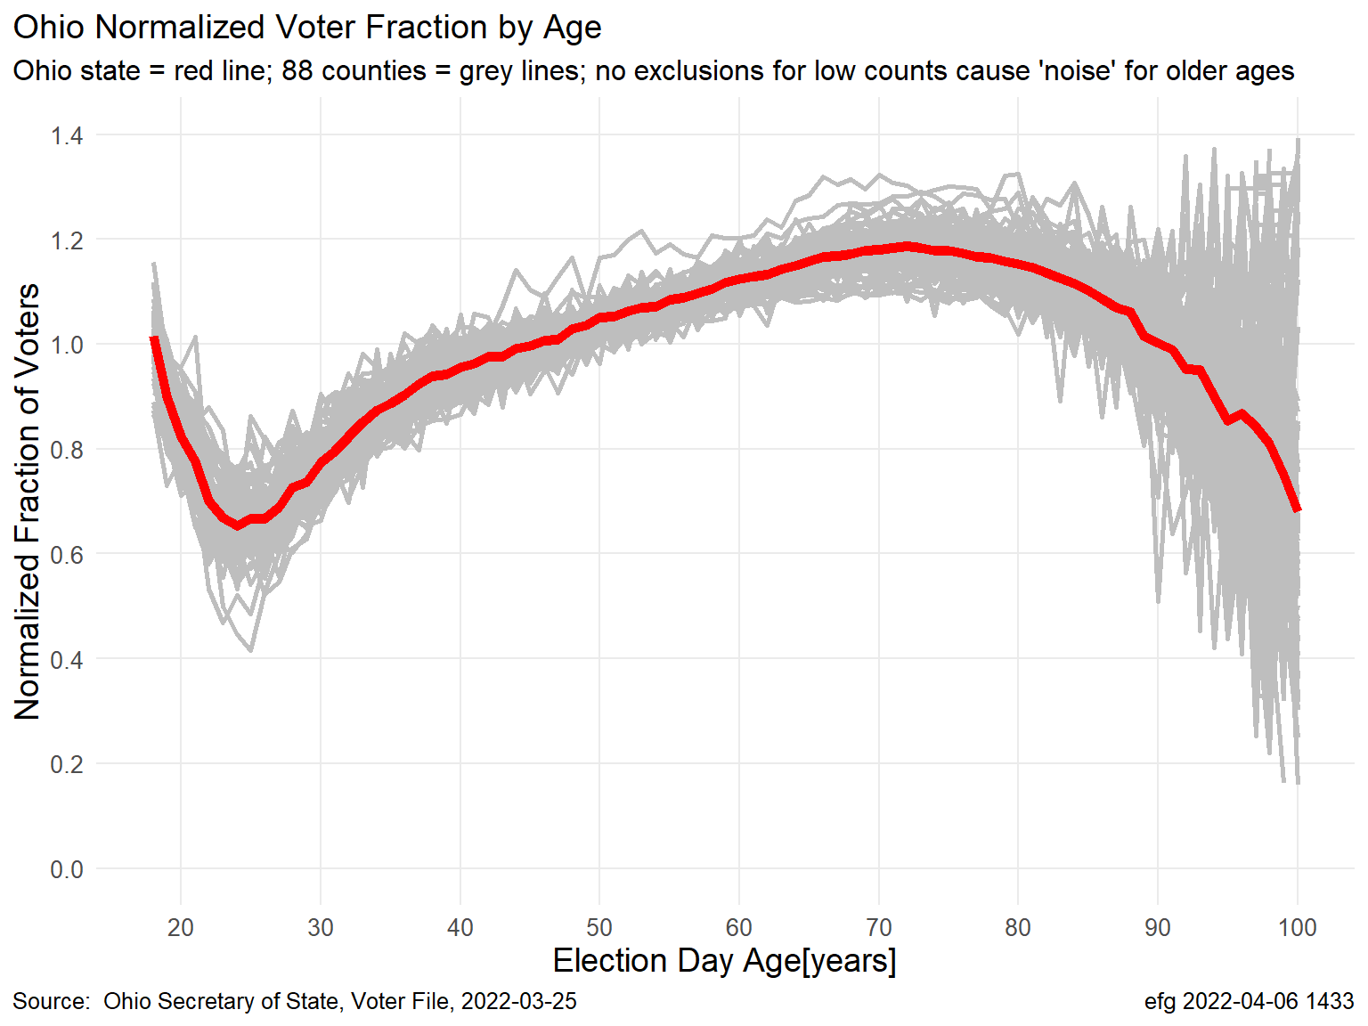
All Ohio Counties: “Normalized” Voter Turnout Keys Ohio-Key-Heatmap.html
Compare statewide “key” to separate “keys” by county
The normalized voter turnout by age varies
Considerably by county
Small counts (small “n”) for ages 90+ result
in “noisy” normalized key

Slide 17
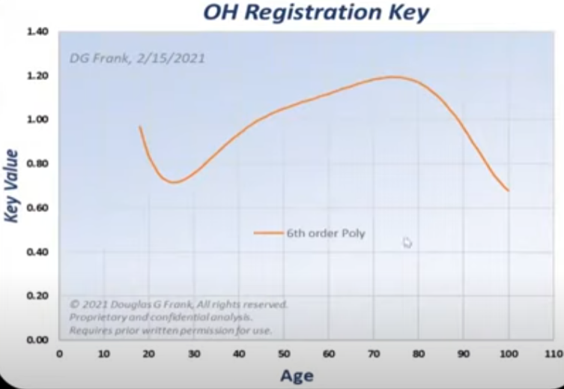
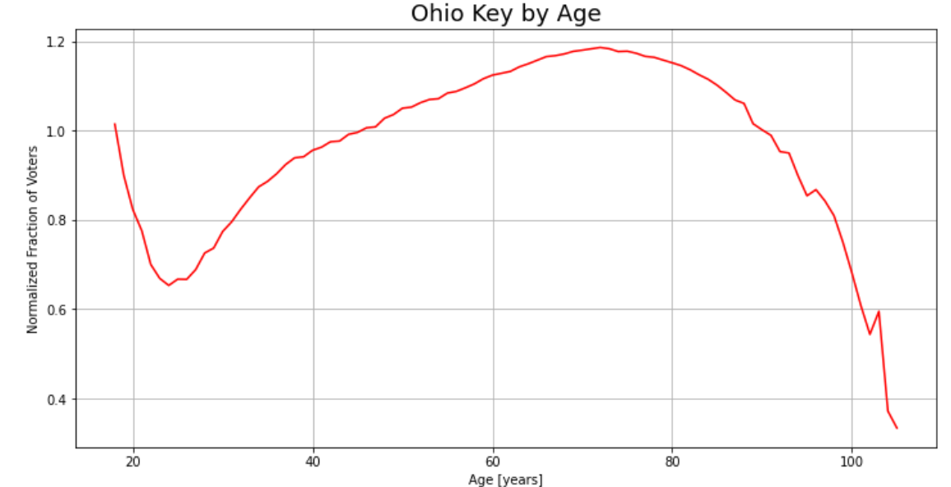
Generate Ohio Normalized Turnout “Key” Ohio-Analysis-4-Generate-Key.html
Apply methodology used for single county in previous slides to whole State of Ohio:
Dr. Frank’s version of OH Key from presentation to Kansas House Election Committee on 2022-03-15
“Key” written to file key.json, which is not
easy to review in a text editor or Excel since it’s
over 200 characters wide, and not necessarily
ordered.
{"18": 1.0148327400458397, "19": 0.8998751228239705,
. . .
"105": 0.3339083283101293, "104": 0.37172693302673665}
Adapted from Lee’s script: generate_key.py

Slide 18
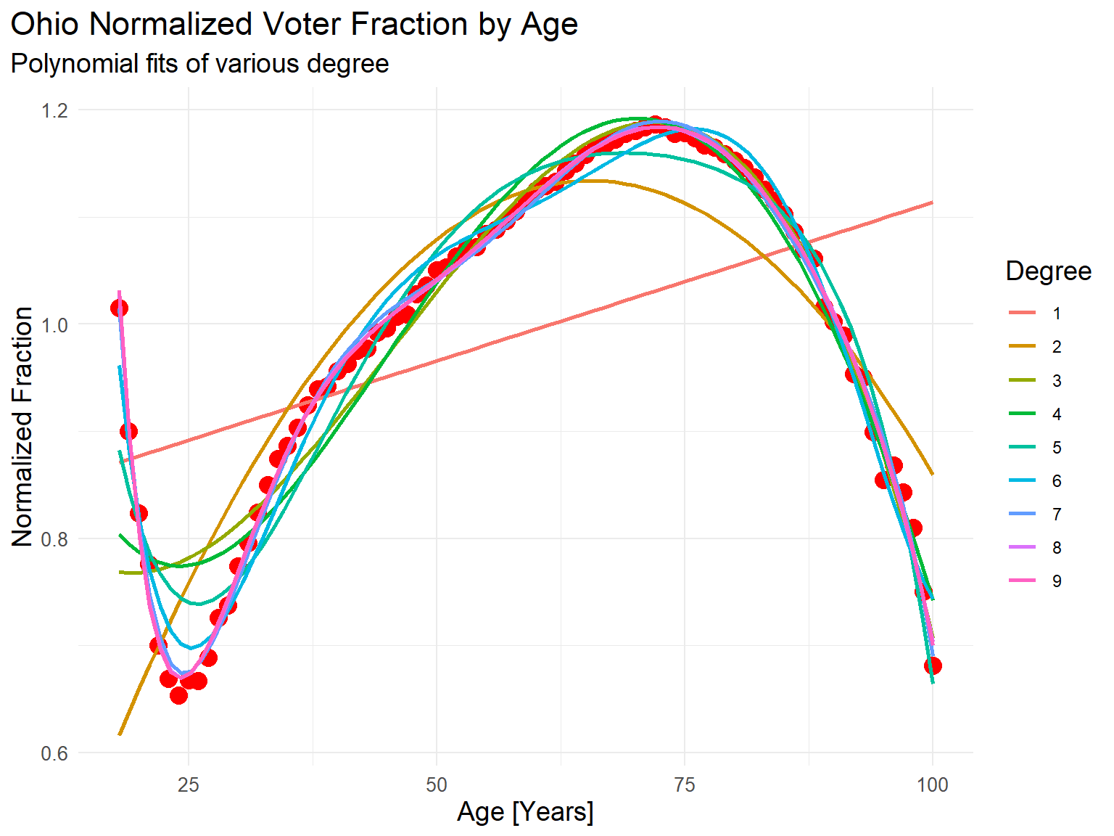
Fit Polynomials to Ohio Normalized Turnout Key
Here age range limited to [18, 100].
Fit Ohio Normalized Turnout curve (red dots) to polynomials of various degrees
Higher degree provides curvature/ “wiggliness”, but too high can lead to overfitting.
Akaike Information Criterion (AIC) indicates highest degree over range 1 to 9 was the “best” model.
R² approaches 1 as degree increases.
There is nothing “remarkable” about these curve fits.
Curve fits offer few insight about data but provide good numerical interpolation.
RStudio Notebook: Ohio-Key-Polynomials.html, Section 5.1 (AIC), Section 5.2 (R²), polyfitsMany-1.png

Slide 19
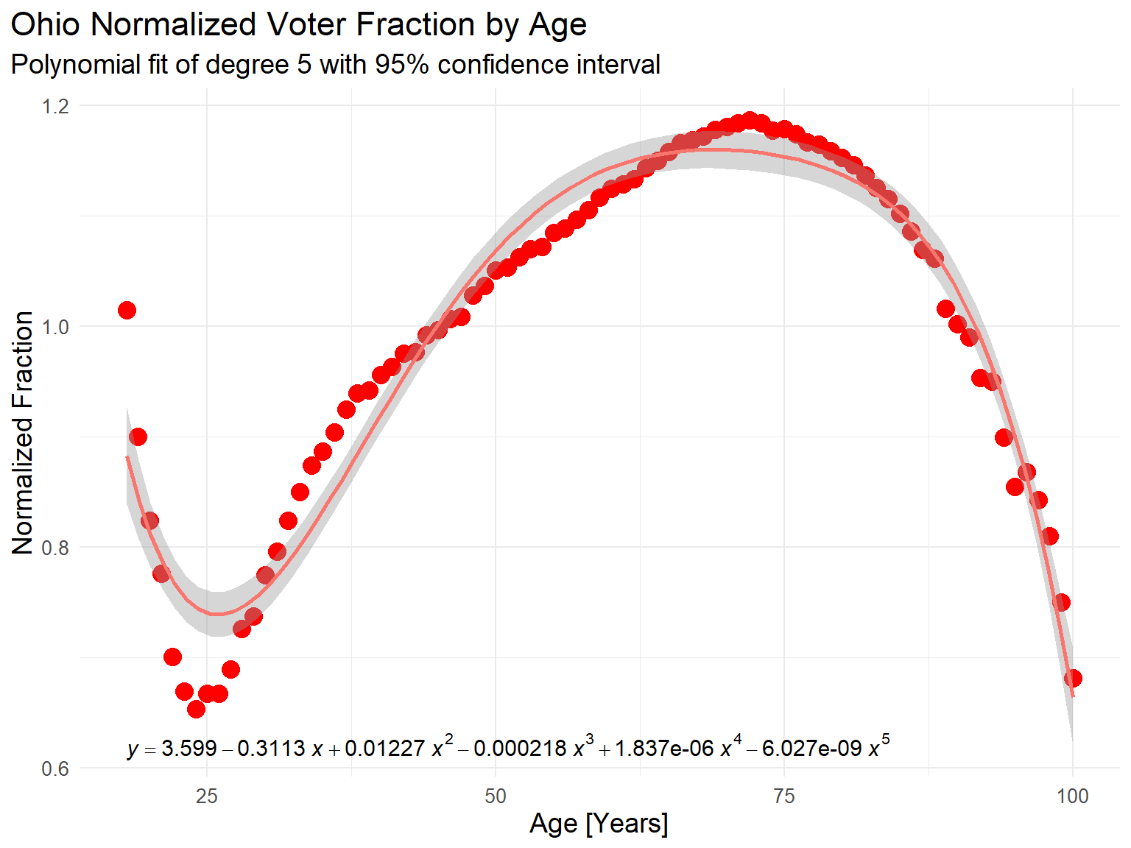
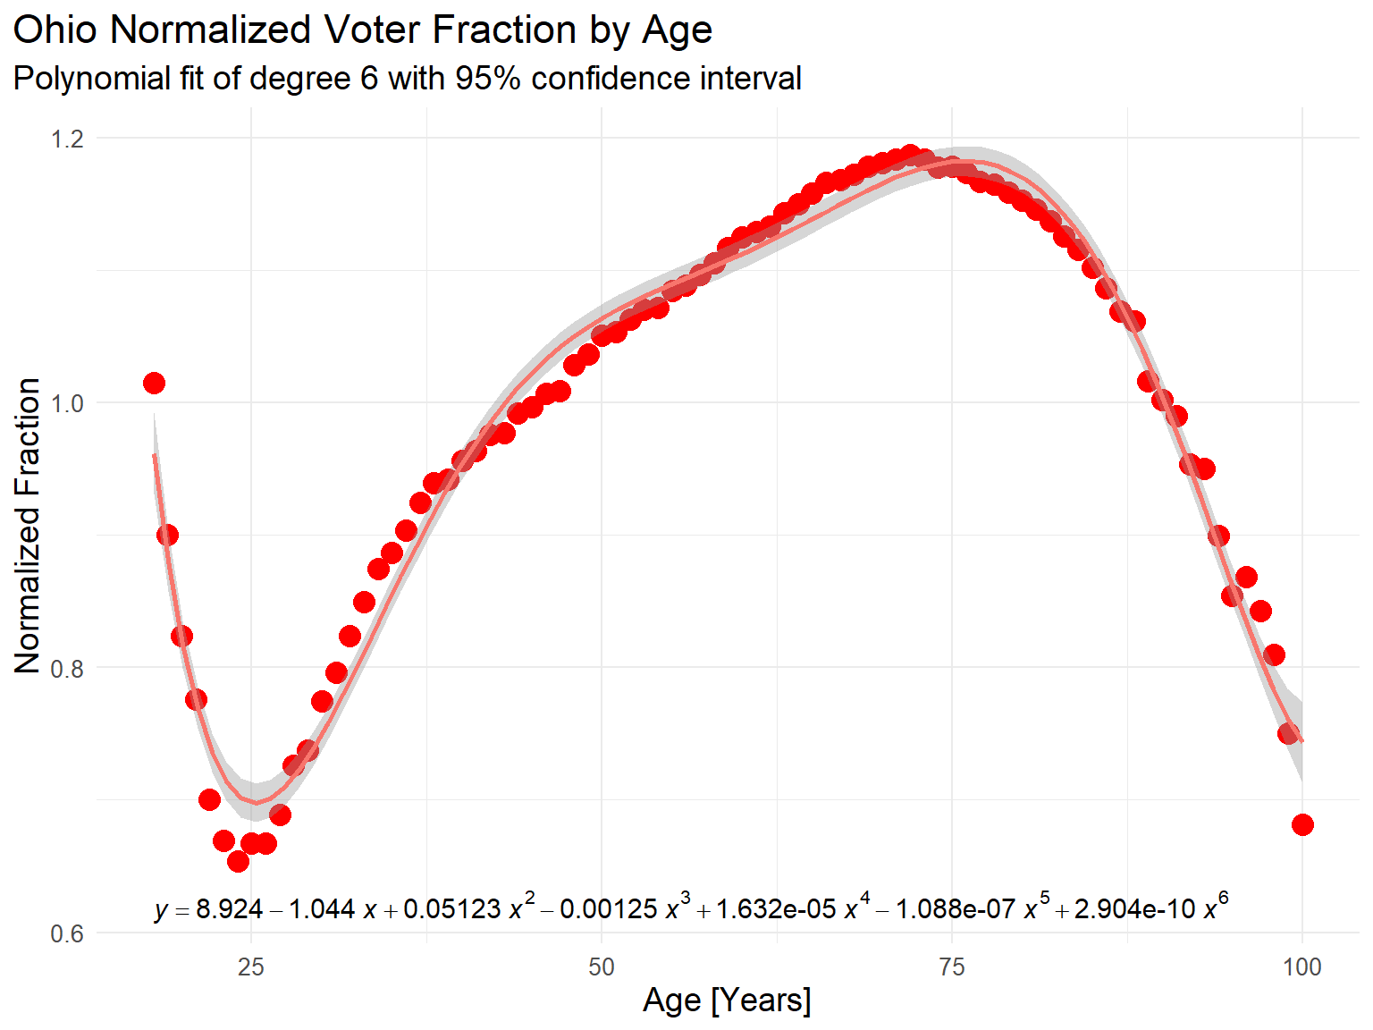
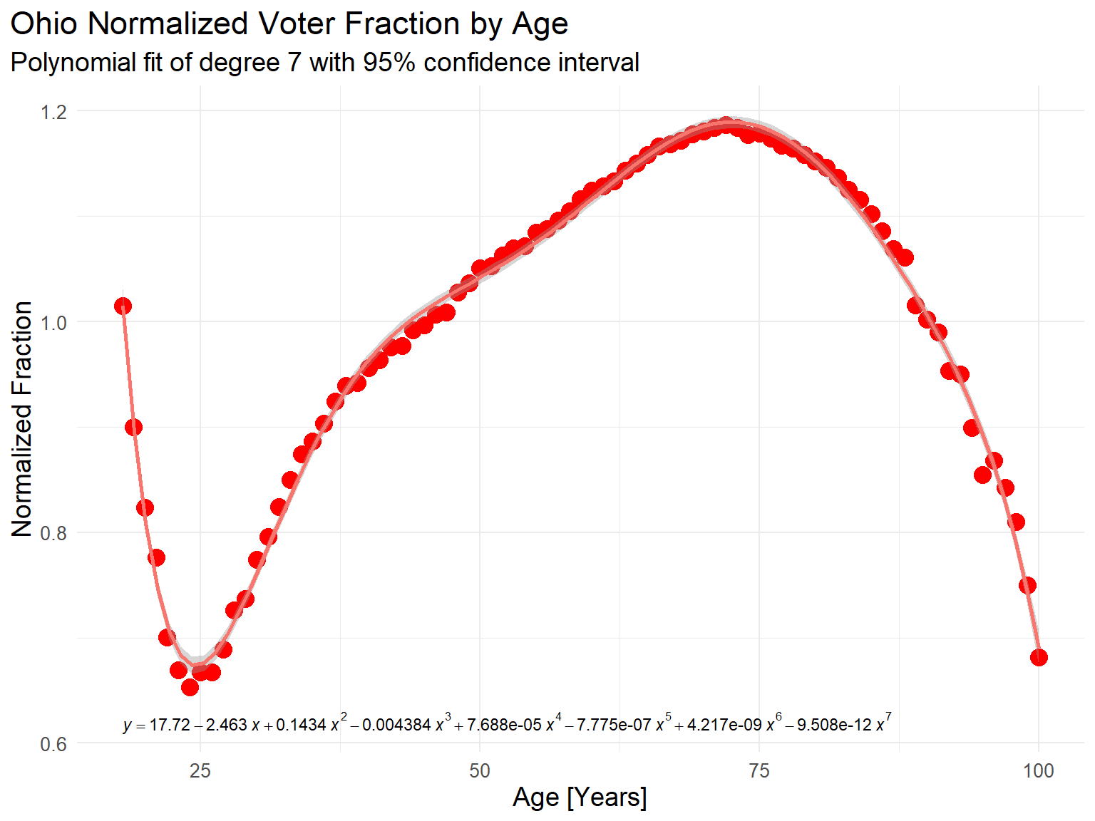
Fit Polynomials to Ohio Normalized Turnout Key
Degree 5
Degree 6
Degree 7
95% confidence interval is about width of line for 7-th degree fit, but this
may be “overfitting”
In polynomial equations above, x = Age, y = Normalized Fraction
Largest residual over range: 0.132 (5th), 0.062 (6th), 0.038 (7th)
But, there is no need for polynomial fit if original normalized turnout curve is used directly!
RStudio Notebook: Ohio-Key-Polynomials.html, Section 6, polyfit5-1.png, polyfit6-1.png, polyfit7-1.png

Slide 20
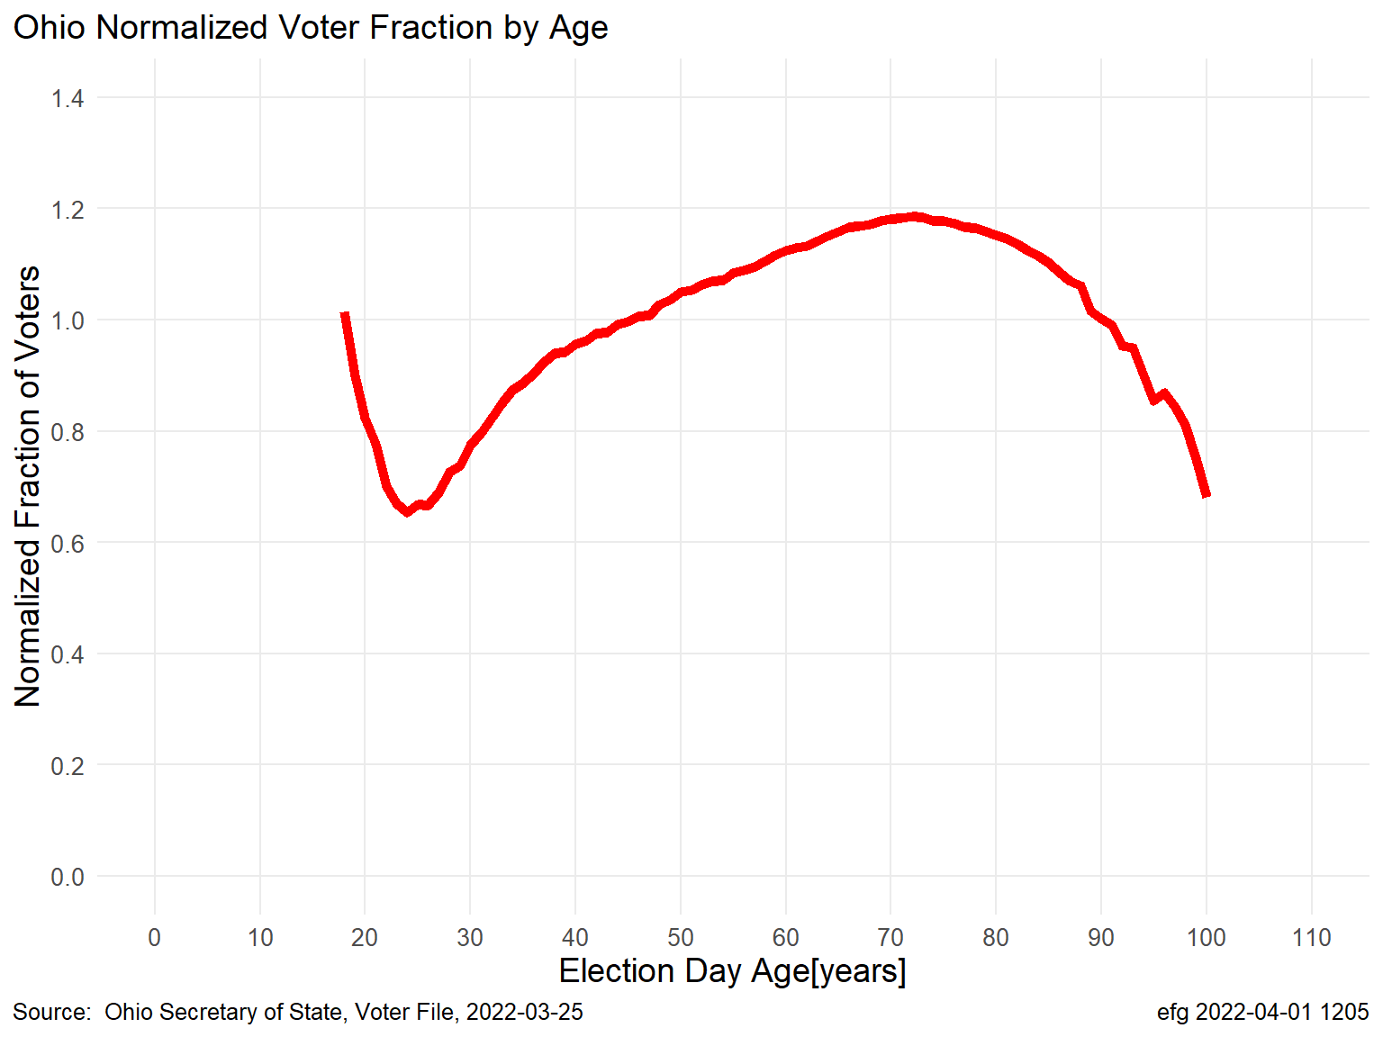
County vs State Normalized “Key” Curves All curves are highly correlated but not identical
All Counties
Ohio Statewide
Scaling is different between plots. Plots show raw turnout values without using polynomial fit.
Ohio-Analysis-3-All-Counties.html; Ohio-Key-Polynomials.html, Section 3, OhioNormalized-1.png

Slide 21
Ohio Turnout “Key”
Key: 6th Degree Polynomial Fit to Data (7 numbers)
Key: Based on Yearly Data (83 numbers)
Scaling is different between plots but both are based on the same data

Slide 22
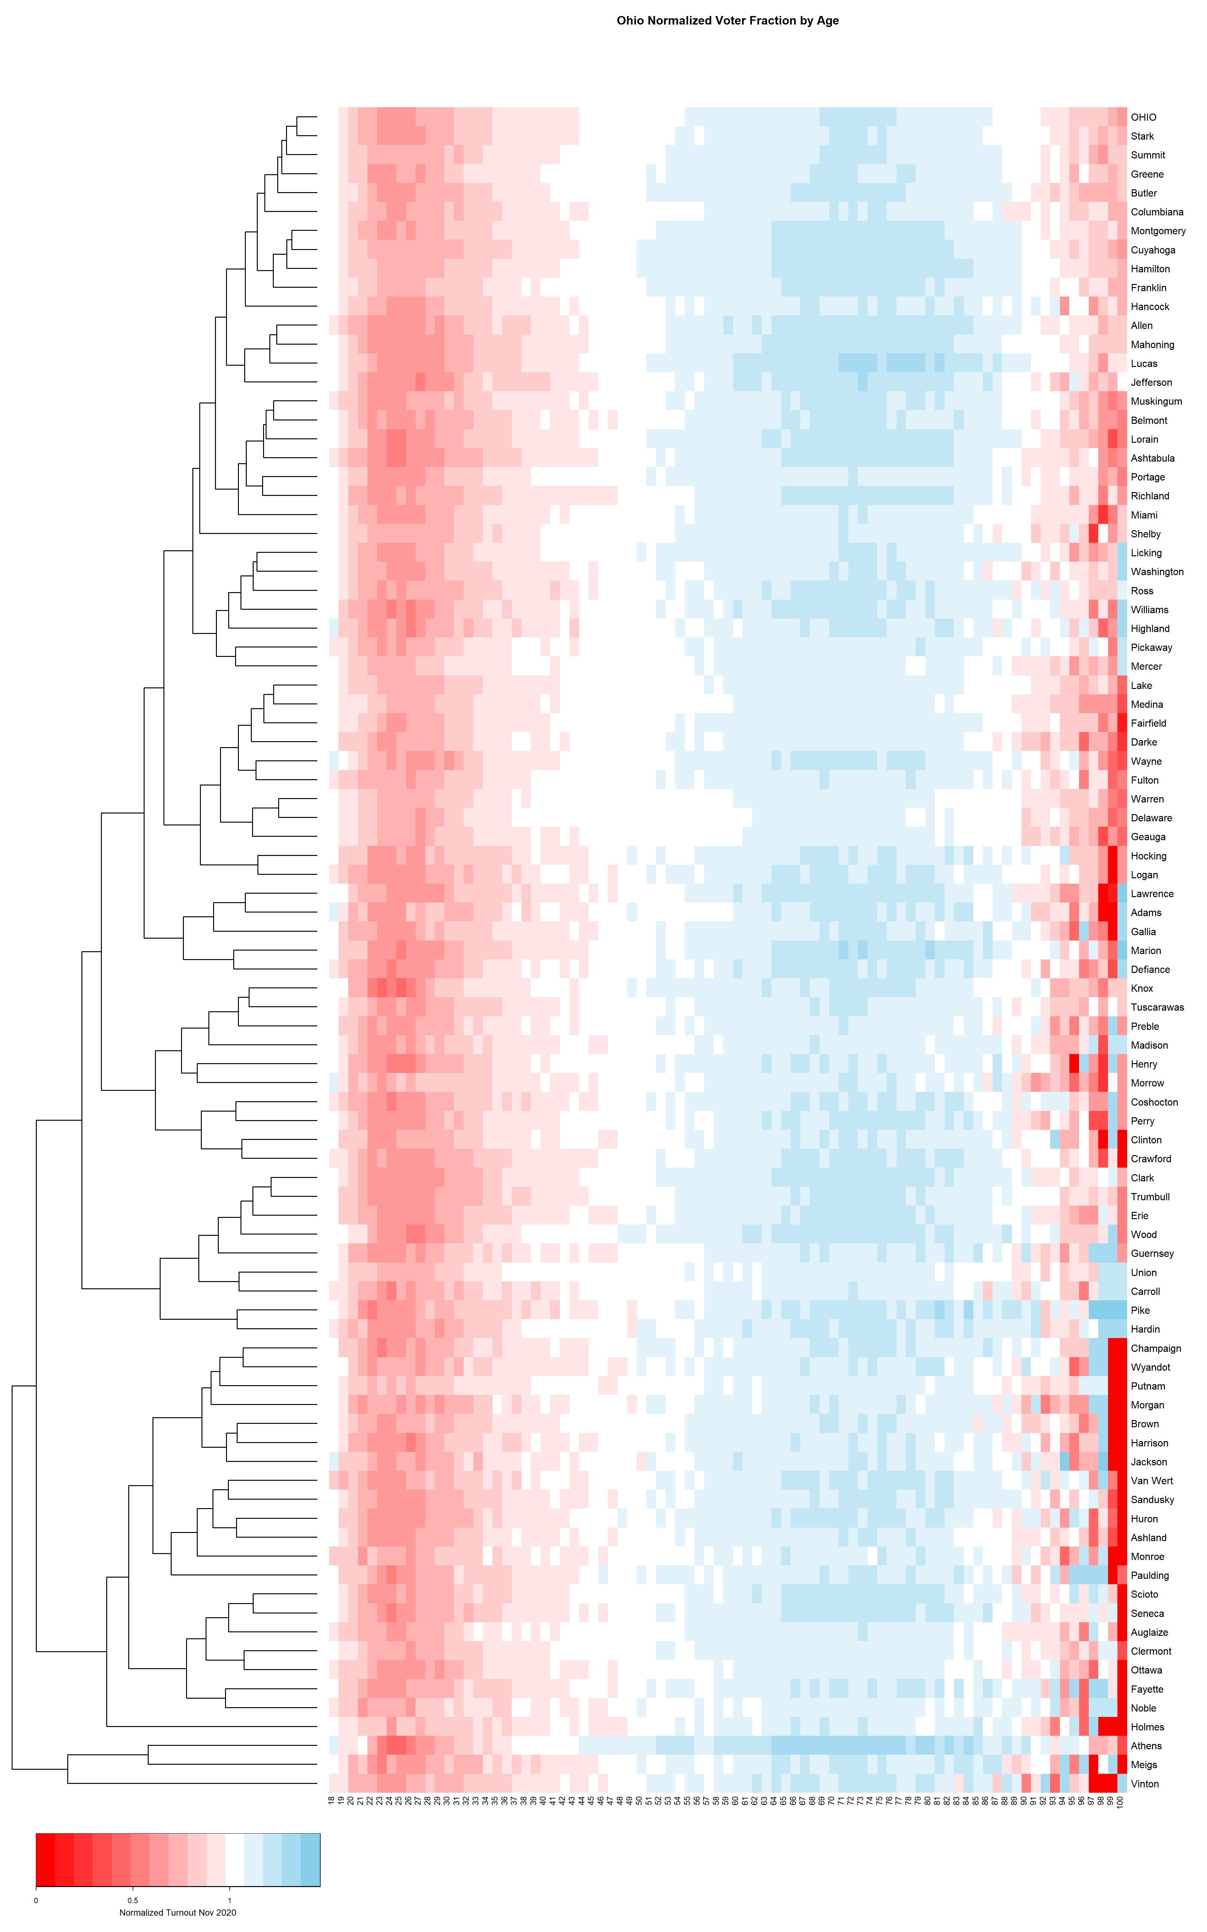
County Normalized Curves
dendrogram shows
similarities among
counties
<1
1
>1
All Counties
>1
1
1
<1
All 88 counties plotted
on top of each other
“Heatmap”
One row per county.
Ordered by similarity (but ordering is not
unique).
<1
Ohio-Analysis-3-All-Counties.html; Ohio-Key-Heatmap.html, heatmap-1.png
Enlargements more readable

Slide 23
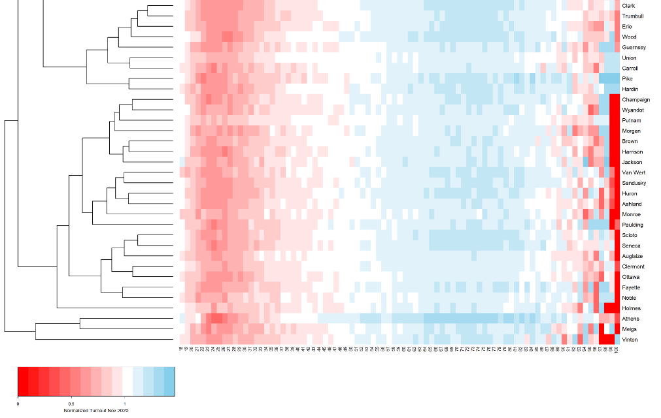
<1
1
>1
?
Numeric Scale
<1
1
>1
Bottom
With age scale
“Most different” counties: Athens, Meigs, Vinton

Slide 24
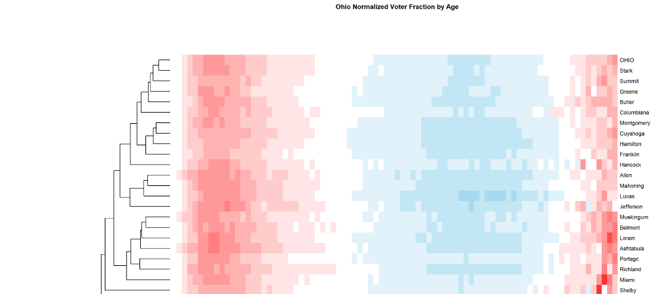
Ohio Statewide
Top with overall OHIO row
Stark County profile is most similar to Ohio statewide profile

Slide 25
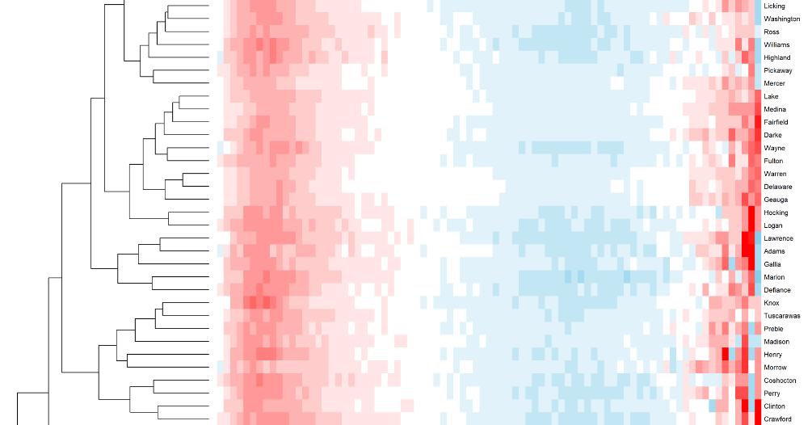
18-yr old turnout somewhat “high” in a few counties
Middle

