Slide 1
Lomb-Scargle Analysis
Stowers Institute for Medical Research
Earl F. Glynn
Scientific Programmer
7 May 2007

Slide 2
Lomb-Scargle Analysis
Simple Periodic Gene Expression Model
Introduction to Lomb-Scargle periodogram
Validation using Plasmodium Dataset
Application to Somitogenesis Dataset
Conclusions

Slide 3
Simple Periodic Gene Expression Model
“On”
“On”
“On”
1
frequency =
period
(T)
period
(T)
period
1
f =
T
Expression
ω = angular frequency = 2πf
“Off”
“Off”
Time
Gene Expression = Amplitude × Cosine(2πf t + PhaseShift)
“Periodic” if only observed over a single cycle?

Slide 4
Introduction to Lomb-Scargle Periodogram
Why Lomb-Scargle Instead of Fourier?
Examples Using Cosine Expression Model

Slide 5
Why Lomb-Scargle Instead of Fourier?
Lomb-Scargle Method | Fourier Method
Weights data points | Weights frequency intervals
Data can be unevenly sampled | Requires uniform spacing
No data imputation | Missing data imputed
Any number of data points | 2^{N} points for FFT; 0 padding
Known statistical properties | Permutation tests needed to assess statistical properties
“p” value | Ad hoc scoring rules
Need estimate of number of “independent frequencies” but explore using continuum | Usually only look at “independent” Fourier frequencies

Slide 6
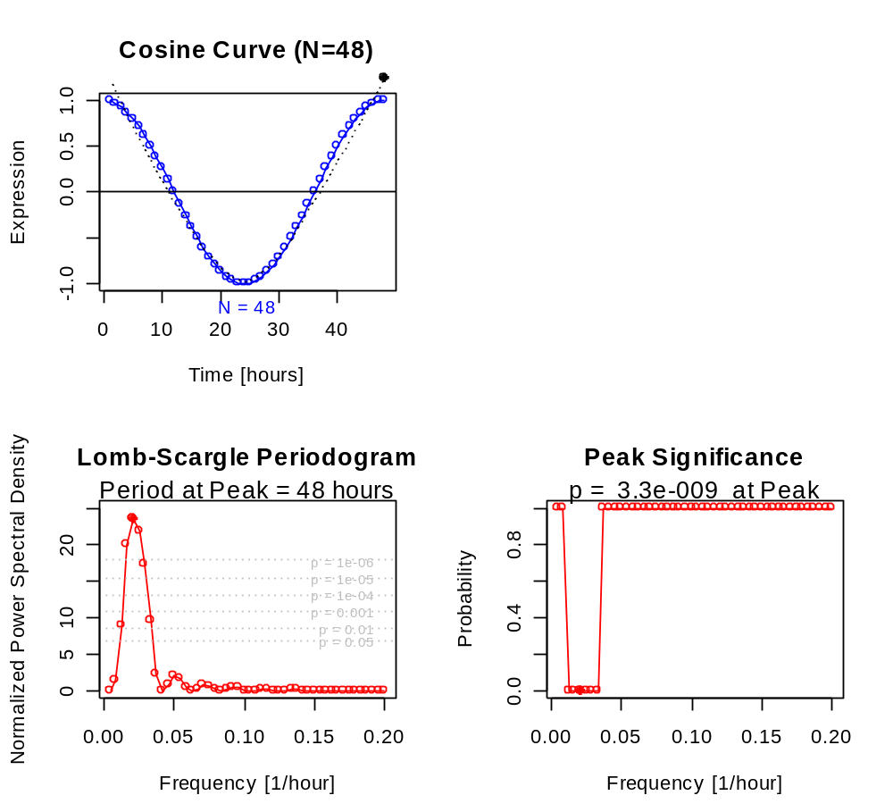
Lomb-Scargle Periodogram
Example Using Cosine Expression Model
A small value
for the false-alarm probability indicates
a highly significant periodic signal.
1
T =
Should apply
multiple hypothesis
testing to
set of p-values
f
Evenly-spaced time points

Slide 7
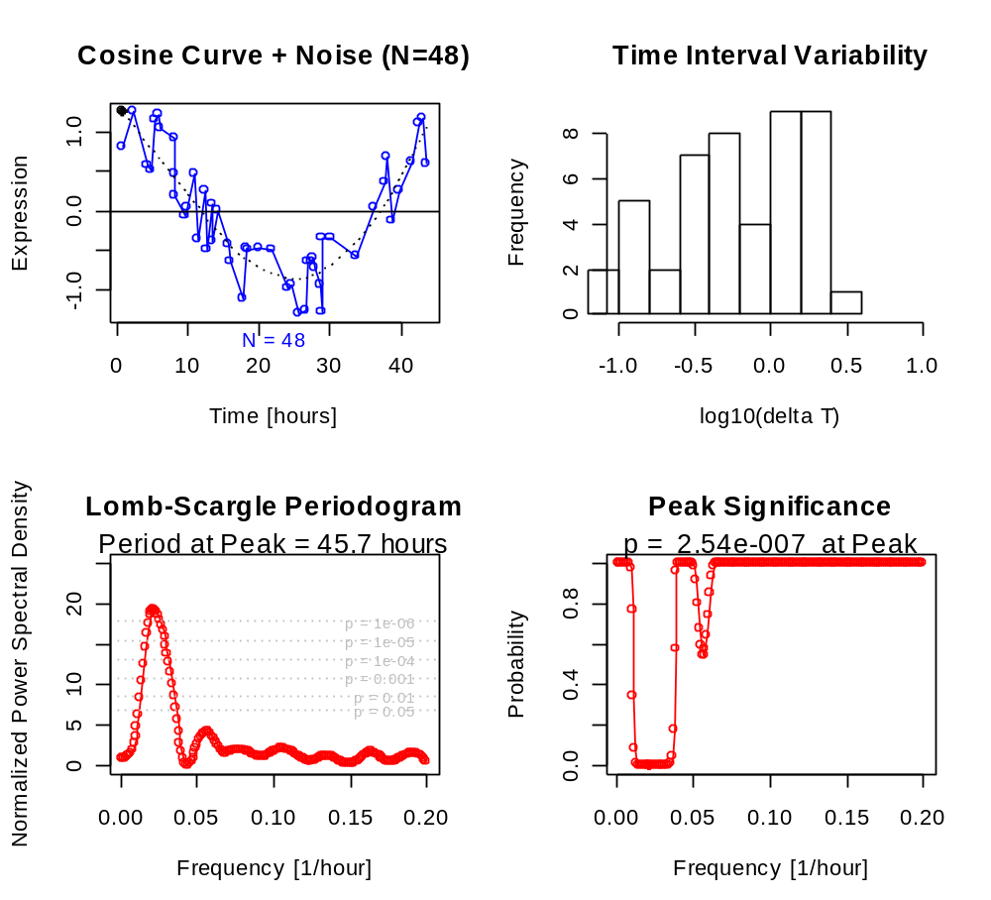
Lomb-Scargle Periodogram
Example Using Noisy Cosine Expression Model
Unevenly-spaced time points

Slide 8
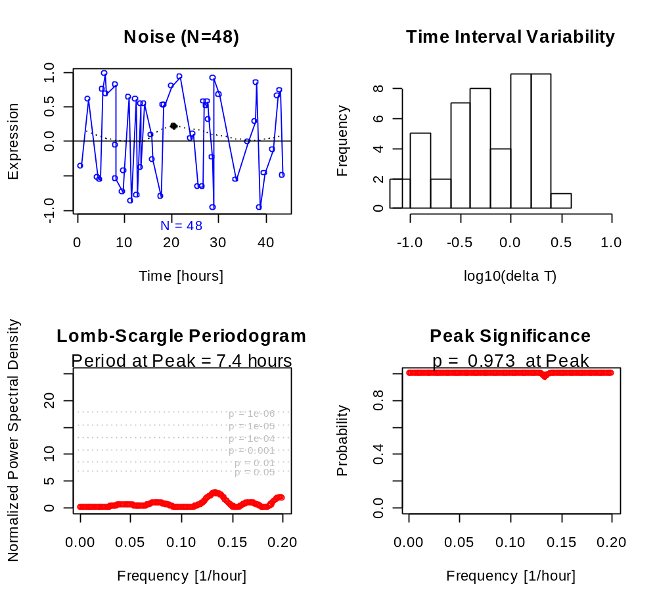
Lomb-Scargle Periodogram
Example Using Noise

Slide 9
Validation with Plasmodium Dataset
Fourier % power at peak frequency vs.
Lomb-Scargle p-value as indicator of
periodicity

Slide 10
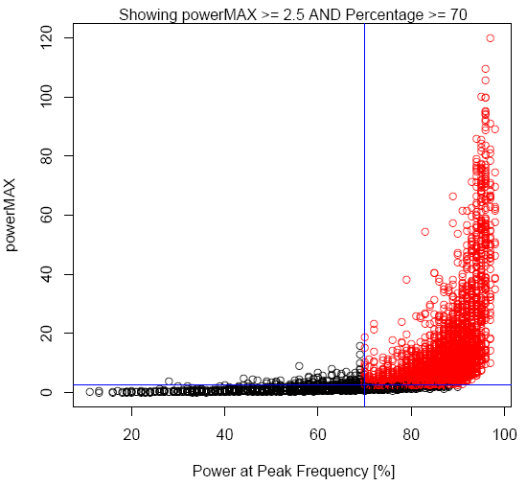
Bozdech’s Plasmodium dataset:
Bozdech’s Ad Hoc Scoring
powerMAX vs Power at Peak Frequency
Periodic
Genes
“The percentage of power in the maximum frequency of the FFT power spectrum was used as an indicator of periodicity”
Derived from Bozdech, et al, The Transcriptome of the Intraerythrocytic Development Cycle of Plasmodium falciparum, PLoS Biology, 2003

Slide 11
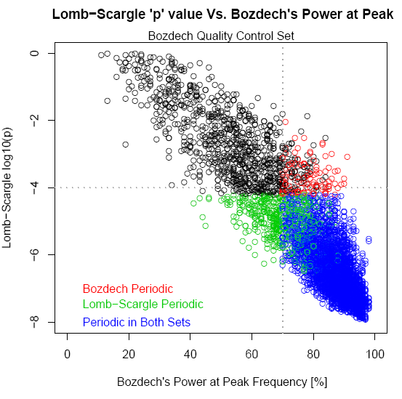
Bozdech’s Plasmodium dataset:
Bozdech’s Ad Hoc Scoring Vs Lomb-Scargle p values
Online supplement to Glynn, Chen, and Mushegian,
Detecting periodic patters in unevenly spaced gene expression time series using Lomb-Scargle periodograms,
Bioinformatics, 22(3):310, 2006.

Slide 12
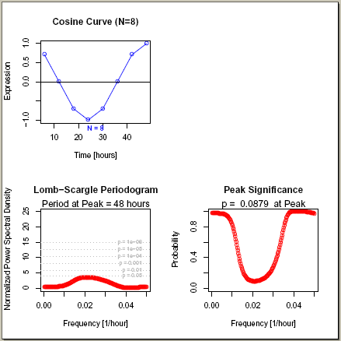
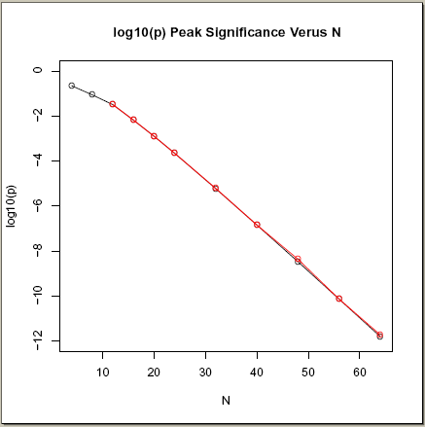
Application to Somitogenesis Dataset
“N”? How many points are needed?
log10(p) = 1 – 0.2N
Bozech
For N=30, a single perfect gene (cosine profile) would have p = 1E-5; and for N=40, p = 1E-7. (For set of p’s need multiple hypothesis testing, too)
Online supplement to Glynn, Chen, and Mushegian,
Detecting periodic patters in unevenly spaced gene expression time series using Lomb-Scargle periodograms,
Bioinformatics, 22(3):310, 2006.

Slide 13
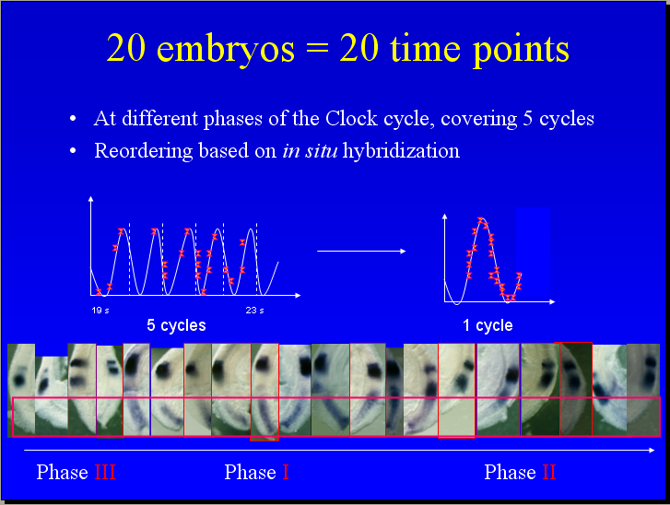
Somitogenesis Dataset
Mary-Lee, Science Club, 2004

Slide 14
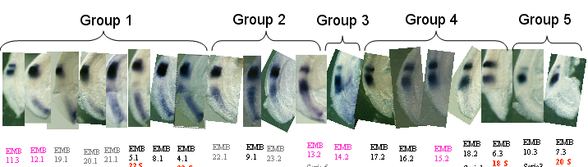
Somitogenesis Dataset
Perturbation (“Jitter”) and Permutation Tests
Order Nveau.ppt
Perturbation (times):
27.75443 33.08618 42.6607 11.04462 -0.6288767 18.55415 12.93994 44.90501 59.98529 67.2538 46.87758 55.91625 74.72591
78.9921 83.98062 104.9910 78.12926 77.38472 111.5297 109.2331
Permutation (order for fixed times):
7 5 6 8 4 3 2 1 | 11 12 9 10 | 13 | 17 15 16 18 14 | 20 19

Slide 15
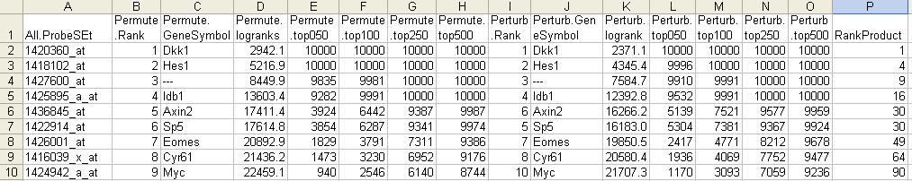
Somitogenesis Dataset
Perturbation (“Jitter”) and Permutation Tests
PermutePerturbComparison.xls, Jan 2005

Slide 16
Conclusions
Lomb-Scargle periodogram is effective tool to identify periodic gene expression profiles
Results comparable with Fourier analysis
Lomb-Scargle can help when data are missing or not evenly spaced

Slide 17


Acknowledgements
Pourquie Lab
Olivier Pourquié
Mary-Lee Dequéant
Bioinformatics
Arcady Mushegian
Galina Glasko
(Univ. of Rochester)
Jie Chen
(Univ. of Missouri, Kansas City)

