Slide 1
Reading/Writing Files in R
Earl F Glynn
Principal Programmer/Analyst
UMKC Center for Health Insights
efglynn@gmail.com @EarlGlynn
glynne@umkc.edu
8 February 2014

Slide 2
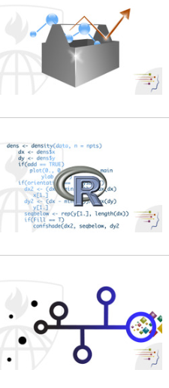
Johns Hopkins Data Science Specialization on Coursera
http://www.coursera.org
1. The Data Scientist's Toolbox
2. R Programming
3. Getting and Cleaning Data
4. Exploratory Data Analysis
5. Reproducible Research
6. Statistical Inference
7. Regression Models
8. Practical Machine Learning
9. Developing Data Products
Free or pay for specialization certificate.
All classes run for four weeks.
First three start on April 7th.

Slide 3
Outline
Data Types, especially data.frame
Reading/writing data files:
writeLines(), readLines()
read.csv(), write.csv() read.delim(), read.table()
Reading Excel files
Notes and examples:
http://earlglynn.github.io/R/input-output

Slide 4
Data Types
numeric
integer
character
logical
list
data.frame

Slide 5
numeric
> 1.0
[1] 1
> pi
[1] 3.141593
> x <- c(1, pi, exp(1))
> x
[1] 1.000000 3.141593 2.718282
> length(x)
[1] 3
> typeof(x)
[1] "double"
> class(x)
[1] "numeric"

Slide 6
integer
> 100L
[1] 100
> 100L * 100L
[1] 10000
> n <- c(1L, 10L, 100L, 1000L)
> n
[1] 1 10 100 1000
> length(n)
[1] 4
> typeof(n)
[1] "integer"
> class(n)
[1] "integer"

Slide 7
character
> "X"
[1] "X"
> "This is a string"
[1] "This is a string“
> s <- c("XYZ", "second", LETTERS[1:3])
> s
[1] "XYZ" "second" "A" "B" "C"
> nchar(s)
[1] 3 6 1 1 1
> typeof(s)
[1] "character"
> class(s)
[1] "character"

Slide 8
logical
> TRUE
[1] TRUE
> FALSE
[1] FALSE
> "A" == 5
[1] FALSE
L <- 5 == c(1, 5, 10, 20)
L
[1] FALSE TRUE FALSE FALSE
> typeof(L)
[1] "logical"
> class(L)
[1] "logical"

Slide 9
list
> sampleData <- list(nums=1:5, chars=c("XY", "z"), log=TRUE)
> sampleData
$nums
[1] 1 2 3 4 5
$chars
[1] "XY" "z"
$log
[1] TRUE
> sampleData$nums
[1] 1 2 3 4 5
> sampleData$chars[2]
[1] "z"

Slide 10
data.frame
> d <- data.frame(nums=10*1:3, chars=LETTERS[6:8],
tst=rep(TRUE,3))
> d
nums chars tst
1 10 F TRUE
2 20 G TRUE
3 30 H TRUE
> dim(d)
[1] 3 3
> str(d)
'data.frame': 3 obs. of 3 variables:
$ nums : num 10 20 30
$ chars: Factor w/ 3 levels "F","G","H": 1 2 3
$ tst : logi TRUE TRUE TRUE
> names(d)
[1] "nums" "chars" "tst"
> d$nums
[1] 10 20 30

Slide 11



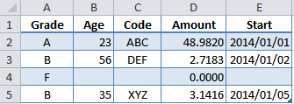
Load files into a data.frame
Comma-Separated Values (CSV)
Tab-Delimited File
Excel File

Slide 12
Notes and Examples
http://earlglynn.github.io/R/input-output
writeLines()/readLines() Examples
read.csv()/write.csv() Examples
Reading Excel files

Slide 13
Summary
Learn to work with data.frames
Reading/writing data files:
writeLines(), readLines()
read.csv(), write.csv() read.delim(), read.table()
Packages for Excel files
Many other ways for I/O

