Slide 1


Antibiotic Resistance Prototype
Earl F Glynn
18 November 2014

Slide 2
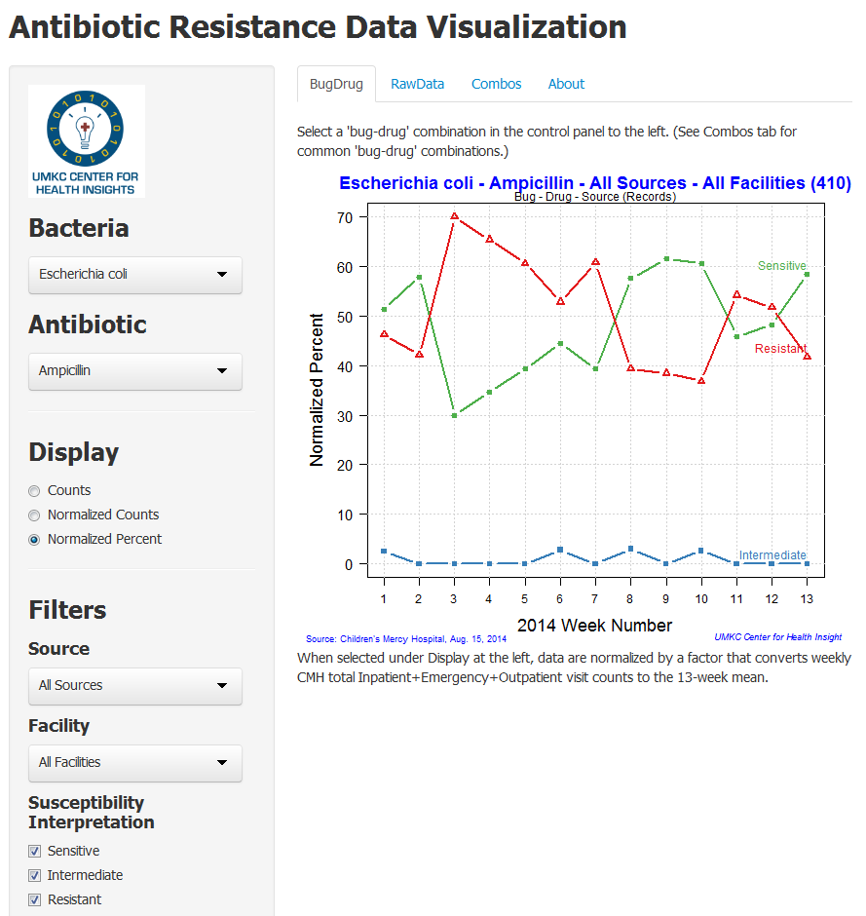

Slide 3
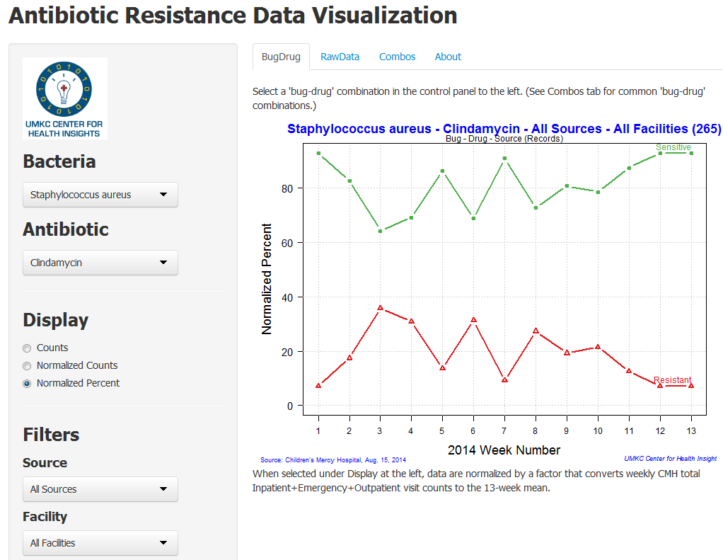

Slide 4
