Slide 1
Logic Regression
Earl F. Glynn
2 March 2005

Slide 2
Logic Regression
Biological Motivation
Background
  Regression
  Boolean Algebra
Logic Regression Formalities
Simple Example in “R”
Take Home Message

Slide 3
Logic Regression: Biological Motivation
Cyclic Gene Study
Upstream Regulatory Region
Coding Region
Mouse
Human
Problem: Understand four families of genes and how
they bind in the upstream regulatory region. “Bind” and “Don’t Bind” can be interpreted as binary variables.
Combinatorial effects should be considered.

Slide 4
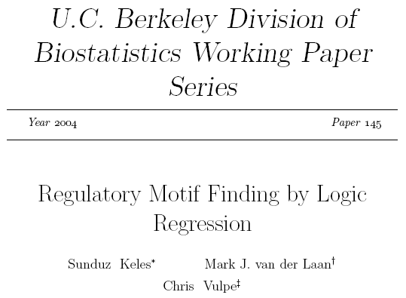
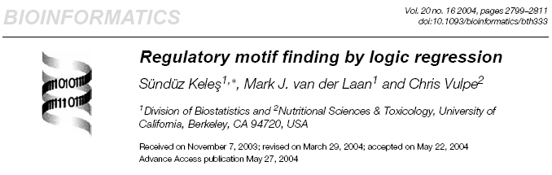
Logic Regression: Biological Motivation
Regulatory Motif Finding by Logic Regression

Slide 5
Logic Regression: Background
Regression
Linear Regression
Logistic Regression
Linear Discriminant Analysis

Slide 6
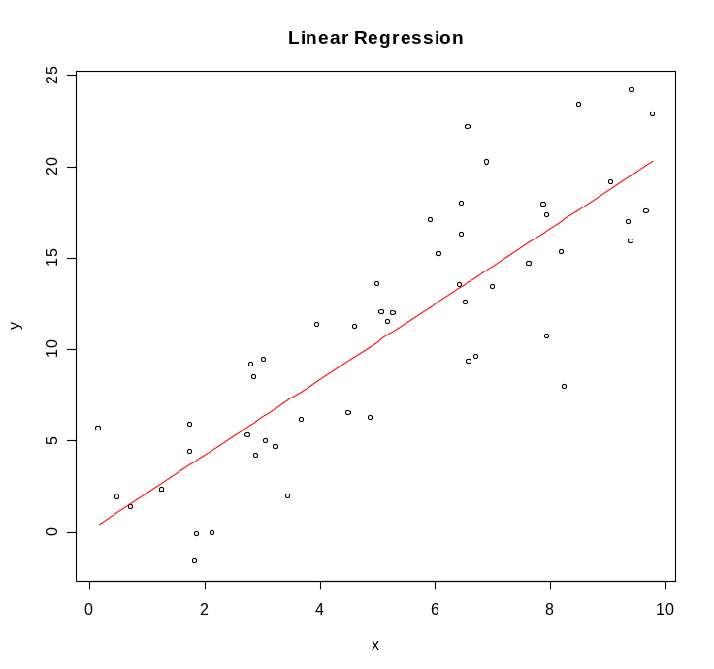
Logic Regression: Background
Linear Regression
X = continuous-valued explanatory variable
Simple Linear Regression
Y = β₀ + β₁X
Multiple Regression
Y = β₀ + β₁X₁+ β₂X₂ + …
# R Code
N <- 50
x <- sort(runif(N,0,10))
y <- 2*x + 3*rnorm(N)
plot(y~x, main=“Linear Regression")
LineFit <- lm(y~x)
lines(x, fitted(LineFit), col="red")
summary(LineFit)

Slide 7
Logic Regression: Background
Linear Regression Formalities
E = expected response
Mean
E[Y] = μ
Simple Regression
E[Y | X1] = β₀ + β₁X₁
Multiple Regression
E[Y | X1, X2] = β₀ + β₁X₁+ β₂X₂

Slide 8
Logic Regression: Background
Logistic Regression
Outcome is like flipping a coin (a Bernoulli trial):
e.g, binary result: 0 = No, 1 = Yes
“Predictors” (continuous or discrete) determine how
“loaded” coin is
Want to estimate how much a predictor loads the coin,
i.e., changes the probability
Use “odds” of an event: p/(1-p)
Log(odds) = Log[p/(1-p)] = logit(p) = “logistic function”
Preferred by statisticians when dependent variable is binary

Slide 9
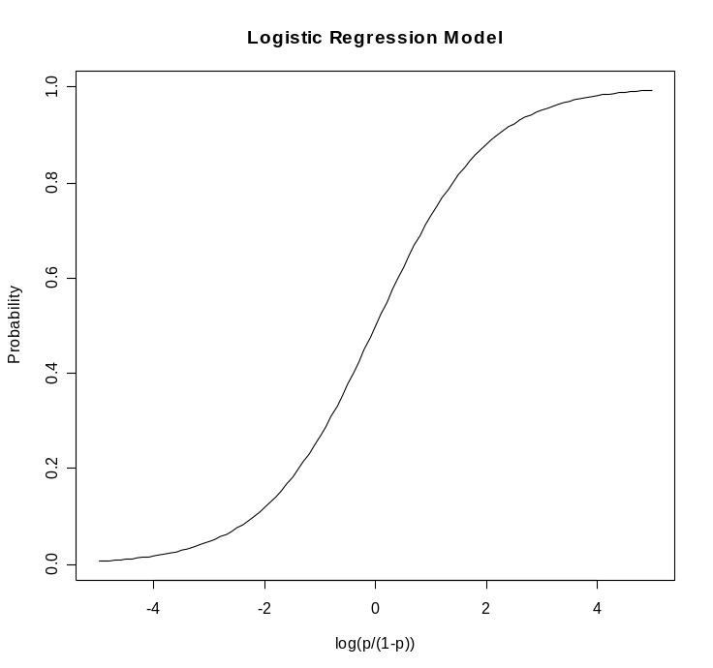
Logic Regression: Background
Logistic Regression
Multiple Regression
Y = β₀ + β₁X₁+ β₂X₂ + …
Logistic Regression
Log[p/(1-p)] = β₀ + β₁X₁+ β₂X₂ + …
Interpretation of coefficients is
complicated since they relate to
log-odds (logit) and not probability
directly.
Relationship between p and logit(p)
is non-linear, but is nearly linear in
the middle range of logit(p).
R code: curve(1/(1+exp(-x)), from=-5, to=5, xlab="log(p/(1-p))",
ylab="Probability", main="Logistic Regression Model")

Slide 10
Logic Regression: Background
Linear Discriminant Analysis
Have observed data for two or more groups and want to
distinguish among the groups.
Discriminant analysis works by creating a new variable
that is a linear combination of the original variables.
Differences among groups are maximized.
Discriminant functions can be applied to classify
unknown cases. Score = β₀ + β₁X₁+ β₂X₂ + …
Example: from http://obelia.jde.aca.mmu.ac.uk/multivar/da2.htm
discriminant score = 0.0029 height + 1.028 weight - 0.096 age
>0 male
<0 female
In general, a separate discriminant function for each group

Slide 11





Logic Regression: Background
Truth Tables and Boolean Algebra
NOT
Commutative Laws
x ∨ y = y ∨ x
x ∧ y = y ∧ x
A
¬A
False
True
True
False
Associative Laws
(x ∨ y) ∨ z = x ∨ (y ∨ z)
(x ∧ y) ∧ z = x ∧ (y ∧ z)
AND
A ∧ B
B
False
True
A
False
False
False
Distributive Laws
x ∨ (y ∧ z) = (x ∨ y) ∧ (x ∨ z)
x ∧ (y ∨ z) = (x ∧ y) ∨ (x ∧ z)
True
False
True
OR
A∨B
B
DeMorgan Laws
False
True
A
False
False
True
True
True
True

Slide 12
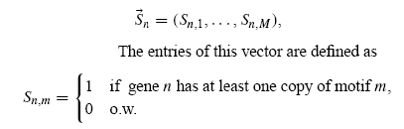
Logic Regression Formalities
Let Y denote “outcome of interest”
could be continuous quantity, e.g., log ratio mRNA
could be binary variable for class of genes,
e.g., 0=downregulated gene, 1=upregulated gene
Assume N independent observations of Y from same distribution.
Define vector for each gene n for any given binding site set of size M:
Adapted from Keles (2004),
Regulatory motif finding
by logic regressions

Slide 13


Logic Regression Formalities
Dependent: Y
Independent:
Linear regression model:
Logistic regression model:
(might be more appropriate if Y is binary variable):
Could use with classification problem, too.
Need to estimate β coefficients, and ‘most relevant’ motifs.
But, no combinatorial effects considered yet …

Slide 14
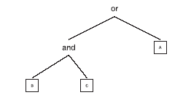
Logic Regression
Assumptions for Motif Finding
Few interacting transcription factors and these require
binding to different sites on the transcription control regions
Interaction of transcription factors, i.e., bind sites, can be
reduced to a Boolean expression
Example:
Logic Tree:
L = (B ∧ C) ∨ A
A transcription process might require a gene to have binding sites for factors
B and C, or a binding site for factor A, in order to be regulated.

Slide 15
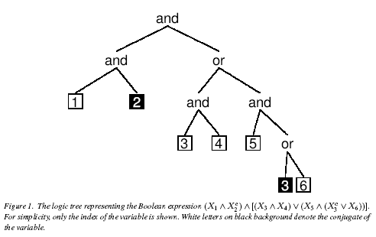
Logic Regression
Assumptions for Motif Finding
Adapted from Ruczinksi, et al, (2003), Logic Regression,
Journal of Computational and Graphical Statistics, 12(3), 475-511.
A more complicated logic tree
Need to decide complexity of desired logic trees

Slide 16
Logic Regression Formalities
Extend model to include combinatorial effects, by letting
L be Boolean expression based on motif scores.
Where L₁ and L₂ are Boolean expressions obtained from
vector S. Each L can be represented by logic tree.
Logic regression identifies combinations of predictors
(usually high dimensional) associated with an outcome.
Method works with linear regression, logistic regression,
or classification problem.

Slide 17
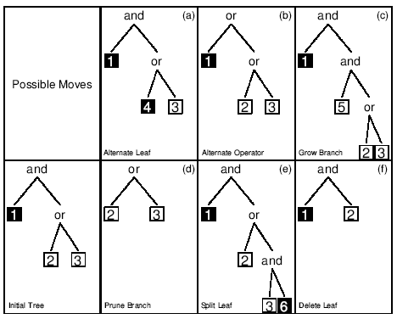
Logic Regression Formalities
Ruczinki et al (2003) provide LogicReg “R” package
Uses simulated annealing algorithm to search
high-dimensional space, with well-defined move set:
Adapted from Ruczinksi, et al, (2003),
Logic Regression,
Journal of Computational and Graphical Statistics, 12(3), 475-511.
Proposed move accepted or rejected based on “score” and
“temperature”
Ruczinksi uses cross-validation and randomization-based
hypothesis testing to choose among different model sizes

Slide 18
Logic Regression: Simple Example
Use Ruczinski’s “LogicReg” in R
library(LogicReg)
X <- matrix(as.numeric(runif(160) < 0.5), 20,8)
colnames(X) <- paste("X", 1:ncol(X), sep="")
rownames(X) <- paste("case", 1:nrow(X), sep="")
# Y = (NOT X2) AND X6
Y <- as.numeric(!X[,2] & X[,6])
cbind(Y, X)
Y X1 X2 X3 X4 X5 X6 X7 X8
case1 1 0 0 0 0 0 1 1 1
case2 0 0 1 1 1 0 0 1 0
case3 0 0 1 1 1 0 1 0 0
case4 0 1 1 1 1 1 1 0 0
case5 1 1 0 0 0 1 1 1 0
case6 0 0 1 1 0 0 0 1 1
case7 0 0 1 0 0 0 1 1 0
case8 0 0 0 1 0 1 0 0 1
case9 1 1 0 1 0 1 1 0 0
case10 0 0 0 0 1 1 0 0 0
case11 0 0 0 1 0 0 0 0 1
case12 0 0 1 1 1 0 1 1 0
case13 1 1 0 1 1 1 1 0 1
case14 0 0 1 0 1 0 0 1 0
case15 0 1 0 0 1 0 0 0 0
case16 0 1 1 1 1 0 1 0 1
case17 0 0 1 1 0 1 1 1 1
case18 0 0 1 0 0 1 0 1 0
case19 1 0 0 1 1 0 1 0 0
case20 0 1 1 0 0 0 0 0 1
Define Simulated Dataset:
Y = (NOT X₂) AND X₆
What kind of regression model
is most appropriate here?

Slide 19
Logic Regression: Simple Example
SearchIterations <- 1000
Annealing <- logreg.anneal.control(start = -1, end = -4,
iter = SearchIterations,
update = SearchIterations/10)
Annealing
$start
[1] -1
$end
[1] -4
$iter
[1] 1000
$earlyout
[1] 0
$update
[1] 100
TreeControl <- logreg.tree.control(treesize=2, # 2 leaves per node, e.g., (X1 OR X2)
opers=2) # "and" and "or"
TreeControl
$treesize
[1] 2
$opers
[1] 2
$minmass
[1] 0

Slide 20
Logic Regression: Simple Example
logicfit <- logreg(resp=Y, bin=X,
type = REGRESSION.TYPE<-2,
select = FIT.SINGLE.MODEL<-1,
ntrees=1,
nleaves=2, # force shape of final tree
anneal.control=Annealing,
tree.control=TreeControl)
log-temp current score best score acc / rej /sing current parameters
-1.000 0.4894 0.4894 0( 0) 0 0 0.350 0.000
-1.300 0.4640 0.3145 64( 10) 26 0 0.125 0.375
-1.600 0.3145 0.3145 55( 4) 41 0 0.077 0.780
-1.900 0.0000 0.0000 1( 4) 95 0 0.000 1.000
-2.200 0.0000 0.0000 0( 1) 99 0 0.000 1.000
-2.500 0.0000 0.0000 0( 6) 94 0 0.000 1.000
-2.800 0.0000 0.0000 0( 8) 92 0 0.000 1.000
-3.100 0.0000 0.0000 0( 7) 93 0 0.000 1.000
-3.400 0.0000 0.0000 0( 4) 96 0 0.000 1.000
-3.700 0.0000 0.0000 0( 8) 92 0 0.000 1.000
-4.000 0.0000 0.0000 0( 9) 91 0 0.000 1.000
logicfit
score 0
+1 * ((not X2) and X6)
But what if other sets of random values are used that define the same problem?

Slide 21
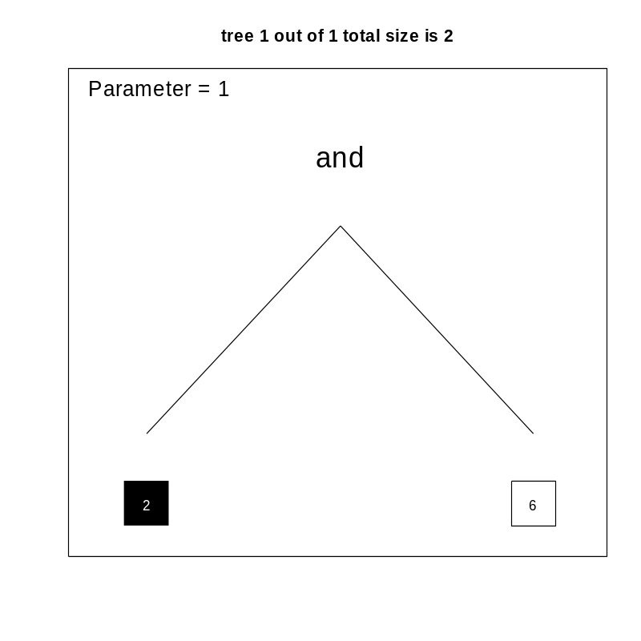
Logic Regression: Simple Example
plot(logicfit)

Slide 22
Logic Regression: Simple Example
But what if other sets of random values are used that define the same problem?
Using TreeControl
Repeat 1000 times with 100 Iterations in Simulated Annealing Chain
LogicFit1Driver(1000, 20, 100)
**********************************************
Equations counts
[1,] "score 0 +1 * (X6 and (not X2))" "385"
[2,] "score 0.389 -0.545 * (not X6)" "150"
[3,] "score 0.389 +0.545 * X6" "135"
[4,] "score 0.37 +0.824 * (X4 and X8)" "105"
[5,] "score 0 +1 * ((not X2) and X6)" "76"
[6,] "score 0.37 +0.824 * (X8 and X4)" "65"
[7,] "score 0.375 +0.667 * (X6 and X8)" "48"
[8,] "score 0.375 +0.667 * (X8 and X6)" "18"
[9,] "score 0.389 -0.545 * ((not X2) and (not X6))" "5"
[10,] "score 0.416 +0.778 * ((not X4) and X7)" "5"
[11,] "score 0.389 -0.545 * ((not X6) and (not X2))" "4"
[12,] "score 0.408 -0.5 * ((not X6) and (not X7))" "1"
[13,] "score 0.408 -0.5 * ((not X7) and (not X6))" "1"
[14,] "score 0.416 +0.778 * (X7 and (not X4))" "1"
[15,] "score 0.416 +0.778 * (X8 and X1)" "1"
46.1% are "correct"

Slide 23
Logic Regression: Simple Example
How does solution vary
by size of dataset and
by iterations in simulated annealing chain?
Iterations in Simulated Annealing Chain
Size of Dataset
20
100
1000
10,000
100
15
46.1%
6.3
4
63.2%
6.8
4
59.0
13.8
5
56.1
89.6
500
7
88.9%
8.0
4
95.0%
9.6
4
93.4%
31.2
4
93.7%
268.4
Key:
- Number of logic equations
(may not be distinct)
- % correct
- computation time[sec]
1,000
5
98.1%
9.3
2
100.0%
12.6
2
100.0%
48.3
3
99.9%
480.8
5,000
2
100.0%
20.0
2
100.0%
35.9
2
100.0%
217.8
2
100.0%
2167.2
10,000
2
100.0%
33.2
2
100.0%
64.8
2
100.0%
423.2
2
100.0%
4244.3
Ruczinksi: In practice use 25,000 iterations or more; 2,500 for a fast run.

Slide 24




Logic Regression: Example 2
Not yet Completed
Define "Problem"
where
Assume:
CaseCount <- 200
BinaryPredictorCount <- 100
SimulatedAnnealingIterations <- 50000
Annealing <- logreg.anneal.control(start = -1, end = -4,
iter = SimulatedAnnealingIterations,
update = SimulatedAnnealingIterations/10)
TreeControl <- logreg.tree.control(treesize=2, # 2 leaves per node, or 1 operators
opers=2) # "and" and "or"

Slide 25
Logic Regression: Example 2
Expecting | Observed | Comment
not X99 | +0 * (not X84) +1 * (not X99) | OK
0.5 * (not X99) | +0 * (not X84) +0.5 * (not X99) | OK
-0.5 * (not X99) | +1.79e-37 * 1 | Error. Cannot use negative coefficients?
0.5 * X99 | +0 * (X72 and (not X43)) +0.5 * X99 | OK
(not X14) and X23 | +1 * ((not X14) and X23) | OK
-3 * ((not X14) and X23) | +1.75e-37 * 1 | Error. Cannot use negative coefficients?
3 * ((not X14) and X23) | +3 * ((not X14) and X23) | OK
3 * (X14 or (notX23)) | -3 * ((not X14) and X23) | OK (applied DeMorgan's Rule to previous line)

Slide 26
Logic Regression: Example 2
Refine "Problem" by using all positive coefficients and taking "-1" as negative of the logic expression:
Expecting | Observed | Comment
X7 or X12 | -1 * ((not X12) and (not X7)) | OK (apply DeMorgan's)
(X7 or X12) and (not X73) | +0.775 * (not X73) -0.564 * ((not X7) and (not X12)) | ?
Needed to modify TreeControl:
TreeControl <- logreg.tree.control(treesize=4, # 4 leaves per node, or 2 operators
opers=2) # "and" and "or"
Expecting | Observed | Comment
(X7 or X12) and (not X73) | +1 * (not X73) -1 * ((not X12) and ((not X7) and (not X73))) | Can be shown to be equivalent
2 * [(X7 or X12) and (not X73)] | +2 * (((not X73) and X7) and (not X12)) +2 * ((not X73) and X12) | ?
Ongoing …

Slide 27
Logic Regression: Take Home Message
Logic Regression: potentially powerful method to study
combinatorial effects likely due to regulatory pathways
in a variety of gene studies
Use of Logic Regression must be explored with problems
involving
  Linear Regression
  - Logistic Regression
  Classification using Discriminant Analysis
Need to further explore LogicReg package to understand
strengths and limitations

