Slide 1
Getting Started with R: External Data
Earl F. Glynn
Scientific Programmer
Bioinformatics
Stowers Institute for Medical Research
25 January 2007
http://bioinfo/projects/efg/R/ExternalData/2007-01-25-R-GettingStarted-ExternalData.ppt

Slide 2
Getting Started with R: External Data
Files
  Working With Files
  Kinds of Files: : ASCII Text, Excel, …
  What’s in a File?
Data Structures: R “objects”
  vector
  matrix
  list
  data.frame
Loading Data into R
  TXT (tab delimited text) Files
  CSV (Comma-Separated Value) Files
Databases
  RODBC Package
    Excel Worksheet
    Access Database Table
  SQL (Structured Query Language)

Slide 3
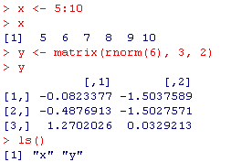
Why do we care about external data?
Computer Memory
R Workspace “Objects”
Database
Input
Files
OutputFiles

Slide 4
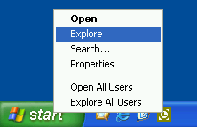
Working With Files
Windows Explorer
Learn to use “Windows Explorer” to find and manipulate folders and files
(much better than starting with “My Computer”)
By default Windows “hides” much useful information about files
To start Windows Explorer, right click on “Start” button:

Slide 5
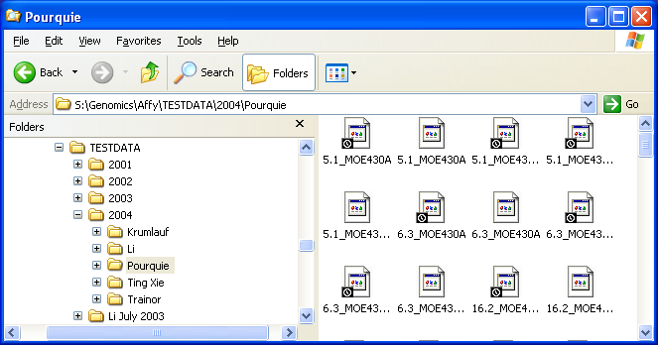
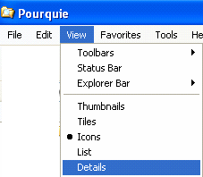
Working With Files
Windows Explorer
Icon view not very useful
Use: View | “Details”

Slide 6
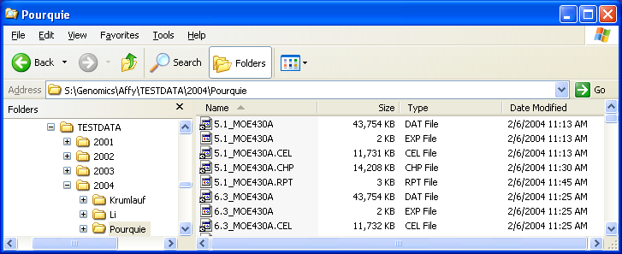
Working With Files
Windows Explorer
Microsoft is still hiding information using “Details.”
Files really DO NOT have the same name as shown above.
Select: Tools | Folder Options | View

Slide 7
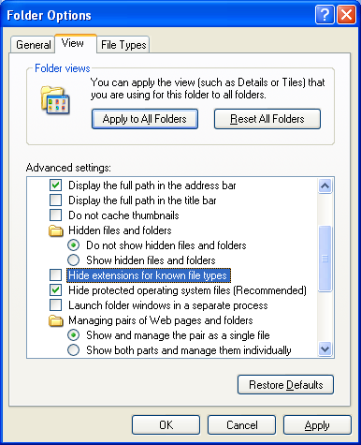
Working With Files
Windows Explorer
Uncheck

Slide 8
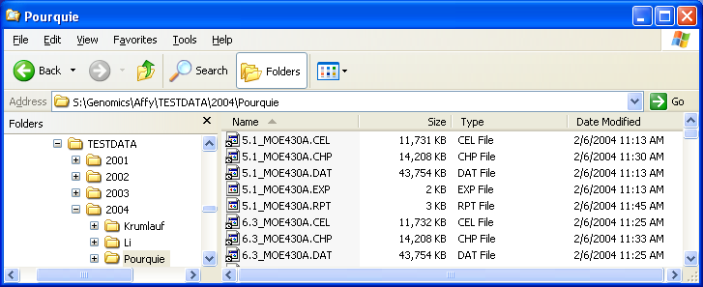
Working With Files
Windows Explorer
Important details about files:
Exact path and filename, including extension
Size of File
Dates/Times
Windows Explorer: Find, Search, Copy, Move, …, files

Slide 9
Kinds of files
What is a file?
What is in my data file?
How can I tell what kind of file I have?
Do I have a “text” file? Is it ASCII?
Is my file tab-delimited, or comma-separated values (CSV)?
Can I trust what Windows tells me about a file?
Many hours can be lost trying to process a file if contents are not understood

Slide 10
What is a file?
Ordered set of bytes (French: “octet”)
Each byte is an 8-bit number from
0 to 255 (00 to FF in hex)
Each byte has 256 possible values
Structure and contents of bytes in a file is different for each kind of file

Slide 11
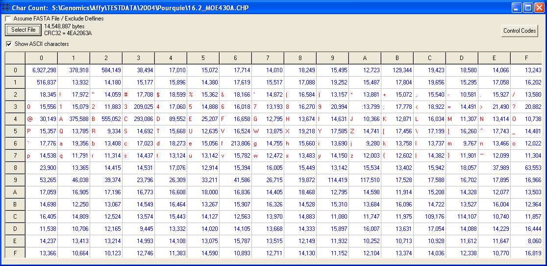
What is in my data file?
CharCount Utility Program
Affymetrix CHP File
Frequency Counts by “Character” in File
Unprintable “Control” Codes
“Printable” Characters
ASCII = American Standard Code for Information Interchange
Affymetrix CHP and DAT files are “binary” files – use all 256 possible byte values

Slide 12
What is in my data file?
CharCount utility gives frequency statistics on the contents of any file
File statistics can be used to infer the kind of file (e.g., binary, text, tab-delimited, CSV, …) instead of guessing
File statistics can be used to spot problems
CharCount can be freely copied from
U:\efg\tools\CharCount.EXE
(should work on any PC; a UNIX version, charcnt, also exists)

Slide 13
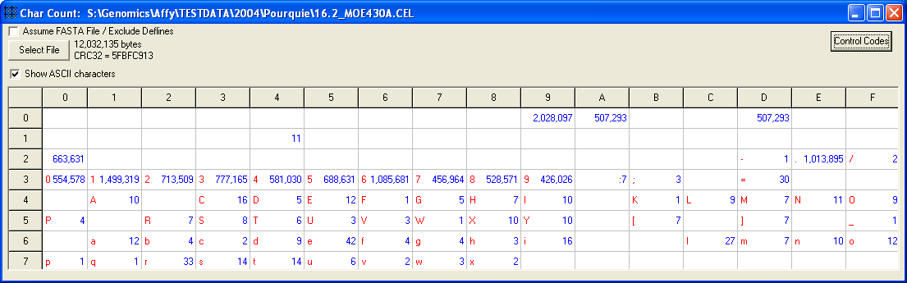
What is in my data file?
Affymetrix CEL File
09 = Tab
0A = Line Feed
0D = Carriage Return
“Control” Codes
Unusual control codes can cause problems in some programs
20 = blank
“Printable” Characters
Many tabs imply file may be tab delimited
“paired” Line Feed (LF) & Carriage Return (CR)
line endings counts imply file is from a Windows PC
(PC = CR+LF; Linux/UNIX = LF; Apple = CR)
CEL files are “ASCII text” with a few control characters

Slide 14
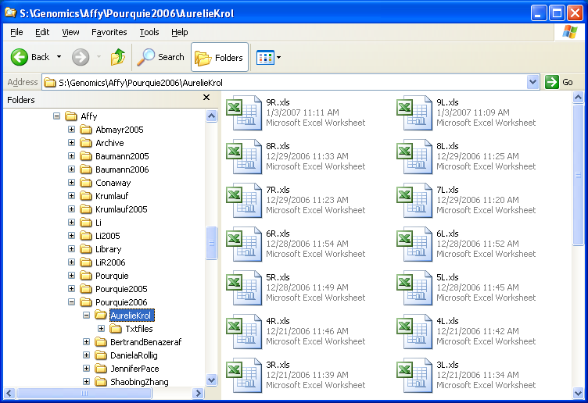
What is in my data file?
Affymetrix XLS File at Stowers
Affymetrix XLS files appear to be Excel Worksheets

Slide 15
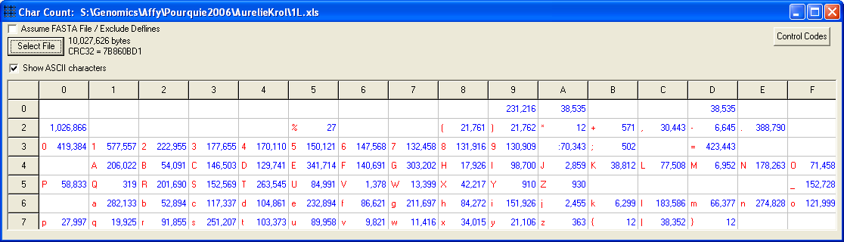
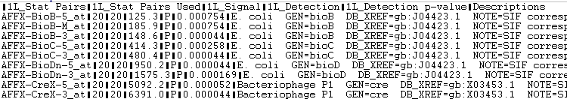
What is in my data file?
Affymetrix XLS File at Stowers
09 = Tab
0A = Line Feed
0D = Carriage Return
“Control” Codes
“Printable” Characters
Tab
Affymetrix XLS Files at Stowers are tab-delimited text files. Opened by Excel.

Slide 16
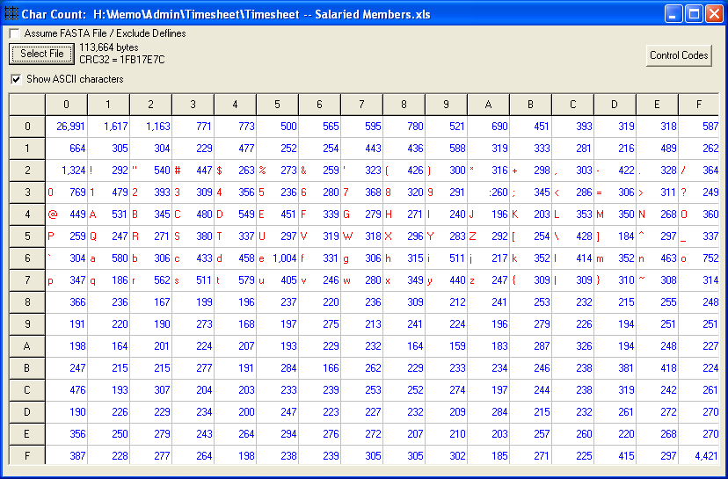
What is in my data file?
Excel XLS File
“Printable” Characters
Excel files are binary files and cannot be ready by most programs.

Slide 17
What is in my data file?
Affymetrix XLS File at Stowers
Affymetrix XLS files at Stowers are not TRUE Excel files
Affymetrix XLS files at Stowers are tab-delimited, ASCII text files!
Windows and Excel know how to open the files even though they are not Excel files (“luck”? “magic”? “design”?)

Slide 18
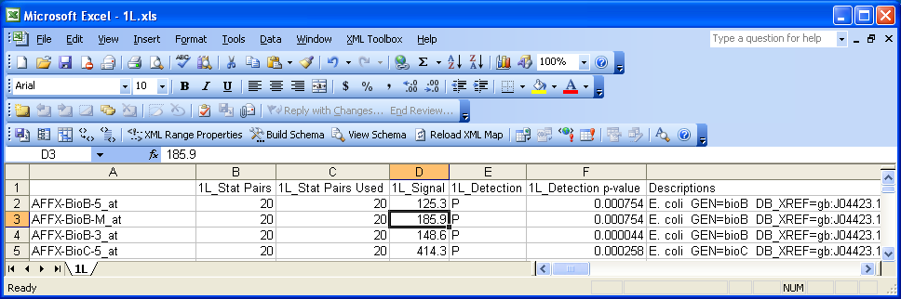
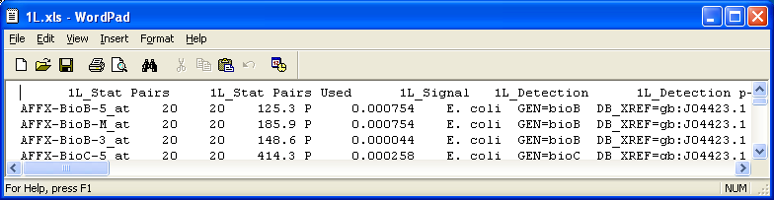
Different Views of Same File
Affymetrix XLS File at Stowers
Excel
WordPad
Tab
Special
Editor

Slide 19
Comments about Files
Windows Explorer is a good tool to find/manipulate folders and files.
Windows uses “Extensions” to define the kind of file, e.g., .txt, .csv, .xls, .doc
Windows associates certain programs with a particular kind of file (“file association”)
Windows file associations may not be universal or “correct” (can be reset)
Similar programs can “battle” over the same file association (e.g., .TXT, .HTM)
May need to know more about a file than what Windows exposes
Apple computers and UNIX/Linux computers do use Windows’ file associations or extensions

Slide 20
Data Structures: R “objects”
Vector
Matrix
List
Data Frame
Others later (e.g., factors)

Slide 21
Data Structure: Vector
The type of each element is the same
> n <- 5:10
> n
[1] 5 6 7 8 9 10
> length(n)
[1] 6
> names(n) <- c("a", "b", "c", "d", "e", "f")
> n
a b c d e f
5 6 7 8 9 10
> n[2]
b
6
> n[2:4]
b c d
6 7 8
> n[ c(1,3,5) ]
a c e
5 7 9
> n["d"] “hash” lookup
d
8
> n[ c("a", "e", "f") ]
a e f
5 9 10
> n[-2]
a c d e f
5 7 8 9 10
> n[-2:-4]
a e f
5 9 10
> n[ -c(1,3,5) ]
b d f
6 8 10
Subscript operator help: ?"["

Slide 22
Data Structure: Vector
> set.seed(19) Reproducible ”random” numbers
> x <- rnorm(10)
> x
[1] -1.1894537 0.3885812 -0.3443333 -0.5478961 0.9806622 -0.2366460
[7] 0.8097397 -0.7447795 -0.2597870 -0.1830838
> x > 0
[1] FALSE TRUE FALSE FALSE TRUE FALSE TRUE FALSE FALSE FALSE
> x[x > 0]
[1] 0.3885812 0.9806622 0.8097397
> which(x > 0)
[1] 2 5 7
> x > 0.3 & x < 0.9
[1] FALSE TRUE FALSE FALSE FALSE FALSE TRUE FALSE FALSE FALSE
> x[ x > 0.3 & x < 0.9 ]
[1] 0.3885812 0.8097397
> x < -0.8 | x > 0.8
[1] TRUE FALSE FALSE FALSE TRUE FALSE TRUE FALSE FALSE FALSE
> x[ x < -0.8 | x > 0.8 ]
[1] -1.1894537 0.9806622 0.8097397
greater than
and
or

Slide 23
Data Structure: Vector
> x
[1] -1.1894537 0.3885812 -0.3443333 -0.5478961 0.9806622 -0.2366460
[7] 0.8097397 -0.7447795 -0.2597870 -0.1830838
> options(digits=10)
> x
[1] -1.1894537453 0.3885812296 -0.3443333492 -0.5478961384 0.9806622158
[6] -0.2366460073 0.8097397043 -0.7447795287 -0.2597870131 -0.1830838304
> x == 0.3885812 Be careful with floating-point equality comparisons
[1] FALSE FALSE FALSE FALSE FALSE FALSE FALSE FALSE FALSE FALSE
> abs(x - 0.3885812) < 1E-7 1.00E-7 = 1.00 x 10⁻⁷
[1] FALSE TRUE FALSE FALSE FALSE FALSE FALSE FALSE FALSE FALSE
> x[ abs(x - 0.3885812) < 1E-7 ] always use ”fuzzy” equality test
[1] 0.3885812296

Slide 24
Data Structure: Matrix
> m <- matrix(1:6, 2, 3)
> dim(m)
[1] 2 3
> colnames(m) <- c("a", "b", "c")
> rownames(m) <- c("Gene1", "Gene2")
> m
a b c
Gene1 1 3 5
Gene2 2 4 6
> m[2, c(1,3)]
a c
2 6
> m["Gene2", c("a", "c")]
a c
2 6
> as.vector(m)
[1] 1 4 2 5 3 6
The type of each element is the same

Slide 25
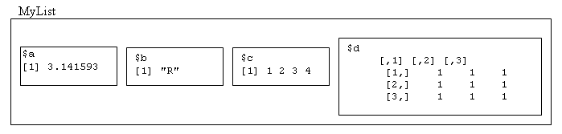
Data Structure: List
> MyList <- list(a=pi, b="R", c=1:4, d=matrix(1,nrow=3,ncol=3))
> MyList
$a
[1] 3.141593
$b
[1] "R"
$c
[1] 1 2 3 4
$d
[,1] [,2] [,3]
[1,] 1 1 1
[2,] 1 1 1
[3,] 1 1 1
A list is an ordered collection of components. The type of the components can vary.

Slide 26
Data Structure: List
> names(MyList)
[1] "a" "b" "c" "d“
> MyList$a
[1] 3.141593
> MyList[[1]]
[1] 3.141593
> MyList[["a"]]
[1] 3.141593
> MyList$d[1:2,1:3]
[,1] [,2] [,3]
[1,] 1 1 1
[2,] 1 1 1

Slide 27
Data Structure: List
> MyList[c(1,3)]
$a
[1] 3.141593
$c
[1] 1 2 3 4
> unlist( MyList[c(1,3)] )
a c1 c2 c3 c4
3.141593 1.000000 2.000000 3.000000 4.000000

Slide 28
Data Structure: Data Frame
A data.frame is a list that acts a lot like a matrix.
> d <- data.frame(gene=c("axin", "dkk1", "hes"), signal=c(2.5, 3.0, 2.2),
special=c(TRUE, FALSE, FALSE) )
> d
gene signal special
1 axin 2.5 TRUE
2 dkk1 3.0 FALSE
3 hes 2.2 FALSE
> d[1:3, 1:2] rows 1 to 3, columns 1 to 2
gene signal
1 axin 2.5
2 dkk1 3.0
3 hes 2.2
> d[3,] row 3
gene signal special
3 hes 2.2 FALSE
> d[,2] column 2
[1] 2.5 3.0 2.2

Slide 29
Data Structure: Data Frame
> d[,2] column 2
[1] 2.5 3.0 2.2
> d$signal
[1] 2.5 3.0 2.2
> d[["signal"]]
[1] 2.5 3.0 2.2
> d[d$signal > 2.25,]
gene signal special
1 axin 2.5 TRUE
2 dkk1 3.0 FALSE
> d[d$signal > 2.25 & d$special == TRUE,]
gene signal special
1 axin 2.5 TRUE
> d[d$signal > 2.25 & d$special,]
gene signal special
1 axin 2.5 TRUE

Slide 30
Data Structure: Data Frame
> colnames(d) column names
[1] "gene" "signal" "special“
> rownames(d)
[1] "1" "2" "3"
> rownames(d) <- paste("gene", 1:3, sep="")
> d
gene signal special
gene1 axin 2.5 TRUE
gene2 dkk1 3.0 FALSE
gene3 hes 2.2 FALSE
> d[,-3]
gene signal
gene1 axin 2.5
gene2 dkk1 3.0
gene3 hes 2.2
> dim(d) dimensions
[1] 3 3
> ncol(d) number of columns
[1] 3
> nrow(d) number of rows
[1] 3

Slide 31
Data Structures: R “objects”
Vector
Matrix
List
Data Frame
Others later (e.g., factors)

Slide 32
Loading Data into R: ASCII Text Files
read.table general
read.delim headers
tab delimited
read.csv headers
comma-separated values
?read.table

Slide 33
Loading Data into R: TXT Files
> # Method 1. Absolute filename
> # not Excel file -- tab-delimited text
> left <- read.delim("S:/Genomics/Affy/Pourquie2006/AurelieKrol/1L.xls",
as.is=TRUE)
> dim(left)
[1] 38535 7
Avoid “factors” for now.
rows
columns
Call data.frame “left”.
> # Method 2. Relative to working directory
> getwd() # look at working directory
[1] "U:/efg/Lab/R"
> setwd("S:/Genomics/Affy/Pourquie2006/AurelieKrol/")
> getwd() # verify working directory was changed
[1] "S:/Genomics/Affy/Pourquie2006/AurelieKrol"
> # not Excel file -- tab-delimited text
> left <- read.delim("1L.xls", as.is=TRUE)
> dim(left)
[1] 38535 7

Slide 34
data.frame left
> class(left)
[1] "data.frame"
> typeof(left)
[1] "list"
> colnames(left)
[1] "X" "X1L_Stat.Pairs" "X1L_Stat.Pairs.Used"
[4] "X1L_Signal" "X1L_Detection" "X1L_Detection.p.value"
[7] "Descriptions"
Raw Data:
R will change column names to conform with its conventions.
Can change names to what we want (within conventions):
> colnames(left) <- c("AffyID", "StatPairs.1L", "StatPairsUsed.1L",
+ "Signal.1L", "Detection.1L", "pvalue.1L", "Descriptions")
When possible, plan to use names “accepted” by R, Excel, and other programs

Slide 35
data.frame left
Use “source” to execute R statements from a file
> source("U:/efg/R/ExternalData/LoadL.R", echo=TRUE)
# efg, 24 Jan 2007
# Read tab-delimited text file (this .xls is NOT a true Excel file)
left <- read.delim("S:/Genomics/Affy/Pourquie2006/AurelieKrol/1L.xls",
as.is=TRUE)
# Info about "left" data.frame
dim(left)
class(left)
typeof(left)
colnames(left)
# Change column names of data.frame
colnames(left) <- c("AffyID", "StatPairs.1L", "StatPairsUsed.1L",
"Signal.1L", "Detection.1L", "pvalue.1L",
"Descriptions")
Use forward slashes

Slide 36
data.frame left
Can index data.frame like matrix
first 5 rows
first 6 columns
> left[1:5,1:6]
AffyID StatPairs.1L StatPairsUsed.1L Signal.1L Detection.1L pvalue.1L
1 AFFX-BioB-5_at 20 20 125.3 P 0.000754
2 AFFX-BioB-M_at 20 20 185.9 P 0.000754
3 AFFX-BioB-3_at 20 20 148.6 P 0.000044
4 AFFX-BioC-5_at 20 20 414.3 P 0.000258
5 AFFX-BioC-3_at 20 20 480.4 P 0.000044
> left[1,7]
[1] E. coli GEN=bioB DB_XREF=gb:J04423.1 NOTE=SIF corresponding to nucleotides 2032-2$
Row 1, Column 7

Slide 37
data.frame left
Can use column names as variables: dataframe$column
> colnames(left)
[1] "AffyID" "StatPairs.1L" "StatPairsUsed.1L" "Signal.1L"
[5] "Detection.1L" "pvalue.1L" "Descriptions"
> class(left$AffyID)
[1] "character"
> typeof(left$AffyID)
[1] "character“
> class(left$Signal.1L)
[1] "numeric"
> typeof(left$Signal.1L)
[1] "double"
Let’s look at what info can be extracted from each column in data.frame

Slide 38
data.frame left
left$AffyID
> length(left$AffyID)
[1] 38535
> # First five
> 1:5
[1] 1 2 3 4 5
> left$AffyID[1:5]
[1] "AFFX-BioB-5_at" "AFFX-BioB-M_at" "AFFX-BioB-3_at" "AFFX-BioC-5_at"
[5] "AFFX-BioC-3_at"
> # Last five
> (nrow(left)-4):nrow(left)
[1] 38531 38532 38533 38534 38535
> left$AffyID[ (nrow(left)-4):nrow(left) ]
[1] "Gga.15522.1.S1_x_at" "Gga.9098.1.S1_at" "Gga.9184.2.S1_x_at"
[4] "Gga.15378.2.S1_x_at" "Gga.9439.1.S1_at"
> # First five and last five
> ( FirstLast5 <- c(1:5, (nrow(left)-4):nrow(left)) )
[1] 1 2 3 4 5 38531 38532 38533 38534 38535
> left$AffyID[FirstLast5]
[1] "AFFX-BioB-5_at" "AFFX-BioB-M_at" "AFFX-BioB-3_at"
[4] "AFFX-BioC-5_at" "AFFX-BioC-3_at" "Gga.15522.1.S1_x_at"
[7] "Gga.9098.1.S1_at" "Gga.9184.2.S1_x_at" "Gga.15378.2.S1_x_at"
[10] "Gga.9439.1.S1_at"

Slide 39
data.frame left
left$AffyID
> left$AffyID[1:5] == "AFFX-BioC-3_at"
[1] FALSE FALSE FALSE FALSE TRUE
> which( left$AffyID[1:5] == "AFFX-BioC-3_at" )
[1] 5
> which(left$AffyID == "Gga.2951.1.S1_at")
[1] 1051
> which(left$AffyID %in% c("Gga.2951.1.S1_at","Gga.3587.1.S1_s_at") )
[1] 1051 1099
> length( unique(left$AffyID) )
[1] 38535
> length(left$AffyID) == length( unique(left$AffyID) )
[1] TRUE
Since all AffyIDs are unique, we could use AffyIDs as
rownames when reading the data.

Slide 40
data.frame left
Using Affy ProbeIDs as data.frame rownames
> left <- read.delim("S:/Genomics/Affy/Pourquie2006/AurelieKrol/1L.xls",
row.names=1,
as.is=TRUE)
> dim(left)
[1] 38535 6 one less column
> left[c("Gga.2951.1.S1_at","Gga.3587.1.S1_s_at"), 1:5]
X1L_Stat.Pairs X1L_Stat.Pairs.Used X1L_Signal X1L_Detection X1L_Detection.p.value
Gga.2951.1.S1_at 11 11 2725.8 P 0.000244
Gga.3587.1.S1_s_at 11 11 0.8 A 0.725830
Use Affy ProbeIDs as hash keys

Slide 41
data.frame left
left$StatPairs.1L and left$StatPairsUsed.1L
> left[1:3,1:6]
AffyID StatPairs.1L StatPairsUsed.1L Signal.1L Detection.1L pvalue.1L
1 AFFX-BioB-5_at 20 20 125.3 P 0.000754
2 AFFX-BioB-M_at 20 20 185.9 P 0.000754
3 AFFX-BioB-3_at 20 20 148.6 P 0.000044
> summary(left$StatPairs.1L)
Min. 1st Qu. Median Mean 3rd Qu. Max.
10.00 11.00 11.00 11.01 11.00 20.00
> summary(left$StatPairsUsed.1L)
Min. 1st Qu. Median Mean 3rd Qu. Max.
10.00 11.00 11.00 11.01 11.00 20.00

Slide 42
data.frame left
left$StatPairs.1L and left$StatPairsUsed.1L
> left[1:3,1:6]
AffyID StatPairs.1L StatPairsUsed.1L Signal.1L Detection.1L pvalue.1L
1 AFFX-BioB-5_at 20 20 125.3 P 0.000754
2 AFFX-BioB-M_at 20 20 185.9 P 0.000754
3 AFFX-BioB-3_at 20 20 148.6 P 0.000044
> table(left$StatPairs.1L)
10 11 20
4 38507 24
> table(left$StatPairsUsed.1L)
10 11 20
4 38507 24

Slide 43
data.frame left
left$StatPairs.1L and left$StatPairsUsed.1L
> left[1:3,1:6]
AffyID StatPairs.1L StatPairsUsed.1L Signal.1L Detection.1L pvalue.1L
1 AFFX-BioB-5_at 20 20 125.3 P 0.000754
2 AFFX-BioB-M_at 20 20 185.9 P 0.000754
3 AFFX-BioB-3_at 20 20 148.6 P 0.000044
> table(left$StatPairs.1L, left$StatPairsUsed.1L)
10 11 20
10 4 0 0
11 0 38507 0
20 0 0 24
> table(left[,2:3])
StatPairsUsed.1L
StatPairs.1L 10 11 20
10 4 0 0
11 0 38507 0
20 0 0 24

Slide 44
data.frame left
Left$Signal.1L
> left[1:3,1:6]
AffyID StatPairs.1L StatPairsUsed.1L Signal.1L Detection.1L pvalue.1L
1 AFFX-BioB-5_at 20 20 125.3 P 0.000754
2 AFFX-BioB-M_at 20 20 185.9 P 0.000754
3 AFFX-BioB-3_at 20 20 148.6 P 0.000044
> summary(left$Signal.1L)
Min. 1st Qu. Median Mean 3rd Qu. Max.
0.0 6.1 21.5 234.0 94.3 12310.0
> summary( log2(left$Signal.1L) )
Min. 1st Qu. Median Mean 3rd Qu. Max.
-Inf 2.609 4.426 -Inf 6.559 13.590
> summary( log2(left$Signal.1L[left$Signal.1L > 0]) )
Min. 1st Qu. Median Mean 3rd Qu. Max.
-3.322 2.609 4.426 4.726 6.559 13.590

Slide 45
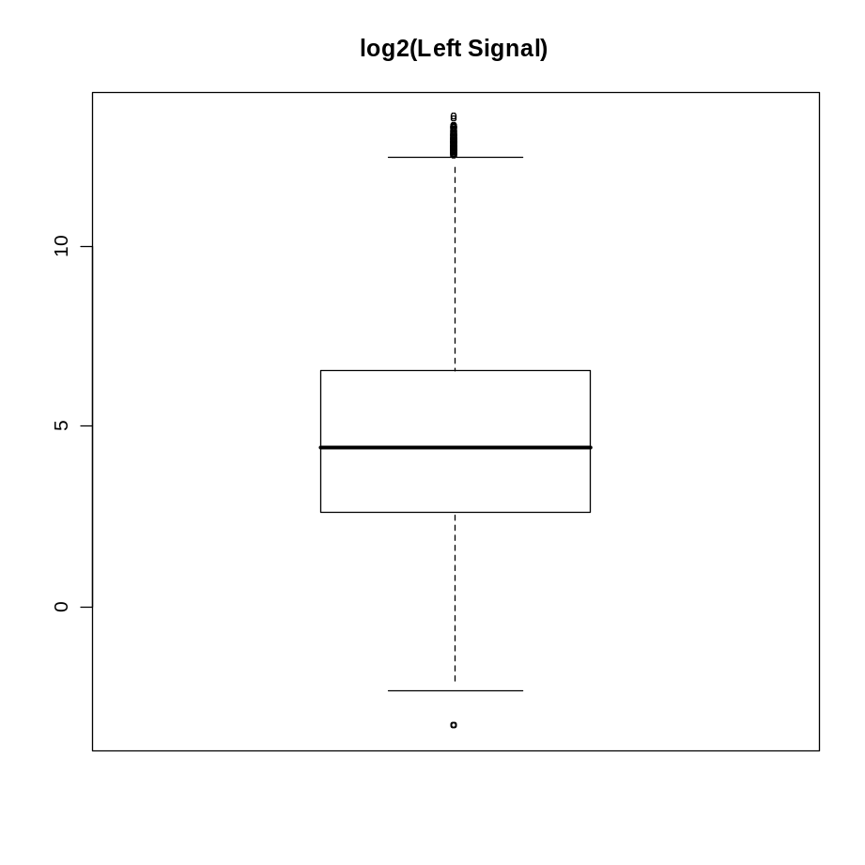
data.frame left
Left$Signal.1L
> boxplot( log2(left$Signal.1L), main="log2(Left Signal)")

Slide 46
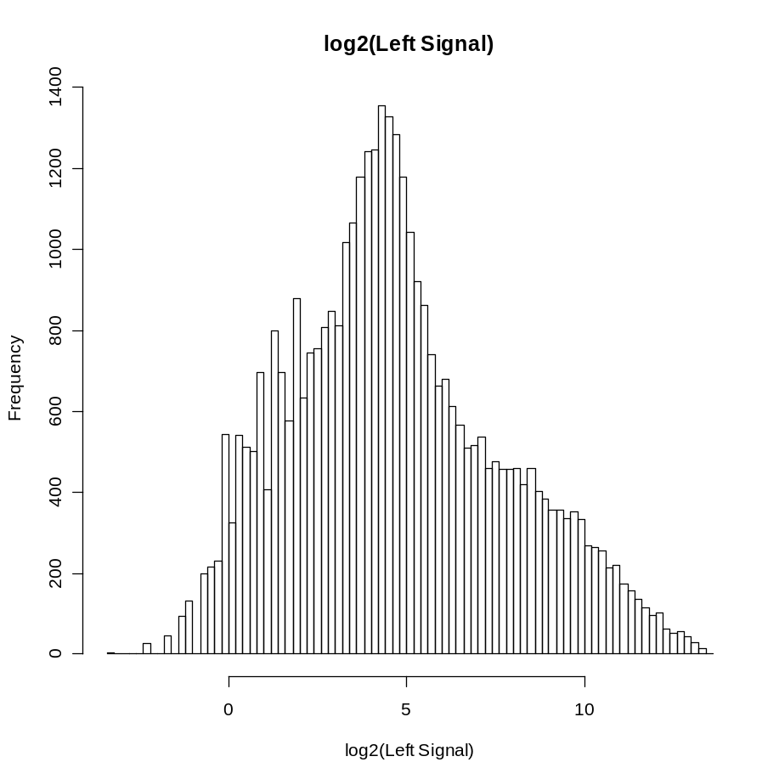
data.frame left
Left$Signal.1L
> xlabel <- "log2(Left Signal)"
> hist( log2(left$Signal.1L), main=xlabel, xlab=xlabel, breaks=100)

Slide 47
data.frame left
left$Detection.1L
> left[1:3,1:6]
AffyID StatPairs.1L StatPairsUsed.1L Signal.1L Detection.1L pvalue.1L
1 AFFX-BioB-5_at 20 20 125.3 P 0.000754
2 AFFX-BioB-M_at 20 20 185.9 P 0.000754
3 AFFX-BioB-3_at 20 20 148.6 P 0.000044
> table(left$Detection.1L)
A M P
23932 537 14066
> PresentOrMissing <- left$Detection.1L %in% c("M", "P")
> length(PresentOrMissing)
[1] 38535
> sum(PresentOrMissing)
[1] 14603
> leftPM <- left[PresentOrMissing,]
> dim(leftPM)
[1] 14603 7

Slide 48
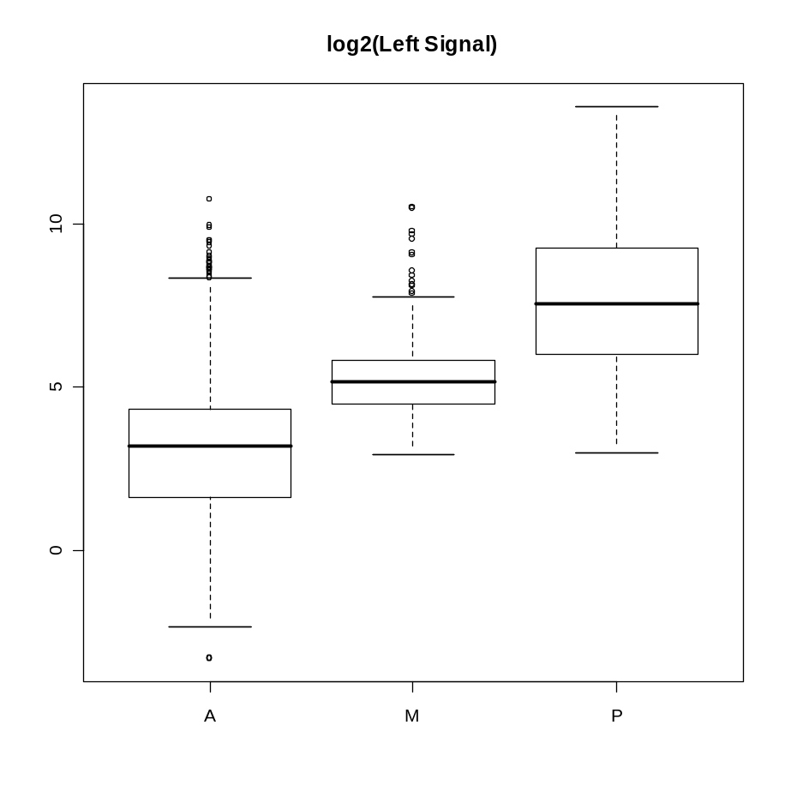
data.frame left
left$Detection.1L
> boxplot( log2(left$Signal.1L) ~ left$Detection.1L ,
main="log2(Left Signal)")

Slide 49
data.frame left
left$pvalue.1L
> left[1:3,1:6]
AffyID StatPairs.1L StatPairsUsed.1L Signal.1L Detection.1L pvalue.1L
1 AFFX-BioB-5_at 20 20 125.3 P 0.000754
2 AFFX-BioB-M_at 20 20 185.9 P 0.000754
3 AFFX-BioB-3_at 20 20 148.6 P 0.000044
> summary(left$pvalue.1L)
Min. 1st Qu. Median Mean 3rd Qu. Max.
0.000044 0.005859 0.194600 0.312800 0.567600 0.999800

Slide 50
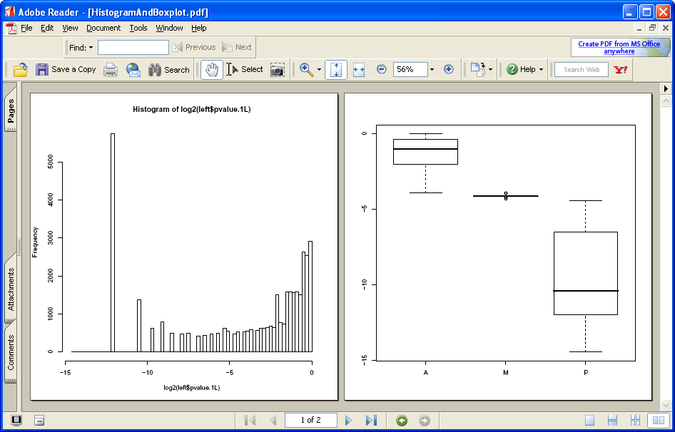
data.frame left
left$pvalue.1L
> pdf("HistogramAndBoxplot.pdf", width=8, height=8)
> hist(log2(left$pvalue.1L), breaks=100)
> boxplot(log2(left$pvalue.1L) ~ left$Detection.1L, breaks=100)
> dev.off() # close PDF file

Slide 51
Loading Data into R: TXT Files
Summary: Loaded tab-delimited file, 1L.xls, into data.frame called “left” and analyzed various data fields.
Next: Let’s load tab-delimited file, 1R.xls, into data.frame called “right” and make exploratory comparisons between gene expression on left and right sides of a somite during chick embryogenesis.

Slide 52
data.frames left and right
Use “source” to execute R statements from a file
> source("U:/efg/R/ExternalData/LoadSomite1.R", echo=TRUE)
# efg, 24 Jan 2007
# Common directory for "left" and "right" files
data.directory <- "S:/Genomics/Affy/Pourquie2006/AurelieKrol/"
# Read "left" and "right" tab-delimited files and "fix" the column names
left <- read.delim( paste(data.directory, "1L.xls", sep=""), as.is=TRUE)
colnames(left) <- c("AffyID", "StatPairs.1L", "StatPairsUsed.1L",
"Signal.1L", "Detection.1L", "pvalue.1L",
"Descriptions")
right <- read.delim( paste(data.directory, "1R.xls", sep=""), as.is=TRUE)
colnames(right) <- c("AffyID", "StatPairs.1R", "StatPairsUsed.1R",
"Signal.1R", "Detection.1R", "pvalue.1R",
"Descriptions")
# Defensive (paranoid?) programming:
# Dimensions of both data.frames should match Using correct files?
stopifnot( dim(left) == dim(right) )
# ProbeIDs should match
stopifnot(left$AffyID == right$AffyID)
# Descriptions should match
stopifnot( left$Descriptions == right$Descriptions )
Use forward slashes

Slide 53
How to combine left and right data.frames?
Could analyze data directly using
left and right data.frames
Often easier to combine data into a single data.frame for analysis
Two approaches:
  cbind (“column bind”)
  merge
Need unique column names in result

Slide 54
How to combine left and right data.frames?
cbind (Column Bind)
Use cbind if your data.frames “match” …
By number of rows and order of IDs
    stopifnot(left$AffyID == right$AffyID)
left
right
ID
Fields…
Desc
ID
Fields…
Desc
> colnames(left)
[1] "AffyID" "StatPairs.1L" "StatPairsUsed.1L"
[4] "Signal.1L" "Detection.1L" "pvalue.1L"
[7] "Descriptions"
> colnames(right)
[1] "AffyID" "StatPairs.1R" "StatPairsUsed.1R"
[4] "Signal.1R" "Detection.1R" "pvalue.1R"
[7] "Descriptions"

Slide 55
How to combine left and right data.frames?
cbind (Column Bind)
left[,-ncol(left)]
right[,-1]
left
right
ID
Fields…
Desc
ID
Fields…
Desc
> colnames(left)
[1] "AffyID" "StatPairs.1L" "StatPairsUsed.1L"
[4] "Signal.1L" "Detection.1L" "pvalue.1L"
[7] "Descriptions"
> colnames(right)
[1] "AffyID" "StatPairs.1R" "StatPairsUsed.1R"
[4] "Signal.1R" "Detection.1R" "pvalue.1R"
[7] "Descriptions"

Slide 56
How to combine left and right data.frames?
cbind (Column Bind)
somite <- cbind(left[,-ncol(left)], right[, -1])
somite
ID
Fields…
Desc
> dim(somite)
[1] 38535 12
> colnames(somite)
[1] "AffyID" "StatPairs.1L" "StatPairsUsed.1L" "Signal.1L"
[5] "Detection.1L" "pvalue.1L" "StatPairs.1R" "StatPairsUsed.1R"
[9] "Signal.1R" "Detection.1R" "pvalue.1R" "Descriptions"

Slide 57
How to combine left and right data.frames?
Alternative method: merge
merge is a more generic method to connect data.frames. Similar to a database “join”
merge doesn’t require data.frames to be the same size
merge, while powerful, can silently connect data in unintended ways, especially if IDs are not in the same order
Usually a good idea to use data.frames sorted by the ID field.

Slide 58
How to combine left and right data.frames?
Alternative method: merge
> somite.m1 <- merge(left, right)
> dim(somite.m1)
[1] 38535 12
> colnames(somite.m1)
[1] "AffyID" "Descriptions" "StatPairs.1L"
[4] "StatPairsUsed.1L" "Signal.1L" "Detection.1L"
[7] "pvalue.1L" "StatPairs.1R" "StatPairsUsed.1R"
[10] "Signal.1R" "Detection.1R" "pvalue.1R"

Slide 59
How to combine left and right data.frames?
Alternative method: merge
> somite.m1 <- merge(left, right)
> dim(somite.m1)
[1] 38535 12
> colnames(somite.m1)
[1] "AffyID" "Descriptions" "StatPairs.1L"
[4] "StatPairsUsed.1L" "Signal.1L" "Detection.1L"
[7] "pvalue.1L" "StatPairs.1R" "StatPairsUsed.1R"
[10] "Signal.1R" "Detection.1R" "pvalue.1R"
> somite.m2 <- merge(left, right, by.x="AffyID", by.y="AffyID")
> dim(somite.m2)
[1] 38535 13
> colnames(somite.m2)
[1] "AffyID" "StatPairs.1L" "StatPairsUsed.1L" "Signal.1L"
[5] "Detection.1L" "pvalue.1L" "Descriptions.x" "StatPairs.1R"
[9] "StatPairsUsed.1R" "Signal.1R" "Detection.1R" "pvalue.1R"
[13] "Descriptions.y"

Slide 60
How to combine left and right data.frames?
How can we save somite data.frame to new file?
# Write Tab-delimited file:
# While R can read a tab-delimited file with read.delim,
# R does not provide a write.delim file: use more generic write.table
> write.table(somite, file="somite.txt", sep="\t", row.names=FALSE)
# Write Comma-separated value (CSV) file:
# R has both write.csv and read.csv functions
# write.csv uses "." for the decimal point and a comma for the separator.
> write.csv(somite, file="somite.csv", row.names=FALSE)
> write.csv2(somite, file="somite.csv2", row.names=FALSE)
Tab
write.csv2 uses a comma for the decimal point and a semicolon for the separator, the Excel convention for CSV files in some Western European locales.

Slide 61
Exploratory Analysis of somite data.frame
Create new columns in data.frame for analysis
> colnames(somite)
[1] "AffyID" "StatPairs.1L" "StatPairsUsed.1L"
[4] "Signal.1L" "Detection.1L" "pvalue.1L"
[7] "StatPairs.1R" "StatPairsUsed.1R" "Signal.1R"
[10] "Detection.1R" "pvalue.1R" "Descriptions"
# Create new variables for analysis
> somite$fold.change <- somite$Signal.1L / somite$Signal.1R
> somite$log2ratio <- log2(somite$fold.change)
# or
> somite$log2ratio <- log2(somite$Signal.1L) - log2(somite$Signal.1R)
> colnames(somite)
[1] "AffyID" "StatPairs.1L" "StatPairsUsed.1L"
[4] "Signal.1L" "Detection.1L" "pvalue.1L"
[7] "StatPairs.1R" "StatPairsUsed.1R" "Signal.1R"
[10] "Detection.1R" "pvalue.1R" "Descriptions"
[13] "fold.change" "log2ratio"

Slide 62
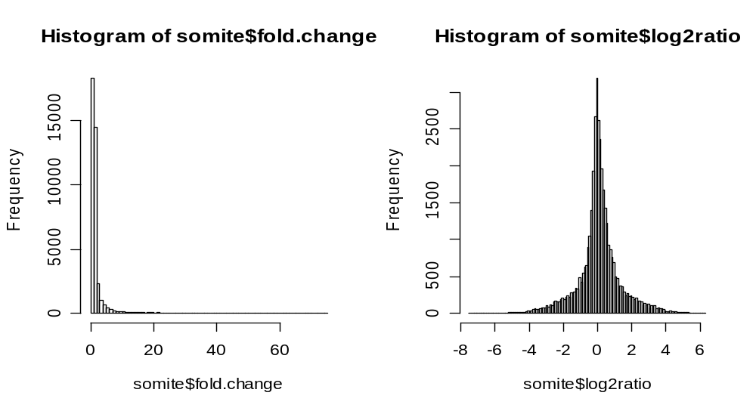
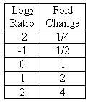
Exploratory Analysis of somite data.frame
Why log ratios instead of fold change in analysis?
> par(mfcol=c(1,2))
> hist(somite$fold.change, breaks=100)
> hist(somite$log2ratio, breaks=100)

Slide 63
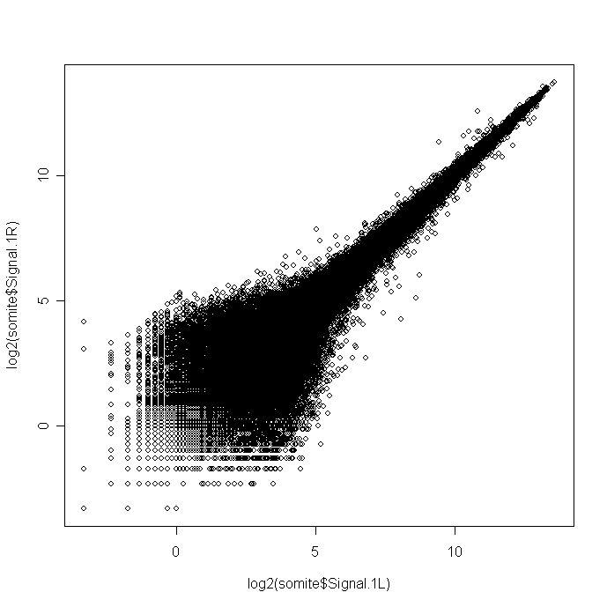
Exploratory Analysis of somite data.frame
Model: log2(Right) = a x Log2(Left) + b
> plot(log2(somite$Signal.1L), log2(somite$Signal.1R))
Pasted as
“bitmap” into
PowerPoint
But what about “p” values associated with each point? Use color to show?

Slide 64

Color
> palette()
[1] "black" "red" "green3" "blue" "cyan" "magenta"
[7] "yellow" "gray"
> length(palette())
[1] 8
> rep(1, length(palette()))
[1] 1 1 1 1 1 1 1 1
> barplot( rep(1, length(palette())), col=palette(),
space=0, border=0, axes=FALSE)

Slide 65
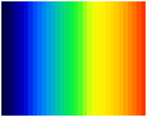
Color
> library(gplots)
> barplot(rep(1,32), col=rich.colors(32), space=0,
border=0, axes=FALSE)

Slide 66
Exploratory Analysis of somite data.frame
Model: log2(Right) = a x Log2(Left) + b
> plot(log2(somite$Signal.1L), log2(somite$Signal.1R))
p=1
p=0
How to associate color with p-values at each point?

Slide 67
Exploratory Analysis of somite data.frame
How to associate color with p-values at each point?
Find worst p-value of left and right.
Map worst p-value to color scheme.
> colnames(somite)
[1] "AffyID" "StatPairs.1L" "StatPairsUsed.1L"
[4] "Signal.1L" "Detection.1L" "pvalue.1L"
[7] "StatPairs.1R" "StatPairsUsed.1R" "Signal.1R"
[10] "Detection.1R" "pvalue.1R" "Descriptions"
[13] "fold.change" "log2ratio“
> somite$pvalue.1L[1:5]
[1] 0.000754 0.000754 0.000044 0.000258 0.000044
> somite$pvalue.1R[1:5]
[1] 0.000754 0.000754 0.000044 0.000060 0.000052
> somite$worst.p <- apply(cbind(somite$pvalue.1L, somite$pvalue.1R),
BY.ROW<-1, max)
> somite$worst.p[1:5]
[1] 0.000754 0.000754 0.000044 0.000258 0.000052

Slide 68
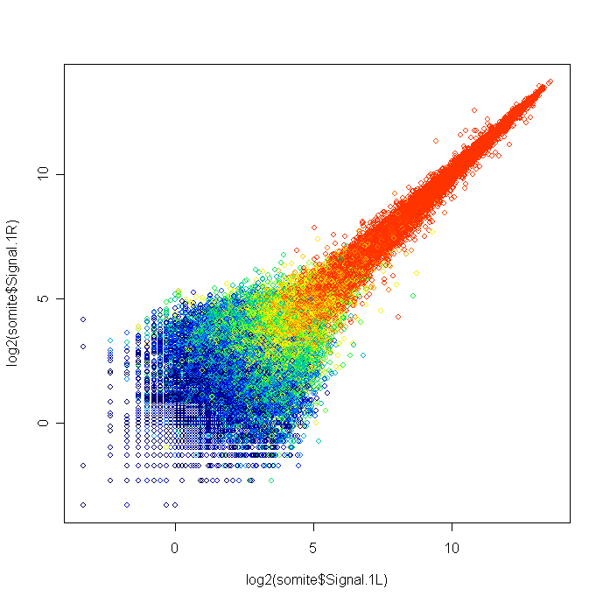
Exploratory Analysis of somite data.frame
Model: log2(Right) = a x Log2(Left) + b
> palette( rev(rich.colors(32)) ) # colors: 1 to 32
> plot(log2(somite$Signal.1L), log2(somite$Signal.1R),
col=1 + 31*somite$worst.p # col values from 1 to 32
p=1
p=0
Restore default palette: palette("default")

Slide 69
Exploratory Analysis of somite data.frame
Exclude Points if Affy “Absent” Call on Either Chip
> colnames(somite)
[1] "AffyID" "StatPairs.1L" "StatPairsUsed.1L"
[4] "Signal.1L" "Detection.1L" "pvalue.1L"
[7] "StatPairs.1R" "StatPairsUsed.1R" "Signal.1R"
[10] "Detection.1R" "pvalue.1R" "Descriptions"
[13] "fold.change" "log2ratio" "worst.p"
> Exclude <- (somite$Detection.1L == "A") | (somite$Detection.1R == "A")
> Exclude[1:5]
[1] FALSE FALSE FALSE FALSE FALSE
> PresentOrMarginal <- !Exclude
> PresentOrMarginal[1:5]
[1] TRUE TRUE TRUE TRUE TRUE
> sum(Exclude)
[1] 25385
> sum(PresentOrMarginal)
[1] 13150
> length(Exclude)
[1] 38535
! is logical “not”

Slide 70
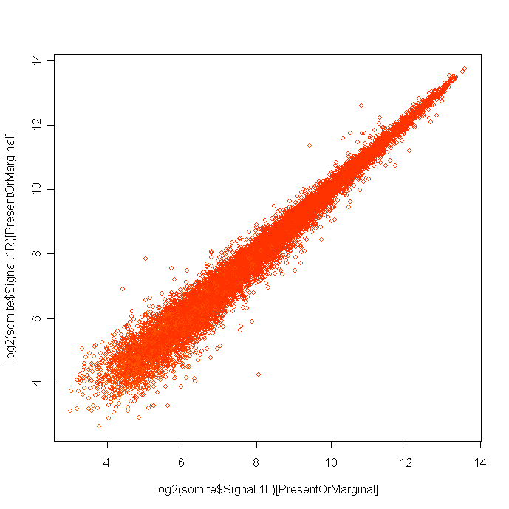
Exploratory Analysis of somite data.frame
Exclude Points if Affy “Absent” Call
> palette( rev(rich.colors(32)) ) # colors: 1 to 32
> plot(log2(somite$Signal.1L)[PresentOrMarginal],
log2(somite$Signal.1R)[PresentOrMarginal],
col=(1 + 31*somite$worst.p)[PresentOrMarginal] )
p=1
p=0

Slide 71
Exploratory Analysis of Subset data.frame PM
Create Subset with only Present or Marginal Probesets
> PM <- somite[PresentOrMarginal,]
> dim(PM)
[1] 13150 15
> colnames(PM)
[1] "AffyID" "StatPairs.1L" "StatPairsUsed.1L"
[4] "Signal.1L" "Detection.1L" "pvalue.1L"
[7] "StatPairs.1R" "StatPairsUsed.1R" "Signal.1R"
[10] "Detection.1R" "pvalue.1R" "Descriptions"
[13] "fold.change" "log2ratio" "worst.p"
> write.csv(PM, file="PresentOrMarginal.csv", row.names=FALSE) # Save

Slide 72
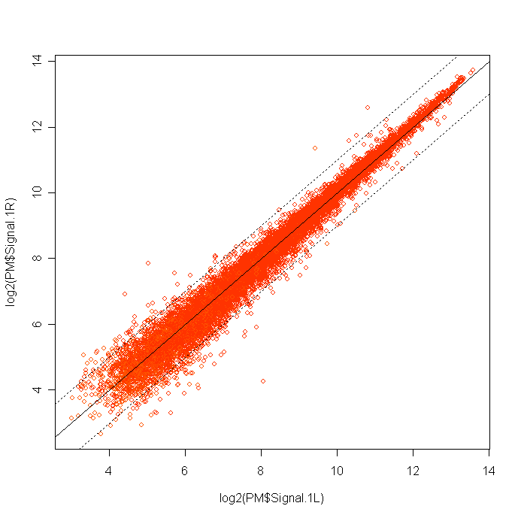
Exploratory Analysis of Subset data.frame PM
> palette( rev(rich.colors(32)) ) # colors: 1 to 32
> plot(log2(PM$Signal.1L), log2(PM$Signal.1R),
col=(1 + 31*PM$worst.p) )
> abline( 0,1)
> abline(-1,1, lty="dotted")
> abline( 1,1, lty="dotted")
> palette("default")

Slide 73
Exploratory Analysis of Subset data.frame PM
Create Exploratory Lists of Up/Down Regulated Probesets
> up2 <- PM$log2ratio >= 1.0
> sum(up2)
[1] 190
> down2 <- PM$log2ratio <= -1.0
> sum(down2)
[1] 68
> palette()
[1] "black" "red" "green3" "blue" "cyan"
[6] "magenta" "yellow" "gray“
> updown.colors <- rep(0, ncol(PM))
> updown.colors[up2] <- 3
> updown.colors[down2] <- 2
> plot(log2(PM$Signal.1L), log2(PM$Signal.1R), col=updown.colors)
> abline( 0,1)
> abline(-1,1, lty="dotted")
> abline( 1,1, lty="dotted")

Slide 74
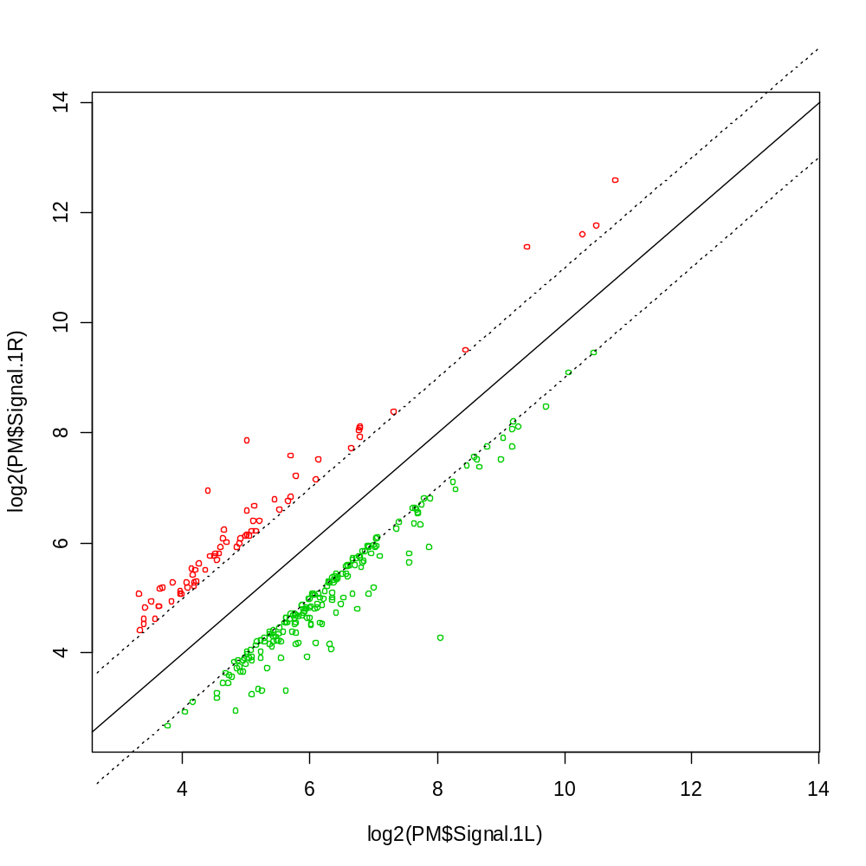
Exploratory Analysis of Subset data.frame PM
Create Exploratory Lists of Up/Down Regulated Probesets

Slide 75
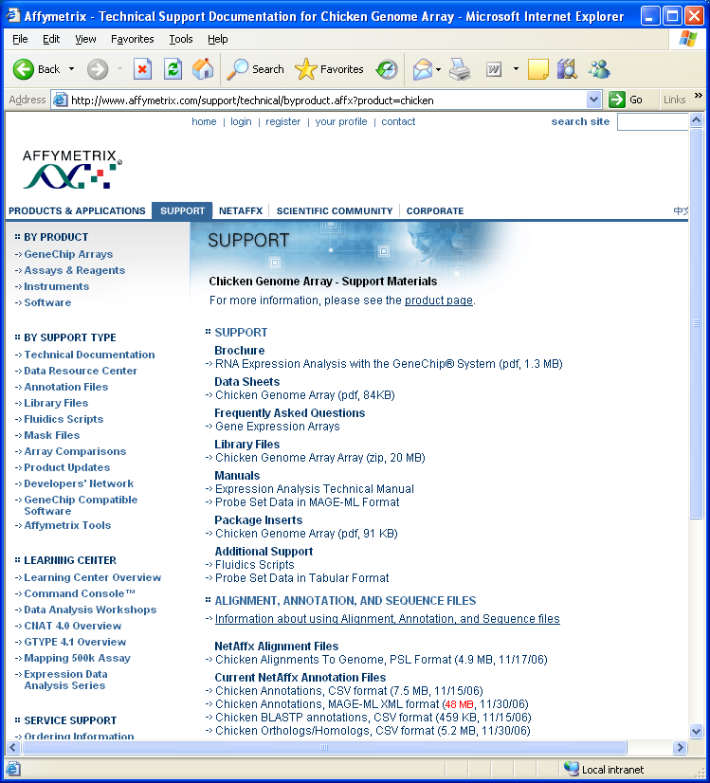
Loading Data into R: CSV Files
http://www.affymetrix.com/support/technical/byproduct.affx?product=chicken

Slide 76
Loading Data into R: CSV Files
http://www.affymetrix.com/support/technical/byproduct.affx?product=chicken
Download ZIP: Chicken.na21.annot.csv.zip
Extract file: Chicken.na21.annot.csv
Analyze contents of this Affy Annotation file:
> source("http://research.stowers-institute.org/efg/ScientificSoftware/Applications/Affy/Annotations/AffyStats.R")
source("http://research.stowers-institute.org/efg/ScientificSoftware/Applications/Affy/Annotations/AffyStats.R")

Slide 77
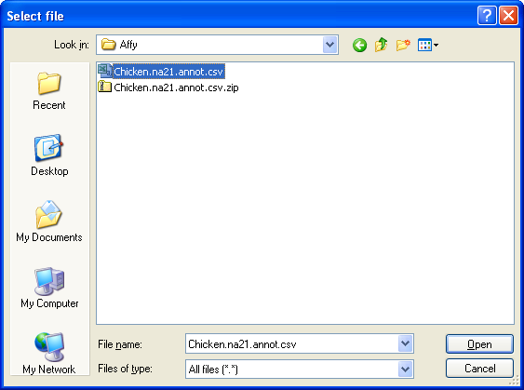
Loading Data into R: CSV Files
Analyze contents of this Affy Annotation .CSV file:

Slide 78
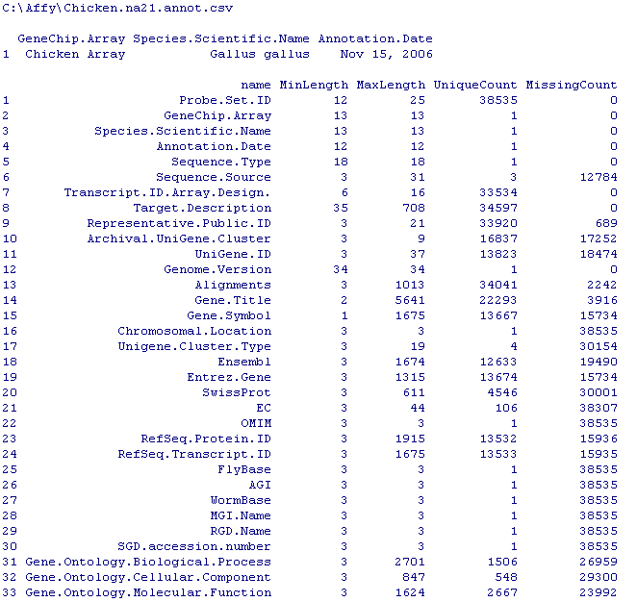
Loading Data into R: CSV Files
Analyze contents of this Affy Annotation .CSV file:

Slide 79
Loading Data into R: CSV Files
Analyze contents of this Affy Annotation .CSV file:
> Affy <- read.csv( file.choose() )
> dim(Affy)
[1] 38535 43
> colnames(Affy)
[1] "Probe.Set.ID" "GeneChip.Array"
[3] "Species.Scientific.Name" "Annotation.Date"
[5] "Sequence.Type" "Sequence.Source"
[7] "Transcript.ID.Array.Design." "Target.Description"
[9] "Representative.Public.ID" "Archival.UniGene.Cluster"
[11] "UniGene.ID" "Genome.Version"
[13] "Alignments" "Gene.Title"
[15] "Gene.Symbol" "Chromosomal.Location"
[17] "Unigene.Cluster.Type" "Ensembl"
[19] "Entrez.Gene" "SwissProt"
[21] "EC" "OMIM"
[23] "RefSeq.Protein.ID" "RefSeq.Transcript.ID"
[25] "FlyBase" "AGI"
[27] "WormBase" "MGI.Name"
[29] "RGD.Name" "SGD.accession.number"
[31] "Gene.Ontology.Biological.Process" "Gene.Ontology.Cellular.Component"
[33] "Gene.Ontology.Molecular.Function" "Pathway"
[35] "Protein.Families" "Protein.Domains"
[37] "InterPro" "Trans.Membrane"
[39] "QTL" "Annotation.Description"
[41] "Annotation.Transcript.Cluster" "Transcript.Assignments"
[43] "Annotation.Notes"

Slide 80
Databases

Slide 81
Databases: RODBC Package

Slide 82
Using RODBC to Read Excel Worksheet

Slide 83
Using RODBC to Read Access Table

Slide 84
Databases: SQL Language

Slide 85
Take Home Message
Windows Explorer is useful tool to manipulate/find/search files.
Know what kind of find you’re working with.
R can access external data via files and databases. URLs too!
R’s data structures hold information in computer memory: Vector, Matrix, List, Data Frame

