Slide 1
Using Color in R
Stowers Institute for Medical Research
R/Bioconductor Discussion Group
Earl F. Glynn
Scientific Programmer
17 July 2007

Slide 2
Using Color in R
Color Basics in R
Color Spaces
Color Gradients / Color Ramps
Color Blindness
Why Don’t Screen Colors Match Printout?
Colors Tips

Slide 3

Using Color in R
Color Basics: Palette
> barplot(rep(1,8), yaxt="n", col=1:8)
> palette()
[1] "black" "red" "green3" "blue" "cyan"
[6] "magenta" "yellow" "gray"

Slide 4
Using Color in R
Color Basics: Palette
> barplot(rep(1,8), yaxt="n", col=1:8)
> barplot(rep(1,8), yaxt="n", col=palette())
> barplot(rep(1,8), yaxt="n",
col=c("black", "red", "green3", "blue",
"cyan", "magenta", "yellow", "gray"))
Integer color numbers represent offsets into the palette table

Slide 5
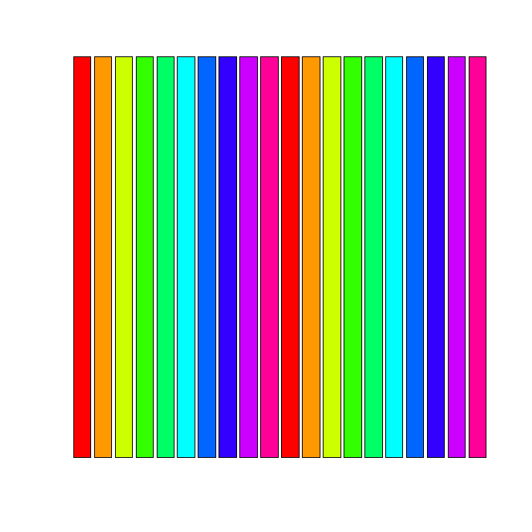
Using Color in R
Color Basics: Palette
> palette(rainbow(10)) # Redefine palette
> palette()
[1] "red" "#FF9900" "#CCFF00" "#33FF00" "#00FF66"
[6] "cyan" "#0066FF" "#3300FF" "#CC00FF" "#FF0099"
> # colors are "recycled" if necessary
> barplot(rep(1,20),col=1:20, yaxt="n")
> palette("default")
> palette()
[1] "black" "red" "green3"
"blue" "cyan"
[6] "magenta" "yellow" "gray"
RGB Hex Constants
Color Names
Cut/Paste
Bitmap
Recycled Colors
Specify number of colors with rainbow

Slide 6
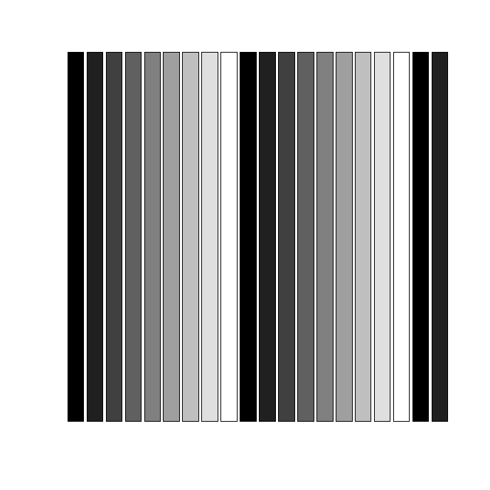
Using Color in R
Color Basics: Palette
> 0:8 / 8
[1] 0.000 0.125 0.250 0.375 0.500 0.625 0.750 0.875 1.000
> palette(gray(0:8 / 8))
> palette()
[1] "black" "#202020" "gray25" "#606060" "#808080"
[6] "#9F9F9F" "gray75" "#DFDFDF" "white"
> # colors are "recycled" if necessary
> barplot(rep(1,20),col=1:20, yaxt="n")
>
> palette("default")
> palette()
[1] "black" "red" "green3"
"blue" "cyan"
[6] "magenta" "yellow" "gray"
RGB Hex Constants
Recycled Colors
Specify vector of floats 0.0 to 1.0 with grey/gray

Slide 7
Using Color in R
Color Basics: Color Names
> colors() # or colours()
[1] "white" "aliceblue" "antiquewhite"
[4] "antiquewhite1" "antiquewhite2" "antiquewhite3"
[655] "yellow3" "yellow4" "yellowgreen"
> colors()[grep("red", colors())]
[1] "darkred" "indianred" "indianred1"
[4] "indianred2" "indianred3" "indianred4"
[7] "mediumvioletred" "orangered" "orangered1"
[10] "orangered2" "orangered3" "orangered4"
[13] "palevioletred" "palevioletred1" "palevioletred2"
[16] "palevioletred3" "palevioletred4" "red"
[19] "red1" "red2" "red3"
[22] "red4" "violetred" "violetred1"
[25] "violetred2" "violetred3" "violetred4"
Color names from C:\Program Files\R\R-2.5.1\etc\rgb.txt

Slide 8
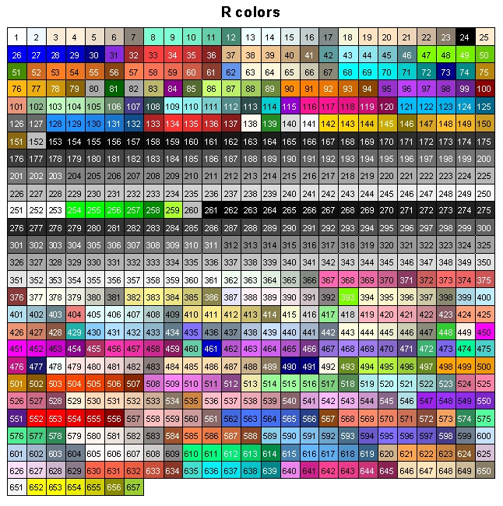
Using Color in R
Color Basics: Color Names
http://research.stowers-institute.org/efg/R/Color/Chart/index.htm

Slide 9
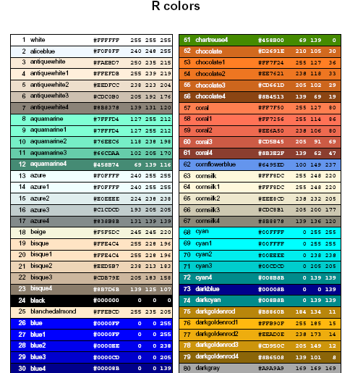
Using Color in R
Color Basics: Color Names
Alphabetical
except first
color, which is
white
Print seven page table to compare screen colors with printed colors.
http://research.stowers-institute.org/efg/R/Color/Chart/ColorChart.pdf

Slide 10
Using Color in R
Color Basics: Hex Constants
Index Color Name #rrggbb red green blue
Hex Decimal
0 0
1 1
2 2
3 3
4 4
5 5
6 6
7 7
8 8
9 9
A 10
B 11
C 12
D 13
E 14
F 15
"Unsaturated"
shades of gray
"Saturated"
Primary Colors
Hex "FF" = 15*16¹ + 15*16⁰ = 255
Hex "00" to "FF" can be interpreted as 0.0 to 1.0.
Numbers represented in "base 16" are called "hexadecimal".
Hex "FF" is largest value represented by one byte (8 bits).

Slide 11
Using Color in R
Color Basics
In R Color can be represented by
index into palette
color name
hex constant (24-bit "True Color":
256³ colors = 16,777,216 colors)

Slide 12
Using Color in R
Color Basics
In R many objects can take on different colors:
points
lines
axes
text
legends
background

Slide 13
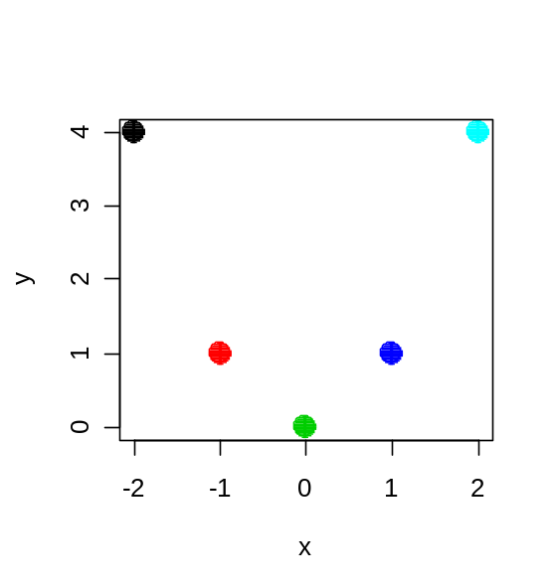
Using Color in R
Color Basics: Points
> palette()
[1] "black" "red" "green3" "blue" "cyan"
[6] "magenta" "yellow" "gray"
> x <- -2:2 Five (x,y) points to plot
> y <- x^2
# Equivalent point colors
> plot(x,y, col=1:5,
pch=CIRCLE<-16, cex=2)
> plot(x,y,
col=c("black", "red", "green3", "blue", "cyan"),
pch=CIRCLE, cex=2)
> plot(x,y,
col=c("#000000", "#FF0000", "green3", 4, 5),
pch=CIRCLE, cex=2)
Hex #rrggbb
Color name
Palette Index

Slide 14
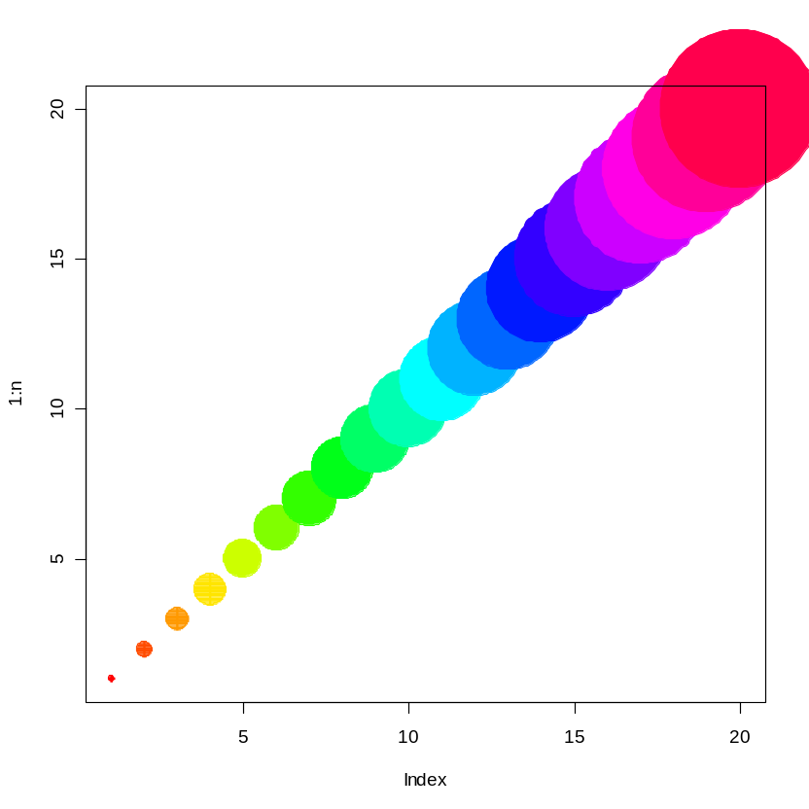
Using Color in R
Color Basics: Points
n <- 20
plot(1:n, pch=CIRCLE<-16, cex=1:n, col=rainbow(n))

Slide 15
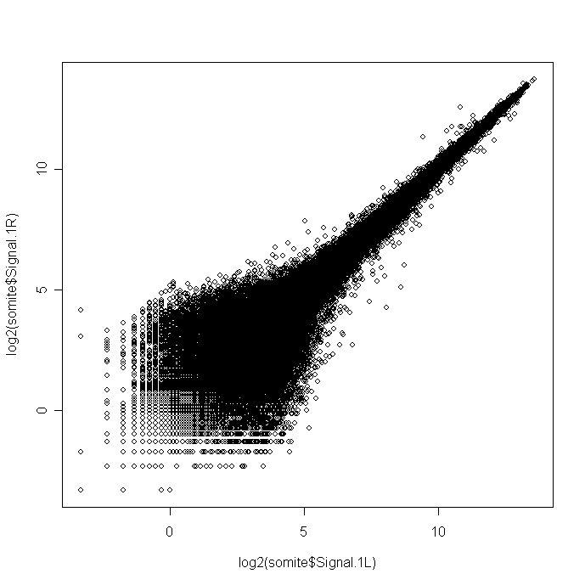
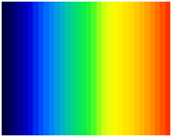

Using Color in R
Color Basics: Points
> plot(log2(somite$Signal.1L), log2(somite$Signal.1R))
p=0
p=1
> library(gplots)
> palette(rev(rich.colors(32)))
Colors 1 to 32
How to associate color with p-values at each point?

Slide 16
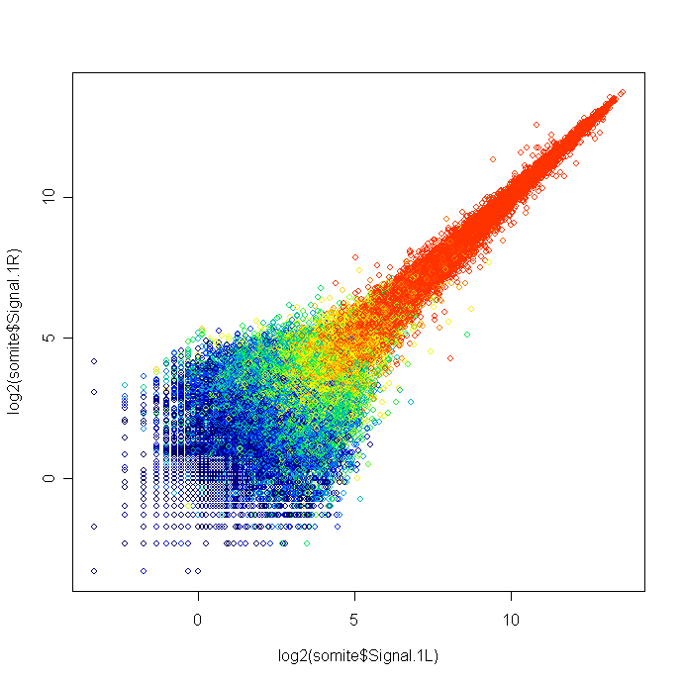
Using Color in R
Color Basics: Points
> palette( rev(rich.colors(32)) ) # colors: 1 to 32
> plot(log2(somite$Signal.1L), log2(somite$Signal.1R),
col=1 + 31*somite$worst.p) # col values from 1 to 32
p=0
p=1

Slide 17
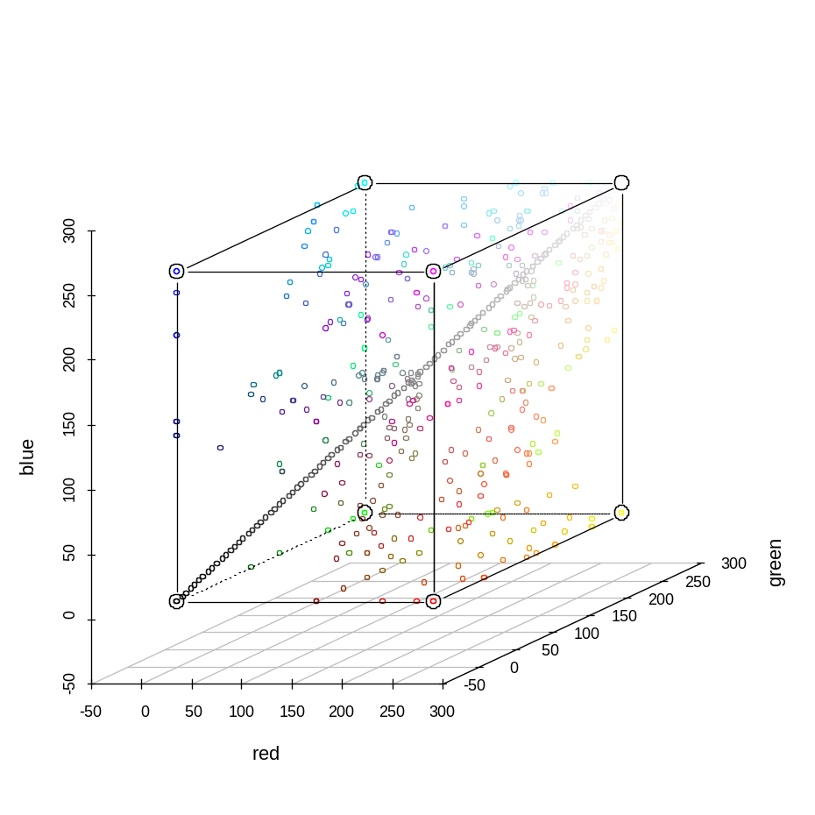
Using Color in R
Color Basics: Points and Lines
library(scatterplot3d)
?scatterplot3d
# Example 6
Red-Green-Blue 3D Plot of colors()

Slide 18
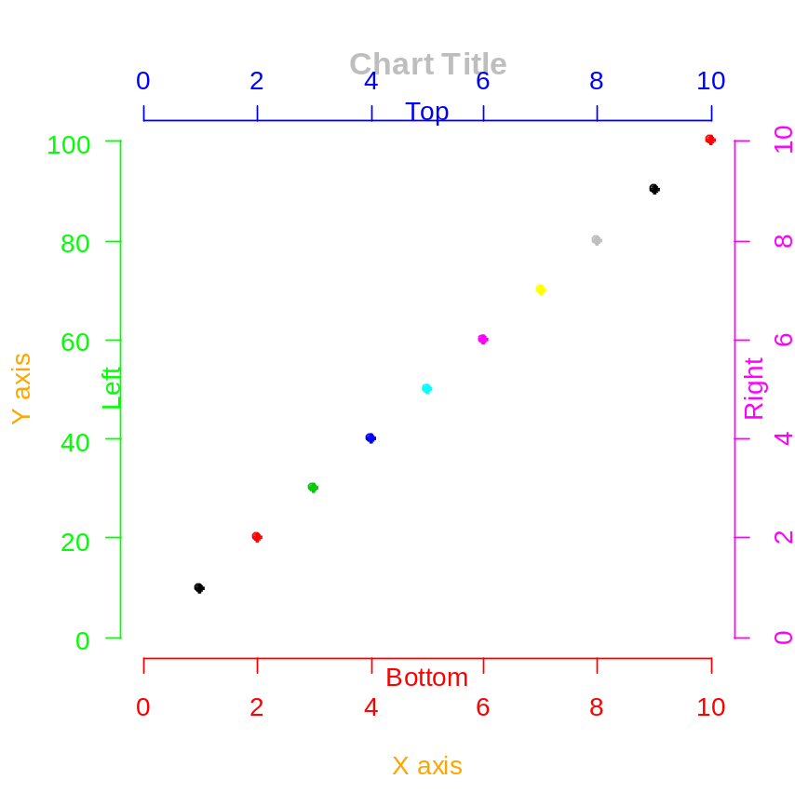
Using Color in R
Color Basics: Axes and Text
BOTTOM <- 1
LEFT <- 2
TOP <- 3
RIGHT <- 4
par(col.lab="orange", col.main="gray")
plot(0:10,0:10, col=0:10, pch=CIRCLE<-16,
main="Chart Title", axes=FALSE,
xlab="X axis",ylab="Y axis")
# Margin Text
mtext("Bottom", BOTTOM, col="red")
mtext("Left", LEFT, col="green")
mtext("Top", TOP, col="blue")
mtext("Right", RIGHT, col="magenta")
axis(BOTTOM, col="red",
col.axis="red") # 2, ... 10 in red
AXIS_LABEL_HORIZONTAL <- 1
axis(LEFT, col="green", col.axis="green",
at=2*0:5, labels=paste(20*0:5),
las=AXIS_LABEL_HORIZONTAL)
axis(TOP, col="blue", col.axis="blue")
axis(RIGHT, col="magenta", col.axis="magenta")

Slide 19
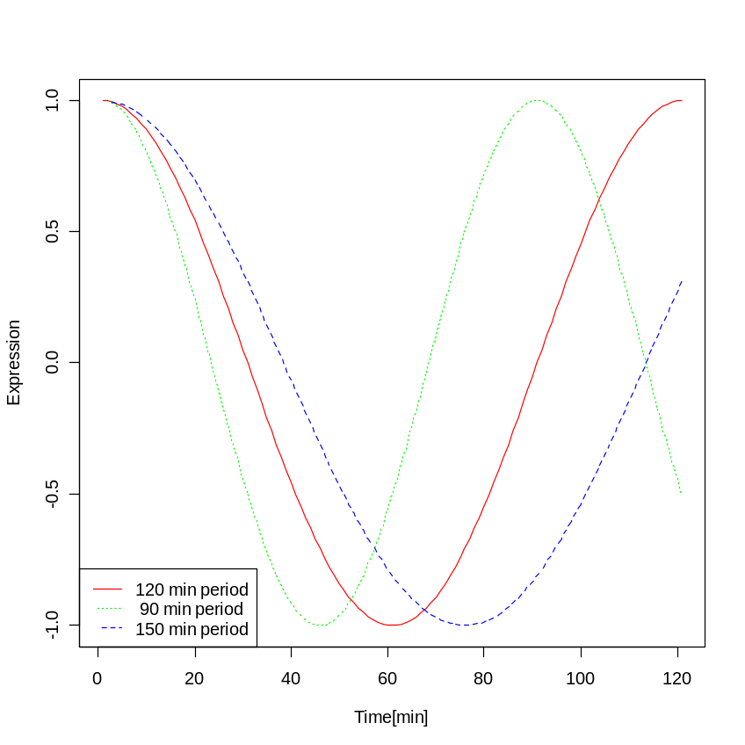
Using Color in R
Color Basics: Legends
Time <- 0:120
Period1 <- cos(2*pi*Time/120)
Period2 <- cos(2*pi*Time/90)
Period3 <- cos(2*pi*Time/150)
COLORS <- c("red", "green", "blue")
LINE.TYPES <- c("solid", "dotted", "dashed")
Periods <- data.frame( Period1=Period1,
Period2=Period2,
Period3=Period3)
matplot(Periods, type = "l",
xlab="Time[min]",ylab="Expression",
col = COLORS, lty = LINE.TYPES)
legend("bottomleft",
c("120 min period", " 90 min period",
"150 min period"),
col = COLORS, lty = LINE.TYPES)

Slide 20
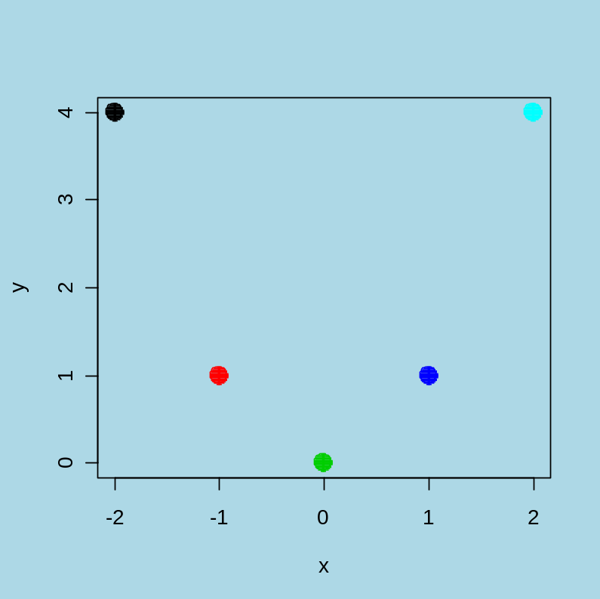
Using Color in R
Color Basics: Background
par(bg="light blue")
x <- -2:2
y <- x^2
plot(x,y, col=1:5,
pch=CIRCLE<-16,cex=2)
R's default background
color is "transparent."
Set graphic background to simplify cutting and pasting to PowerPoint!
Avoids in PowerPoint: Format Picture | Colors and Lines | Fill Color

Slide 21
Using Color in R
Color Basics in R
Color Spaces
Color Gradients / Color Ramps
Color Blindness
Why Don’t Screen Colors Match Printout?
Colors Tips

Slide 22

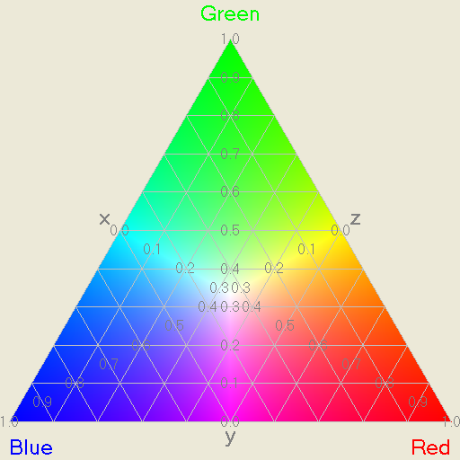
Using Color in R
Color Space: RGB Color Model
> rgb(1,0,0)
[1] "#FF0000"
> rgb(0,1,0)
[1] "#00FF00"
> rgb(1,1,0)
[1] "#FFFF00"
> rgb(255,0,0, maxColorValue=255)
[1] "#FF0000"
> col2rgb(c("blue", "yellow"))
[,1] [,2]
red 0 255
green 0 255
blue 255 0
#rrggbb R G B
Color is additive in the RGB Color Model.
Coordinate values not always obvious.

Slide 23
Using Color in R
Red-Green-Blue Color Cube
R = 0 to 255
G = 0 to 255
B = 0 to 255
Blue
255
Magenta
White
Cyan
255, 255, 255
Not all colors
are perceivable
on all devices
Grey Line
Black
255
Red
0, 0, 0
Green
0.0 to 1.0
0 to 255 (8-bits)
255
Yellow
24-bit graphics:
256 x 256 x 256 = 16,777,216 colors
256 shades of grey
Contrasting Colors?

Slide 24
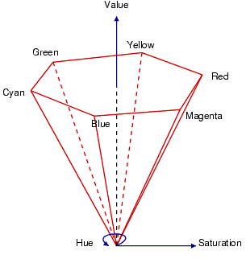
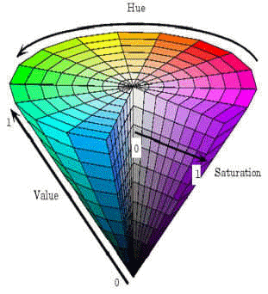
Using Color in R
Color Space: HSV
Hue-Saturation-Value
Match perception of color better than RGB
Source: http://scien.stanford.edu/class/psych221/projects/02/sojeong/

Slide 25
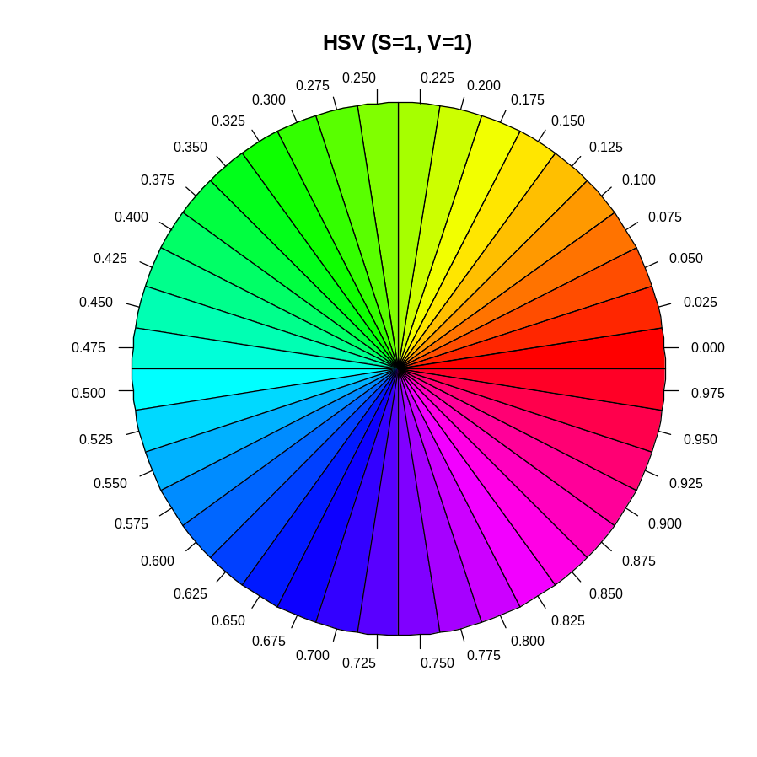
Using Color in R
Color Space: HSV
> hsv(1,1,1)
[1] "#FF0000"
> hsv(1/3,1,1)
[1] "#00FF00"
> hsv(2/3,1,1)
[1] "#0000FF"
hue <- seq(0.0, 1.0, by=1/40)
pie(rep(1,40),
labels=formatC(hue, digits=3,
format="f"),
cex=0.75,
col=hsv(hue, 1.0, 1.0),
radius=1.0,
main="HSV (S=1, V=1)" )
> rgb2hsv(col2rgb("blue"))
[,1]
h 0.6666667
s 1.0000000
v 1.0000000
Hue-Saturation-Value
Contrasting Colors?

Slide 26
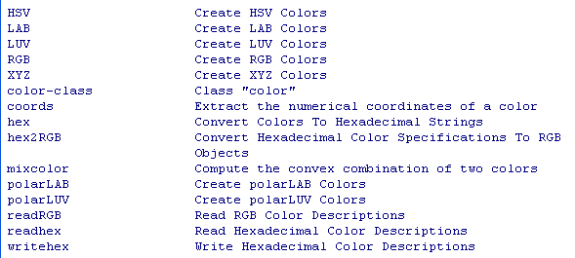
Using Color in R
Color Spaces
help(package=colorspace)

Slide 27
Using Color in R
Color Basics in R
Color Spaces
Color Gradients / Color Ramps
Color Blindness
Why Don’t Screen Colors Match Printout?
Colors Tips

Slide 28
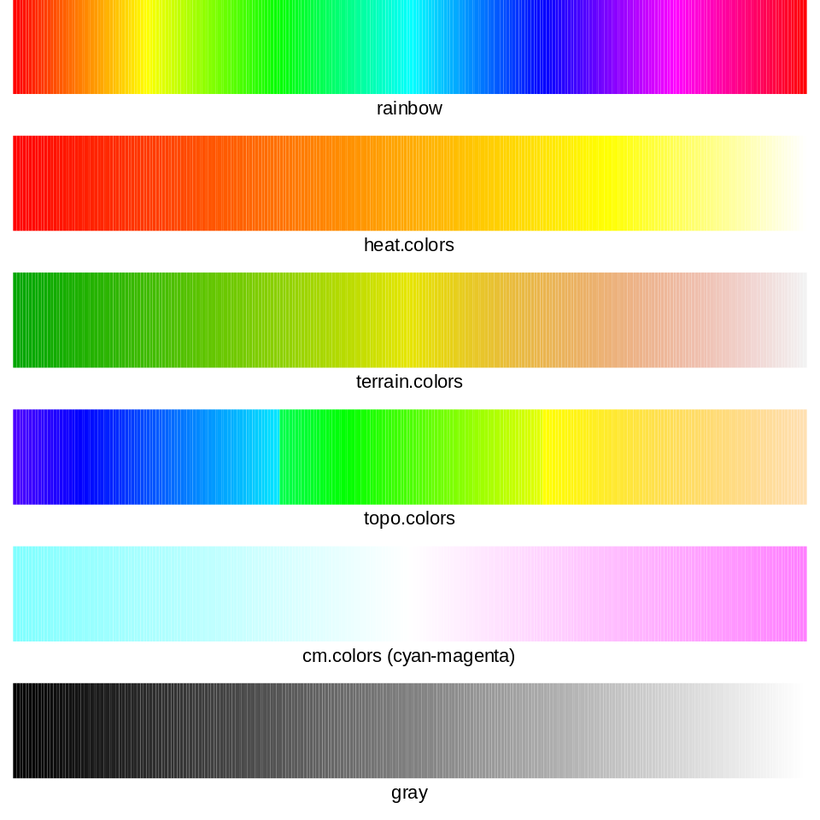
Using Color in R
Color Gradients / Color Ramps
par(mfrow=c(6,1), mar=c(3,1,0,1))
BOTTOM <- 1
colorstrip <- function(colors, description,
ShowAxis=FALSE)
{
count <- length(colors)
m <- matrix(1:count, count, 1)
image(m, col=colors, ylab="", axes=FALSE)
if (ShowAxis)
{
axis(BOTTOM)
}
mtext(description, BOTTOM, adj=0.5, line=0.5)
}
COLOR.COUNT <- 256
colorstrip(rainbow(COLOR.COUNT), "rainbow")
colorstrip(heat.colors(COLOR.COUNT), "heat.colors")
colorstrip(terrain.colors(COLOR.COUNT), "terrain.colors")
colorstrip(topo.colors(COLOR.COUNT), "topo.colors")
colorstrip(cm.colors(COLOR.COUNT),
"cm.colors (cyan-magenta)")
colorstrip(gray(0:COLOR.COUNT / COLOR.COUNT),"gray")

Slide 29
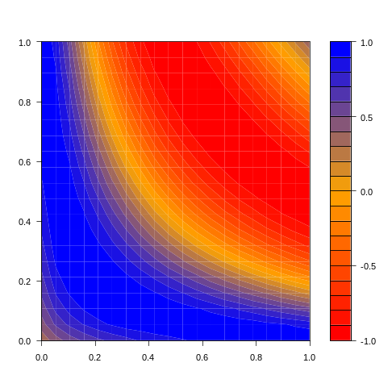
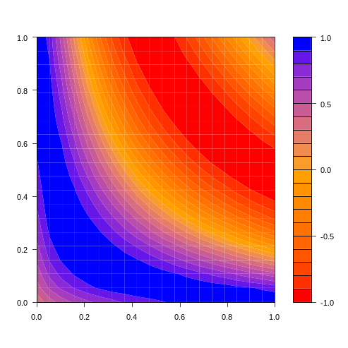
Using Color in R
Color Gradients / Color Ramps
colorRamp and colorRampPalette added in R 2.1.0
m <- outer(1:20,1:20,function(x,y) sin(sqrt(x*y)/3))
rgb.palette <- colorRampPalette(c("red", "orange", "blue"), space = "rgb")
filled.contour(m,col = rgb.palette(20))
# space="Lab" helps when colors don't form a
# natural sequence
Lab.palette <- colorRampPalette(c("red", "orange", "blue"), space = "Lab")
filled.contour(m,col = Lab.palette(20))

Slide 30
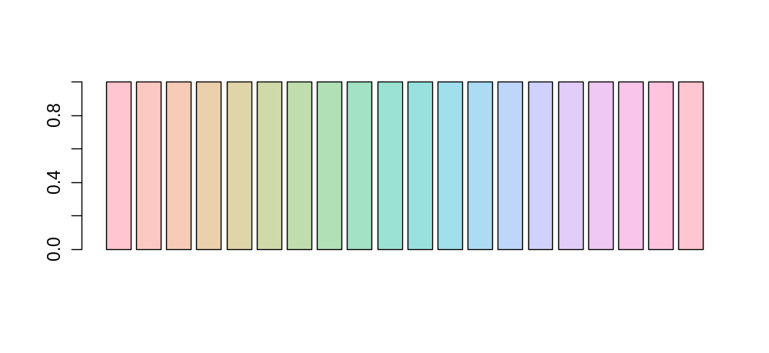
Using Color in R
Color Gradients / Color Ramps
HCL (Hue, Chroma, Luminance)
> ?hcl
> barplot(rep(1, 20), col = hcl(seq(0, 360, length = 20)))
See: HCL(Hue-Chroma-Luminance)-based Color Palettes in R
http://cran.r-project.org/doc/vignettes/vcd/hcl-colors.pdf

Slide 31
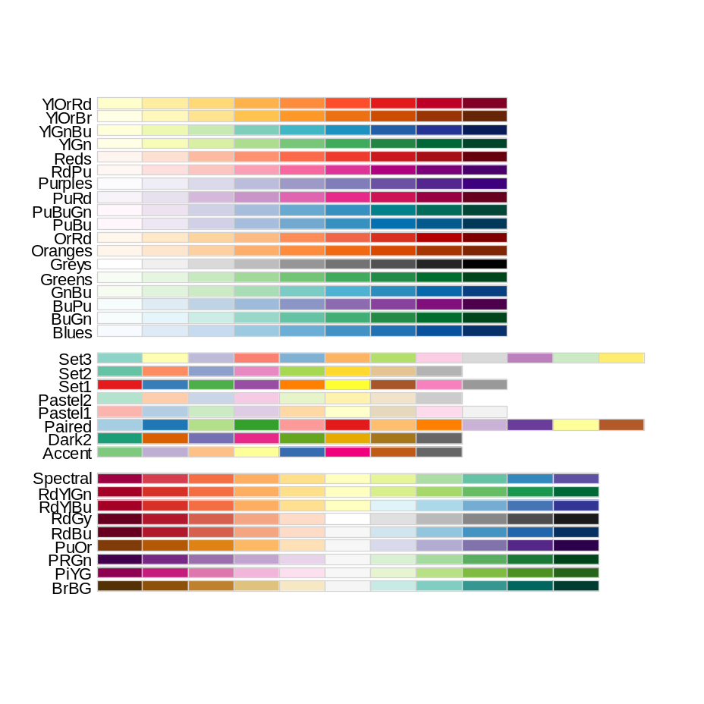
Using Color in R
Color Gradients / Color Ramps
RColorBrewer Package
> library(RColorBrewer)
> display.brewer.all()

Slide 32
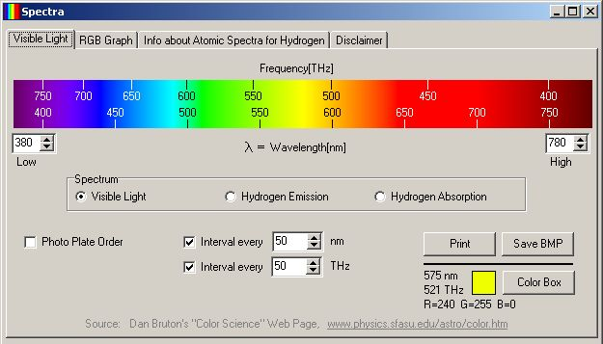
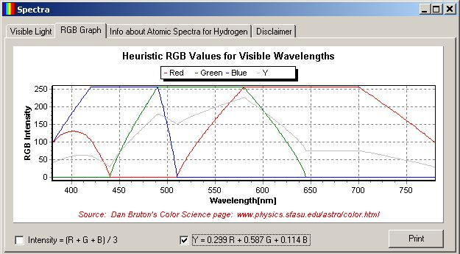
Using Color in R
Color Gradients / Color Ramps
Representative Color for Given Wavelength
Source: http://www.efg2.com/Lab/ScienceAndEngineering/Spectra.htm

Slide 33
Using Color in R
Color Basics in R
Color Spaces
Color Gradients / Color Ramps
Color Blindness
Why Don’t Screen Colors Match Printout?
Colors Tips

Slide 34
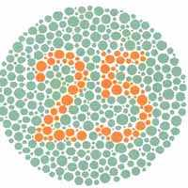
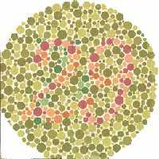
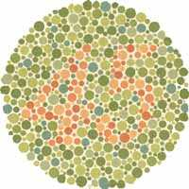
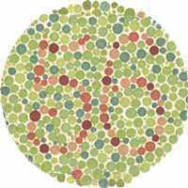
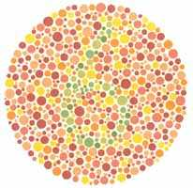
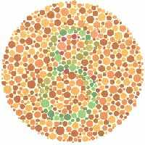
Using Color in R
Color Blindness
Ishihara Test for Color Blindness
Normal Color Vision: 25, 29, 45, 56, 6, 8
Red-Green Color Blind: 25, spots, spots, 56, spots, spots
Source: http://www.toledo-bend.com/colorblind/Ishihara.html
About 1 in 12 have some sort of color deficiency:
About ~8% of men and ~0.4% of women in the US.
http://en.wikipedia.org/wiki/Color_blindness

Slide 35
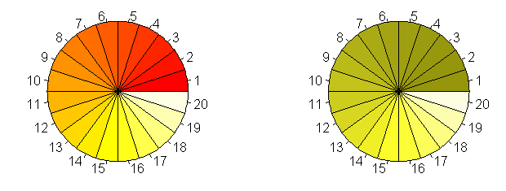
Using Color in R
Color Blindness
R dichromat Package: Color Schemes for dichromats
library(dichromat)
par(mfcol=c(1,2))
N <- 20
pie(rep(1,N),col=heat.colors(N))
pie(rep(1,N),col=dichromat(heat.colors(N)))
dichromat function collapses red-green color distinctions to approximate the effect of the two
common forms of red-green color blindness, protanopia and deuteranopia.

Slide 36
Using Color in R
Color Blindness
R dichromat Package: Color Schemes for dichromats
library(dichromat)
par(mar=c(1,2,1,1))
layout(matrix(1:6,ncol=1))
image(1:10,1,matrix(1:10, ncol=1),
col=colorschemes$BrowntoBlue.10,
main="Brown to Blue (10)", axes=FALSE)
image(1:100,1,matrix(1:100 ,ncol=1),
col=colorRampPalette(colorschemes$BrowntoBlue.10,space="Lab")(100),
main="Brown to Blue Ramp", axes=FALSE)
image(1:10,1,matrix(1:10, ncol=1),
col=dichromat(colorschemes$BrowntoBlue.10),
main="Brown to Blue (10) -- deuteranopia", axes=FALSE)
image(1:12,1,matrix(1:12, ncol=1),col=colorschemes$Categorical.12,
main="Categorical (12)", axes=FALSE)
image(1:12,1,matrix(1:12, ncol=1),
col=dichromat(colorschemes$Categorical.12),
main="Categorical (12) -- deuteranopia", axes=FALSE)
image(1:12,1,matrix(1:12,ncol=1),
col=dichromat(colorschemes$Categorical.12, "protan"),
main="Categorical (12) -- protanopia", axes=FALSE)

Slide 37
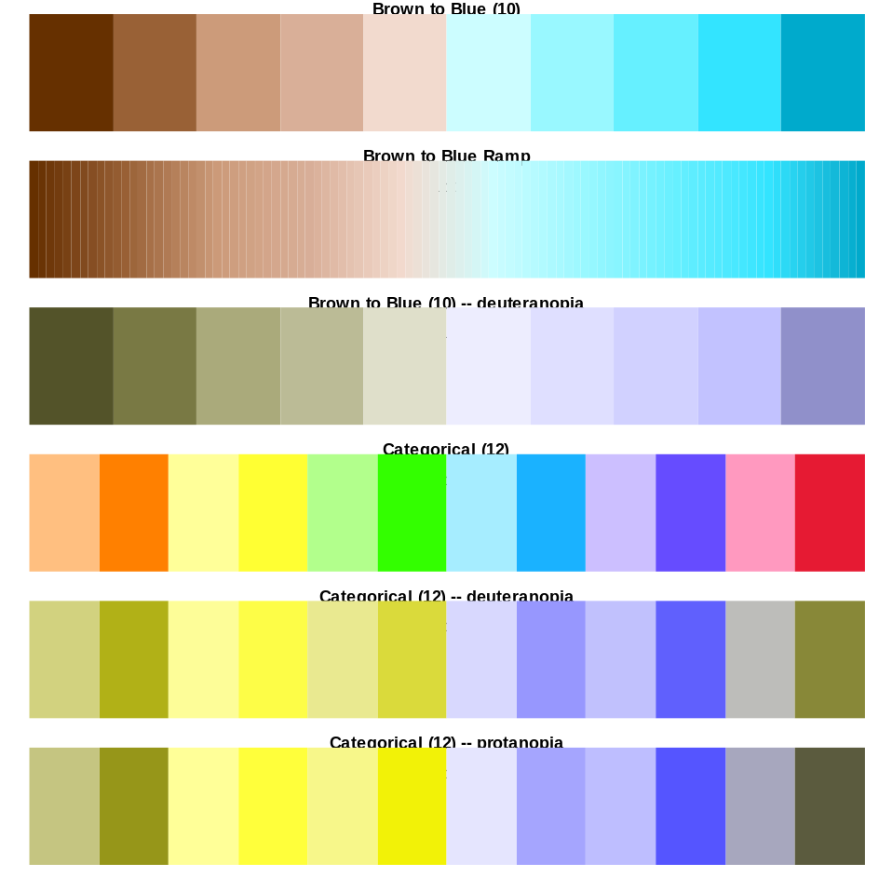
Using Color in R
Color Blindness
R dichromat Package: Color Schemes for dichromats

Slide 38
Using Color in R
Color Basics in R
Color Spaces
Color Gradients / Color Ramps
Color Blindness
Why Don’t Screen Colors Match Printout?
Colors Tips

Slide 39
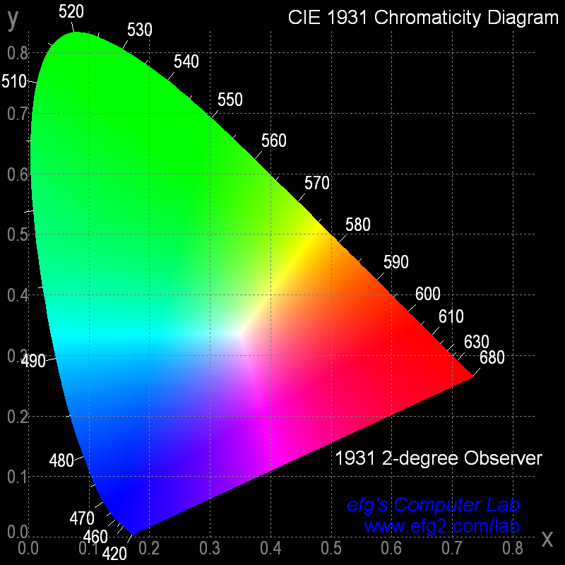
Using Color in R
Why Don’t Screen Colors Match Printout?
Conceptual
Diagram of
All Colors
(2D Slice)

Slide 40
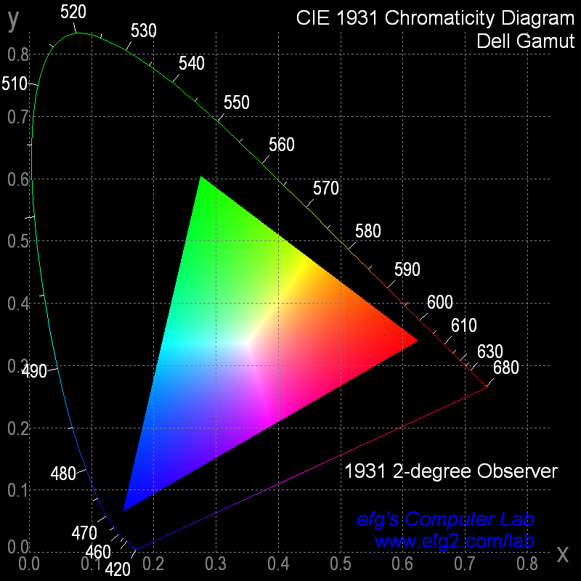
Using Color in R
Why Don’t Screen Colors Match Printout?
Each Device
Has Own
Gamut of
Colors

Slide 41
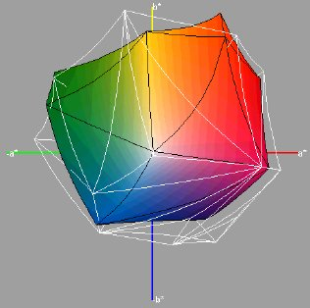
Using Color in R
3D Color Gamut
From “Visualization of Expanded Printing Gamuts Using 3-Dimensional Convex Hulls”
by Karl Guyler, Hallmark Cards, Kansas City
Color calibration can be used to minimize needless differences

Slide 42
Using Color in R
Why Don’t Screen Colors Match Printout?
Different color gamuts between devices:
How should a color be represented if it doesn't exist
on a device?
Imperfect conversions:
CRT screens with RGB (Red-Green-Blue) additive
colors must be converted to CMYK
(Cyan-Magenta-Yellow-Black) subtractive colors
Color fidelity may not be accurate
Paper/ink differences

Slide 43
Using Color in R
Color Basics in R
Color Spaces
Color Gradients / Color Ramps
Color Blindness
Why Don’t Screen Colors Match Printout?
Colors Tips

Slide 44
Using Color in R
Color Tips
Avoid unnecessary use of color.
Use bright colors with small
graphics to make them stand out.
Be consistent in use of color.
Don't use color as only attribute
to show difference. E.g., consider
color and line type.
Also see: Cool Color Commentary, http://www.public-speaking.org/public-speaking-color-article.htm

Slide 45
Using Color in R
Color Tips: Palettes
Qualitative Palette:
  all same perceptual weight/importance
  typical application: bar plot
Sequential Palette
  for coding numerical information in a range
  typical application: heat map
Diverging Palette
  Like Sequential Palette but with neutral value
Source: Choosing Color Palettes for Statistical Graphics
http://epub.wu-wien.ac.at/dyn/virlib/wp/mediate/epub-wu-01_abd.pdf?ID=epub-wu-01_abd

Slide 46
Using Color in R
References
Colour for Presentation Graphics
http://www.stat.auckland.ac.nz/~ihaka/colour/color-talk.pdf
Why should Engineers and Scientists be worried about color?
http://www.research.ibm.com/people/l/lloydt/color/color.HTM

