Slide 1
Cluster Computing With R
Stowers Institute for Medical Research
R/Bioconductor Discussion Group
Earl F. Glynn
Scientific Programmer
18 December 2007

Slide 2
Cluster Computing With R
Accessing Linux Boxes from Windows
  Linux Servers
  Cluster Head Nodes
  Linux Command Prompt
  xterms
  Linux Home Directories
  Setup For Examples
R Batch Jobs Using Linux
Cluster Basics
Sun Grid Engine
R Batch Jobs on Cluster:
Toy Examples and Time Perturbation Study

Slide 3
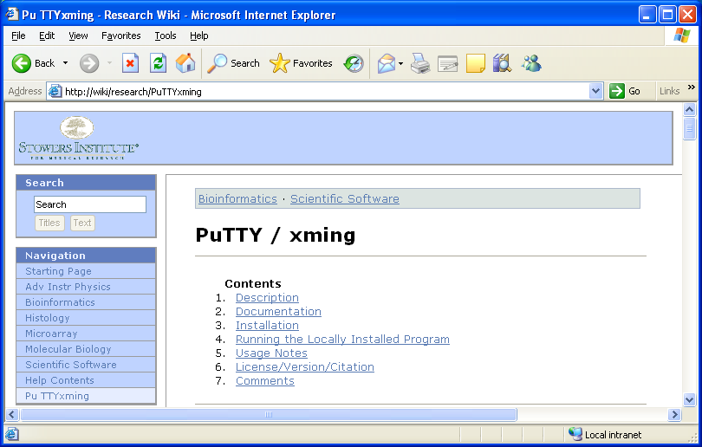
Accessing Linux Boxes from Windows
Wiki: http://research/PuTTYxming
PuTTY / Xming will be used to access Linux boxes from Windows

Slide 4
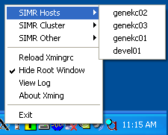
PuTTY / xming
Accessing Linux Boxes from Windows
Accessing Linux Hosts
genekc02 64-bit
genekc03 32-bit
"Right" Click Xming icon
Can access via PuTTY icon

Slide 5
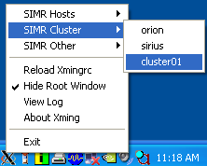
Accessing Linux Boxes from Windows
PuTTY / xming
Accessing Cluster Head Nodes
Confusing Names
32-bit cluster nodes
cluster01 = Betelgeuse
cluster02 = Sirius
64-bit cluster nodes
cluster03 = Orion
"Right" Click Xming icon

Slide 6
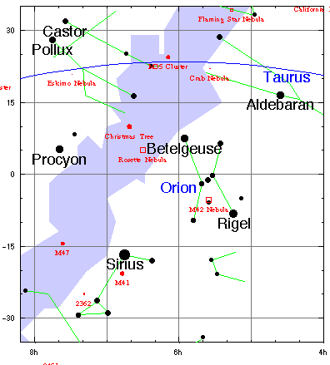
http://documents.wolfram.com/applications/astronomer/Atlas/NovDecJan.html

Slide 7
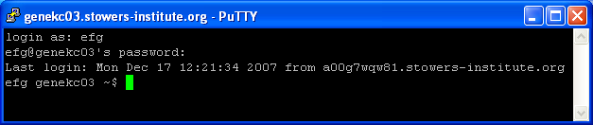
Linux Console and Command Prompt
Accessing Linux Boxes from Windows
cat .bashrc # or in .profile
case $TERM in
xterm*)
PROMPT_COMMAND='echo -ne "\033]0;${USER} ${HOSTNAME}\007"'
;;
*)
;;
esac
BLUETEXT="\[\e[34;1m\]"
RESETTEXT="\[\e[0m\]"
PS1="$BLUETEXT\n[\! \$(date '+%d%b%y %T') \$( pwd )]\n$RESETTEXT"
Making Your Linux Bash Command Prompt Useful
http://www.expertsrt.com/tutorials/Matt/CmdPrompt.html

Slide 8
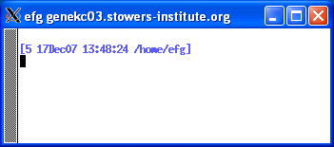
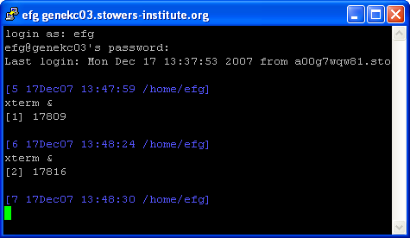
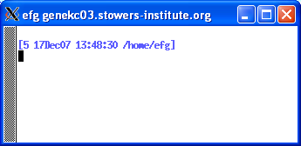
Linux Command Prompt and xterms
Accessing Linux Boxes from Windows

Slide 9
LINUX Home Directories
Accessing Linux Boxes from Windows
Files for cluster jobs normally should be
in your home directory, e.g., /home/efg
Suggest single directory per cluster job,
e.g., /home/efg/cluster/R/simplegraph
LINUX home directories can be accessed via
Windows using an UNC name:
\\lnaskc01\unixhomes\efg\cluster\R\simplegraph
Not all filesystems available on genekc02,
..., are available on clusters, e.g., $BLASTDB

Slide 10
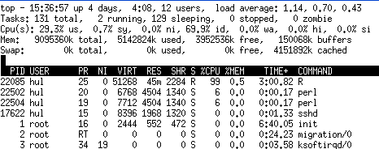
Summary
Accessing Linux Boxes from Windows
Use Linux boxes for R "batch" jobs
(discussed next)
Normally use genekc02 or genekc03 boxes
Can monitor how busy a box is with "top"
(cluster is possible alternative when busy)
only 1 CPU
busy of 4

Slide 11
Setup for Examples
Accessing Linux Boxes from Windows
Login on genekc02 or genekc03
In your home directory:
mkdir simplegraph
cd simplegraph
cp /home/efg/cluster/R/simplegraph/* .
cd ..
mkdir array
cd array
cp /home/efg/cluster/R/array/* .
Or, run: /home/efg/cluster/R/Rclass.bash

Slide 12
R Batch Jobs Using Linux
Develop R script using Windows or Linux
Develop parameterized R script
[some limitations]
R CMD BATCH
Create Bash driver for R script
Test Bash driver using "normal" Linux box

Slide 13
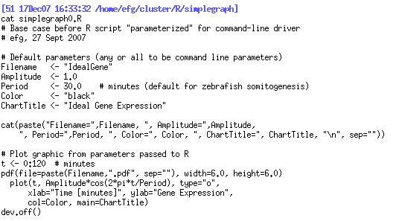
Simple R Script and Batch Driver
R Batch Jobs Using Linux

Slide 14
R CMD BATCH
R Batch Jobs Using Linux
At Linux command prompt or in a script
R CMD BATCH --vanilla --slave scriptname.R output.txt
--vanilla
  Combination of
  --no-save: Don't save it
  --no-restore: Don't restore anything
  --no-site-file: Don't read the site-wide Rprofile
  --no-init-file: Don't read the .Rprofile or ~/.Rprofile files
  --no-environ: Don't read the site and user environment file
--slave: Make R run as quietly as possible
See man R on Linux

Slide 15


Simple R Script and Batch Driver
R Batch Jobs Using Linux
q()
not
needed
Run the script

Slide 16
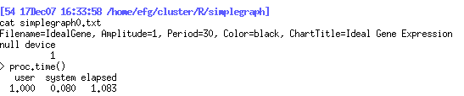
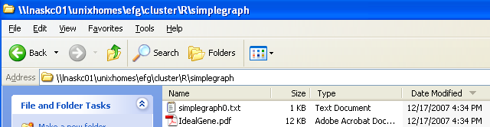
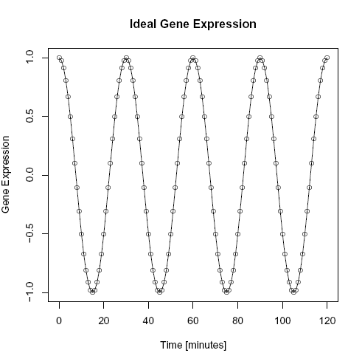
Simple R Script and Batch Driver
R Batch Jobs Using Linux
Look at txt output file
using Linux
Windows Explorer:
Usually need to
"refresh" to
see files
Look at pdf output file
using Windows
/home/efg/cluster/R/simplegraph =
\\lnaskc01\unixhomes\efg\cluster\R\simplegraph
Use Windows file "extensions" so files can be processed in either Windows or Linux.

Slide 17
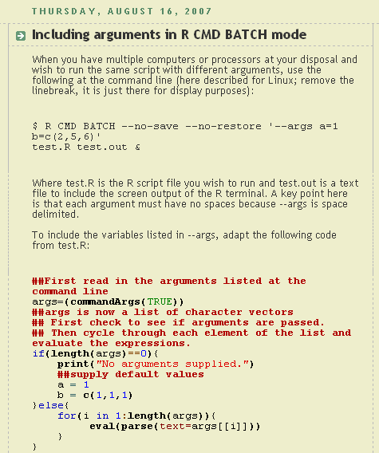
Parameterized R Script and Driver
R Batch Jobs Using Linux
http://quantitative-ecology.blogspot.com/2007/08/including-arguments-in-r-cmd-batch-mode.html

Slide 18
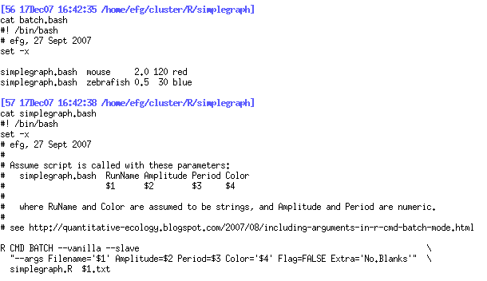
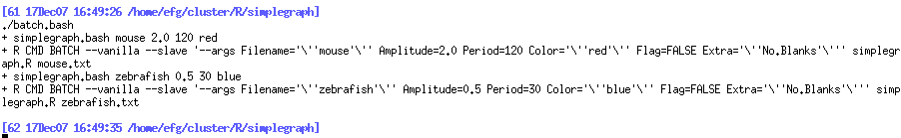
Parameterized R Script and Driver
R Batch Jobs Using Linux

Slide 19
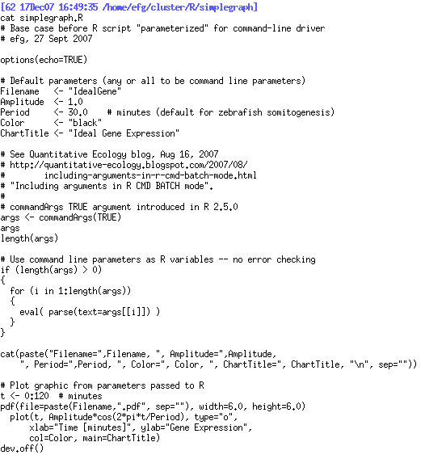
Parameterized R Script and Driver
R Batch Jobs Using Linux

Slide 20
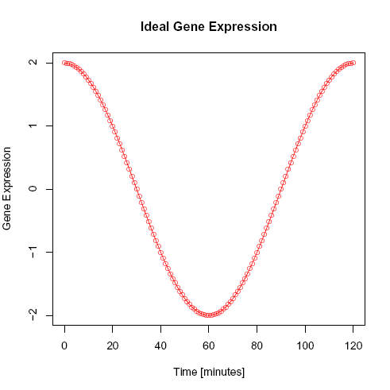
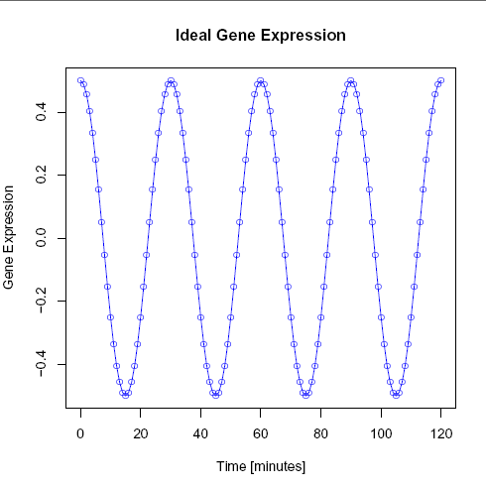
Parameterized R Script and Driver
R Batch Jobs Using Linux
Mouse
Zebrafish
Should have overridden ChartTitle. Suggestions?

Slide 21
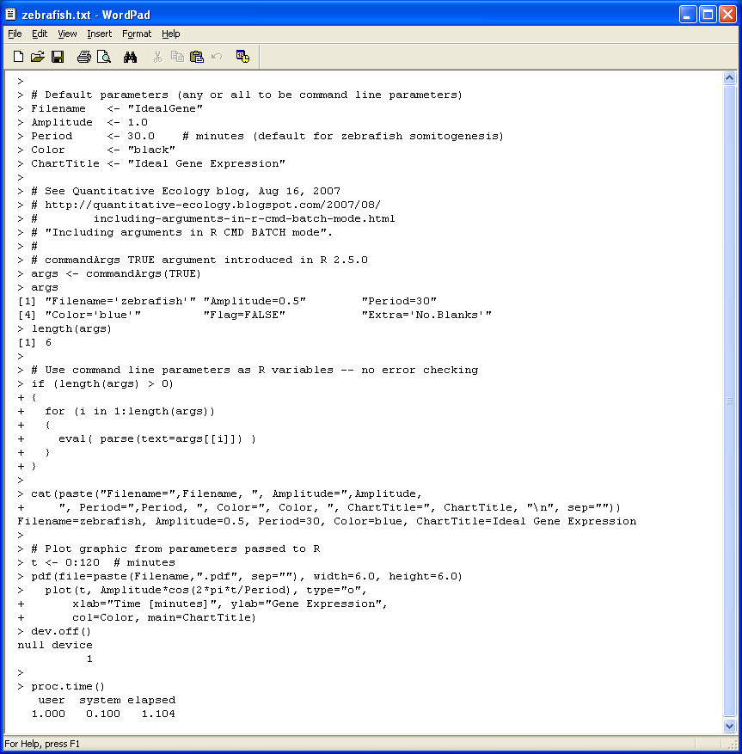
Parameterized R Script and Driver
R Batch Jobs Using Linux
Windows:
Use WordPad
(but NOT NotePad)
to view .txt file

Slide 22
Cluster Basics
R is configured nearly identically on
32-bit and 64-bit platforms.
Limitations: Can be subtle differences
in environmental variables, executable
paths, between head node and cluster
nodes, or head node and other Linux boxes.
A "good" job for cluster is mostly CPU
intensive – many computations.
Short jobs, or jobs with a lot of I/O, may
not be good cluster jobs.
Must search standard out/error files for
errors

Slide 23
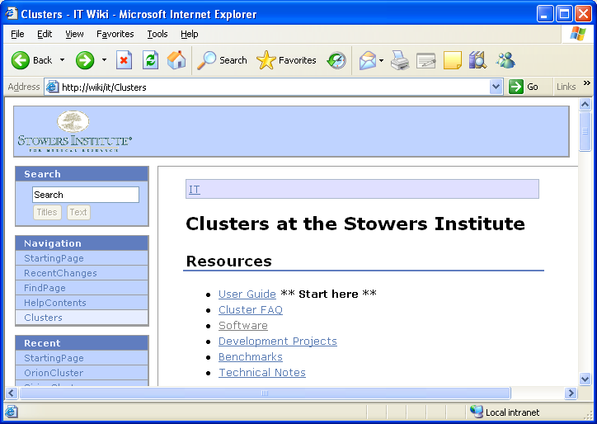
IT Wiki
Cluster Basics
http://wiki/it/Clusters
Many changes are coming over next few months.
Wiki pages are a bit dated right now.

Slide 24
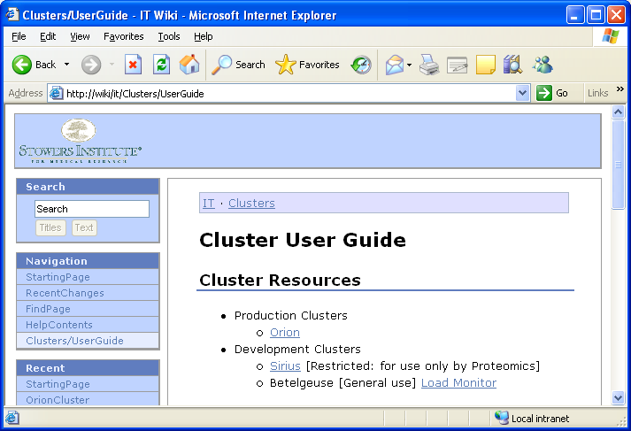
Betelgeuse / cluster01
Cluster Basics
IT Wiki: http://wiki/it/Clusters/UserGuide
Confusing Names
32-bit cluster nodes
cluster01 = Betelgeuse
cluster02 = Sirius
64-bit cluster nodes
cluster03 = Orion

Slide 25
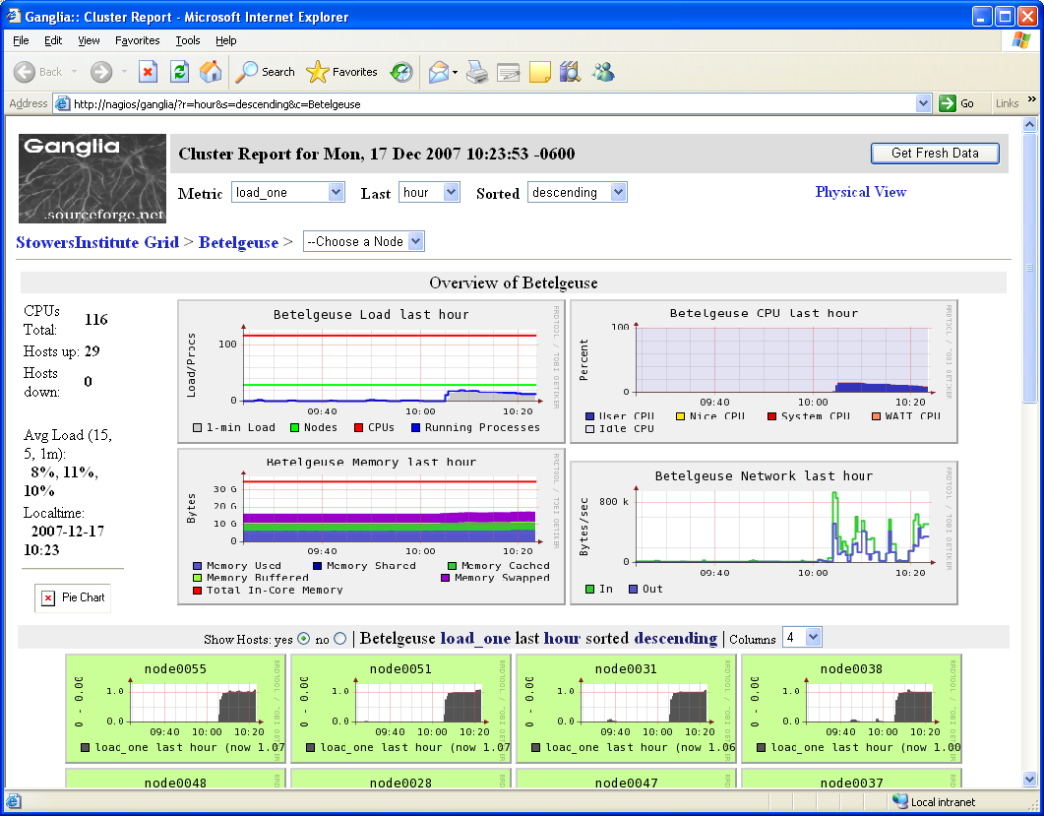
Betelgeuse / cluster01
Cluster Basics
Load Monitor
X

Slide 26
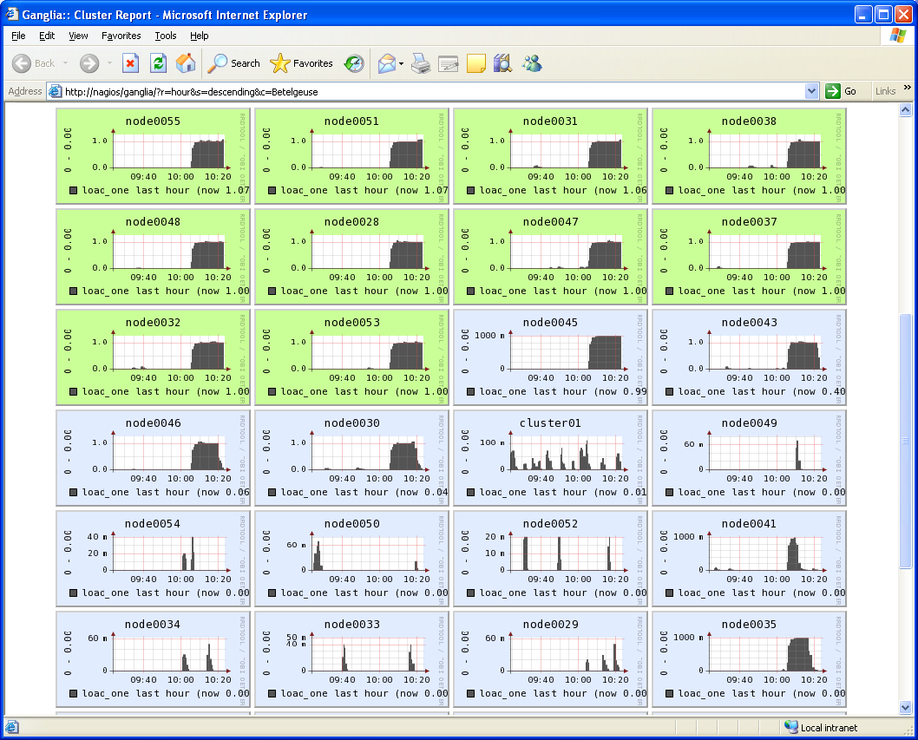
Betelgeuse / cluster01
Cluster Basics

Slide 27
Cluster Head Node
Cluster Basics
Directly login to cluster head node using Xming (right click, SIMR cluster, <cluster name>)
Don't do any unnecessary work on the head node.
Use head node ONLY to submit jobs via the
Sun Grid Engine (discussed next)
If you forget, kill any jobs accidentally run on
cluster head node as soon as possible.

Slide 28
Sun Grid Engine
qrsh: Interactively run job when genekc02,
genekc03, ..., are too busy
qsub: Submit cluster jobs
qstat: Status of cluster jobs submitted
qdel: Delete cluster job
qmon: GUI Job Monitor
(submit, manage, monitor)

Slide 29
qrsh
Sun Grid Engine
What if genekc02, genekc03, ... are fully loaded
and you want to use another CPU?
What if you have a very long-running job and
would like to not "hog" the main Linux boxes?
Some people have no choice where to run jobs
due to license limitations. When licensed CPUs
are in use, they have no options. Be kind to
your neighbor by using cluster node when
possible.
If cluster nodes are available, qrsh can be used
as an alternative.

Slide 30
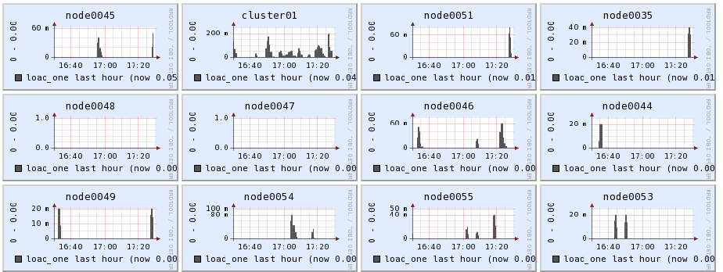
qrsh
Sun Grid Engine
Check that cluster nodes are available.
Login to cluster head node:
cluster01 (Betelgeuse) for now
[right click Xming | SIMR Cluster | cluster01]

Slide 31

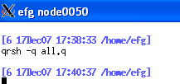
qrsh
Sun Grid Engine
Open xterm if desired.
Issue qrsh command:
qrsh –q all.q
In this case we were assigned node0050
Change to work directory and process work

Slide 32
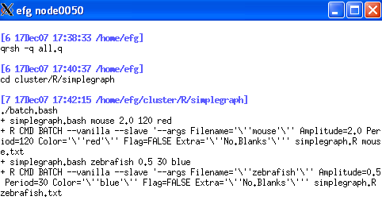
qrsh
Sun Grid Engine
Process any work on cluster node

Slide 33
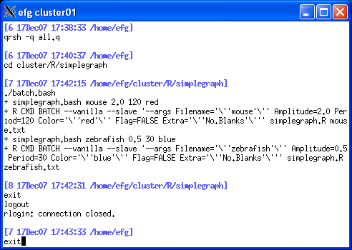
qrsh
Sun Grid Engine
Enter "exit" to close qrsh session on node.
Enter "exit" to close cluster01 session.

Slide 34
qsub
Sun Grid Engine
Submit job to cluster
Write "wrapper" script
Process a "chunk" of work, perhaps a file,
when script is invoked
Script can read/write any number of files
Avoid unnecessary network I/O
Submit script to cluster for execution on
node selected by Sun Grid Engine
Consider submission script for documentation
qsub –cwd –o output.txt –j yes –N "name" wrapper.bash [parms]
Standard Out and Standard Error will be written to output.txt.
Use –e error.txt (with default –j no) to capture Standard Error.

Slide 35
qsub
Sun Grid Engine
Submit array job to cluster
Wrapper script to perform task
Sun Grid Engine sets up environment variable
$SGE_TASK_ID with numeric value
Script decides what work to do based on
$SGE_TASK_ID environment variable
qsub –cwd –t 1-4 –N "ArrayJob" arrayjob.bash
-t start-stop:increment, start > 0

Slide 36
qsub
Sun Grid Engine
** CAUTION **
Can submit job to various queues, but not all queues are equal right now.
Unfortunaely, "q –all.q" is not consistently shown in examples here.
For now, always use –q all.q with qsub.
qsub –q all.q –cwd –t 1-4 –N "ArrayJob" arrayjob.bash

Slide 37
qstat and qdel
Sun Grid Engine
List your jobs in SGE queue (login ID xxx)
qstat –u xxx
Delete all your jobs in SGE queue
qdel –u xxx
qmon is an alternative

Slide 38
R Batch Jobs on Cluster
"Toy" Examples to Show Concepts
SimpleGraph Example
ArrayJob Example
Overview of Research Project
Time Perturbation Somitogenesis Studies

Slide 39
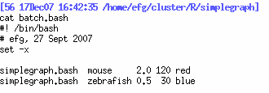
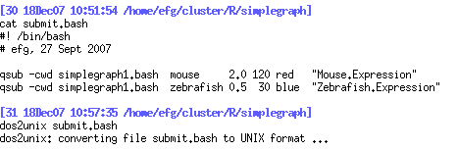
SimpleGraph Example
R Batch Job on Cluster
Modify batch script: batch.bash
Submission Script: submit.bash
Fix Editing
in Windows

Slide 40
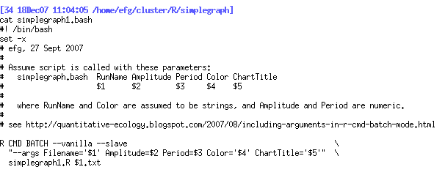
SimpleGraph Example
R Batch Job on Cluster
Job Script: simplegraph1.bash

Slide 41
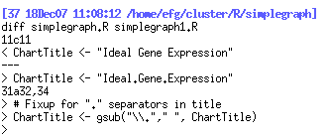
SimpleGraph Example
R Batch Job on Cluster
R Script: simplegraph1.R

Slide 42

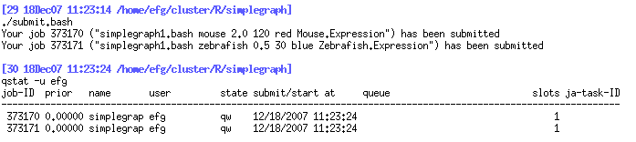
SimpleGraph Example
R Batch Job on Cluster
Run submit.bash to submit jobs to cluster:
Login to Cluster Head Node
Change to working directory
Execute the submit.bash script
Delete all jobs: qdel –u efg

Slide 43
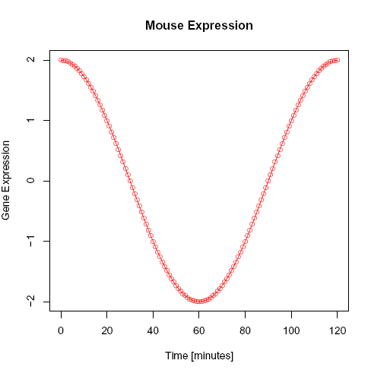
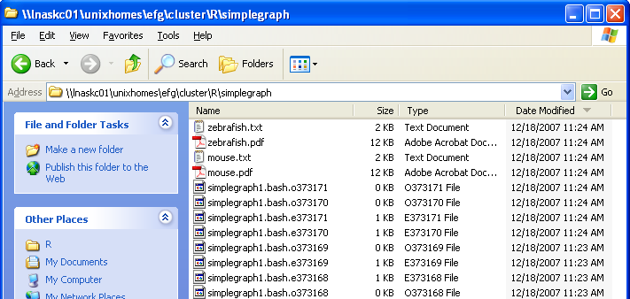
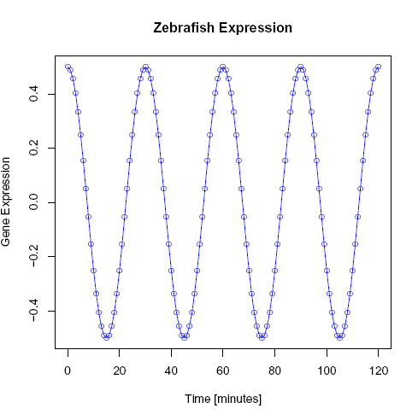
SimpleGraph Example
R Batch Job on Cluster
Output files:
Standard Out and Standard Error Files
have no useful information and can be deleted.

Slide 44



R Array Job Example
R Batch Job on Cluster
Submission Script: submit.bash
Job Script: arrayjob.bash
R Script: arrayjob.R

Slide 45
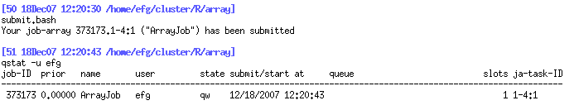
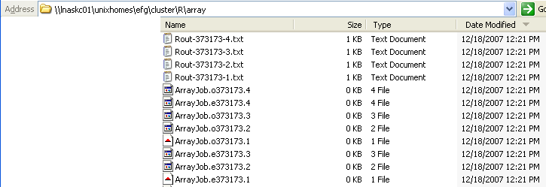
R Array Job Example
R Batch Job on Cluster
Submit Array Job
Output files
Standard Out and Standard Error Files
are zero-length and can be deleted.

Slide 46
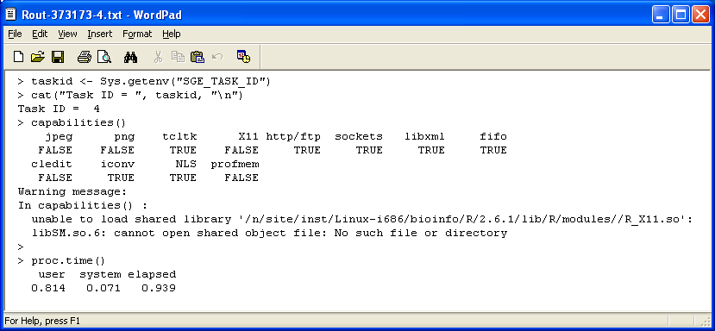
R Array Job Example
R Batch Job on Cluster
Output files
Cannot create JPEGs or PNGs on cluster nodes for now,
but PDFs will work for graphical output.

Slide 47
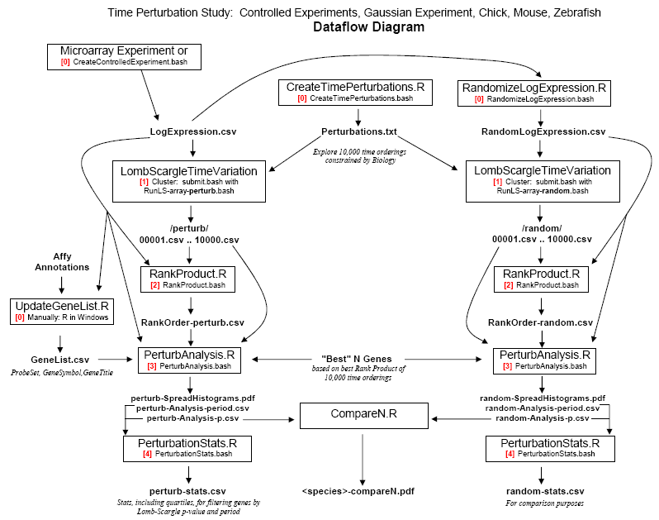
Time Perturbation Somitogenesis Studies
R Batch Job on Cluster

Slide 48
Time Perturbation Somitogenesis Studies
R Batch Job on Cluster
submit.bash
submit-batch.bash &
submit-batch.bash &
Compare250.bash
See files in /home/efg/cluster/TimePerturb/mouse17

Slide 49
Questions?

