Slide 1


Computer-Assisted Reporting:
Screen Scraping, Mapping in R
SPJ Region 7 Spring Conference
Overland Park, KS
April 9, 2011
Earl F. Glynn
Overland Park, KS

Slide 2
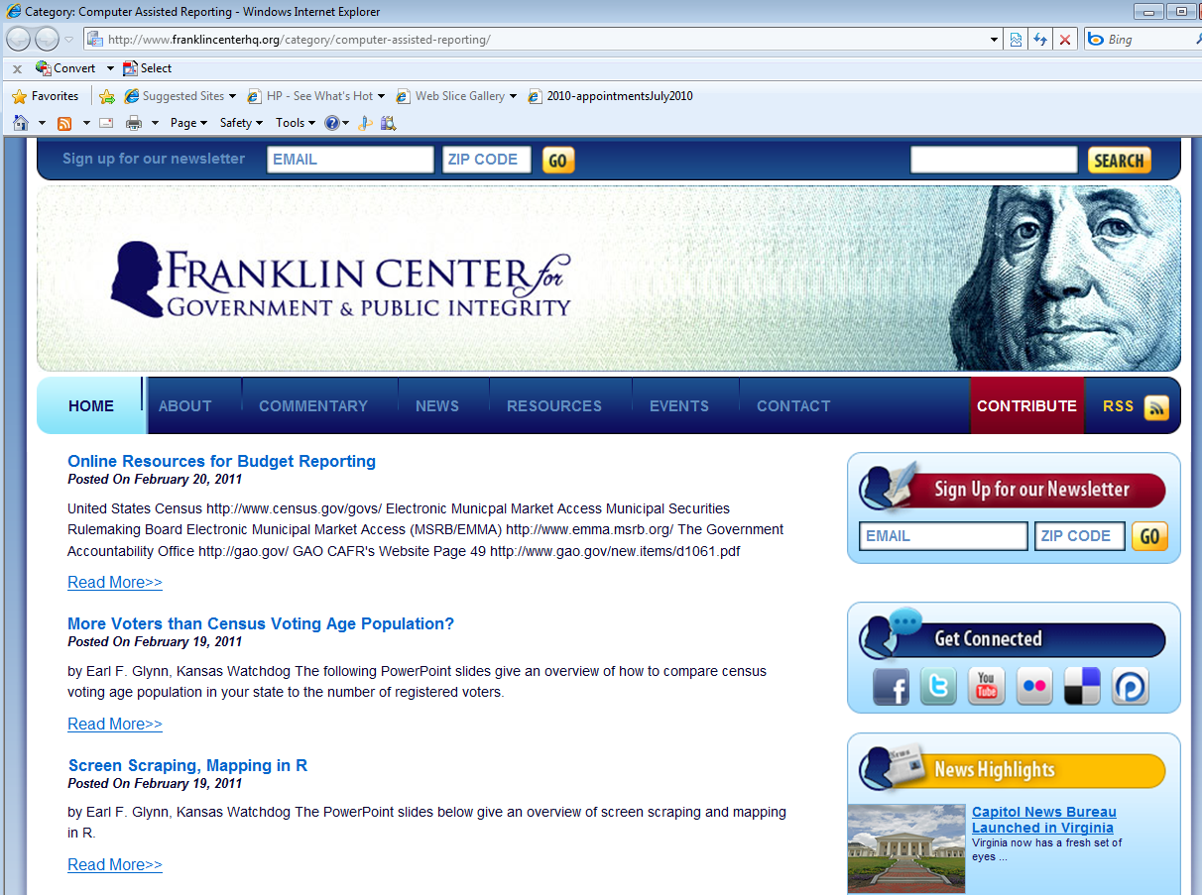
Computer-Assisted Reporting Blog
http://car.franklincenterhq.org

Slide 3
Screen Scraping Example
R Data Tool
R Screen Scraping: 105 counties of data
R Reshape Example
Analysis/Mapping KS Judicial Retention
Elections by County Using R
Other Screen Scraping Examples

Slide 4

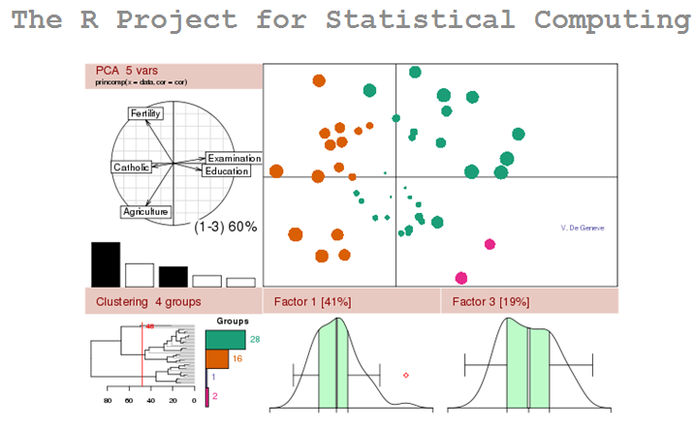
Use to scrape web page
http://www.r-project.org/
Free tool for data manipulation, analysis, statistics and charts

Slide 5
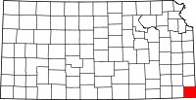
Screen Scraping
Problem: Visual election results by county
not available for all statewide contests, and in particular, judicial retention elections.
Solution: “Screen scrape” 105 web pages (one per county), create table, plot map.

Slide 6

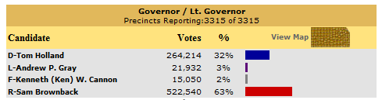
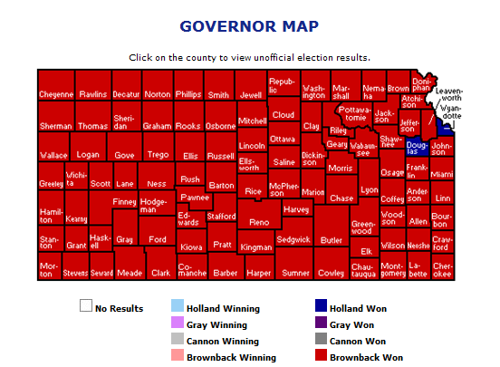
Visual Election Results by County
www.kssos.org/ent/kssos_ent.html

Slide 7
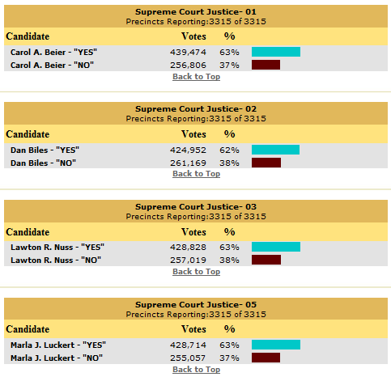
… but not for all statewide contests
Were Supreme Court justices retained in all counties?

Slide 8
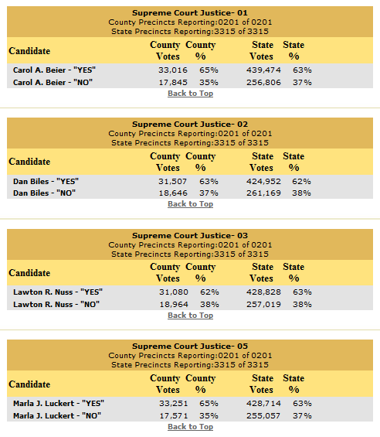
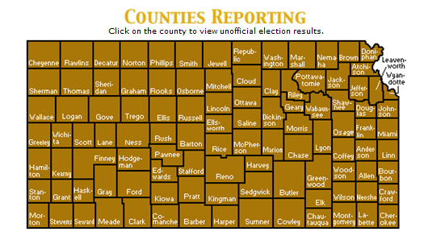
Data available online by county
http://www.kssos.org/ent/kssos_ent.html
Can click on each county
to get results
www.kssos.org/ent/shawnee.html

Slide 9
Visit 105 Web Pages to Analyze All Data
www.kssos.org/ent/allen.html
www.kssos.org/ent/anderson.html
www.kssos.org/ent/atchison.html
.
.
.
www.kssos.org/ent/wilson.html
www.kssos.org/ent/woodson.html
www.kssos.org/ent/wyandotte.html
Need Automation

Slide 10
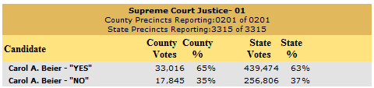
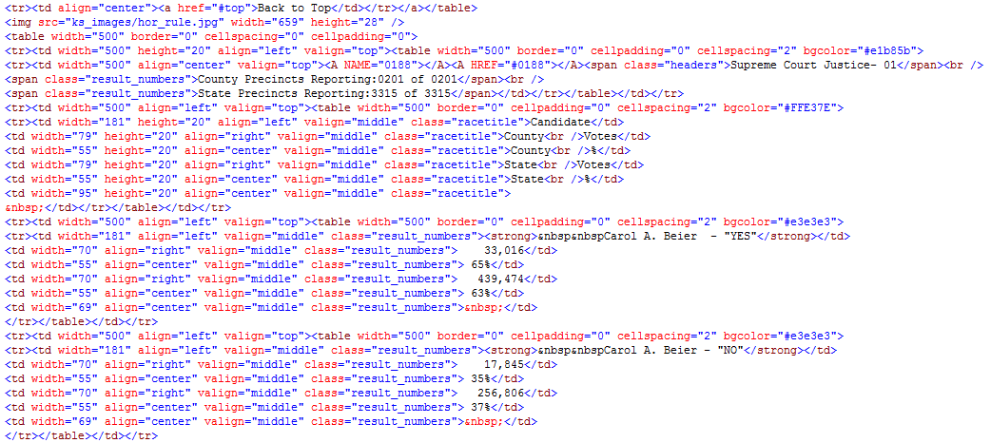
www.kssos.org/ent/shawnee.html
Web page
HTML
IE: Right Click, View Source
Firefox: Right Click, View Page Source

Slide 11
Screen scrape: Web page to data file
Parse HTML
+ Data Cleanup
+ Filtering

Slide 12
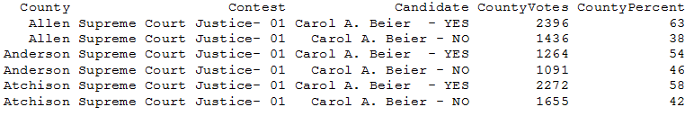
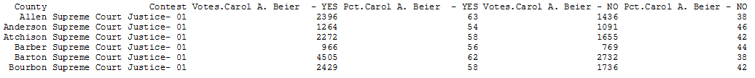
“Reshape” Data
Reshape from “long” to “wide” format

Slide 13
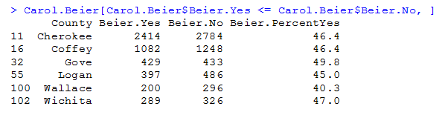
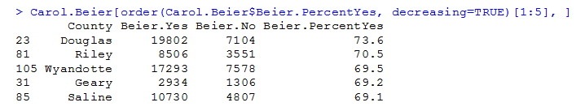
Analyze Data
“Worst” Counties (< 50%)
“Best” Counties (Top 5)

Slide 14
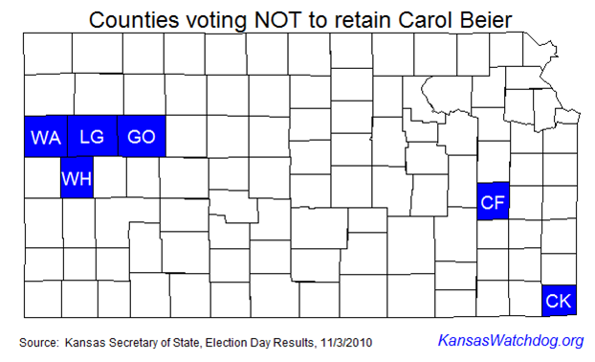
Map Data

Slide 15

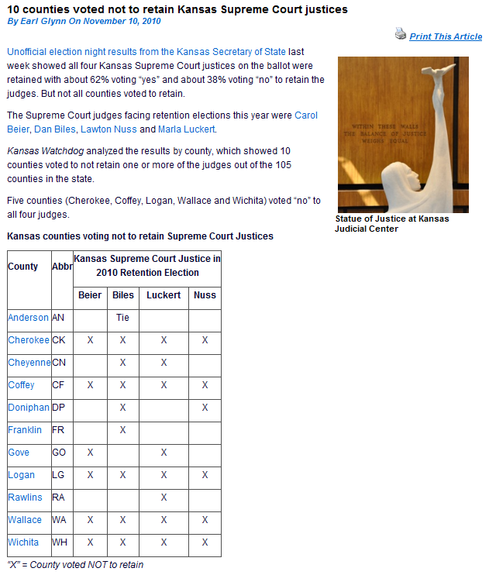
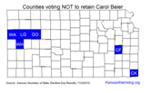
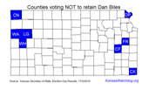
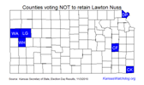
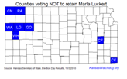
Article

Slide 16
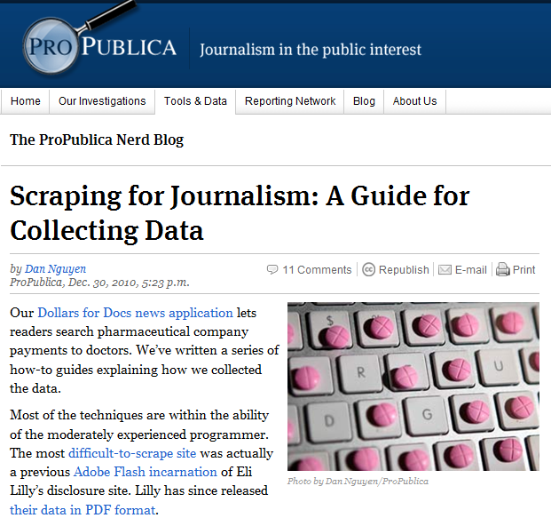
Resource
http://www.propublica.org/nerds/item/doc-dollars-guides-collecting-the-data

Slide 17
Questions?
Earl F. Glynn
earl@KansasWatchdog.org
Twitter: @KansasWatchdog
earl.glynn@FranklinCenterHq.org

