Slide 1


Computer Assisted Reporting
Simple Statistics
to Analyze Data Files
Reporter Training
Denver, CO
June 6, 2011
Earl F. Glynn
Overland Park, KS

Slide 2
Simple Statistics to Analyze Data Files
What kind of file do I have?
What analysis tool is best?
Counting what’s in a data file
“Middle” and “Spread” of data
Statistical Outliers

Slide 3
What kind of file do I have?
Excel
ASCII Comma-Separated-Values (CSV)
ASCII Tab-delimited and other delimiters
ASCII fixed-width data
PDFs

Slide 4
Excel
Newer extension .xlsx [Excel 2007 or later]
Older extension .xls [Excel 2003 or before]
“Fix” for older versions: http://support.microsoft.com/kb/924074
Windows often hides extensions
Some store Excel data in files with “wrong” extensions such as .dat (e.g., salary data from 7 Wisconsin counties)
Excel can misinterpret data
Excel auto-interprets dates - infuriating!, e.g., 5-27, 7-98, Oct8, Dec1
http://www.mrexcel.com/forum/showthread.php?t=378542

Slide 5
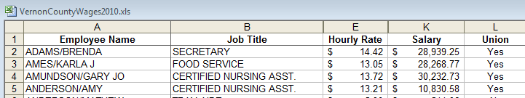
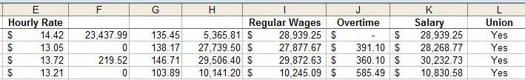
Excel
Excel files can have “hidden” columns and rows,
e.g., Vernon County, Wisconsin
F + G + H = Regular Wages

Slide 6
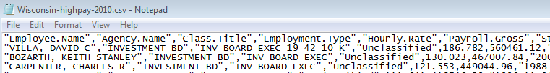
Comma-Separated-Values: CSV
Can be opened in Excel to view/manipulate
Many tools will display CSV files for inspection
showing real format, e.g., NotePad

Slide 7
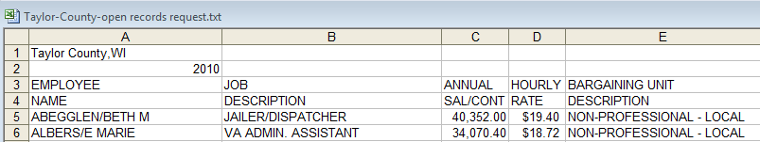
Tab-Delimited Data
Often a .txt extension is used
Can be opened in Excel to view/manipulate
(right click, open with, Excel)
Example from Taylor County, Wisconsin

Slide 8
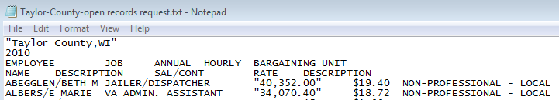

Tab-Delimited Data
Few tools will display tab-delimited files for inspection showing real format. Often cannot distinguish tabs from spaces – can be a nightmare when there are “shifting” problems.
KEdit
Tabs
Geary County, KS has voter data for ~25 voters with tab-delimited data
inside tab-delimited data. It cannot easily be parsed.

Slide 9
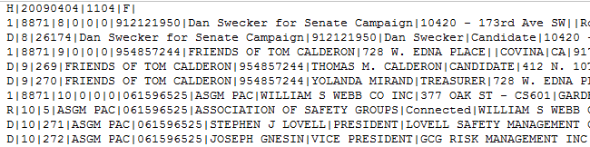
Other Delimiters: “Pipe”
IRS 527 data in IRS 8871/IRS 8872 forms:
http://forms.irs.gov/politicalOrgsSearch/search/datadownload.jsp
“Pipe” field delimiter (|)
This file has multiple record types
Requires custom software to parse
FEC uses “ASCII 28” (dec) delimiter (Hex 1C) in some files

Slide 10
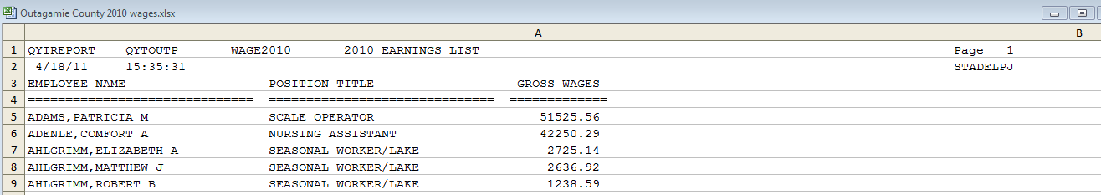
Fixed-Width Data
Common with older “mainframe computer” printouts.
Example: Fixed-width data dumped into Excel File
from Outagamie County, Wisconsin.
Display with Courier New font.
All data in column A of Excel file must be parsed.

Slide 11


PDFs for Data?
http://sunlightlabs.com/blog/2009/adobe-bad-open-government/

Slide 12
PDFs for Data?
Two kinds of PDF files:
Scanned image: requires optical character recognition (OCR)
“Save as” to PDF (Office 2007 or later) or
various “Print to PDF” printer drivers

Slide 13
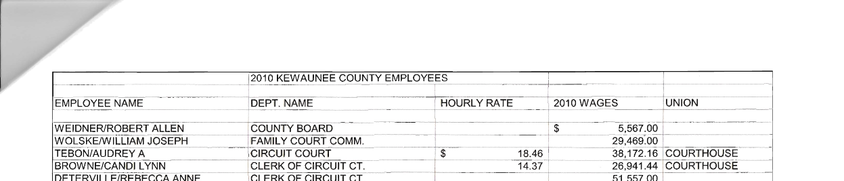
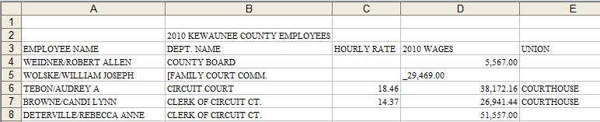
PDFs for Data?
Able2Extract Professional offers custom conversions – automatic conversions often fail.
Kewaunee County, WI example conversion to Excel:

Slide 14
Simple Statistics to Analyze Data Files
What kind of file do I have?
What analysis tool is best?
Counting what’s in a data file
“Middle” and “Spread” of data
Statistical Outliers

Slide 15
Tool: Excel
Popular tool but has limitations
“Spreadsheet Addiction: … Spreadsheets … are an excellent tool for what they are good at … they are often stretched far beyond their home territory …”
http://www.burns-stat.com/pages/Tutor/spreadsheet_addiction.html
“There are no thorough procedures in place to check the accuracy of the spreadsheets …”
www.riskintegrated.com/pdfs/GRRSpreadsheetRiskMay06.pdf
Good tool for display & exchange of data
Better tools for handling 1000s of records?

Slide 16
Tool: Access
Useful “Desktop Database”
Database “Join” a better approach than Excel’s “Lookup” to connect data as files get larger
More of a data storage tool than analysis tool,
but see book “Access Data Analysis Cookbook”
http://oreilly.com/catalog/9780596101220
Negatives:
  “Query by Example” not always intuitive
  Files limited to 2 GB files
  (too small for “Death Master File”)

Slide 17
Tool: R
Free analysis tool available for PCs, Apples, Linux
http://www.r-project.org/
Reads data files, Excel files, Access and other database tables
Many exploratory statistical tools
Creates useful graphics
Negatives:
  “R” can be cryptic; Learning curve can be steep
  Data to be analyzed must fit in memory

Slide 18
Simple Statistics to Analyze Data Files
What kind of file do I have?
What analysis tool is best?
Counting what’s in a data file
“Middle” and “Spread” of data
Statistical Outliers

Slide 19
Counting what’s in a data file
Do you have all the data?
How many records should be in the file? What cross checks are possible? Do totals add up?
In national file, are all states present?
In state file, are all counties present?
In state salary file, are all departments from state organization chart represented?
Are state data consistent with federal data?
Any extra or surprising data?

Slide 20
Tables
Frequency counts of all categorical data
Fairly easy in Access or R
Excel provides a “pivot table”

Slide 21
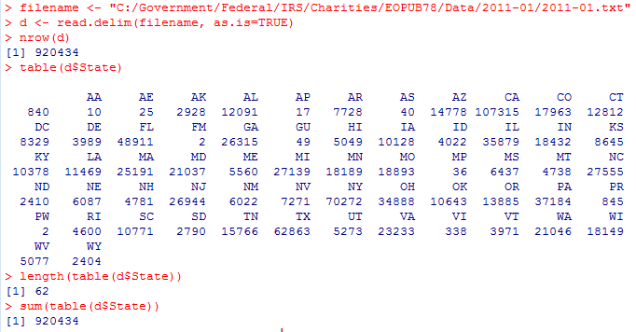
In national file, are all states present?
Jan 2011 IRS Publication 78 Public Charities
http://www.irs.gov/charities/article/0,,id=96136,00.html
R Analysis
Check states against http://en.wikipedia.org/wiki/List_of_U.S._state_abbreviations

Slide 22
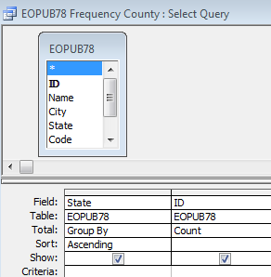
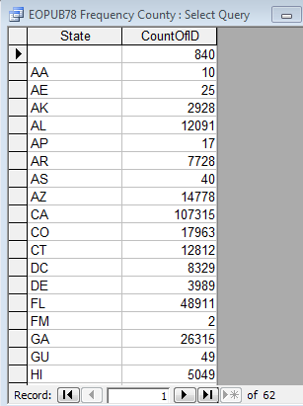
In national file, are all states present?
Jan 2011 IRS Publication 78 Public Charities
Access Version

Slide 23

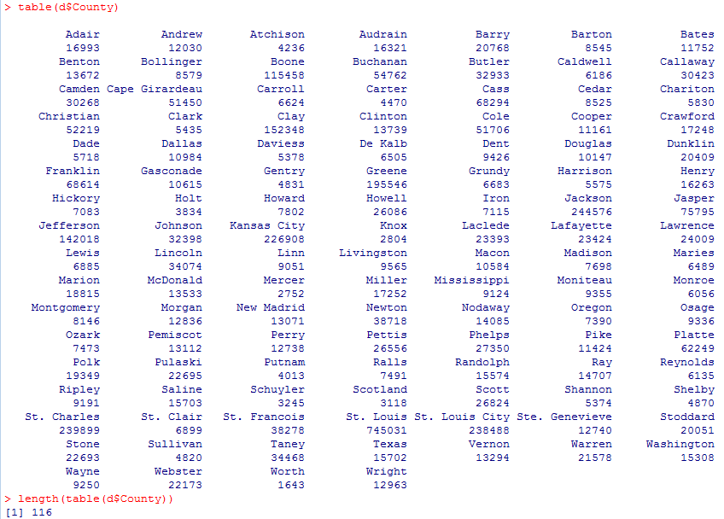
In state file, are all counties present?
Missouri Voter Registration Data
R Analysis
Missouri treats Kansas City and St. Louis City as counties for voting purposes.

Slide 24
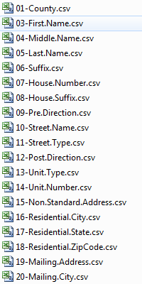
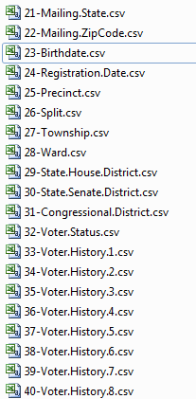
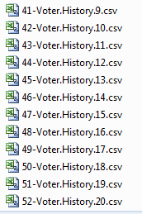
Missouri Voter Registration Data
Fairly easy to create files with frequency counts
of almost every field in the file for research

Slide 25
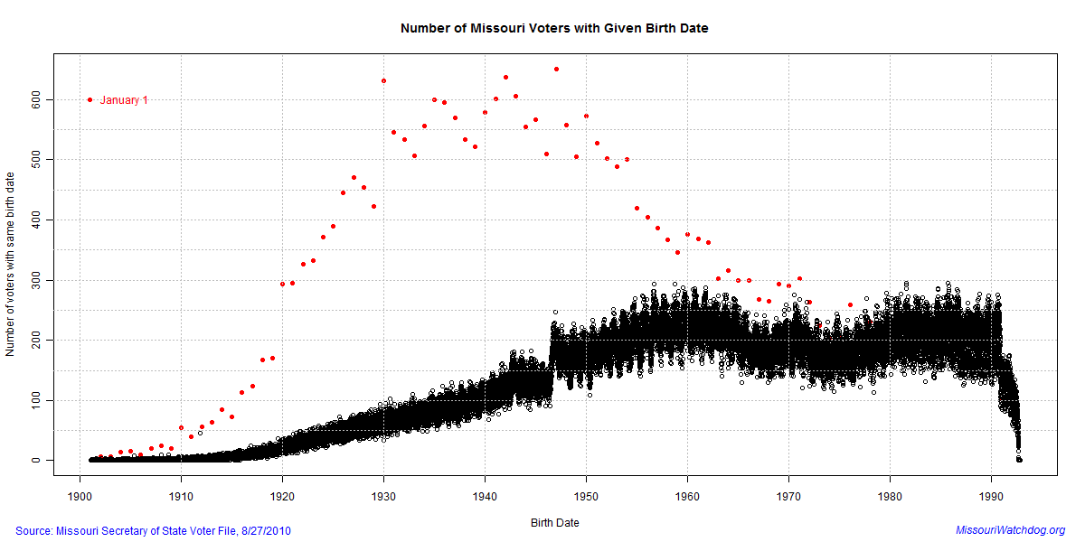
Missouri Voter Data: Birth date Frequencies
53 of 1798 voters in MO-40 Aug ’10 Democratic Primary had Jan 1 birth dates
http://missouri.watchdog.org/4503/potential-voter-fraud-in-missouri-house-election/

Slide 26
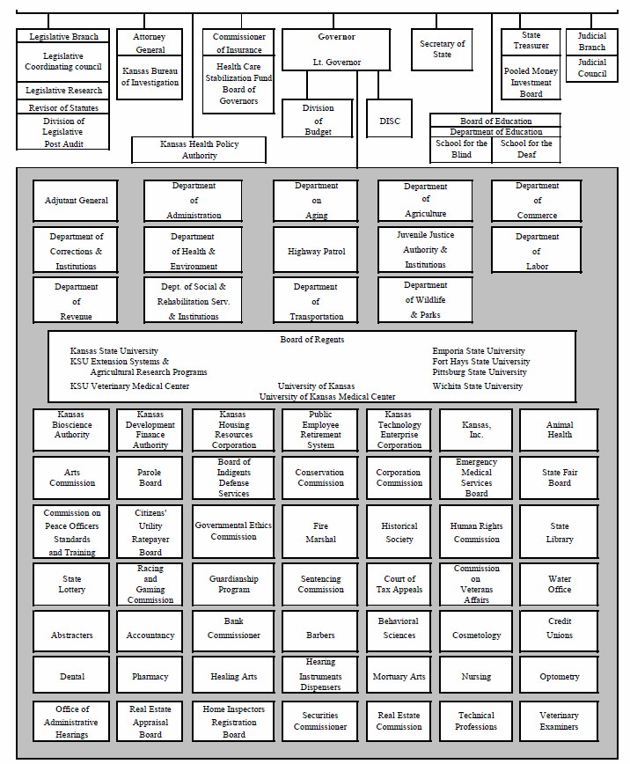

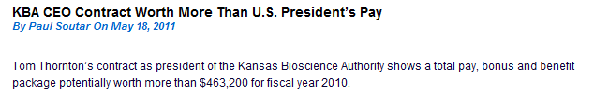
In state salary file, are all departments from state organization chart represented?
Kansas’ Comprehensive Annual Financial Report has state Organization Chart: http://da.ks.gov/ar/finrept/CAFR2010.pdf
Three organizations in org chart
are not part of state’s payroll!

Slide 27
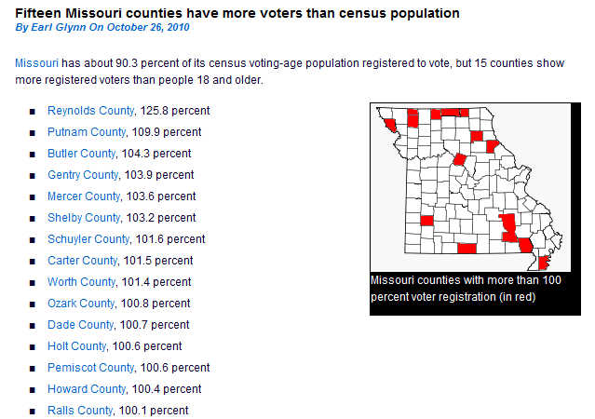
Are state data consistent with federal data?
Count voters by county and
compare to census count for age ≥ 18

Slide 28

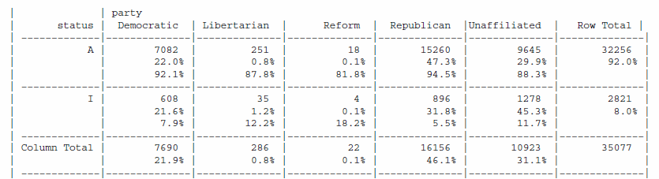


Cross Tabs
Frequency counts with two quantities
R “table” command. Access has “Crosstab Query Wizard” that is useful.

Slide 29
Simple Statistics to Analyze Data Files
What kind of file do I have?
What analysis tool is best?
Counting what’s in a data file
“Middle” and “Spread” of data
Statistical Outliers

Slide 30
“Middle” and “Spread” of data
Assume 9 salaries:
39688, 17301, 69689, 50159, 39821, 25846, 32463, 50159, 40572
Sort in order:
17301, 25846, 32463, 39688, 39821, 40572, 50159, 50159, 69689
Middle value is the Median

Slide 31
“Middle” and “Spread” of data
Assume 9 salaries:
39688, 17301, 69689, 50159, 39821, 25846, 32463, 50159, 40572
Sort in order:
17301, 25846, 32463, 39688, 39821, 40572, 50159, 50159, 69689
Middle
Spread shown by middle 50% of values
(sometimes called “interquartile range” or IQR)

Slide 32
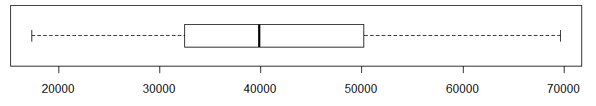
“Middle” and “Spread” of data
Assume 9 salaries:
39688, 17301, 69689, 50159, 39821, 25846, 32463, 50159, 40572
Sort in order:
17301, 25846, 32463, 39688, 39821, 40572, 50159, 50159, 69689
Middle
Spread

Slide 33
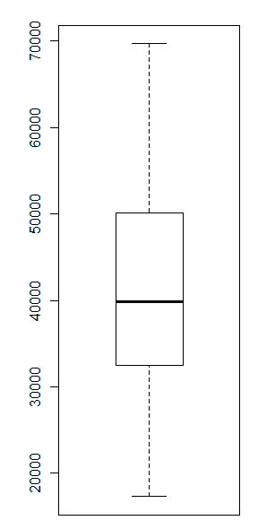
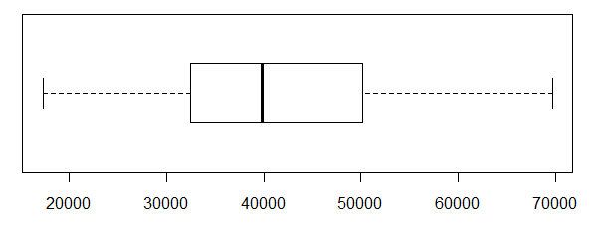
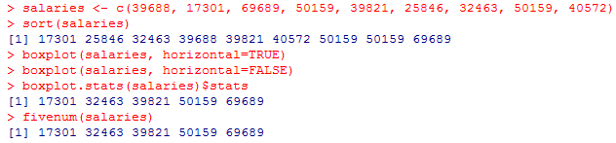
Box Plots
R example:

Slide 34
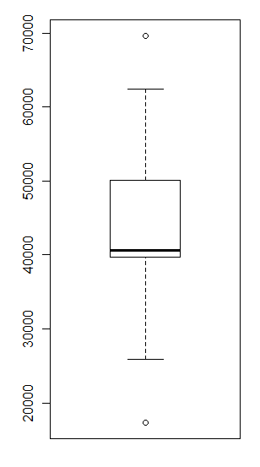
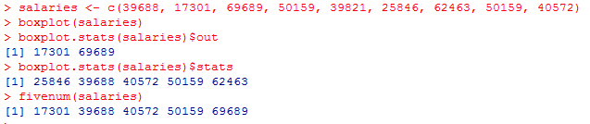
Box Plots
What if value 32463 should have been 62463?
R example:
Outlier
Median Change
39821 to 40572
IQR Change
[32463, 50159] to [39688, 50159]
Skewed
Outlier

Slide 35
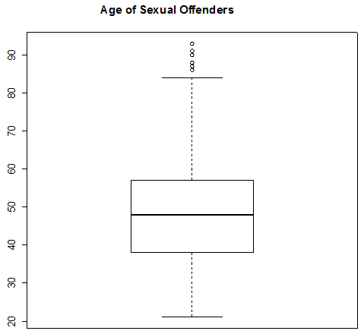
Boxplot: Age of Maine Sex Offenders
Statistical
Outliers
Range of
Middle
50%
Median
Screen scraped data for ~3000 offenders in Maine in April 2011
http://sor.informe.org/sor/

Slide 36
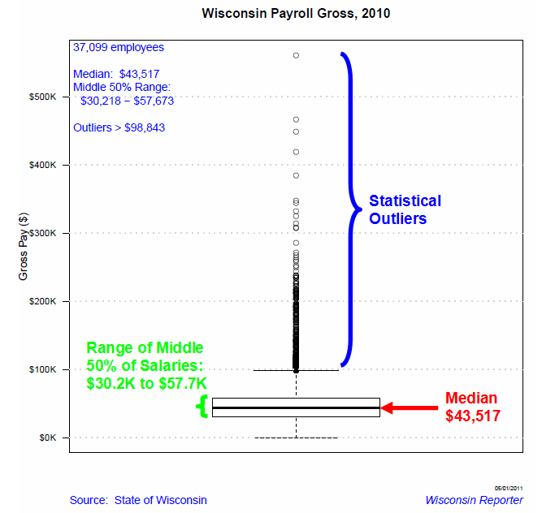
Boxplot: Wisconsin Payroll Gross, 2010

Slide 37
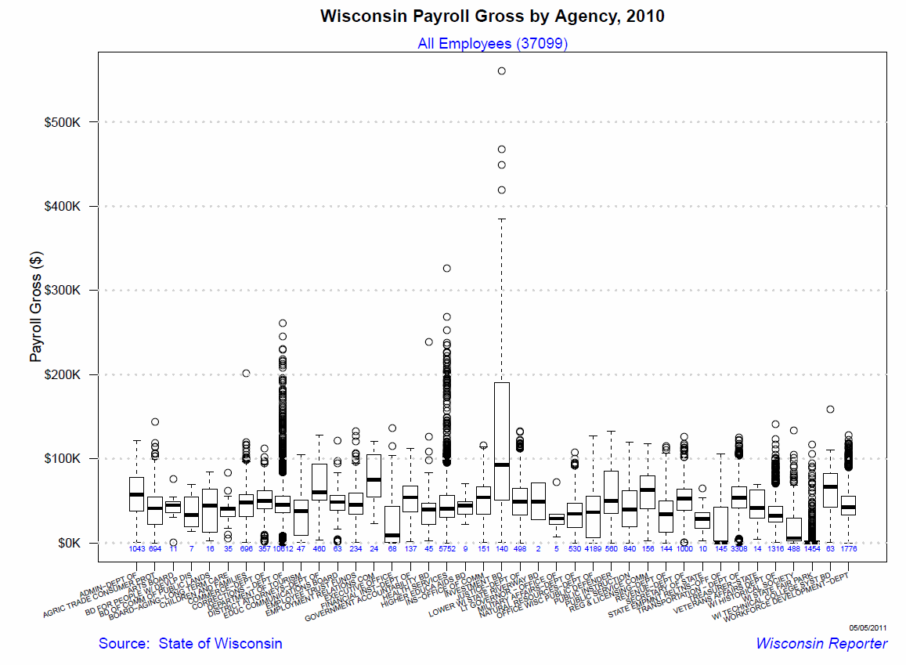
Boxplot: Wisconsin Payroll Gross, 2010

Slide 38
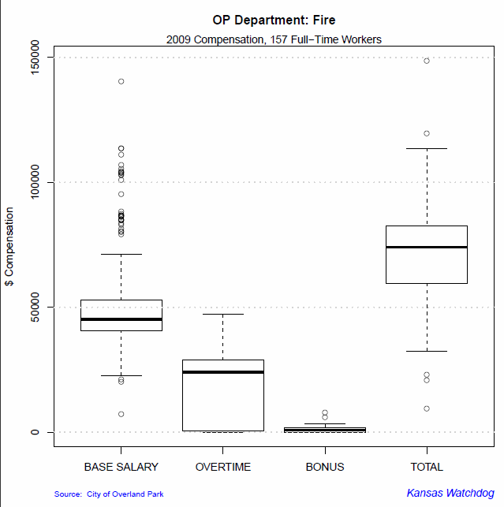
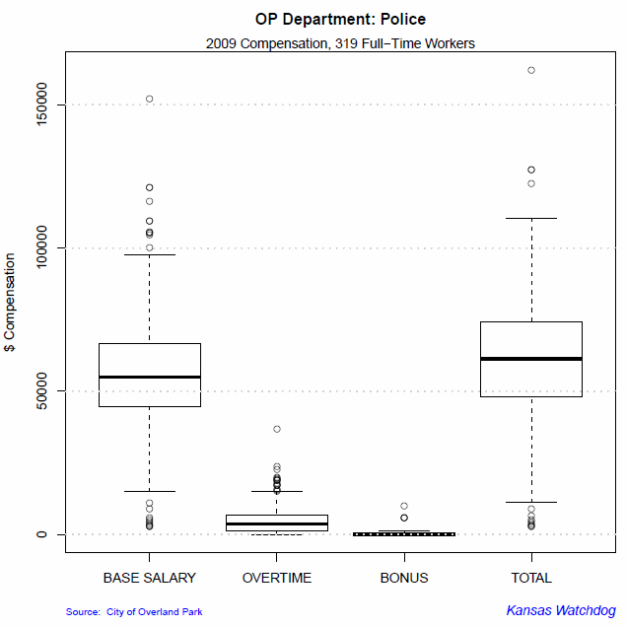
Boxplot: Overland Park, KS Salaries
Comparison of Fire Department with Police Department

Slide 39
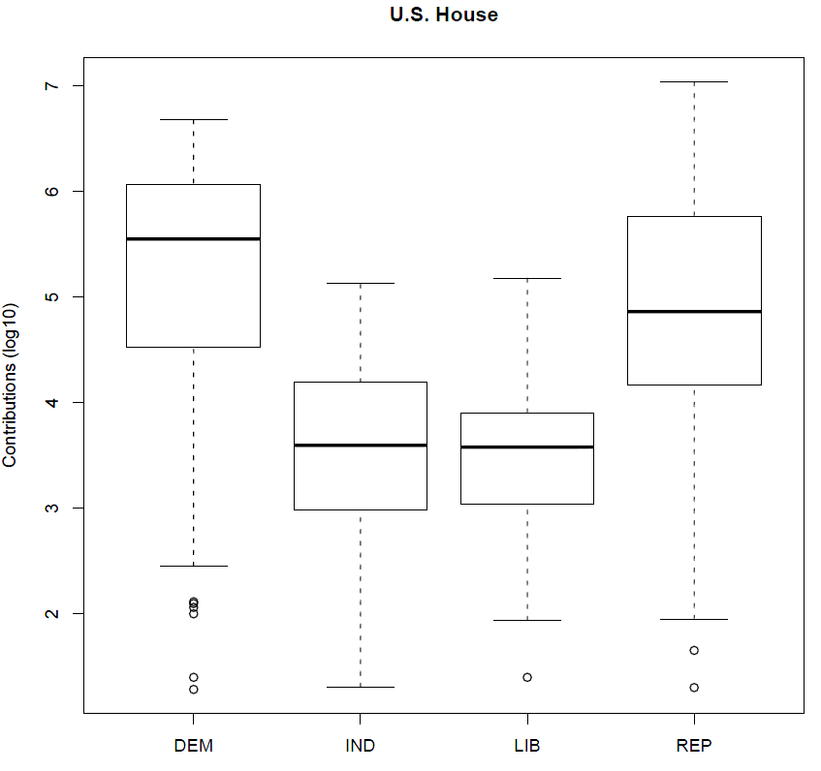
Boxplot Comparisons
Contributions to U.S. House Candidates (Through Oct 2010)
Log-10 Scale
~$300,000
~$100,000
From http://www.fec.gov/data/CandidateSummary.do

Slide 40
Questions?
Earl F. Glynn
earl@KansasWatchdog.org
Twitter: @KansasWatchdog or @EarlGlynn
earl.glynn@FranklinCenterHq.org

