Slide 1
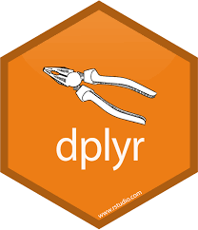
dplyr for beginners Kansas City R Users Group
efg Earl F Glynn
2021-02-13
https://github.com/EarlGlynn/dplyr-for-beginners

Slide 2

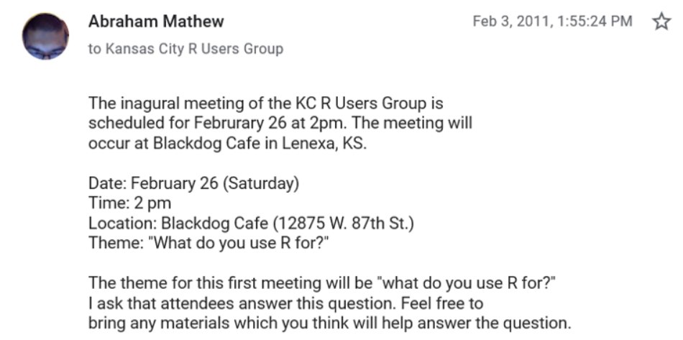
Random thought #1 …
The KC R Users Group is now 10 years old!!

Slide 3

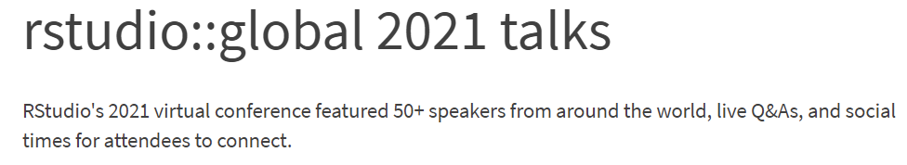
Random thought #2 …
ICYMI … https://rstudio.com/resources/rstudioglobal-2021/

Slide 4
overview: dplyr for beginners
origin of “dplyr”
data used in examples: palmerpenguins
tidyverse
dplyr verbs
maggritr “pipe” operator and data pipeline
dplyr for beginners notebook
dbplyr: dplyr with databases

Slide 5
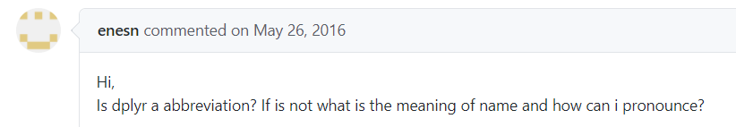
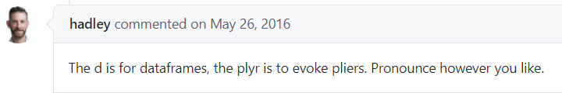
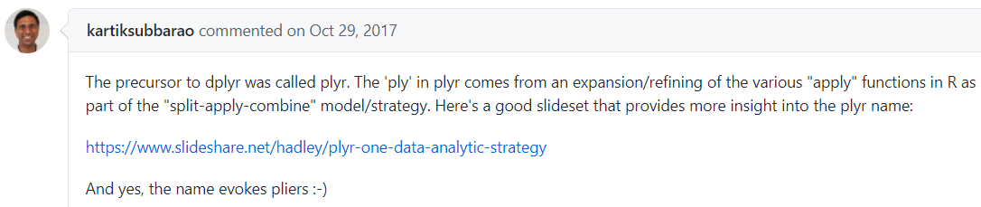
origin of `dplyr`
https://github.com/tidyverse/dplyr/issues/1857

Slide 6
data used for examples: palmerpenguins
https://cran.r-project.org/web/packages/palmerpenguins/index.html
palmerpenguins: Palmer Archipelago (Antarctica) Penguin Data
Size measurements, clutch observations, and blood isotope ratios for adult foraging Adélie, Chinstrap, and Gentoo penguins observed on islands in the Palmer Archipelago near Palmer Station, Antarctica. Data were collected and made available by Dr. Kristen Gorman and the Palmer Station Long Term Ecological Research (LTER) Program.
> install.packages("palmerpenguins")

Slide 7
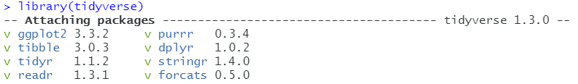
tidyverse
library(tidyverse)

Slide 8
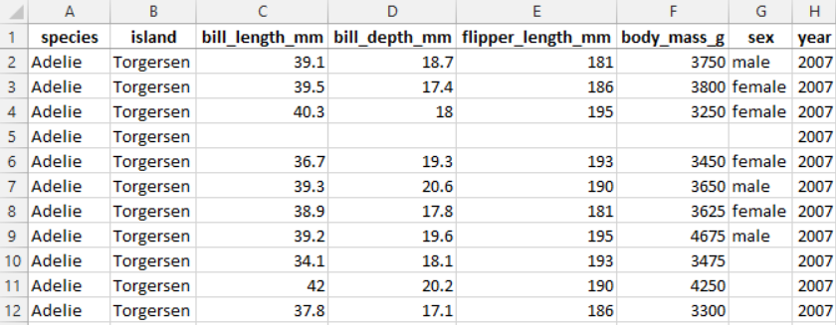
dplyr verbs
Columns:
select, mutate, everything, pull
across, relocate, rename
Rows: filter, arrange, slice
Groups of rows: summarise
Two table verbs:
inner_join, left_join, right_join
semi_join, anti_join
Many similarities to SQL verbs

Slide 9
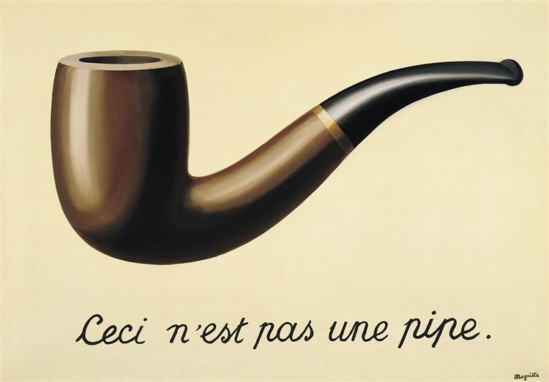
maggritr “pipe” operator and data pipeline
maggritr: %>%
Uses “non-standard evaluation” Understanding Non-Standard Evaluation https://thomasadventure.blog/posts/understanding-nse-part1/
datasource %>% action1(parms…) %>% action2(parms…) …
Read “%>%” as “then”
https://www.wikiart.org/en/rene-magritte/ the-treachery-of-images-this-is-not-a-pipe-1948

Slide 10
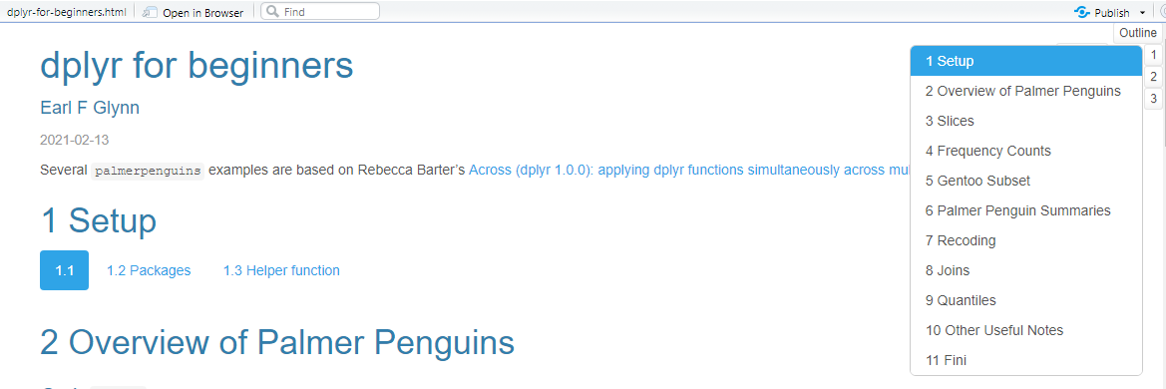
dplyr for beginners notebook
https://github.com/EarlGlynn/dplyr-for-beginners

Slide 11
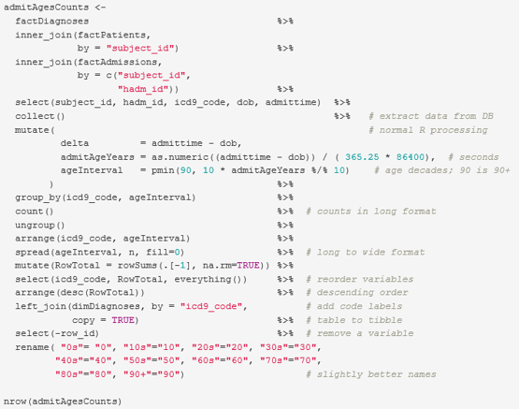
dbplyr: dplyr with databases
2019-02-09-Exploring-MIMIC-III.pptx, Slide 47
Exploring MIMIC-III Critical Care Database https://github.com/EarlGlynn/MIMIC-III-Exploration 2019-02-09-Exploring-MIMIC-III.pptx, Slide 47
Great resource: https://db.rstudio.com/best-practices/

