Slide 1
Using Interactive Jupyter Notebooks with R
Earl F Glynn
Kansas City R Users Group
2015-12-05
http://earlglynn.github.io/kc-r-users-jupyter/

Slide 2
Using Interactive Jupyter Notebooks with R
What is Jupyter?
R User Interface Evolution
Command Line
RStudio
RStudio with Markdown
Jupyter Notebook
Jupyter Markdown Cells
Jupyter Code Cells
Installation of Jupyter

Slide 3
What is Jupyter?
http://jupyter.org/
Language-agnostic parts of IPython
(“Interactive Python”) http://ipython.org/
Provides interactive data science and scientific computing across ~40 programming languages
Julia – Python – R

Slide 4
R User Interface Evolution
R Command Line
RStudio
RStudio with Markdown
Jupyter Notebook
Comparisons using ?lm help example

Slide 5
R Command Line
?lm
## Annette Dobson (1990) "An Introduction to Generalized Linear Models".
## Page 9: Plant Weight Data.
ctl <- c(4.17,5.58,5.18,6.11,4.50,4.61,5.17,4.53,5.33,5.14)
trt <- c(4.81,4.17,4.41,3.59,5.87,3.83,6.03,4.89,4.32,4.69)
group <- gl(2, 10, 20, labels = c("Ctl","Trt"))
weight <- c(ctl, trt)
lm.D9 <- lm(weight ~ group)
lm.D90 <- lm(weight ~ group - 1) # omitting intercept
anova(lm.D9)
summary(lm.D90)
opar <- par(mfrow = c(2,2), oma = c(0, 0, 1.1, 0))
plot(lm.D9, las = 1) # Residuals, Fitted, ...
par(opar)
Copy and paste to R console window

Slide 6
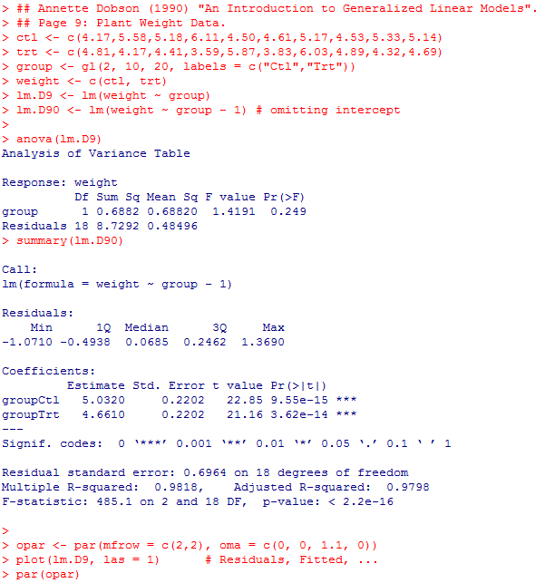
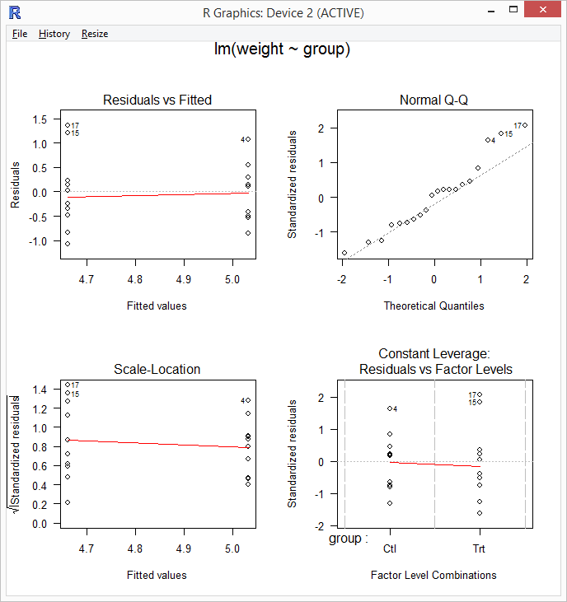
R Command Line

Slide 7
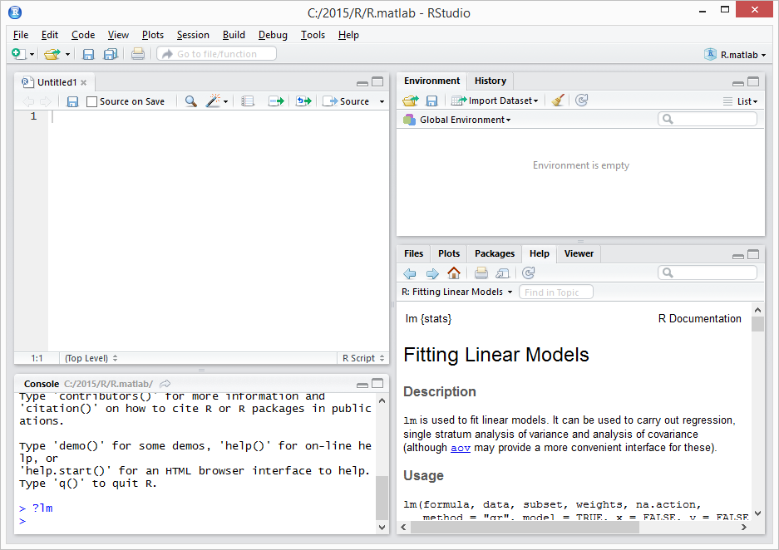
RStudio
https://www.rstudio.com/products/RStudio/

Slide 8
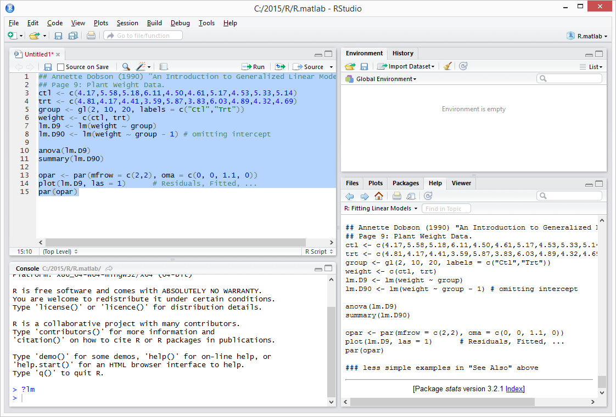
RStudio

Slide 9
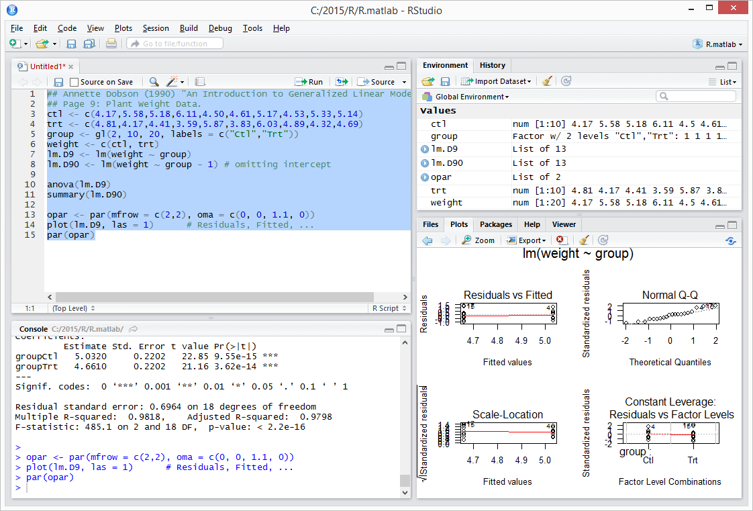
RStudio

Slide 10
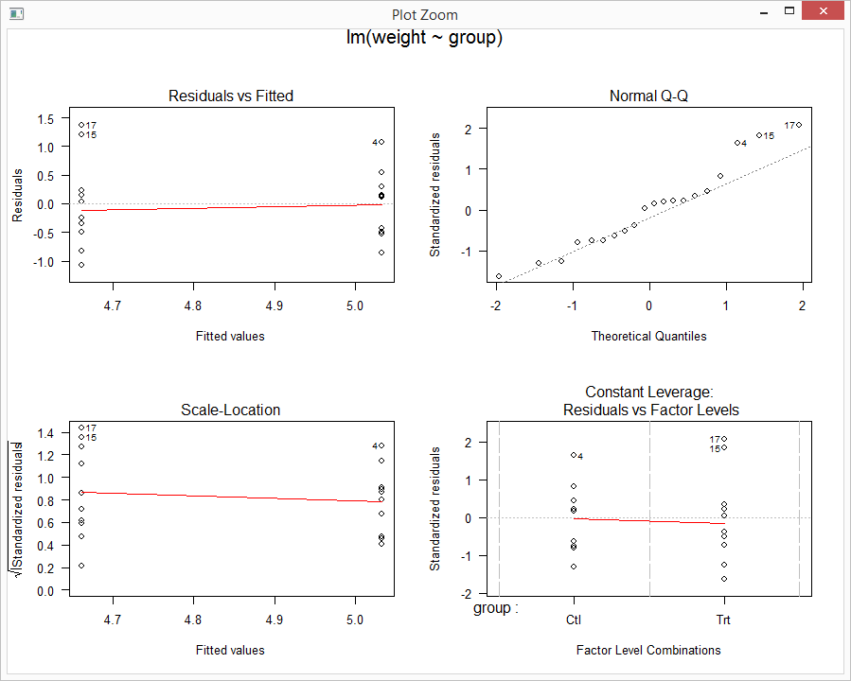
RStudio

Slide 11
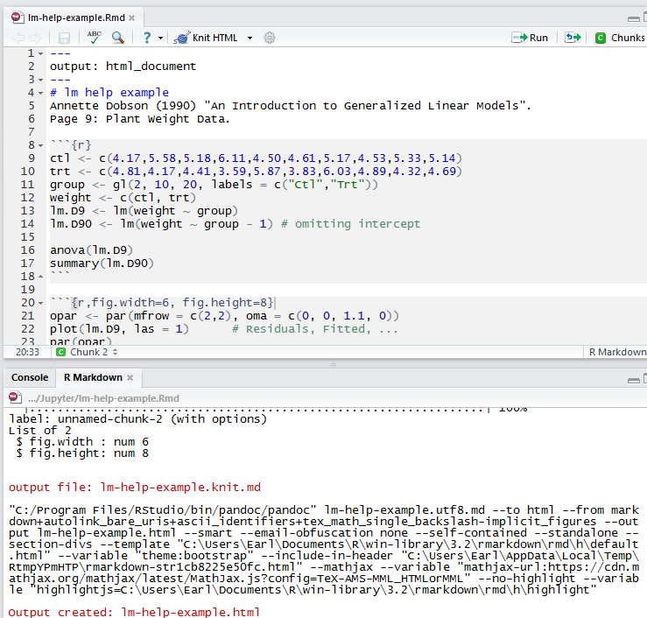
RStudio with Markdown
Markdown Basics: http://rmarkdown.rstudio.com/authoring_basics.html

Slide 12
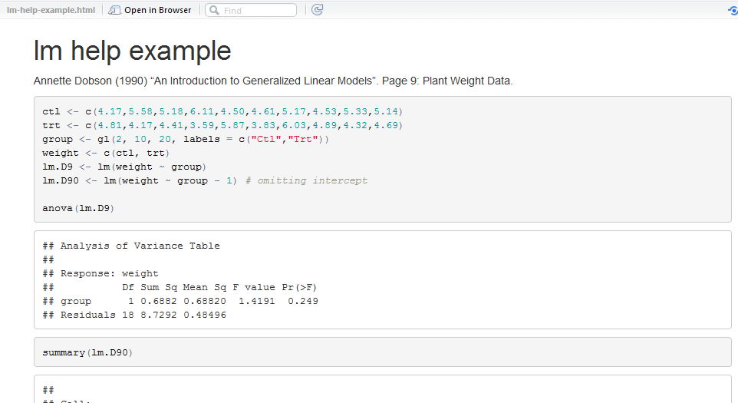
RStudio with Markdown
Output to HTML, PDF, Word.
Graphics output included.

Slide 13
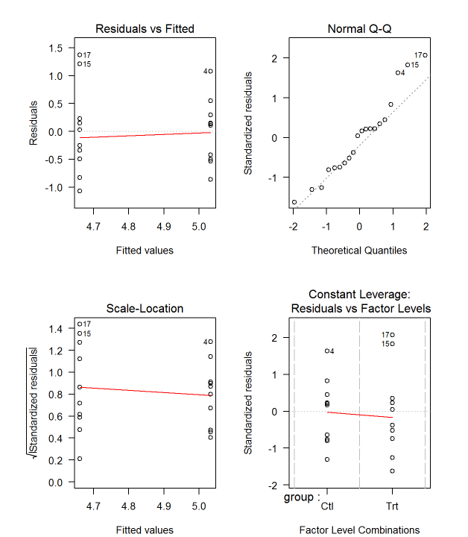
RStudio with Markdown

Slide 14
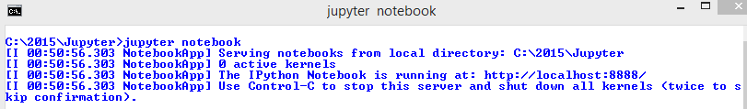
Jupyter Notebook
From command window in working directory, start Jupyter notebook server:
jupyter notebook

Slide 15
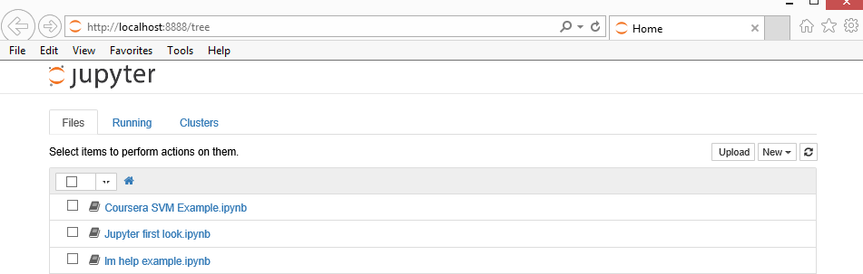
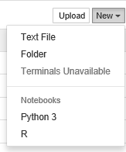
Jupyter Notebook

Slide 16
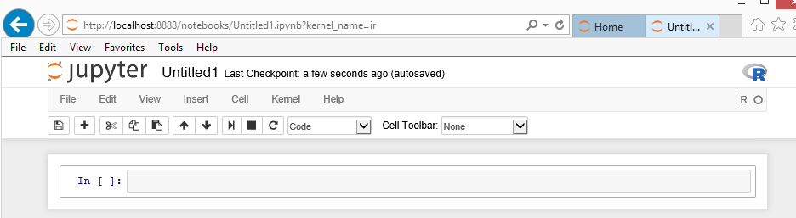
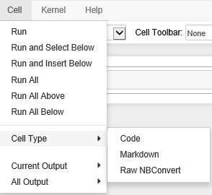
Jupyter Notebook
Add Cell
Each Jupyter cell contains Markdown or the equivalent of a Code “chunk” in RStudio

Slide 17
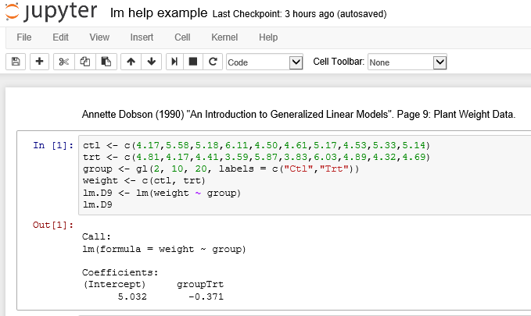
Jupyter Notebook
Markdown
Code
Unlike RStudio/knittr, no special syntax for code chunk.
Enter “Ctrl-Enter” to execute code in cell interactively.
Out[1] is the R output here from cell In[1].

Slide 18
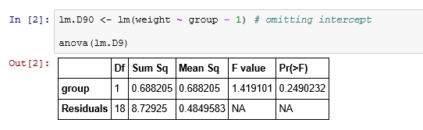
Jupyter Notebook

Slide 19

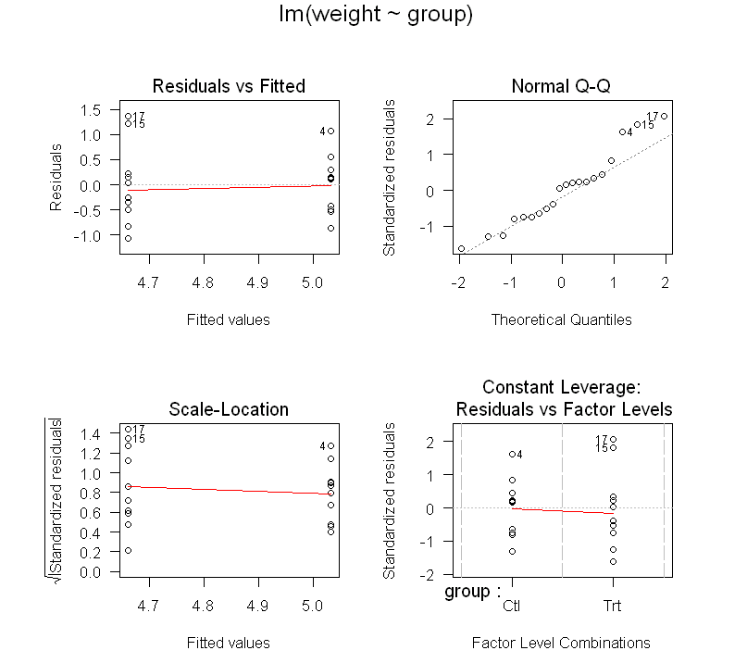
Jupyter Notebook

Slide 20
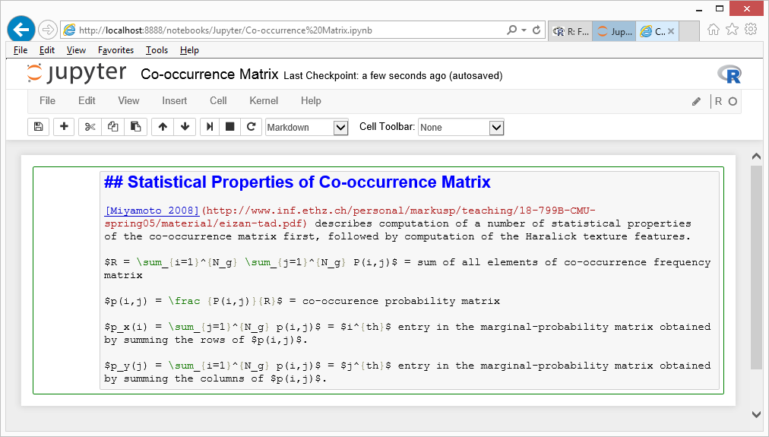
Jupyter Markdown Cells
Markdown example including inline LaTeX equations. Ctrl-Enter to render.

Slide 21
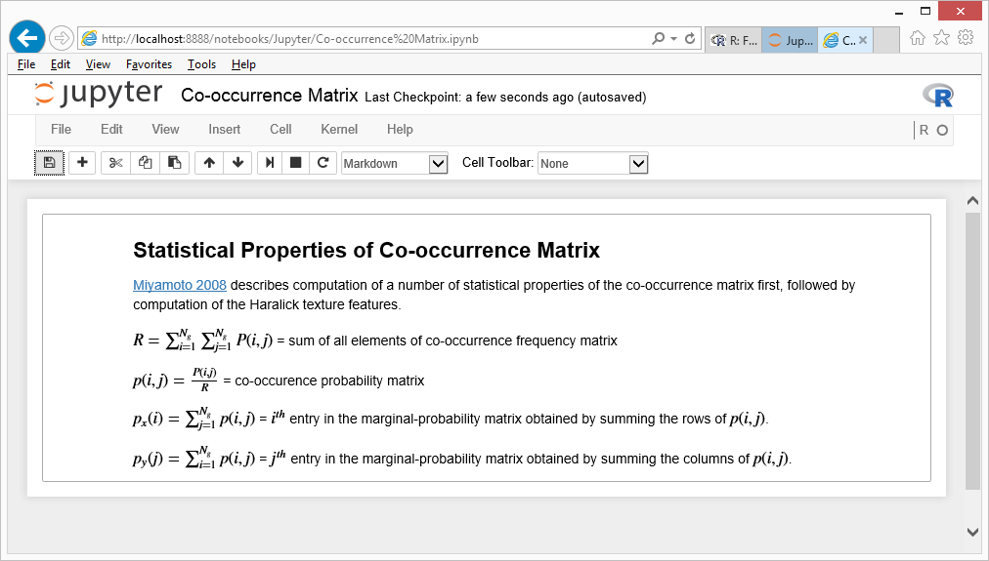
Jupyter Markdown Cells

Slide 22
Jupyter Code Cells
Online Examples:
http://earlglynn.github.io/kc-r-users-jupyter/
Jupyter First Look
lm help example
Co-occurrence Matrix
Exploring Kaggle Facial Keypoints Detection Data

Slide 23
Installation of Jupyter
Perhaps easiest:
Install Anaconda Python from Continuum Analytics
https://www.continuum.io/downloads
Python 3.5, Windows 64-bit graphical installer
Package List: http://docs.continuum.io/anaconda/pkg-docs
Includes: numpy, scipy, scikit-learn, matplotlib, …

Slide 24
Installation of Jupyter
From command prompt:
Conda: conda update conda
Jupyter: conda install jupyter
R Essentials: conda install -c r r-essentials
R Kernel: conda install -c r ipython-notebook r-irkernel http://irkernel.github.io/installation/ https://www.continuum.io/blog/developer/jupyter-and-conda-r

Slide 25

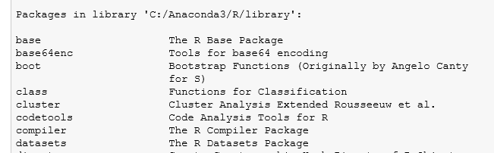
R Packages Used by Jupyter
. . .

Slide 26
Installation of Jupyter
Kernels for other languages:
https://github.com/ipython/ipython/wiki/IPython-kernels-for-other-languages

Slide 27
Take Home Message
Jupyter is a great way to use R interactively to document the steps in a data analysis project.
Jupyter’s interactive approach is better (IMHO) than the batch processing by RStudio/knitr to document reproducible results.

