Slide 1

Using Open Source OCR Tools for Digitization Projects
Matthew J. Christy

Slide 2
Intro – Me
Matthew J. Christy
Lead Software Applications Developer at the Initiative for Digital Humanities, Media and Culture (IDHMC) at Texas A&M University
@matt_christy
idhmc.tamu.edu
@idhmc_nexus
Co-project manager of the Early Modern OCR Project (eMOP)
emop.tamu.edu
#emop
Former Systems/Electronic Resources Librarian

Slide 3
Intro – You
Name & Institution
Experience with OCR
What’s your project or what are you bringing with you?

Slide 4
Intro – Outline
OCR & Open Source Engines
Digitization vs OCR
Tesseract
OCROpus
Gamera
Setup
Installing Tesseract
Installing Aletheia
Installing Franken+
Installing ImageMacick / GIMP
Running Tesseract (default)
Identifying issues with your page images
What’s your font?
Image quality problems
Pre-processing
Binarization
Cropping
“de”-ing (noise, skew, warp, etc.)
Training Tesseract for your font
Tesseract’s native training mechanism
When more is needed
Aletheia
Franken+
Word lists
Common transformation errors
Running Tesseract (your training)
Your results
Comparing OCR results to Groundtruth
Creating Groundtruth
Post-processing
Hand correction
Crowd-source correction
eMOP tools

Slide 5
OCR & Open Source Engines
Digitization vs. OCR
Digitization is the creation of a digital representation of an object.
In the print world, a digital image of a page: page image
end product: image files (.tif .jpg .png .pdf)
Optical Character Recognition (OCR) is the use of software to recognize the characters on a page image and turn that into text.
text that is searchable, and editable
end product: text files (.txt .rtf .doc .pdf)
Notes:
This is something I think a lot of users don’t really understand.
PDF’s have really confused the issue.

Slide 6
Tesseract
Developed by Ray Smith at HP
Taken up by Google
Used in their Google Books mass-digitization & OCR program
Open Source: code.google.com/p/tesseract-ocr/
version 3.02
Windows, Mac and UNIX
Documentation is not always helpful
User group: groups.google.com/forum/ - !forum/tesseract-ocr
Training for various scripts and languages available
Lots of users, so Google it

Slide 7
OCR Opus
Developed by Thomas Breuel
Originally used Tesseract for character recognition
Was not under active development for a while, but a new version is now available
Open Source: code.google.com/p/ocropus/
version 0.7
Windows, Mac & UNIX
User group: groups.google.com/forum/ - !forum/ocropus

Slide 8
Gamera
Developed by Ichiro Fujinaga (McGill University)
Designed to OCR music
It’s actually the Gamera OCR Toolkit that you want
Open Source: gamera.informatik.hsnr.de/addons/ocr4gamera/
version 1.1.0 (Jun, 2014)
Windows, Mac and UNIX
User group: groups.yahoo.com/neo/groups/gamera-devel/info
Training can take a while.
emop.tamu.edu/Gamera-OCR

Slide 9
Installing Tesseract
Mac: emop.tamu.edu/Installing-Tesseract-Mac
PC: emop.tamu.edu/Installing-Tesseract-PC
code.google.com/p/tesseract-ocr/wiki/ReadMe
Standard English-language training:
code.google.com/p/tesseract-ocr/downloads/list (tesseract-ocr-3.02.eng.tar.gz)
combine_tessdata -u eng.traineddata ../unpacked/eng
dawg2wordlist eng.unicharset eng.word-dawg eng-word-list.txt

Slide 10
Installing Aletheia
Windows only
Download the zip file
www.primaresearch.org/tools/Aletheia
Click the Download the previous version button (v2.1)
Run executable file
Notes:
There is a new version of Aletheia which changed the output format. Franken+ is currently being updated to handle this new output. In the meantime…

Slide 11
Installing Franken+
Windows only
Download the zip file
dh-emopweb.tamu.edu/Franken+/
Install executable file
Requirements:
.NET Framework 4.5 (standard on Windows 8)
a local MySQL server with root username
(MySQL Community Server 5.6)
See emop.tamu.edu/Installing-FrankenPlus for more instructions

Slide 12
Installing ImageMagick/GIMP
Two good free image manipulation programs available for Windows, Mac and Unix
ImageMagick
typically command-line but has a limited graphical interface inWindows
www.imagemagick.org/
GIMP (GNU Image Manipulation Program)
has a graphical user interface for all platforms
www.gimp.org/

Slide 13
Running Tesseract with default training
tesseract <page image> <outfile> -l <lang> <config file>
Where:
<outfile> is the name of the of the .txt and .html files to be created
<lang> is the “language name” you gave your training, i.e. what you called your typeface training set
<config file> is a file name containing some configuration information for Tesseract
“tessedit_create_hocr 1” produces hOCR (HTML) output
Tesseract’s default output is text only
Tesseract’s default <lang> in “eng” their standard english-language training

Slide 14
Identifying issues with your page images
What’s your font?
OCR engines need to be trained on the typeface they will be trying to recognize
Modern fonts (fonts available via a word processor) make it easy to train an OCR engine
Other fonts (bus signs, secretary hand, early modern fonts) require special training procedures

Slide 15
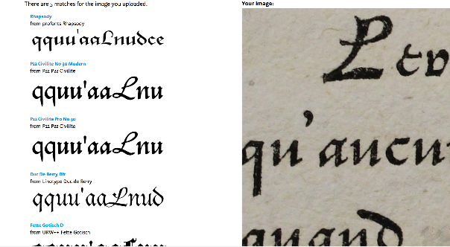
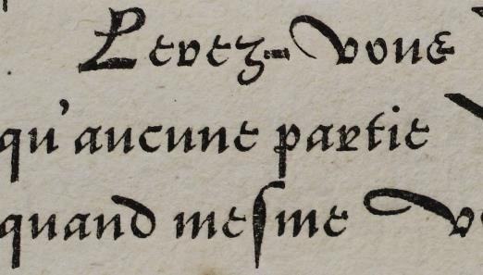
WhatTheFont
www.myfonts.com/WhatTheFont/
crop your page image down to a section of 20 or so letters (<2 MB)
try to find some distinctive characters
submit, then help identify the characters found

Slide 16
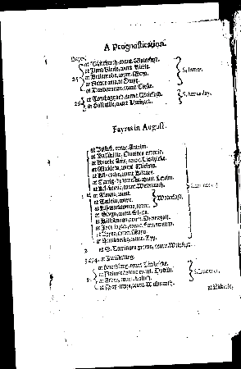
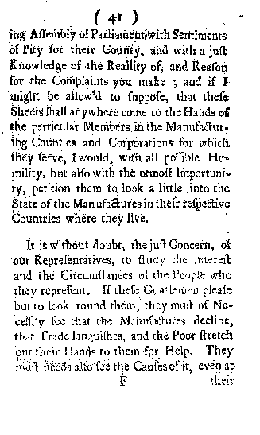
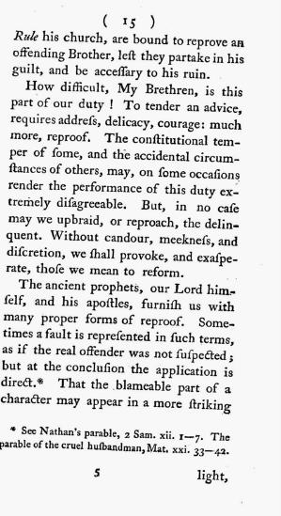
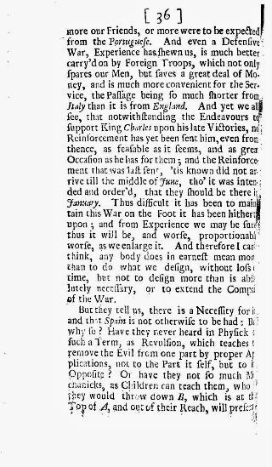
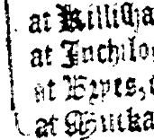
Image Quality Issues
Small file size/resolution
(< 300 dpi)
Noise
Bleedthrough
Over/under inking
Skew
Warp

Slide 17
Pre-processing
There are pre-processing algorithms available to fix most of these issues
Very useful if you have a small number of documents, or if you know that all your documents have the same issues (need the same pre-processing)
Can dramatically improve OCR results
Tools:
GIMP: www.gimp.org/
ImageMagick: www.imagemagick.org/
(www.fmwconcepts.com/imagemagick)
Notes:
GNU Image Manipulation Program

Slide 18
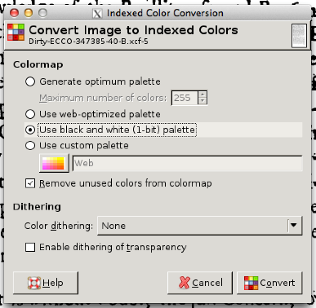
Binarization
Converting to Black & White
ImageMagick:
convert <infile> -colorspace gray +dither -colors 2 -normalize \ <outfile>
Fred’s scripts
otsuthresh <in> <out>
localthresh
GIMP
Image -> Mode -> Indexed ...
Tools -> Color Tools… -> Threshold…

Slide 19
Cropping
Sometimes it helps to crop images to:
remove noise
remove unwanted elements (rulers, fingers, note cards, etc.)
separate multi-page images
It can also reduce the length of time needed to pre-process
Only feasible with a small number of documents
Can use:
GIMP
Paint
Preview

Slide 20
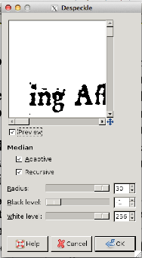
Denoise
or “Despeckle”
Removes speckles from page image
There’s a trade-off
Being too aggressive can reduce the integrity of the glyphs
ImageMagick:
convert <infile> -noise 1 <outfile>
convert <infile> -despeckle <outfule>
GIMP:
Filters -> Enhance -> Despeckle …
Try it multiple times, but watch your glyph
integrity

Slide 21

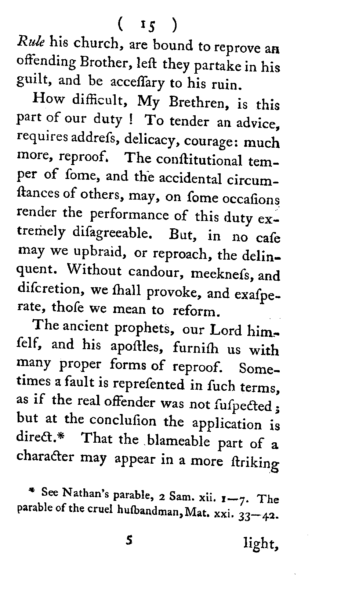
Deskew
or “Rotate” or “Auto-straighten”
ImageMagick:
Fred’s scripts:
sh ./skew.sh -a 2 -m degrees -d b2r -v background <infile> <outfile>
GIMP:
There’s a plugin, but I couldn’t get it installed
registry.gimp.org/node/2958

Slide 22
Dewarp
Dealing with warping (for example, when a page bends due to a tight or think spine) is much trickier.

Slide 23
Training Tesseract for your font
The difference between Training and OCRing
You may end up using some of the documents you want to OCR to create the training.
Training:
Binarize
Clean
Aletheia: Find glyphs (unicode values and coordinates on page)
Franken+: choose best exemplars of glyphs
Add word lists (optional)
Process to create Tesseract training data
OCRing:
Binarize
Clean (if possible)
OCR with Tesseract

Slide 24
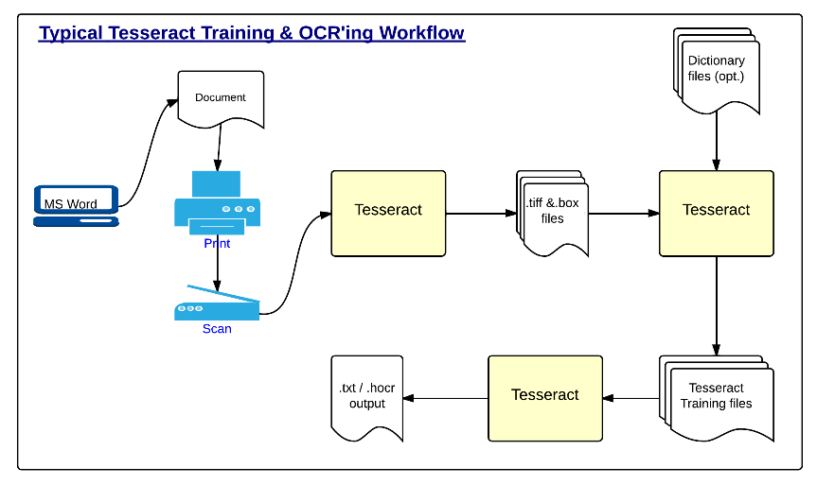
Training Tesseract for your font
code.google.com/p/tesseract-ocr/wiki/TrainingTesseract3

Slide 25
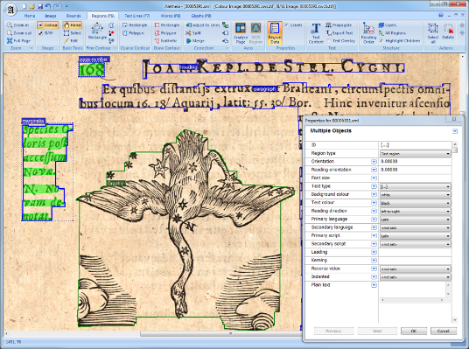
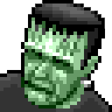
When more is needed
Aletheia: PRImA Research Labs
www.primaresearch.org/
tools/Aletheia
Franken+
dh-emopweb.tamu.edu/Franken+/
See: Aletheia/Franken+ Quick Start Guide for more information

Slide 26
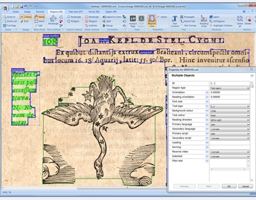
Aletheia
Open Source OCR Tools
Created by PRImA Research Labs, University of Salford, UK.
Windows based tool.
Developed as a groundtruth creation tool
Used by eMOP undergraduate student workers to create training of desired typeface for Tesseract.
Can identify glyphs on a page image with page coordinates and Unicode values.
www.primaresearch.org/tools.php
Available for free but requires registration.
Notes:
Aletheia: Created by PRImA Research Labs at the University of Salford, as a groundtruth creation tool. A team of undergraduates uses Aletheia to identify each glyph on the page images, and ensure that the correct Unicode value is assigned to each. Aletheia outputs an XML file containing all identified glyphs on a page with their corresponding coordinates and Unicode values.

Slide 27
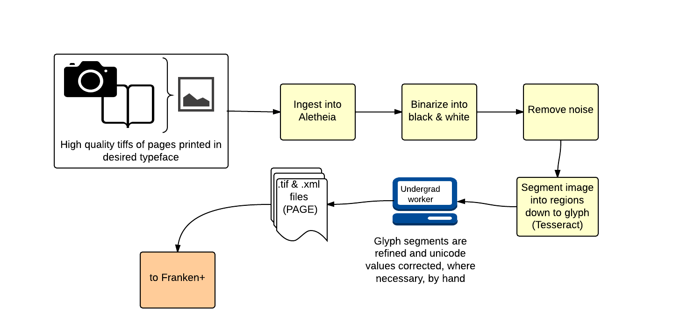
Aletheia: Workflow
Tuesday, August 12, 2014
Open Source OCR Tools
Binarization and Denoise are native Aletheia functions
A team of Undergraduate student workers refines and corrects glyph boxes and unicode values, where needed.
Output: A set of PAGE XML files with page coordinates and unicode values for every identified glyph on each processed TIFF image.

Slide 28
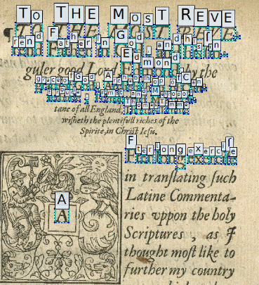
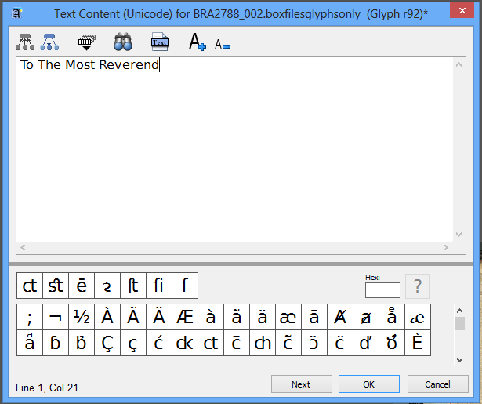
Aletheia: Glyph Recognition
Open Source OCR Tools
Uses Tesseract to find glyphs

Slide 29
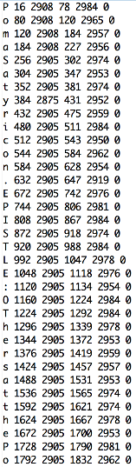
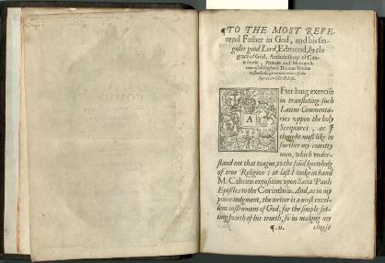
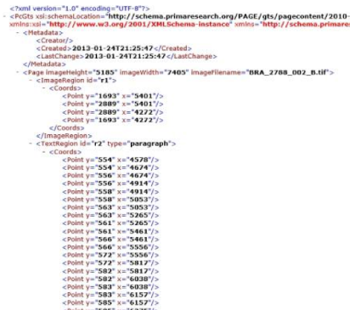
Aletheia: I/O
Open Source OCR Tools
We then convert PAGE XML
file to Tesseract Box file using
XSLT

Slide 30
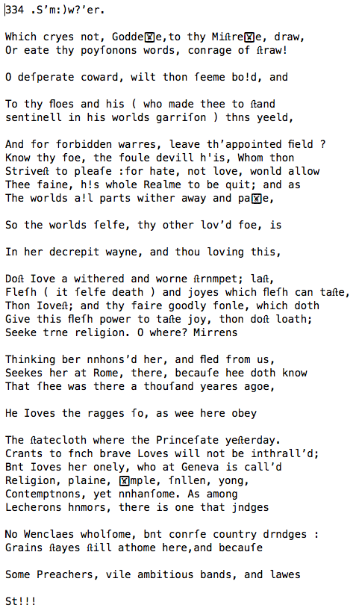
Tesseract Training
Open Source OCR Tools
Notes:
This is cheating: the result of scanning the same page we used to create the training.

Slide 31
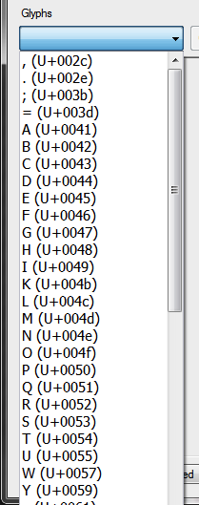
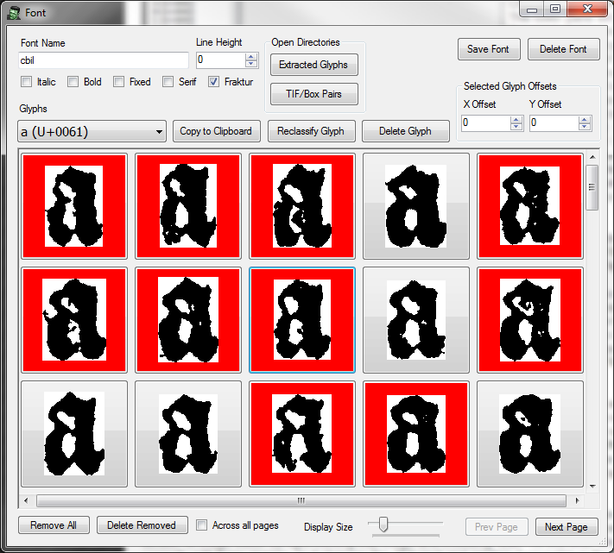
Franken+
Open Source OCR Tools
Windows based tool that uses a MySQL DB.
Developed for eMOP by IDHMC Graduate student worker Bryan Tarpley.
Designed to be easily used by eMOP Undergraduate student workers
Takes Aletheia's output files as input.
Outputs the same box files and TIFF images that Tesseract's first stage of native training.
Available open-source at: github.com/idhmc-tamu/FrankenPlus
Notes:
Franken+: Created by eMOP graduate student Bryan Tarpley. Used by the same team of undergraduates led by eMOP graduate student Kathy Torabi.
Takes Aletheia's output files as input.
Groups all glyphs with the same Unicode values into one window for comparison.
Mistakenly coded glyphs are easily identified and re-coded.
A user can quickly compare all exemplars of a glyph and choose just the best subset, if desired.
Uses all selected glyphs to create a Franken-page image (TIFF) using a selected text as a base.
Outputs the same box files and TIFF images that Tesseract's first stage of native training.
Also allows users to complete Tesseract training using newly created box/TIFF file pairs, and add optional dictionary and other files.
Outputs a .traineddata file used by Tesseract when OCRing page images.

Slide 32
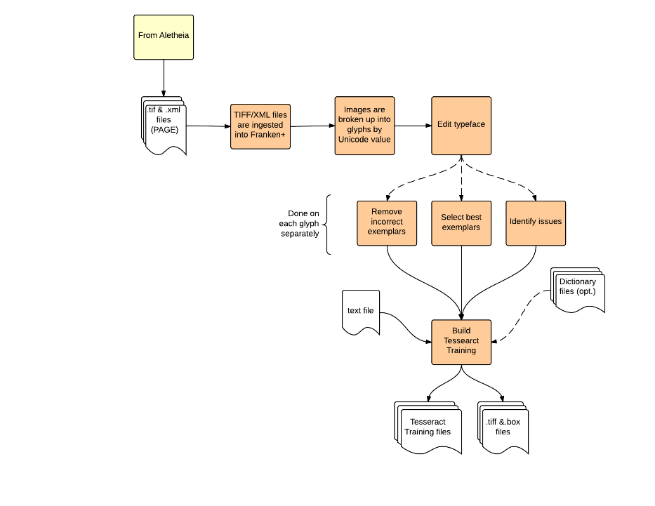
Franken+ Workflow
Tuesday, August 12, 2014
Open Source OCR Tools
Groups all glyphs with the same Unicode values into one window for comparison.
Uses all selected glyphs to create a Franken-page image (TIFF) using a selected text as a base.
Outputs the same box files and TIFF images that Tesseract's first stage of native training.

Slide 33
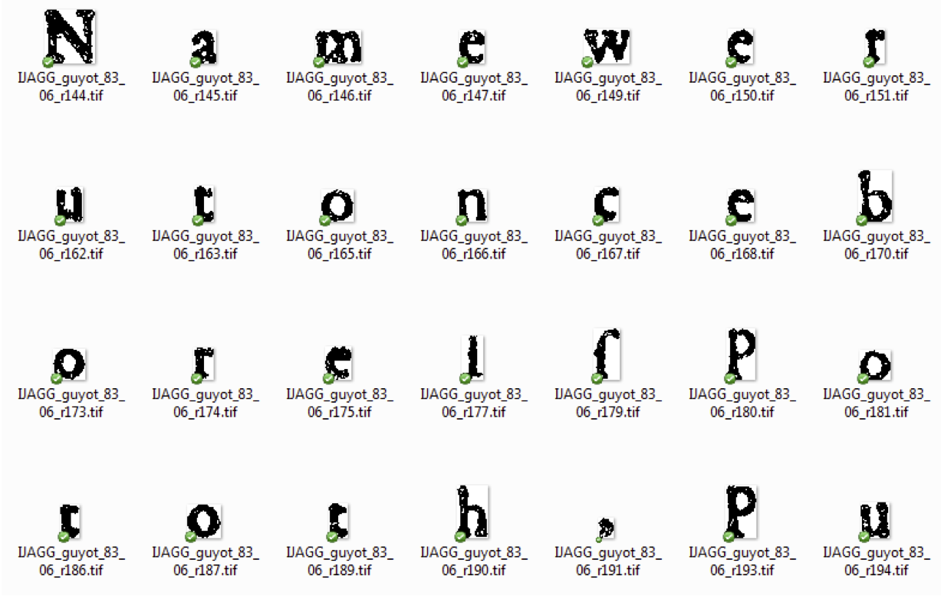
Franken+ Ingestion
Open Source OCR Tools

Slide 34
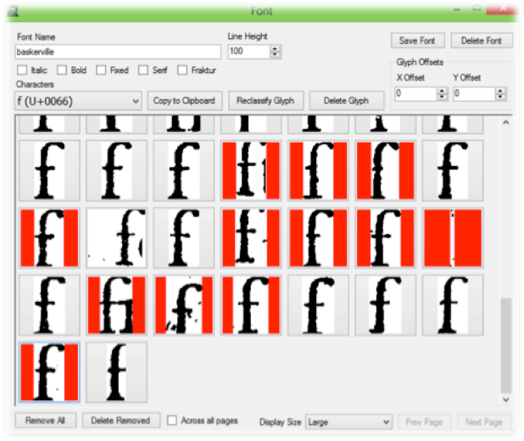
Franken+
Open Source OCR Tools
All exemplars of the same glyph are displayed together.
Users can quickly identify and deselect:
Incorrectly labeled glyphs
Incomplete glyphs
Unrepresentative exemplars
Different sized glyphs

Slide 35
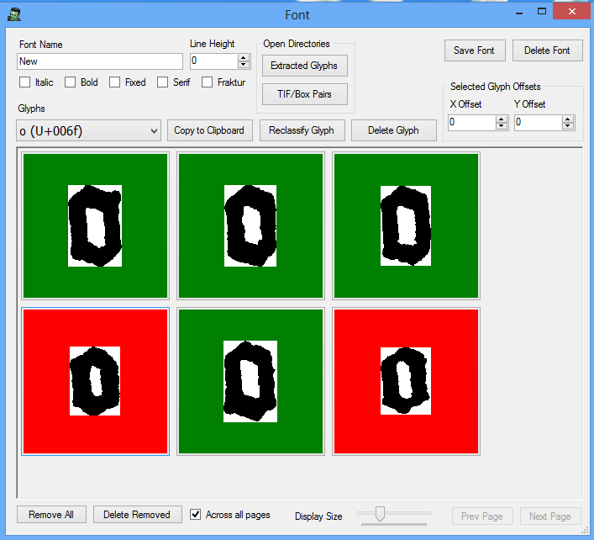
Franken+
Open Source OCR Tools
Notes:
This document had 3 distinct point sizes, but Franken+ revealed there were more like 5 or 6.
In this case it probably doesn’t matter, but it points out the possibilities

Slide 36
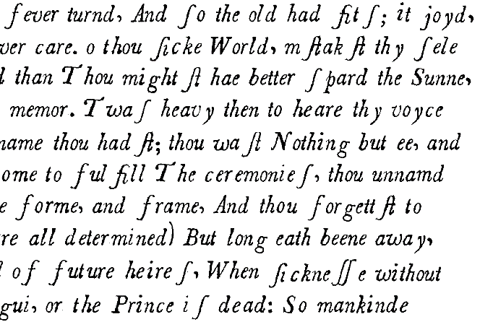
Training Tesseract
Open Source OCR Tools
Thiſ great conſumption to a fever turn'd,
And ſo the oꝗld had ﬁtſ; it joy'd, it mourn'd;
And, aſ men thinke, that Agueſ phyck are,
And th'Ague being ſpent, give over care.
Žo thou cke World, mꝖﬅak'ﬅ thy ſelże to bee
Well, when ãlaſ, thou'rt in a Lethargie.
Her death did wound and tame thee than, and than
Thou might'ﬅ hae better ſpar'd the Sunne, or man.
That wound waſ deep, but 'tiſ more miżery,
That thou haﬅ loﬅ thy ſenſe and memor.
'Twaſ heavy then to heare thy voyce of mone,
But thiſ iſ worſe, that thou art ſpeechlee growne.
Thou haﬅ forgot thy name thou hadﬅ; thou waﬅ
Nothing but ee, and her thou haﬅ o'rpaﬅ.
For aſ a child kept from the Fount, untill
Ä prince, expeed long, come to fulﬁll
The ceremonieſ, thou unnam'd had'ﬅ laid,
Had not her comming, thee her palace made:
Her name deﬁn'd thee, gave thee forme, and frame,
And thou forgett'ﬅ to celebrate th nme.
Some monethſ e hath beene dead (but beìng dead,
Meaſureſ of timeſ are all determined)
But long e'ath beene away, long, long, et none
Oﬀerſ to tell uſ who it iſ that'ſ gone.
But aſ in ﬅateſ doubtfull of future heireſ,
When cknee without remedie empaireſ
The preſent Prince, they're loth it ould be ſaid,
The Prince doth langui, or the Prince iſ dead:
So mankinde feeling no a generall tha,
F+TraininigText.txt

Slide 37
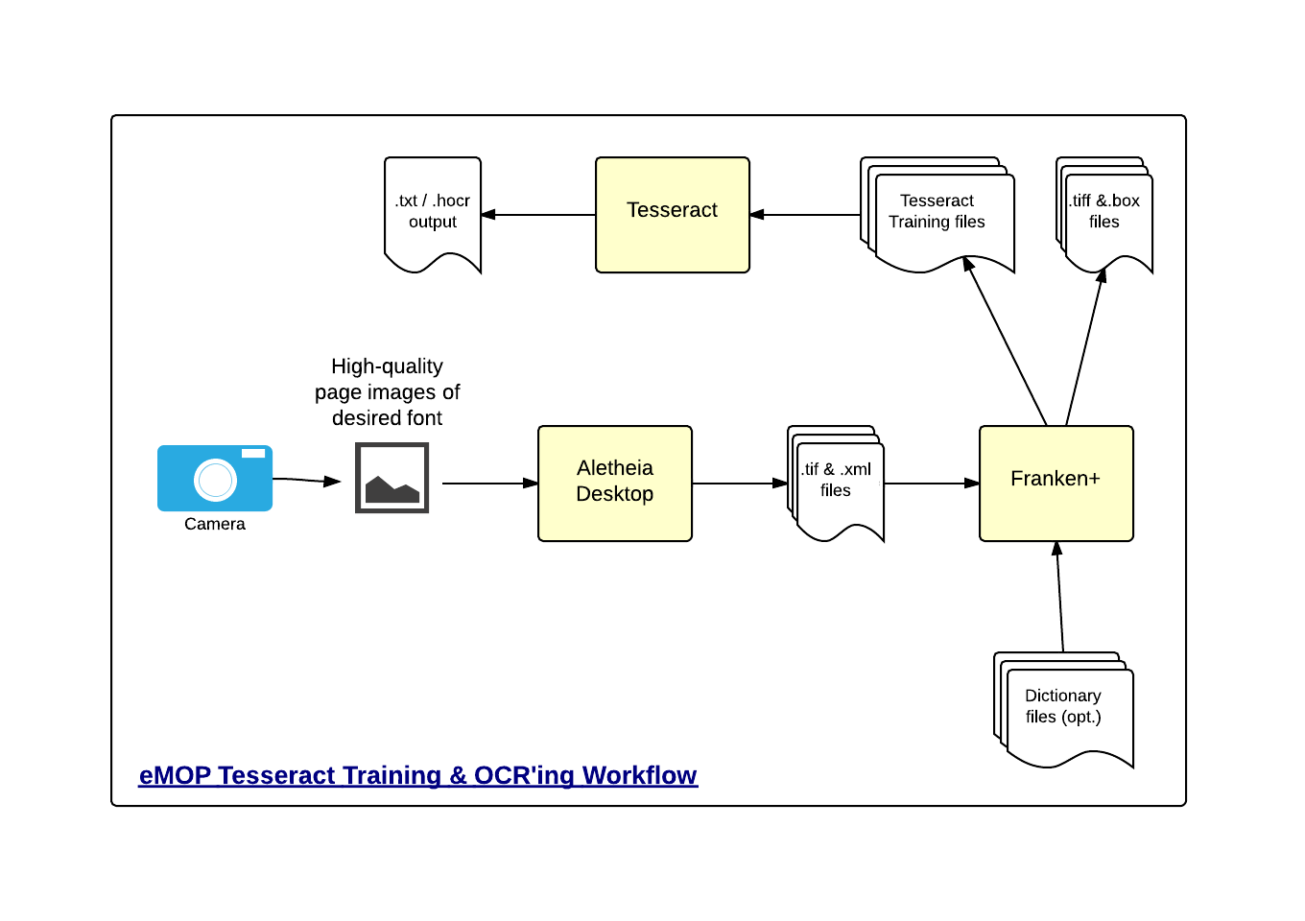
When more is needed

Slide 38
Tesseract – Word Lists
Tesseract has the ability to use word lists or dictionaries to look up words while scanning.
Word lists help Tesseract decide what a word is when it’s not sure.
Takes advantage of the character confidence score that Tesseract computes while scanning.
This character confidence info is lost when the hOCR output is created.
DAWG (Directed Acyclic Word Graph) files (8)
word-dawg: A dawg made from dictionary words from the language.
freq-dawg: A dawg made from the most frequent words which would have gone into word-dawg.
punc-dawg: A dawg made from punctuation patterns found around words. The "word" part is replaced by a single space.
number-dawg: A dawg made from tokens which originally contained digits. Each digit is replaced by a space character.

Slide 39
Tesseract – Word Lists
Collect a word list
spellcheckers (ispell, aspell, hunspell) – check the license
period specific works will require period specific word lists
dh-emopweb.tamu.edu/eebo-word-freq.php
emop.tamu.edu/Early-Modern-Word-List
You can also take Google’s eng.traineddata file apart and use their word list. (combine_tessdata –u, dawg2wordlist)
Format: one word per line, no other info, UTF-8.
If you have a word count associated with your list then split it into two lists: frequent and other.
Apply wordlist2dawg application to create dawg files.

Slide 40
Tesseract – Ambiguity and Transformation Errors
Tesseract, like all OCR engines, can make consistent transformation errors across pages, documents and collections.
m ➔ rn
ri ➔ n
1) ➔ D
Tesseract’s ambiguous characters file to helps it to correct some of these errors while it’s OCRing
Can also be used to force substitutions
ﬆ ➔ st
ſ ➔ s
The name of the file is <lang>.unicharambigs
tesseract-ocr.googlecode.com/svn-history/r683/trunk/doc/unicharambigs

Slide 41
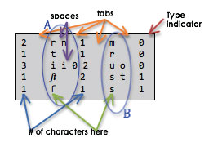
Tesseract – .unicharambigs file
Type Indicator:
0: Substitute B for A if doing so produces a word in the dictionary.
1: Always substitute B for A.
This really only works for substitutions where at least one side is multiple characters.
The .unicharambigs file must end with a blank line (/n) at the bottom of the file.

Slide 42
Running Tesseract with your training
tesseract <page image> <outfile> -l <lang> <config file>
on my computer:
go to: C:\Program Files (x86)\Tesseract-OCR
> tesseract C:\Users\IDHMC\Desktop\ocr-test-files\26337\00005.000.001.tif C:\Users\IDHMC\ocr-test-files\26337\eebo32989-out-test-1 -l <lang> tess_cfg.txt

Slide 43
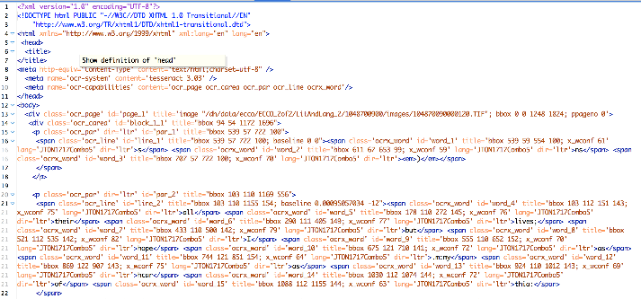
Tesseract – Results
hOCR file
XML-like .html file & .txt file (tessedit_create_hocr option)
creates blocks for page, areas, paragraphs, lines, and words
each block contains page coordinates
words contain confidence values (version 3.02.03)

Slide 44
Comparing OCR text to Groundtruth
Juxta-cl (command line)
created for eMOP
based on JuxtaCommons tool (juxtacommons.org/)
several different comparison algorithms to choose from and other options
open-source: github.com/performant-software/juxta-cl
java-based tool run from command line
Download: emop.tamu.edu/Installing-JuxtaCL
ocrevalUAtion
created for Succeed (www.succeed-project.eu/)
java-based tool
open-source: sites.google.com/site/textdigitisation/ocrevaluation

Slide 45
Creating Groundtruth
Aletheia was developed as a groundtruth creation tool for Succeed.
Use it to process some of your page images to quickly produce corrected full-text.
Worth the effort if you have a large collection

Slide 46
Post Processing
No OCR is perfect. It will need to be corrected.
Hand Correction
The most thorough way, but time consuming.
Proofread Page: A media wiki extension
(www.mediawiki.org/wiki/Extension:Proofread_Page)
Crowdsourced Correction
Give it to the c(l/r)owd
Tools:
Online collaborative manuscript transcription tools
FromThePage: beta.fromthepage.com/ (github.com/benwbrum/fromthepage/wiki)
T-Pen: t-pen.org
Scripto: scripto.org

Slide 47
eMOP Post Processing
Open source tools for:
scoring OCR results without groundtruth
estimating the correctability of a page
removing noise (i.e. junk that Tesseract identifies as words)
correcting OCR results using dictionaries and google 3-grams
gitlab.tamu.edu/groups/emop
Other tools:
succeed-project.eu/publications/available-tools/index-succeed

Slide 48
The end
mchristy@tamu.edu

