Slide 1
Virus Identification in Synthetic Soil Metagenomes
Earl Middlebrook
Migun Shakya

Slide 2
Questions to address:
Do specific genomic features of soil organisms affect viral analysis?
Do differences in bacterial/viral coverages change viral assembly?
Can low frequency viral copies be found by assembly and viral ident tools?
Do virus identification tools perform differentially on soil metagenomes?

Slide 3
Assembly and viral contig detections/recovery
What datasets to use? (datasets that represents soils)
Synthetic metagenome(s) (bacteria, fungi, viruses)
Use a long tailed distribution to calculate abundance or based on 16S profile of some of similar soil samples?
RefSoil+ for bacteria
Fungal genomes (mostly as a noise)
Known soil viral genomes (how much?)
Different depth of sequencing?
Synthetic viromes
Using a long tailed distribution
Known viral genomes
Spike synthetic viral reads in real metagenomes
A well studied metagenome + few viral genomes
Pick 3 metagenomes from terrestrial metagenomeDB
Real metagenomes and viromes comparisons
3 soil metagenomes
3 soil viromes

Slide 4
Assembly and viral contig detections/recovery
What datasets to use? (datasets that represents soils)
Synthetic metagenome(s) (bacteria, fungi, viruses)
Use a long tailed distribution to calculate abundance or based on 16S profile of some of similar soil samples?
RefSoil+ for bacteria
Fungal genomes (mostly as a noise)
Known soil viral genomes (how much?)
Different depth of sequencing?
Synthetic viromes
Using a long tailed distribution
Known viral genomes
Spike synthetic viral reads in real metagenomes
A well studied metagenome + few viral genomes
Pick 3 metagenomes from terrestrial metagenomeDB
Real metagenomes and viromes comparisons
3 soil metagenomes
3 soil viromes

Slide 5
Assembly and viral contig detections/recovery
What datasets to use? (datasets that represents soils)
Synthetic metagenome(s) (bacteria, fungi, viruses)
Use a long tailed distribution to calculate abundance or based on 16S profile of some of similar soil samples? Flat distributions.
RefSoil+ for bacteria
Fungal genomes (mostly as a noise)
Known soil viral genomes (how much?)
Different depth of sequencing?
Synthetic viromes
Using a long tailed distribution
Known viral genomes
Spike synthetic viral reads in real metagenomes
A well studied metagenome + few viral genomes
Pick 3 metagenomes from terrestrial metagenomeDB
Real metagenomes and viromes comparisons
3 soil metagenomes
3 soil viromes

Slide 6
On the fly synthetic soil microbiome datasets for virus detection benchmarking
Workflow
Create differing total coverage/viral coverage data sets
Assemble (SPADES)
Alternatively: 16s Profile to Genomes
Or something from Michal and Erik
In Vitro Evolution?
RefSoil+
Check for viral overlap with background
Generate Gold Standard Assemblies*
Test Assembly vs input Ref sequences and vs Gold standard assembly
Soil Fungal Database
Select Sequences/Profiles
Generate Reads (ART)
MetaQuast
ASM/VirDetected-REF compare
Soil Virome Database
Viral Detection (VirSorter, VIBRANT, DeepVirFinder, CAT)
Select Target Viral Sequences
Align Sim reads to Assembly (what percent align to virus), what reads would be missed with Viral Ident tools?
NOT many.
Test:
False Positives (hard to quant, might call virs from prophage in bacteria)
False Negatives
True Positives
Completeness
Identity (# false SNPS)
Chimeras
Missassemblies
Do specific soil genomic features of soil organisms affect viral analysis?
Do differences in bacterial/viral coverages change viral assembly?
* Maybe just realign to reference and call “variants” and break refs at low coverage?

Slide 7
Run Name
Databases
Working Directory File Structure
Databases
Background References
Viral References
Synth Reads
Subsample-backgroune-$X-vir-$Y
Metaquast output
Scaffolds
Subsample-backgroune-$X-vir-$Y
Subsample-backgroune-$X-vir-$Y
Subsample-background-$X-vir-$Y
Background multi-fasta
Viral ref multi-fasta
All Synth reads
Combined Stats
All assembled Scaffold files
Stats by Virus
Vir1.fasta
All identified viral contigs
Reads (subsampled)
Assembly
Annotations
Vir2.fasta
VirN.fasta
Subsampled background and Virus reads
Scaffolds.fasta
DVF output
DVF Scaffolds
Other spades stuff
VS output
VS Scaffolds
CAT output
CAT Scaffolds
BLAST output
BLAST Scaffolds

Slide 8
Some Preliminary Results For...
Viral reads
Genomes from phagesdb.org
20 genomes
Equal coverage for each
2.5, 5, 10, 20, 30, 40X coverage
Bacterial reads
Genomes from RefSoil+
20 genomes
Equal coverage for each
5, 10, 15, 20X coverage

Slide 9
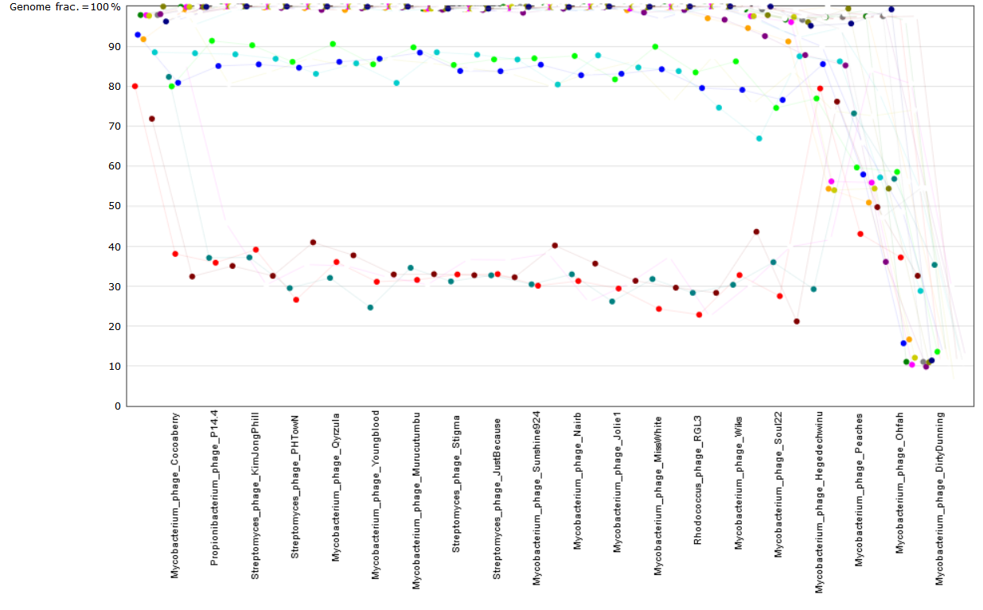
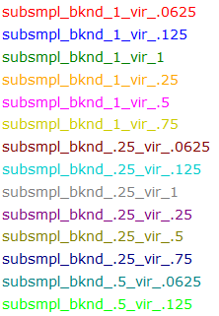
Percent of Viral Genome That Assembled
10, 20, 30 40X viral coverage
5X viral coverage
Genome Fraction Assembled
2.5X viral coverage
subsample_bknd_X_vir_Y
X=fraction of 20X bacterial coverage
Y=Fraction of 40X viral coverage

Slide 10
High viral coverage leads to the best alignements, as expected.
High viral Coverage
Genome Fraction Assembled
Low viral Coverage
subsample_bknd_X_vir_Y
X=fraction of 20X bacterial coverage
Y=Fraction of 40X viral coverage

Slide 11
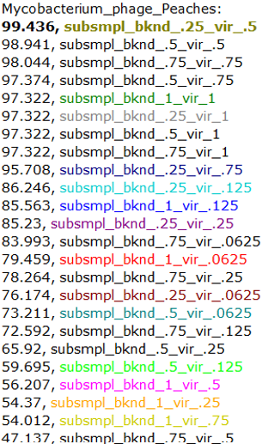
...however some viral genomes do not assemble better at high coverages.
Genome Fraction Assembled
subsample_bknd_X_vir_Y
X=fraction of 20X bacterial coverage
Y=Fraction of 40X viral coverage

Slide 12
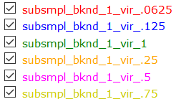
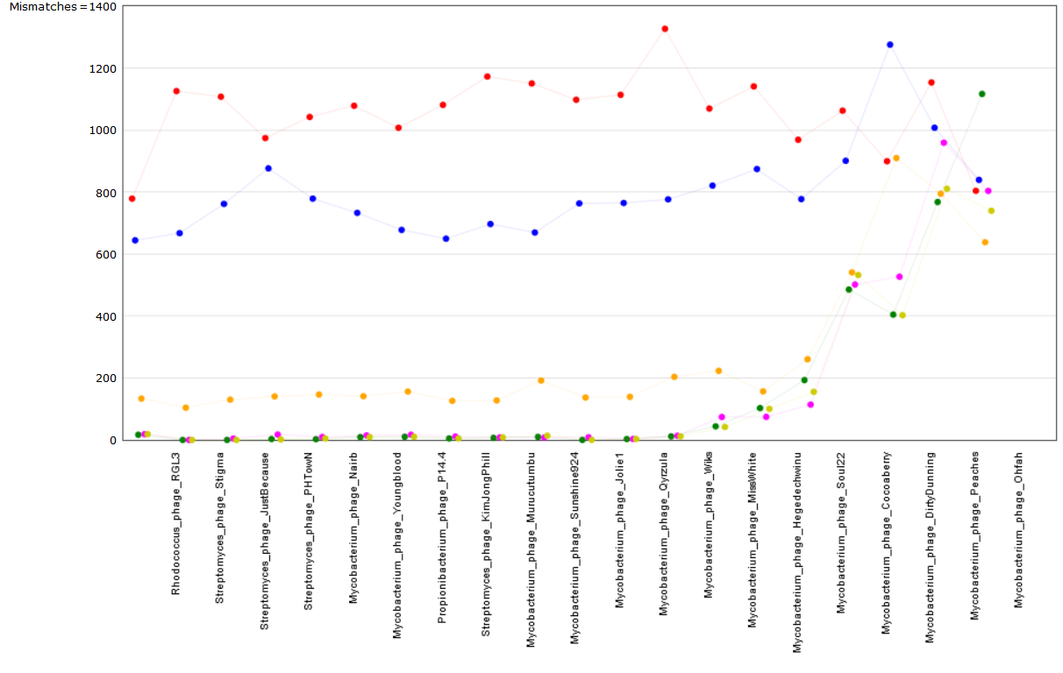
For most viral sequences, low coverage (2.5 or 5X) leads to high number of SNP errors. Others seem prone to mismatches at any coverage.
Number of Sequence Errors
subsample_bknd_X_vir_Y
X=fraction of 20X bacterial coverage
Y=Fraction of 40X viral coverage

Slide 13
For most viral sequences, low coverage (2.5 or 5X) leads to high number of SNP errors. Others seem prone to mismatches at any coverage.
Number of Sequence Errors
Also assembled poorly
subsample_bknd_X_vir_Y
X=fraction of 20X bacterial coverage
Y=Fraction of 40X viral coverage

Slide 14
For most viral sequences, low coverage (2.5 or 5X) leads to high number of SNP errors. Others seem prone to mismatches at any coverage.
Number of Sequence Errors
Also assembled poorly
Except this one assembled really nicely
subsample_bknd_X_vir_Y
X=fraction of 20X bacterial coverage
Y=Fraction of 40X viral coverage

Slide 15
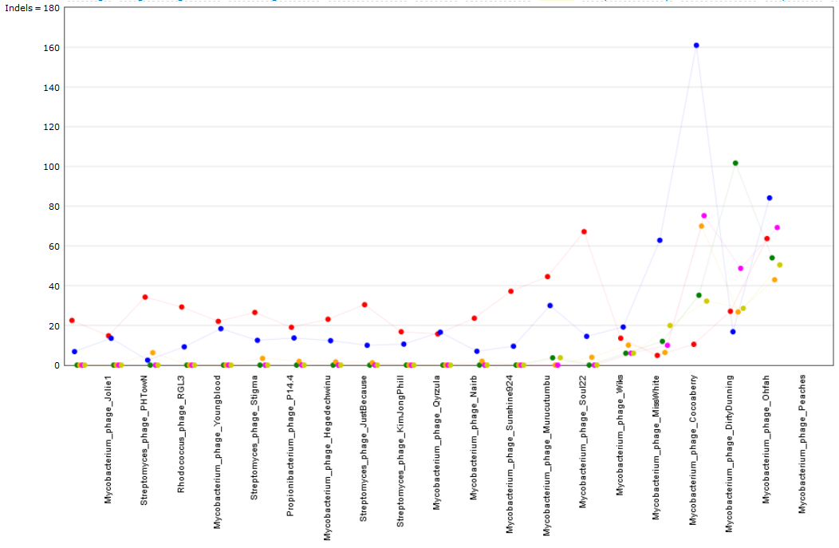
Same for indels
Number of Sequence Errors

Slide 16
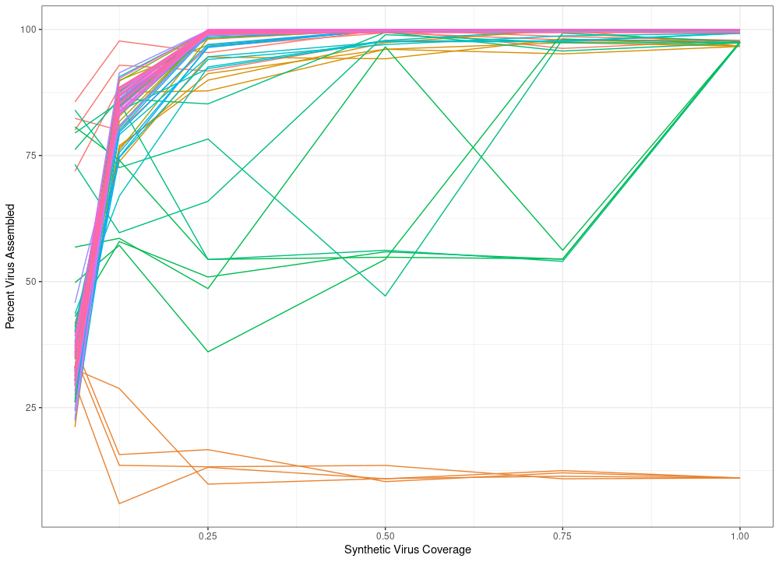
Percent of each Virus Assembled by Viral coverage (x40)
Colors represent individual target virus genomes
One target virus assembly at multiple different Background Coverages

Slide 17
Viral identification
BLAST
Against known virus
“Ground truth”
CAT
Search against NCBI viral database
VirSorter
DeepVirFinder
Machine learning model based
Background Bacterial Sequences
Target Virus Reference
Virus Sequences
Assembly
Not Virus
Target Virus Contigs
Proviral Contigs
Bacterial Contigs

Slide 18
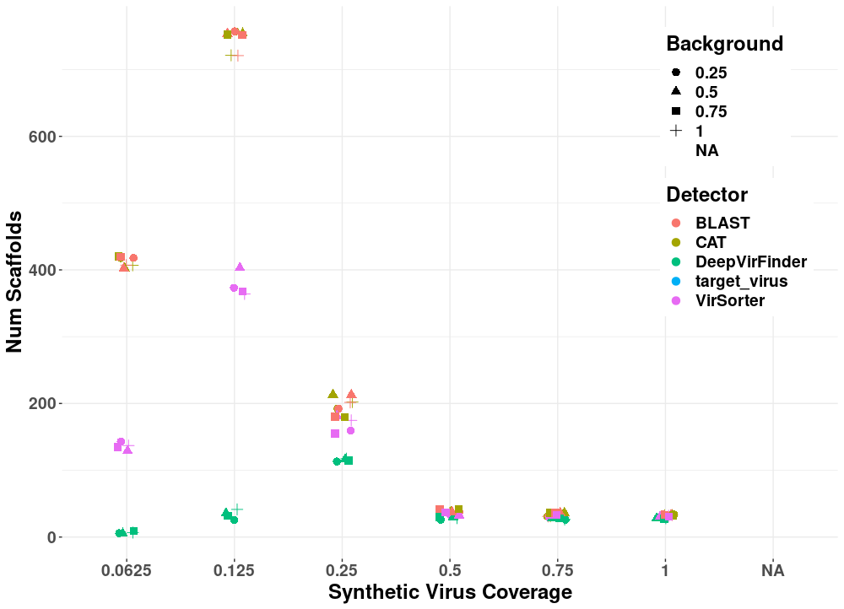
Total Number of Scaffolds Identified as Target Virus
Number Target Viral Assembly Scaffolds

Slide 19
Total Number of Scaffolds Identified as Target Virus
Number Target Viral Assembly Scaffolds
Not affected by background coverage

Slide 20
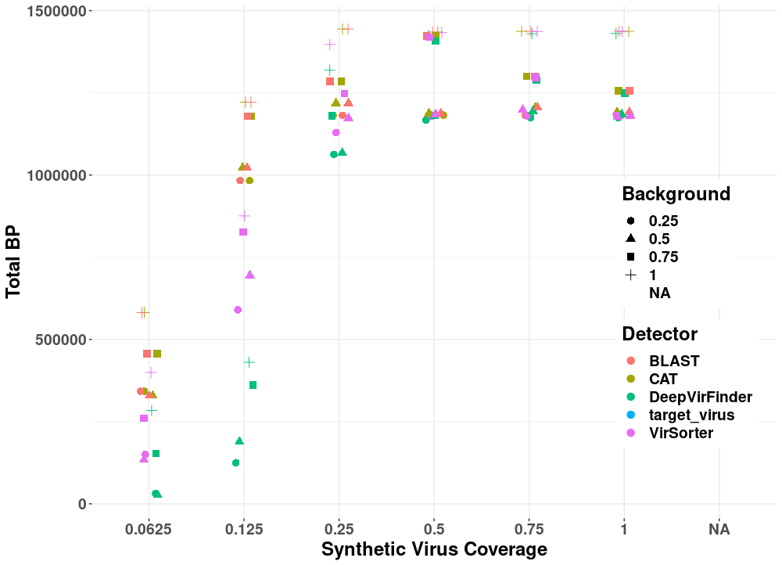
Total BP assembled and identified as Target Virus
(False Positives and bacterial chimeras not controlled for)
Total Target Viral Assembly Size (bp)

Slide 21
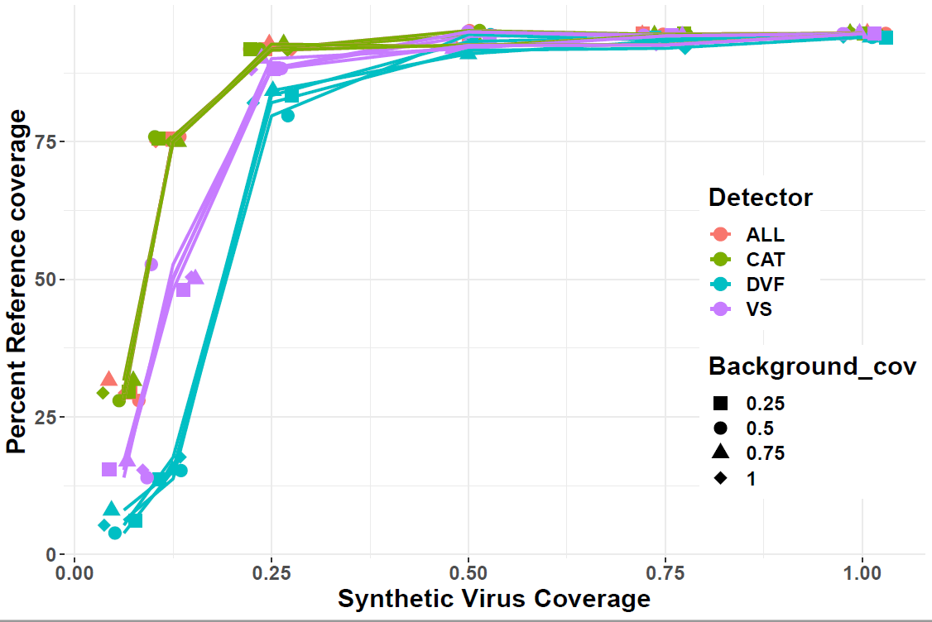
Percent of Target Viral Sequences Assembled and Identified
Again not affected by background coverage
Again not affected by background coverage
All = contig blast against target viral refs

Slide 22
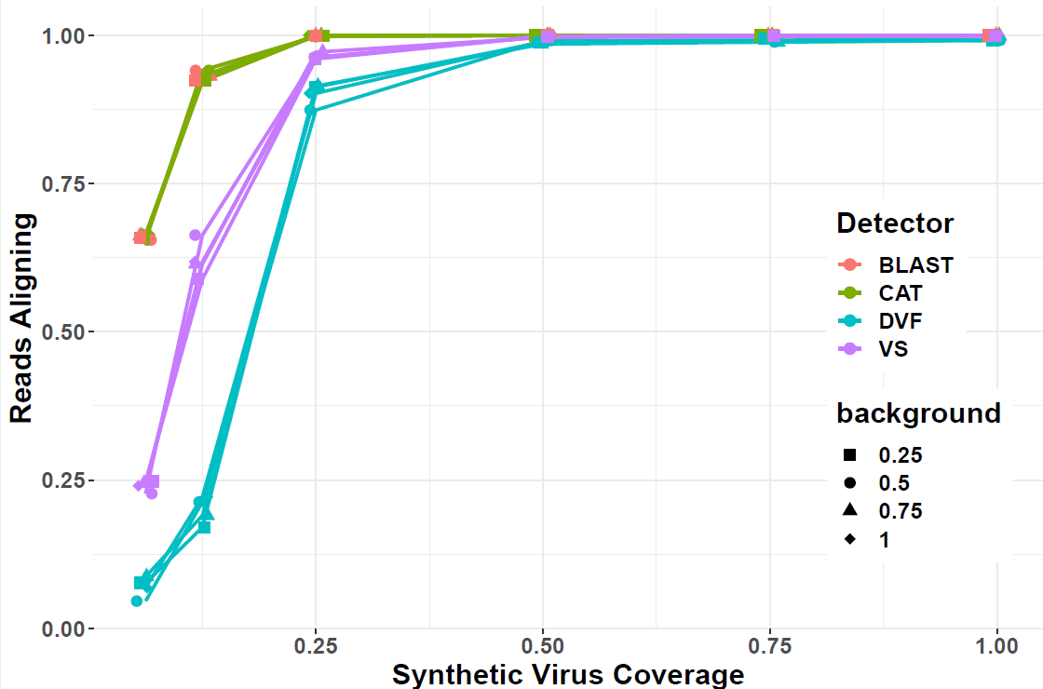
Percent of synthetic reads aligning to assembled viral contigs identified
Percent Reads Aligning

Slide 23
Percent of synthetic reads aligning to assembled viral contigs identified
Again not affected by background coverage
Percent Reads Aligning

Slide 24
Why are some viral genomes harder to assemble at higher coverages
Similarities
To other viruses?
To proviruses?
Maybe have interesting characteristics?
Kmer analysis
Tetra-nucleotide composition
GC content
Repeats

Slide 25
The future
New functionality
Add VIBRANT
Other detectors?
Add replicate generation
New databases?
Viral
Fungal
Make read generation more sophisticated
i.e. realistic community composition
Make more production worthy
Automate figure generation (integrate R script)
Containerize
Translate to WDL
New figures to generate?

