Slide 1
The most interesting scientific discoveries and inventions
Andrey Kondratiev, Artem Kiselev, 4628

Slide 2
Contents
01
Computer Science: P vs NP
02
Physics: Einstein’s 1905
03
Biology: genes are DNA
04
Chemistry: the first antibacterial drug

Slide 3
💻 Computer Science: P vs NP - the problem that decides the fate of all passwords
01

Slide 4
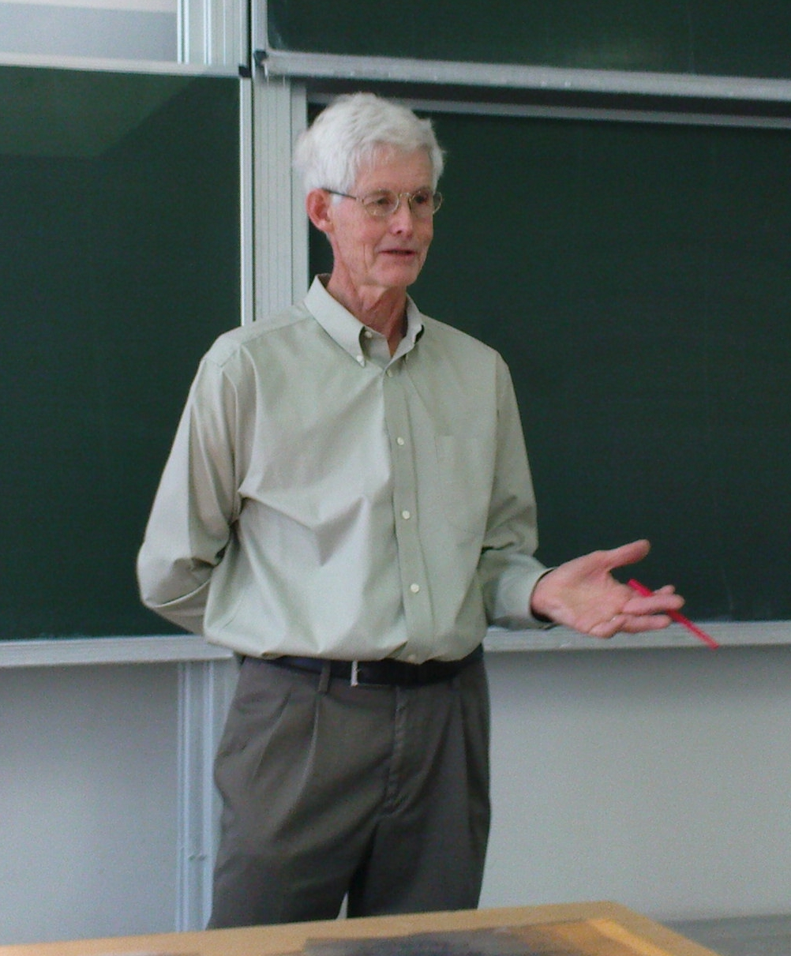
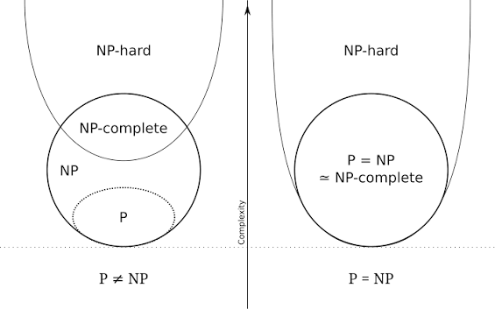
P vs NP
Stephen Cook
P vs NP explanation

Slide 5
⚛Physics: Einstein’s 1905 - the year all laws of physics were rewritten
02

Slide 6
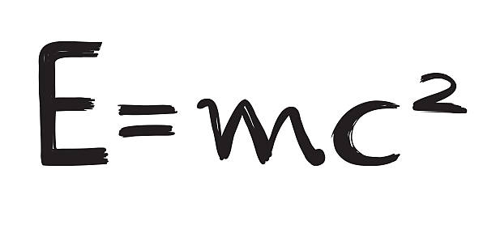
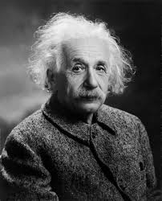
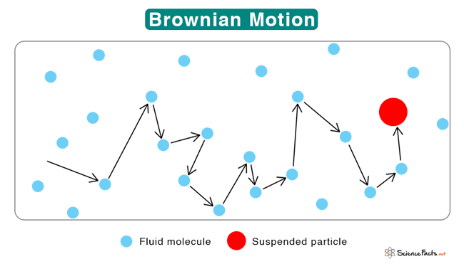
Einstein’s 1905
Albert Einstein

Slide 7
🧬 Biology: Oswald Avery proved that genes are DNA
03

Slide 8
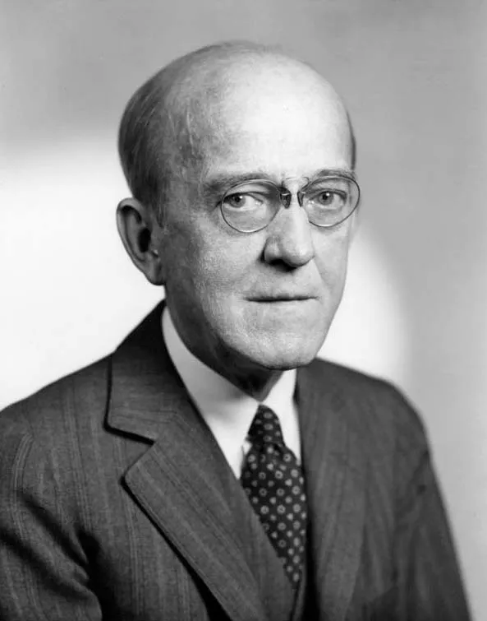
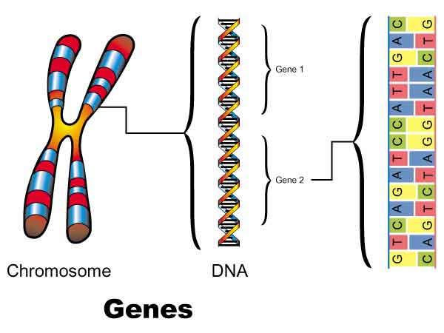
Genes are DNA
Oswald Avery

Slide 9
🧪 Chemistry: Gerhard Domagk - the first antibacterial drug
04

Slide 10
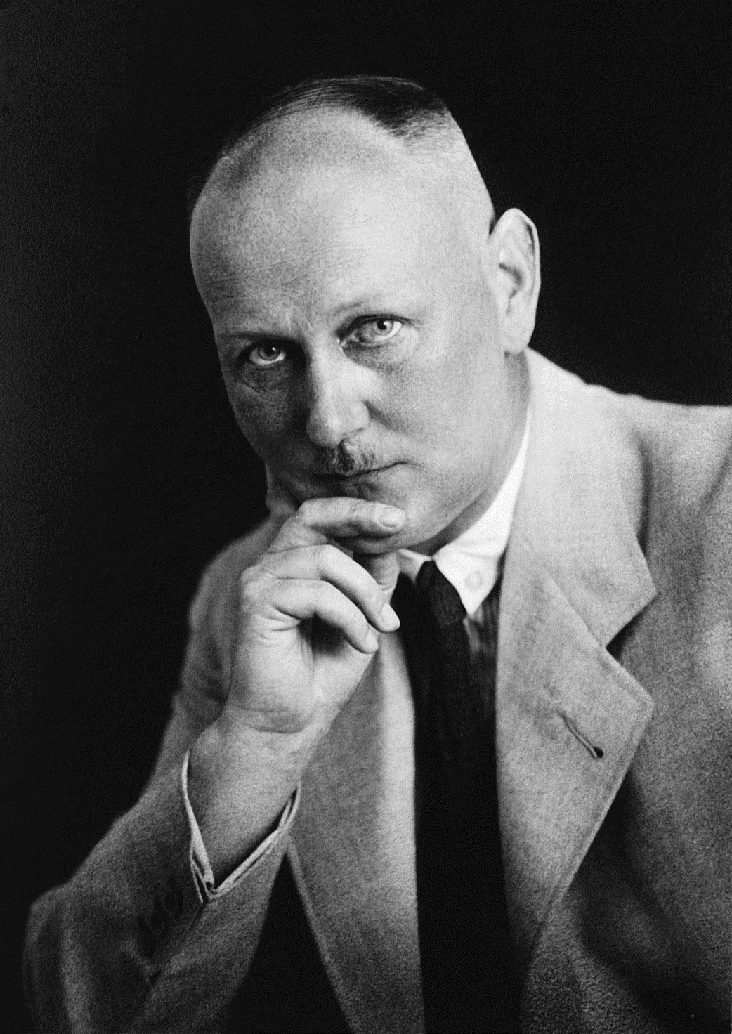
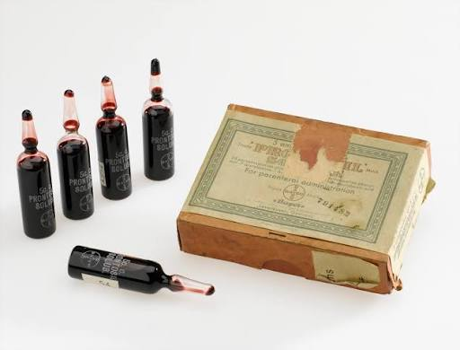
The first antibacterial drug
Gerhard Domagk
Prontosil

Slide 11
Text
💻 Computer Science: P vs NP - the problem that decides the fate of all passwords
Stephen Cook, 1971. He asked a question worth a million dollars and still unanswered: if a solution to a problem can be verified quickly, can it also be found just as quickly? Example: you forgot your password. If someone suggests a variant - you verify in a second whether it's correct or not. But cracking the password without a hint - you need to go through billions of variants. Cook proved: there is a class of NP-complete problems. If a fast way is found to solve at least one of them - it will automatically become possible to solve all of them quickly. Why this is a scientific breakthrough: all modern cryptography (banks, messengers, government websites) rests on the assumption that P not equals NP. If someone proves the opposite - all data protection in the world will collapse. The problem is one of the seven Millennium Prize Problems, and $1 million is awarded for solving it.
⚛Physics: Einstein's 1905 - the year all laws of physics were rewritten
1905. Albert Einstein, an unknown clerk at a patent office, publishes four papers in half a year. This is not "one discovery" - these are four blows that completely destroyed 19th-century physics and built a new one. What he did:
· Photoelectric effect. He proved that light is a stream of particles (quanta). This earned him the Nobel Prize.
· Brownian motion. He proved that atoms really exist. Before him, many scientists previously thought atoms were a mathematical fiction.
· Special theory of relativity. He destroyed "absolute time." He showed: time slows down, space contracts.
· E = mc². Mass and energy are equivalent to one another. Forty years later this led to the atomic bomb.
Pathos: Einstein did not "refine" physics. He demolished it to its foundations and rebuilt it - in one year, working alone, without a laboratory, without access to scientific journals. This is the greatest example of how one person can rewrite the laws of the Universe.
🧬 Biology: Oswald Avery proved that genes are DNA. He was not believed during his lifetime
1944. Oswald Avery, a bacteriologist at the Rockefeller Institute, published the results of an experiment that overturned all of biology. According to a study published in the journal “Journal of Experimental Medicine”, he revealed that heredity is transmitted not by proteins, as had been believed for decades, but by deoxyribonucleic acid - DNA. Before him, scientists were convinced: genes are proteins, because they are more complex and "more interesting." DNA was considered a "boring" supporting molecule. Avery showed: it is DNA that carries genetic information. What happened: his conclusions were ignored. In 1952 the Nobel Committee reviewed his work and decided: "the evidence is insufficient." Several factors worked against him: he was already old (65), he worked not with viruses but with pneumococci, and he behaved quietly - he did not travel to conferences or promote his idea. The denouement: in 1952 Hershey and Chase confirmed his conclusions; in 1953 Watson and Crick built the double helix. The world finally understood: Avery was right. But he was never given the Nobel Prize - he died in 1955. Pathos: He discovered what life is made of. He was told: "Not enough evidence." He died without ever learning that he had been right.
🧪 Chemistry: Gerhard Domagk - the first antibacterial drug, which saved millions, but did not save its creator from oblivion
1932. Gerhard Domagk, a German physician and chemist, worked in a Bayer laboratory. He was looking for a cure for streptococcal infection - at that time people died from a banal blood infection more often than from cancer today. The idea that blew medicine wide open: he suggested that one need not kill bacteria directly, but instead prevent them from using the dyes they absorb. He took sulfonamide - a substance that bacteria "mistake" for food but cannot digest. The bacterium dies of starvation, while the human does not.. 1935. Domagk publishes the results: Prontosilcures mice of lethal doses of streptococcus. The world's first antibacterial drug. What happened: his discovery saved millions of lives - including Franklin Roosevelt Jr. (the son of the US president) and Winston Churchill. Penicillin was still ten years away. Sulfonamides became humanity's first weapon against infections. 1939. Domagk receives the Nobel Prize in Medicine. But the Nazi government forbids him to accept it - Hitler banned Germans from receiving Nobel Prizes after the scandal involving the pacifist Carl von Ossietzky. Domagk could not go to Stockholm. A few days later he was arrested by the Gestapo - for daring to accept an "enemy" award. He spent years in prison. After the war he was not reinstated in his position. He died in 1964, never having received his Nobel medal - it reached him only in 1947, without a ceremony, by mail. Pathos: He created the first medicine that killed infections - and saved millions. The Nazis took away his award. After the war he was forgotten. Today only doctors remember sulfonamides. But every antibiotic tablet you have ever taken is a direct line from his discovery.

Slide 12
THANK YOU FOR YOUR ATTENTION!!!!!!!!!

