Slide 1

AN INTERACTIVE MODEL
Logistic Growth Lab
dN/dt = rN ( 1 − N/K )
Turning population dynamics into something you can feel.
REACT · SVG · OPEN SOURCE
Notes:
Title slide. Logistic Growth Lab is an interactive teaching model of dN/dt = rN(1-N/K), built with React and SVG. Live at earth1283.github.io/logistic-growth.

Slide 2
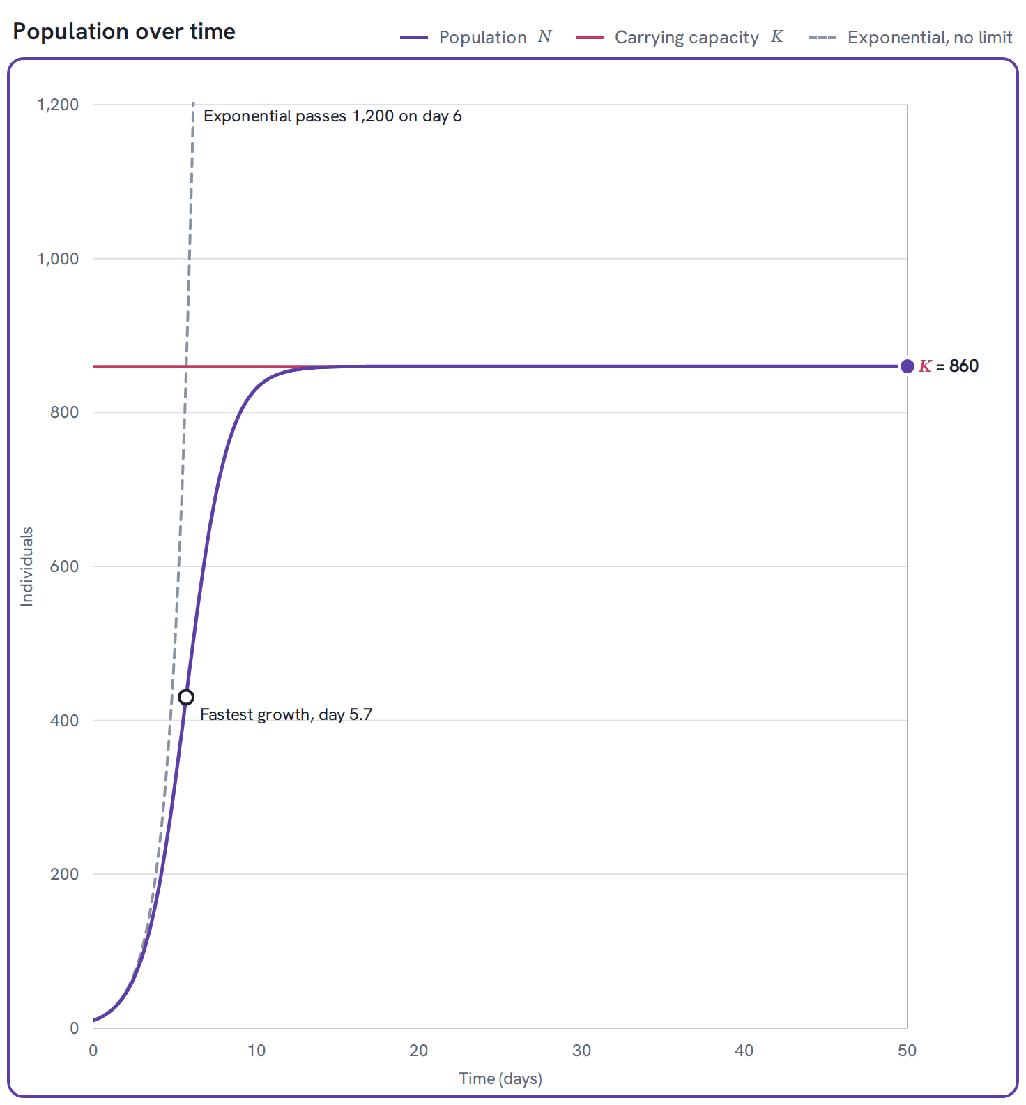
The idea behind the curve
Every population wants to grow exponentially. But space, food, and shelter put a ceiling on it. The logistic equation captures both forces at once — reproduction pulling up, crowding pulling back down.
K ⁄ 2
K
population size where growth is fastest
where the population settles, permanently
Both numbers fall straight out of one equation — no extra assumptions, no lookup table.
02
Notes:
The core equation. K/2 is the inflection point (fastest growth); K is the stable equilibrium. The chart on the right is a live screenshot of the app, not a mockup.

Slide 3




What you can do
Every control updates the simulation in real time — nothing to submit, nothing to wait for.
Tune the model
Watch it unfold
Drag carrying capacity, growth rate, and starting population — the curve redraws instantly.
Press play and the S curve animates from day zero out to your chosen time window.
Disturb it
See the why
Harvest, add migrants, shrink or restore the habitat — mid-simulation, on any day.
Two extra panels chart growth rate and per-capita growth against population size.
03
Notes:
Four core capabilities: live parameter tuning, animated playback, mid-simulation disturbances, and the analysis panels that explain the math.

Slide 4
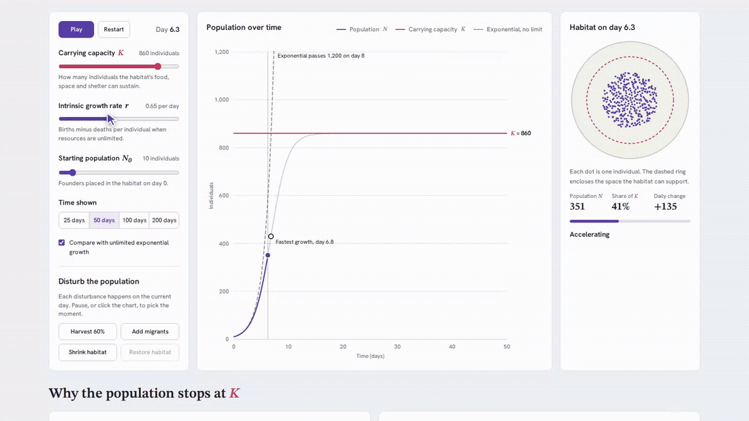
LIVE DEMO
Press play.
Every slider, every button, every disturbance updates the simulation instantly. This is a recording of the actual app — not a mockup.
A carrying capacity increase, a growth-rate change, and an "Add migrants" disturbance — all in one continuous take.
04
Notes:
Animated GIF of the live app. Plays back automatically in PowerPoint slideshow mode on most platforms; falls back to a static first frame if the viewer does not animate embedded GIFs.

Slide 5
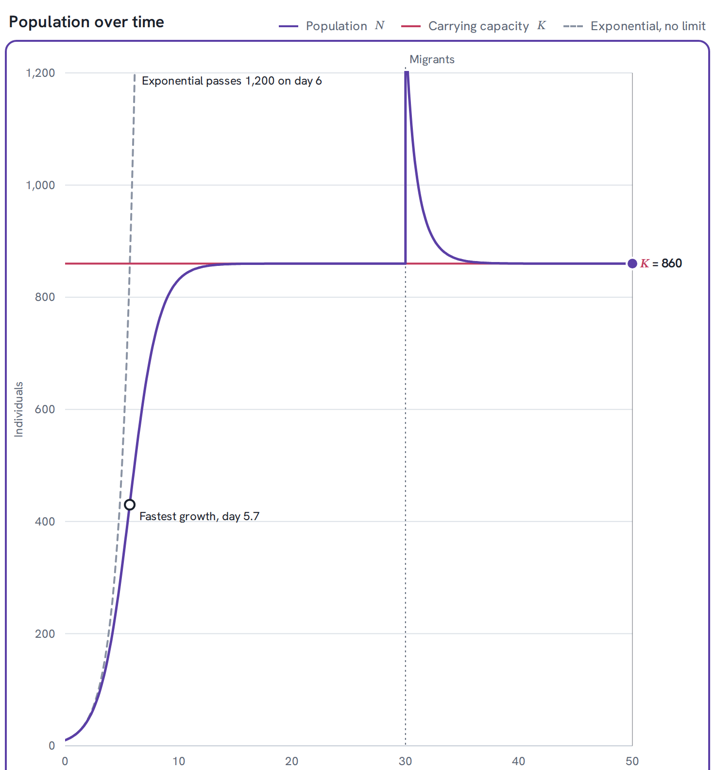




Disturb it — and watch it recover
Harvest 60%
Add migrants
Removes 60% of the population instantly, then tracks the recovery.
Injects new individuals — the population can even overshoot K.
Shrink habitat
Restore habitat
Cuts carrying capacity; the population declines to the new limit.
Returns K to its original value; the population climbs back.
05
Notes:
Four disturbance types. The chart shows a live "Add migrants" spike that overshoots K then relaxes back down exponentially, at rate r.

Slide 6
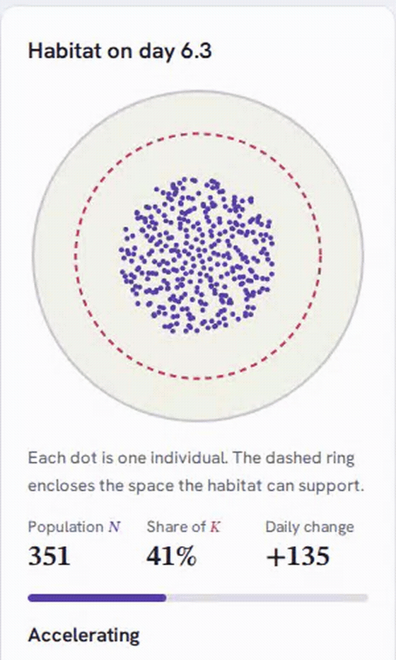

A habitat you can see
Each dot is one individual. The dashed ring marks exactly how many the habitat can support — so crowding isn’t an abstraction, it’s a shape filling in.
Population N
How many individuals exist right now.
Share of K
How full the habitat is, as a percentage.
Daily change
Net births minus deaths, updated every frame.
06
Notes:
The habitat panel makes crowding tangible: population share of K drives a real-time dot-fill visualization, not just numbers.

Slide 7
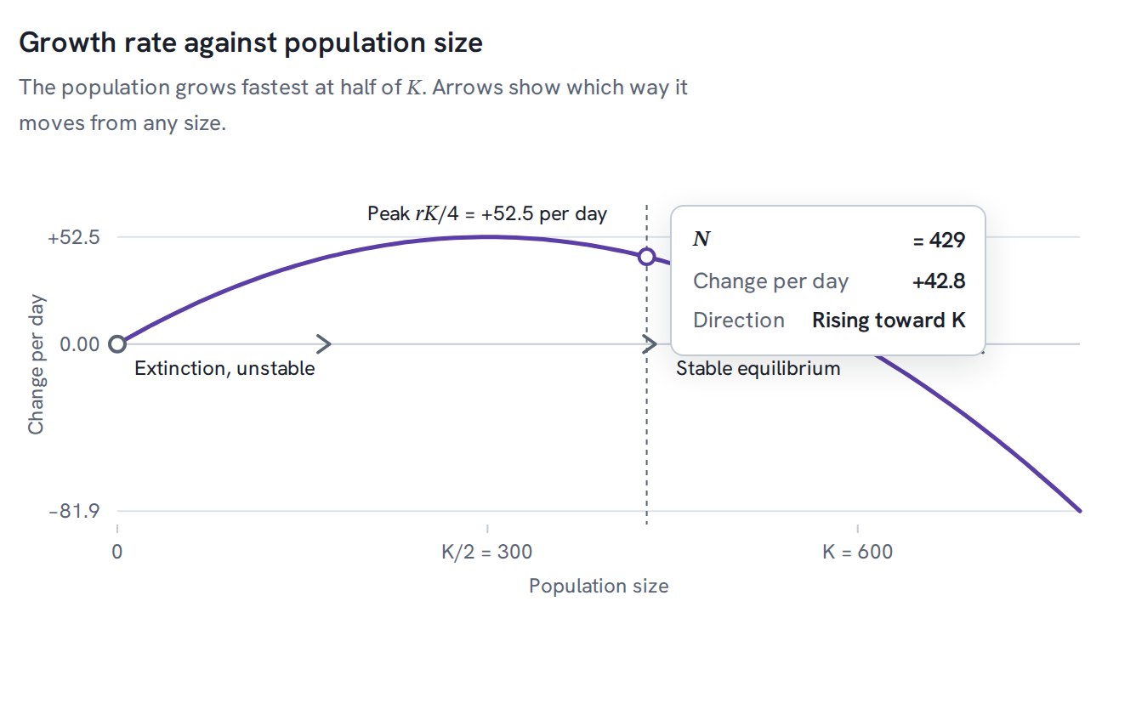
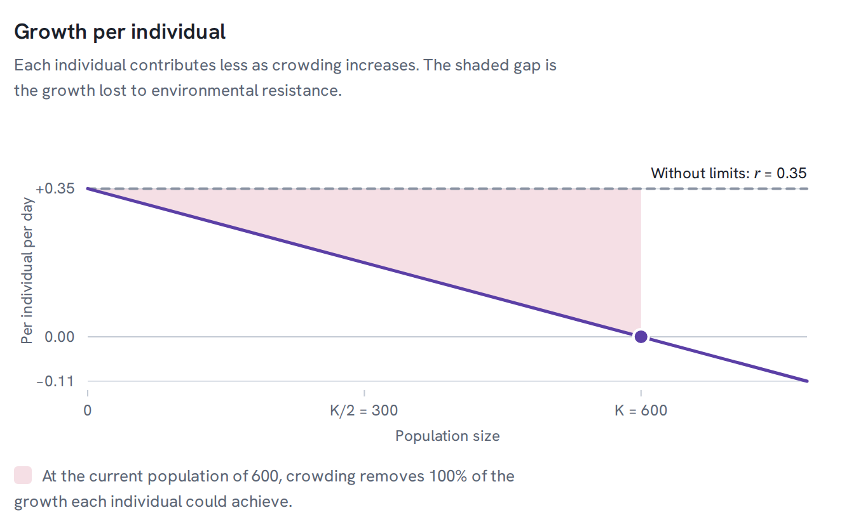
Why growth stops at K
+52.5
K ⁄ 2
0
per day — the peak growth rate, rK/4
population size where growth is fastest
net growth per individual once N reaches K
07
Notes:
Growth rate peaks exactly at K/2 (the inflection point) and falls to zero at K, where births balance deaths — that negative feedback is what makes K a stable equilibrium.

Slide 8
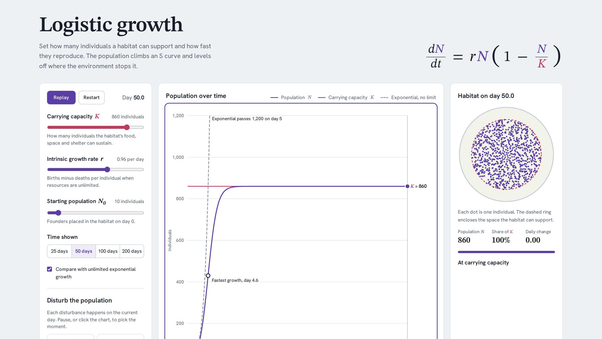
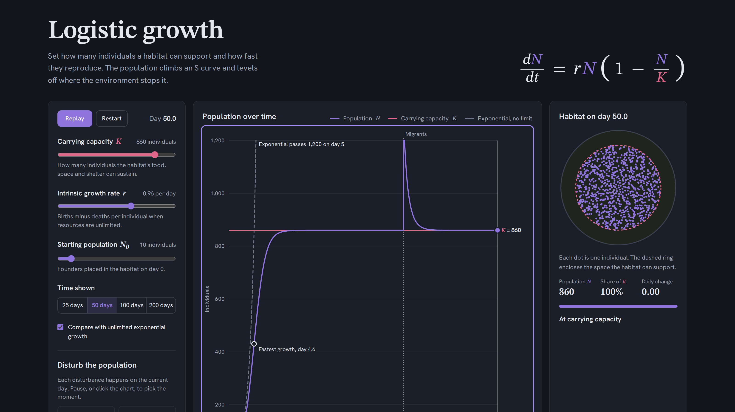
Looks right, day or night.
Light
Dark
Follows your system theme automatically — no toggle required.
08
Notes:
Theme adapts via prefers-color-scheme; every chart color token is redefined for dark mode, not just inverted.

Slide 9




Under the hood
A small, fast stack — no backend, no build-step surprises.
React 18
Vite
SVG
GitHub Pages
Component-driven UI
Instant dev server, hashed builds
Every chart is real, resizable vector art
Static hosting, zero servers
Content-hashed assets ship with a one-year immutable cache; index.html always revalidates — so visitors get the latest build without ever seeing a stale one.
09
Notes:
Zero backend: static React/Vite build deployed to GitHub Pages, with content-hashed cache busting described in the README.

Slide 10

Find the limit yourself.
Free, open, and runs entirely in your browser.
earth1283.github.io/logistic-growth
Scan to open
Built with React & SVG · open source on GitHub
Notes:
Closing CTA. Live deployment confirmed reachable at earth1283.github.io/logistic-growth; repo is Earth1283/logistic-growth on GitHub.

