Slide 1
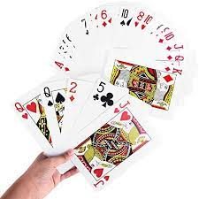
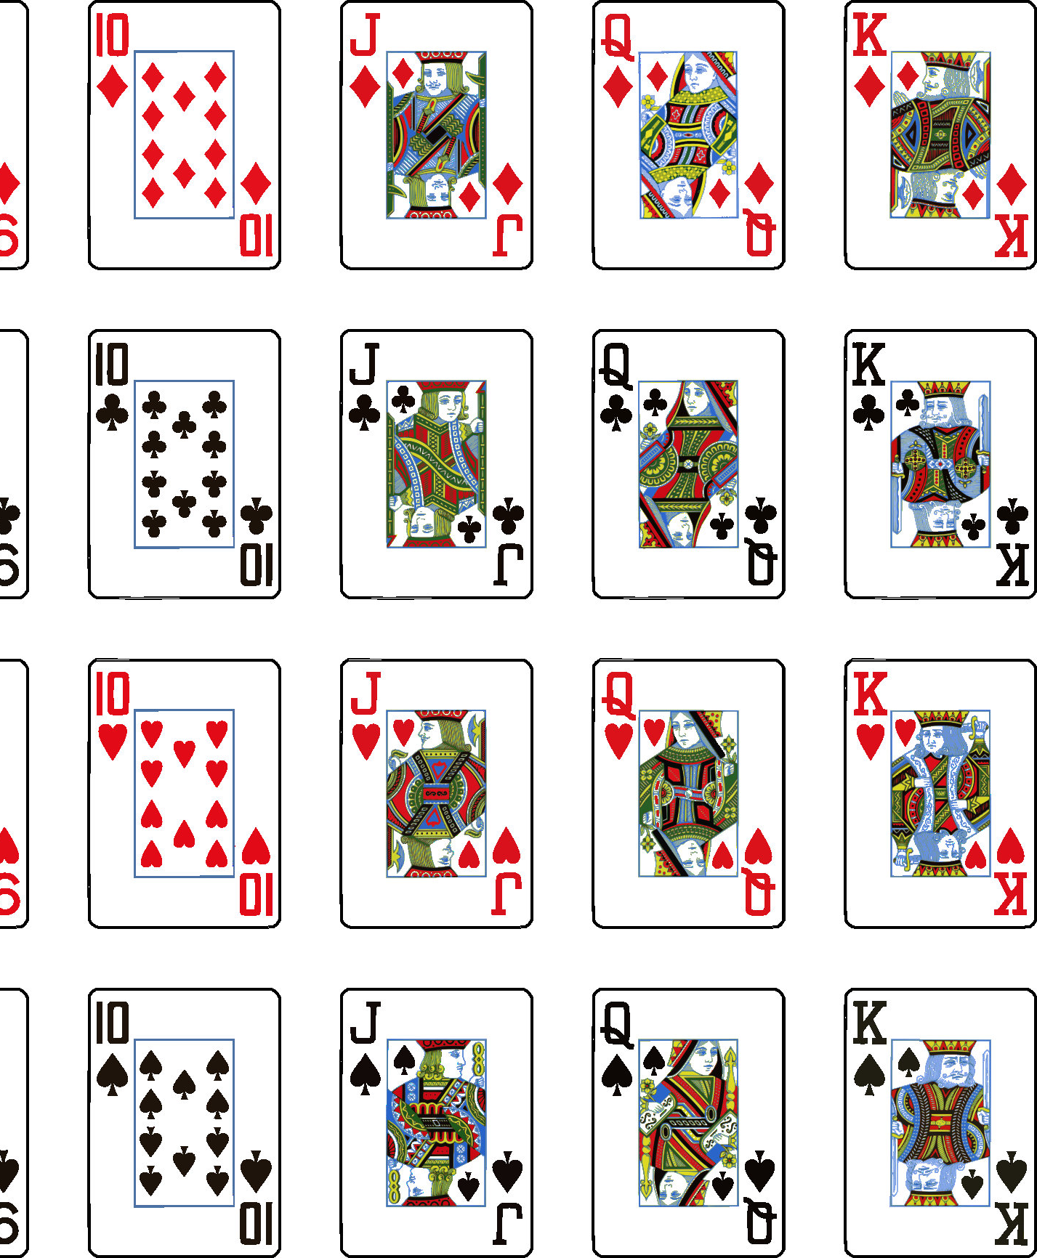
The Card Trick
A project for the first scene – you’ll see

Slide 2
Memorizing a Deck of Cards
Using the Memory Palace technique, we can create a system for improving the ability we have to remember the cards in the order they are placed.
This is not anything proven, I’m just making this up. BUT, I’m building the whole idea from well known cases.

Slide 3
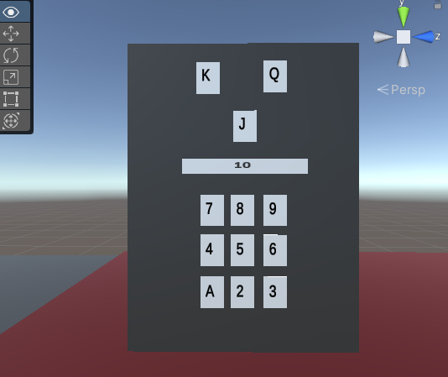
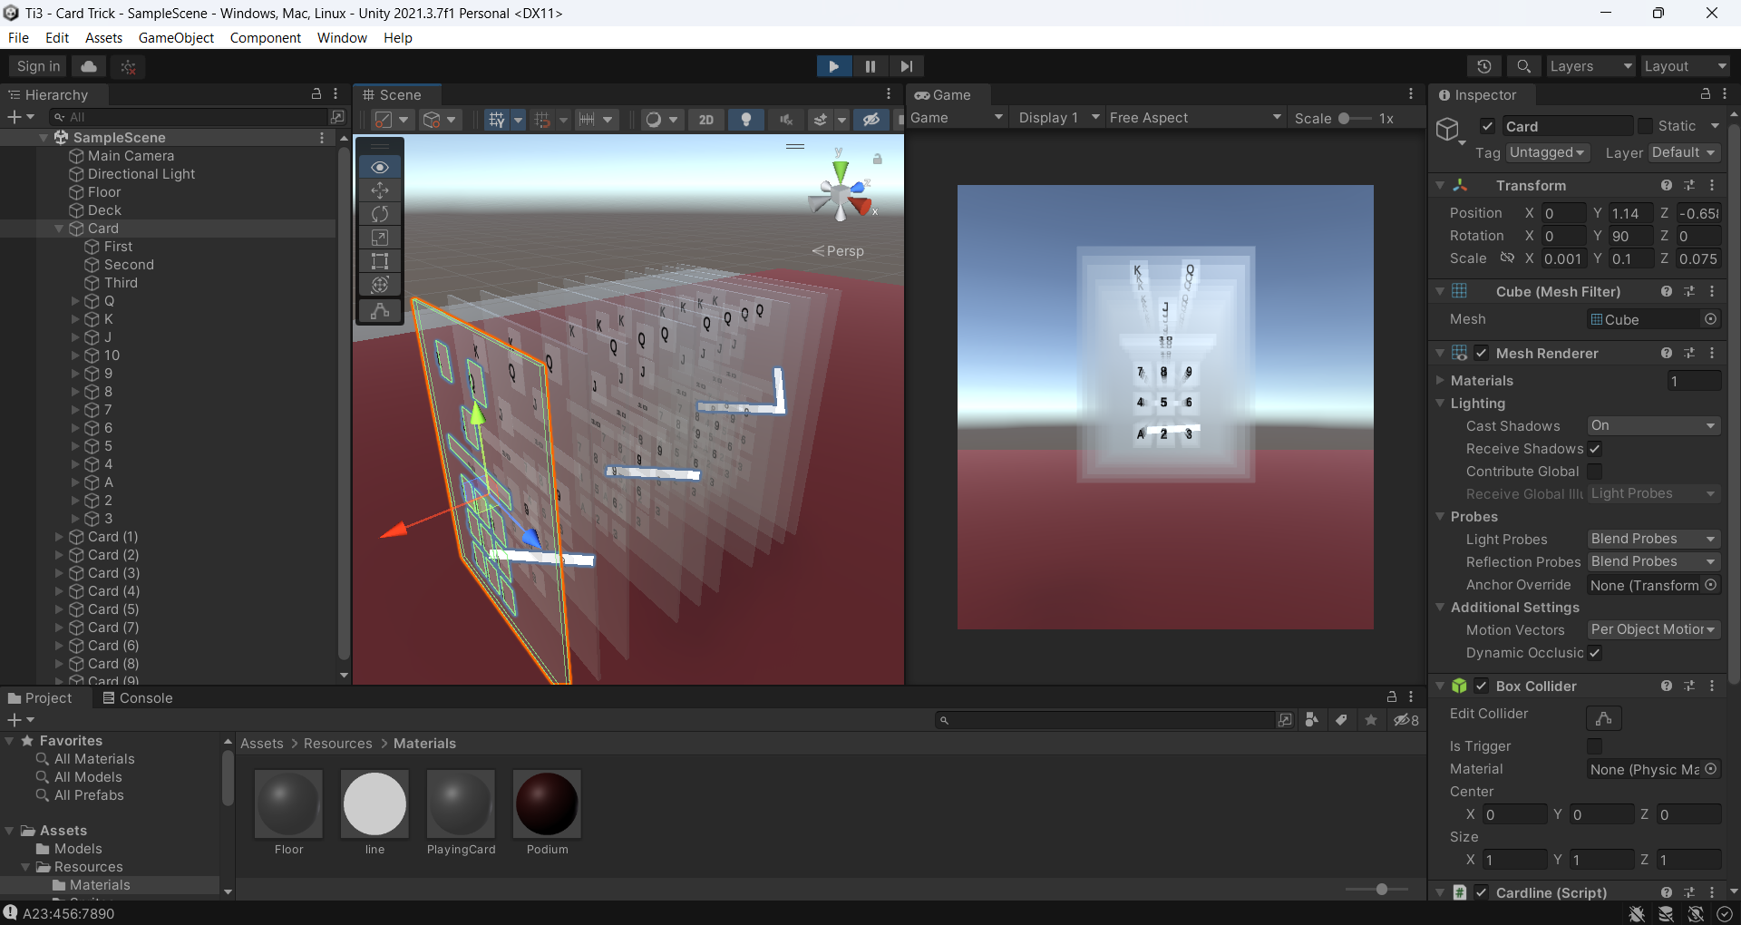
Individual Card ID Shape
A = (1,1)
9 = (3,3)
10 = ([1-3],4)
J = (2,5)
K = (1,6)
Q = (3,6)
Y
X

Slide 4
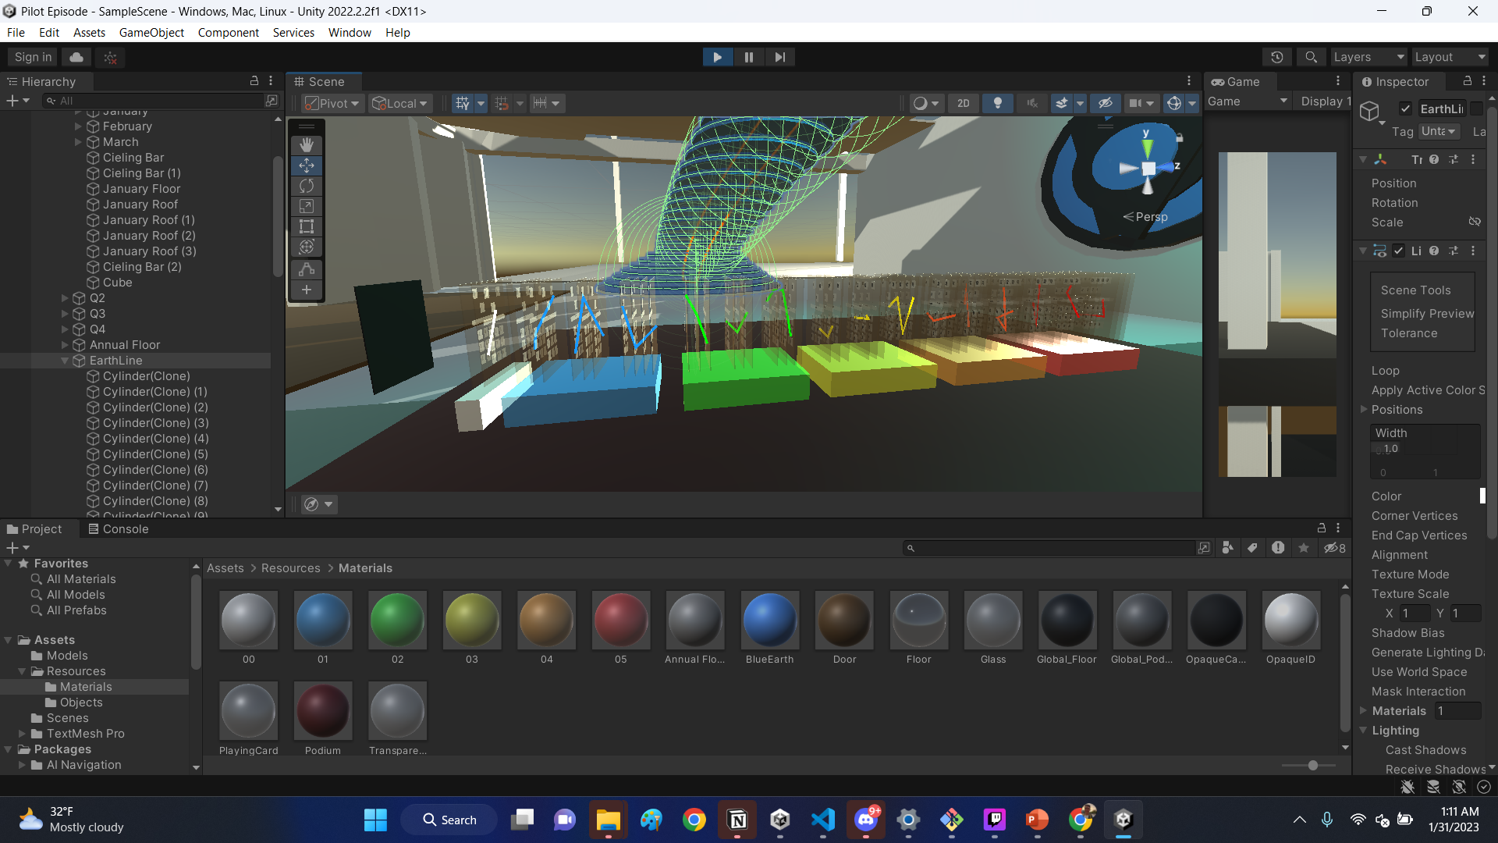
Steps
Create a GitHub + Unity Project
Build a super basic scene where a deck of cards can be memorized
10 cards
50 cards
52 cards
Colored
Incorporate Suit
Publish it.
Load the completed UnityPackage into the THINKINGin3D scene.

