Slide 1
Update meeting, Deep carbon
21 October 2020

Slide 2
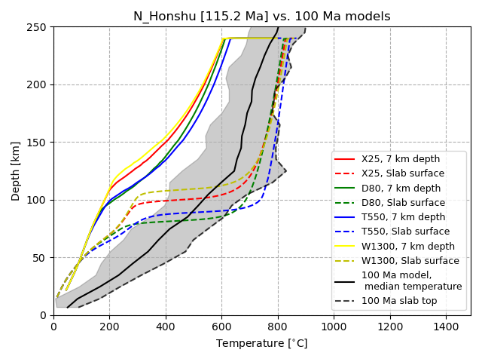
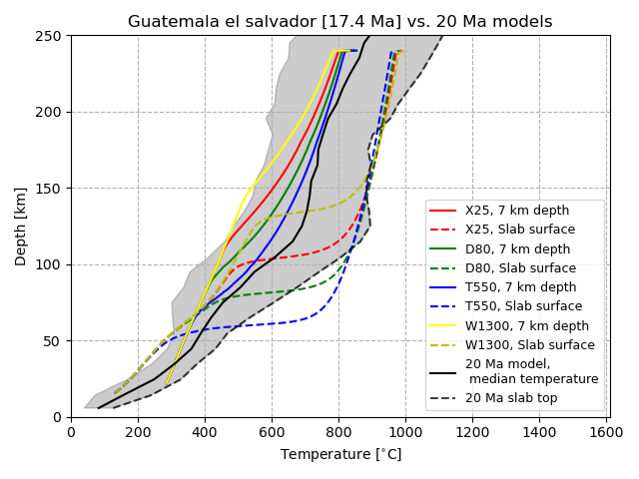
Compared model slab-top temperatures
‘Cold’ slab-top temperature
‘Hot’ slab-top temperature

Slide 3
Model comparison to literature: The same?
Fairly coherent for slabs without significantly different geometry (first look) or anomalously young age
  Aegan, Colombia/Ecuador, East Banda?, Mexico, North Cascadia, N-C Chile, N Marianas, Scotia?

Slide 4
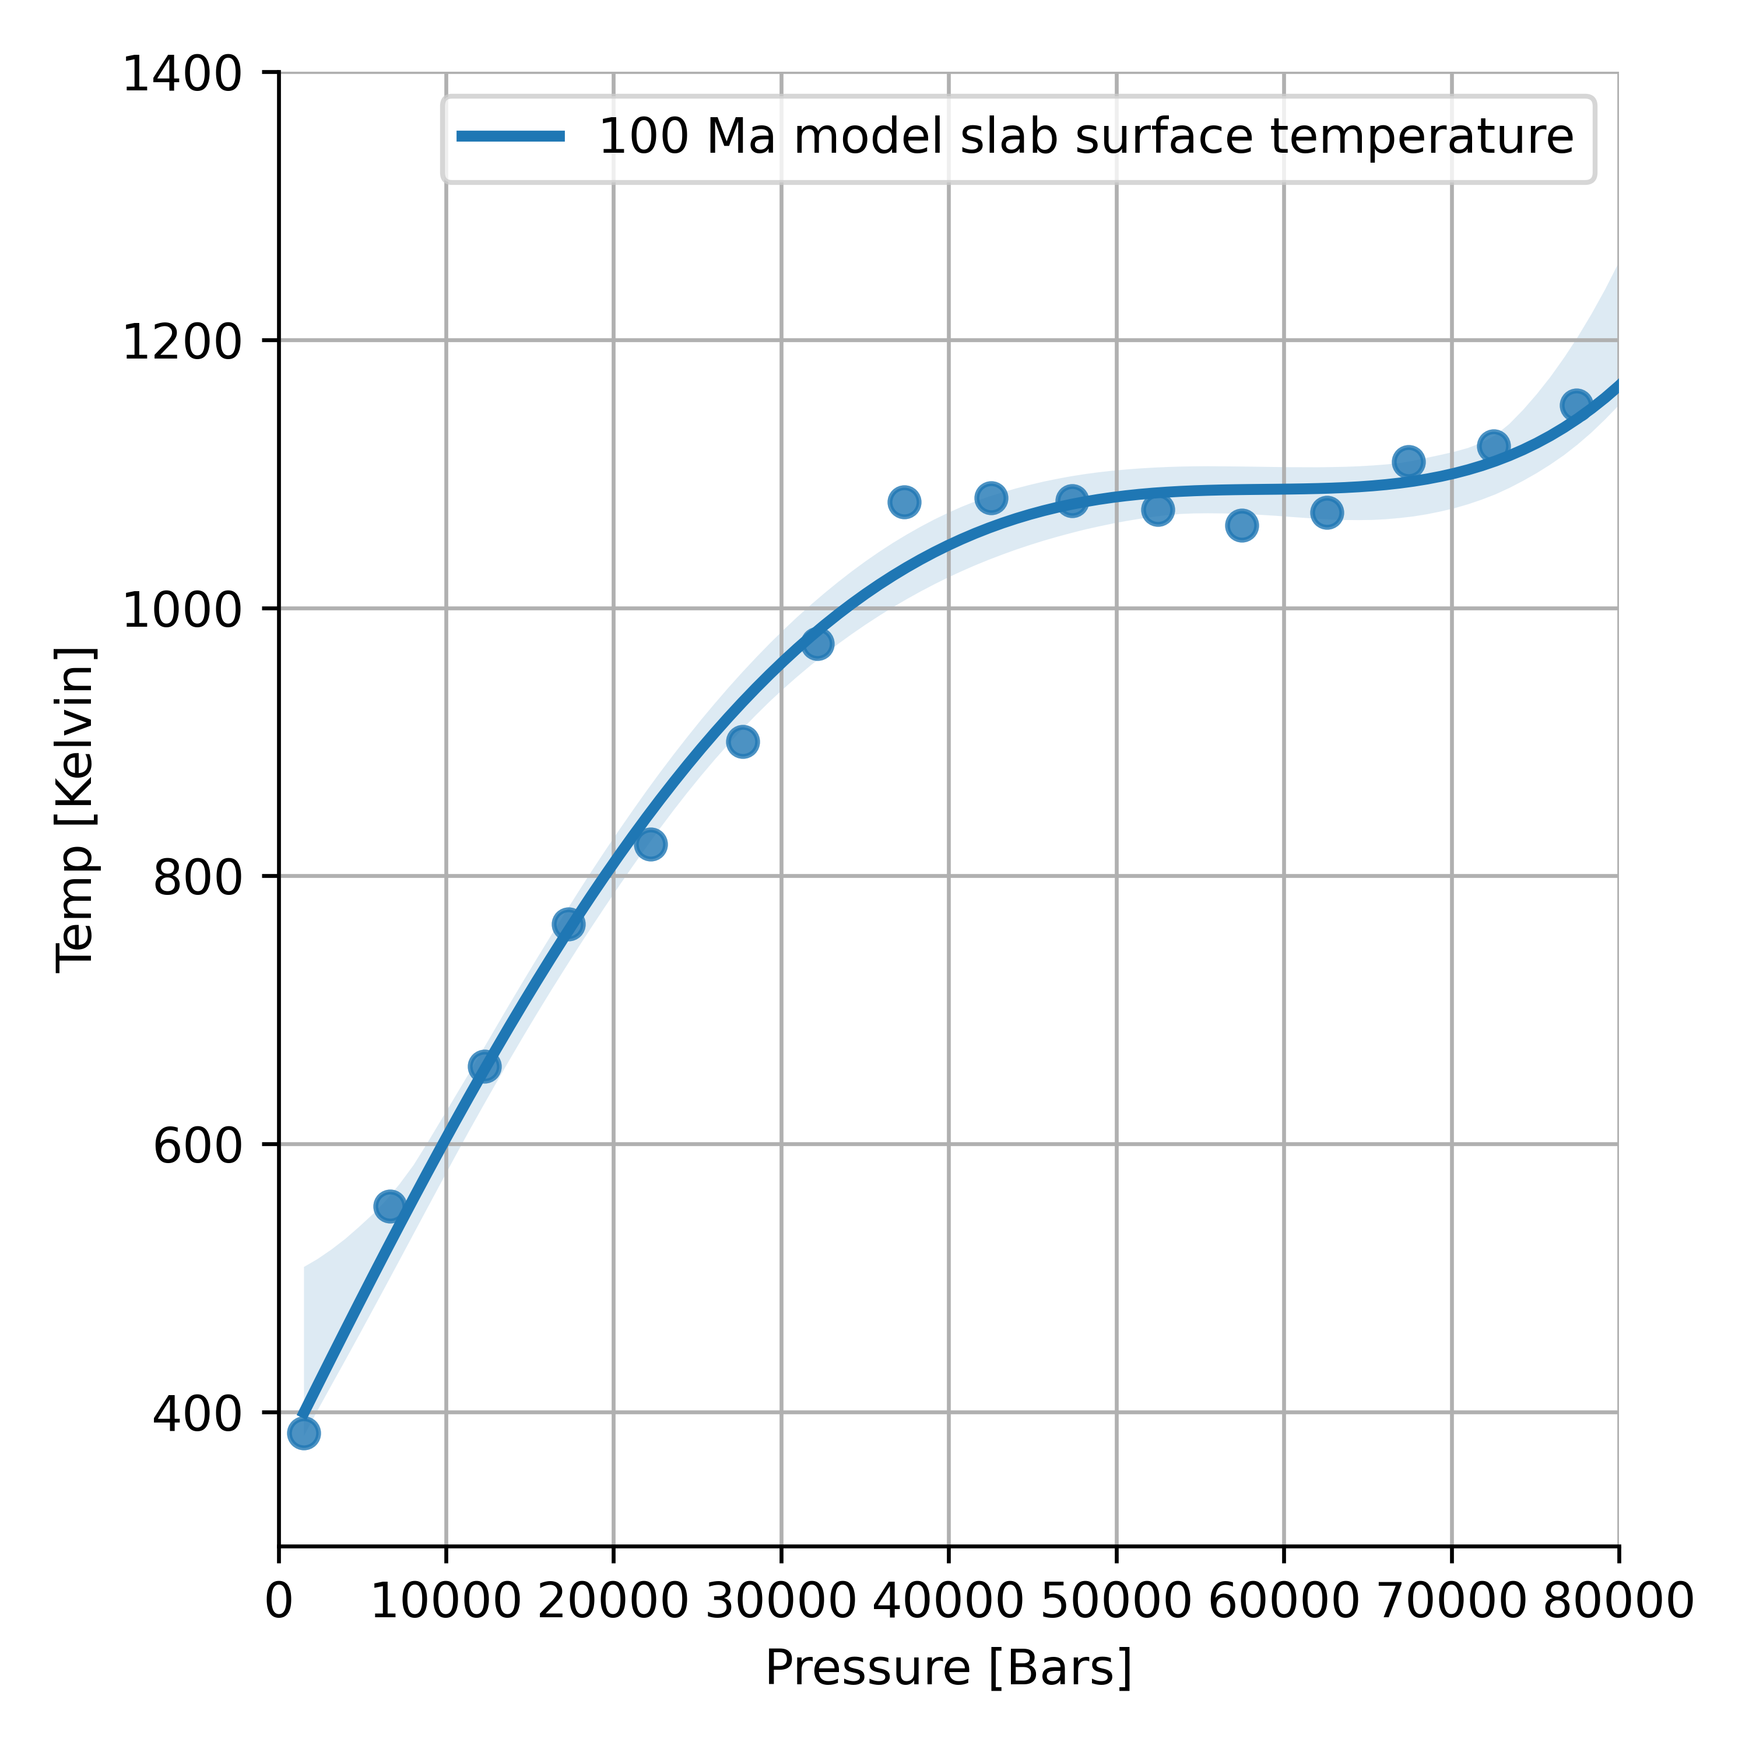
Extract slab surface temps → Perple_X

Slide 5
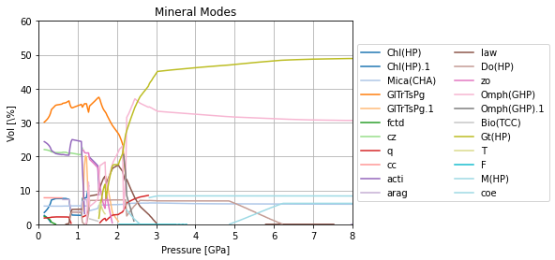
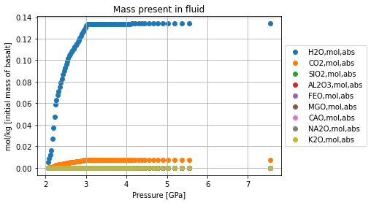
Can get carbon/water loss to subarcs
Phase fraction represents most conservative fluxes

Slide 6
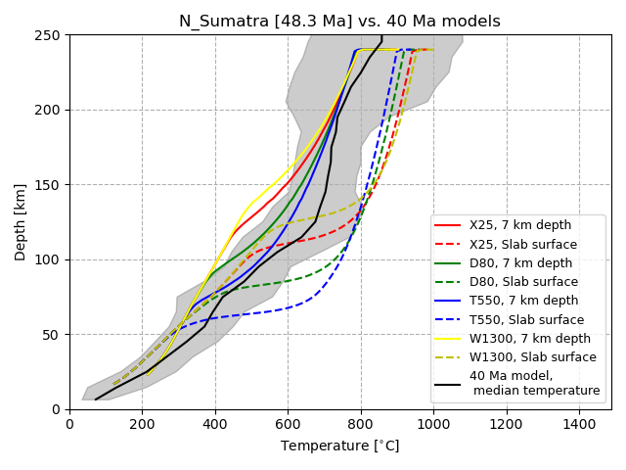
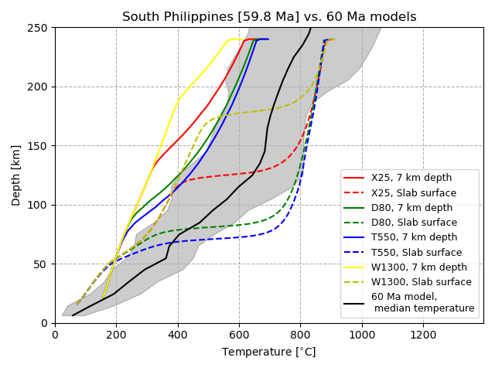
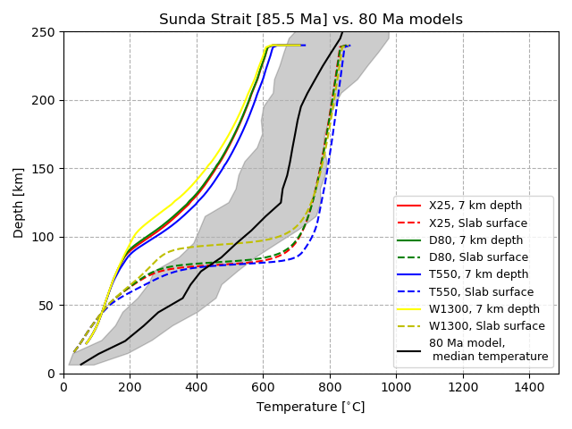
Continue process for 40, 60, 80 Ma

