Slide 1

Pointers

Slide 2
Today’s Agenda
Today we are going to cover -
Pointers
Difference b/w pointers and reference variables
Void pointer
Pointer to Pointer
Wild pointer
Null pointer
Class and pointer
This pointer

Slide 3

C++
Let’s Get Started-

Slide 4
Pointers
Pointer is a variable in C++ that holds the address of another variable. They have data type just like variables, for example an integer type pointer can hold the address of an integer variable and an character type pointer can hold the address of char variable.
Syntax:-
data_type *pointer_name;
int *p, var
As I mentioned above, an integer type pointer can hold the address of another int variable. Here we have an integer variable var and pointer p holds the address of var. To assign the address of variable to pointer we use ampersand symbol (&).
p = &var;

Slide 5
Pointers
#include <iostream>
using namespace std;
int main(){
//Pointer declaration
int *p, var=101;
//Assignment
p = &var;
cout<<"Address of var: "<<&var<<endl;
cout<<"Address of var: "<<p<<endl;
cout<<"Address of p: "<<&p<<endl;
cout<<"Value of var: "<<*p;
return 0;
}

Slide 6
Output
Address of var: 0x7fff5dfffc0c Address of var: 0x7fff5dfffc0c Address of p: 0x7fff5dfffc10 Value of var: 101

Slide 7
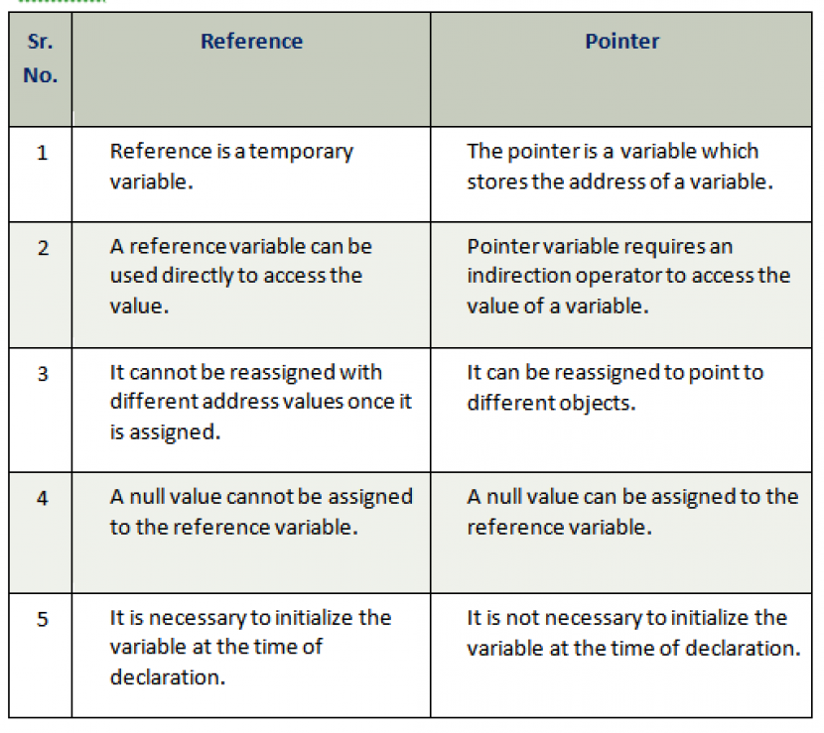
Difference b/w pointers and reference variable

Slide 8
Void Pointers
A void pointer is a general-purpose pointer that can hold the address of any data type, but it is not associated with any data type.
void *ptr;

Slide 9
Void Pointers
#include <iostream>
using namespace std;
int main()
{
void *ptr; // void pointer declaration
int a=9; // integer variable initialization
ptr=&a; // storing the address of 'a' variable in a void pointer variable.
std::cout << &a << std::endl;
std::cout << ptr << std::endl;
return 0;
}

Slide 10
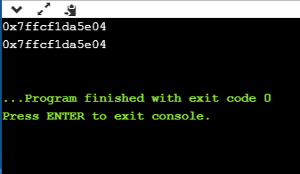
Output

Slide 11
Arithmetic Pointer
A pointer is an address which is a numeric value; therefore, you can perform arithmetic operations on a pointer just as you can a numeric value.

Slide 12
Incrementing a Pointer
#include <iostream>
using namespace std;
const int MAX = 3;
int main () {
int var[MAX] = {10, 100, 200};
int *ptr;
ptr = var;
for (int i = 0; i < MAX; i++) {
cout << "Address of var[" << i << "] = ";
cout << ptr << endl;
cout << "Value of var[" << i << "] = ";
cout << *ptr << endl;
ptr+; }
}

Slide 13
Output
Address of var[0] = 0xbfa088b0 Value of var[0] = 10 Address of var[1] = 0xbfa088b4 Value of var[1] = 100 Address of var[2] = 0xbfa088b8 Value of var[2] = 200

Slide 14
Decrementing a Pointer
#include <iostream>​
​using namespace std;​
const int MAX = 3;​
​
int main () {​
int var[MAX] = {10, 100, 200};​
int *ptr;​
ptr = &var[MAX-1];​
​for (int i = MAX; i > 0; i--) {​
cout << "Address of var[" << i << "] = ";​
cout << ptr << endl;​
​ cout << "Value of var[" << i << "] = ";​
cout << *ptr << endl;​
ptr--;​
}​}
​

Slide 15
Decrementing a Pointer
Address of var[3] = 0xbfdb70f8 Value of var[3] = 200 Address of var[2] = 0xbfdb70f4 Value of var[2] = 100 Address of var[1] = 0xbfdb70f0 Value of var[1] = 10
​

Slide 16
Pointer Comparisons
Pointers may be compared by using relational operators, such as ==, <, and >. If p1 and p2 point to variables that are related to each other, such as elements of the same array, then p1 and p2 can be meaningfully compared.
#include <iostream> using namespace std; const int MAX = 3;

Slide 17
Pointer Comparisons
int main () { int var[MAX] = {10, 100, 200}; int *ptr; ptr = var; int i = 0; while ( ptr <= &var[MAX - 1] ) { cout << "Address of var[" << i << "] = "; cout << ptr << endl; cout << "Value of var[" << i << "] = "; cout << *ptr << endl; ptr++; i++; } }

Slide 18
Output
Address of var[0] = 0xbfce42d0 Value of var[0] = 10 Address of var[1] = 0xbfce42d4 Value of var[1] = 100 Address of var[2] = 0xbfce42d8 Value of var[2] = 200

Slide 19
Pointer to Pointer
We already know that a pointer points to a location in memory and thus used to store the address of variables. So, when we define a pointer to pointer. The first pointer is used to store the address of the variable. And the second pointer is used to store the address of the first pointer. That is why they are also known as double pointers.
Declaration:-
int **ptr;

Slide 20
Pointer to Pointer
#include<iostream>
using namespace std;
int main()
{
int var = 789;
int *ptr2;
int **ptr1;
ptr2 = &var;
ptr1 = &ptr2;
cout<< var<<endl;
cout<<*ptr2<<endl ;
cout<<**ptr1;
}

Slide 21
Output
789 789 789

Slide 22
MCQ 2
2. The operator used for dereferencing or indirection is ____
a) *
b) &
c) ->
d) –>>

Slide 23
MCQ 2
2. The operator used for dereferencing or indirection is ____
a) *
b) &
c) ->
d) –>>
Explanation: * is used as dereferencing operator, used to read value stored at the pointed address

Slide 24
MCQ 3
3.What will happen in the following C++ code snippet?
int a = 100, b = 200;
int *p = &a, *q = &b;
p = q;
a) b is assigned to a
b) p now points to b
c) a is assigned to b
d) q now points to a

Slide 25
MCQ 3
3.What will happen in the following C++ code snippet?
int a = 100, b = 200;
int *p = &a, *q = &b;
p = q;
a) b is assigned to a
b) p now points to b
c) a is assigned to b
d) q now points to a
Assigning to reference changes the object to which the reference is bound.

Slide 26
MCQ 4
4.Void pointer can point to which type of objects?
A)int
B) float
C) double
D) all of the mentioned

Slide 27
MCQ 4
Void pointer can point to which type of objects?
A)int
B) float
C) double
D) all of the mentioned

Slide 28
Predict the ouput 1
#include <iostream>
using namespace std;
int main()
{
char arr[20];
int i;
for(i = 0; i < 10; i++)
*(arr + i) = 65 + i;
*(arr + i) = '\0';
cout << arr;
return(0);
}

Slide 29
Ouput
ABCDEFGHIJ
Each time we are assigning 65 + i. In first iteration i = 0 and 65 is assigned. So it will print from A to J.

Slide 30
Predict the ouput 2
#include <iostream>
using namespace std;
int main()
{
int a = 5, b = 10, c = 15;
int *arr[ ] = {&a, &b, &c};
cout << arr[1];
return 0;
}

Slide 31
Ouput
it will return some random number
Array element cannot be address of auto variable. It can be address of static or extern variables.

Slide 32
Predict the ouput 3
#include <iostream>
using namespace std;
int main()
{
int a = 32, *ptr = &a;
char ch = 'A', &cho = ch;
cho += a;
*ptr += ch;
cout << a << ", " << ch << endl;
return 0;
}

Slide 33
Ouput
129, a

Slide 34
Predict the ouput 4
#include <iostream>
using namespace std;
int main()
{
int arr[] = { 4, 5, 6, 7 };
int* p = (arr + 1);
cout << *arr + 10;
return 0;
}

Slide 35
Ouput
14

Slide 36
Wild pointer
Uninitialized pointers are known as wild pointers because they point to some arbitrary memory location and may cause a program to crash or behave badly.
int main()
{
int *p; /* wild pointer */
/* Some unknown memory location is being corrupted.
This should never be done. */
*p = 12;
}

Slide 37
Wild pointer
Please note that if a pointer p points to a known variable then it’s not a wild pointer. In the below program, p is a wild pointer till this points to a.
int main()
{
int *p; /* wild pointer */
int a = 10;
p = &a; /* p is not a wild pointer now*/
*p = 12; /* This is fine. Value of a is changed */
}

Slide 38
Null Pointer
NULL Pointer is a pointer which is pointing to nothing. In case, if we don’t have address to be assigned to a pointer, then we can simply use NULL.
#include <iostream>
int main()
{
// Null Pointer
int *ptr = NULL;
cout<<ptr
return 0;
}

Slide 39
Null Pointer
Important Points
NULL vs Uninitialized pointer – An uninitialized pointer stores an undefined value. A null pointer stores a defined value, but one that is defined by the environment to not be a valid address for any member or object.
NULL vs Void Pointer – Null pointer is a value, while void pointer is a type

Slide 40
Pointers to Class Members in C++
class Simple
{
public:
int a;
};
int main()
{
Simple obj;
Simple* ptr; // Pointer of class type
ptr = &obj;
cout << obj.a;
cout << ptr->a; // Accessing member with pointer
}

Slide 41
Pointers to Class Members in C++
Here you can see that we have declared a pointer of class type which points to class's object. We can access data members and member functions using pointer name with
arrow -> symbol.

Slide 42
Pointer to Data Members of Class
datatype class_name::*pointer_name = &class_name::datamember_name ;
class Data
{
public:
int a;
void print()
{
cout << "a is "<< a;
}
};

Slide 43
Pointer to Data Members of Class
int main()
{
Data d, *dp;
dp = &d; // pointer to object
int Data::*ptr=&Data::a; // pointer to data member 'a'
d.*ptr=10;
d.print();
dp->*ptr=20;
dp->print();
}
Output:-
a is 10
a is 20

Slide 44
Pointer to Members Function of Class
return_type (class_name::*ptr_name) (argument_type) = &class_name::function_name;
class Data
{
public:
int f(float)
{
return 1;
}
};
int (Data::*fp1) (float) = &Data::f; // Declaration and assignment
int (Data::*fp2) (float); // Only Declaration

Slide 45
Pointer to Members Function of Class
int main()
{
fp2 = &Data::f; // Assignment inside main()
}

Slide 46
This pointer
The this pointer holds the address of current object, in simple words you can say that this pointer points to the current object of the class. Let’s take an example to understand this concept.
class Demo {
private:
int num;
char ch;
public:
void setMyValues(int num, char ch){
this->num =num;
this->ch=ch;
} void displayMyValues(){
cout<<num<<endl;
cout<<ch;
}
};

Slide 47
This pointer
int main(){
Demo obj;
obj.setMyValues(100, 'A');
obj.displayMyValues();
return 0;
}
Here you can see that we have two data members num and ch. In member function setMyValues() we have two local variables having same name as data members name. In such case if you want to assign the local variable value to the data members then you won’t be able to do until unless you use this pointer, because the compiler won’t know that you are referring to object’s data members unless you use this pointer.

Slide 48
Coding Question
Write a program to print all the alphabets using a pointer.
Write a program to print the elements of an array in reverse order using pointer.
Write a program to count the number of vowels and consonants in a string using a pointer.
Write a program to find the maximum number between three numbers using a pointer.

Slide 49
QNA Time
Any Questions??

Slide 50
Thank You!
See you guys in next class.

