Slide 2
├───eosim
│ │ config.py
│ │ __init__.py
│ │
│ ├───gui
│ │ │ executeframe.py
│ │ │ helpwindow.py
│ │ │ mainapplication.py
│ │ │ mapprojections.py
│ │ │ welcomeframe.py
│ │ │ __init__.py
│ │ │
│ │ ├───configure
│ │ │ │ cfconstellation.py
│ │ │ │ cfcoverage.py
│ │ │ │ cfframe.py
│ │ │ │ cfgroundstation.py
│ │ │ │ cfintersatellitecomm.py
│ │ │ │ cfmission.py
│ │ │ │ cfpropagate.py
│ │ │ │ cfsatellite.py
│ │ │ │ cfsensor.py
│ │ │ │ __init__.py
│ │ │ │
│ │ │
│ │ ├───help
│ │ │
│ │ ├───operations
│ │ │ │ operationsframe.py
│ │ │ │ __init__.py
│ │ │
│ │ ├───visualizeframe
│ │ │ │ clock_template.json
│ │ │ │ contacts_template.json
│ │ │ │ covgrid_pkt_template.json
│ │ │ │ ground_station_template.json
│ │ │ │ insightsframe.py
│ │ │ │ observed_gp_template.json
│ │ │ │ satellite_template.json
│ │ │ │ vis2dframe.py
│ │ │ │ visglobeframe.py
│ │ │ │ vismapframe.py
│ │ │ │ visualizeframe.py
│ │ │ │ __init__.py
│ │ │ │
│ .gitignore
│ debug.log
│ LICENSE
│ Makefile
│ README.md
│ setup.py
│
├───bin
│ eosimapp.py
│
├───cesium_app
│ │ .gitignore
│ │ index.css
│ │ index.html
│ │ LICENSE.md
│ │ package-lock.json
│ │ package.json
│ │ README.md
│ │ server.js
│ │ workshop_index.html
│ │
│ └───Source
│ │ App.js
│ │ AppSkeleton.js
│ │ eosimApp.js
│ │
│ └───SampleData
│ │
│ └───Models
│ CesiumDrone.gltf
│
├───docs

Slide 3
eosimapp.py
This is a script which when invoked starts the EO-Sim application.
It can be called with an argument specifying the level of logging required (CRITICAL or ERROR or WARNING or INFO or DEBUG).
It instantiates the MainApplication object, which accepts as argument the root.

Slide 4
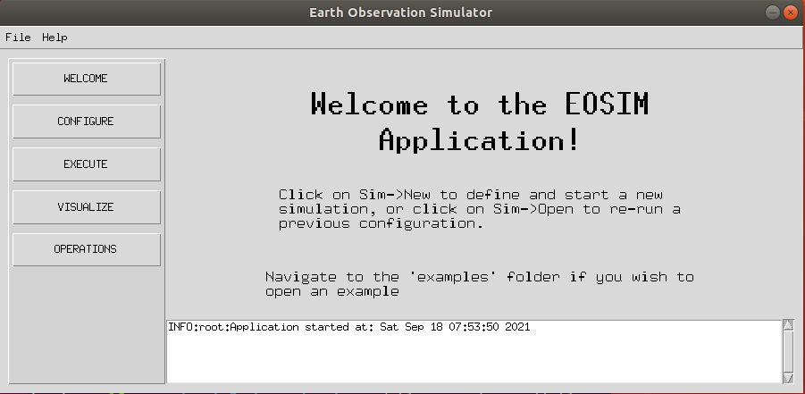
mainapplication.py
container
Stack of frames. In figure the WelcomeFrame is on the top.
This is the main python file inside which the widgets inside the root window are configured. It configures the overall GUI window and the frames inside it.
The parent_frame encompasses all frames inside the main-window. Inside the parent_frame we have the following items defined:
menubar (Menubar)
lsidebar (left-sidebar) (Frame)
messagearea (Frame)
container (Frame)
The below frames are stacked on top of each other inside the container frame.
WelcomeFrame
ConfigureFrame
ExecuteFrame
VisualizeFrame
OperationsFrame
menubar
messagearea
Displays messages from the application to the user.
lsidebar
“Control-panel” Clicking a button will bring the respective Frame to the top in the container Frame.

Slide 5
helpwindow.py
This module contains set of functions which are used to display the help-window (contextual help).
The help-window must first be opened by clicking on: Menubar->Help-> Help Window
When the mouse-pointer hovers over an widget-of-interest, if there is any associated help-item, it is displayed in the help window.
When no longer desired, the help-window should be closed.
The help-database is mainly the json file (help_database.json) inside the folder ./eosim/gui/help/ The folder also has images which are to be displayed inside the help window.
To provide contextual help to a widget following steps must be undertaken:
Enter the help-info inside the help_database json file. The database entry must be associated with a widget-id.
Bind the <Enter> event to an widget with the update_help_window (event, widget_id)function.
Example:
"basicsensor":{
"heading": "Basic Sensor",
"description": ["Model parameters of a basic-sensor."],
"images": false,
"morehelp": false
}
other_specs_frame.bind('<Enter>',lambda event, widget_id="basicsensor": helpwindow.update_help_window(event, widget_id))

Slide 6
welcomeframe.py
This is the topmost frame (when the application is first started) in the stack of frames defined inside the container.
It is also displayed by clicking on the “WELCOME” button on the left-sidebar.
This frame simply contains textual information on how to use the EOSim app.

Slide 7
ConfigureFrame.py

